Slide 1

What is the relationship between healthcare informatics and statistics?
Christopher I. Macintosh, PhD, RN

Slide 2

What are we called?
Informaticist vs Informatician?
Synonymous
Informaticist - A person practicing the science of informatics.
Informatician - Someone who practices informatics.
https://wikidiff.com/informaticist/informatician
Still debated
One of those who commented on the blog—a techie whom I actually know—suggested “the plain and simple ‘guru of everything.'”
https://www.meaningfulhitnews.com/2005/07/14/you-say-tomato/

Slide 3

Desired Skills
Clinical knowledge
Data management
Data visualization
Analytics
Statistical procedures
Ebook: Forecasting Informatics Competencies for Nurses in the Future of Connected Health

Slide 4

How will data be used?
You may be consulted on data collection and storage.
You need to know what data will be used for.
A major use of healthcare data is for research.
Statistical analyses are totally dependent on the format of how measurements are made and how data are stored.
You may not be called upon to run the actual analyses and interpret the results, but it will be in everyone’s best interest if you have an understanding of how to properly store the data needed.
You can’t really do that without knowing something about how it will be used.

Slide 5
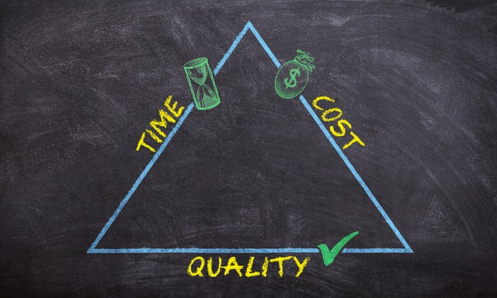
Data to Improve Quality and Efficiency
You may be asked to help improve quality and efficiency in your own operation or other operations in healthcare.
You need to know the tools and skills that will help you make a meaningful contribution.
A knowledge of statistical tools and techniques will help you be a meaningful contributor.

Slide 6
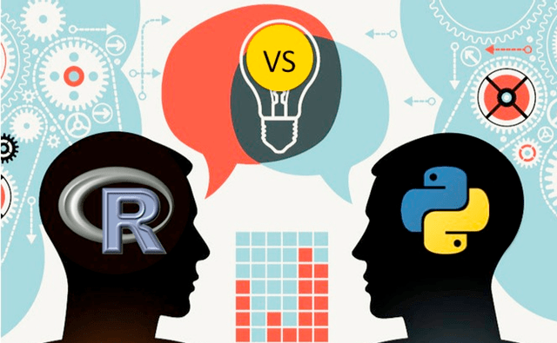
Data Analytics
Data analytics is a growing field.
R is widely used and worth getting to know.

