Slide 1


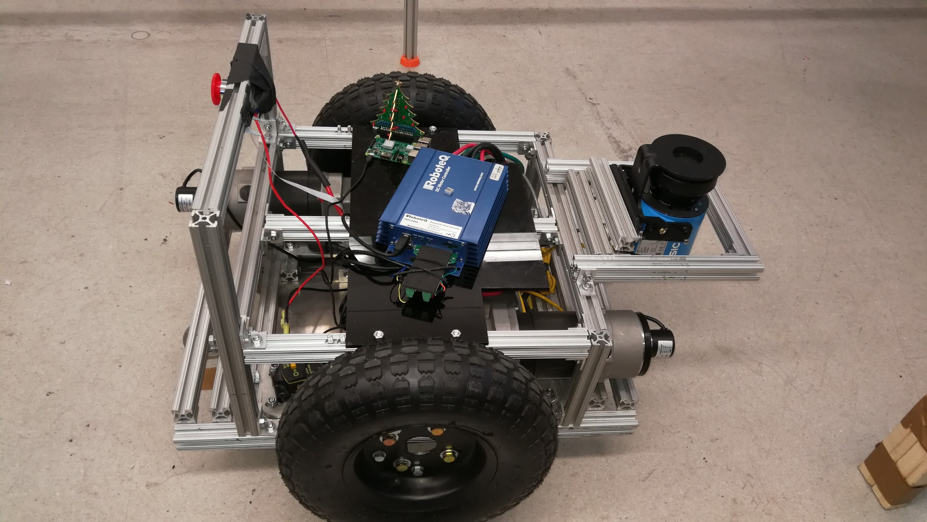
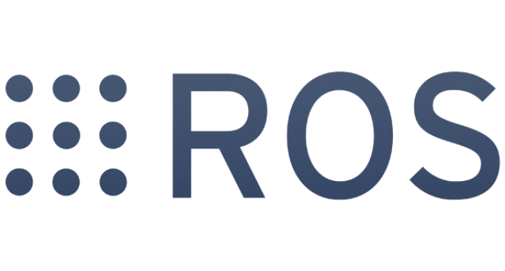
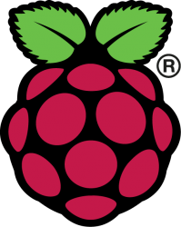

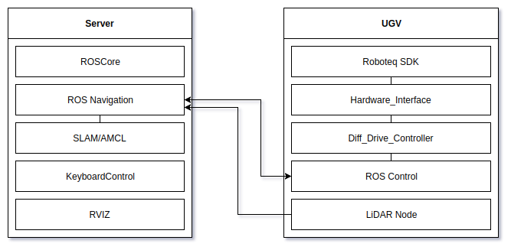
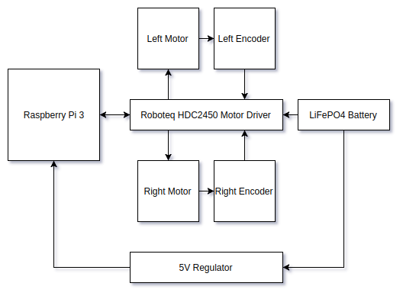
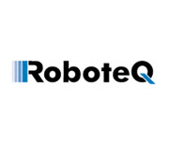
TEAM UGV
Chris Collander, Darrell Rasco, Chase Huffman, Paul Asyn
University of Texas at Arlington
VISION
Mission and Overview
The vision of the team is to create a ROS-enabled Payload Transportation robot for use in distributed robotic systems. The robot should be able to move as far a distance as possible while still staying in range of the WiFi access point with proper safeguards and be able to be controlled through a centralized network with other robots.
One of the primary uses for this robot is to transport items between human and robot operators as a form of Human-Robot Collaboration. In many working environments, robotic arms are kept far from human operators to prevent workplace accidents. This is a prototype of a robot that can autonomously navigate the environment to transport items between operators.
Distributed robotic networks are used in military applications and factories worldwide. Multiple robots communicate between each other through either a centralized or decentralized network. These robots can be of multiple types including UAVs, UGVs, robotic arms, or humanoid robots. These systems may interact with one or more human operators as well.
One common form of robot in these distributed networks are payload transport robots. These robots are designed to move items between any combination of robot and human operators.
The way the team has achieved this vision is with an Unmanned Ground Vehicle (UGV), which could also be referred to as a robotic table. The UGV uses a primarily square-framed design. Two opposing wheels are controlled with motors as differential drive while the other two wheels are casters on free-spinning axles.
In this configuration the UGV is able to move forwards, backwards, and rotate in place.
The UGV utilizes a spinning LiDAR with SLAM for environment recognition and localization. ROS (Robot Operating System) is used to control the robot due to ROS’s broad use in industry with many robots, allowing easy interfacing with modules. The UGV software consists of one custom-created ROS package called UGV.
One ROS Node publishes the LiDAR data while another ROS Node has been created to communicate with the motor driver (and the motors and encoders) as an extension to ROS Control's Hardware_Interface class. The Hardware_Interface class is then called from the Controller Manager with a Differential Drive Controller, allowing both linear and rotational velocities to be subscribed, while simultaneously publishing odometry data from the encoders.
A centralized server is able to use multiple combinations of ROS packages to handle the autonomous navigation. These are referred to as Configurations and they consist of various combinations of GMapping SLAM, Hector SLAM, RAT Slam, AMCL, TrajectoryPlanner, DWAPlanner, NavFN, A*, predefined and dynamic maps, and speed and navigation parameters. This versatility allows quick adaption to different environments and uses.
SOFTWARE ARCHITECTURE
SOFTWARE ARCHITECTURE
HARDWARE ARCHITECTURE

