Slide 1
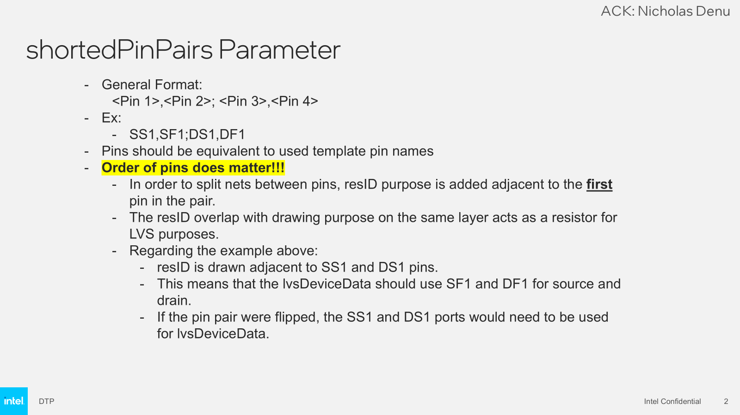
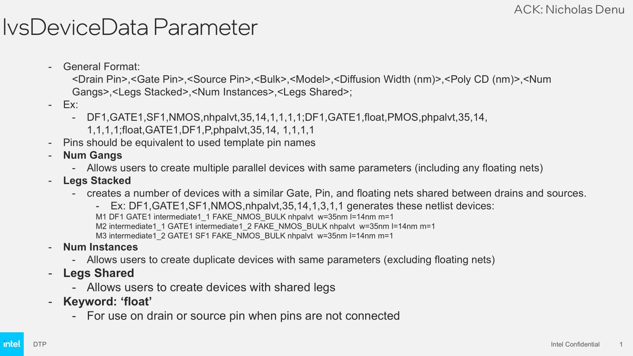

LVS Parameters
shortedPinPairs Parameter →
  Suppress shorted nets error.
  Check open between shorted pins
  Second pin used as the source/drain terminals for the netlist
lvsDeviceData Parameter→
  Identify all the devices and match with the LVS string
  Used to create netlist from devices
LVS_Capabilities.pptx

Slide 2
Check List to create LVS string
Identify and count independent* Active and Nonactive Transistors:
  Active → DUT (All terminals S/G/D connected to pads)
  Nonactive → Gate connected to the pad. Either S or D or both are floating.
Identify Pins
Identify model and Vt flavor
Identify Diff
Identify Poly CD
Identify Number of Gangs
Identify number of stacked transistors
Identify number of instances
Identify shared legs
Generate string for each transistor
Combine strings with “;” as a delimiter
* →Independent = Not sharing gates

Slide 3
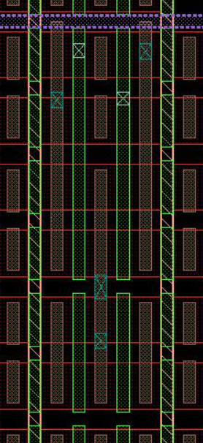
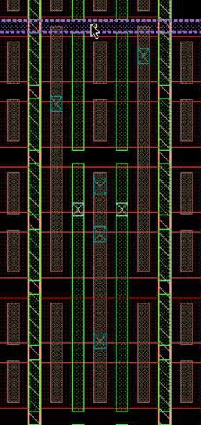
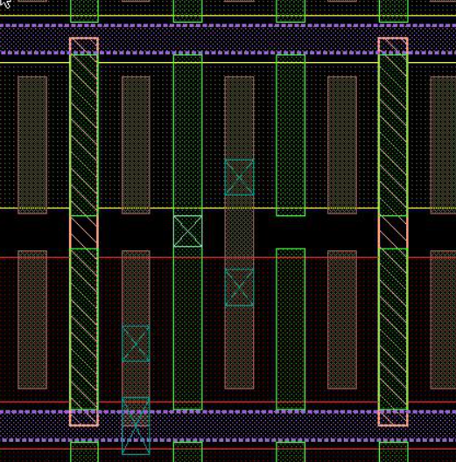
Identifying Active and Nonactive Device
Active (DUT) → All terminals connected to pad
NonActive → Gate connected to the pad. At least one of the S/D TCN is floating.
NMOS GNAC
PMOS GNAC
NMOS PFT
Note: Often Active and passive transistors have opposite polarity.
Exception is unipolar and GNAC devices where both active and nonactive devices have same polarity.
Please check while generating the string
NonActive
NonActive
Active
Active
Active
NonActive

Slide 4
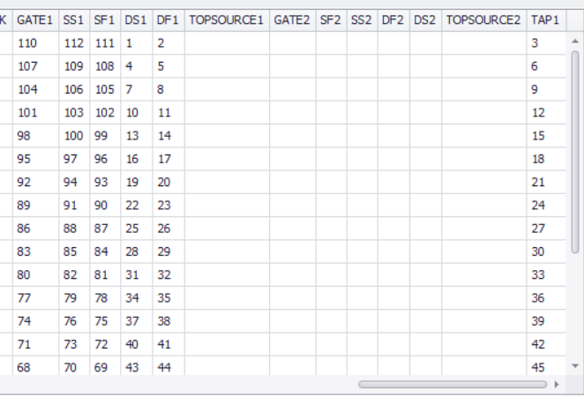
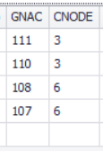
Identify Pins
Use pad names to specify Pin
PFT
GNACs
DF1,GATE1,SF1,TAP1,nhpalvt,35,12,1,1,1,1
CNODE,CNODE,CNODE,FAKE_NMOS_BULK,nhpblvt,46,12,1,2,80,1;CNODE,CNODE,GNAC,FAKE_NMOS_BULK,nhpblvt,46,12,1,1,80,2
Note:
Floating node→ use “float”
If Bulk is not used →
use “FAKE_NMOS_BULK” for NMOS and “FAKE_PMOS_BULK” for PMOS

Slide 5
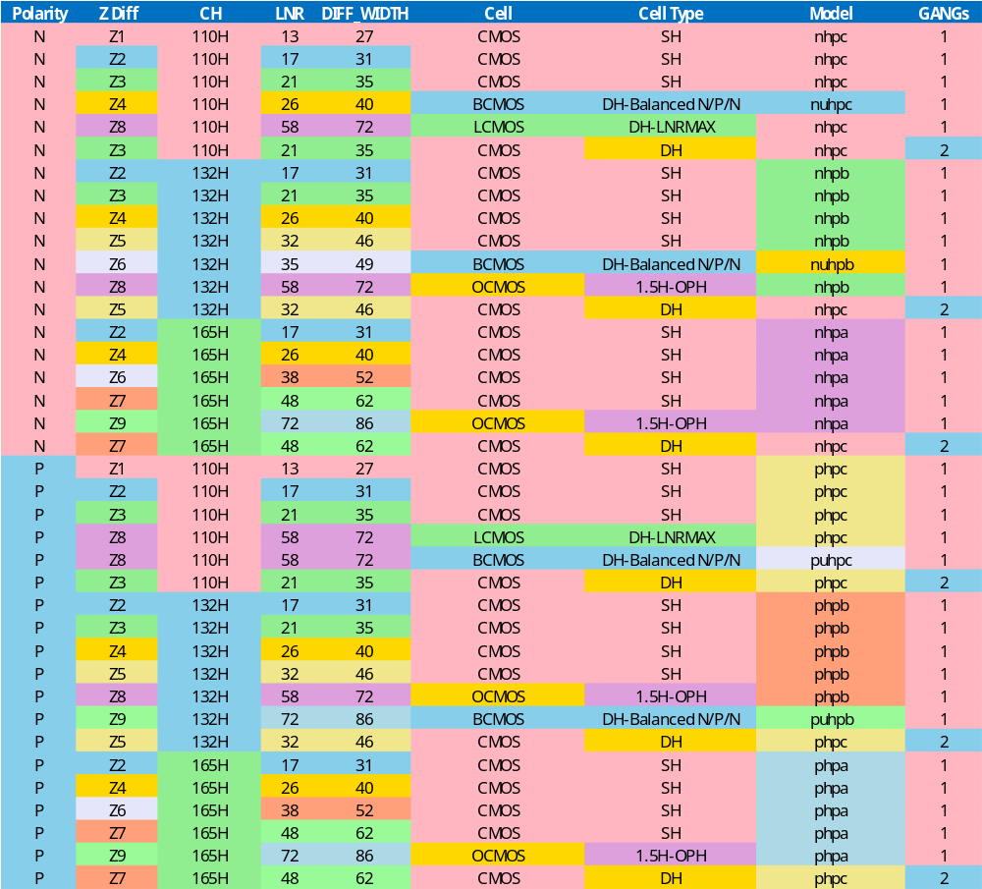
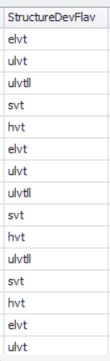
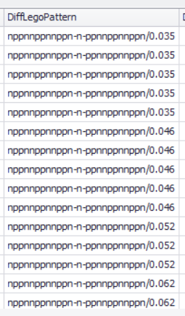
Identify Model,Vt and Diff
DF1,GATE1,SF1,TAP1,nhpalvt,35,12,1,1,1,1
model
vt
Diff Width

Slide 6
Identify Poly CD
DF1,GATE1,SF1,TAP1,nhpalvt,35,12,1,1,1,1
Poly CD
Poly CD number to 12 for most skews except PP and Poly CD skews

Slide 7
Identify: Gangs, Legs Stacked, Num Instances, Legs Shared
    Format →<Drain Pin>,<Gate Pin>,<Source Pin>,<Bulk>,<Model+Vt>,<Diffusion Width (nm)>,<Poly CD (nm)>,<Num Gangs>,<Legs Stacked>,<Num Instances>,<Legs Shared>;
Gangs→ Number of devices sharing
the same poly, and TCN tracks across multiple diffusions
Shared Legs→ Number of parallel devices on the same diff with source/drains connected in parallel
Stacked Legs→ Number of devices with shared gate and floating TCN
Instances→ Number of parallel devices in an array.
D
D
D
D
D
G
G
G
G
G
D
S
G
S
S
S
S
S
2,1,1,1
1,2,1,1
1,1,3,1
1,1,1,2
e.g. DH devices
Total number of transistors = Gangs × Stacked Legs × Instances, Shared Legs

Slide 8
Form the string and combine active and nonactive device strings
NMOS PFT
NonActive
DF1,GATE1,FLOAT,FAKE_NMOS_BULK,phpcelvt,35,12,1,1,1,1
DF1,GATE1,SF1,TAP1,nhpcelvt,35,12,1,1,1,1
Active
shortedPinPairs | lvsDeviceData
SS1,SF1;DS1,DF1 | DF1,GATE1,SF1,TAP1,nhpcelvt,35,12,1,1,1,1;DF1,GATE1,FLOAT,FAKE_NMOS_BULK,phpcelvt,35,12,1,1,1,1

Slide 9
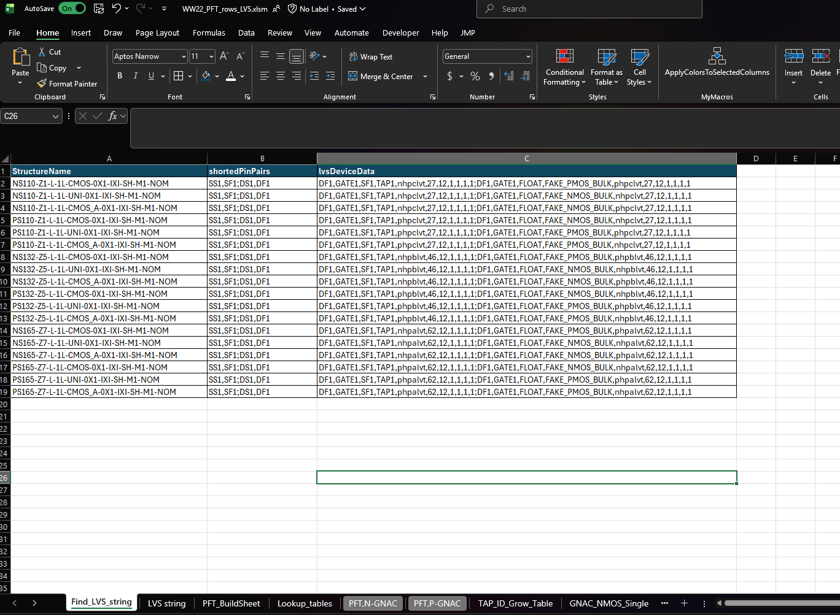
Searching LVS string of a Golden (POR) Device
Go to Find_LVS_string tab
Paste structure name in column A
ShortedPinPairs and lvsDeviceData columns will be populated by searching the structure in the LVS string sheet
2
3
1

Slide 10

NMOS GNAC
Non-Active
Gangs = 1, stacked legs =2, instances=80, shared leg =1
CNODE,CNODE,CNODE,FAKE_NMOS_BULK,nhpblvt,46,12,1,2,80,1;
NMOS
Anode→ CNODE
Active
PID TAP
Gangs = 1, stacked legs =1, instances=80, shared leg =2
CNODE,CNODE,GNAC,FAKE_NMOS_BULK,nhpblvt,46,12,1,1,80,2
M1
CNODE,CNODE,GNAC,FAKE_NMOS_BULK,nhpblvt,46,12,2,1,40,2
Cathode
CNODE,CNODE,GNAC,FAKE_NMOS_BULK,nhpblvt,46,12,2,1,80,1

Slide 11
PMOS GNAC
Active
Gangs = 2, stacked legs =2, instances=80, shared leg =1
PMOS
Anode
GNAC,GNAC,CNODE,FAKE_NMOS_BULK,nhpblvt,46,12,2,1,40,2
nonActive
Gangs = 2, stacked legs =1, instances=80, shared leg =1
PID TAP
M1
float,GNAC,GNAC,FAKE_NMOS_BULK,nhpblvt,46,12,2,1,80,1
Cathode→ CNODE

Slide 12

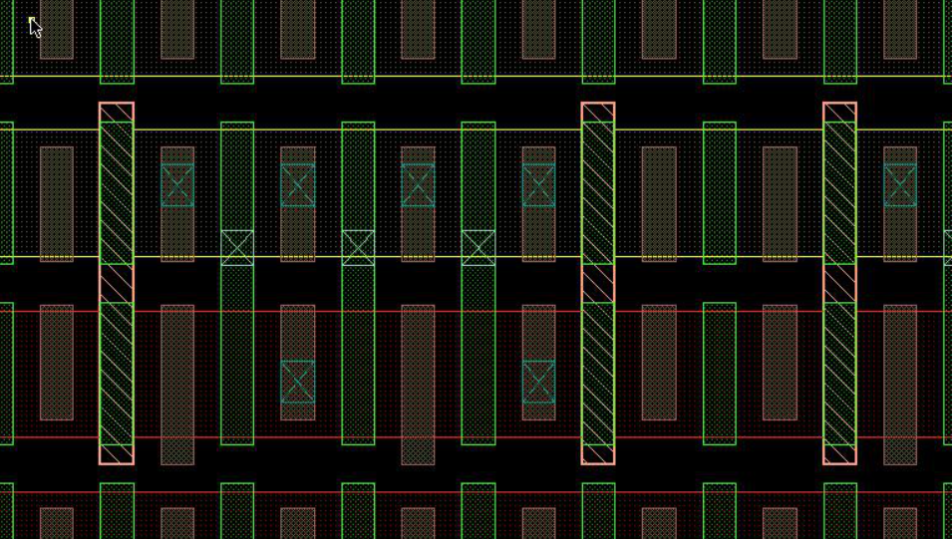
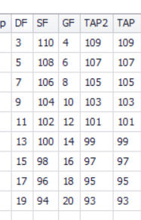
General Format:
    <Drain Pin>,<Gate Pin>,<Source Pin>,<Bulk>,<Model>,<Diffusion Width (nm)>,<Poly CD (nm)>,<Num Gangs>,<Legs Stacked>,<Num Instances>,<Legs Shared>;
DF,GF,SF,TAP,nhpblvt,46,12,1,1,105,3;
TAP, GF, TAP, FAKE_PMOS_BULK,phpalvt,46,12,1,1,105,3

Slide 13
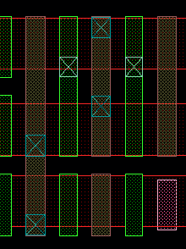
lvsDeviceData Parameter Examples (Multi-Gang)
ACK: Nicholas Denu
General Format:
    <Drain Pin>,<Gate Pin>,<Source Pin>,<Bulk>,<Model>,<Diffusion Width (nm)>,<Poly CD (nm)>,<Num Gangs>,<Legs Stacked>,<Num Instances>,<Legs Shared>;
Input:
DF1,GATE1,SF1,NMOS,nhpalvt,35,14,2,1,1,1;
float,GATE1,SF1,NMOS,nhpalvt,35,14,2,1,1,1
Netlist:
M1 DF1 GATE1 SF1 FAKE_NMOS_BULK nhpalvt w=35nm l=14nm m=2
M2 float_1 GATE1 SF1 FAKE_NMOS_BULK nhpalvt w=35nm l=14nm m=2
FLOAT1
SF1
DF1
M1
M2

Slide 14
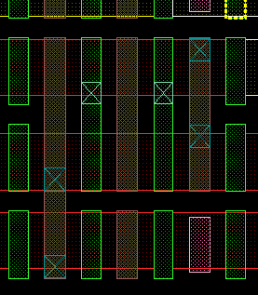
lvsDeviceData Parameter Examples (Stacked)
ACK: Nicholas Denu
FLOAT1
General Format:
    <Drain Pin>,<Gate Pin>,<Source Pin>,<Bulk>,<Model>,<Diffusion Width (nm)>,<Poly CD (nm)>,<Num Gangs>,<Legs Stacked>,<Num Instances>,<Legs Shared>;
Input:
DF1,GATE1,SF1,NMOS,nhpalvt,35,14,2,2,1,1
Netlist:
M1 DF1 GATE1 float_1 FAKE_NMOS_BULK nhpalvt w=35nm l=14nm m=2
M2 float_1 GATE1 SF1 FAKE_NMOS_BULK nhpalvt w=35nm l=14nm m=2
SF1
M1
M2
DF1

Slide 15
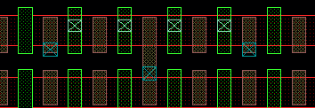
lvsDeviceData Parameter Examples (Shared Leg)
ACK: Nicholas Denu
General Format:
    <Drain Pin>,<Gate Pin>,<Source Pin>,<Bulk>,<Model>,<Diffusion Width (nm)>,<Poly CD (nm)>,<Num Gangs>,<Legs Stacked>,<Num Instances>,<Legs Shared>;
Input:
DF1,GATE1,SF1,NMOS,nhpalvt,35,14,1,2,1,2;
Netlist:
M1 DF1 GATE1 float_1 FAKE_NMOS_BULK nhpalvt w=35nm l=14nm m=1
M2 float_1 GATE1 SF1 FAKE_NMOS_BULK nhpalvt w=35nm l=14nm m=1
M3 DF1 GATE1 float_2 FAKE_NMOS_BULK nhpalvt w=35nm l=14nm m=1
M4 float_2 GATE1 SF1 FAKE_NMOS_BULK nhpalvt w=35nm l=14nm m=1
DF1
FLOAT1
SF1
FLOAT2
DF1

Slide 16
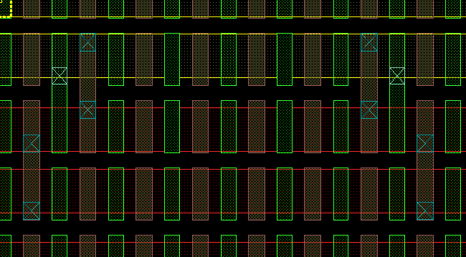
lvsDeviceData Parameter Examples (Multiple Instances)
General Format:
    <Drain Pin>,<Gate Pin>,<Source Pin>,<Bulk>,<Model>,<Diffusion Width (nm)>,<Poly CD (nm)>,<Num Gangs>,<Legs Stacked>,<Num Instances>,<Legs Shared>;
Input:
DF1,GATE1,SF1,NMOS,nhpalvt,35,14,1,1,2,1;
float,GATE1,SF1,PMOS,phpalvt,35,14,1,1,2,1
Netlist:
M1 DF1 GATE1 SF1 FAKE_NMOS_BULK nhpalvt w=35nm l=14nm m=1
M2 DF1 GATE1 SF1 FAKE_NMOS_BULK nhpalvt w=35nm l=14nm m=1
M3 float_1 GATE1 SF1 FAKE_PMOS_BULK phpalvt w=35nm l=14nm m=1
M4 float_2 GATE1 SF1 FAKE_PMOS_BULK phpalvt w=35nm l=14nm m=1
FLOAT1
M3
M4
FLOAT2
SF1
SF1
M1
M2
DF1
DF1

