Slide 1
Structure Naming for x TCs – Best practices
WW19’26
Important Link from Etest team on DFT check:
How_to_TestRow_DFT_check_in_Atlantis 6.6.3.0.docx
TEST_CONFIG_STRUCTURE_NAME_AS_TESTED
Etest / Super flow format
TEST_NAME[STRUCTURE_NAME_AS_TESTED]
WIJT data pull default setting
TEST_NAME_MOD|STRUCTURE_NAME
CNAI Dashboard
Key Priorities to address
Automation handiness for quick disposition
Consistency with PDK, across teams, across dashboards
Readability in plots/Standard Lot Report
Conciseness for Etest limitations
Reference Links:
Delimiter
Test Name
Row Name
Structure Name
Library Offering
Ack: Greg, Roberto, Andrew, Habib

Slide 2
Row Name
Limit to 23 chars
ROS: Library_ros_iteration
ROS PFT: Library_rospft_iteration
LLE-neutral PFT: Library_(polarity)cl(row-identifier)_iteration
LLE-PFT: Library_(polarity)lle(row-identifier)_iteration
WID: Library_wid(row-identifier)_iteration
Matching PFT : Library_ m(polarity)cl(row-identifier) _iteration
Bit PFT : Library_bitpft(row-identifier) _iteration
ISO: Library_failmode_iteration
IL Row: Library_StandardRowFormat_(il)iteration

Slide 3
Delimiter
Structure name in Atlantis reflects on STRUCTURE_NAME_AS_TESTED on tester concatenated with TC number or SL
Test name in Atlantis reflects config type which consists of a several tests included in the config by the Etest team
Test name at tester may differ from test name in dashboard – follow methodology here
Make a uniform delimiter “-” (hyphen) within structure name except for additional details
Structure name, seat name, row instance are separated by “_” (underscore) – done post catalog gen.
Test name and structure name to be separated by pipe symbol “|” at CNAI dashboard level
Try to maintain equal number of delimiters across all structure types for ease of automation and text to column separation
Any additional detail must be added in appropriate position separated by a colon symbol “:” for ISO structures to separate chunks of data
Any additional detail must be added at the end of the structure name and before seat name with “_” (underscore) as delimiter

Slide 4
WW43 additions (to WW19 slide 3)
Make a uniform delimiter
'/' only inside the environment field (/D = no diffusion; CMOS/NP, CMOS/PP = matching pair), in back-end layer pairs / W-S values, and between alternative DIR / SKEW values of a POR reference (OGD/PGD, CD/REG)
POR structures without a TSDR skew carry A:NOM (lego type first, as in skews) as the first additional token; POR / REF / SDR are written NOM
Signed magnitudes are written N#/P#/NOM - never '+' / '-' (collides with the '-' delimiter)
Inline '_' is not allowed; '_' only before seat name for a trailing instance index (e.g. _2)
LLE (local layout effects) rows: a structure carries an LLE layout descriptor (NEST, VTMX, UDEG, FTIRST, ...) or, if it has none (A:NOM, A:PXL), the tag ':LLE' (A:NOM:LLE)
Every TSDR skew (ISO, PFT, MLR, KLV, BE) uses TYPE:LAYER:DIR:SKEW:MAG[:extra]; TYPE = lego type ('A' when not specified); DIR: PXL=PGD, PLY/TCN/FTI=OGD; decimals as D (N1D2); CD relative to nominal (VCR 12 nm, VCRNUB 44 nm)
Layout-variant descriptors that are not TSDR skews (VTMX, NEST, UDEG, JOG, FTIRST, ...) carry the lego type as prefix (A:VTMX:CRL:H); a trailing REF / POR inside them is written NOM; signed values '+5' -> P5

Slide 5
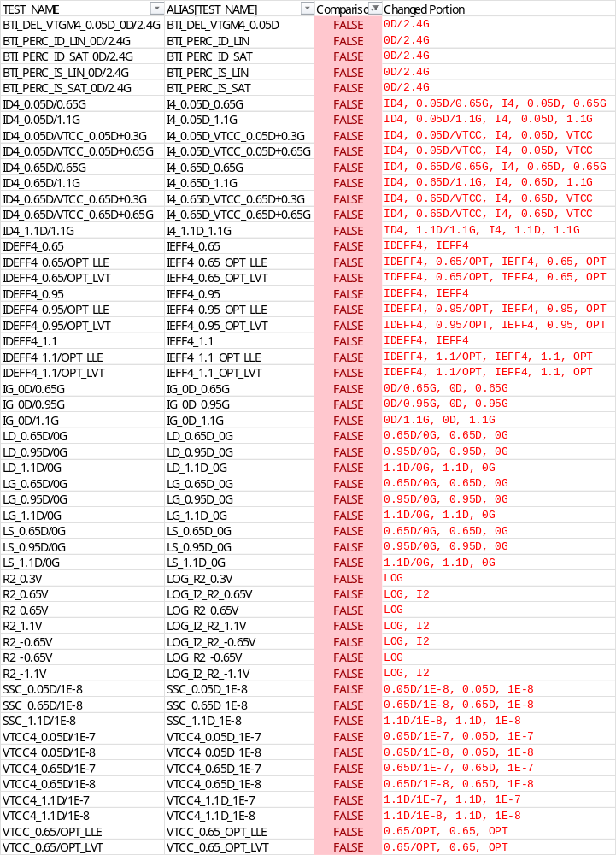
BKM from x78D -> x78E -> 80C
Test Name ALIAS
No more test name aliasing between Etest and dashboard on x818 TC and on
Each config contains a list of tests depending on what config type it is
      PFT config consists of a larger subset than a config designed for an 2pt ISO structure
      Naming convention changes for ease of use, detailed drain/source pin information should be retained
      IDEFF was referred as IEFF -> IDEFF will be retained
      Current –voltage separator “/” (forward slash) was replaced with “_” (underscore) -> forward slash will be retained
      LOG of test name is added in some cases -> required test config update to calculate logarithm of current at Etest
      BTI tests drop current/voltage spec -> retain Etest output
Notes:
Test Name BKM WW19.xlsx

Slide 6
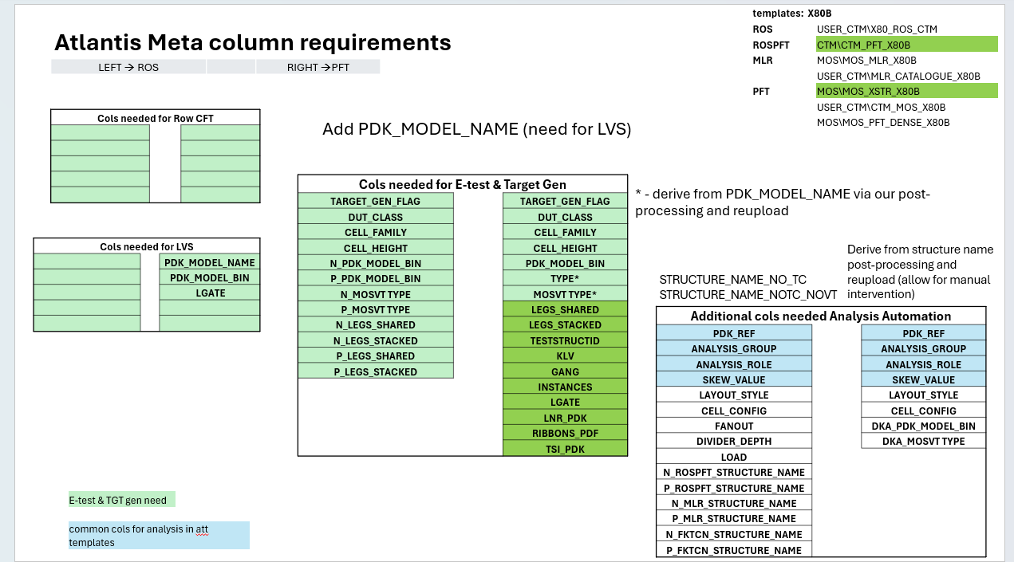
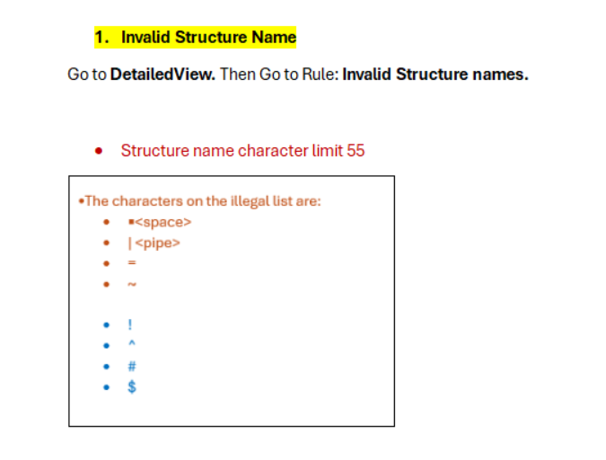
Device Ack: Wenjun, Brian, Andrew, Harap
Etest Ack: Habib, Farid
Structure Name
Limit to 64 chars
STRUCTURE_NAME_AS_TESTED to be the same as STRUCTURE_NAME in CNAI dashboard
Character limit is 64 reserved for structure name +TC information – 7 characters reserved for Etest; Etest can be restrictive, but alignment is needed
  Use PDK reference to align on naming convention
  Follow new metadata column entries in Atlantis intended for uniform and auto scalar generation – do not use structure name to generate device attributes, instead use device attributes to construct structure name
VT Flavor | Code in name
HVT | H
SVT | S
SRAM VT | SRAMVT
LVT | L
ULVT | U
ULVTLL | UL
ELVT | E
Atlantis Metadata column requirements (Ack: Andrew, Brian)
Ack: Habib, Etest
Notes:
Move VT after diff width
Try with JMP and make a script
WW43 decision: VT stays after LEGS/#ADF as in the slide templates (supersedes "Move VT after diff width"); names use the single-letter metal-gate code.

Slide 7
WW43 additions (to WW19 slide 5)
Character limit is 64
64-character limit is checked on the full name including _TCxx_y
Metal-gate VT is written with the single-letter code (table) and follows LEGS/#ADF

Slide 8
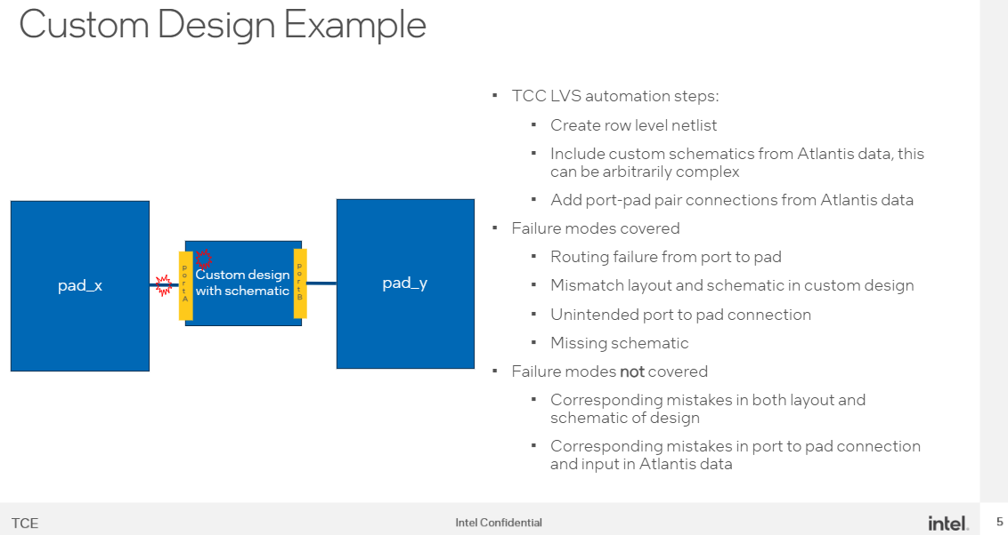
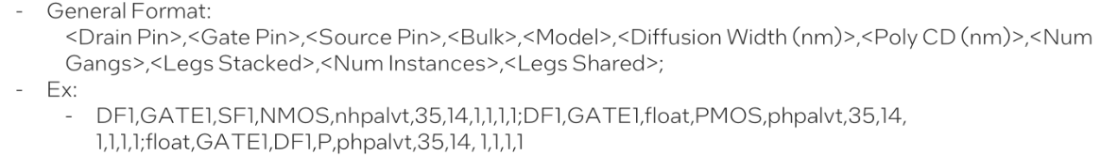
Device Ack: Harap
Ack: TCE team / Eduardo
Structure Name Validation
Validator Tool 1: Atlantis-based Layout vs Schematic (LvS)
Validates for layout checks to check for routing fails, missing schematic, mismatch in layout and schematics, unintended connections etc.
Device attributes covered: PLY CD, #Gangs, #Legs, #Instances, Shared Legs
Inputs: LVS String
Output: Pass/Fail – Routing, Schematic, Mapping errors
Validator Tool 2: Excel macro-based structure name constructor and validator – owned by Device
Inputs: DUT class, Polarity, CH, LNR, #Legs, Cell Env, VT, etc
        Output: LVS string, STRUCTURE_NAME
Atlantis Metadata column requirements (Ack: Andrew, Brian)
Validator Tool 2 is a requirement pre-tape in for LVS string generation as well as post-tape-in/pre-Etest for verification of entered device attribute to Structure name mapping. Second validation is done after database is closed to prevent layout edits. More updates to follow in WW20’26 since this area is under active development.

Slide 9
Library Offering
x81Z
Derived from Roberto’s table – WW17.4v, updated w/ 1281 PDK model WW20
Library Model Naming for 1281
Segment | CH | Diff. Width | LNR | Z
Standard Logic | 110 | 27 | 13 | Z1
 |  | 31 | 17 | Z2
 |  | 35 | 21 | Z3
 |  | 40 | 26 | Z4
 | 132 | 31 | 17 | Z2
 |  | 35 | 21 | Z3
 |  | 40 | 26 | Z4
 |  | 46 | 32 | Z5
 |  | 49 | 35 | Z6
 | 165 | 31 | 17 | Z2
 |  | 40 | 26 | Z4
 |  | 52 | 38 | Z6
 |  | 62 | 48 | Z7
Turbo Logic | 110 | 72 | 58 | Z8
 |  | 72 | 26/58/26 | Z8
 | 132 | 86 | 35/72/35 | Z9
 |  | 72 | 58 | Z8
 | 165 | 86 | 72 | Z9
Segment | Library | CH | Diff. Width | LNR | Z
Column Logic | HCC | 114 | 27 | 13 | Z1
 |  |  | 31 | 17 | Z2
 |  |  | 37 | 23 | ?
 | HDC | 128 | 31 | 17 | Z2
 |  |  | 35 | 21 | Z3
 |  |  | 40 | 26 | Z4
 |  |  | 44 | 30 | ?
 | TPRF | 126 | 31 | 17 | Z2
 |  |  | 35 | 21 | Z3
 |  |  | 40 | 26 | Z4
 |  |  | 43 | 29 | ?
 | HDC2 | 132 | 31 | 17 | Z2
 |  |  | 35 | 21 | Z3
 |  |  | 40 | 26 | Z4
 |  |  | 46 | 32 | Z5
BNPN PMOS
BNPN PMOS
Diffmax
BNPN PMOS
BNPN PMOS
x81A
OPH
OPH
x81A
Notes:
Z convention vs Diff. Width – needs alignment

Slide 10
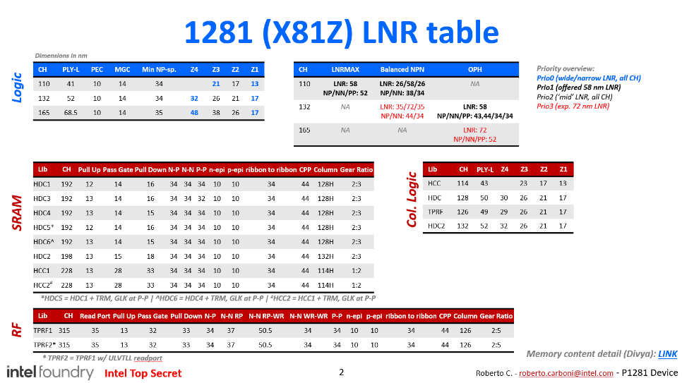
Library Offering
x81Z
Derived from Roberto’s table – WW17.4v
Segment | Library | CH | Diff. Width | LNR | PFT
SRAM | HDC1 HDC5 | 192 | 26 | 12 | PU
 |  |  | 28 | 14 | PG
 |  |  | 30 | 16 | PD
 | HDC3 | 192 | 26 | 13 | PU
 |  |  | 28 | 14 | PG
 |  |  | 30 | 16 | PD
 | HDC4 HDC6 | 192 | 27 | 13 | PU
 |  |  | 28 | 14 | PG
 |  |  | 29 | 15 | PD
 | HDC2 | 198 | 27 | 13 | PU
 |  |  | 29 | 15 | PG
 |  |  | 32 | 18 | PD
 | HCC1 HCC2 | 228 | 27 | 13 | PU
 |  |  | 39 | 25 | PG
 |  |  | 47 | 33 | PD
Segment | Library | CH | Diff. Width | LNR | PFT
TPRF | TPRF1 | 315 | 49 | 35 | RP
 |  |  | 27 | 13 | PU
 |  |  | 46 | 32 | PG
 |  |  | 47 | 33 | PD
 | TPRF2 | 315 | 49 | 35 | RP
 |  |  | 27 | 13 | PU
 |  |  | 46 | 14 | PG
 |  |  | 47 | 16 | PD

Slide 11
Structure Name - ROS
TESTNAME_CATEGORYCELLHEIGHT-DIFF-LEGS-VT-Style-Stages-FanOut-LayoutHeight-Type:NOM|Type:Skew-(Routing)-Additional_TCxx_Count
Inline Structure Example
X81ZROS132-Z5-2L-U-NAN-STG11-FO3-SH-A:NOM-M1_TCxx_y
EOL Structure Example
X81ZROS132-Z5-2L-L-INV-STG11-FO3-SH-A:NOM-M2-WAC_TCxx_y
Ring Oscillator
Cell Height
N/P Legs
Style/
Environment
Single/Double Height Cell
Row Instance
N/P LNR
Metal Gate
#Stages
Fan Out
Metal Routing
Test Chip
ROS PFT and ROS follow style convention right after legs in place of environment for CMOS PFT consistency
Stages is replaced with Nesting, Fan out is replaced with Isolation in ROSPFT
Notes:
PDK model names – 1278
CH, LNR, VT type –
1280
Diff box width
1281 reference – Andrew to share list of column names that will be present in Atlantis templates
Ask Wenjun to write this out based on PDK reference

Slide 12
Structure Name - ROS PFT
TESTNAME_CATEGORYCELLHEIGHT-DIFF-LEGS-VT-Style-FTI-ISO-LayoutHeight-Type:NOM|Type:Skew-(Routing)-Additional_TCxx_Count
Inline Structure Example
ROSN132-Z3-2L-E-NAN-1X1-IXI-SH-A:NOM-M1-WAC-6X_TCxx_y
EOL Structure Example
ROSP132-Z3-2L-S-AOI-10X10-IXI-SH-M2-STK-16X_TCxx_y
ROS-env. PFT
Cell Height
Metal Gate
Style/
Environment
Isolation
Metal Routing
Test Chip
Polarity
LNR
Nesting
Single/Double Height Cell
Additional WAC/Instance Information
Legs
Row Instance
Precedes with M – Matching Pair PFT (MNS/MPS); pair given in environment as CMOS/NP or CMOS/PP
Precedes with W – Within Die PFTs (W prefix replaces the '-WID' suffix; W before M)
ROS PFT and ROS follow style convention right after legs in place of environment for CMOS PFT consistency
Notes:
PDK model names – 1278
CH, LNR, VT type –
1280
Diff box width
1281 reference – Andrew to share list of column names that will be present in Atlantis templates
Ask Wenjun to write this out based on PDK reference

Slide 13
Structure Name – LLE-neutral PFT
TESTNAME_CATEGORYCELLHEIGHT-DIFF-LEGS-VT-Environment-FTI-ISO-LayoutHeight-Type:NOM|Type:Skew-Additional_TCxx_Count
Inline Structure Example
NS132-Z5-1L-U-CMOS-1X1-IXI-SH-A:NOM_TCxx_y
EOL Structure Example
NS110-Z8-1L-E-BCMOS-1X1-IXI-DH-A:NOM_TCxx_y
LLE-neutral PFT
LNR
Legs
Isolation
Metal Routing
Row Instance
Polarity
Cell Height
Metal Gate
Environment
Nesting
Test Chip
Precedes with M – Matching Pair PFT (MNS/MPS); pair given in environment as CMOS/NP or CMOS/PP
Precedes with W – Within Die PFTs (W prefix replaces the '-WID' suffix; W before M)
BCMOS – Balanced NPN
LCMOS – LNR Max
OCMOS - OPH
Environment
A:FTI:PGD:CD:P5
PLY:PP:CD:45/12
A:PLY:OGD:CD:12
A:PLY:OGD:PP:45
For PW skews, follow ISO convention in additional section
Notes:
BCMOS – Balanced NPN
LCMOS – LNR Max
OCMOS - OPH
Make comments
-CMOS_DH_LNRREF, *-CMOS_DH_LNRMAX80,

Slide 14
WW43 additions (to WW19 slide 11)
BCMOS – Balanced NPN
/D – no diffusion (replaces CMOS/UNI)
CMOS/NP, CMOS/PP – matching pair
ADTUNI – two active diffusion (ADT)
If nesting not specified: 0X0-IXI
Inline Structure Example
Matching: MNS132-Z5-1L-L-CMOS/NP-0X1-IXI-SH-A:NOM_TCxx_y
WID: WNS132-Z5-1L-L-CMOS-0X1-IXI-SH-A:NOM_TCxx_y
PLY/TCN CD skews - layer code states TCN and poly-pitch behaviour (POR PP 44): PLYFTCN = PLY skew, TCN fixed, PP = 44+MAG (A:PLYFTCN:OGD:CD:N1 = 43PP); PLYFPP = PLY only, fixed 44PP, TCN nominal; PLYITCN = PLY skew, TCN inverse, fixed 44PP (A:PLYITCN:OGD:CD:N0D4 = PLY -0.4 / TCN +0.4); TCNFPP = TCN only, fixed 44PP. ISO/KLV keep A:TCN:OGD:CD:{MAG}

Slide 15
Structure Name – Bitcell/Column/TPRF PFT
TESTNAME_CATEGORYCELLHEIGHT-DIFF-LEGS-DUT-Bitcell-FTI-ISO-Type:NOM|Type:Skew-Additional_TCxx_Count
Inline Structure Example
SRN192-30-1L-PD-HDC1-SNXSN-SNXSN-A:NOM_TCxx_y
EOL Structure Example
SRP192-26-1L-PU-HDC1-SNXSN-SNXSN-A:NOM_TCxx_y
RFN315-49-1L-RP-TPRF1-SNXSN-SNXSN-A:NOM_TCxx_y
SR192-HDC1BCLA_TCxx_y
Cell Height
Legs
Metal Routing
SRAM
Metal Gate
Isolation
Row Instance
phpsrhdc1pu
nhpsrhdc1pg
nhpsrhdc1pd
phpsrhdc2pu
nhpsrhdc2pg
nhpsrhdc2pd
phpsrhcc1pu
nhpsrhcc1pg
nhpsrhcc1pd
phprf1pu
nhprf1pg
nhprf1pd
nhprf1rp
phprf2pu
nhprf2pg
nhprf2pd
nhprf2rp
Bitcell
Diff. Width
DUT/
Environment
Nesting
Test Chip
All SRAM PD/PG/PU are HVT
TPRF PD/PG/PU are HVT
TPRF1 RP is SVT; TPRF2 RP is ULVTLL
Ack: Divya, Andrew
Notes:
VT to be replaced from SRAM structure name – to PG/PD – VT type to be POR for bitcell PFT
What about target being attached to a given structure?
SRAM and logic co centering plots – needs documentation on which VT type is mapped
IREAD to look different – IR for stacked

Slide 16
Structure Name - MLR
TESTNAME_CATEGORYCELLHEIGHT-DIFF-#ADF-VT-Environment-FTI-ISO-LayoutHeight-Type:NOM|Type:Skew-Additional_TCxx_Count
Inline Structure Example
NM132-Z5-1ADF-L-CMOS-0X0-IXI-SH-A:NOM_TCxx_y
EOL Structure Example
PM110-Z8-2ADF-E-UNI-0X0-IXI-SH-A:NOM_TCxx_y
Miller
LNR
#Active Diffusion Tracks
Metal Routing
Row Instance
Polarity
Cell Height
Metal Gate
Environment
Test Chip
Notes:
LNR max should be a number – character – what does PDK follow?

Slide 17
WW43 additions (to WW19 slide 13)
Inline Structure Example
Metal routing (M#) is not part of PFT / MLR / BITCELL names (kept only for ROS / ROSPFT where needed); FTI-ISO-LayoutHeight padded 0X0-IXI-SH
/D environment = no diffusion: NM132-Z5-1ADF-E-/D-0X0-IXI-SH-A:NOM_TCxx_y
VCRNUB PGD CD relative to single-sided nominal 8.4 nm (110H) / 13.4 nm (132H, 165H); double-sided 16.8 / 26.8 nm

Slide 18
Structure Name - ISO-FE
FailmodeCH-PolarityDIFF-NL-VT-Type:Layer|NOM:Direction:SkewType:Magnitude[:Additional]_TCxx_y
Examples:
CTGOGD132-NZ5-NL-UL-A:TCP:OGD:REG:N7_TCxx_y
TCNETE165-NZ6-NL-L-A:NOM_TCxx_y
DIFFOGD110-PZ3-NL-S-B:FTIML:OGD:CD:P2_TCxx_y
DIFFOGD110-PZ3-NL-S-A:DPR:PGD:CD:N2_TCxx_y
Cell Height
LNR
Type
TSDR Layer
Skew Type
Test Chip
Fail Mode Segment
Polarity
Metal Gate
Direction
Magnitude
Row Instance
Notes:
My sub name is FailmodeTestRowName
Now, I want to generate a full structure spread of every structure name in sheet 3, column 2 along with test row name in column 1 - there is one row of header in sheet 3
The structure name should be generated as follows:
TSDRIdentifierCellHeight-PolarityDiffusionWidth-MetalGate-SkewIdentifier
TSDRIdentifier is in column F
Cellheight and Diff Width are in column J coupled together in the format 132Z4, Z4 is going to be Diffusion Width
​‌

Slide 19
WW43 additions (to WW19 slide 14)
Examples:
POR layer 'SDR' is written NOM; diffusion always Z code (NZ1, not N27)
POR reference without its own direction lists all DIR / SKEW of its series: DIFFOGD132-NZ5-NL-L-A:FTIML:OGD/PGD:CD/REG:NOM
Qualifiers (e.g. NDBI) go to a trailing ':' chunk: A:NOM:PGD:ESD:2TRK1PP:NDBI
No legs in ISO / KLV names: 'NL' (no legs) keeps VT in field 4; SRAM bitcells already carry the device type (PD/PG/PU/RP/IR) in field 4; bitcells have no layout height, so the skew is field 8; two diffusions are joined with ':' (SRN192-29:28-1L-PD-...)
KLV structures use this layout: GATEKLV132-NDZ5-NL-L-NPXLNGLK, VTKLV132-NZ5-NL-L-SDRENC

Slide 20
Structure Name – ADT
TESTNAME_CATEGORYCELLHEIGHT-DIFF-LEGS-VT-Environment-FTI-ISO-LayoutHeight-Type:NOM|Type:Skew-Additional_TCxx_Count
Inline Structure Example
PS165-Z6-1L-L-ADTUNI-3X3-IXI-DH-48X-STK_TCxx_y
EOL Structure Example
NS110-Z8-1L-L-ADTUNI-3X3-IXI-DH-4X-STK_TCxx_y
PFT
LNR
Legs
Nesting
Single/Double Height Cell
Additional WAC/Instance Information
Row Instance
Polarity
Cell Height
Metal Gate
Two active diffusion type ADT
Isolation
Metal Routing
Test Chip

Slide 21
Use old name to extrapolate what grouping is
Use new name to extrapolate what grouping is
Compare new and old names
Use LVS strings to make sure structure names are right
Spot check structures individually
Generate (Ask Agent)
Generate structure names that are compliant with this

Slide 22
Structure Name – Full KTCN (FK) PFT [NEW WW43]
TESTNAME_{N|P}S{CH}-{Z}-1L-{VT}-CMOS-1X1-IXI-SH-A:FKTCN:{Dir}:{SkewType}:{Mag}:44PP_TCxx_y
Follows the CMOS PFT template; full-KTCN identity carried by the skew layer FKTCN; 44 = 44 PP
Old: FKNS44-132-Z5-L-TCN:OGD:CD:N1_TCxx_y
New: NS132-Z5-1L-L-CMOS-1X1-IXI-SH-A:FKTCN:OGD:CD:N1:44PP_TCxx_y
Old: FKPS44-165-Z7-L-TCN:OGD:CD:NOM_TCxx_y
New: PS165-Z7-1L-L-CMOS-1X1-IXI-SH-A:FKTCN:OGD:CD:NOM:44PP_TCxx_y

Slide 23
Structure Name – Back-end (Via / Metal) [NEW WW43]
{VIA}{TEST}{CH}-{Layers}-{W/S}-{W/S}-{Dim}-A:{VIA}:{Dir}:{Skew}:{N#|P#|NOM}_TCxx_y
TEST = back-end structure type, joined to the category like the front-end KLV family (VT_KLV_…_132H -> VTKLV132-…, cf. VTKLV132-NZ5-L-…): KLV kelvin, MV via zipper, VCHN via chain, ECD electrical CD, SRP serpentine
'-' replaces '_' as field delimiter; CH follows the category; '/' kept for layer pairs and W/S; skew in TYPE:LAYER:DIR:SKEW:MAG with layer = via/metal and DIR Z (back-end, as DIFFCHN); structures without skew carry A:NOM
Old: V0_KLV_M0B/M1_12/9_24/20_21X9_CD_-3_TCxx_y -> V0KLV-M0B/M1-12/9-24/20-21X9-A:V0:Z:CD:N3_TCxx_y
Old: V1_VCHN_M1/M2B_…_REGOGD_-13_TCxx_y -> V1VCHN-M1/M2B-…-A:V1:OGD:REG:N13_TCxx_y
Old: V0_MV_M0B/M1_12/9_24/20_24X12_V0M0_-10_TCxx_y -> V0MV-…-A:V0:Z:V0M0:N10_TCxx_y
Old: VG_KLV_Z1N/M0B_12X10_DR_E_110H_TCxx_y -> VGKLV110-Z1N/M0B-12X10-DR-E_TCxx_y
DR -> NOM only where confirmed per structure (DR_to_NOM_Decisions.csv)
Uniform field count per {VIA}{TEST}: core fields - skew field (A:... / A:NOM / DR) - one optional ':'-joined additional field (NUB:0:1VCR, WL:DEN, TOP:L); '-WID' -> 'W' head prefix

Slide 24
Structure Name – QnR (draft, decoder pending) [NEW WW43]
{QFAM}{CH}-{Z}-{VT}-{ENV}-{NEST}-{ISO}-R{rev}:{MOS code}:{CH variant}:{Geometry}:{Style}:{Topology}-{Location}
Old: QMN3-NM44-132A-Z521616I-0X0-IXI-SVT-L-2T-CMOS-BP35_TCxx_y
Draft: QMN132-Z5-S-CMOS-0X0-IXI-R3:NM44:A:21616I:L:2T-BP35_TCxx_y
Interim rule: '-' delimiter (QCNP used '_'), single-letter VT, 'ULVT-LL' -> UL
MOS code NM/PM/PC + 44 (PP); A = lego/orientation variant; BP/VP = pad/site index

Slide 25
WW43 change log
Slide 9: VT-Style-FTI-ISO-LayoutHeight-(Routing)-Style-Additional_TCxx_Count -> VT-Style-Stages-FanOut-LayoutHeight-Type:NOM|Type:Skew-(Routing)-Additional_TCxx_Count
Slide 9: X81ZROS132-Z5-2L-ULVT-NAN-STG11-FO3-SH-M1_TCxx_y -> X81ZROS132-Z5-2L-U-NAN-STG11-FO3-SH-A:NOM-M1_TCxx_y
Slide 9: X81ZROS132-Z5-2L-LVT-INV-STG11-FO3-SH-M2-WAC_TCxx_y -> X81ZROS132-Z5-2L-L-INV-STG11-FO3-SH-A:NOM-M2-WAC_TCxx_y
Slide 10: -LayoutHeight-(Routing)-Additional_TCxx_Count -> -LayoutHeight-Type:NOM|Type:Skew-(Routing)-Additional_TCxx_Count
Slide 10: ROSN132-Z3-2L-ELVT-NAN-1X1-IXI-SH-M1-WAC-6X_TCxx_y -> ROSN132-Z3-2L-E-NAN-1X1-IXI-SH-A:NOM-M1-WAC-6X_TCxx_y
Slide 10: ROSP132-Z3-2L-SVT-AOI-10X10-IXI-SH-M2-STK-16X_TCxx_y -> ROSP132-Z3-2L-S-AOI-10X10-IXI-SH-M2-STK-16X_TCxx_y
Slide 10: Precedes with M – Matching Pair PFT , Structure instance to be added in additional section -> Precedes with M – Matching Pair PFT (MNS/MPS); pair given in environment as CMOS/NP or CMOS/PP
Slide 10: Precedes with W – Within Die PFTs, Structure instance to be added in additional section -> Precedes with W – Within Die PFTs (W prefix replaces the '-WID' suffix; W before M)
Slide 11: -LayoutHeight-(Routing)-Additional_TCxx_Count -> -LayoutHeight-Type:NOM|Type:Skew-Additional_TCxx_Count
Slide 11: NS132-Z5-1L-ULVT-CMOS-1X1-IXI-SH-M1-NOM_TCxx_y -> NS132-Z5-1L-U-CMOS-1X1-IXI-SH-A:NOM_TCxx_y
Slide 11: NS110-Z8-1L-ELVT-BCMOS-1X1-IXI-DH_TCxx_y -> NS110-Z8-1L-E-BCMOS-1X1-IXI-DH-A:NOM_TCxx_y
Slide 11: Precedes with M – Matching Pair PFT, Structure instance to be added in additional section -> Precedes with M – Matching Pair PFT (MNS/MPS); pair given in environment as CMOS/NP or CMOS/PP

Slide 26
WW43 change log (cont.)
Slide 11: Precedes with W – Within Die PFTs, Structure instance to be added in additional section -> Precedes with W – Within Die PFTs (W prefix replaces the '-WID' suffix; W before M)
Slide 11: FTI:PGD:CD:P5 -> A:FTI:PGD:CD:P5
Slide 11: PLY:OGD:CD:12 -> A:PLY:OGD:CD:12
Slide 11: PLY:OGD:PP:45 -> A:PLY:OGD:PP:45
Slide 12: DIFF-LEGS-VT-Environment-FTI-ISO-Bitcell-(Routing)-Additional_TCxx_Count -> DIFF-LEGS-DUT-Bitcell-FTI-ISO-Type:NOM|Type:Skew-Additional_TCxx_Count
Slide 12: SRN192-30-1L-PD-HCC1-SNXSN-SNXSN-M1_TCxx_y -> SRN192-30-1L-PD-HDC1-SNXSN-SNXSN-A:NOM_TCxx_y
Slide 12: SRP192-30-1L-PU-HCC1-SNXSN-SNXSN-M1_TCxx_y -> SRP192-26-1L-PU-HDC1-SNXSN-SNXSN-A:NOM_TCxx_y
Slide 12: RFN315-49-1L-RP-TPRF1-SNXSN-SNXSN-M2_TCxx_y -> RFN315-49-1L-RP-TPRF1-SNXSN-SNXSN-A:NOM_TCxx_y
Slide 13: DIFF-#ADF-VT-Environment-(Routing)-Additonal_TCxx_Count -> DIFF-#ADF-VT-Environment-FTI-ISO-LayoutHeight-Type:NOM|Type:Skew-Additional_TCxx_Count
Slide 13: NM132-Z5-1ADF-LVT-CMOS-M1-NOM_TCxx_y -> NM132-Z5-1ADF-L-CMOS-0X0-IXI-SH-A:NOM_TCxx_y
Slide 13: PM110-Z8-2ADF-ELVT-UNI-NOM_TCxx_y -> PM110-Z8-2ADF-E-UNI-0X0-IXI-SH-A:NOM_TCxx_y
Slide 14: FailmodeCH-PolarityDIFF-VT-(SDR)TSDRSkew_Additional_Detail_Magnitude_TCxx_y -> FailmodeCH-PolarityDIFF-NL-VT-Type:Layer|NOM:Direction:SkewType:Magnitude[:Additional]_TCxx_y

Slide 27
WW43 change log (cont.)
Slide 14: CTGOGD132-NZ5-ULVTLL-A:TCP:OGD:REG:N7_TCxx_y -> CTGOGD132-NZ5-NL-UL-A:TCP:OGD:REG:N7_TCxx_y
Slide 14: TCNETE165-NZ6-LVT-SDR_TCxx_y -> TCNETE165-NZ6-NL-L-A:NOM_TCxx_y
Slide 14: DIFFOGD110-PZ3-SVT-B:FTIML:OGD:CD:P2_TCxx_y -> DIFFOGD110-PZ3-NL-S-B:FTIML:OGD:CD:P2_TCxx_y
Slide 14: DIFFOGD110-PZ3-SVT-A:DPR:PGD:CD:N2_TCxx_y -> DIFFOGD110-PZ3-NL-S-A:DPR:PGD:CD:N2_TCxx_y
Slide 15: -LayoutHeight-(Routing)-Additional_TCxx_Count -> -LayoutHeight-Type:NOM|Type:Skew-Additional_TCxx_Count
Slide 15: PS165-Z6-1L-LVT-ADT-3X3-IXI-DH-M1-48X-STK_TCxx_y -> PS165-Z6-1L-L-ADTUNI-3X3-IXI-DH-48X-STK_TCxx_y
Slide 15: NS110-Z8-1L-LVT-ADT-3X3-IXI-DH-4X-STK_TCxx_y -> NS110-Z8-1L-L-ADTUNI-3X3-IXI-DH-4X-STK_TCxx_y
Slide 20: ROSN132-Z3-E-2L-INV-1X1-IXI-SH-M1_TCxx_y -> ROSN132-Z3-2L-E-INV-1X1-IXI-SH-A:NOM-M1_TCxx_y
Slide 20: ROSN132-Z3-E-2L-INV-1X1-IXI-SH-M1-WAC-6X -> ROSN132-Z3-2L-E-INV-1X1-IXI-SH-A:NOM-M1-WAC-6X
Slide 5: VT table symbol Symbol -> Code in name
Slide 5: VT table symbol HVT -> H
Slide 5: VT table symbol SVT -> S

Slide 28
WW43 change log (cont.)
Slide 5: VT table symbol LVT -> L
Slide 5: VT table symbol ULVT -> U
Slide 5: VT table symbol ULVTLL -> UL
Slide 5: VT table symbol ELVT -> E
Slide 3: Added: '/' only inside the environment field (/D = no diffusion; CMOS/NP, CMOS/PP = matching pair), in back-end layer pairs / W-S values, and between alternative DIR / SKEW values of a POR reference (OGD/PGD, CD/REG)
Slide 3: Added: POR structures without a TSDR skew carry A:NOM (lego type first, as in skews) as the first additional token; POR / REF / SDR are written NOM
Slide 3: Added: Signed magnitudes are written N#/P#/NOM - never '+' / '-' (collides with the '-' delimiter)
Slide 3: Added: Inline '_' is not allowed; '_' only before seat name for a trailing instance index (e.g. _2)
Slide 3: Added: LLE (local layout effects) rows: a structure carries an LLE layout descriptor (NEST, VTMX, UDEG, FTIRST, ...) or, if it has none (A:NOM, A:PXL), the tag ':LLE' (A:NOM:LLE)
Slide 3: Added: Every TSDR skew (ISO, PFT, MLR, KLV, BE) uses TYPE:LAYER:DIR:SKEW:MAG[:extra]; TYPE = lego type ('A' when not specified); DIR: PXL=PGD, PLY/TCN/FTI=OGD; decimals as D (N1D2); CD relative to nominal (VCR 12 nm, VCRNUB 44 nm)
Slide 3: Added: Layout-variant descriptors that are not TSDR skews (VTMX, NEST, UDEG, JOG, FTIRST, ...) carry the lego type as prefix (A:VTMX:CRL:H); a trailing REF / POR inside them is written NOM; signed values '+5' -> P5
Slide 5: Added: 64-character limit is checked on the full name including _TCxx_y

Slide 29
WW43 change log (cont.)
Slide 5: Added: Metal-gate VT is written with the single-letter code (table) and follows LEGS/#ADF
Slide 11: Added: /D – no diffusion (replaces CMOS/UNI)
Slide 11: Added: CMOS/NP, CMOS/PP – matching pair
Slide 11: Added: ADTUNI – two active diffusion (ADT)
Slide 11: Added: If nesting not specified: 0X0-IXI
Slide 11: Added: Matching: MNS132-Z5-1L-L-CMOS/NP-0X1-IXI-SH-A:NOM_TCxx_y
Slide 11: Added: WID: WNS132-Z5-1L-L-CMOS-0X1-IXI-SH-A:NOM_TCxx_y
Slide 11: Added: PLY/TCN CD skews - layer code states TCN and poly-pitch behaviour (POR PP 44): PLYFTCN = PLY skew, TCN fixed, PP = 44+MAG (A:PLYFTCN:OGD:CD:N1 = 43PP); PLYFPP = PLY only, fixed 44PP, TCN nominal; PLYITCN = PLY skew, TCN inverse, fixed 44PP (A:PLYITCN:OGD:CD:N0D4 = PLY -0.4 / TCN +0.4); TCNFPP = TCN only, fixed 44PP. ISO/KLV keep A:TCN:OGD:CD:{MAG}
Slide 13: Added: Metal routing (M#) is not part of PFT / MLR / BITCELL names (kept only for ROS / ROSPFT where needed); FTI-ISO-LayoutHeight padded 0X0-IXI-SH
Slide 13: Added: /D environment = no diffusion: NM132-Z5-1ADF-E-/D-0X0-IXI-SH-A:NOM_TCxx_y
Slide 13: Added: VCRNUB PGD CD relative to single-sided nominal 8.4 nm (110H) / 13.4 nm (132H, 165H); double-sided 16.8 / 26.8 nm
Slide 14: Added: POR layer 'SDR' is written NOM; diffusion always Z code (NZ1, not N27)

Slide 30
WW43 change log (cont.)
Slide 14: Added: POR reference without its own direction lists all DIR / SKEW of its series: DIFFOGD132-NZ5-NL-L-A:FTIML:OGD/PGD:CD/REG:NOM
Slide 14: Added: Qualifiers (e.g. NDBI) go to a trailing ':' chunk: A:NOM:PGD:ESD:2TRK1PP:NDBI
Slide 14: Added: No legs in ISO / KLV names: 'NL' (no legs) keeps VT in field 4; SRAM bitcells already carry the device type (PD/PG/PU/RP/IR) in field 4; bitcells have no layout height, so the skew is field 8; two diffusions are joined with ':' (SRN192-29:28-1L-PD-...)
Slide 14: Added: KLV structures use this layout: GATEKLV132-NDZ5-NL-L-NPXLNGLK, VTKLV132-NZ5-NL-L-SDRENC
Slide 5: Speaker note: WW43 decision: VT stays after LEGS/#ADF as in the slide templates (supersedes "Move VT after diff width"); names use the single-letter metal-gate code.
Slide new: Structure Name – Full KTCN (FK) PFT
Slide new: Structure Name – Back-end (Via / Metal)
Slide new: Structure Name – QnR (draft, decoder pending)

Slide 32
Structure Name – 82Z vs 80BR
TESTNAME_CATEGORYCELLHEIGHT-DIFF-LEGS-VT-Environment-FTI-ISO-LayoutHeight-(Routing)-Additional_TCxx_Count
80BR CMOS PFT
NS144-A50-1X1-IXI-L-CMOS_TC31_1
80BR CMOS PFT
ROSN-144-50-2L-INV-LVT_M1FECL_TC31_1
82Z CMOS PFT
NS-108-A36-1X1-IXI-LVT-CMOS_TCxx_y
82Z ROS PFT
NROSMOS-INV-L18-108H-FS_TC13_1
Lego Type
Environment
CH | Diff. Width | LNR | Z
120 | 34 | 16 | Z2
 | 36 | 18 | Z3
 | 42 | 24 | Z4
108 | 30 | 12 | Z1
 | 36 | 18 | Z3
96 | 30 | 12 | Z1
92 | 30 | 12 | Z1
 | 34 | 16 | Z2
Polarity
Cell Height
N/P Diff.
Nest/Roost
Metal Gate
Style/
Environment
Polarity
#Legs
Metal Gate
Cell Height
N/P Diff.
Metal Routing
Lego Type
Polarity
Cell Height
N/P Diff.
Nest/Roost
Metal Gate
Environment
Polarity
Style/
Environment
N/P LNR
Metal Routing
#Unique LNRs
12, 16, 18, 24

Slide 33
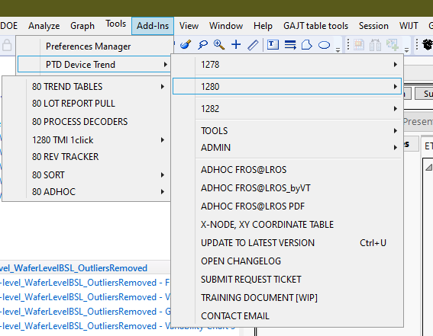
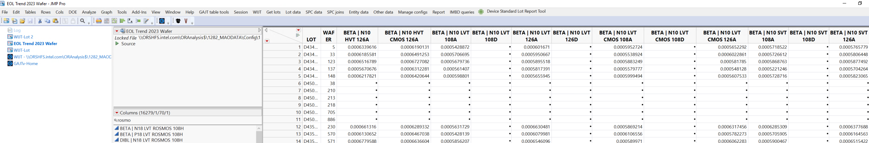
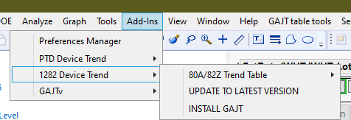
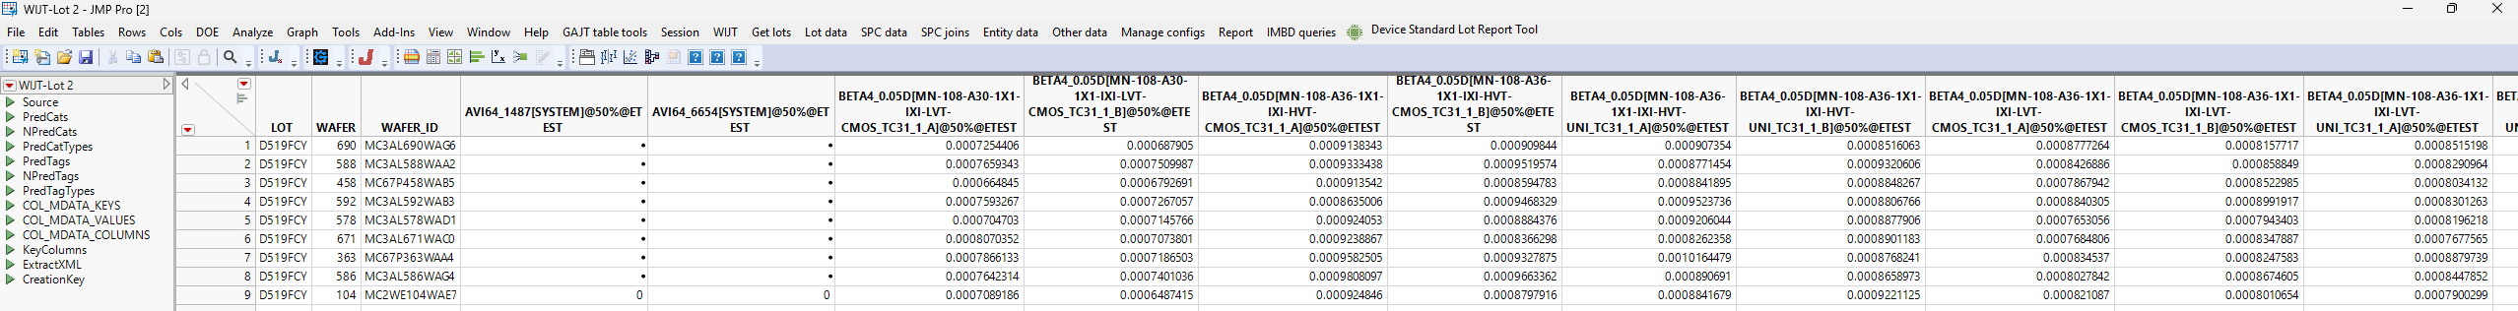
80BR Data from CNAI Addin
82Z Addin Old Method
82Z WIJT pull

Slide 34
^
Testchip | Etest Name | CNAI Name | Testname to Structurename Delimiter
X802Z | ROSN-108-32-2L-INV-LVT_M1BECL-WAC_TC31_1 | ROSPFT_NZ1_108H_2LG_LVT_BM1WAC_INV | _
X80C | ROSN-144-50-2L-INV-LVT-SH-M2_WAC_TC12_1 | ROSPFT_NZ3_144H_2LG_LVT_M2_INV | |
X82Z | NROSMOS-INV-L18-108H-FS_TC31_1 | ROSN108-Z3-L-1L-INV-1X1-IXI-SH-M1 | |
X81Z | ROSN132-Z3-2L-E-INV-1X1-IXI-SH-A:NOM-M1_TCxx_y | ROSN132-Z3-2L-E-INV-1X1-IXI-SH-A:NOM-M1-WAC-6X | |

