Slide 1
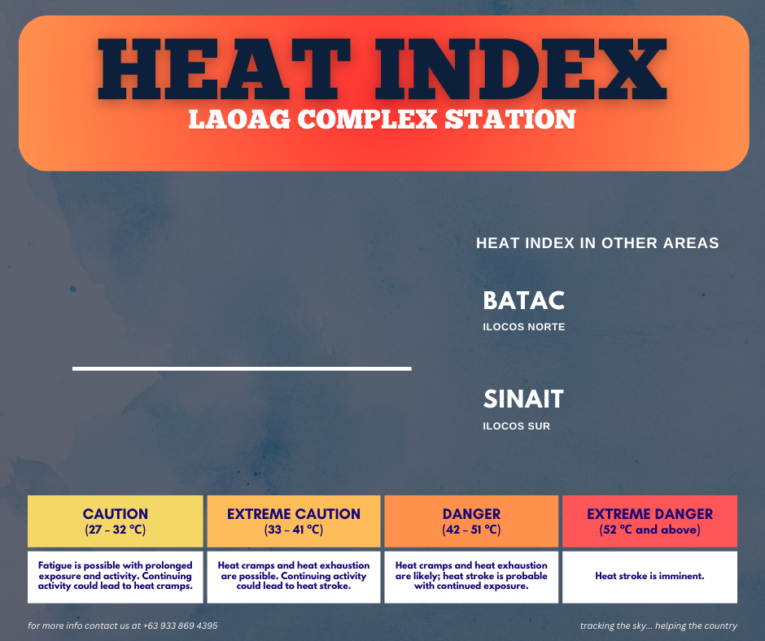
4:00 PM– March 17, 2025
34°C
EXTREME CAUTION
33°C | EXTREME CAUTION
34°C | EXTREME CAUTION

Slide 3
HOW TO EDIT

Slide 4
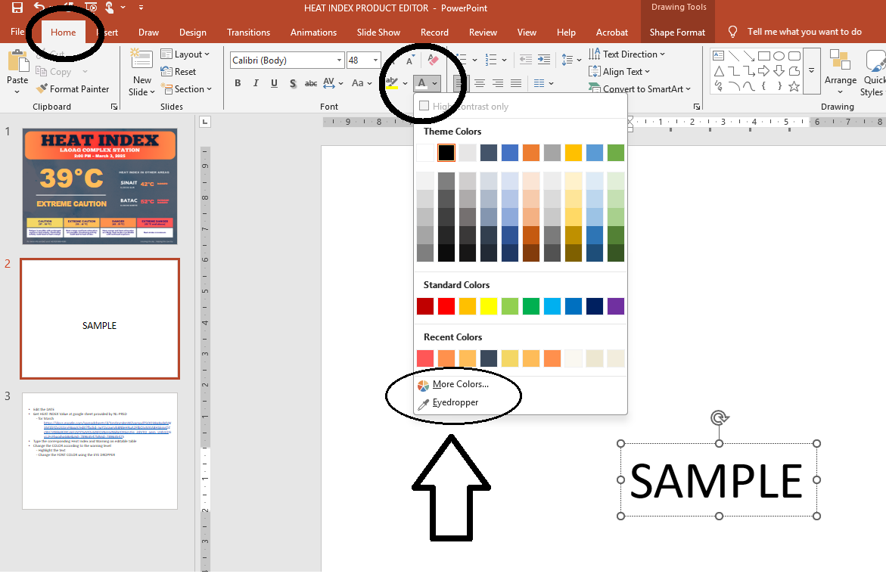
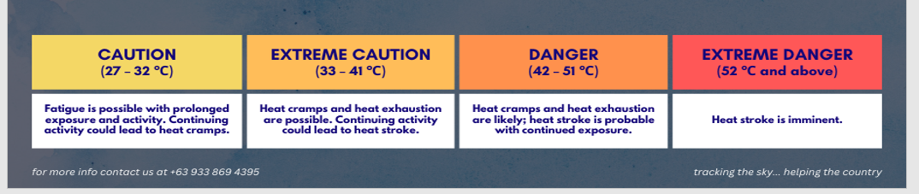
Edit the DATE
Get HEAT INDEX Value on the google sheet provided by NL-PRSD
- for March
https://docs.google.com/spreadsheets/d/1mQnmBmWZyampdT5OO38q8xdehW3M1bYZxUUzryF8qqA/edit?fbclid=IwY2xjawIyhBNleHRuA2FlbQIxMAABHSEmrOZc9H7i48Bq9DXCgeFzMYYuMQyGNFQiNeHxN6lGIOKGzUFe_ZdVTQ_aem_U3h1D1ivLJFsFhpoihqGBg&gid=789635475#gid=789635475
Type the corresponding Heat Index and Warning on editable tables
Change the COLOR according to the warning level
- Highlight the text
- Change the FONT COLOR using the EYE DROPPER
- Then click the color of the corresponding warning

Slide 5
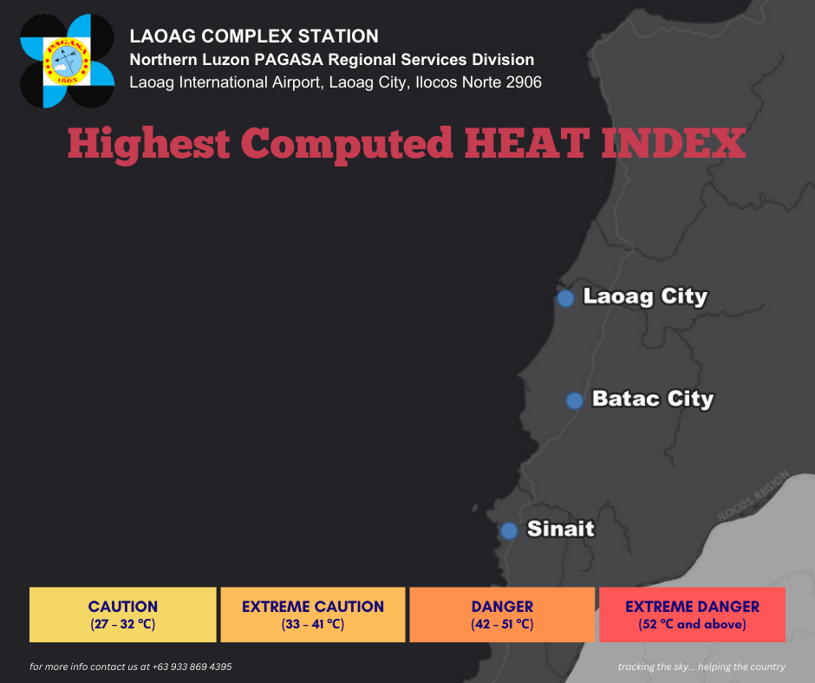
March 18, 2025
34°C 1:00 PM | EXTREME CAUTION
FORECAST HEAT INDEX
Station Name | Mar. 19 | Mar. 20
Laoag City | 35 °C | 34 °C
Batac City | 34 °C | 33 °C
Sinait | 35 °C | 34 °C
33°C 10:00 AM | EXTREME CAUTION
33°C 3:00 PM | EXTREME CAUTION

Slide 6
FORECAST HEAT INDEX
Station Name | Mar. 19 | Mar. 20
Laoag City
Batac City
Sinait

Slide 7
HOW TO EDIT

Slide 8
Edit the DATE
Get highest HEAT INDEX Value on the google sheet provided by NL-PRSD
- for March
https://docs.google.com/spreadsheets/d/1mQnmBmWZyampdT5OO38q8xdehW3M1bYZxUUzryF8qqA/edit?fbclid=IwY2xjawIyhBNleHRuA2FlbQIxMAABHSEmrOZc9H7i48Bq9DXCgeFzMYYuMQyGNFQiNeHxN6lGIOKGzUFe_ZdVTQ_aem_U3h1D1ivLJFsFhpoihqGBg&gid=789635475#gid=789635475
for the FORECAST, visit
https://www.pagasa.dost.gov.ph/weather/heat-index
Type the corresponding Heat Index and Warning on editable tables
Change the COLOR according to the warning level
- Highlight the text
- Change the FONT COLOR using the EYE DROPPER
- Then click the color of the corresponding warning

