Slide 1
JBROWSE 2 BENCHMARKS
What three years bought a reader
of the 2023 paper
Current HEAD measured against v2.4.0 — the version archived and benchmarked in the 2023 Genome Biology paper — on the same corpus, the same simulation commands, and the same machine on the same day.
Rendering, interaction, decoding, and transport.

Slide 2
THE FINDING BEHIND THE NUMBERS
It is not the GPU
A record crosses six stages between file byte and pixel: decompression, parsing, an in-memory representation, a thread boundary, an encode step, a draw.
Each of those stages was individually reasonable. None profiled as the bottleneck.
The cost was not inside them but at the boundaries between them — every stage handed the next a record in a shape that stage had to rebuild.
A profiler charges that work to the stage doing the rebuilding, not to the boundary that forced it. So no measurement of a single layer points at it, and no owner of a single layer can remove it: the shapes have to agree, so one party has to choose all of them.
We maintain the decoders, the transport and the renderer, so we chose all of them.

Slide 3
1 OF 2 — UNDER THE RENDERER
Techniques: representation and transport
Applied at every stage a record passes through, rather than at the one that profiled worst.
Technique | Replaces | Measured effect
Columnar typed arrays, end to end | One object per feature holding all its attributes | The layout the encoder copies from and the shader reads
Arena allocation per decoded block | One small object per record or read feature | A CRAM read feature falls from 64 to 19 bytes
Numeric decoding instead of strings (packed CIGAR → opcodes; genotypes interned) | A string per record, or per sample per site, that a later stage re-parses | Genotype-matrix prep 1.87× / 2.47× faster, output byte-identical
WebAssembly for innermost loops (libdeflate, htscodecs, clustering kernel) | A JavaScript inflate and codec implementation | 2.5–3× on inflation alone — but only a few % of a whole query
Zero-copy transport across the worker | A structured clone costing time proportional to payload size | Shape parsed = shape moved = shape drawn; no translation step
The WebAssembly row is why the distinction matters: a stage optimized alone is bounded by the stages around it.
The strategies that compound are the ones that change what crosses a boundary — columnar layout, the arena, and the zero-copy transport those two make possible.

Slide 4
2 OF 2 — TRANSPORT AND RENDERER
Techniques: what is requested, and what is drawn
Two changes to the request pattern, and the residency the layout makes possible.
Technique | Replaces | Measured effect
One read per byte range, shared between callers | One request per caller, cancelled by the first to abandon it | No refetch or spurious failure when a neighbouring block is dropped
Coalesce many regions into one pass | One request per region | 25-chromosome overview: 27 range requests and 691 kB → 3 and 312 kB
One chunked, compressed store for many samples | One BigWig per sample, each latency-bound | 2,504 individuals: 15,048 requests / 24.5 s → 3 requests / 0.2 s
Absolute genomic coordinates resident on the GPU | Rendered output bound to a specific bpPerPx | Pan, zoom, recolour and re-sort are shader parameter changes — no refetch
One shader source in Slang → WGSL + GLSL + buffer layout | Two hand-maintained implementations kept in step | The encoder and the shader that reads it cannot disagree
WebGPU compute over the resident genotype matrix | A precomputed file fixing panel, metric and window when written | Those three become analytical choices; CPU fallback below threshold
Latency was the cost on the multi-sample path, not bytes: 48.4 MB over 15,048 requests against 0.22 MB over 3.

Slide 5
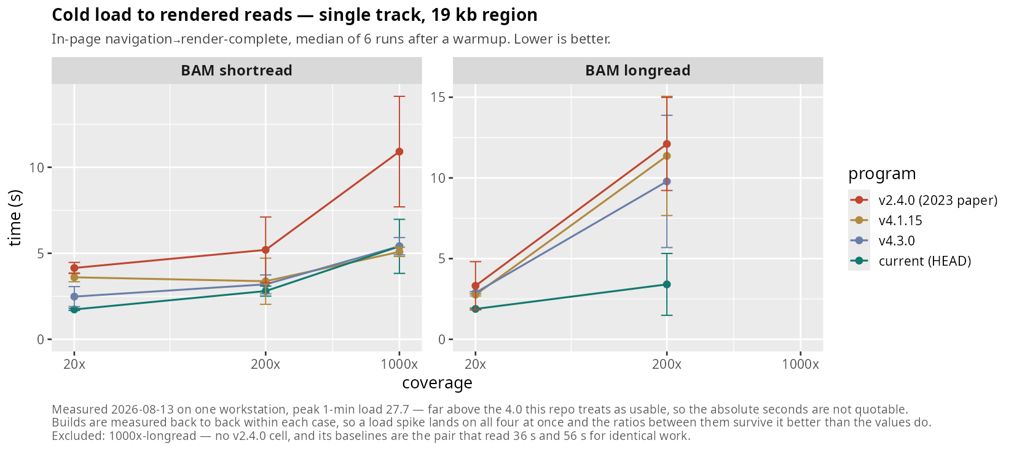
RESULT — INITIAL LOAD
End to end: cold load to rendered reads
Navigation → render-complete, median of 6 runs after a warmup. Lower is better.
Fetch-dominated, so it understates the renderer difference. Every build parses in a worker and pulls the same bytes.

Slide 6
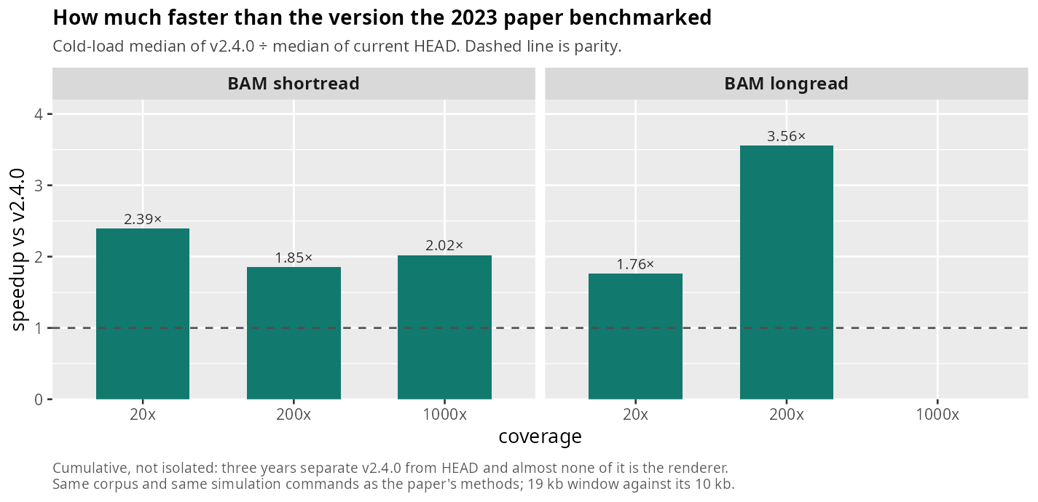
RESULT — INITIAL LOAD
Against the version the paper benchmarked
Cold-load median of v2.4.0 ÷ median of current HEAD.
Cumulative, not isolated: three years separate v2.4.0 from HEAD and almost none of it is the renderer.

Slide 7
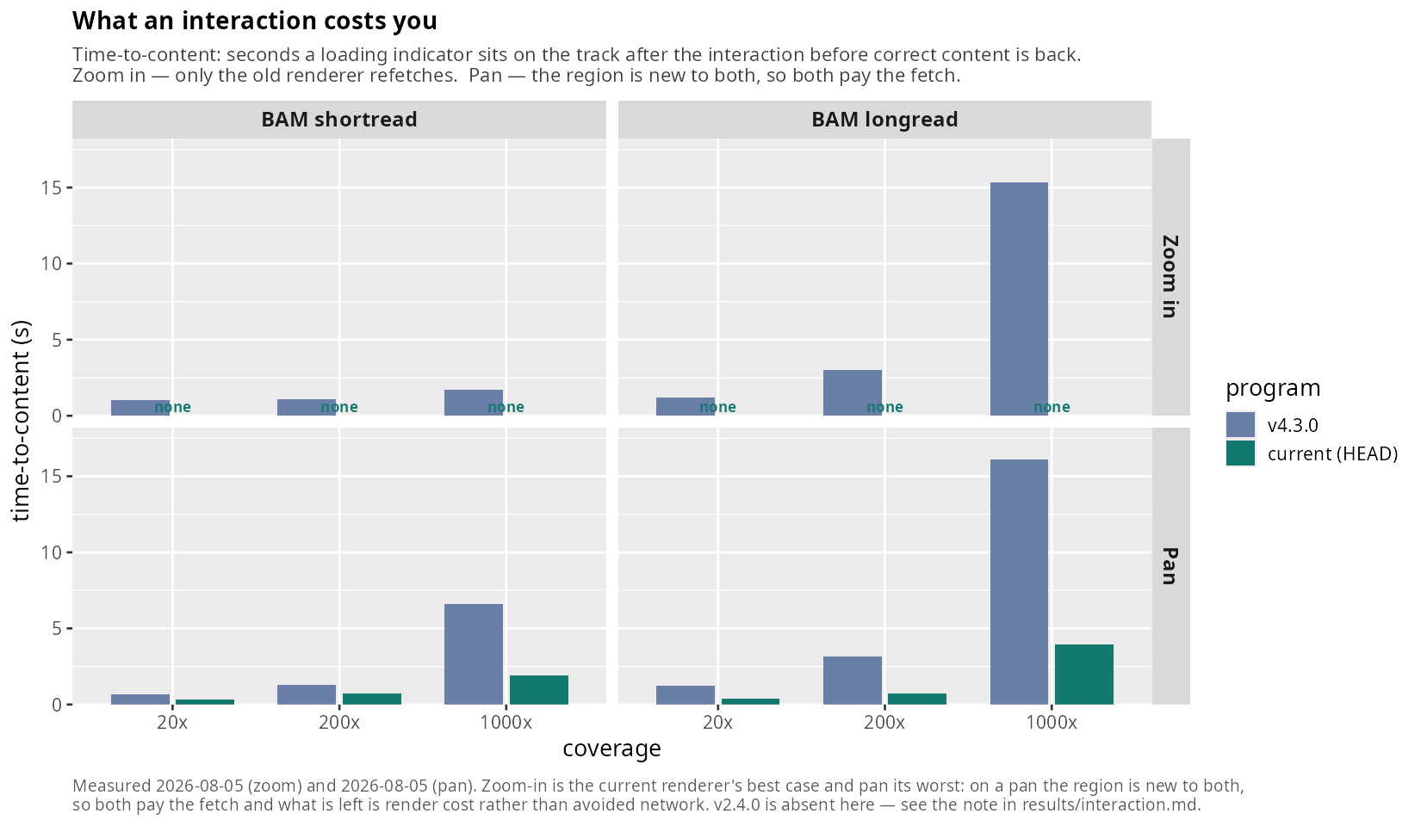
RESULT — INTERACTIVITY
What an interaction costs you
Time-to-content: seconds a loading indicator sits on the track before correct content is back.
Zoom in is the current renderer's best case and pan its worst. On a pan the region is new to both, so both pay the fetch.

Slide 8
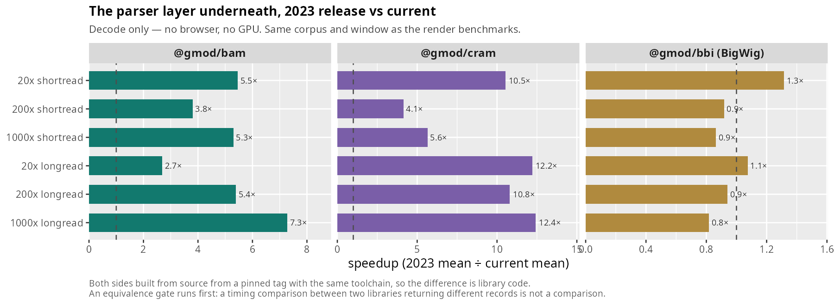
RESULT — DECODING
The parser layer underneath
Decode only — no browser, no GPU. 2023 release against current, both built from source at pinned tags.
BigWig is the honest exception: 1.1–1.3× at 20x and 6–22% slower above it, on 1–3 ms operations.

Slide 9
READ THIS BEFORE QUOTING A FIGURE
What these numbers are, and are not
The machine was not idle.
The cold-load rows were taken at 1-minute load 7–28 from unrelated jobs. This repo marks anything above 4.0 unusable, so the absolute seconds are not quotable. The four builds are measured back to back within each case, so a spike lands on all of them and the ratios survive it better than the values do.
The zoom table has no v2.4.0 column.
The loading-indicator detector matched wording v2.4.0 does not use, so it scored the 2023 build 0 ms on every zoom — a perfect result produced by the instrument missing. Fixed, then found to break the 4.3.0 column the other way. The column is owed, not delivered.
Cumulative, not isolated.
Three years separate v2.4.0 from HEAD. The v4.3.0 column isolates the current release; the v2.4.0 column tells a reader of the paper what the whole period bought them.
One machine, one locus, one workload family.
Alignment pileups over a 19 kb window, against the paper's 10 kb. Same corpus and the same pbsim and wgsim commands its methods describe.

