Slide 1
PASSWORD
MANAGERS
MD Chowdhury

Slide 2
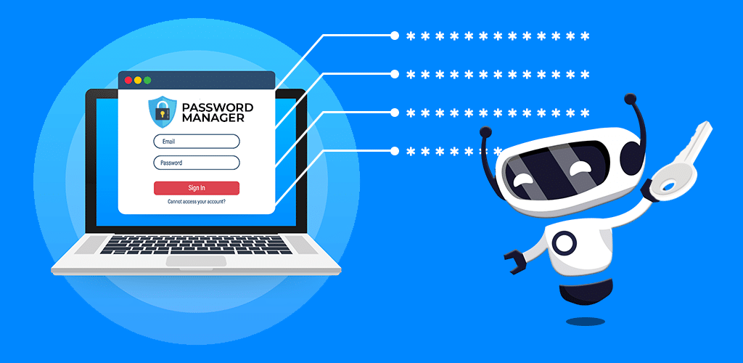
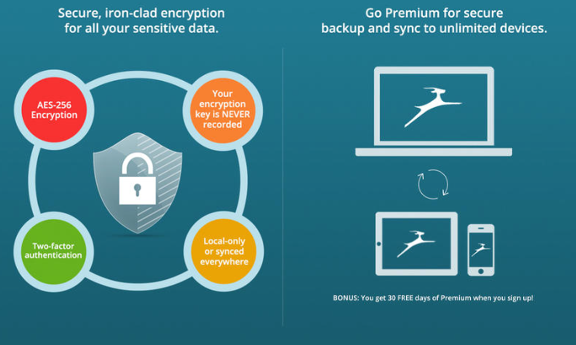
What are password managers?
People nowadays have hundreds of accounts. Most of these accounts are secured by a password. However, remembering hundreds of passwords is not feasible for the average person. So that leaves two options, either write down these passwords somewhere and reference that every time you need to login or have the same password for multiple sites. The first option means that if anyone steals the written passwords then they have access to all your passwords. The second option is even riskier than the first because if someone comes across the password for one of your accounts then they could potentially access your other accounts.
This is where password managers come in, they provide both security and convenience. There are two types of password managers, local and cloud based. Local password managers are often seen as more secure, but that security comes at a lack of convenience. Local password managers like Keepass, store your passwords on your device. On the other hand, cloud password managers store your passwords on an encrypted vault. The presentation will mostly cover methodology of cloud password managers, and the lab will be more local style.

Slide 3
How do password managers work?
LastPass:
1Password
Authentication
H(V | Pass)
VAULT
------ -------
------- ---------
--------- ----
Master Password
H(email | Pass)
Vault Key
VAULT
------ -------
------- ---------
--------- ----
Secret Key
Private Key
Vault Key
Master Password
Authentication
PAKE

Slide 4
What are the pros and cons?
Pros:
Generate random passwords: Instead of having to produce secure passwords, a password manager can do that for you
Auto Login: Password manager will fill in login information
Work across multiple devices: Sync passwords across devices
Don’t have to remember all passwords, just the master password
Security Alerts: Get informed about how secure your passwords are and about the sites you are logging into
Cons:
Single point of failure: If your master password gets compromised then the attacker will have access to all your accounts
Pay for premium services: Some services are only available after paying for them
Does not protect from key loggers

Slide 5
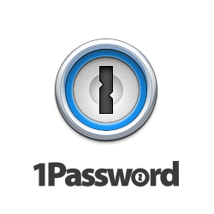


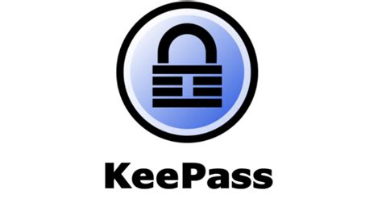
Comparing Popular Password Managers
Dashlane
LastPass
1Password
KeePass
Offline
2FA
Browser Integration
Autofill Forms
Security Alerts
Security Audits
Cloud Based
Free
Price (USD)
6.49
2.99
2.99
FREE
Notes:
Dashlane = 50 accounts and passwords

Slide 6
LAB: Local Password Manager
https://github.com/cmdhowdhury/PasswordManager
$ git clone https://github.com/cmdhowdhury/PasswordManager.git
$ cd PasswordManager
$ make

Slide 7
Credits
How password managers work:
https://www.youtube.com/watch?v=w68BBPDAWr8
Pros and Cons:
https://www.csoonline.com/article/3325326/using-a-password-manager.html
https://wisdomplexus.com/blogs/pros-cons-password-manager/
Comparison:
https://webdevolutions.blob.core.windows.net/blog/2019/01/PasswordManagerCompareTable-Devolutions.jpg
https://www.techradar.com/best/password-manager
https://www.tomsguide.com/us/best-password-managers,review-3785.html
Pricing:
https://www.lastpass.com/pricing
https://www.dashlane.com/plans
https://1password.com/sign-up/

