Slide 1
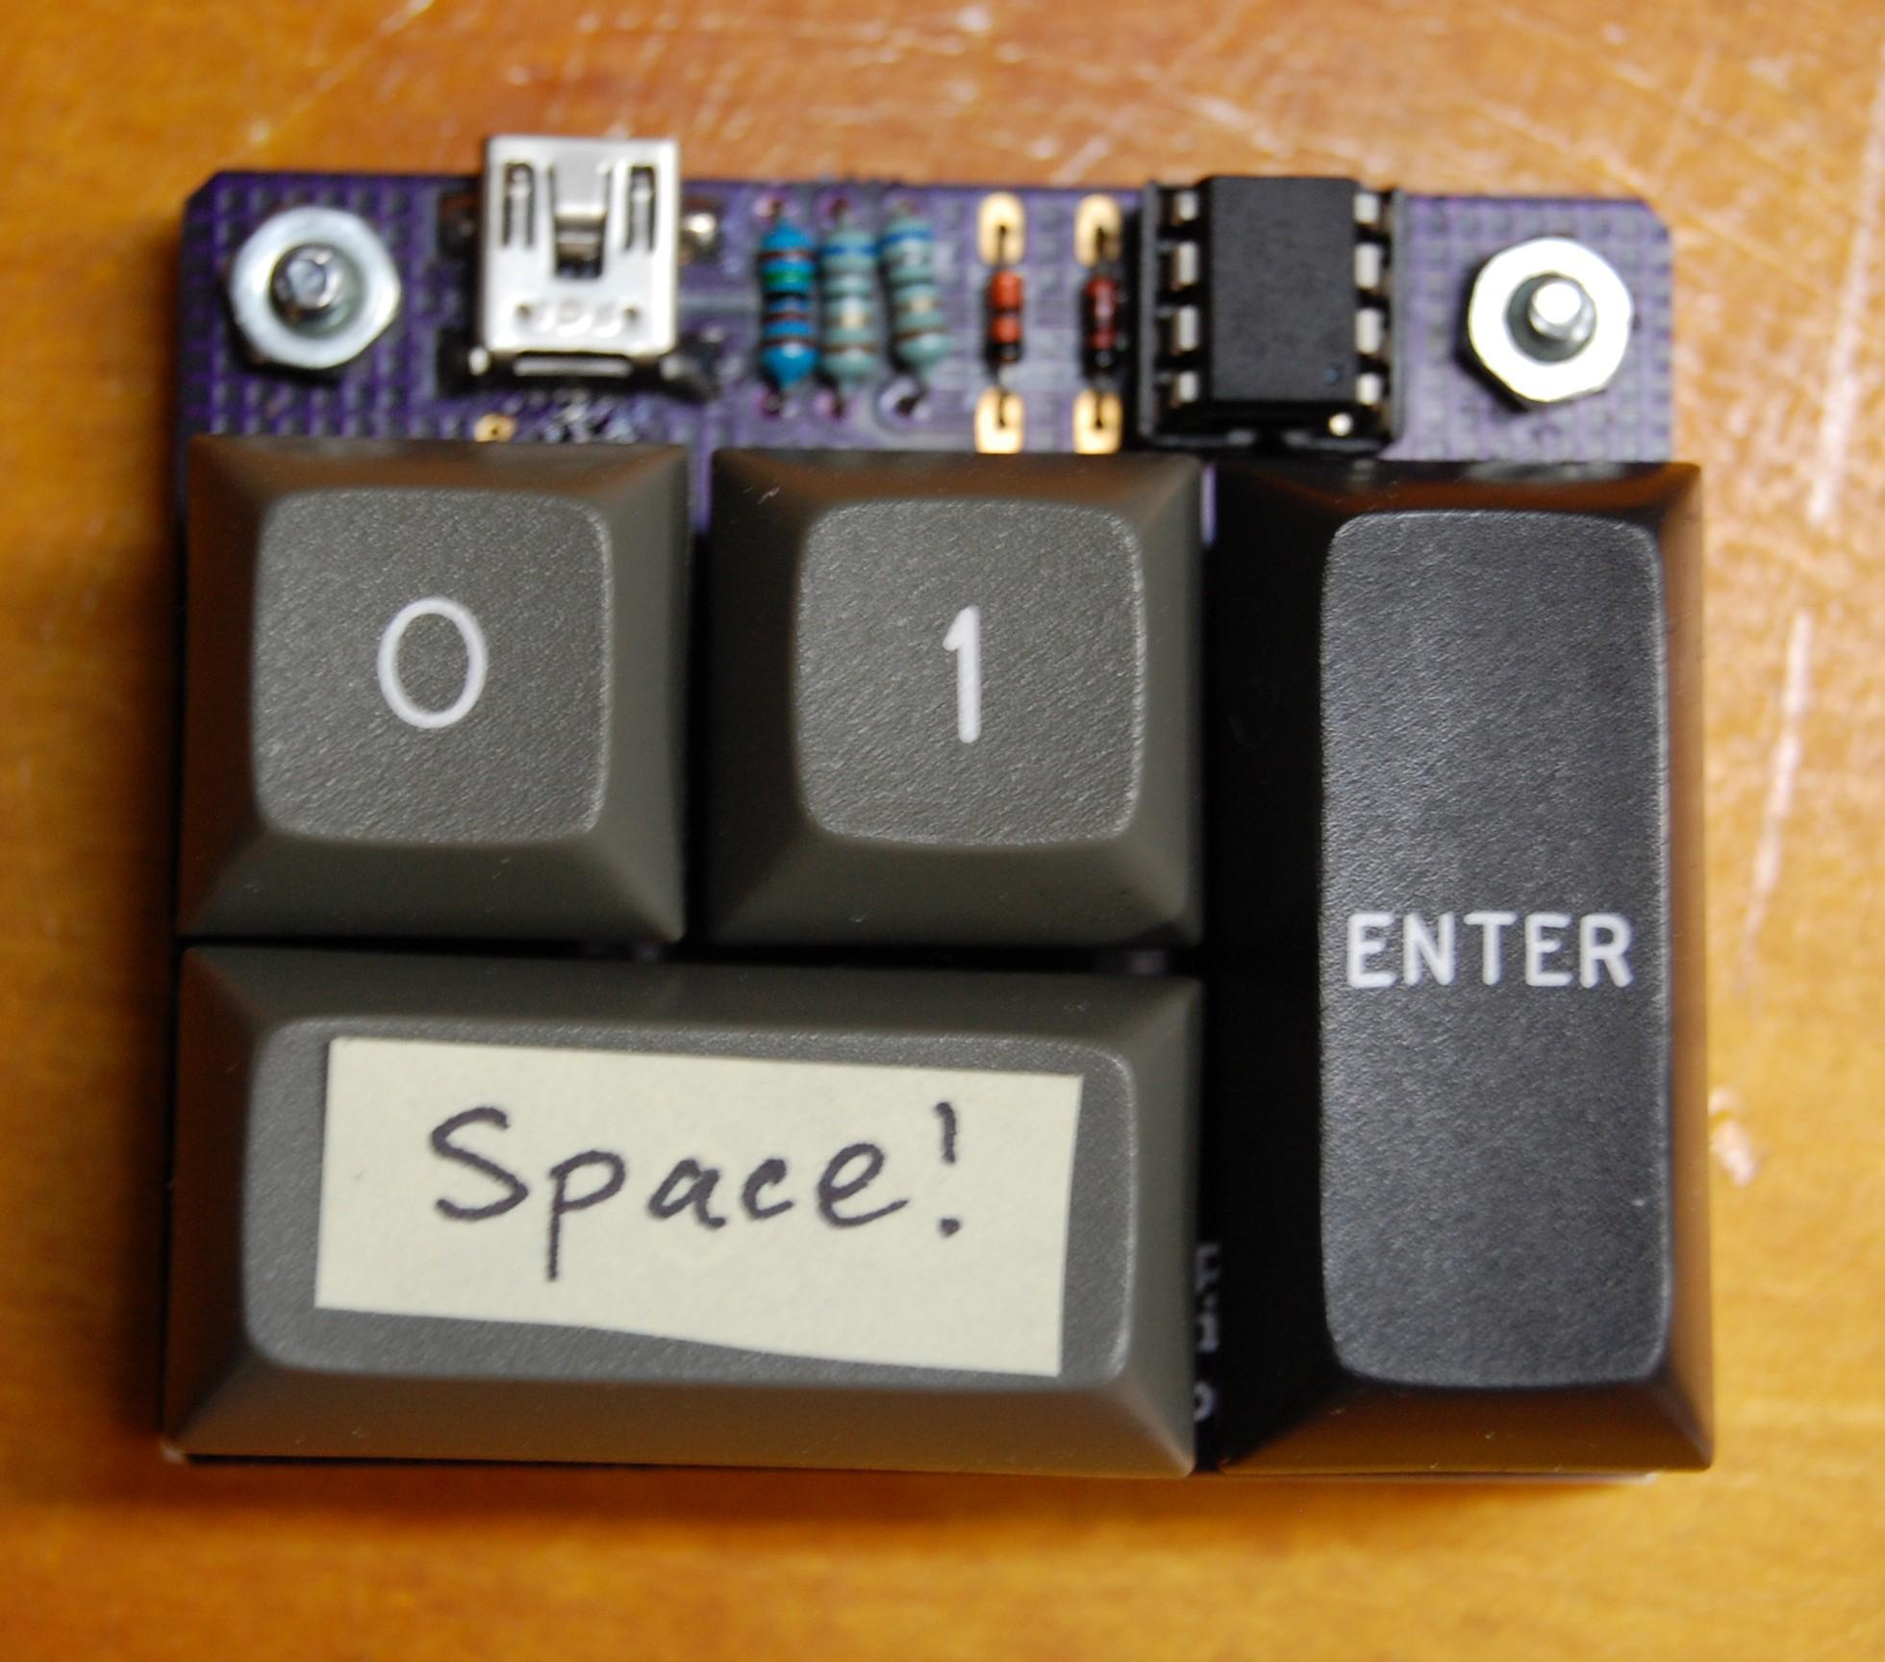
-rw-r----- professional_u:object_r:bsides_t 1 joek cmd 684 Mar 14 14:25 .workshop
A bespoke, artisan, hand crafted, organic, grass-fed SELinux Workshop

Slide 2
Overview_
Quick intro to the concepts of SELinux
Overview of tools and approach for policy creation
Introduce our vulnerable “test subject”
Get-stuck-in
Review
Discussion of a real-world policy (if time permits)

Slide 3
SELinux concepts_
Mandatory Access Control
Labels
Domain transitions

Slide 4
An example setup_
1st domain
2nd binary
Socket
Domain transition
app files
1st app
2nd domain
app files
Notes:
Remember to discuss how the 1st domain can do `execute_notrans` yet this can be dangerous, analagous to setuid

Slide 5
Key things you need to know about_
Tools
sestatus
setenforce/getenforce
sepolgen
semodule
audit2allow/audit2why
ps -Z / ls -Z
chkcon/restorecon
There’s a lot - https://github.com/SELinuxProject/selinux/wiki/Tools
Important Locations
/etc/selinux/config
/var/log/audit/audit.log
/usr/share/selinux/

Slide 6
Common things in a SELinux policy_
selinux-policy/
├── policy.fc ------------------> list of files your policy targets
├── policy.if ------------------> macros
├── policy_selinux.spec ------------------> rpm build spec
├── policy.sh ------------------> helper script
└── policy.te ------------------> the SELinux policy

Slide 7
policy.fc: file_contexts file_
/home/foo(/.*)? -- gen_context(system_u:object_r:web_exec_t,s0)
filepath
type
file label
  user : role : type
  Multi-Level Security (MLS) -> # trivia: Bell-LaPadula Model
Notes:
regexp <-type> ( <file_label> | <<none>> )
Type is like the ls type e.g. directory

Slide 8
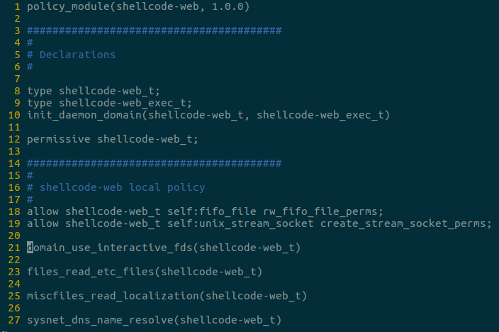
policy.te: type_enforcement file_
Some points of interest
<x>_<y>_<z>( ...
allow <type x> ...
permissive ...
Notes:
regexp <-type> ( <file_label> | <<none>> )
Type is like the ls type e.g. directory

Slide 9
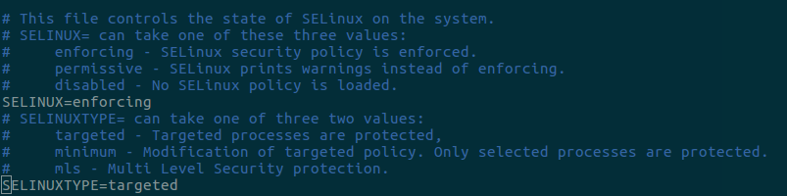
Learning mode_
sestatus
getenforce
setenforce
<editor-of-choice> /etc/selinux/config

Slide 10
# cat /var/log/audit/audit.log | audit2allow -m <mod>
This command is so valuable, it will tell you all the violations that were found in your testing and format them for copy-paste into your policy

Slide 11
Type transitions_
type_transition source_type target_type : class default_type;
e.g. type_transition web_exec_t web_bin_t:file web_t;

Slide 12
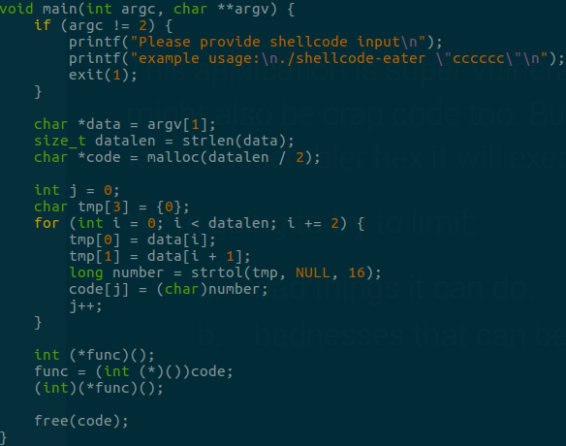
$ ./shellcode_eater 4831c004990f05
This application is super vulnerable, it might also be crap code too. But, if you feed it assembler hex it will exec it 😱
We’re going to try to limit:
  bad things it can do
  badnesses that can be done unto it

Slide 13
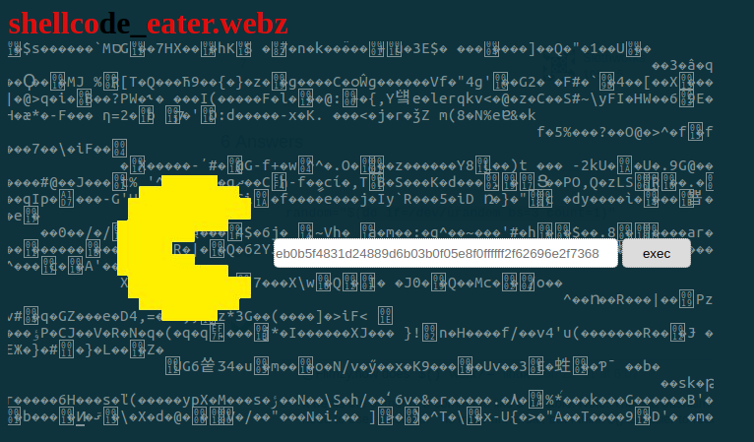
WEB 2.0_
I’ve created a website for us to try and protect with SELinux based on the previous tool

Slide 14
Lets get going_
Vagrant/VBox (recommended):
https://github.com/cmdinc/selinux-workshop/tree/master/vagrant
Notes:
$ Vagrant box add <package> --name bsides
Or if no vagrantfile
$ Vagrant init <package>

Slide 15
Painpoints: labelling_
You can go very wrong if you don’t have a plan for what files should be in which distinct contexts/domains.
Spend time upfront thinking about that so you don’t fall into a trap!
Notes:
Mention that this can be done iteratively when you discover something doesn’t work, but by then you may have granted too many perms to the monolith domain

Slide 16
Painpoints: relabelling_
Things to try when relabelling doesn’t work!
try `chcon -v <user>:<object>:<type <yourfile>` and see what it says
  If that works, then you have an issue with your `policy.fc` file labels
  When your policy works `restorecon -F -vv <yourfile>` should change the labels
Always have a ` tail -n1 -f /var/log/audit/audit.log` running just in case
To debug whether your file-contexts are even on the system try:
  `semanage fcontext -l | grep <my labels>`
Double check your helper script `policy.sh` has included restorecon for the newly updated fc files, it’s a common mistake I made

Slide 17
Painpoints: relabelling 2.0_
SELinux doesn’t execute regex matches by most specific 😒
Therefore you may need to go hunting for what is messing with your restore, or just create your directory somewhere that doesn’t conflict

Slide 18
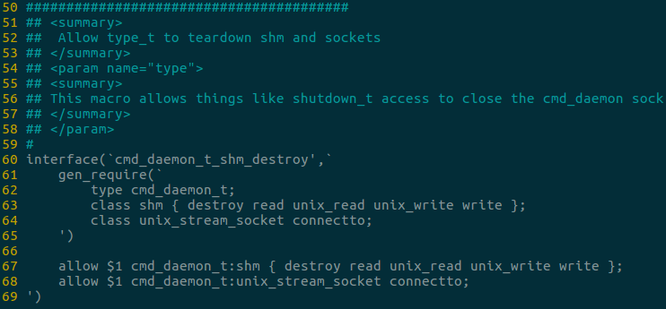
Advanced: macros_
These help when:
You have repetitive things applying to many domains
Want to share/reuse some complex config across SELinux policies
The GNU M4 macro syntax is weird IMO
* Just note, ` == push, ‘ == pop
Notes:
Talk about how it’s stack based with the backticks being a push and the single-quotes being a pop!

Slide 19
Thanks for your time
Slides + webapp + shellcode_eater + the policy
Can be found at:
https://github.com/cmdinc/selinux-workshop
I also plan to add more updates to that repo with some current work I’m doing on “how to integration test SELinux policies”

