Slide 1
Topologically Associated Domains
Jennifer Yihong Tan
Cyril Matthey-Doret

Slide 2
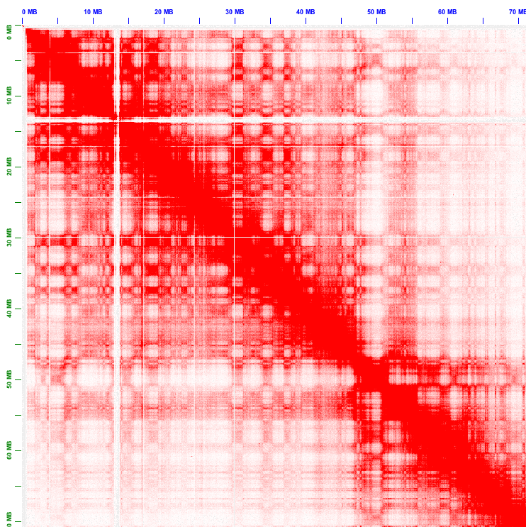
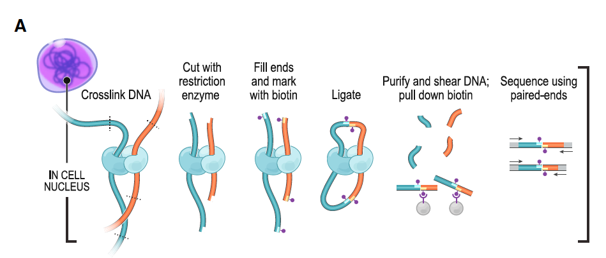
Hi-C experiments
Using NGS to infer 3D stucture of the genome
Detects intra- and inter-chromosomal contacts
Generates contact matrices at up to 5kb resolution
Rao et al, 2014. A 3D map of the human genome at kilobase resolution reveals principles of chromatin looping. Cell

Slide 3
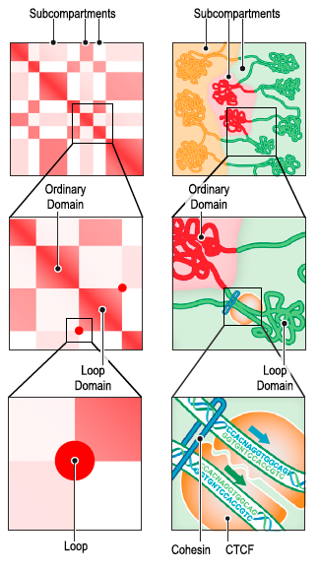
Contact matrices
Reveals zones of with high frequencies of contacts
Regions of high contacts represent TADs
Peaks represent loops
Rao et al, 2014. A 3D map of the human genome at kilobase resolution reveals principles of chromatin looping. Cell

Slide 4
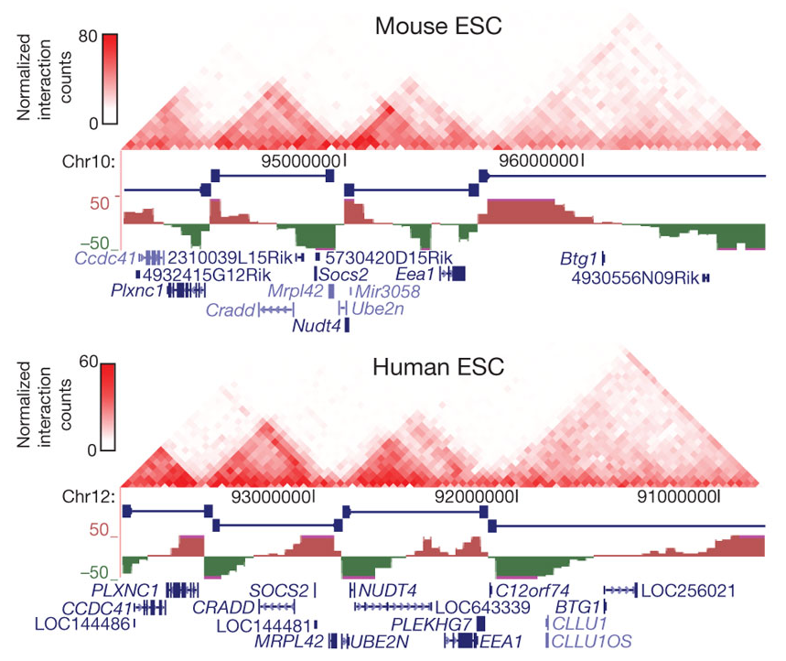
TADs
Boundaries are enriched in highly transcribed genes
Boundaries enriched in CTCF and cohesin
Conserved across cell-lines
Dixon, 2012. Topological domains in mammalian genomes identified by analysis of chromatin interactions. Nature

Slide 5
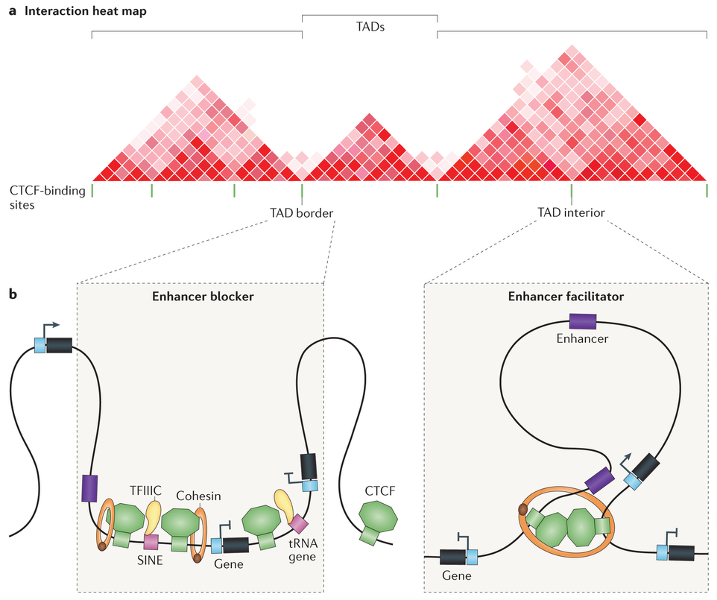
TAD boundaries
CTCF and cohesin are enriched at TAD boundaries.
They are involved in the insulation of TAD boundaries
They facilitate enhancer-promoter contact in TADs
Ong et Corces, 2014. CTCF: an architectural protein bridging genome topology and function. Nature reviews Genetics

Slide 6
Folding and expression
Disruption of TAD boundaries deregulates enhancer-promoters interactions
This causes malformation syndromes

