Slide 1
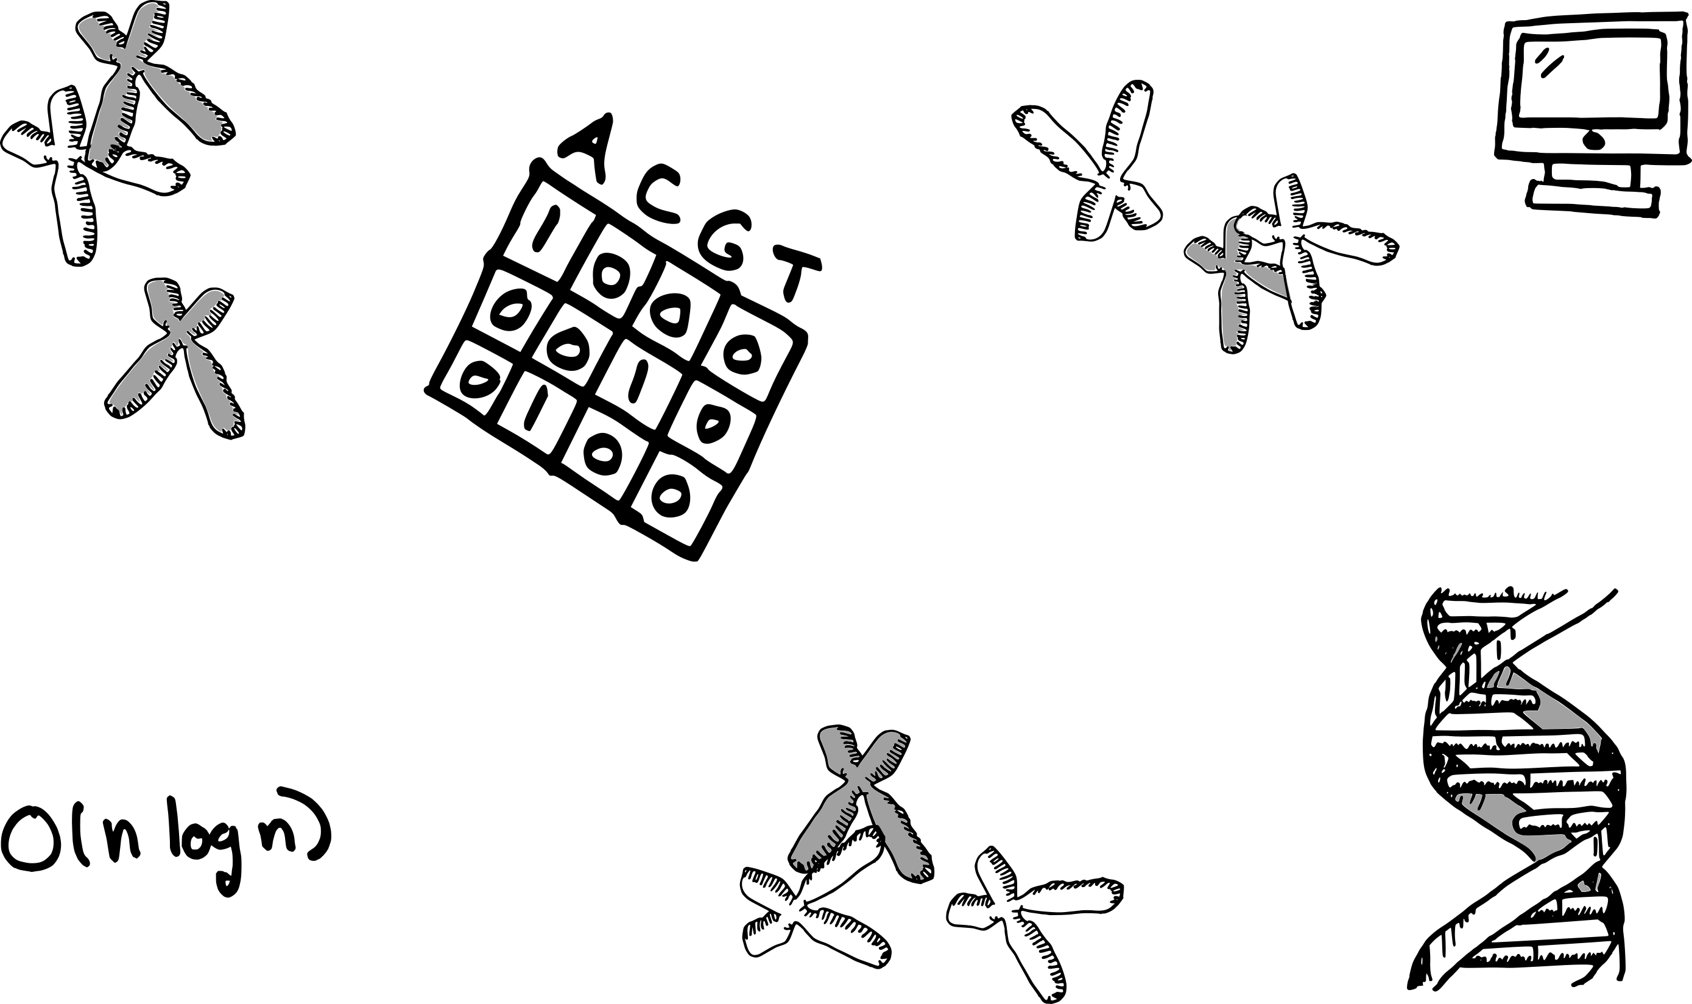




Sequence algorithms
DAG workshop, 2020
Cyril Matthey-Doret
cyril.mattheydoret@gmail.com
cmdoret

Slide 2
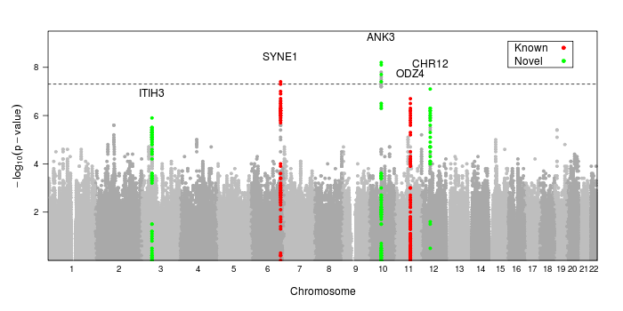


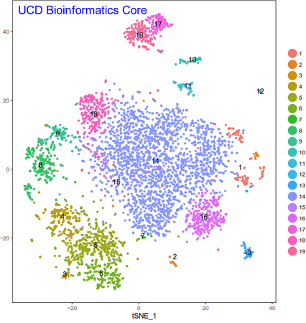
Genomics
Use DNA sequences to answer biological questions
But how ?

Slide 3
The tools
Computer algorithms to automate tedious tasks
We use programming languages to write algorithms

Slide 4
Thinking like a computer
Computers can perform a limited set of instructions (i.e. comparisons, allocating / deallocating memory, ...)
address | content
100 | instruction
101 | data
102 | instruction
103 | empty
104 | data
CPU
write
RAM
(memory)
read
Executes many
simple instructions

Slide 5
Example: max of an array
Scripting languages make our lives easy
Python:
a = [1, 0, 31, 4]
max(a)

Slide 6
Example: max of an array
Scripting languages make our lives easy
Python:
a = [1, 0, 31, 4]
max(a)
m = 1
0 > m ?
31 > m ?
4 > m ?
1 | 0 | 31 | 4
Algorithm:
a = [1, 0, 31, 4]
m = a[0]
for i in a[1:]:
if i > m:
m = i
m = 31

Slide 7
Algorithms in genomics
Assembling genomes
Aligning reads
Cluster samples by gene expression similarity
Predict gene functions from their sequence

Slide 8
Time complexity
Big O notation is used to describe run time
Examples:
a = [3, 1, 40, 3]
for i in a:
print(i)
for i in a:
For i in a:
print(i)
Time complexity
3 | 1 | 40 | 3
O(n²)
Operations
3 | 1 | 40 | 3
O(n)
Elements

Slide 9
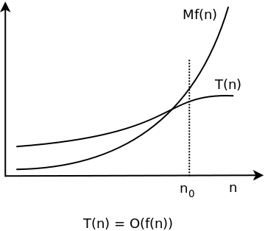
Big O notation: definition
T(n) (your algorithm) has order of f(n) if there are positive constants M and n₀ such that T(n) ≤ M*f(n) for all n ≥ n₀
T(n) does not grow faster than f(n)

Slide 10
Big O notation: definition
T(n) (your algorithm) has order of f(n) if there are positive constants M and n₀ such that T(n) ≤ M*f(n) for all n ≥ n₀
T(n) does not grow faster than f(n)
Example:
If T(n) is O(1): T(n) ≤ M*1
In english: If T(n) has order O(1), it will always be faster or same than a constant value M, no matter the input size
What if T(n) is O(n) ?

Slide 11
Example: Improving an algorithm
Checking if value v is in an array a
What is the time complexity ?

Slide 12
A naive approach
Checking if value v is in an array a
What is the time complexity ?
v = 4
a =
3 | 1 | 51 | 0 | 21

Slide 13
A naive approach
Checking if value v is in an array a
What is the time complexity ?
Naive implementation:
found = “no”
for i in a:
if i == v:
found = “yes”
v = 4
a =
3 | 1 | 51 | 0 | 21
O(n)
Is there a better way ?

Slide 14
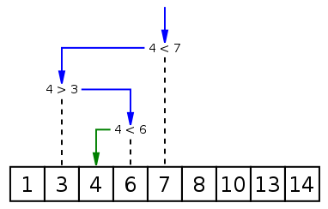
Getting faster
Checking if value v is in an array a
What is the time complexity ?
Sort array
Sorting costs O(n log n)
1 | 10 | 13 | 3 | 7 | 14 | 8 | 6 | 4
Binary search

Slide 15
Getting faster
Checking if value v is in an array a
What is the time complexity ?
Sort array
Sorting costs O(n log n)
1 | 10 | 13 | 3 | 7 | 14 | 8 | 6 | 4
Binary search
But allows to search in O(log n) → better than O(n)

Slide 16
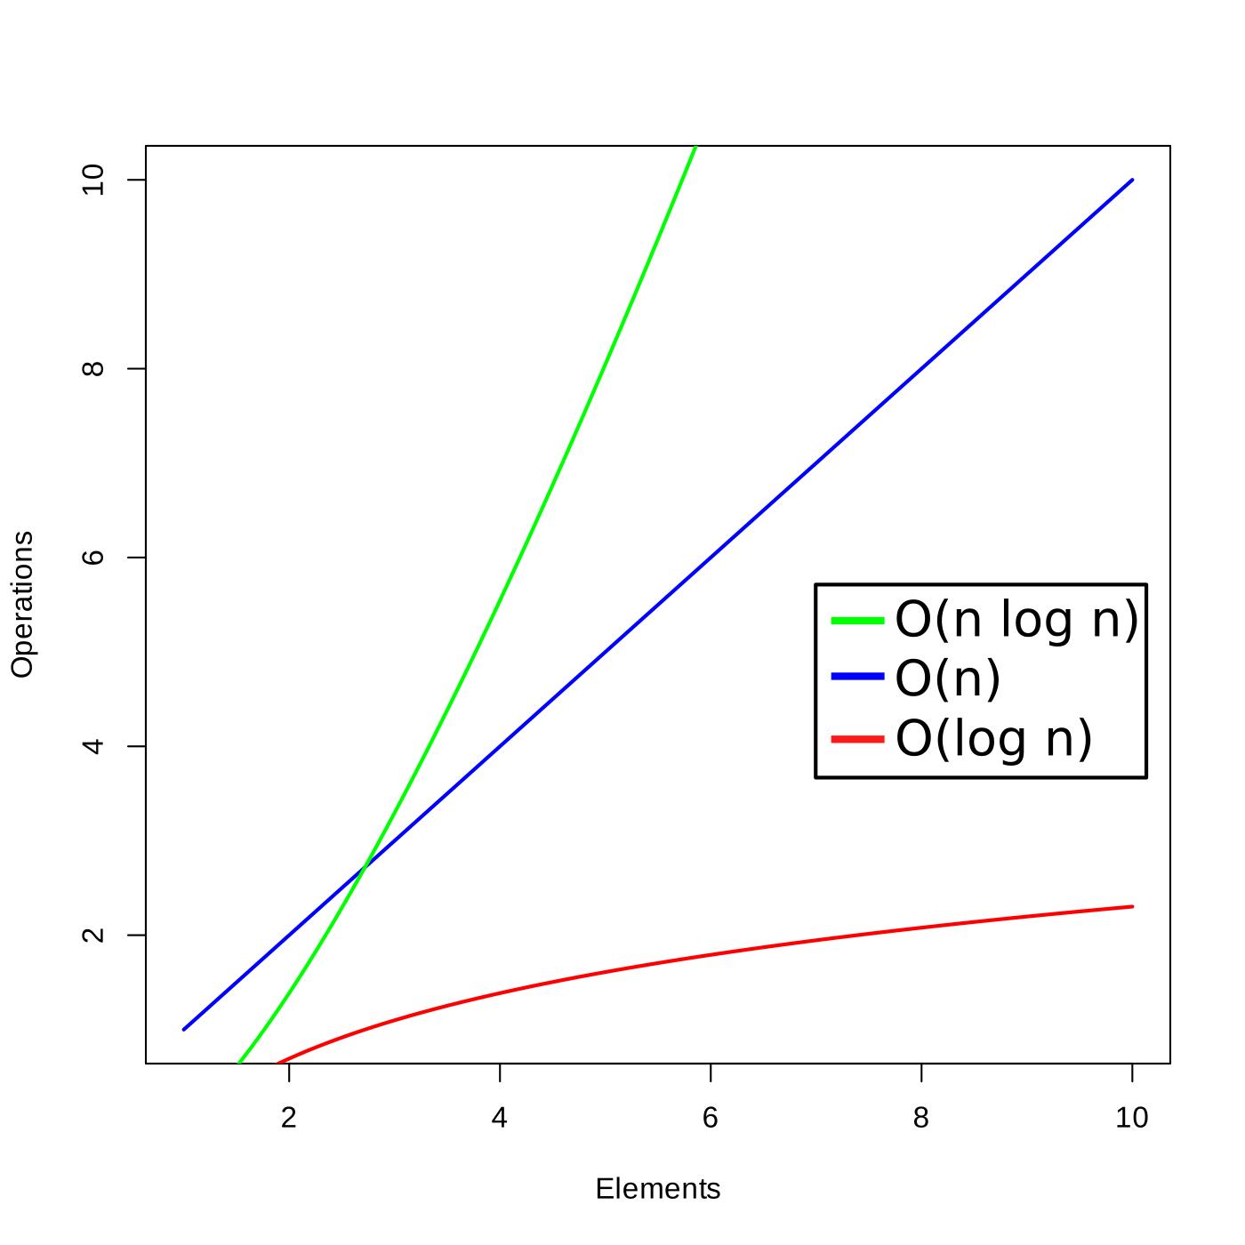
Getting faster
Checking if value v is in an array a
What is the time complexity ?
Sort array
1 | 10 | 13 | 3 | 7 | 14 | 8 | 6 | 4
Binary search

Slide 17
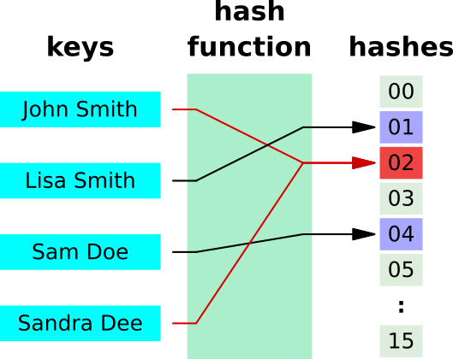
Hashing to the rescue
Best solution: Hash table (aka maps, dicts)
Data structures with a mapping function

Slide 18
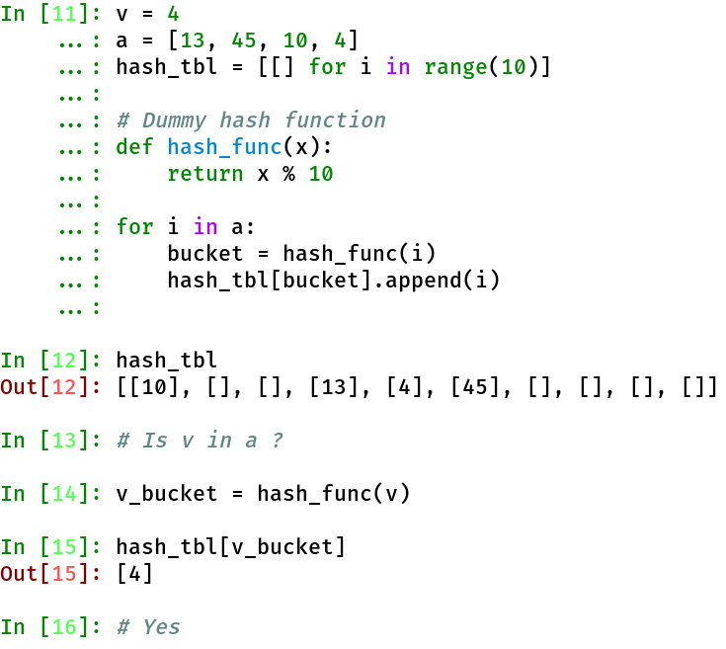
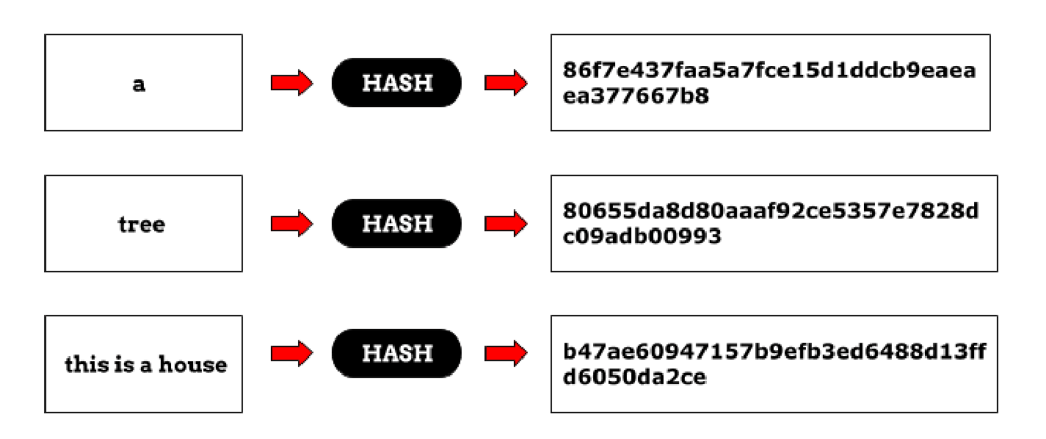
Wait, what’s hashing ?
Hash function: “A function mapping data
of arbitrary size to fixed-size values”
v = 4
a = [13, 45, 10, 4]
hash_tbl = [[] for i in range(10)]
# Dummy hash function
def hash_func(x):
return x % 10
for i in a:
bucket = hash_func(i)
hash_tbl[bucket].append(i)
# Is v in a ?
hash_tbl[hash_func(v)]

Slide 19
Hash tables
Hash function: “A function mapping data
of arbitrary size to fixed-size values”
Fill the table
v = 4
a = [13, 45, 10, 4]
hash_tbl = [[] for i in range(10)]
# Dummy hash function
def hash_func(x):
return x % 10
for i in a:
bucket = hash_func(i)
hash_tbl[bucket].append(i)
# Is v in a ?
hash_tbl[hash_func(v)]

Slide 20
Hash tables
Hash function: “A function mapping data
of arbitrary size to fixed-size values”
Fill the table
v = 4
a = [13, 45, 10, 4]
hash_tbl = [[] for i in range(10)]
# Dummy hash function
def hash_func(x):
return x % 10
for i in a:
bucket = hash_func(i)
hash_tbl[bucket].append(i)
# Is v in a ?
hash_tbl[hash_func(v)]

Slide 21
Hash tables
Hash function: “A function mapping data
of arbitrary size to fixed-size values”
Fill the table
v = 4
a = [13, 45, 10, 4]
hash_tbl = [[] for i in range(10)]
# Dummy hash function
def hash_func(x):
return x % 10
for i in a:
bucket = hash_func(i)
hash_tbl[bucket].append(i)
# Is v in a ?
hash_tbl[hash_func(v)]
Query the table

Slide 22
Hash tables
Hash function: “A function mapping data
of arbitrary size to fixed-size values”
Fill the table
What’s the time complexity of filling and querying ?
v = 4
a = [13, 45, 10, 4]
hash_tbl = [[] for i in range(10)]
# Dummy hash function
def hash_func(x):
return x % 10
for i in a:
bucket = hash_func(i)
hash_tbl[bucket].append(i)
# Is v in a ?
hash_tbl[hash_func(v)]
Query the table

Slide 23
Hash tables
Hash function: “A function mapping data
of arbitrary size to fixed-size values”
Fill the table
O(n)
What’s the time complexity of filling and querying ?
v = 4
a = [13, 45, 10, 4]
hash_tbl = [[] for i in range(10)]
# Dummy hash function
def hash_func(x):
return x % 10
for i in a:
bucket = hash_func(i)
hash_tbl[bucket].append(i)
# Is v in a ?
hash_tbl[hash_func(v)]
Query the table
O(1)

Slide 24
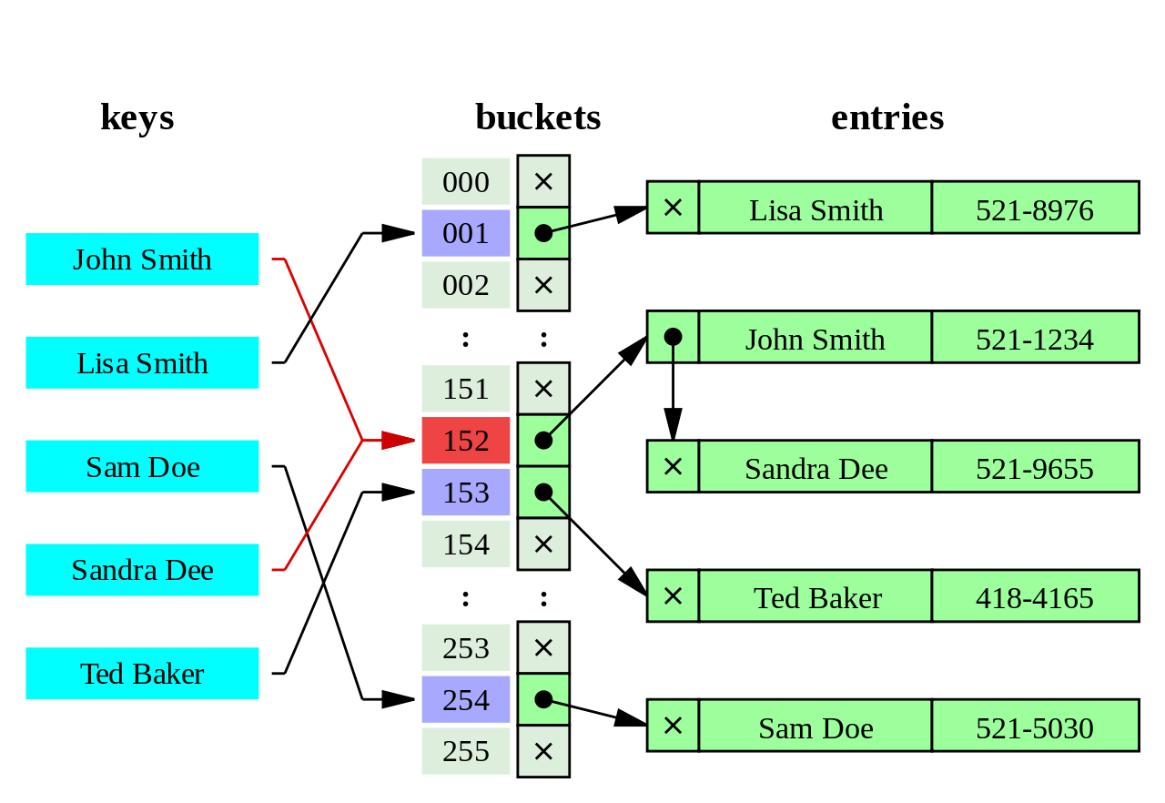
Hash collisions
What happens when multiple hash have the same hash ?
Multiple entries stored in the same bucket

Slide 25
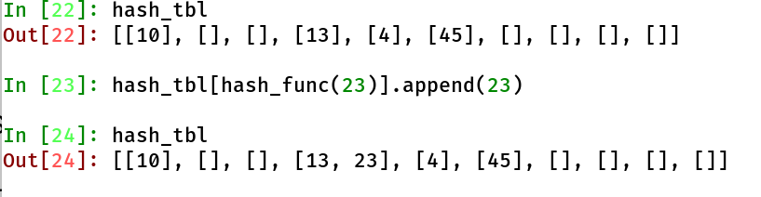
Hash collisions
What happens when multiple hash have the same hash ?
Multiple entries stored in the same bucket

Slide 26
Hash collisions
What happens when multiple hash have the same hash ?
Multiple entries stored in the same bucket
What does that imply for query time ?

Slide 27
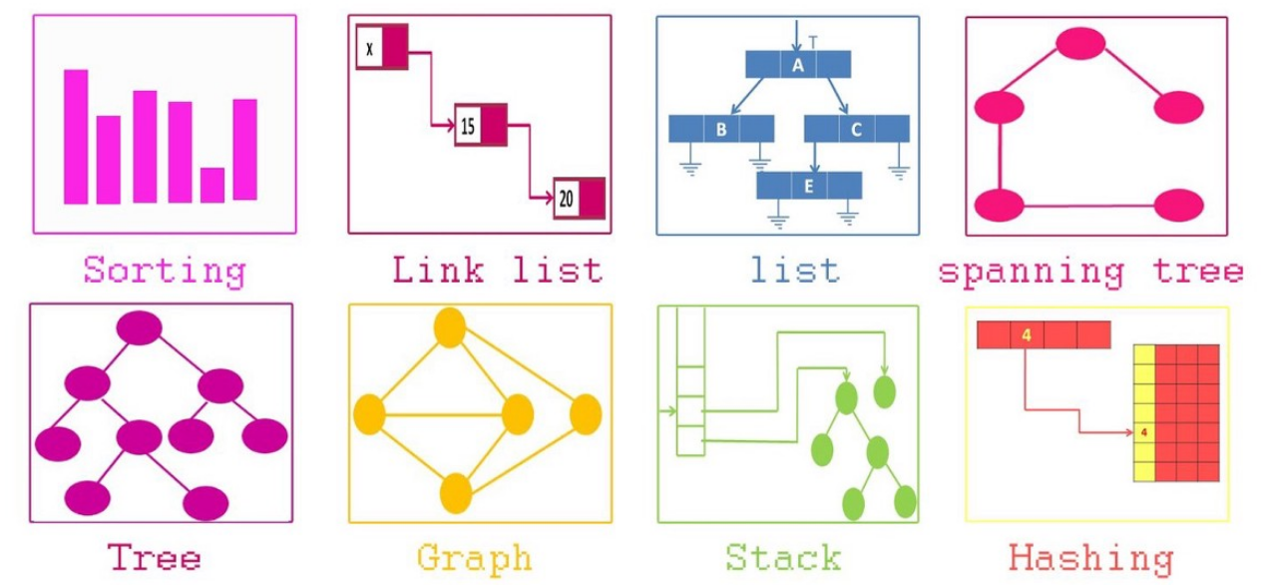
Data structures as a tool
Storing our data in a hash table enabled O(1) query time
Data structures are as important as the algorithm

Slide 28
Exercises
Provided as a jupyter notebook (requires python)
Apply knowledge on biological data
A bit harder :)

