Slide 1

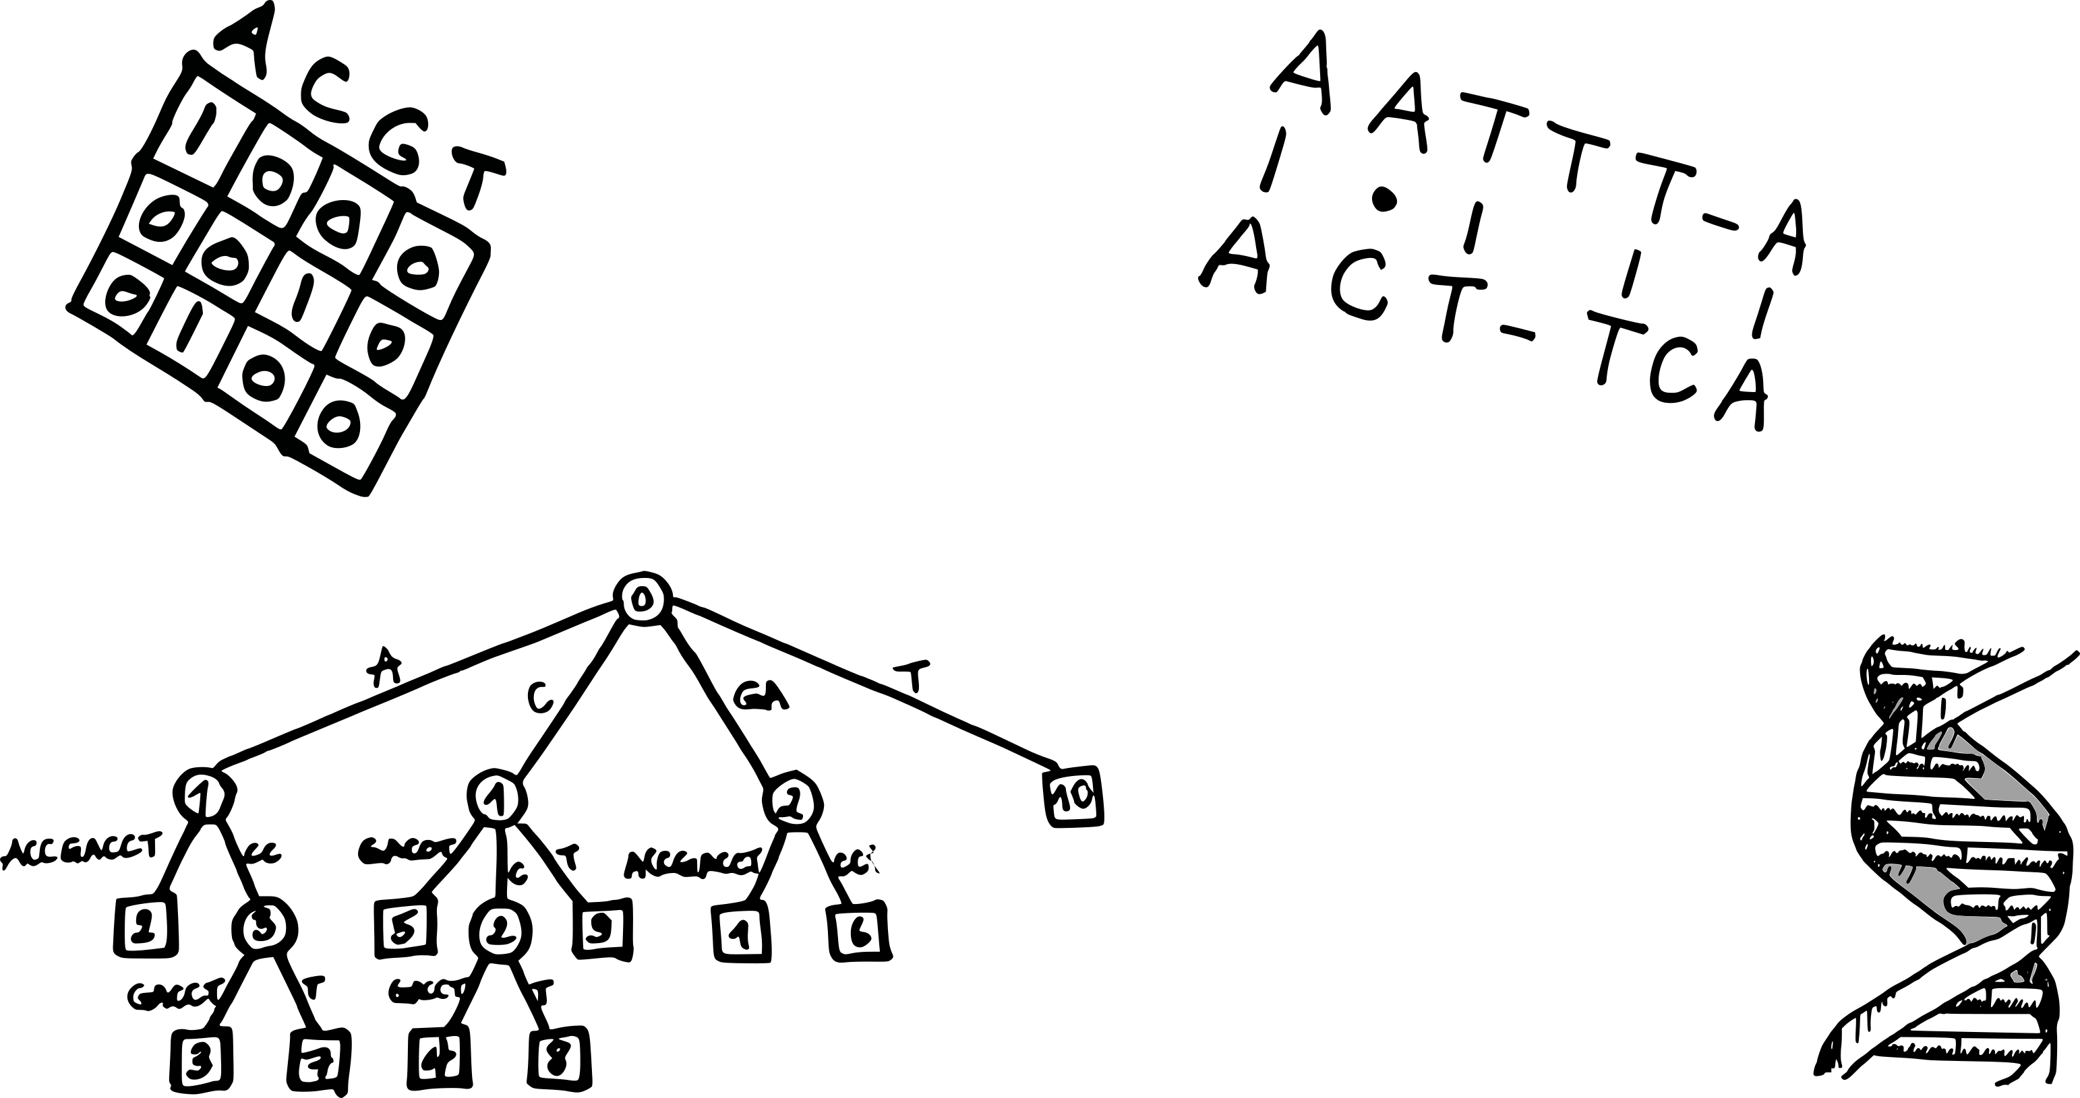



Sequence algorithms
DAG workshop, 2020
Cyril Matthey-Doret
cyril.mattheydoret@gmail.com
cmdoret

Slide 2
Exercises from session 1

Slide 3
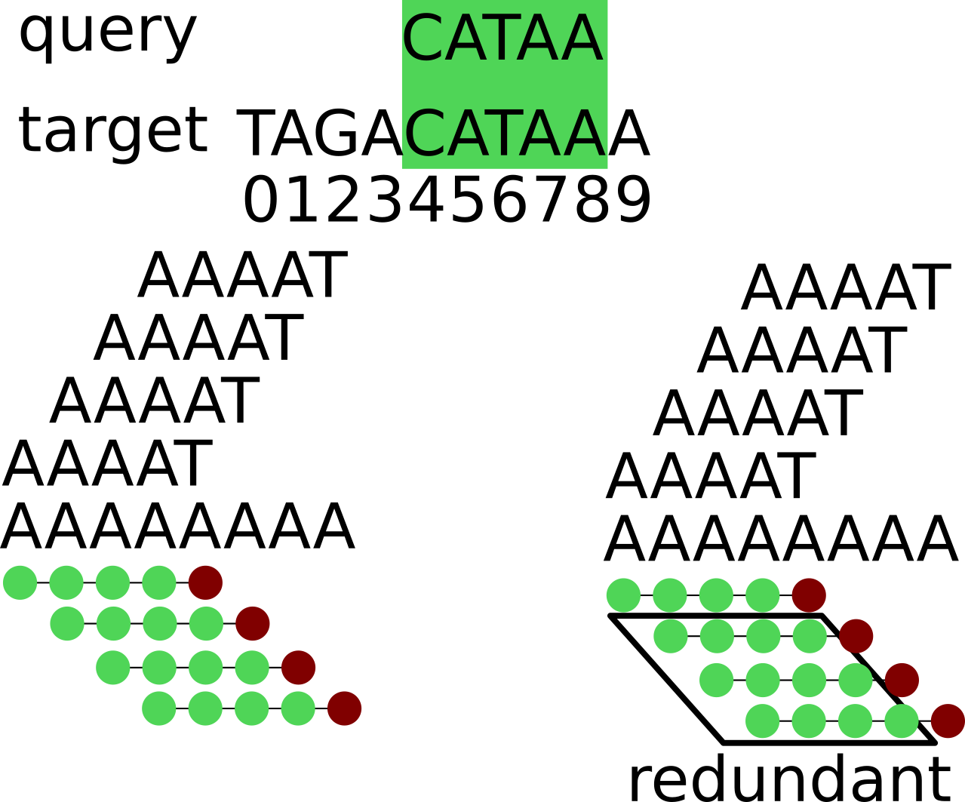
Exact sequence matching
Given two sequences (DNA, RNA, proteins, …)
At what position of target does query occur ?
When is this useful ?
RNA quantification
Read overlapping in genome assembly
Primer design
4

Slide 4
Exact sequence matching
Given two sequences (DNA, RNA, proteins, …)
At what position of target does query occur ?
Pythonic way:
target = “TAGACATAAAAGA”
query = “CATAA”
target.find(query)
4
4
Can we come up with a naive algorithm ?

Slide 5
Naive solution
How many possible alignments ?
Number of comparisons ? (worst case)
m
query
target
n

Slide 6
Naive solution
How many possible alignments ? → n - m + 1
Number of comparisons ? (worst case)
query
target

Slide 7
Naive solution
How many possible alignments ? → n - m + 1
Number of comparisons ? (worst case) → m(n - m + 1)
Big O notation ?
query
target

Slide 8
Naive solution
How many possible alignments ? → n - m + 1
Number of comparisons ? (worst case) → m(n - m + 1)
Big O notation ?
O(mn)
query
target
How to get faster ? 🏎️
Redundant
comparisons

Slide 9
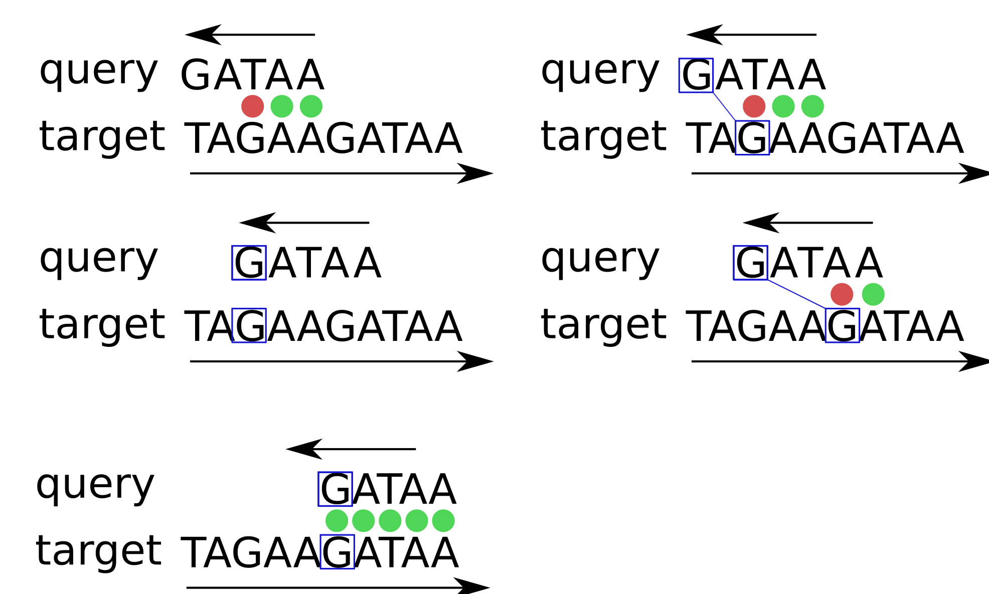
The bad character rule
Skip multiple positions at once
One of the optimisations used in the Boyer-Moore algorithm

Slide 10
The bad character rule
Skip multiple positions at once
One of the optimisations used in the Boyer-Moore algorithm

Slide 11
The bad character rule
Skip multiple positions at once
One of the optimisations used in the Boyer-Moore algorithm

Slide 12
The bad character rule
Skip multiple positions at once
One of the optimisations used in the Boyer-Moore algorithm

Slide 13
The bad character rule
Skip multiple positions at once
One of the optimisations used in the Boyer-Moore algorithm
Upon mismatch, skip until
next matching character

Slide 14
The bad character rule
Skip multiple positions at once
One of the optimisations used in the Boyer-Moore algorithm

Slide 15
Preprocessing jumps
Pre-compute jump sizes using a hash table !
Scanning the query for the next match would take O(m)
Looking up [“A-G”] in the hash table takes O(1)
Query
 | G | A | T | A | A
A | 0 | - | 0 | - | -
C | 0 | 1 | 2 | 3 | 4
T | 0 | 1 | - | 0 | 1
G | - | 0 | 1 | 3 | 3
Alphabet

Slide 16
Preprocessing jumps
Pre-compute jump sizes using a hash table !
Scanning the query for the next match would take O(m)
Looking up [“A-G”] in the hash table takes O(1)
Query
 | G | A | T | A | A
A | 0 | - | 0 | - | -
C | 0 | 1 | 2 | 3 | 4
T | 0 | 1 | - | 0 | 1
G | - | 0 | 1 | 3 | 3
Alphabet
This and other optimisations, lead to the Boyer-Moore algorithm, which is O(m+n)

Slide 17
Indexing
Pre-processing the input sequence allows faster queries
Different data structures can serve as an index
  Hash table
  suffix array
  suffix tree
  ...
When is this useful ?
Read alignment
Random access of large files

Slide 18
Indexing
Pre-processing the input sequence allows faster queries
Different data structures can serve as an index
  Hash table
  suffix array
  suffix tree
  ...
ACCACC
index
3-mer | pos
ACC | 0,3
CAC | 2
CCA | 1
CAC
query

Slide 19
Indexing
With a fix query size, we can use a k-mer based dictionary
But what if the query size varies ?
ACCACC
index
3-mer | pos
ACC | 0,3
CAC | 2
CCA | 1
CAC
query

Slide 20
Indexing
With a fix query size, we can use a k-mer based dictionary
But what if the query size varies ?
  → Index all suffixes instead of k-mers
target
ATAGGGCA
TAGGGCA
AGGGCA
GGGCA
GGCA
GCA
CA
A
suffixes

Slide 21
Indexing
With a fix query size, we can use a k-mer based dictionary
But what if the query size varies ?
  → Index all suffixes instead of k-mers
target
ATAGGGCA
TAGGGCA
AGGGCA
GGGCA
GGCA
GCA
CA
A
A
AGGGCA
ATAGGGCA
CA
GCA
GGCA
GGGCA
TAGGGCA
sort
suffixes

Slide 22
Indexing
With a fix query size, we can use a k-mer based dictionary
But what if the query size varies ?
  → Index all suffixes instead of k-mers
target
ATAGGGCA
TAGGGCA
AGGGCA
GGGCA
GGCA
GCA
CA
A
A
AGGGCA
ATAGGGCA
CA
GCA
GGCA
GGGCA
TAGGGCA
Query GGGCA
sort
Binary search
suffixes

Slide 23
Space analysis
This is fast ! What is the query time complexity ?
n
m
target
ATAGGGCA
TAGGGCA
AGGGCA
GGGCA
GGCA
GCA
CA
A
A
AGGGCA
ATAGGGCA
CA
GCA
GGCA
GGGCA
TAGGGCA
Query GGGCA
sort
Binary search
suffixes

Slide 24
Space analysis
This is fast ! What is the query time complexity ? O(m log n)
n
m
target
ATAGGGCA
TAGGGCA
AGGGCA
GGGCA
GGCA
GCA
CA
A
A
AGGGCA
ATAGGGCA
CA
GCA
GGCA
GGGCA
TAGGGCA
Query GGGCA
sort
Binary search
suffixes

Slide 25
Space analysis
This is fast ! What is the query time complexity ? O(m log n)
But… It’s huge ! How to estimate memory requirement ?
  → Big O notation
target
ATAGGGCA
TAGGGCA
AGGGCA
GGGCA
GGCA
GCA
CA
A
A
AGGGCA
ATAGGGCA
CA
GCA
GGCA
GGGCA
TAGGGCA
Query GGGCA
sort
Binary search
suffixes

Slide 26
Space analysis
This is fast ! What is the query time complexity ? O(m log n)
But… It’s huge ! How to estimate memory requirement ?
  → Big O notation: n + (n – 1) + (n – 2) … + 1 = n(n+1) = O(n^2)
2
target
ATAGGGCA
TAGGGCA
AGGGCA
GGGCA
GGCA
GCA
CA
A
A
AGGGCA
ATAGGGCA
CA
GCA
GGCA
GGGCA
TAGGGCA
Query GGGCA
sort
Binary search
suffixes

Slide 27
Space analysis
Any ideas how to remove the redundant parts ?
A
AGGGCA
ATAGGGCA
CA
GCA
GGCA
GGGCA
TAGGGCA

Slide 28
Space analysis
Any ideas how to remove the redundant parts ?
→ Only store the offsets
7
A
AGGGCA
ATAGGGCA
CA
GCA
GGCA
GGGCA
TAGGGCA
2
0
6
5
4
3
1

Slide 29
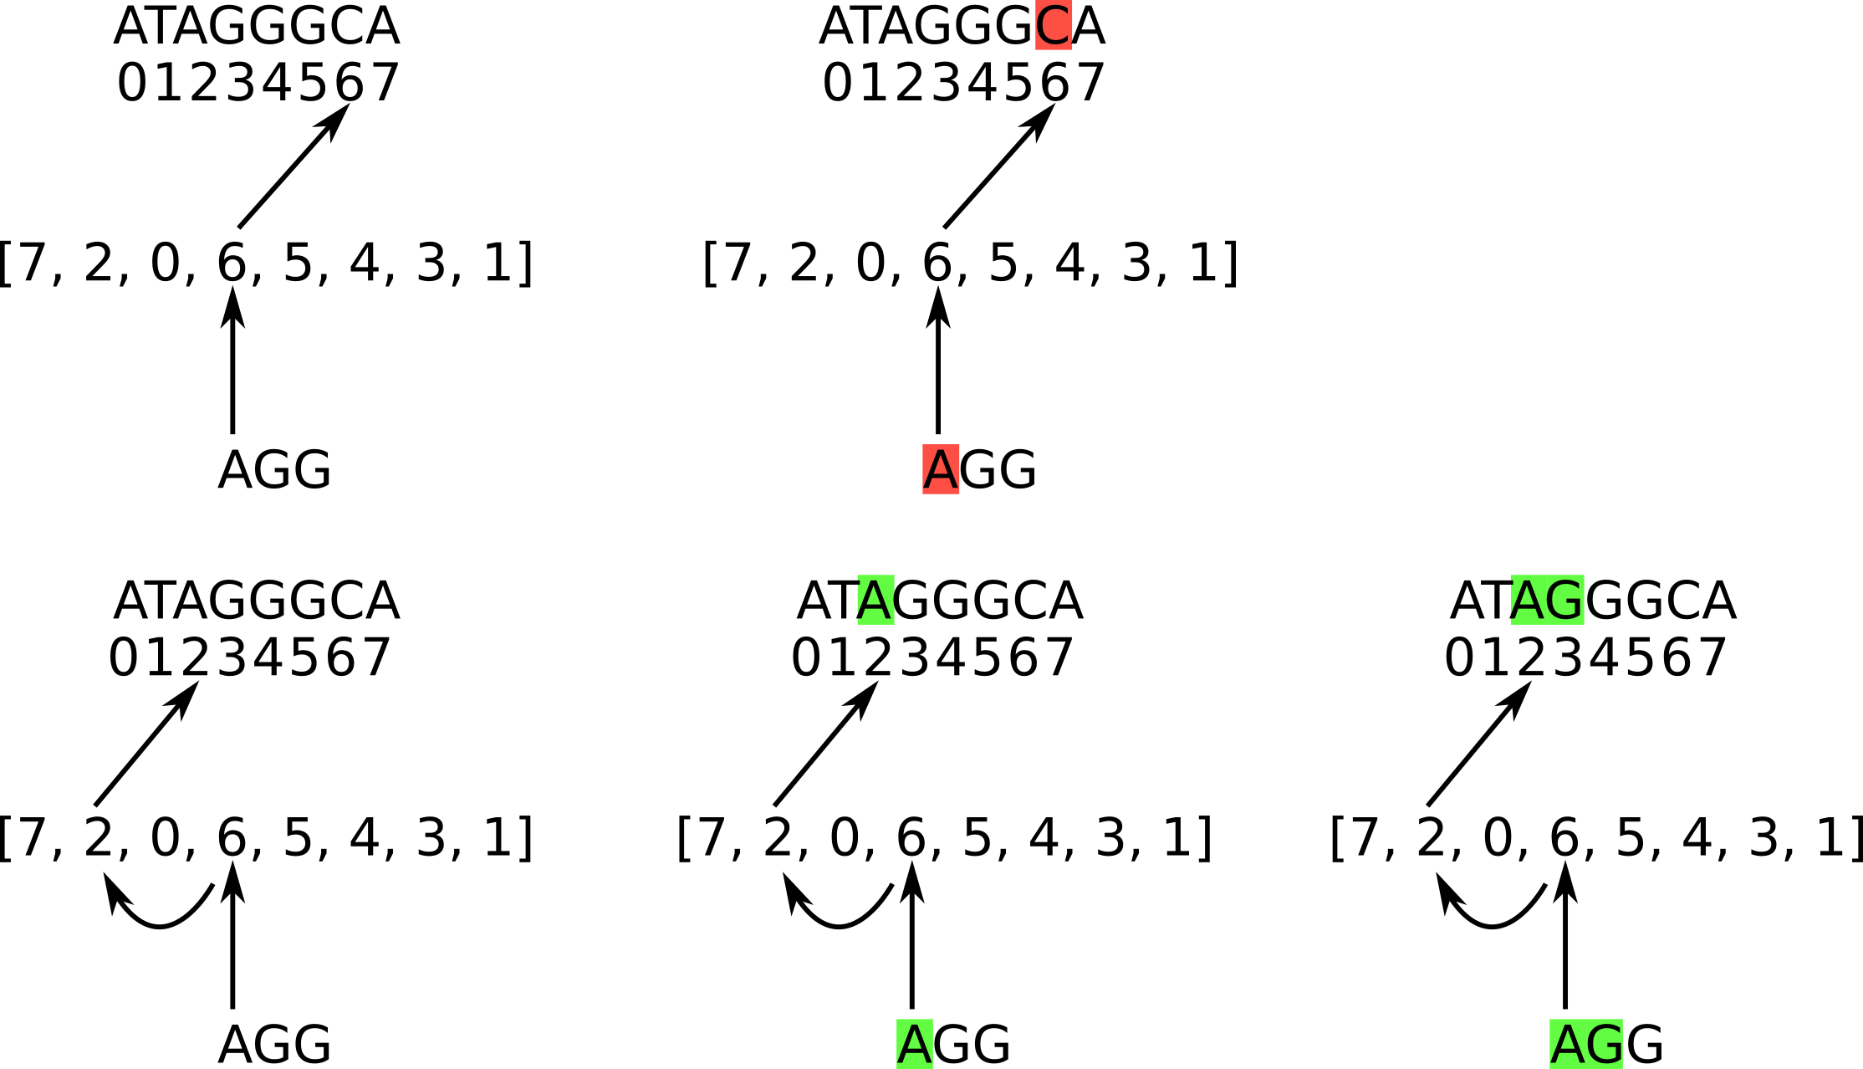
Suffix array
We can use binary search to look up the suffix (offset) array
`

Slide 30
Suffix array
We can use binary search to look up the suffix (offset) array
A < C

Slide 31
Suffix array
We can use binary search to look up the suffix (offset) array

Slide 32
Suffix array
We can use binary search to look up the suffix (offset) array

Slide 33
Suffix array
We can use binary search to look up the suffix (offset) array
What is the search time for a pattern of length m ?

Slide 34
Suffix array
We can use binary search to look up the suffix (offset) array
What is the search time for a pattern of length m ? O(m log n)

Slide 35
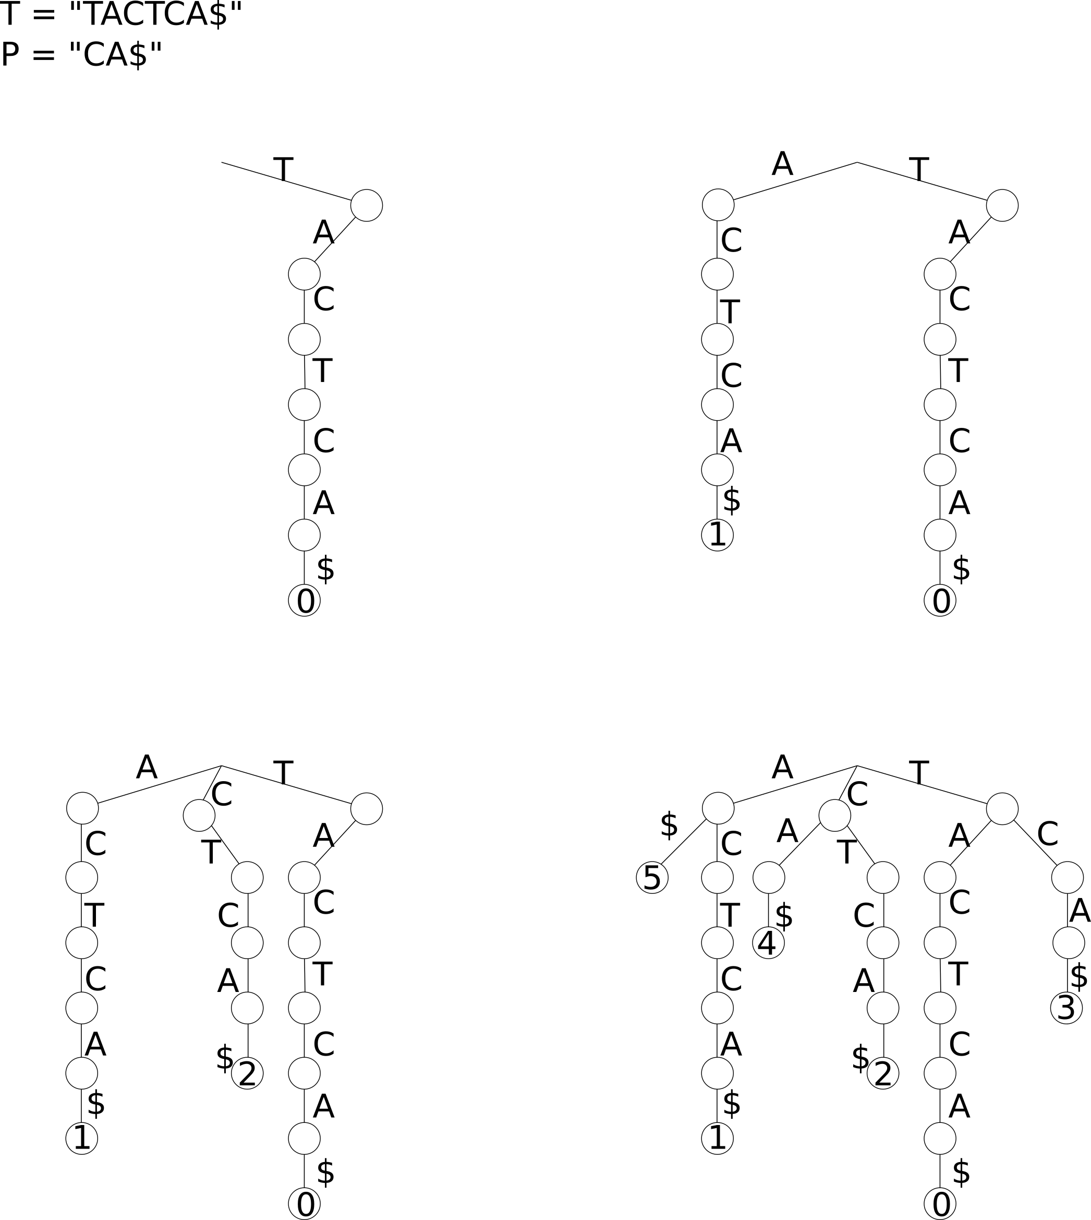
Suffix trees
We can search in O(m) using a suffix tree
Construction time is non-trivial (O(n))

Slide 36
Suffix trees
We can search in O(m) using a suffix tree
Construction time is non-trivial (O(n))

Slide 37
Suffix trees
We can search in O(m) using a suffix tree
Construction time is non-trivial (O(n))

Slide 38
Suffix trees
We can search in O(m) using a suffix tree
Construction time is non-trivial (O(n))

Slide 39
Suffix trees
We can search in O(m) using a suffix tree
Construction time is non-trivial (O(n))

Slide 40
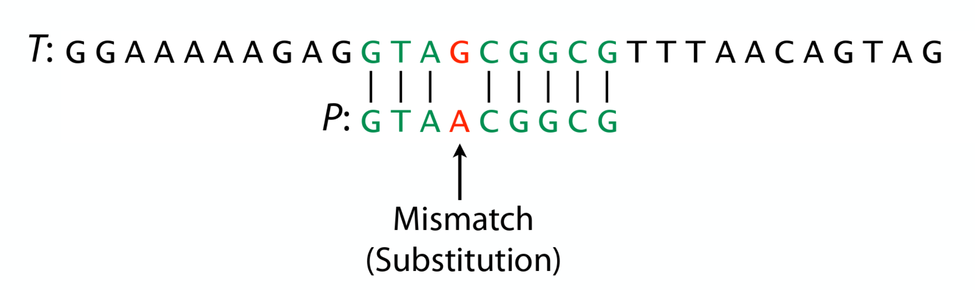
Inexact alignments
We often want to allow some errors in alignments !
  Sequencing errors in reads
  Measure strain / species divergence
  Find homologous genes

Slide 41
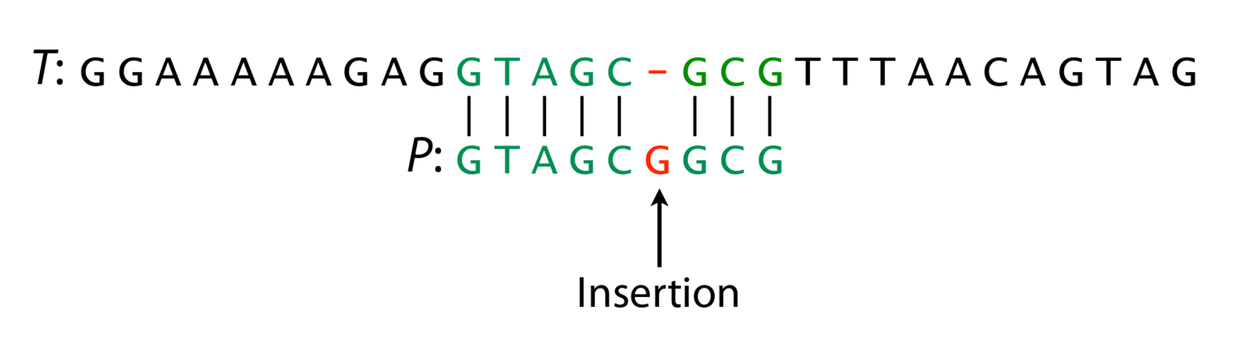
Inexact alignments
We often want to allow some errors in alignments !
  Sequencing errors in reads
  Measure strain / species divergence
  Find homologous genes

Slide 42
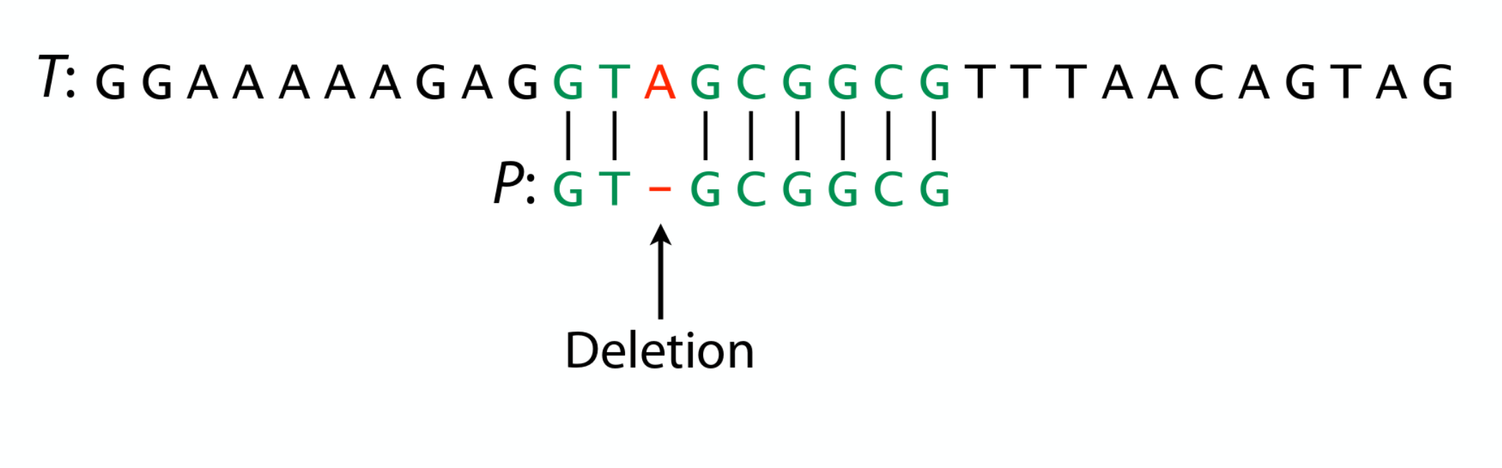
Inexact alignments
We often want to allow some errors in alignments !
  Sequencing errors in reads
  Measure strain / species divergence
  Find homologous genes

Slide 43
Quantifying errors
Hamming distance: # of substitutions to turn P into T
Edit distance: Same, but allows insertions / deletions
T = TTGCC
P = CTCGC
Substitute C → T
TTGCC
TTCGC
Substitute C → G
What if P ant T have different lengths ?
TTGCC
TTGGC
Hamming distance = 2

Slide 44
Inexact alignments
Aligned sequence will almost always have different lengths
This can be solved with 2 approaches
n
T = TTGCCC
P = TGCG
m
Global alignment
Local alignment
Search for substring of length m in T with smallest edit distance
Naive: compute all possible alignments
TTGCCC
TGCG__
TTGCCC
TGC_G_
TTGCCC
TGC__G
TTGCCC
TGCG
TTGCCC
TC_C_G
TTGCCC
_TGC_G
...

Slide 45
Inexact alignments
Aligned sequence will almost always have different lengths
This can be solved with 2 approaches
n
T = TTGCCC
P = TGCG
m
Global alignment
Local alignment
Edit distance: Too many possibilities !

Slide 46
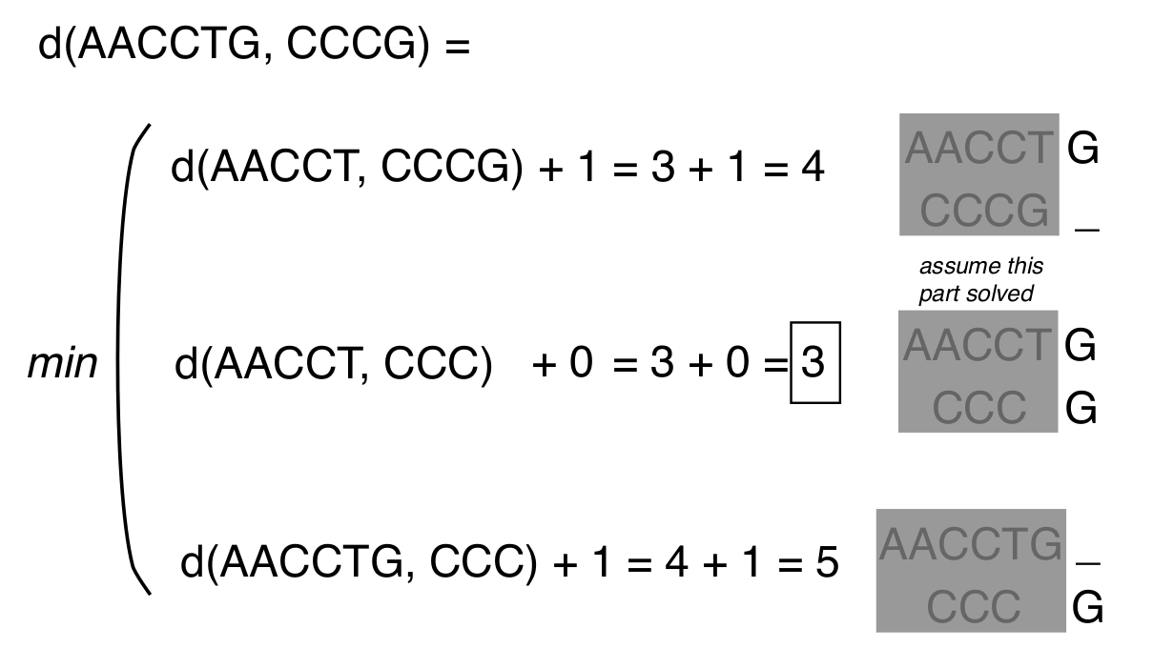
Inexact alignments
Can be formulated as a recursive problem
Large exploration space

Slide 47
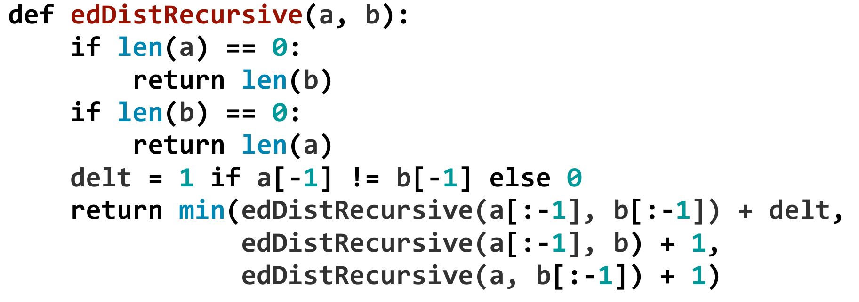
Inexact alignments
Can be formulated as a recursive problem
How to reduce the exploration space ?
Image source: https://github.com/BenLangmead/ads1-slides/

Slide 48
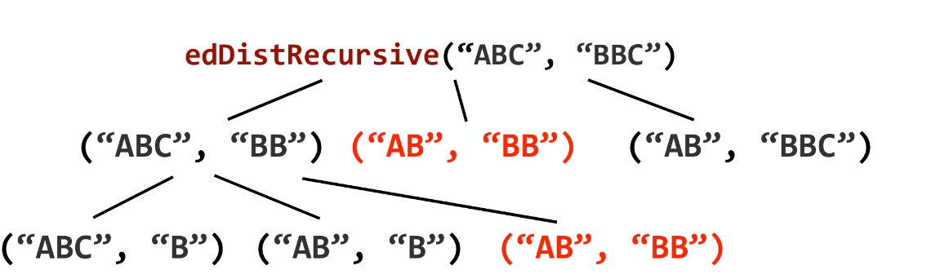
Inexact alignment in feasible time
Can be formulated as a recursive problem
How to reduce the exploration space ?
Image source: https://github.com/BenLangmead/ads1-slides/

Slide 49
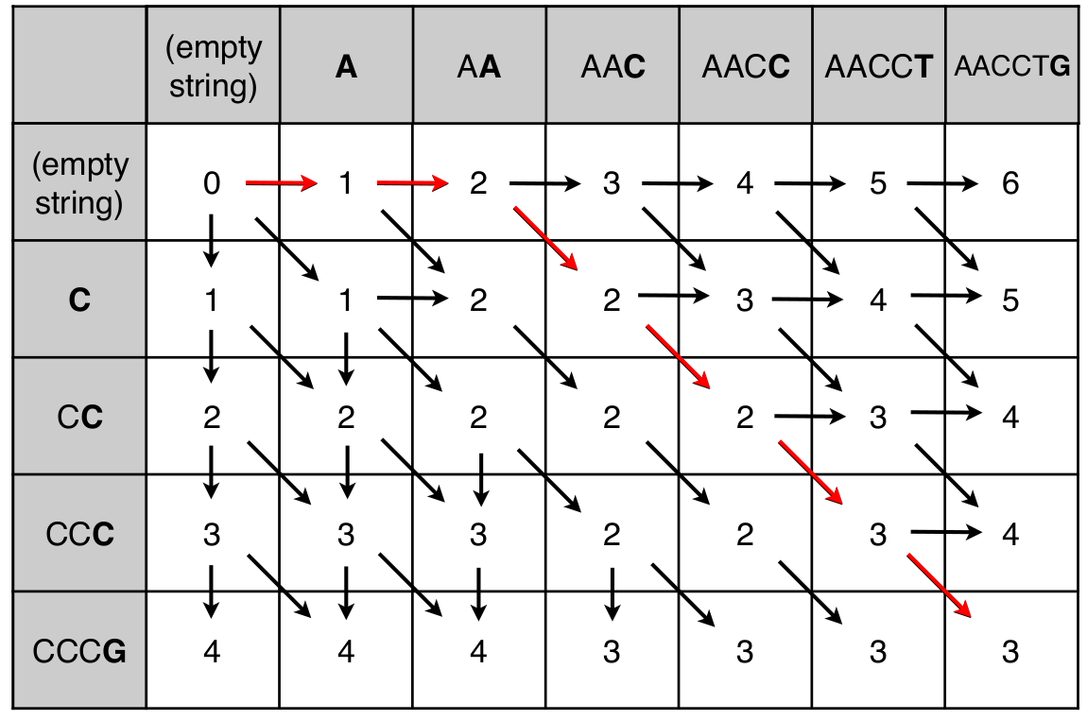
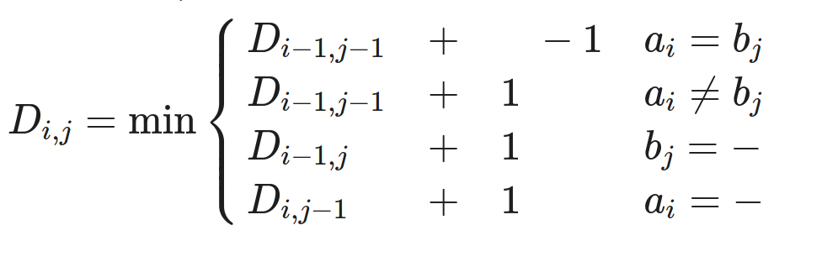
Dynamic programming
We perform “traceback to recover the alignment from scores
Recursion equation
AACCTG
__CCCG

Slide 50
Dynamic programming
We perform “traceback to recover the alignment from scores
Recursion equation
AACCTG
__CCCG
Live visualisation here !

Slide 51
Dynamic programming
For any pair of sequence prefixes, score is calculated once
Time complexity ?
  how many operations /cell ?
  How many cells ?

Slide 52
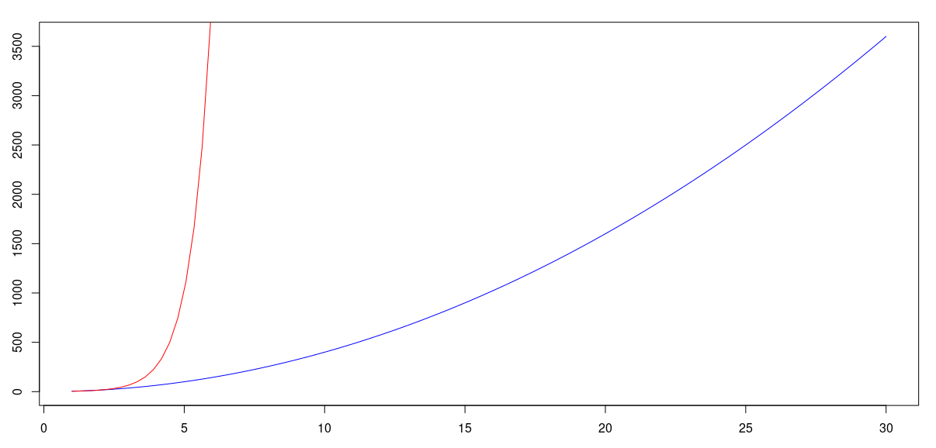
Dynamic programming
For any pair of sequence prefixes, score is calculated once
Time complexity ? O(mn)
  how many operations /cell ? 3 addition and 1 minimum
  How many cells ? (m + 1) (n + 1)
O(4^{n})
O(4n²)

Slide 53
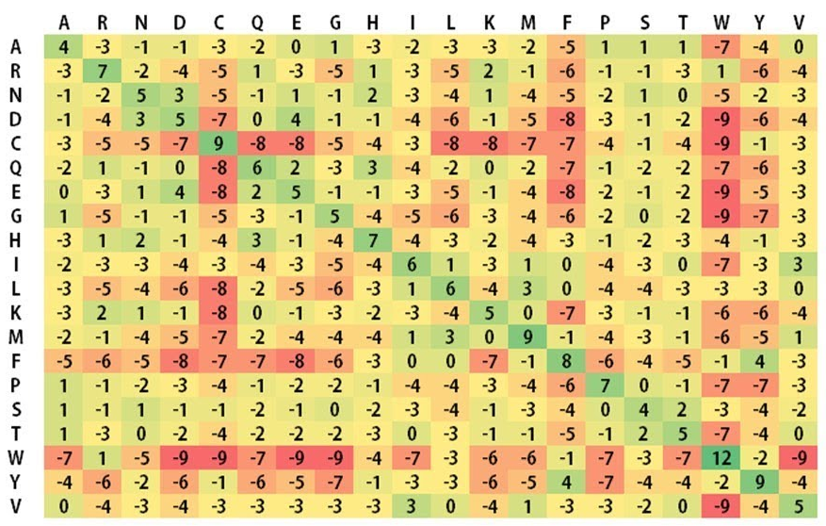
Refining dynamic programming
Add different penalties (e.g. match=1, gap=-2, mismatch=-1)
Use a substitution matrix (measures amino-acid similarity)
A→ R: -3
A → W: -7

Slide 54
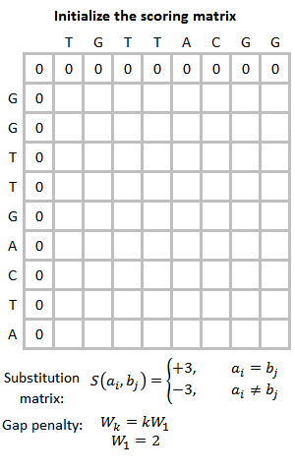
Local alignment
Smith-waterman uses Dynamic programming for local alignments
  All negative scores set to 0
  Stop extending when encountering zeros
  Start backtracking from highest score
Gif: https://w.wiki/ZAL

Slide 55
Dynamic programming in real life
Used in most alignment tools
Often combined with a first step of exact matching for speed
Example: BLAST
  1. Extract k-mers from the query
  2. Find their position in the database (exact match)
  3. Identify regions with several exact matches as “High scoring pairs”
  4. Extend HSPs in both directions using dynamic programming

Slide 56
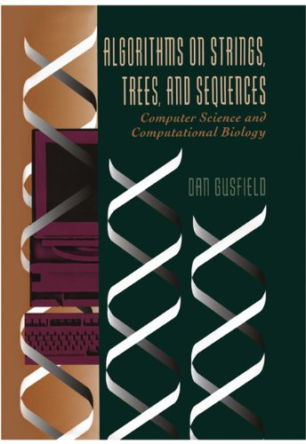

Additional resources
Book on string-based algorithms: Algorithms on Strings, Trees, and Sequences Computer Science and Computational Biology, Dan Gusfield

