Slide 1
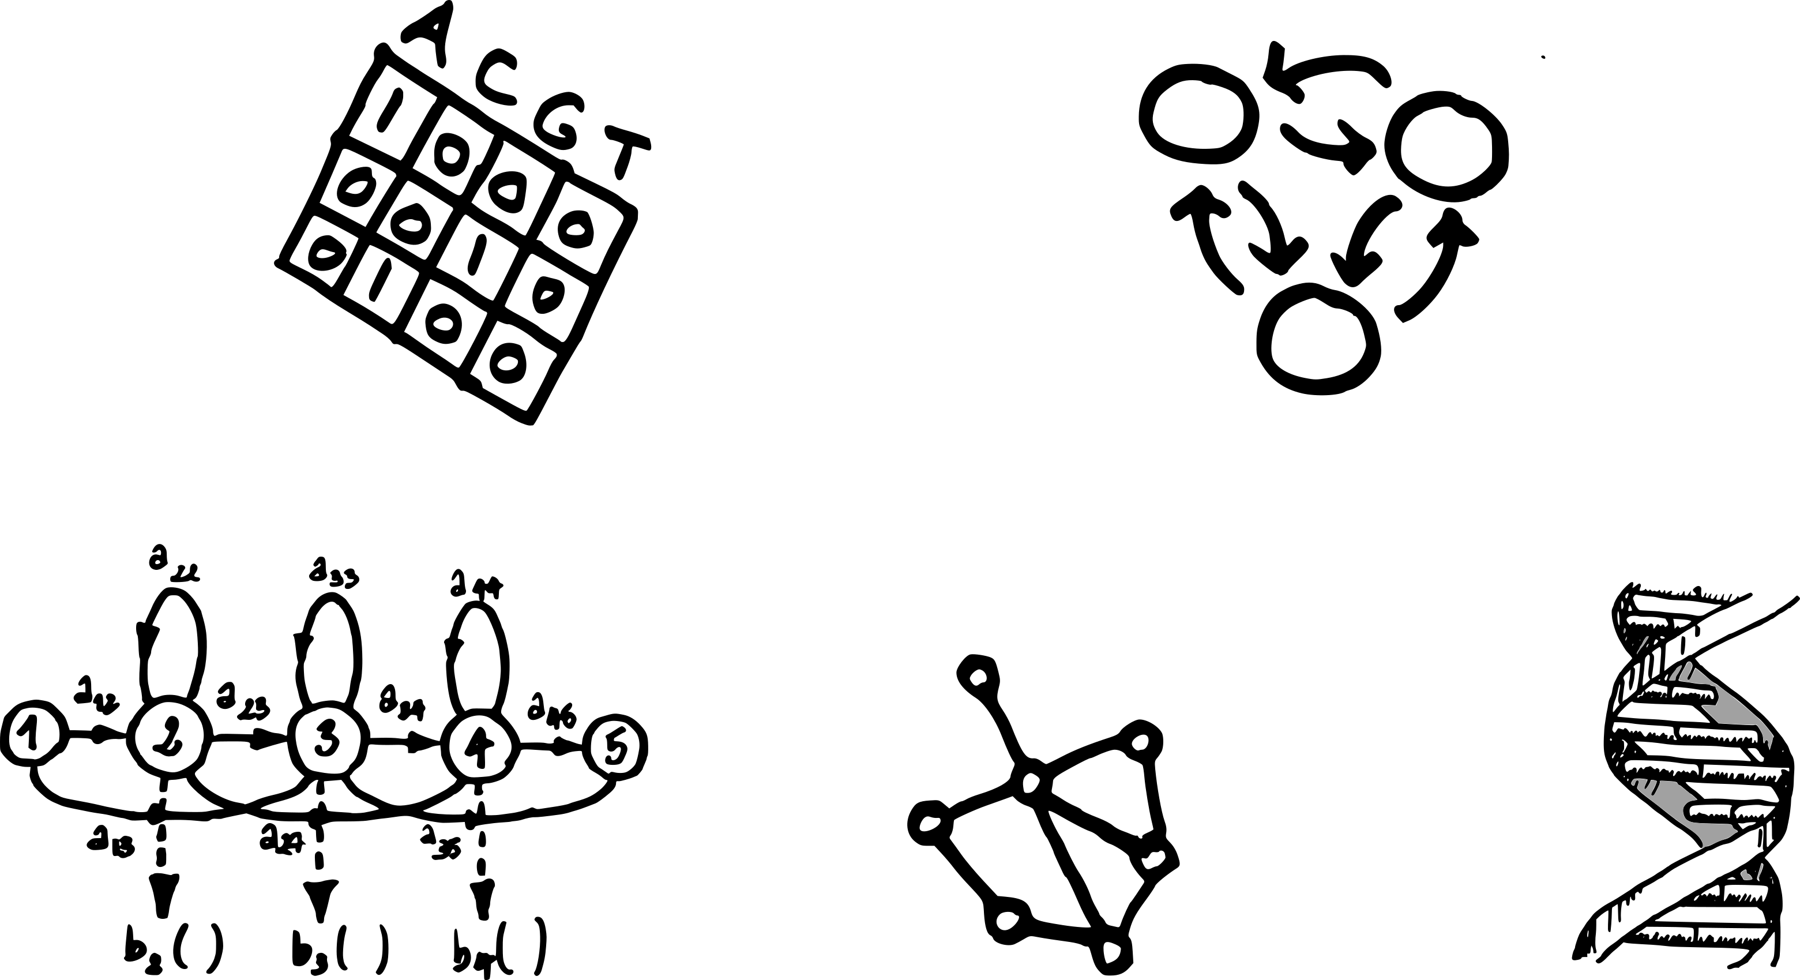




Sequence algorithms
DAG workshop, 2020
Cyril Matthey-Doret
cyril.mattheydoret@gmail.com
cmdoret

Slide 2
Exercises from session 3

Slide 3
Working with sequences of states
Different from classification: Input and output have an order
Markov models: define states and transition probabilities
Example: nucleotide transition matrix from DNA sequence
 | A | C | G | T
A | 1 | 1 | 1 | 0
C | 0 | 0 | 0 | 1
G | 2 | 0 | 0 | 0
T | 0 | 0 | 1 | 2
A
C
Input:
AACTTTGAGAC
G
T

Slide 4
Working with sequences of states
Different from classification: Input and output have an order
Markov models: define states and transition probabilities
Example: nucleotide transition matrix from DNA sequence
 | A | C | G | T
A | 0.33 | 0.33 | 0.33 | 0
C | 0 | 0 | 0 | 1
G | 1 | 0 | 0 | 0
T | 0 | 0 | 0.33 | 0.66
A
C
Input:
AACTTTGAGAC
G
T

Slide 5
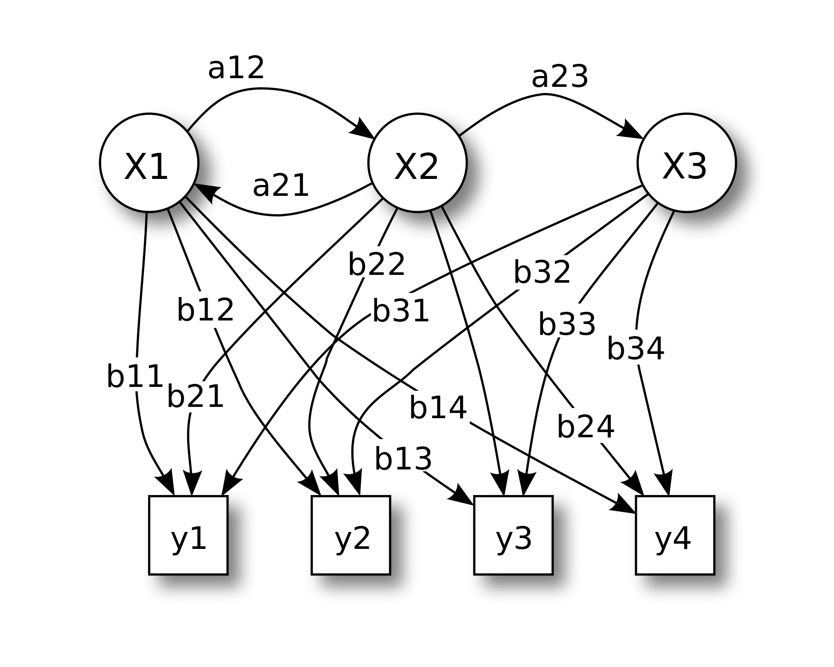
Predicting states from sequence
Markov models by themselves have limited use in genomics
Hidden Markov models (HMM) are more useful in genomics
  Input: observations → DNA sequence
  Output: states → gene / not gene
Hidden states
a = transition probabilities
b = emission probabilities
Observations

Slide 6
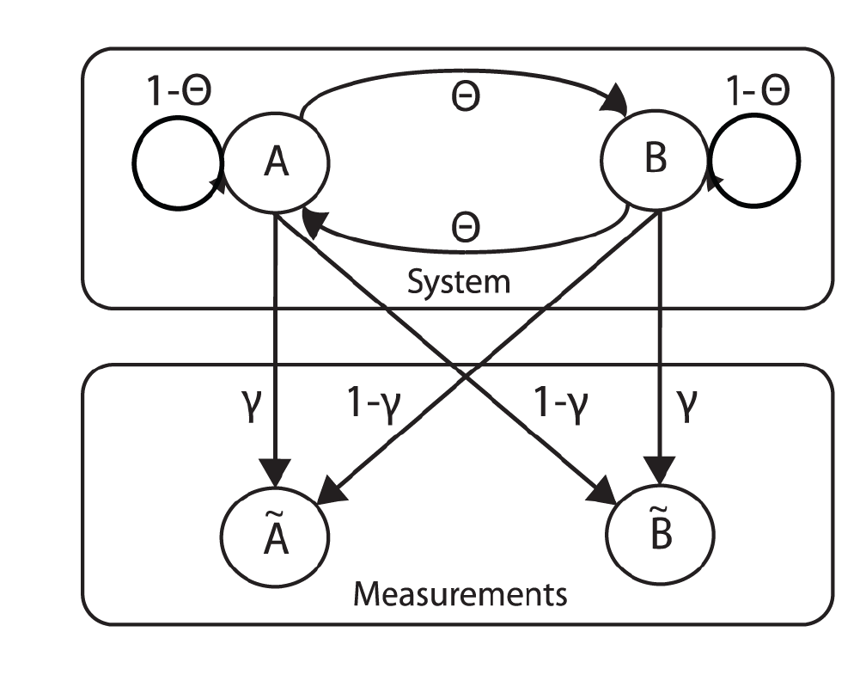
HMM: example
A system switches between two (hidden) states A and B
A device measures the system state, but it is error prone
It shows Ã or B̃ when it measures A or B, respectively
What we want to know →
What we see →
Example from: Sunnåker et al., PloS Comp.Biol. 2013

Slide 7
HMM: example
Given the measurement sequence:
What is the probability of the observed measurement sequence ?
  Naive: Sum probabilities of all possible state sequences

Slide 8
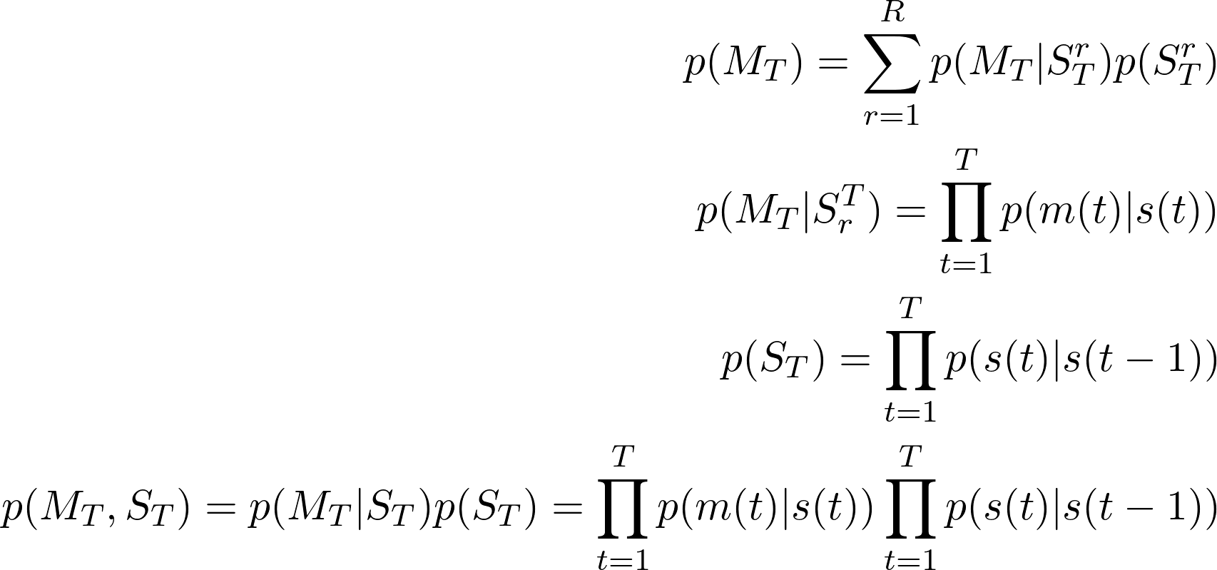
HMM: Naive sequence probability
Find the probability of measurements:
Weighted sum probabilities of every single state sequence
With X different hidden states, the number of possible sequences S of length T is: R=X^{T} (here: 8=2³)
State sequence of length T
Measurement sequence of length T

Slide 9
HMM: Naive sequence probability
Find the probability of measurements:
Weighted sum probabilities of every single state sequence
With X different hidden states, the number of possible sequences S of length T is: R=X^{T} (here: 8=2³)
State sequence of length T
AAA
AAB
ABB
...
AAA
AAB
ABB
...
Measurement sequence of length T

Slide 10
HMM: Naive sequence probability
Find the probability of measurements:
Weighted sum probabilities of every single sequences
With X different hidden states, the number of possible sequences S of length T is: R=X^{T}
State sequence of length T
S
?
?
M
Measurement sequence of length T

Slide 11
HMM: Naive sequence probability
Find the probability of measurements:
Weighted sum probabilities of every single sequences
Measurement at position t of M
State at position t of S

Slide 12
HMM: Naive sequence probability
Find the probability of measurements:
Weighted sum probabilities of every single sequences
Emission prob
S
M

Slide 13
HMM: Naive sequence probability
Find the probability of measurements:
Weighted sum probabilities of every single sequences
S
Emission prob
M

Slide 14
HMM: Naive sequence probability
Find the probability of measurements:
Weighted sum probabilities of every single sequences
S
Emission prob
M
Transition prob

Slide 15
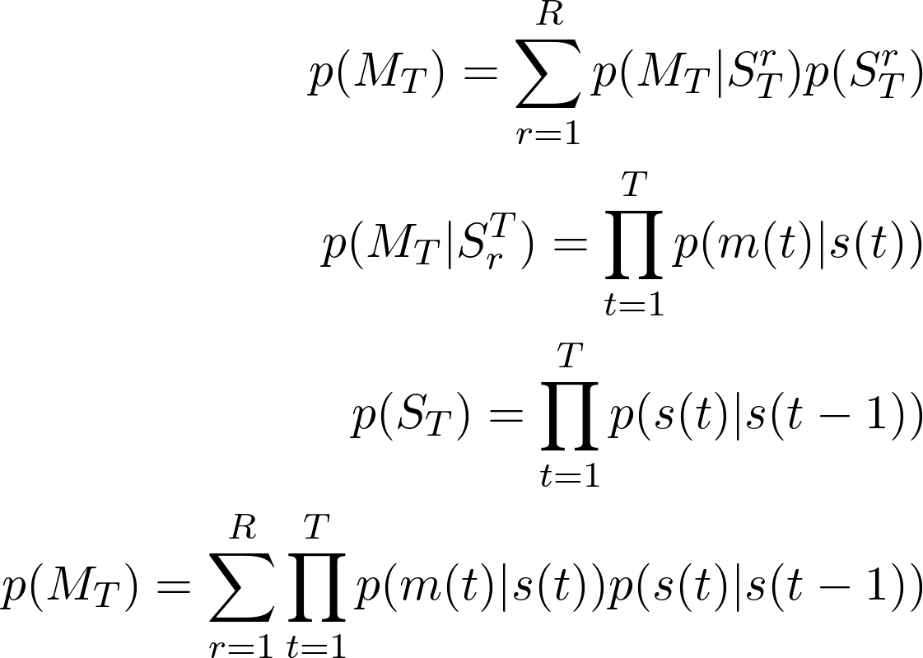
HMM: Naive sequence probability
Find the probability of measurements:
Sum probabilities of every single sequences
What if t=0 and t-1 = -1 ?

Slide 16
HMM: Naive sequence probability
Find the probability of measurements:
Sum probabilities of every single sequences
start
z
1-z
What if t=0 and t-1 = -1 ?

Slide 17
HMM: Naive sequence probability
Find the probability of measurements:
Sum probabilities of every single sequences
Example:
p(GRR|AAA) = p(G1|A1) * z * p(R2|A2) * p(A2|A1) * p(R3|A3) * p(A3|A2)
= Ɣ * z * (1-Ɣ) * (1-Θ) * (1-Ɣ) * (1-Θ)
p(GRR|AAB) = ...
p(GRR|ABB) = …
…
P(GRR) = Σ

Slide 18
HMM: Naive sequence probability
Find the probability of measurements:
Sum probabilities of every single sequences
What is the time complexity according to T and X (number of states) ?

Slide 19
HMM: Naive sequence probability
Find the probability of measurements:
Sum probabilities of every single sequences
What is the time complexity according to T and X (number of states) ? O(X^{T} T)

Slide 20
HMM: Forward algorithm
Sequence probability can be solved using dynamic programming
Avoid recomputing the same products many time
T
A
A
A
START
B
B
B

Slide 21

HMM: Forward algorithm
Sequence probability can be solved using dynamic programming
Avoid recomputing the same products many time
T
p(G|A)*p(A|start)
A
A
A
α_{1.1}=z*ɣ
START
α_{1.2}=(1-z)*(1-ɣ)
p(G|B)*p(B|start)
B
B
B

Slide 22
HMM: Forward algorithm
Sequence probability can be solved using dynamic programming
Avoid recomputing the same products many time
T
p(R|A)*p(A|A)
A
A
A
α_{1.1}=z*ɣ
p(R|B)*p(B|A)
START
α_{1.2}=(1-z)*(1-ɣ)
p(R|A)*p(A|B)
B
B
B
p(R|B)*p(B|B)

Slide 23
HMM: Forward algorithm
Sequence probability can be solved using dynamic programming
Avoid recomputing the same products many time
T
p(R|A)*p(A|A)
A
A
A
α_{1.1}=z*ɣ
p(R|B)*p(B|A)
α_{2.1}=α_{1.1}*(1-ɣ)*(1-Θ)
+α_{1.2}*(1-ɣ)*Θ
START
α_{1.2}=(1-z)*(1-ɣ)
p(R|A)*p(A|B)
α_{2.2}=α_{1.1}*ɣ*Θ
+α_{1.2}*ɣ*(1-Θ)
B
B
B
p(R|B)*p(B|B)

Slide 24
HMM: Forward algorithm
Sequence probability can be solved using dynamic programming
Avoid recomputing the same products many time
T
p(R|A)*p(A|A)
A
A
A
α_{1.1}
α_{2.1}
p(R|B)*p(B|A)
α_{3.1} = α_{2.1}*(1-ɣ)*(1-Θ)
+ α_{2.2}*(1-ɣ)*Θ
START
α_{1.2}
α_{2.2}
p(R|A)*p(A|B)
α_{3.2} = α_{2.1}*ɣ*Θ
+ α_{2.2}*ɣ*(1-Θ)
B
B
B
p(R|B)*p(B|B)

Slide 25
HMM: Forward algorithm
Sequence probability can be solved using dynamic programming
Avoid recomputing the same products many time
Weighted sum of probs for
all possible sequences
T
P(GRR) = α_{3.1} + α_{3.2.}
p(R|A)*p(A|A)
A
A
A
α_{1.1}
α_{2.1}
p(R|B)*p(B|A)
α_{3.1} = α_{2.1}*(1-ɣ)*(1-Θ)
+ α_{2.2}*(1-ɣ)*Θ
START
α_{1.2}
α_{2.2}
p(R|A)*p(A|B)
α_{3.2} = α_{2.1}*ɣ*Θ
+ α_{2.2}*ɣ*(1-Θ)
B
B
B
p(R|B)*p(B|B)

Slide 26
HMM: Forward algorithm
Complexity of the forward algorithm is O(TX²) which is << O(TX^{T})
Example use: Distinguishing between two models
  e.g. Is my sequence more probable with a strand-aware model ?
p(R|A)*p(A|A)
A
A
A
α_{1.1}
α_{2.1}
p(R|B)*p(B|A)
α_{3.1} = α_{2.1}*(1-ɣ)*(1-Θ)
+ α_{2.2}*(1-ɣ)*Θ
START
α_{1.2}
α_{2.2}
p(R|A)*p(A|B)
α_{3.2} = α_{2.1}*ɣ*Θ
+ α_{2.2}*ɣ*(1-Θ)
B
B
B
p(R|B)*p(B|B)

Slide 27
HMM: Viterbi algorithm
What is the most likely sequence of states, given the observations ?
Just like the forward algorithm, but using max() instead of sum()
T
α_{1.1} = a
α_{2.1}= max(α_{1.1}c, α_{1.2}e)
α_{3.1} = max(α_{2.1}g, α_{2.1}h)
A
c
A
A
g
a
d
h
START
b
e
i
f
j
B
B
B
α_{1.2}= b
α_{2.2}= max(α_{1.1}d, α_{1.2}f)
α_{3.2} = max(α_{2.1}i,α_{2.2}j)

Slide 28
HMM: Viterbi algorithm
Backtrack from T to 0 (similar to Needleman-Wunsch)
T
α_{1.1} = a
α_{2.1}= max(α_{1.1}c, α_{1.2}e)
α_{3.1} = max(α_{2.1}g, α_{2.1}h)
A
c
A
A
g
a
d
h
START
α_{3.1} > α_{3.2}
b
e
i
f
j
B
B
B
α_{1.2}= b
α_{2.2}= max(α_{1.1}d, α_{1.2}f)
α_{3.2} = max(α_{2.1}i,α_{2.2}j)

Slide 29
HMM: Viterbi algorithm
Backtrack from T to 0 (similar to Needleman-Wunsch)
T
α_{1.1} = a
α_{2.1}= max(α_{1.1}c, α_{1.2}e)
α_{3.1} = max(α_{2.1}g, α_{2.1}h)
A
c
A
A
g
a
d
h
START
α_{3.1} > α_{3.2}
b
e
i
f
j
B
B
B
α_{1.2}= b
α_{2.2}= max(α_{1.1}d, α_{1.2}f)
α_{3.2} = max(α_{2.1}i,α_{2.2}j)

Slide 30
HMM: Viterbi algorithm
Backtrack from T to 0 (similar to Needleman-Wunsch)
T
α_{1.1} = a
α_{2.1}= max(α_{1.1}c, α_{1.2}e)
α_{3.1} = max(α_{2.1}g, α_{2.1}h)
A
c
A
A
g
a
d
h
START
α_{3.1} > α_{3.2}
b
e
i
f
j
B
B
B
α_{1.2}= b
α_{2.2}= max(α_{1.1}d, α_{1.2}f)
α_{3.2} = max(α_{2.1}i,α_{2.2}j)

Slide 31
HMM: Applications
Gene annotation: Genome sequence → Intron/exon/splice site
  AUGUSTUS
Long read correction: Noisy long reads → most probable sequence
  HERCULES
Sequence alignment: Sequences → Insertion/Deletion/(Mis)match
  HMMER
Chromatin states: Histone marks → regulatory state
  ChromHMM

Slide 32
Graph theory
Many biological systems can be represented with graphs
  Protein interactions, gene regulation, residues in proteins
Nodes and edges (Markov models are also graphs)
Nodes / Vertices
Edges / Links

Slide 33
Graph theory
Many biological systems can be represented with graphs
  Protein interactions, gene regulation, residues in proteins
Nodes and edges (Markov models are also graphs)
Nodes / Vertices
Edges / Links
A graph is a set of nodes V and edges E: G = (V, E)
Number of nodes: |V| = N
Number of edges: |E|

Slide 34
Graph theory
Various metrics can give information about a graph or its nodes
2 connected components
k=2
k=3
Basic concepts:
- Neighbours: adjacent nodes
- Degree (k): Number of neighbours
- Connected component: Group of connected nodes
- Path: List of adjacent nodes
- Shortest path: Shortest list of adjacent nodes which
leads from one node to another

Slide 35
Graph theory
Maximum number of edges in a network of N nodes ?
  Hint: How many max edges / node ?
Example with 4 nodes:
Fully connected:
4 Nodes, 6 edges

Slide 36
Graph theory
(N-1)!
Maximum number of edges in a network of N nodes ?
  Hint: How many max edges / node ?
In practice, edges scale in O(N) for most networks (“sparse”)
Example with 4 nodes:
Fully connected:
4 Nodes, 6 edges

Slide 37
Graph theory
Edges can be 0/1 or have weights or even directions
This allows to model different types of processes
Undirected
Weighted
Directed
Ex: interacts
Ex: binding affinity
Ex: promotes/inhibits

Slide 38
Mathematical representation of graphs
To work with graph, we need to use a formal representation
There are 3 common representations:
Adjacency list
Adjacency matrix
Neighbour list
A
C
A – B
A – C
B – C
C – D
A B C D
A 0 1 1 0
B 1 0 1 0
C 1 1 0 1
D 0 0 1 0
A – B,C
B – A,B
C – A,B,D
D – C
B
D
Note: for undirected graphs: A[i, j] = A[j,i]

Slide 39
Random walks on a graph
START
A
B
Imagine you move randomly on the graph
Probability to go from node A to D in 2 steps ?
C
D
FINISH

Slide 40
Random walks on a graph
START
A
B
Imagine you move randomly on the graph
Probability to go from node A to D in 2 steps ?
C
D
FINISH
All possible paths:
ABA
ABC
ABD
1 success / 3 paths = 0.33

Slide 41
Random walks on a graph
START
A
As the graph grows larger, it becomes infeasible to list each path
There are O(K^{T}) paths of length T where K is the average degree
B
C
D
FINISH
All possible paths:
ABA
ABC
ABD
1 success / 3 paths = 0.33

Slide 42
Random walks, but faster
START
A
B
All neighbours of A → X¹
All the neighbours of X¹ → X²
C
D
FINISH
1) Probability of A→ X¹: P(A, X¹)
2) Probability of X¹ → X²: P(X¹, X²)
3) Sum P(A, X¹) x P(X¹, D), all cases reaching D
4) Generalization to N steps:

Slide 43
Random walks, but faster
START
A
B
All neighbours of A → X¹
All the neighbours of X¹ → X²
C
D
FINISH
1) Probability of A→ X¹: P(A, X¹)
2) Probability of X¹ → X²: P(X¹, X²)
3) Sum P(A, X¹) x P(X¹, D), all cases reaching D
4) Generalization to N steps:
 | A | B | C | D
A | 0 | 1 | 0 | 0
B | 1 | 0 | 1 | 1
C | 0 | 1 | 0 | 1
D | 0 | 1 | 1 | 0

Slide 44
Random walks, but faster
START
A
B
All neighbours of A → X¹
All the neighbours of X¹ → X²
C
D
FINISH
Adjacency → stochastic matrix (W)
1) Probability of A→ X¹: P(A, X¹)
2) Probability of X¹ → X²: P(X¹, X²)
3) Sum P(A, X¹) x P(X¹, D), all cases reaching D
4) Generalization to N steps:
 | A | B | C | D
A | 0 | 1 | 0 | 0
B | 0.33 | 0 | 0.33 | 0.33
C | 0 | 0.5 | 0 | 0.5
D | 0 | 0.5 | 0.5 | 0

Slide 45
Random walks, but faster
The T’th power of the stochastic matrix gives the probability of going from node i to j in T steps
Scales with O(T) instead of O(K^{T})
P(A, D) in 1 step: W[A, D]
P(A, D) in 2 steps: W²[A,D]
P(A, D) in T steps: W^{T}[A, D]
 | A | B | C | D
A | 0 | 1 | 0 | 0
B | 0.33 | 0 | 0.33 | 0.33
C | 0. | 0.5 | 0 | 0.5
D | 0 | 0.5 | 0.5 | 0
 | A | B | C | D
A | 0 | 1 | 0 | 0
B | 0.33 | 0 | 0.33 | 0.33
C | 0. | 0.5 | 0 | 0.5
D | 0 | 0.5 | 0.5 | 0
 | A | B | C | D
A | 0.33 | 0 | 0.33 | 0.33
B | 0 | 0.66 | 0.17 | 0.17
C | 0.17 | 0.5 | 0.42 | 0.17
D | 0.17 | 0.5 | 0.17 | 0.42
X
=

Slide 46
Network clustering
Easiest scenario: Identify all disconnected components
How would you do it ?
F
E
G
A
B
C
D

Slide 47
Identification of disconnected components
Easiest scenario: Identify all disconnected components
How would you do it ?
  Start from any node
  Explore neighbours, neighbours of neighbours…
  Skip nodes already visited
F
E
G
A
B
C
D

Slide 48
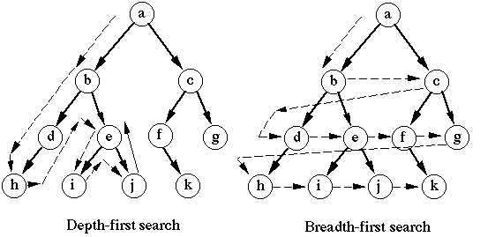
Identification of disconnected components
Breadth first search
visited = []
queue = [initial]
while queue:
node = queue.pop(0)
if node not in visited:
visited.append(node)
neighbours = graph[node]
for neighbour in neighbours:
queue.append(neighbour)
F
E
G
A
B
C
Repeat with the remaining nodes, if any
D
Image: https://www.cse.unsw.edu.au/~billw/Justsearch.html

Slide 49
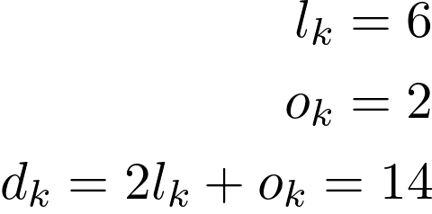
How to define clusters within a network ?
We need a metric to quantify the accuracy of clusters
We use modularity
  Nodes in a cluster should have more edges among them than with other nodes than expected by chance
F
E
G
Number of edges among nodes in k:
Number of edges between k and outside:
Sum of nodes degrees in k:
A
B
C
Cluster k
D

Slide 50
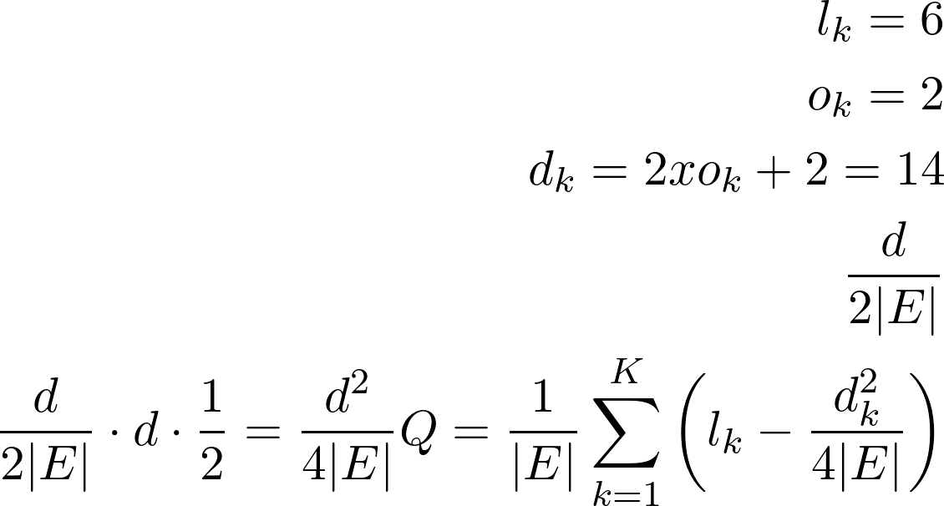
How to define clusters within a network ?
We need a metric to quantify the accuracy of clusters
We use modularity
  Nodes in a cluster should have more edges among them than with other nodes than expected by chance
F
E
G
Number of possible edges in k
A
B
C
Probability that one edge is in cluster:
Number of possible edges in the whole network
D

Slide 51
How to define clusters within a network ?
We need a metric to quantify the accuracy of clusters
We use modularity
  Nodes in a cluster should have more edges among them than with other nodes than expected by chance
F
E
G
A
B
C
Expected number of internal nodes in a cluster:
D

Slide 52
How to define clusters within a network ?
We need a metric to quantify the accuracy of clusters
We use modularity
  Nodes in a cluster should have more edges among them than with other nodes than expected by chance
F
E
G
# expected internal edges
Normalizing factor
A
B
C
Network modularity:
D
# observed internal edges

Slide 53
Network clustering
There are several algorithms to find clusters in a network
Modularity can be used to measure the validity of the clusters
Hierarchical clustering: Merge nodes until modularity stops increasing.
Markov clustering: Number of clusters automatically detected

Slide 54
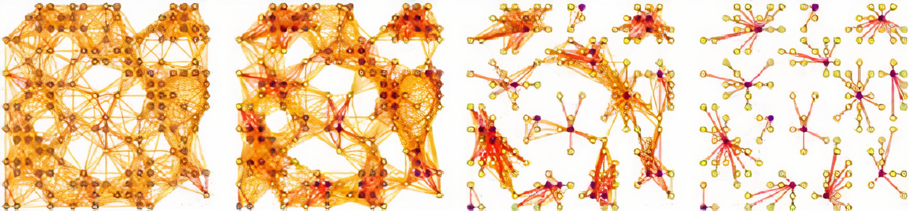
Markov clustering
Consider the network as a markov process
Nodes as states, edges as transition probabilities
Random walks on the graph will infrequently go from one natural cluster to another

Slide 55
Markov clustering
3 operations repeated until convergence:
  Expansion: Simulate random walk on the graph
  Pruning: Remove the least frequented (low probability) paths
  Inflation: Increase contrast between probabilities

Slide 56
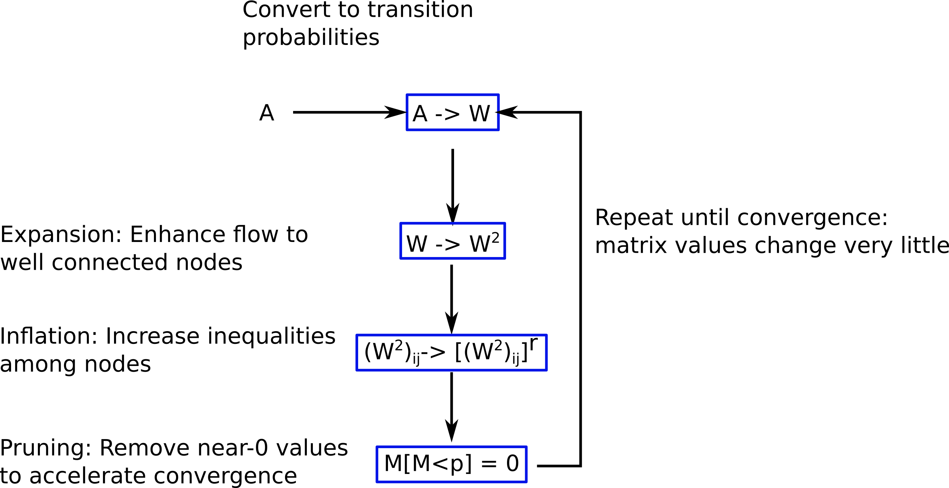
Markov clustering

Slide 57
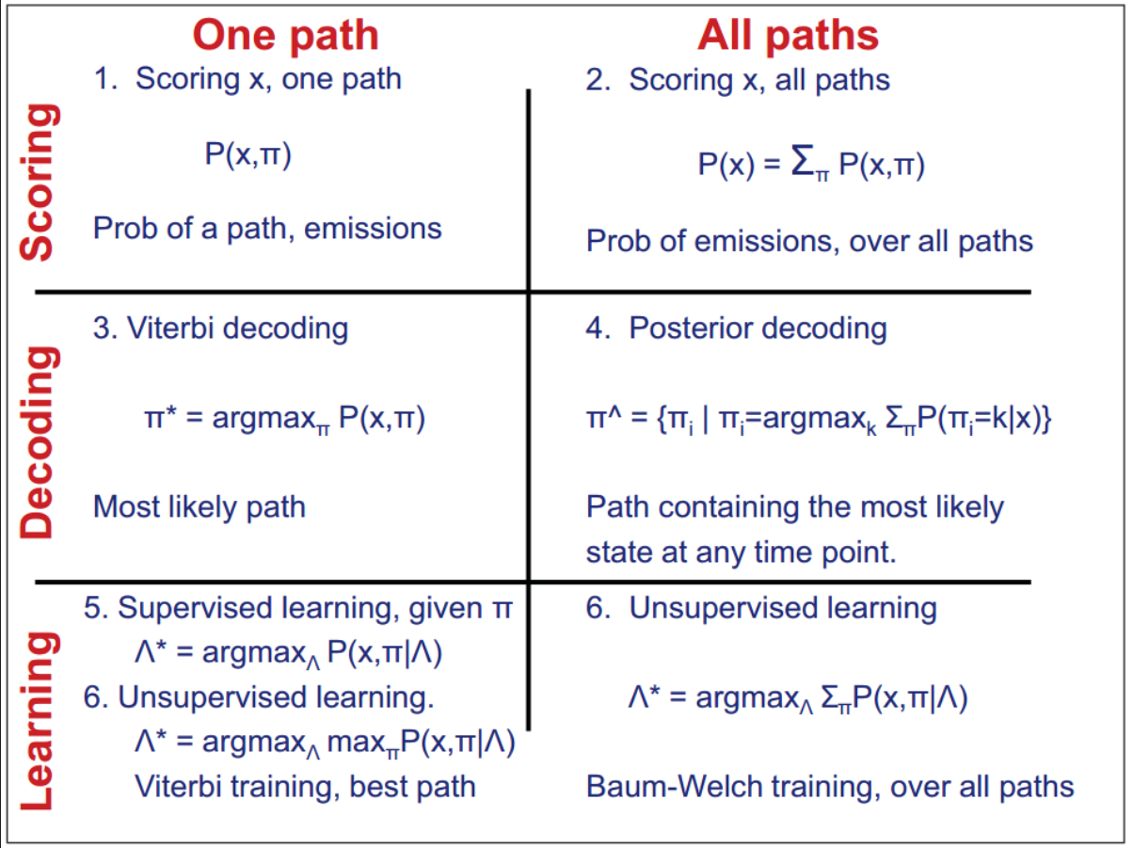
If you want to learn more about HMM
6.047/6.878 Computational Biology: Genomes, Networks, Evolution (Fall 2012) Lecture 07 - HMMs II (2012-09-29): `link

Slide 58
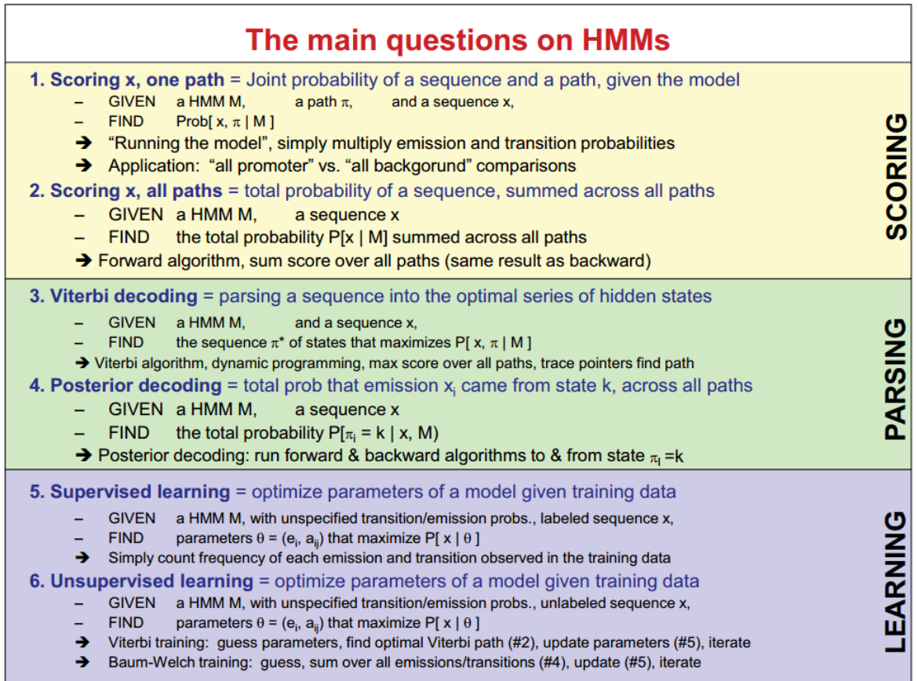

Slide 59



Additional Resources
Yoon, 2009, Curr. Genomics: Review on the applications of HMM in genomics: https://www.ncbi.nlm.nih.gov/pmc/articles/PMC2766791/
Blog post on Markov clustering: https://medium.com/analytics-vidhya/demystifying-markov-clustering-aeb6cdabbfc7
Book on graph theory: Graphs, Networks and Algorithms, Dieter Jungnickel, 2013
Book on probabilitic models in genomics: Biological Sequence Analysis Probabilistic Models of Proteins and Nucleic Acids by Richard Durbin, Sean R. Eddy, Anders Krogh, Graeme Mitchison

