Slide 1

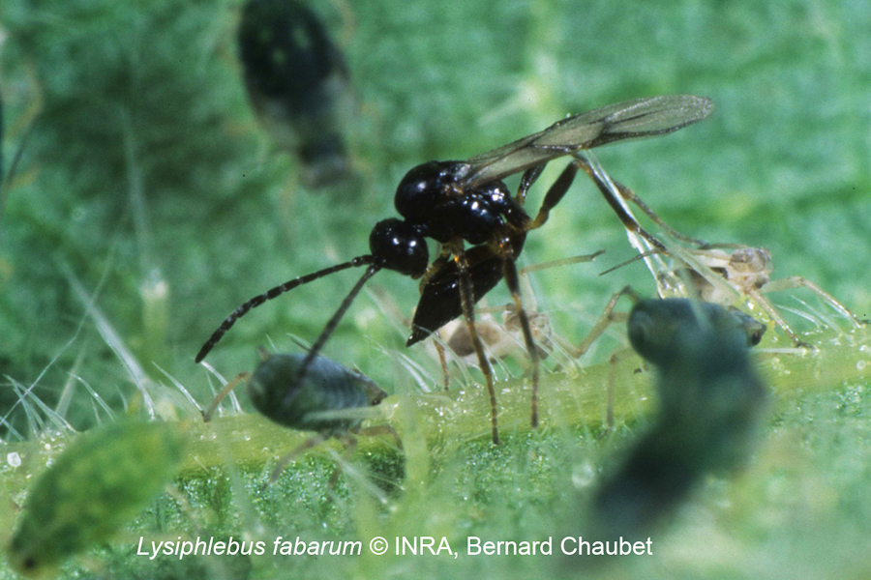
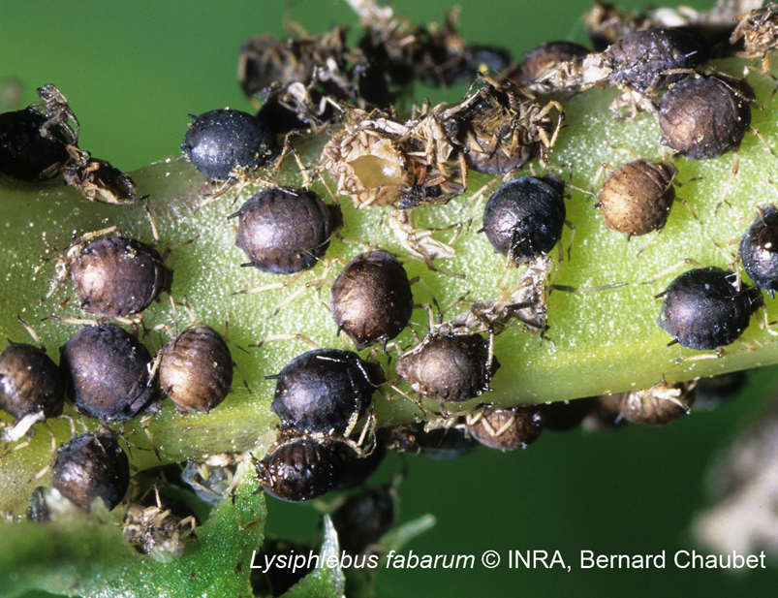
Genetics of sex determination in Lysiphlebus fabarum
Cyril Matthey-Doret
Supervised by: Casper Van Der Kooi
Directed by: Tanja Schwander

Slide 2
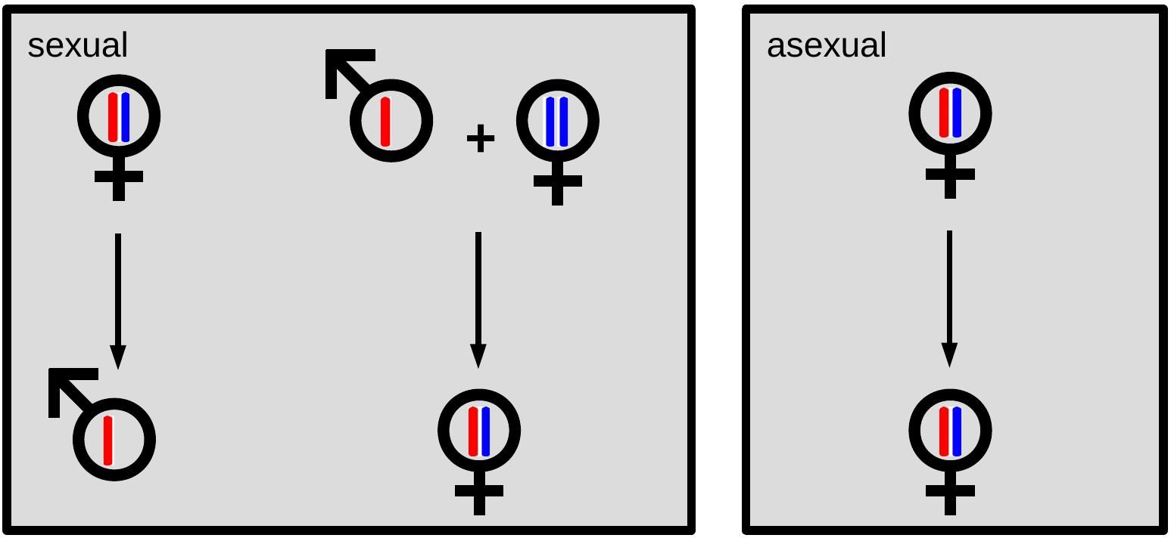
Sex determination
Hymenoptera are haplodiploids
In sexual lineages: egg fertilization --> female

Slide 3
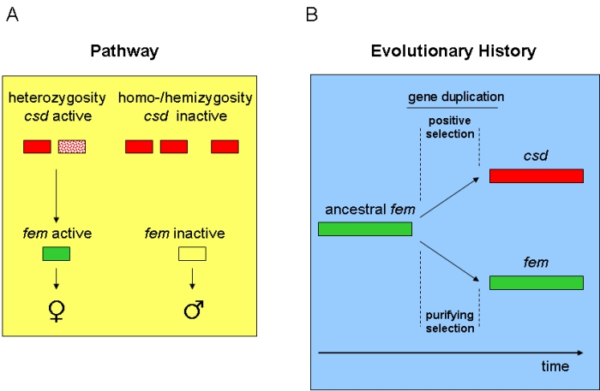
CSD mechanism
2 different alleles required to trigger female development
Males are normally haploid: single copy
Diploid individuals with homozygous CSD --> males
Can be single or multi-locus CSD

Slide 4
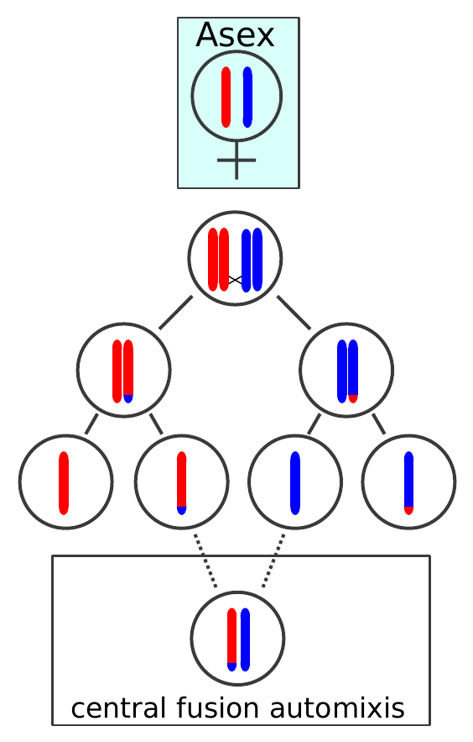
L.fabarum : Introduction
Sex and asex populations
Central fusion automixis: recombination
Multi-locus or single-locus csd ?

Slide 5
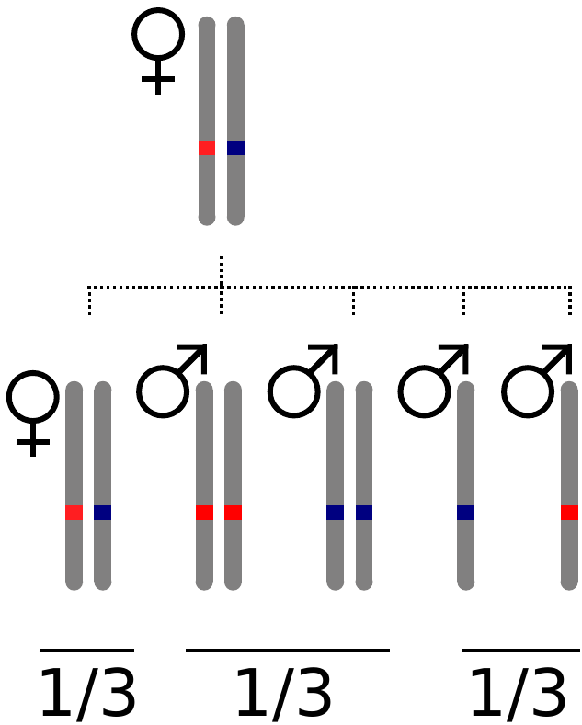
Crossed individuals
Thelytokous females
Stronlgy inbred
  High rate of diploid males production
  Highly homozygous background

Slide 6
Crossed individuals
Total of 201 offspring
From 12 different thelytokous mothers
X 12
[6 – 30]

Slide 7
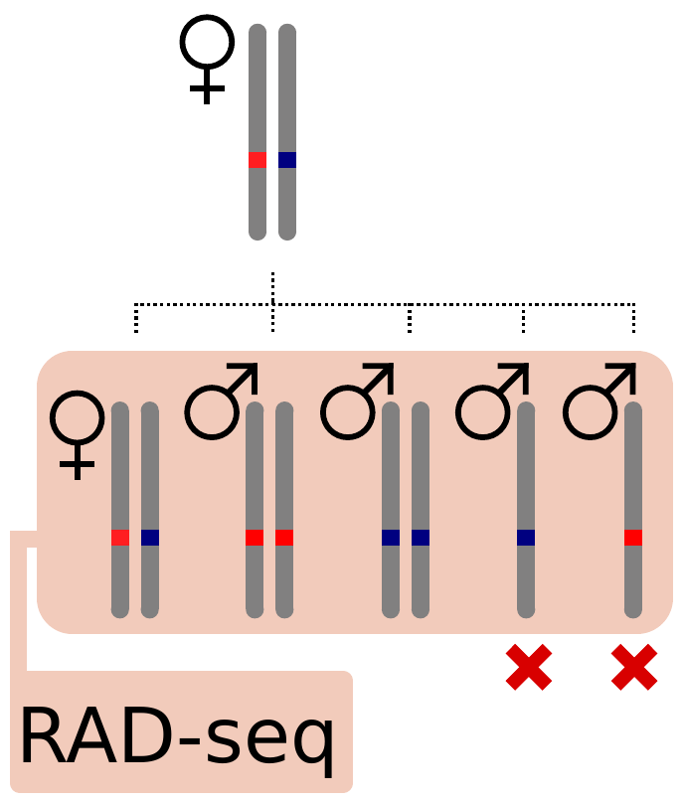
Crossed individuals
Different allelic combinations of CSD
Haploid males: useless
Sequencing data:
  201 offspring
  11 mothers (1 missing)

Slide 8
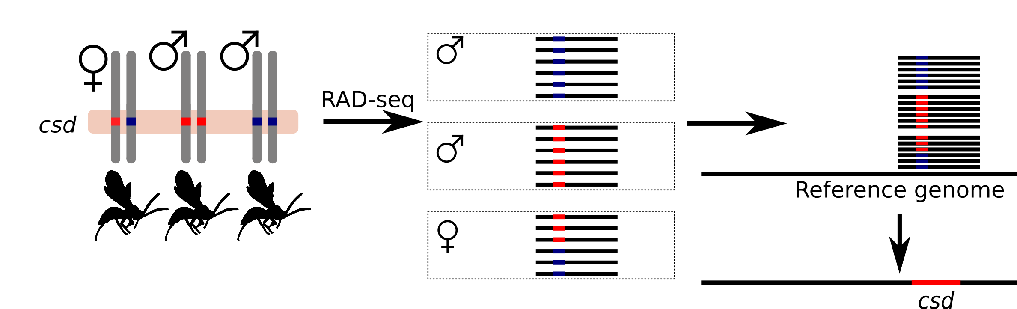
Finding CSD: General idea
Find regions that are homozygous in males and heterozygous in females

Slide 9
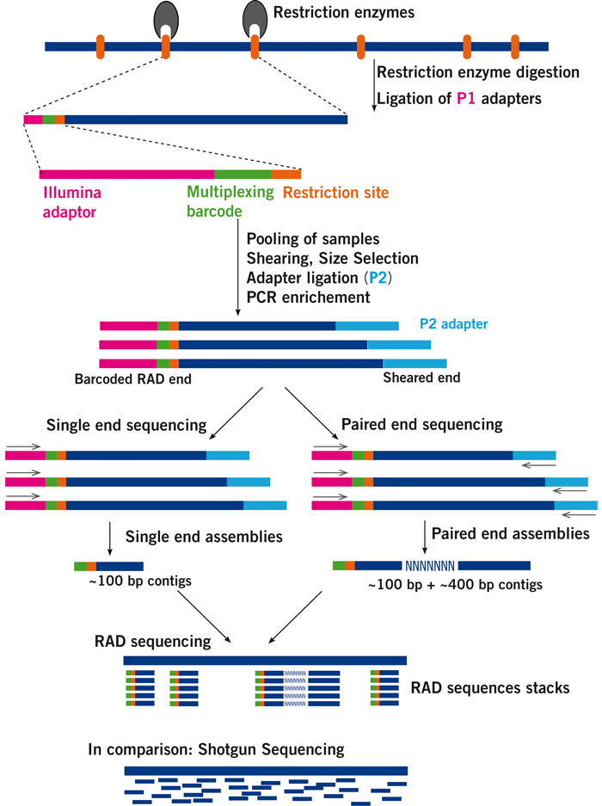
RAD-seq
Digest genome
Sequence flanking regions
Single-end sequencing
http://www.floragenex.com

Slide 10
Bioinformatic analysis of RAD-seq
Processing raw reads into a catalog of loci
Different pipelines available
  STACKS, PyRAD, Rtd, RAD-tools…
Requires setting several parameters through empirical testing

Slide 11
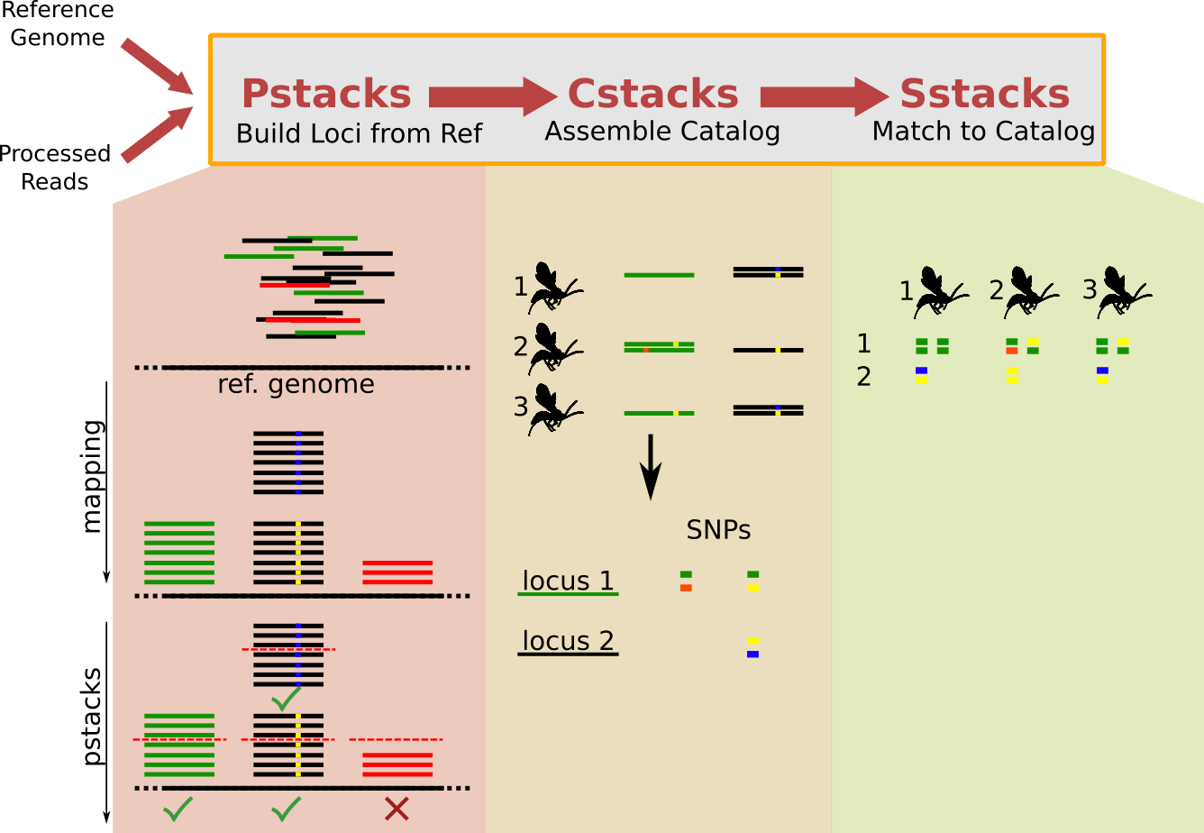
STACKS Pipeline
Builds loci from reference, or de novo
Each module takes arbitrary parameters

Slide 12
STACKS Pipeline

Slide 13
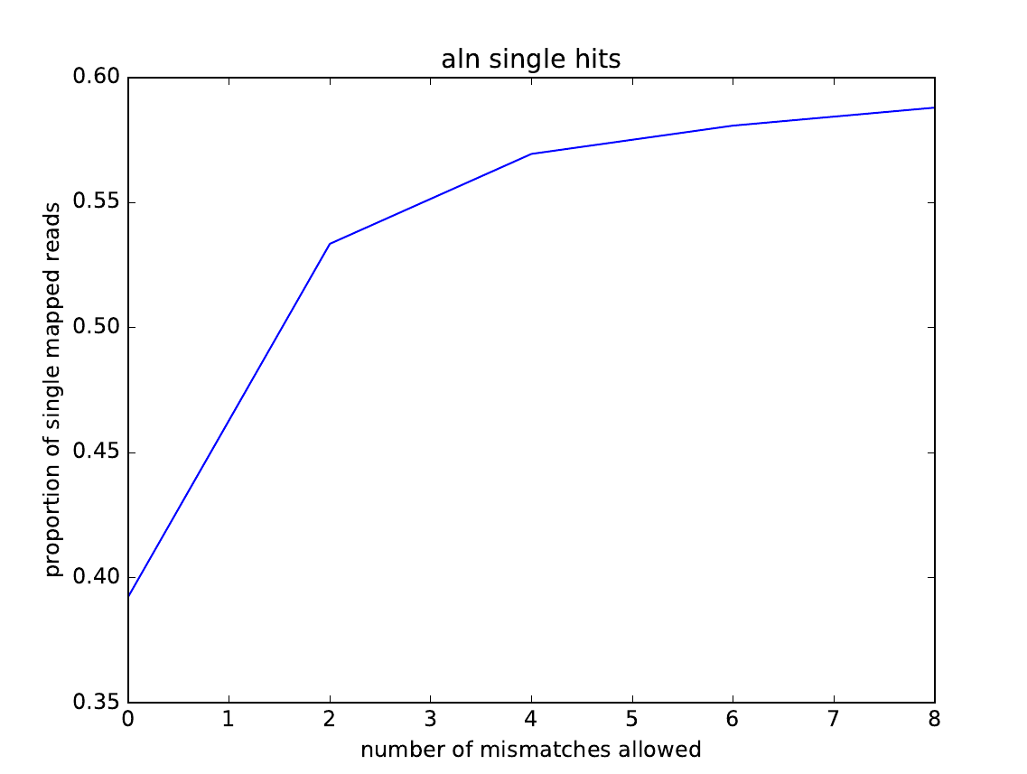
STACKS Pipeline
How many mismatches allowed for 2 reads to map at the same position ?
?
# Mismatches allowed

Slide 14
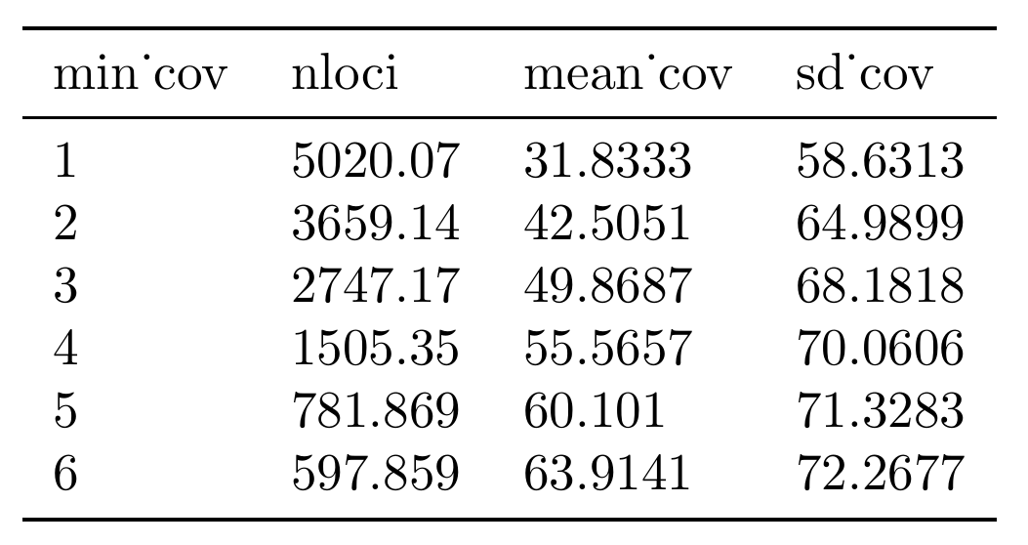
STACKS Pipeline
Minimum stack depth

Slide 15
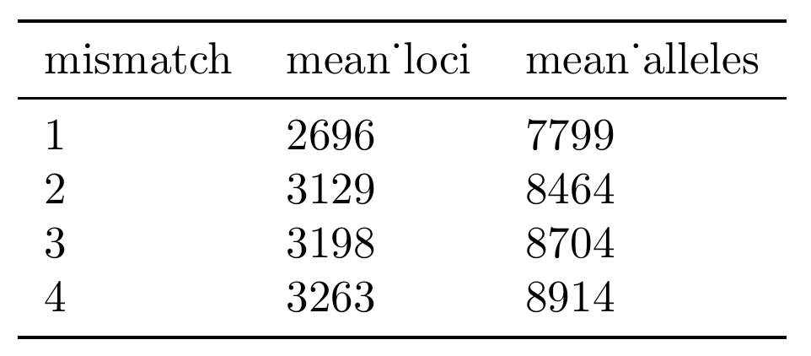
STACKS Pipeline
Building catalog from all
individuals
Position and coverage of every
SNP variant
# Mismatches: homologous loci

Slide 16
STACKS Pipeline
Each individual’s SNPs matched to the catalog

Slide 17
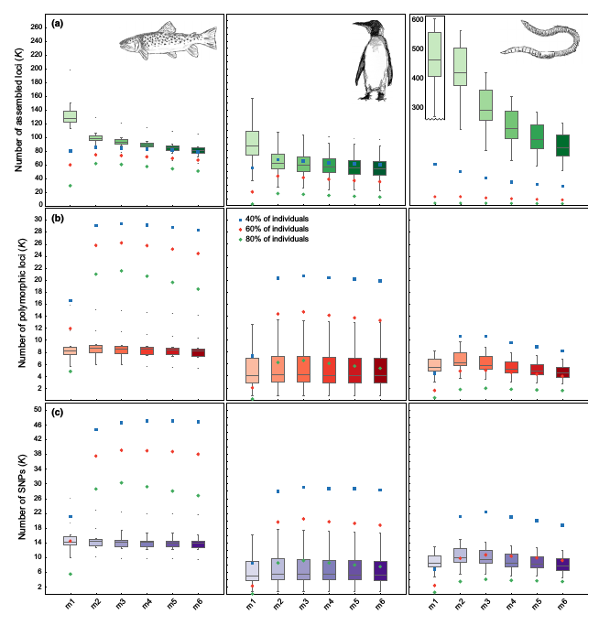
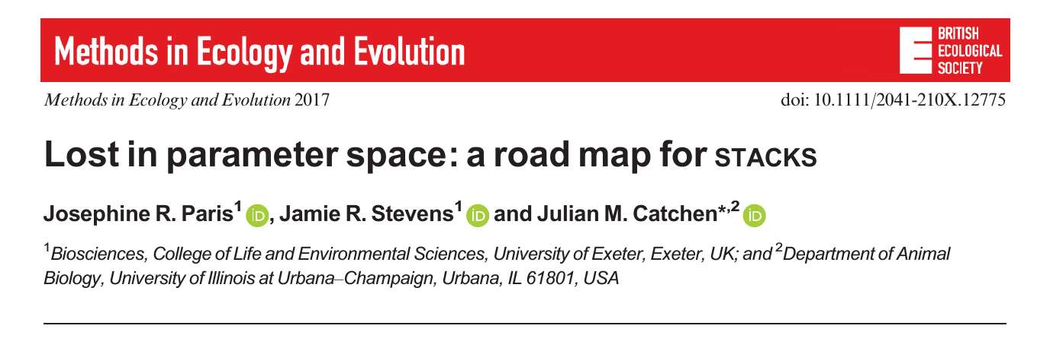
STACKS Pipeline
Each individual’s SNPs matched to the catalog

Slide 18
Excluding haploids
Loci obtained in haploids should all be homozygous.
But this is not the case! Why ?
  Sequencing errors
  Paralogue merging
  Repetitive sequences ?
Ideal case
Density
2N
1N
Homozygosity

Slide 19
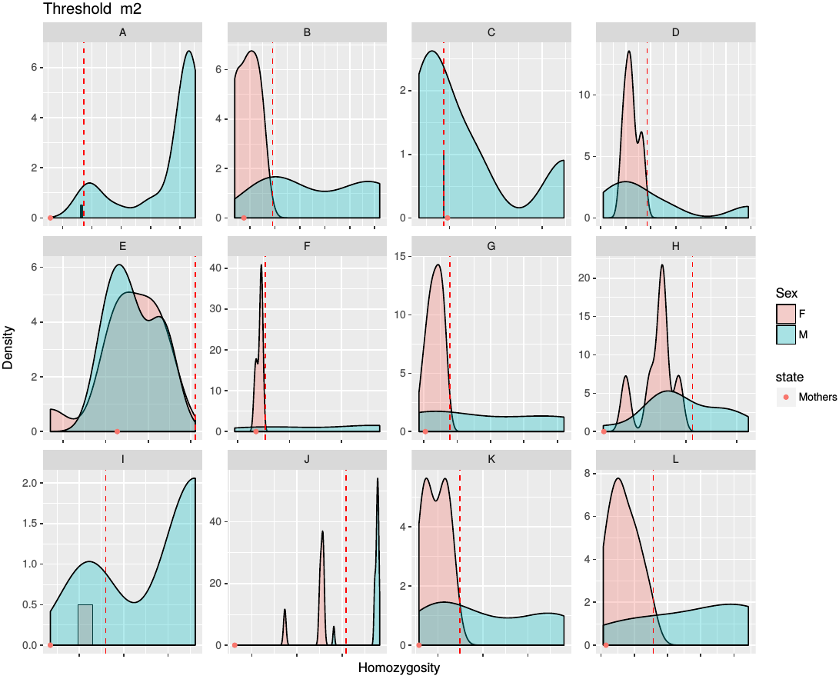
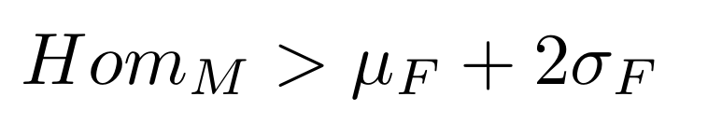
Excluding haploids
How to split haploids and diploids ?
Current solution: Choose a homozygosity threshold:
Mu: mean of daughters hom.
Sigma: stdev of daughters hom.

Slide 20
Improving ploidy separation
Remove alleles with low number of reads relative to other allele
Remove loci with excessive coverage (paralogues)

Slide 21
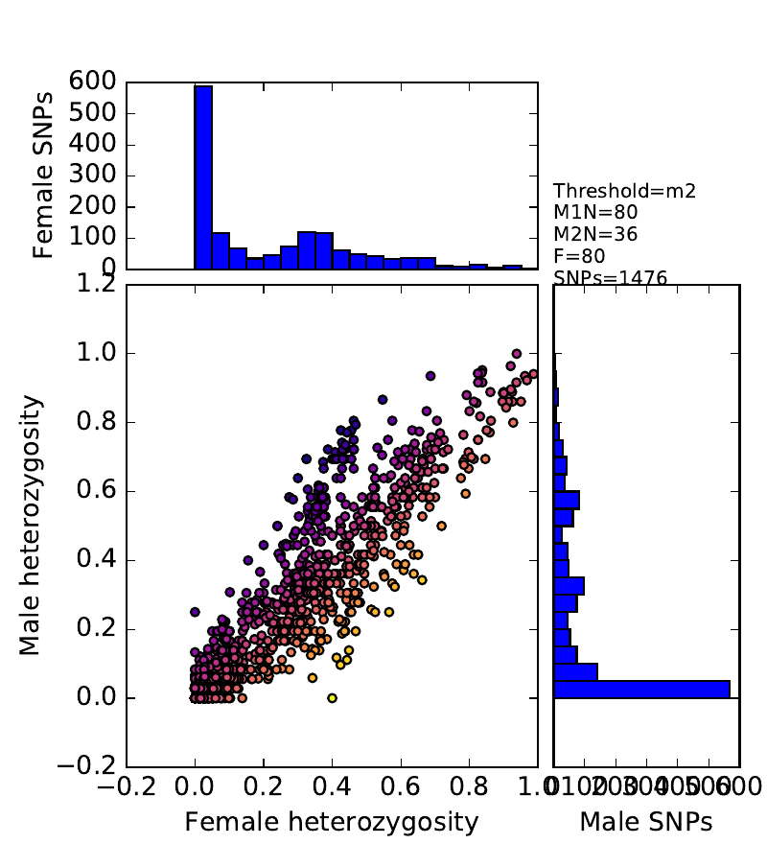
Back to CSD
How many SNPs are “CSD-like” in diploids ?
0 100 200 300 400 500 600

Slide 22
Back to CSD
How many SNPs are “CSD-like” in diploids ?
Pooling all wasps together:
  None
“CSD-like”
0 100 200 300 400 500 600

Slide 23
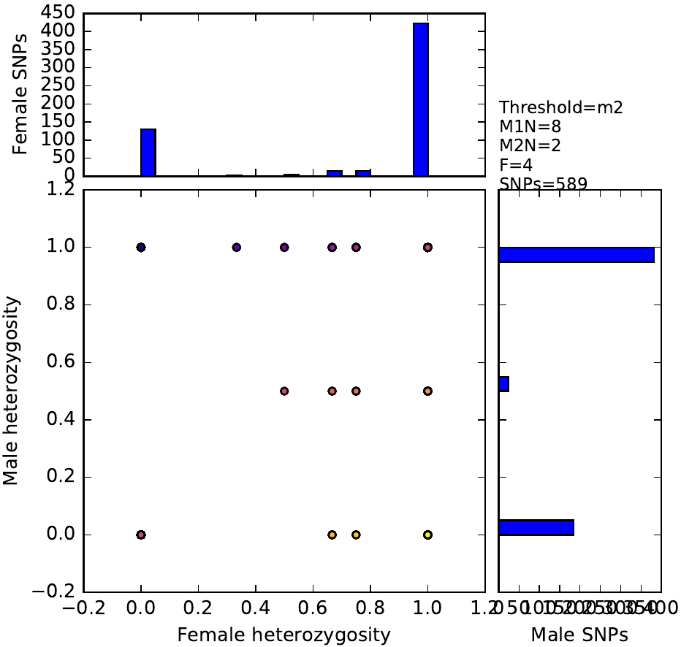
Back to CSD
How many SNPs are “CSD-like” in diploids ?
Per family:
  Too many
Family B
“CSD-like”
0 50 100 150 200 250 300 350 400

Slide 24
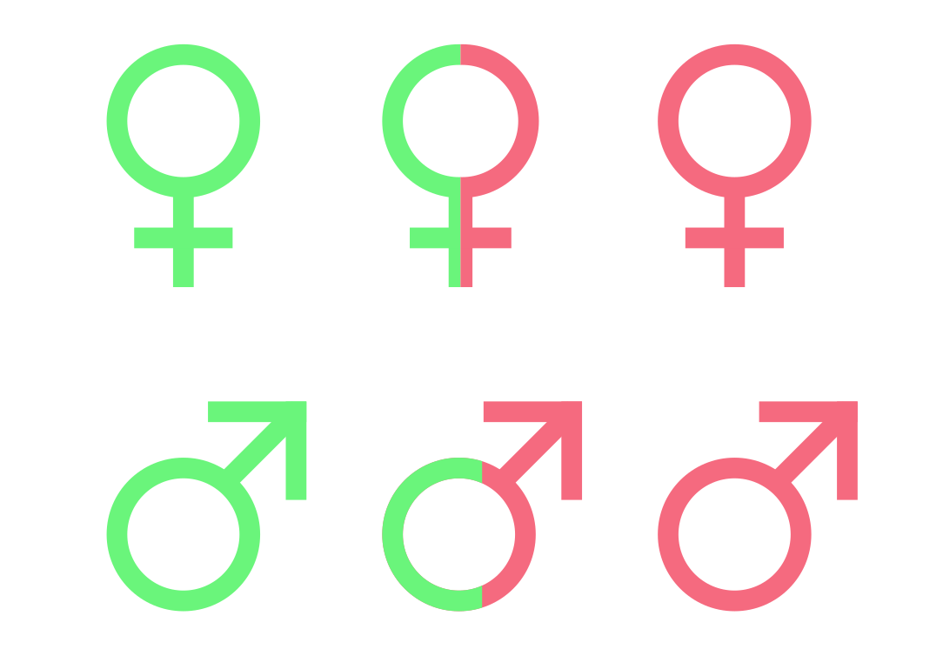
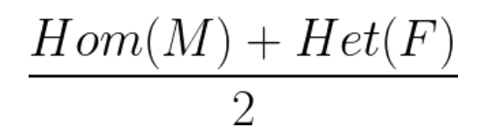
Finding CSD
What regions are inherited like CSD ?
For each SNP: proportion of individuals where SNP fit CSD pattern
CSD=1
CSD=0

Slide 25
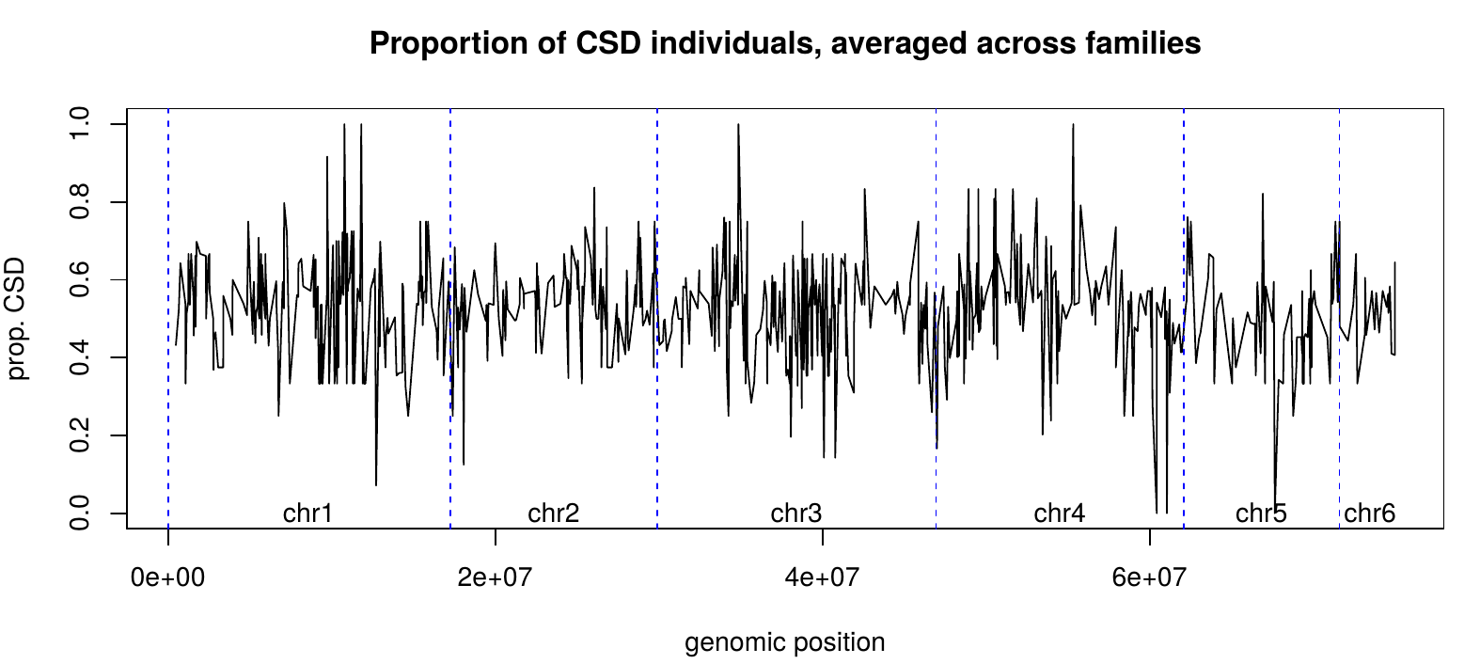
Finding CSD
Computing CSD prop. in each family
Average each position’s value across families

Slide 26
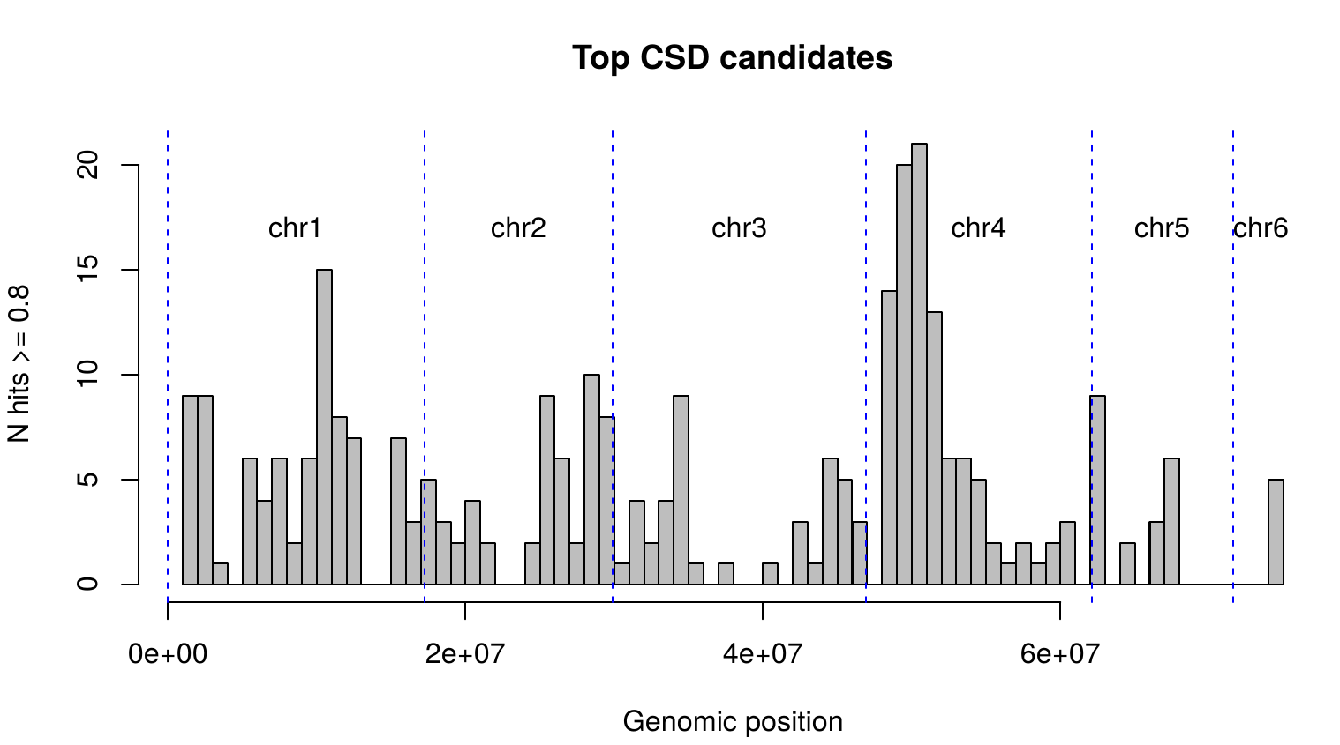

Slide 27
Challenges
Probably no restriction site inside CSD locus
  Imperfect male-female segregation
May be multi-locus CSD
  Different causative loci in different clutches

Slide 28
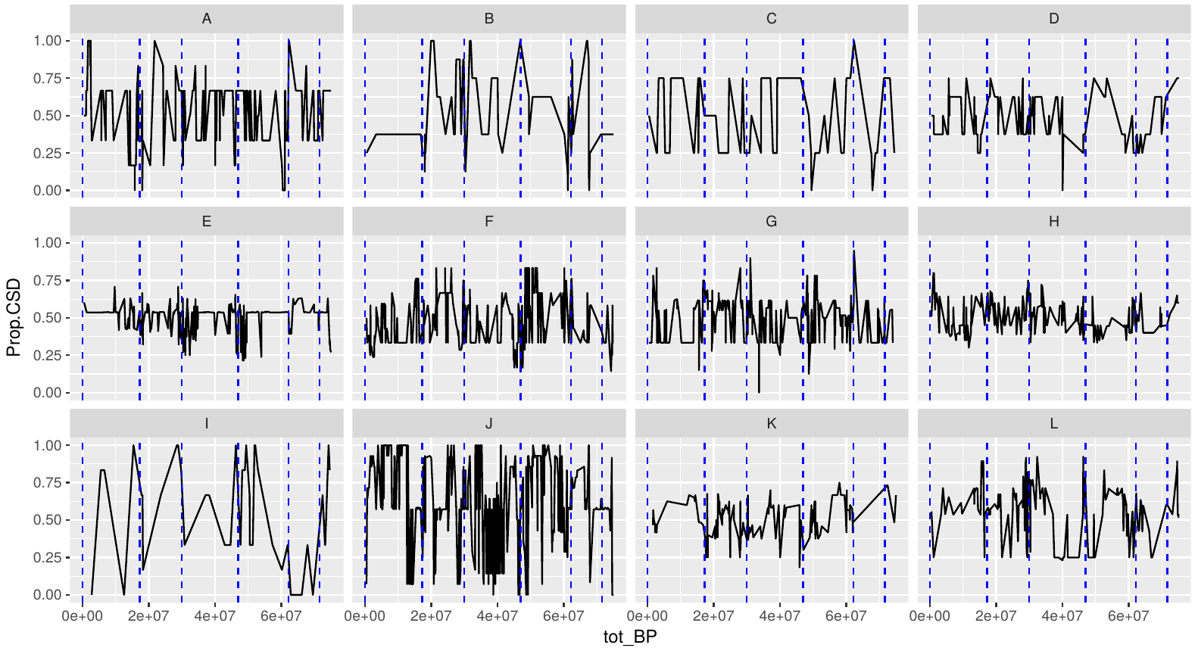
Zooming into families

Slide 29
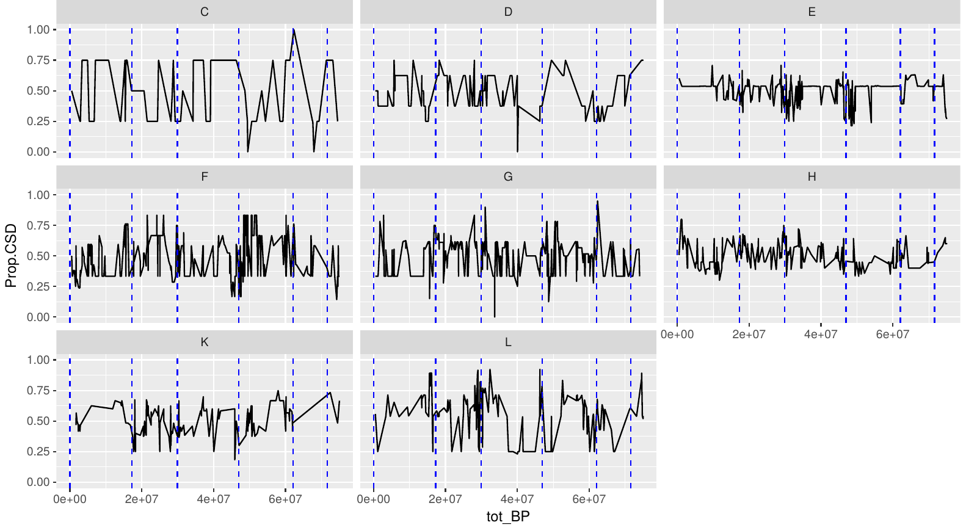
Zooming into families

Slide 30
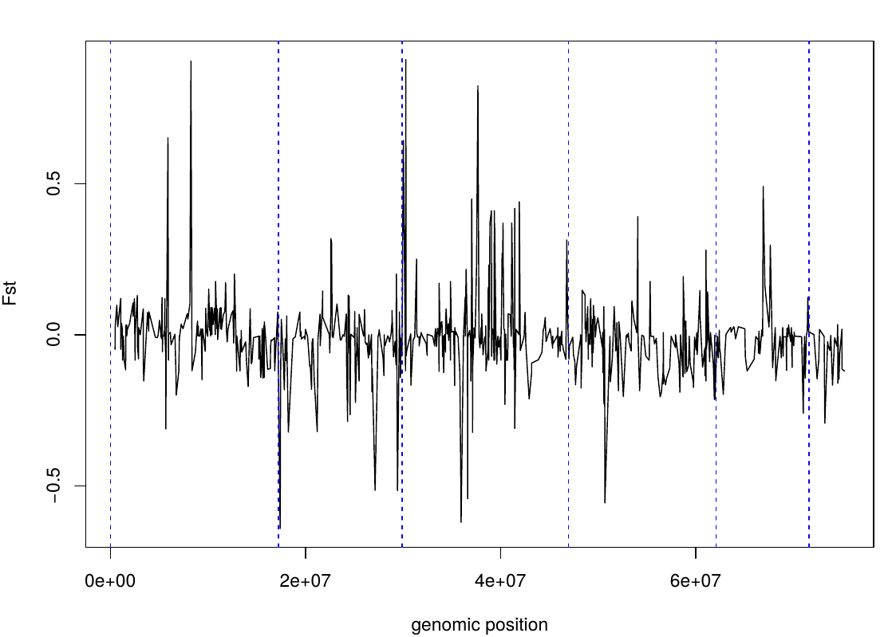
M-F Fst along genome
Pooling all families together

Slide 31
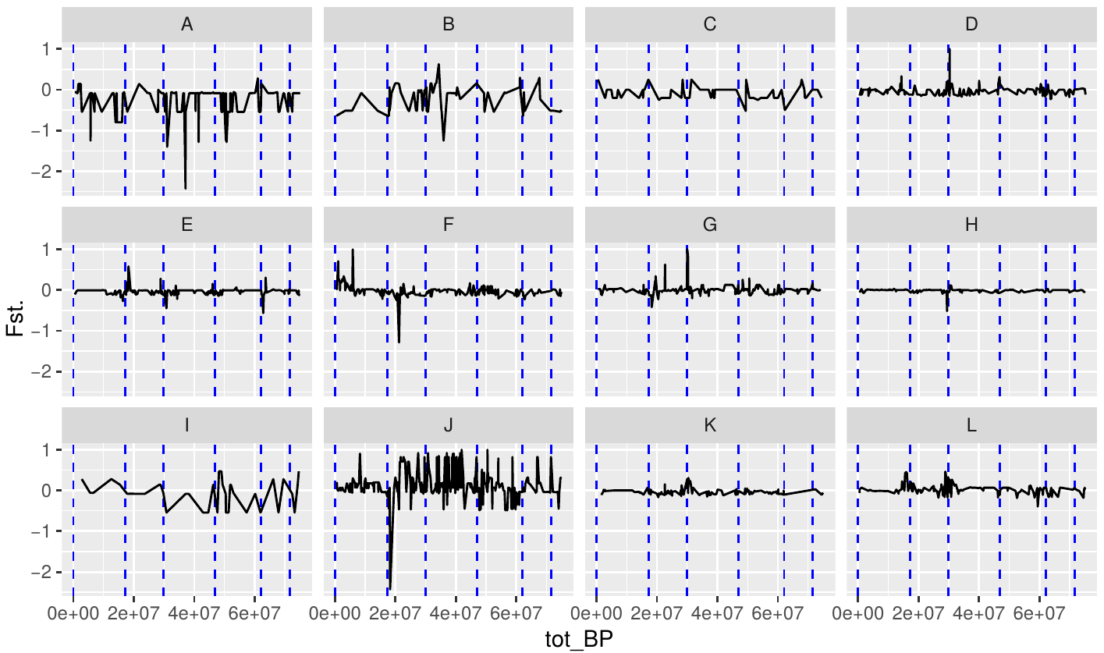
Splitting by family
Using ordered genome

Slide 32
First results
Using ordered genome

Slide 33
Family | Mother | Sons | Daughters
A | 1 | 26 | 4
B | 1 | 10 | 4
C | 1 | 6 | 1
D | 1 | 6 | 4
E | 1 | 3 | 15
F | 1 | 10 | 7
G | 1 | 6 | 9
H | 1 | 15 | 6
I | 1 | 4 | 2
J | 1 | 20 | 7
K | 1 | 14 | 4
L | 1 | 4 | 14
Family | Mother | Sons | Daughters
A | 1 | 1 | 2
B | 1 | 1 | 3
C | 1 | 2 | 1
D | 0 | 4 | 4
E | 1 | 3 | 13
F | 1 | 3 | 6
G | 1 | 3 | 9
H | 1 | 10 | 6
I | 1 | 1 | 2
J | 1 | 1 | 6
K | 1 | 6 | 4
L | 1 | 2 | 13
213 individuals sequenced
117 individuals left for downstream analyses.

Slide 34
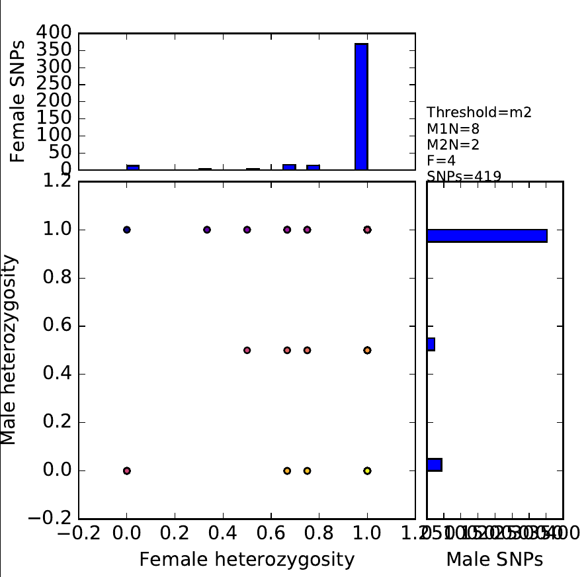
Back to CSD
Exclusion of SNPs that are homozygous in mother
Family B
“CSD-like”
0 50 100 150 200 250 300 350 400

