Slide 1

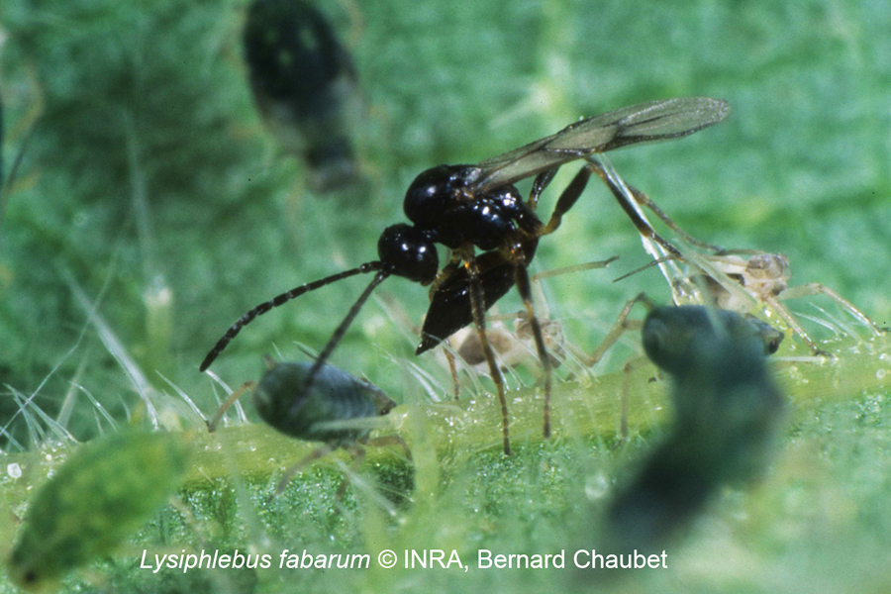
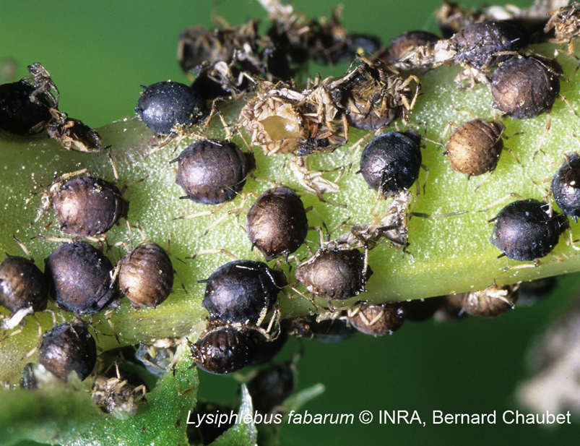
Genetics of sex determination in the parasitoid wasp Lysiphlebus fabarum
Cyril Matthey-Doret
Supervised by: Casper Van Der Kooi
Directed by: Tanja Schwander
Notes:
11/27/17
1
1

Slide 2
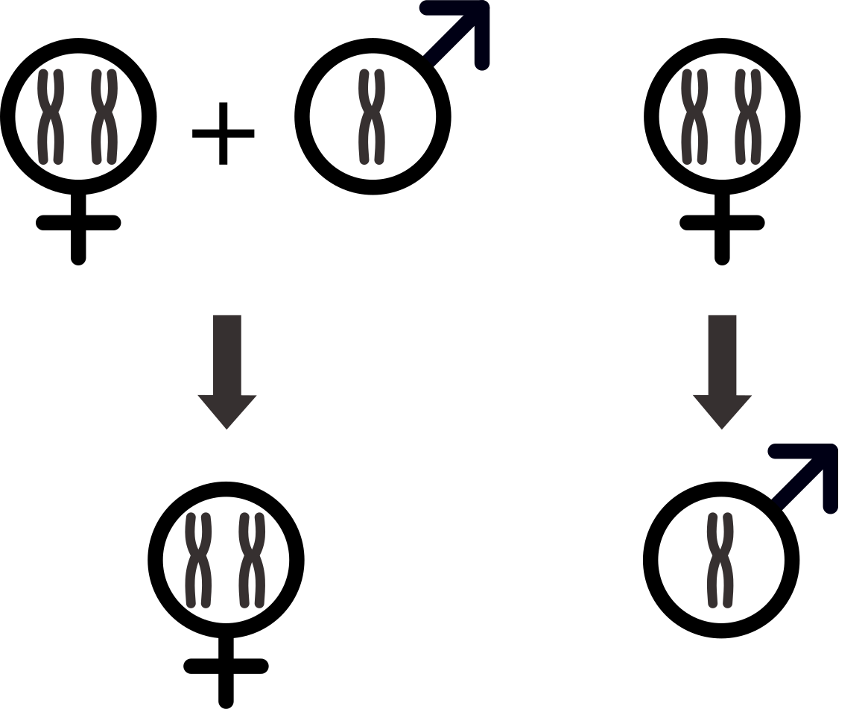
Sex determination in Hymenoptera
Introduction Questions Ploidy Centromeres Mapping Discussion
Hymenoptera comprise 150,000 described species
  They include ants, wasps, bees and sawflies
Hymenoptera are all haplodiploids
Notes:
11/27/17
2
2

Slide 3
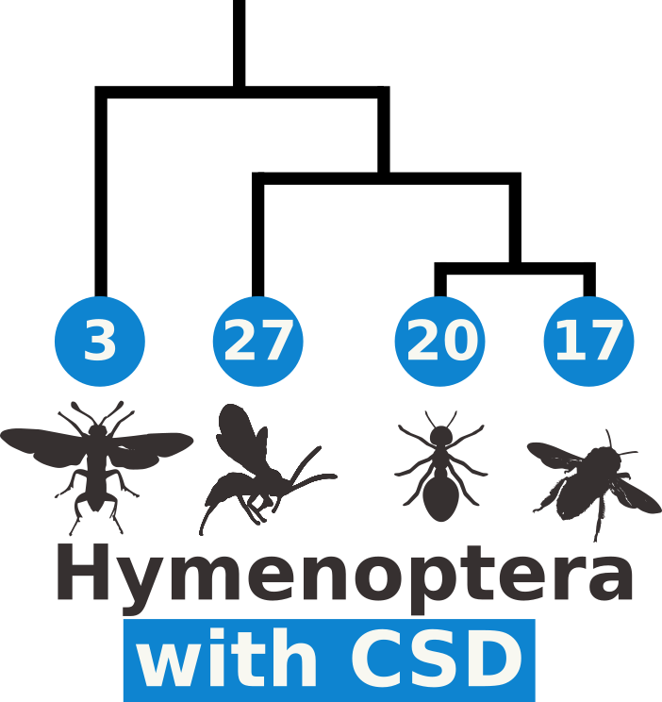
Complementary sex determination
Introduction Questions Ploidy Centromeres Mapping Discussion
Sex determined by one or a few loci only
Suspected in more than 60 Hymenoptera species¹
Molecular mechanism only known in the honeybee
¹ Van Wilgenburg, Driessen and Beukeboom. Frontiers in Zoology, 2006
Notes:
11/27/17
3
3

Slide 4
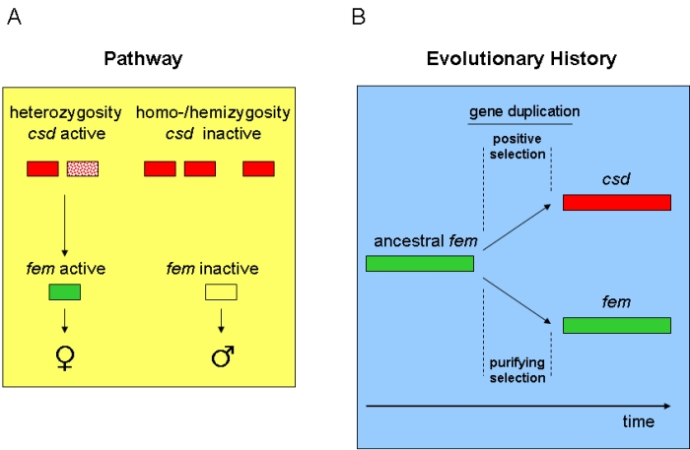
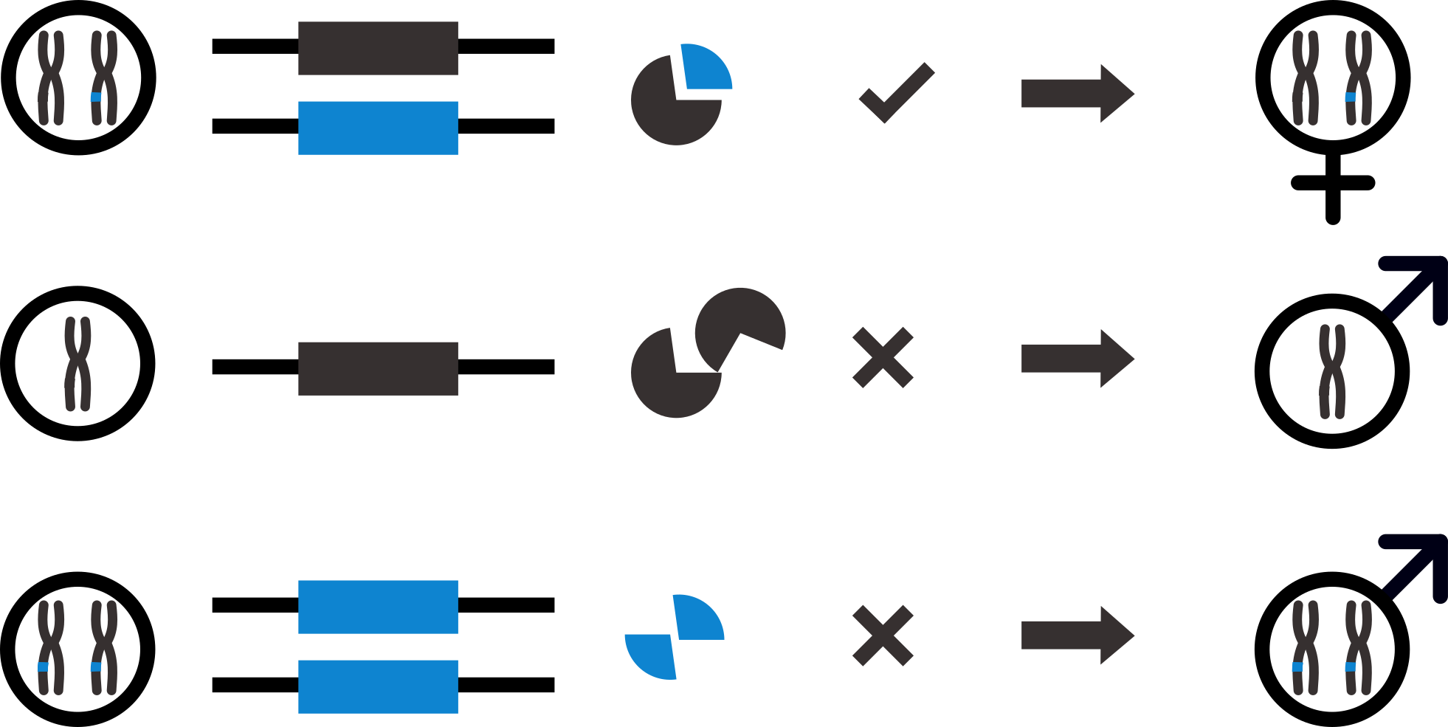
Complementary sex determination
Introduction Questions Ploidy Centromeres Mapping Discussion
2 different alleles required to trigger female development
Egg
CSD
Notes:
11/27/17
4
4

Slide 5
Complementary sex determination
Introduction Questions Ploidy Centromeres Mapping Discussion
2 different alleles required to trigger female development
  Diploid eggs homozygous at all CSD loci become abnormal diploid males
Egg
CSD
Notes:
11/27/17
5
5

Slide 6
Lysiphlebus fabarum
Introduction Questions Ploidy Centromeres Mapping Discussion
Asexual female
Complementary sex determination (CSD)
Sexual and asexual populations
Central fusion automixis
  Recombination in asexuals
Central fusion automixis
Notes:
11/27/17
6
6

Slide 7
Questions
Introduction Questions Ploidy Centromeres Mapping Discussion
How many CSD loci are and where are they in the chromosomes ?
  Loci in regions with low recombination rates should minimize diploid male production.
Is the CSD mechanism in L. fabarum similar to the honeybee or did different mechanisms evolve independently ?
Notes:
11/27/17
7
7

Slide 8
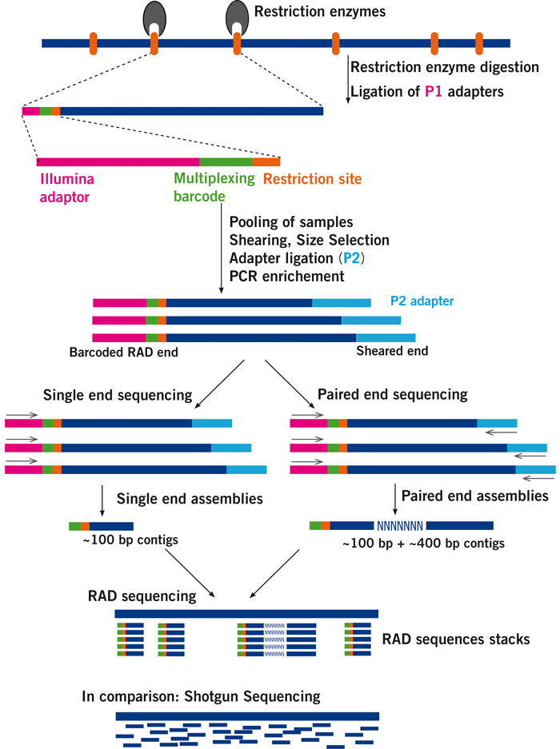
Samples
Introduction Questions Ploidy Centromeres Mapping Discussion
RADseq data: 588 Wasps from 31 mothers
  382 males
  148 females
Reference genome available
http://www.floragenex.com
Notes:
11/27/17
8
8

Slide 9
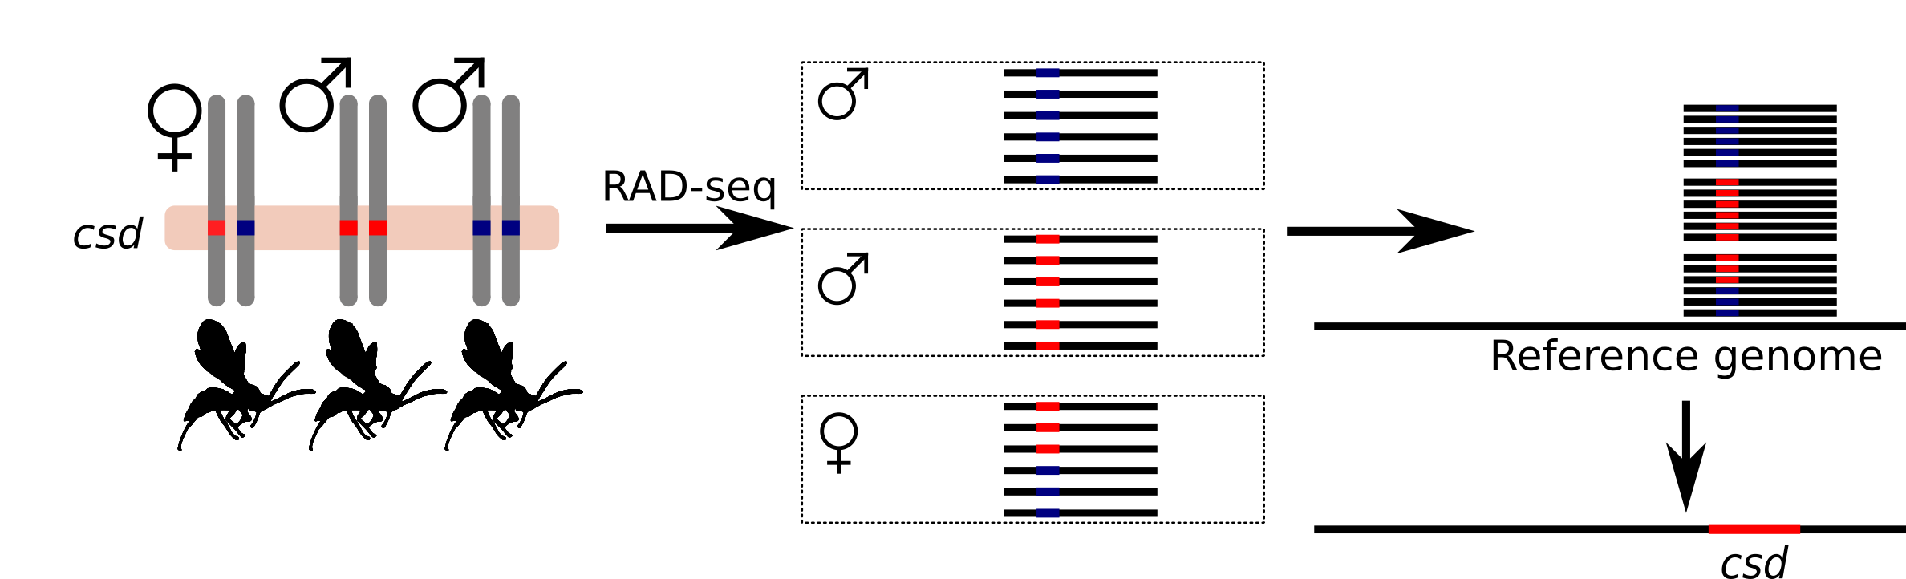
Finding CSD: General concept
Introduction Questions Ploidy Centromeres Mapping Discussion
Find regions that are homozygous in males and heterozygous in females
  Haploid males are not informative
  Ploidy is unknown
Notes:
11/27/17
9
9

Slide 10
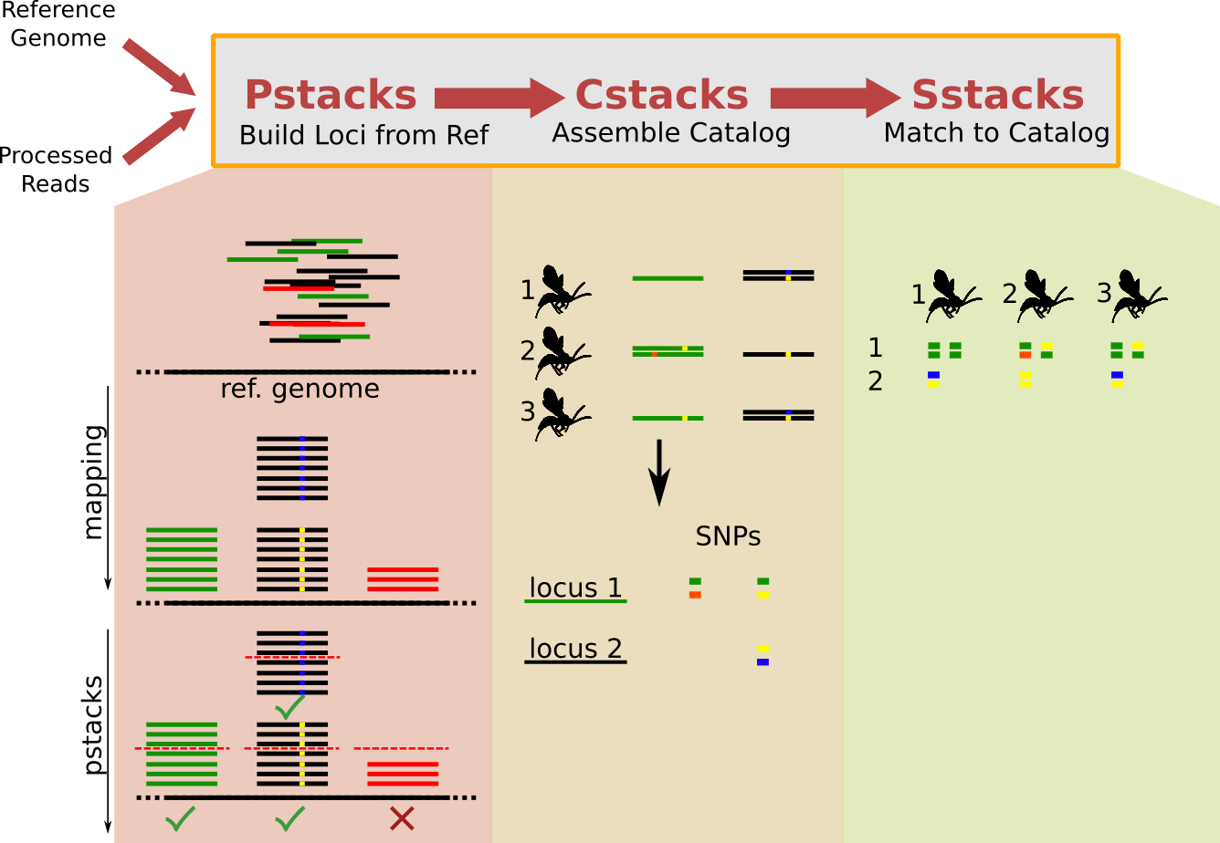
Bioinformatic analysis of RAD-seq
Introduction Questions Ploidy Centromeres Mapping Discussion
Notes:
11/27/17
10
10

Slide 11
Excluding haploids
Introduction Questions Ploidy Centromeres Mapping Discussion
Loci obtained in haploids should all be homozygous
This is not the case because of:
  Sequencing errors
  Paralogue merging
Expected distribution of
Genome-wide homozygosity
Density
2N
1N
Homozygosity
Notes:
11/27/17
11
11

Slide 12
Excluding haploids
Introduction Questions Ploidy Centromeres Mapping Discussion
Ploidy assigned based on the proportion of homozygous variant sites.
Using a conservative threshold (90%):
  314 diploids and 216 haploids
Notes:
11/27/17
12
12

Slide 13
Locating centromeres
Contigs anchored to chromosomes using a linkage map
  53% of Assembly length
Central fusion automixis:
  Regions distal to a recombination event are homozygous
  Offspring heterozygosity =< mother
Notes:
11/27/17
13
13

Slide 14
Locating centromeres
Centromeres: regions with the highest heterozygosity on the chromosome
Notes:
11/27/17
14
14

