Slide 1
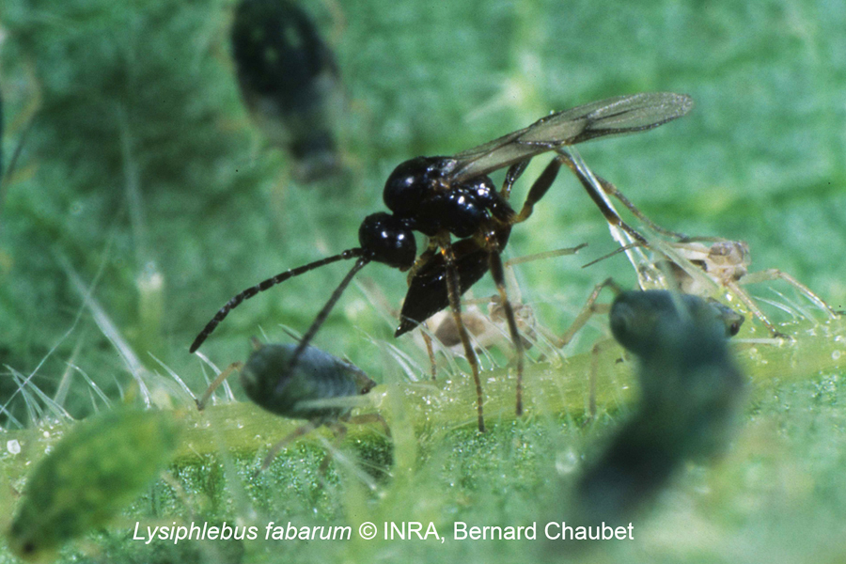
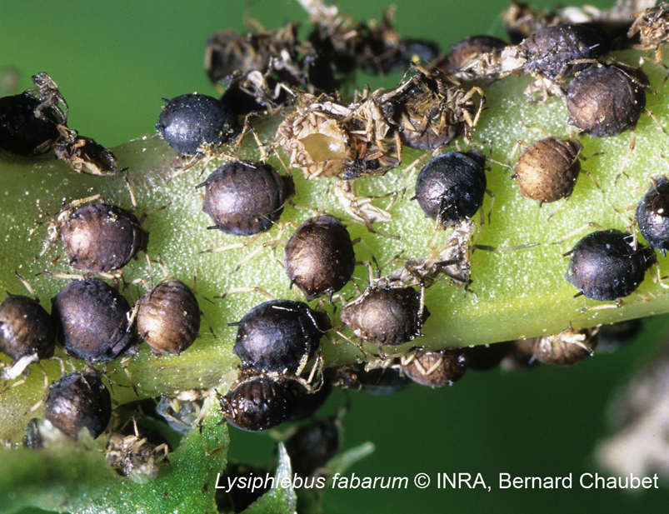
Identification of the complementary sex determination (CSD) locus in Lysiphlebus fabarum
Cyril Matthey-Doret
Supervised by: Casper Van Der Kooi
Directed by: Tanja Schwander

Slide 2
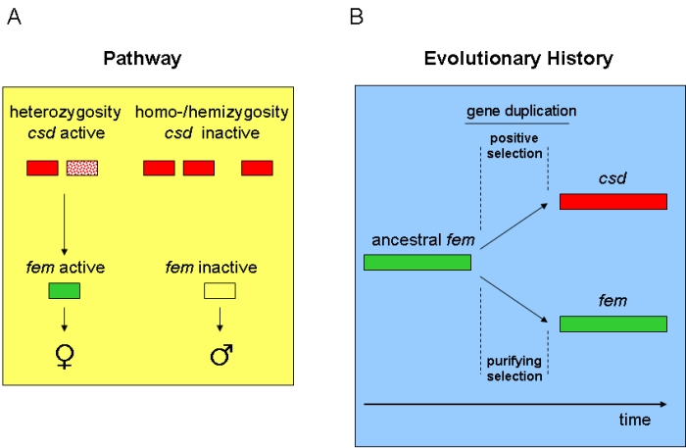
CSD mechanism
2 different alleles required to trigger female development
Males are normally haploid: single copy
Diploid individuals with homozygous CSD develop into males
Can be single or multi-locus CSD

Slide 3
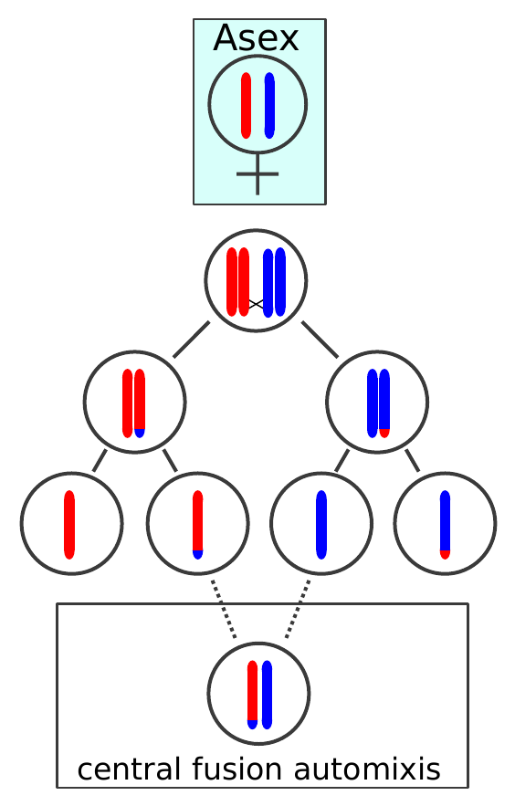
L.fabarum : Introduction
Sex and asex populations
Central fusion automixis: recombination
Thelytoky: recessively inherited from a single locus
Multi-locus or single-locus csd ?

Slide 4
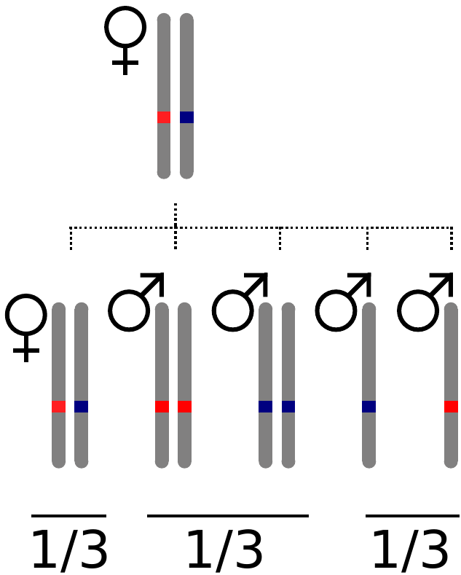
Crossed individuals
Thelytokous females
Stronlgy inbred
High rate of diploid males production
Highly homozygous background

Slide 5
Crossed individuals
Total of 172 individuals
From 11 different thelytokous mothers
X 11
X 172

Slide 6
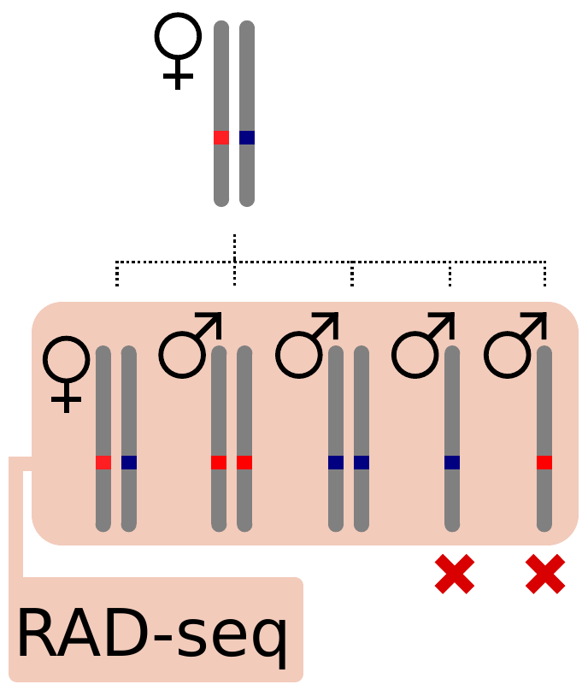
Crossed individuals
Different allelic combinations of CSD
Haploid males: useless

Slide 7
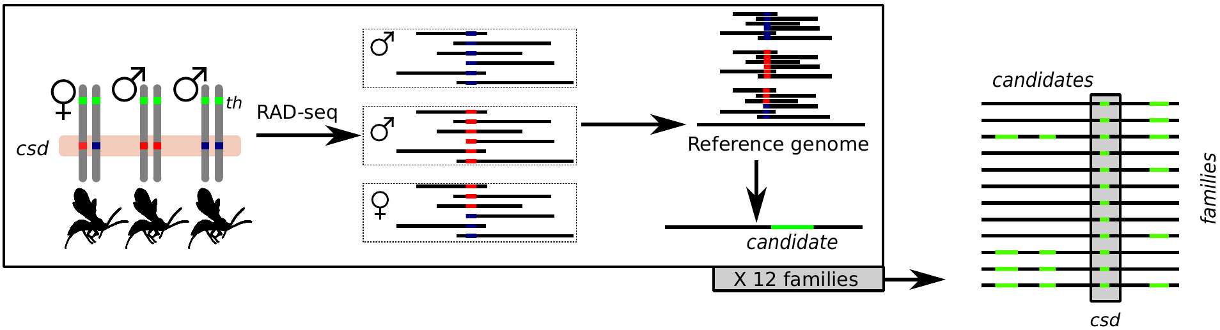
Design
172 wasps RAD-seq'uenced
Exclude haploid males: homozygosity levels
Build catalogue of loci (reference genome available !)
Identify candidate loci in each family using SNPs
Filter common candidate across all families

Slide 8
Alternative approach (plan B)
First approach could fail because:
not any loci close enough to CSD
L.fabarum may be ml-CSD
Use association between blocks of SNPs and diploid male phenotype instead

Slide 9
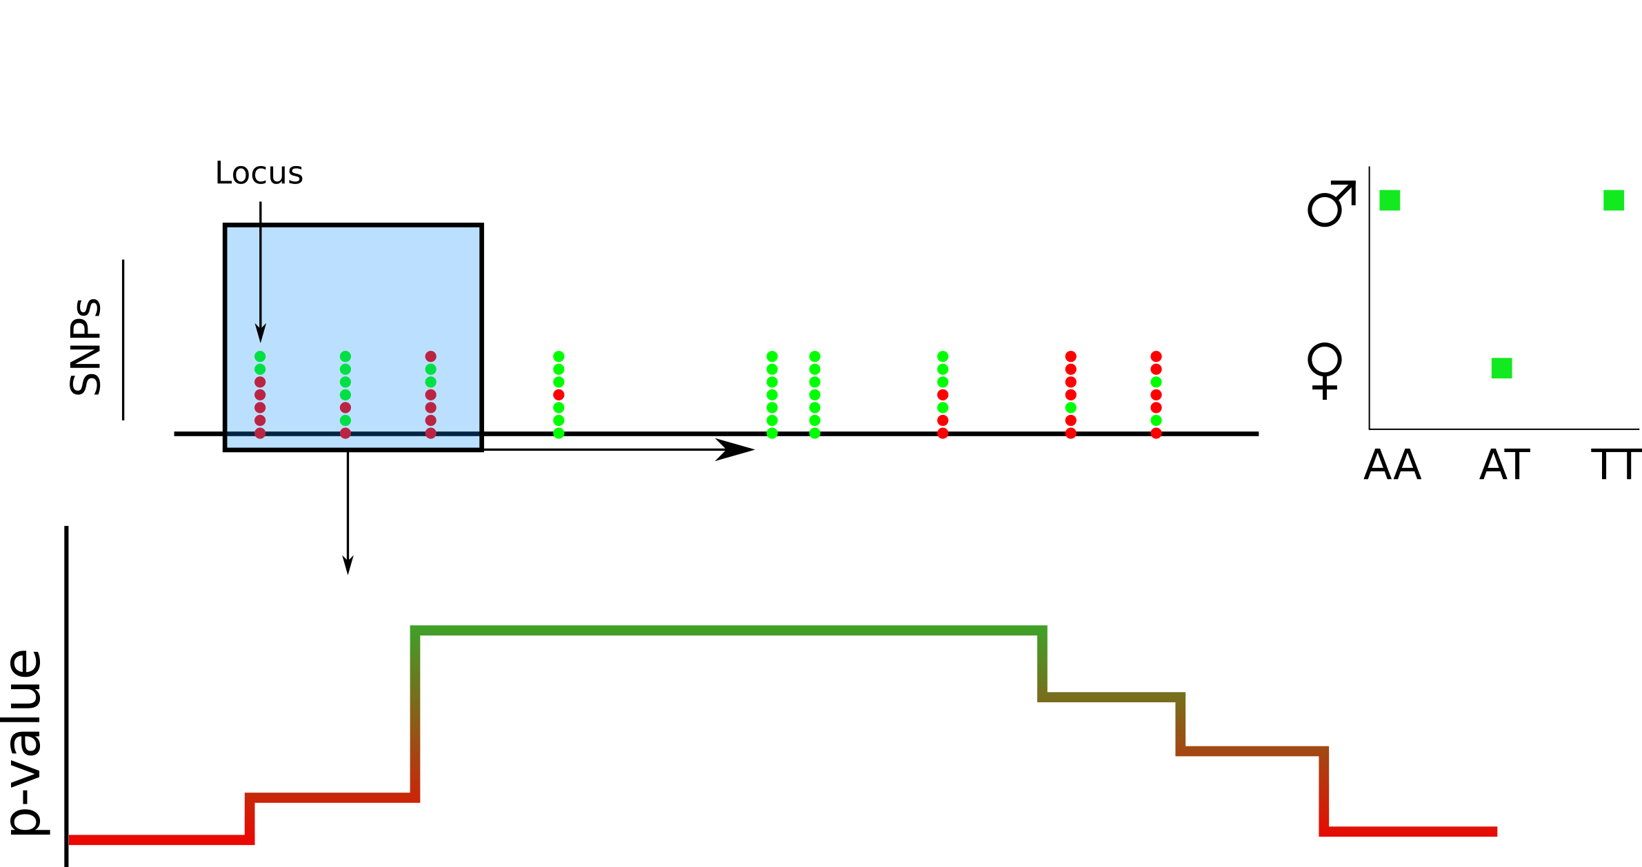
Alternative approach (plan B)
Classify SNPs in each individual as in approach 1
Identify regions frequently associated with diploid male phenotype
genome

Slide 10
Alternative approach (plan B)
Classify SNPs in each individual as in approach 1
Identify regions frequently associated with diploid male phenotype

Slide 11
After finding CSD locus ?
Reference genome currently being annotated
If annotated: look for candidate genes in CSD locus
Else: gene prediction in CSD locus
Look for homologous sequences in related species with CSD

Slide 12
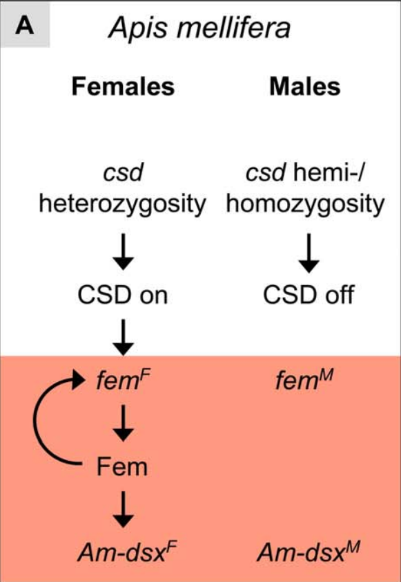
CSD in the honeybee
In honeybee: recent duplication of ancestral feminizer (fem) into csd and fem
Neofunctionalization of csd
Happened after split between stingless bees, bumble bee and honeybee
Gempe, T. et al. (2009). PLoS Biology 7(10):e1000222
Gempe, T. & Beye, M. (2009) Nature Education 2(2):1

Slide 13
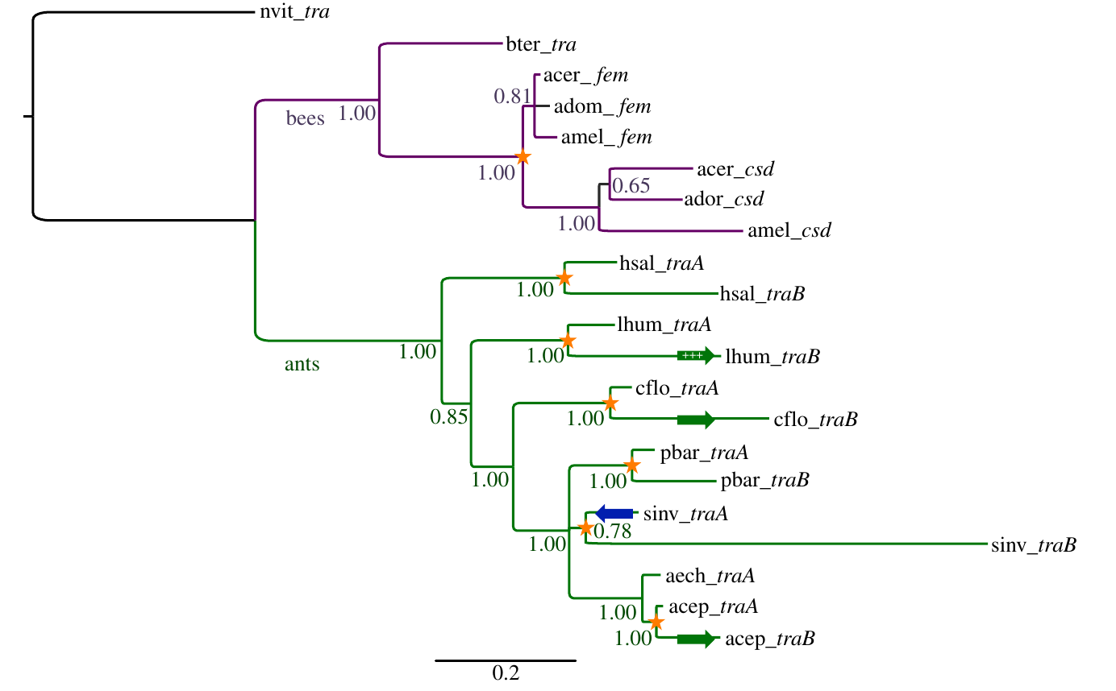
fem/tra across Hymenoptera
Independent duplication(s) of transformer (tra) (fem ortholog) in ants
What happened in L. Fabarum ?
Proof of CSD system
Putative gene duplication event
Privman E, Wurm Y, Keller L. 2013. Proc R Soc B 280: 20122968

Slide 14
Thank you !

Slide 15
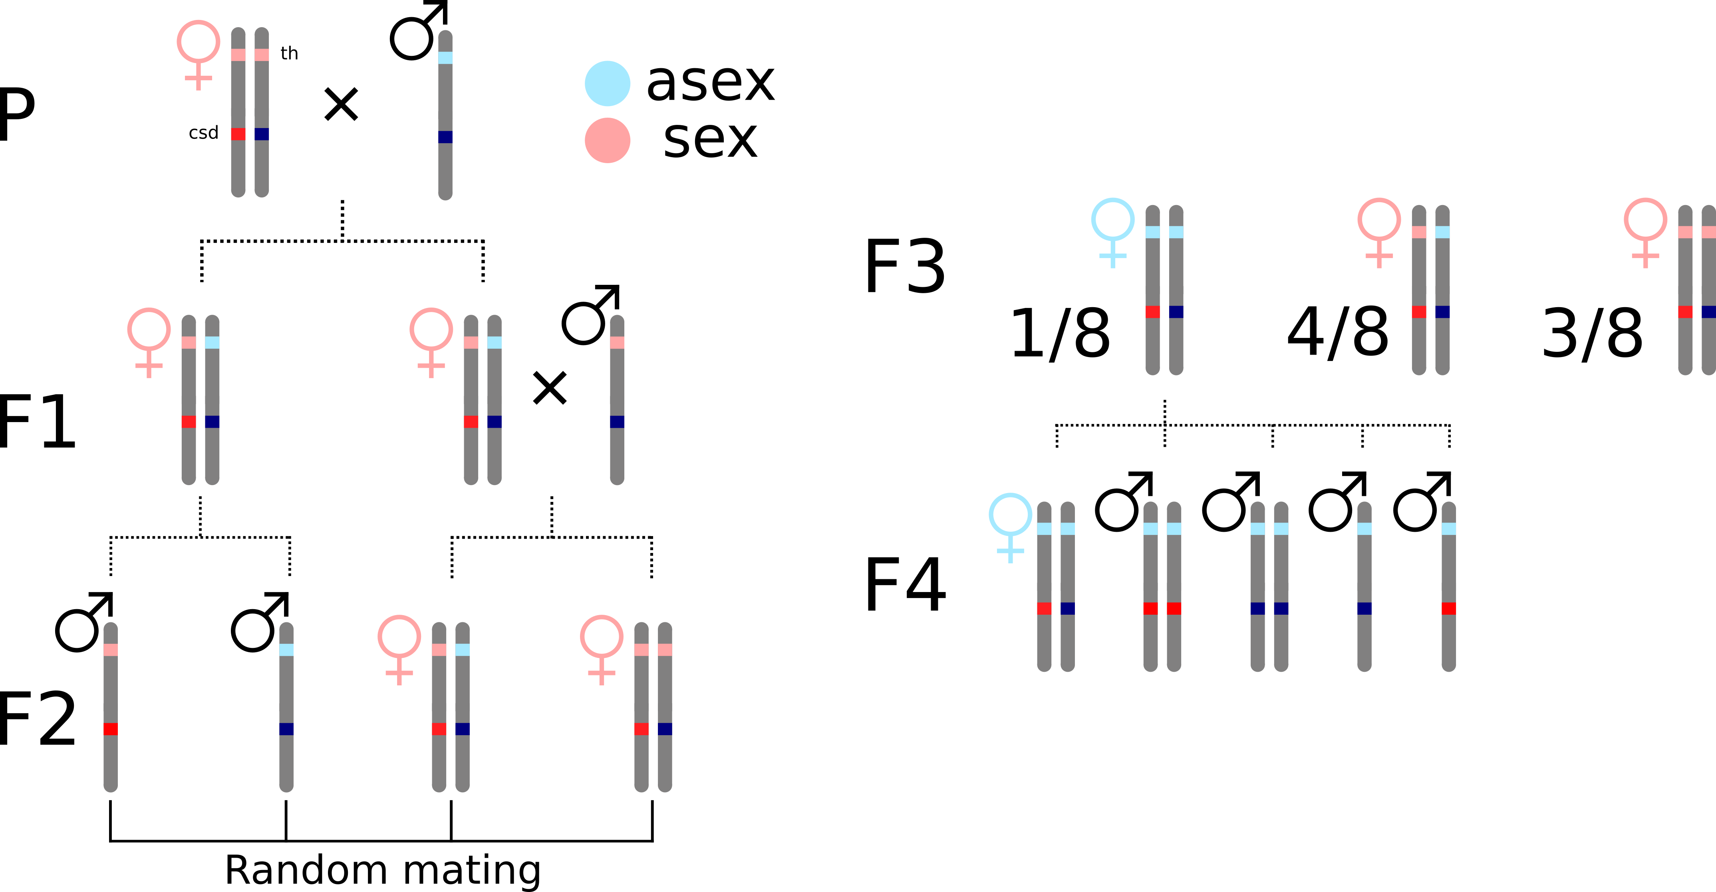
Casper's crossings

Slide 16
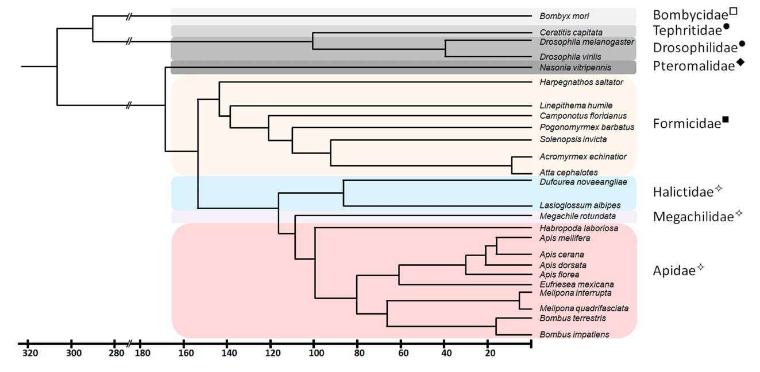
CSD

Slide 17
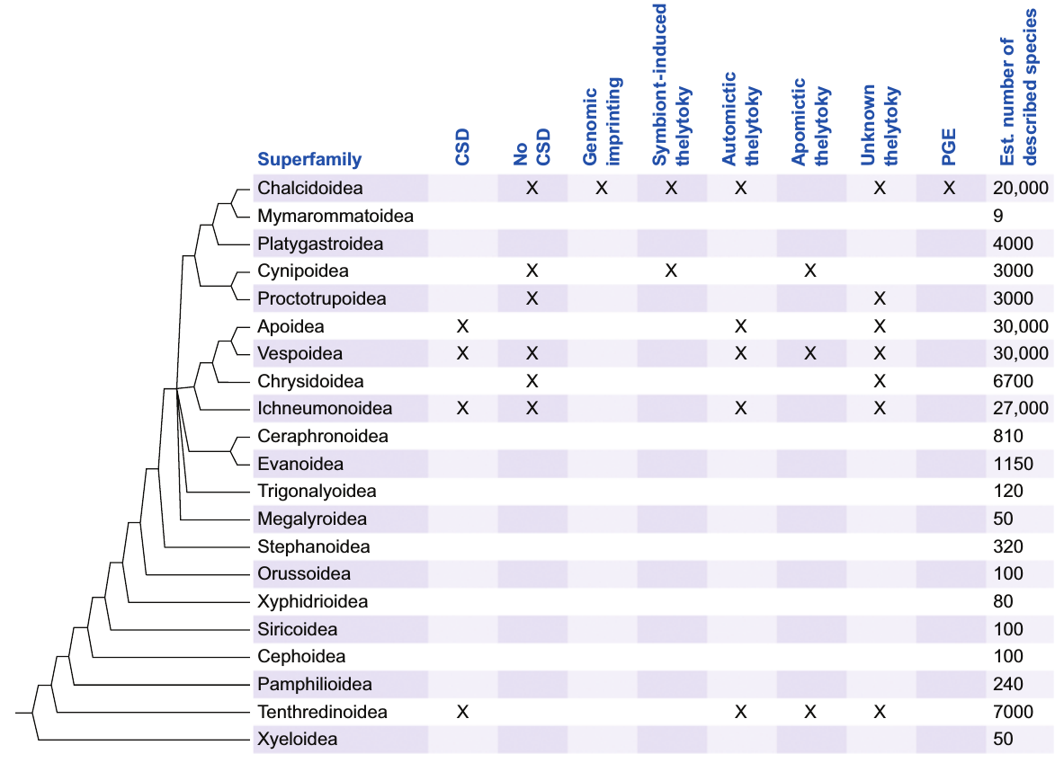

Slide 18
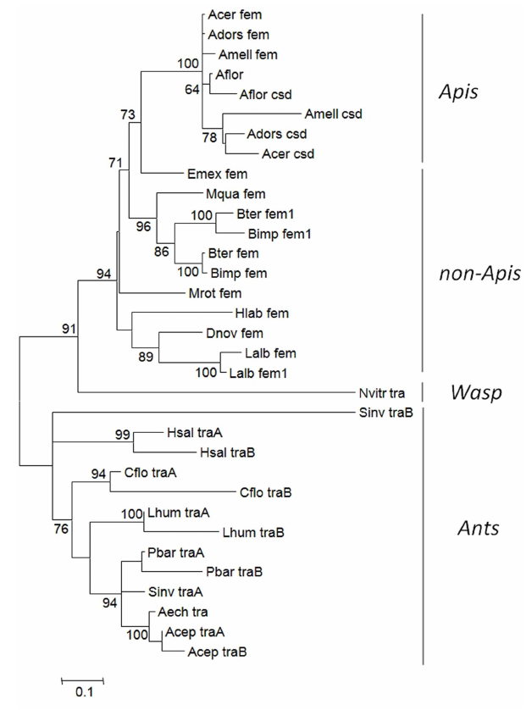
fem gene copies in social insect species

