Slide 1
去中心化交易所 & OKDex
区块链工程院
2019.11.10

Slide 2
提纲
中心化交易所
为什么要有去中心化交易所
几种主流去中心化交易所
OKChain & OKDex

Slide 3
数据库特征
确定性状态机
不断接受外部输入(transactions: insert, update & delete)
发生状态变化，依此循环
Apply(transaction1 – transaction10)
State 0
State 1
Apply(transaction2 – transaction20)
State 2
State 3
Apply(transaction3 – transaction30)
Notes:
the state machine is deterministic. This means that if you start at a given state and replay the same sequence of transactions, you will always end up with the same final state

Slide 4
区块链
World wide 数据库
由全球各地的组织&个人维护的节点组成
有完全一样状态，运行一样的代码
之间通过P2p网络连接 (gossip, kad)
P2p网络保证transactions全网同步
通过共识，执行完全一样transactions(block)
过渡到下一个完全一样的状态
提高了储存的成本
降低了记录的效率
保障数据的一致性
Block n
State n
…
…
Block 1
State 1
Block 0
State 0

Slide 5
共识
World wide 数据库
节点
之间通过P2p网络连接 (gossip, kad)
有完全一样状态
执行完全一样transactions(block)
过渡到下一个完全一样的状态
提高了储存的成本，
降低了记录的效率，
但是达到了一致性，从而保障网络信任的目的
Block n
State n
…
…
Block 1
State 1
Block 0
State 0

Slide 6
OKChain Overview
Delegator
Delegator
Delegator
Delegator
Validator candidate
Delegator
Validator candidate
Delegator
Validator Node
Delegator
Delegator
Delegator
Validator Node
Validator Node
Delegator
Delegator
Delegator
Validator candidate
Delegator
Validator Node
Validator Node
Delegator
Delegator
Delegator
Delegator
Delegator
Delegator

Slide 7
OKDex Overview
Web socket
channel
Web
Web
Mobile APP
Mobile APP
API
API
http channel
P2P channel
Nginx
3rd socket API
Full
Node A
Full
Node A
Full
Node A
Full
Node B
Full
Node B
…
区块链浏览器
Dex web server
推送服务
Validator
Mysql A
Mysql B
BI web server
Validator
Validator
Full node
redis
Mysql C
Mysql D
Validator
Validator
pulsar
行情K线
BI 系统

Slide 8
Privacy issue – CryptoNote
中心化交易所
为什么要有去中心化交易所
主流的去中心化交易所工作原理
OKChain & OKDex
中心化交易所为什么要有去中心化交易所主流的去中心化交易所工作原理OKChain & OKDex

Slide 9
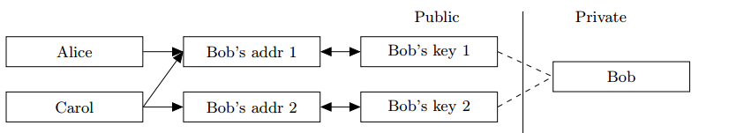
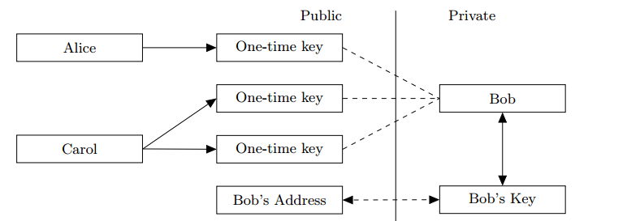
CryptoNote - Unlinkability

Slide 10
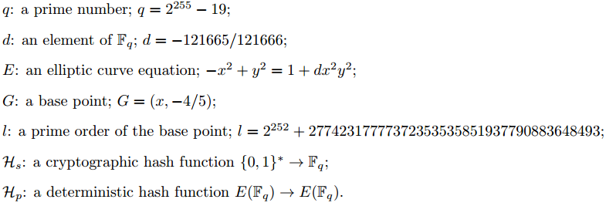
CryptoNote - Unlinkability

Slide 11
CryptoNote - Unlinkability
private ec-key : a standard elliptic curve private key: a number a ∈ [1, l − 1]; public ec-key : a standard elliptic curve public key: a point A = aG;
private user key : a pair (a, b) of two different private ec-keys; public user key : a pair (A, B) of two public ec-keys derived from (a, b);

Slide 12
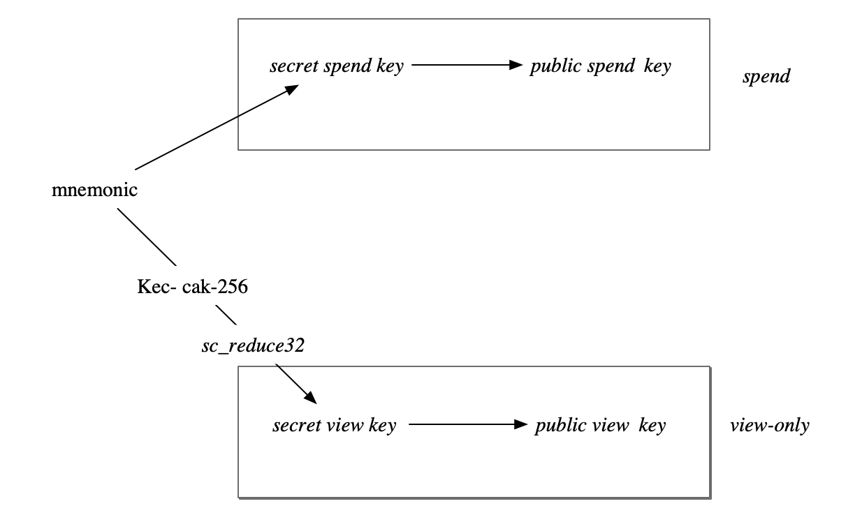
CryptoNote - Unlinkability

Slide 13
CryptoNote - Unlinkability
Sender
Receiver
Private key: (a, b)
Public key : (A, B)
A = aG
B = bG
(A, B)
Random data(private): r
Random data(public): R
R = rG
P’= Hs(aR)G + B
(P = P’) ?
x = Hs(rA) + b
R, P=H_{s}(rA)G + B

Slide 14
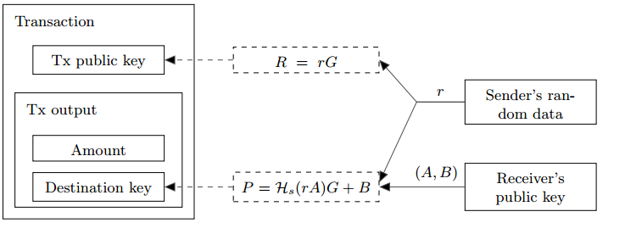
CryptoNote - Unlinkability
tracking key : a pair (a, B) of private and public ec-key (where B = bG and a ≠ b);

Slide 15
CryptoNote - Untraceability
A one-time ring signature contains four algorithms: (GEN, SIG, VER, LNK): GEN: takes public parameters and outputs an ec-pair (P, x) and a public key I. SIG: takes a message m, a set S₀ of public keys {Pi}_{i≠s}, a pair (P_{s}, x_{s}) and outputs a signature σ and a set S = S₀ ∪ { P_{s} } VER: takes a message m, a set S, a signature σ and outputs “true” or “false”. LNK: takes a set I = { I_{i} }, a signature σ and outputs “linked” or “indep”.

Slide 16
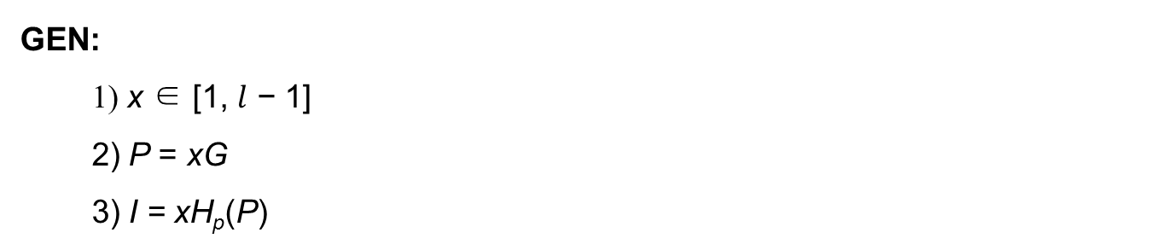
Untraceability - GEN

Slide 17
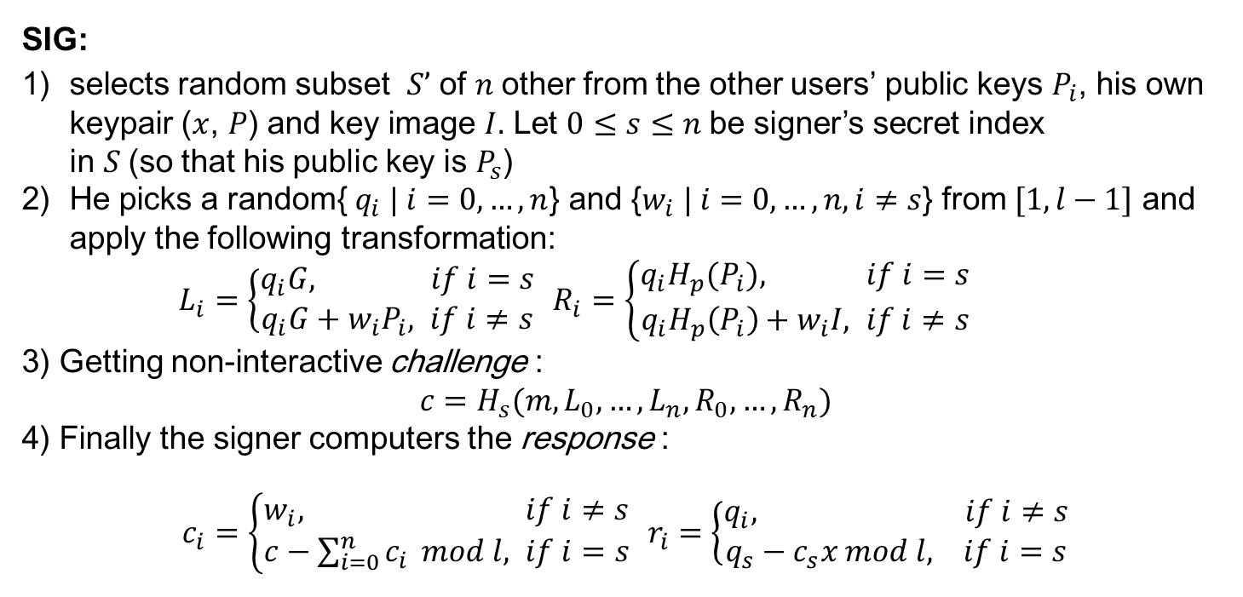
Untraceability - SIG

Slide 18
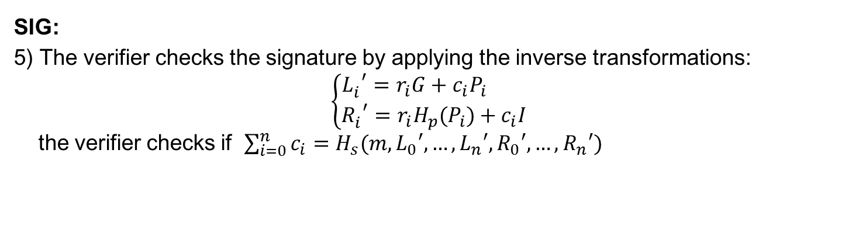
Untraceability - SIG

Slide 19
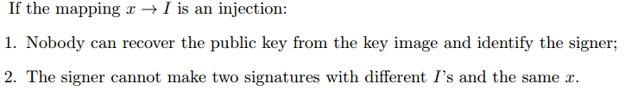
Untraceability - LNK
LNK:
The verifier checks if I has been used in past signatures (these values are stored in the set{ I_{i} }). Multiple uses imply that two signatures were produced under the same secret key.

Slide 20
Monero Crypto
KeyGen
Sign
Verify
M

