Slide 1
去中心化交易所 & OKDex
区块链工程院
2019.11.10

Slide 2
提纲
中心化交易所
为什么要有去中心化交易所
几种主流去中心化交易所
OKChain & OKDex

Slide 3
Privacy issue – CryptoNote
一台世界范围的状态转换永动机
https://cosmos.network/docs/intro/#sdk-application-architecture
它不断的接受外部输入(transcation)，达成共识，
发生状态的跃迁，依此循环
提高了储存的成本，
降低了记录的效率，
但是达到了一致性，从而保障网络信任的目的

Slide 4
Privacy issue – CryptoNote
中心化交易所
为什么要有去中心化交易所
主流的去中心化交易所工作原理
OKChain & OKDex
中心化交易所为什么要有去中心化交易所主流的去中心化交易所工作原理OKChain & OKDex

Slide 5
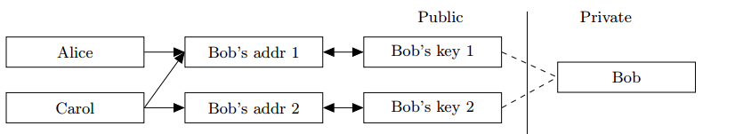
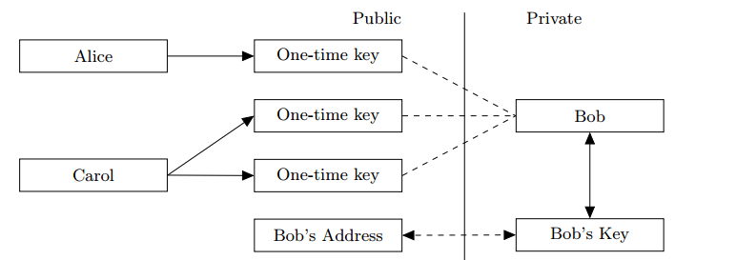
CryptoNote - Unlinkability

Slide 6
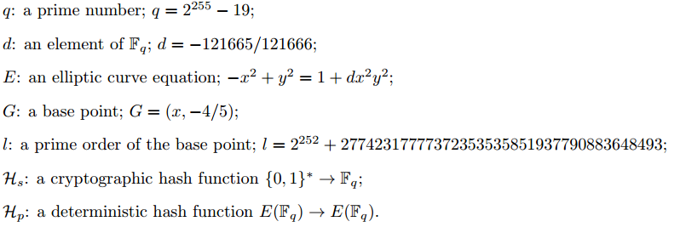
CryptoNote - Unlinkability

Slide 7
CryptoNote - Unlinkability
private ec-key : a standard elliptic curve private key: a number a ∈ [1, l − 1]; public ec-key : a standard elliptic curve public key: a point A = aG;
private user key : a pair (a, b) of two different private ec-keys; public user key : a pair (A, B) of two public ec-keys derived from (a, b);

Slide 8
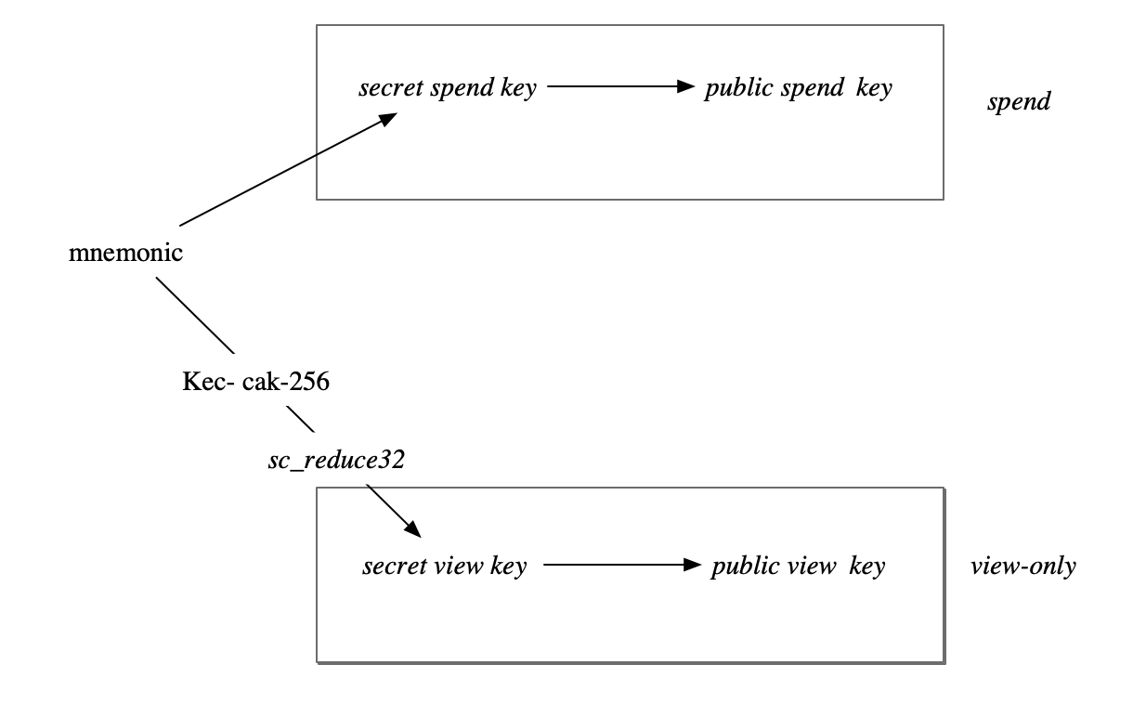
CryptoNote - Unlinkability

Slide 9
CryptoNote - Unlinkability
Sender
Receiver
Private key: (a, b)
Public key : (A, B)
A = aG
B = bG
(A, B)
Random data(private): r
Random data(public): R
R = rG
P’= Hs(aR)G + B
(P = P’) ?
x = Hs(rA) + b
R, P=H_{s}(rA)G + B

Slide 10
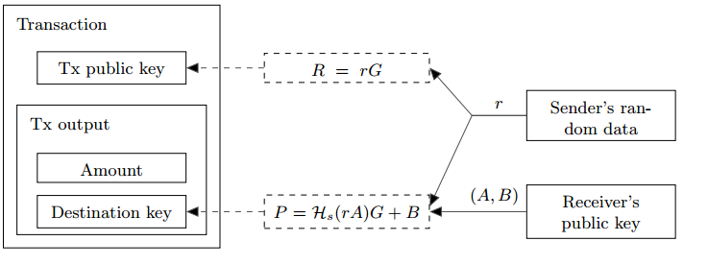
CryptoNote - Unlinkability
tracking key : a pair (a, B) of private and public ec-key (where B = bG and a ≠ b);

Slide 11
CryptoNote - Untraceability
A one-time ring signature contains four algorithms: (GEN, SIG, VER, LNK): GEN: takes public parameters and outputs an ec-pair (P, x) and a public key I. SIG: takes a message m, a set S₀ of public keys {Pi}_{i≠s}, a pair (P_{s}, x_{s}) and outputs a signature σ and a set S = S₀ ∪ { P_{s} } VER: takes a message m, a set S, a signature σ and outputs “true” or “false”. LNK: takes a set I = { I_{i} }, a signature σ and outputs “linked” or “indep”.

Slide 12
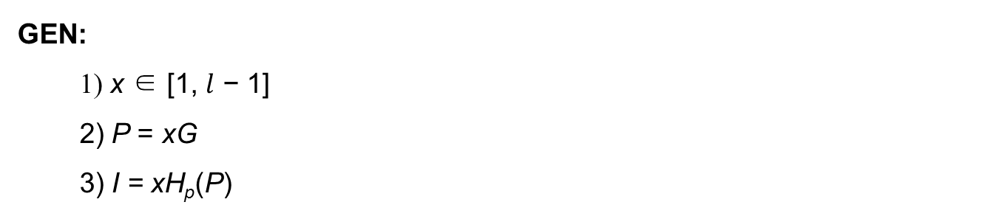
Untraceability - GEN

Slide 13
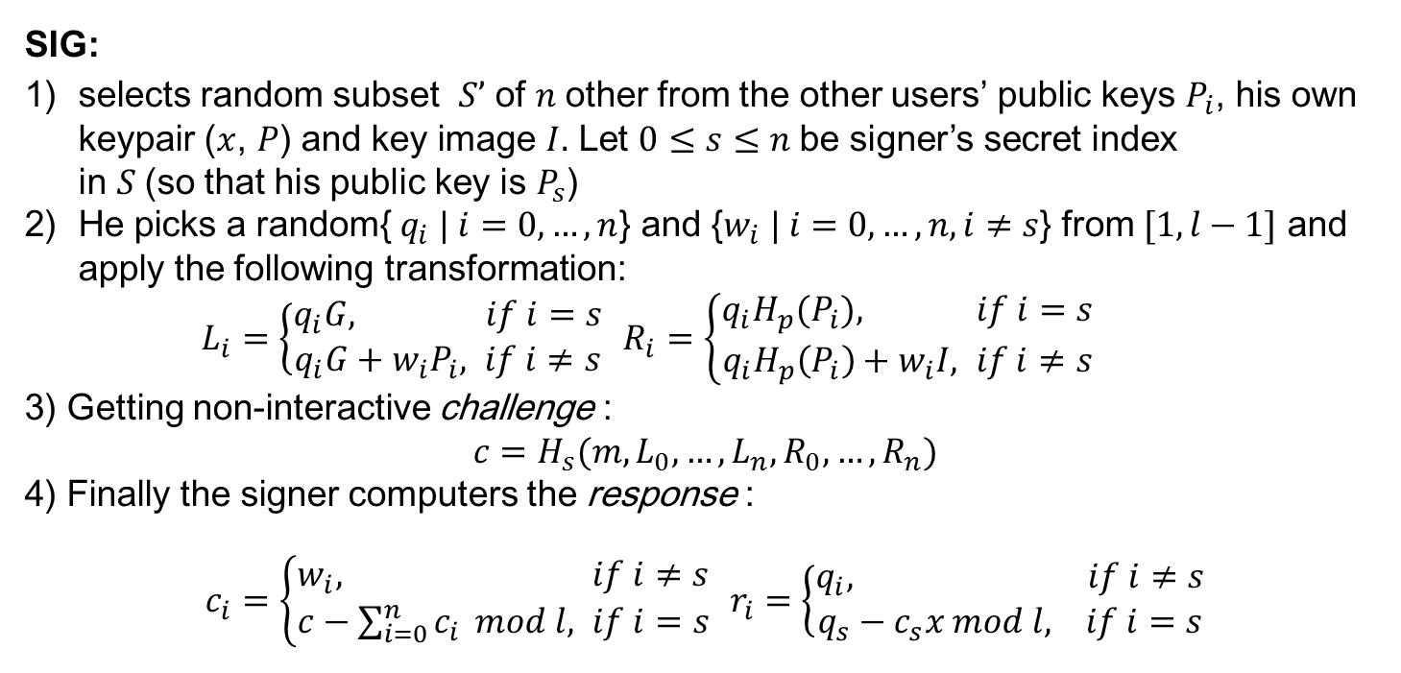
Untraceability - SIG

Slide 14
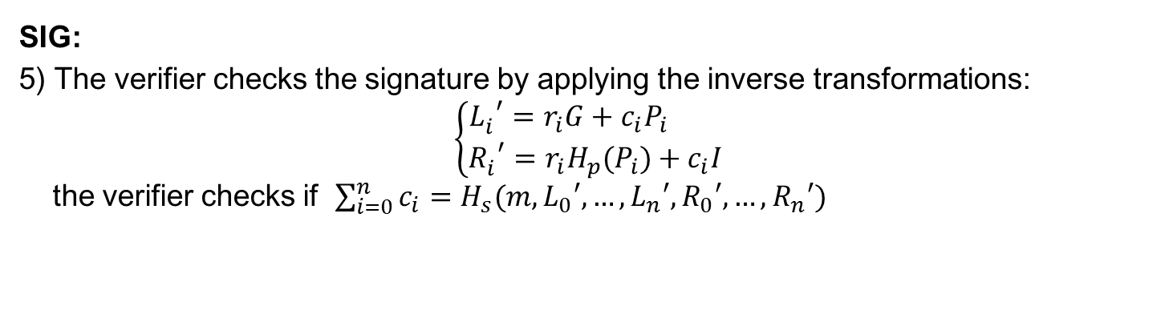
Untraceability - SIG

Slide 15
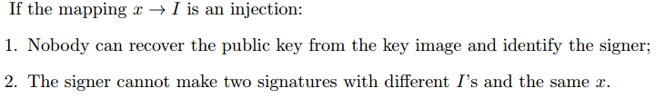
Untraceability - LNK
LNK:
The verifier checks if I has been used in past signatures (these values are stored in the set{ I_{i} }). Multiple uses imply that two signatures were produced under the same secret key.

Slide 16
Monero Crypto
KeyGen
Sign
Verify
M

