Slide 1
Bitcoin: A Peer-to-Peer
Electronic Cash System
Download a copy of all slides and resources here:
https://github.com/cmdruid/bitcoin-programming-course
Notes:
Questions to ask:
- Who is new to Bitcoin?
- Bought and sold bitcoin on an exchange.
- Holds their own private keys.
- Purchased something with bitcoin.
- Interacted with the Bitcoin blockchain.
- Interacted with the Ethereum blockchain.
- Runs their own node.
- Used the lightning network.
Good luck!

Slide 2
Overview
Transactions
Blocks
Proof Of Work / Finality
Nodes / Relay Network
Incentive / Rewards
Storage Optimization
SPV / Light Clients
Combine / Split Funds
Privacy
Attacks / Vulnerabilities
Notes:
test

Slide 3
What is Bitcoin?
World’s first crypto-currency
Payment Network
Computer Software
Community
Solution to double-spending.
Notes:
Otherwise known as “magic internet money.”
Bitcoin is NOT a solution to all the problems in the world. “Bitcoin fixes this” is a bad meme.
Satoshi created Bitcoin in order to solve the double-spending problem.

Slide 4
What is Double Spending?
Alice wants to sell Bob a widget for $500. Bob shows proof of $500 deposit.
Bob signs a check for $500 and gives it to Alice.
Alice leaves to deposit the check. Carol walks in.
Carol wants to sell Bob a widget for $500. Bob shows proof of $500 deposit.
Bob signs a check for $500 and gives it to Carol.
Carol leaves to deposit the check. Bob's check to Alice clears.
Carol’s check bounces at the bank. Carol is screwed!
Bob receives two widgets for the price of one!
How do we solve the double-spending problem?
Notes:
Payments take time to clear.
Bob can exploit that, and re-use his proof of deposit to sign multiple checks.
It becomes a race to see who redeems their check first.

Slide 5
What is Double Spending?
Banker’s Edition
Alice deposits $500 with Bob for safe-keeping. Bob now has $500.
Carol borrows $500 from Bob. Bob credits Carol $500.
Eve borrows $500 from Bob. Bob credits Eve $500.
Carol and Eve spend $1,000 at Dave’s shop, who banks with Bob.
Alice and Dave go to withdraw their money from Bob. What happens?
Notes:
Bob is lending out more money than he has on his books i.e fractional reserve lending.
If Alice and Dave try to withdraw all of their funds at once, Bob will immediately go bankrupt. That is considered a “bank run”.
50% leverage is still above the reserve requirements for commercial banks operating today.

Slide 6
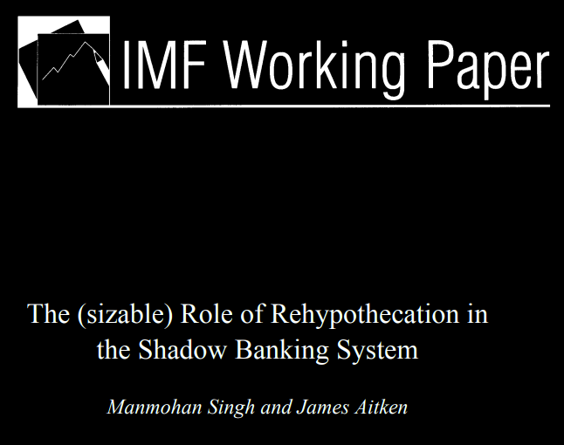

Slide 7
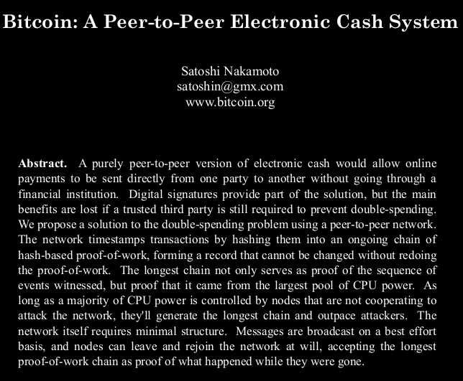
Notes:
The white-paper was published on October 21st, 2008.
The world had just gone through a major financial collapse.
Q: What caused the 2008 financial collapse?
A: Reckless and fraudulent “Rehypothecation” of financial assets.
The word “Bitcoin” only appears twice in the white-paper. Can students guess where?

Slide 8
Abstract
Satoshi proposes a peer-to-peer version of electronic cash, that allows online payments to be sent directly to others, without having to settle through a financial institution.
He mentions digital signatures as part of the solution, but they do not prevent double-spending attacks and still require trust in a central authority.
Notes:
Electronic Cash, or “e-cash”. Like e-mail.
Digital signatures provide a “non-revocable” claim, but a bad actor can produce multiple claims to the same funds (i.e double-spend, rehypothecate, or fractional reserve).

Slide 9
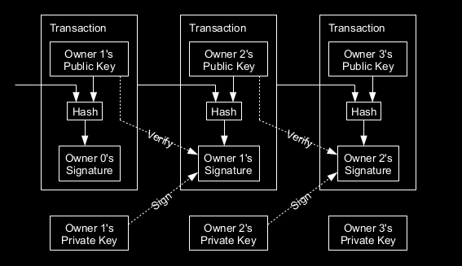
Transactions

Slide 10
{
"txid": "2b59c31bc232c0399acee4c2a381b564b6fec295c21044fbcbb899ffa56c3da5",
"hash": "2b59c31bc232c0399acee4c2a381b564b6fec295c21044fbcbb899ffa56c3da5",
"version": 2,
"size": 85,
"vsize": 85,
"weight": 340,
"locktime": 0,
"vin": [
{
"txid": "ca4898d8f950df03d6bfaa00578bd0305d041d24788b630d0c4a32debcac9f36",
"vout": 0,
"scriptSig": {
"asm": "",
"hex": ""
},
"sequence": 4294967295
}
],
"vout": [
{
"value": 0.00001000,
"n": 0,
"scriptPubKey": {
"asm": "OP_DUP OP_HASH160 e7c1345fc8f87c68170b3aa798a956c2fe6a9eff OP_EQUALVERIFY OP_CHECKSIG",
"hex": "76a914e7c1345fc8f87c68170b3aa798a956c2fe6a9eff88ac",
"reqSigs": 1,
"type": "pubkeyhash",
"addresses": [
"n2eMqTT929pb1RDNuqEnxdaLau1rxy3efi"
]
}
}
]
}

Slide 11
Requirements
We need a way for the payee to know that a previous owner did not sign the transaction over to someone else.
The only way to confirm this is to publicly announce all transactions to the network.
We need a system for participants to agree on a single transaction history.
The payee needs proof that when he accepts a transaction, the majority of participants agree it was the first received.

Slide 12
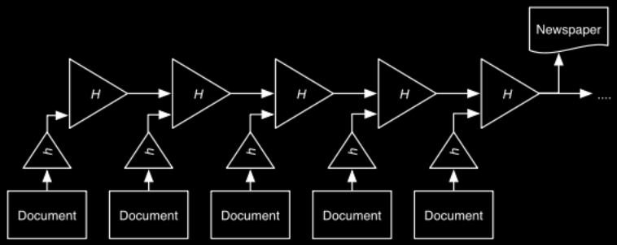
Linked Hashing
Notes:
Q: Who knows what a time server is?
Q: Have you ever lost power to a computer, and the time was reset? What problems did you run into?
It is really important for computers to understand what time it is.
Stuart Haber and W. Scott Stornetta released a proposal in 1990, decribing how to link time-stamps together into a chain, using a hash function.
They later turned their idea into a company called Surety, and they would publish their hashes weekly in the New York Times.
https://en.wikipedia.org/wiki/Linked_timestamping

Slide 13
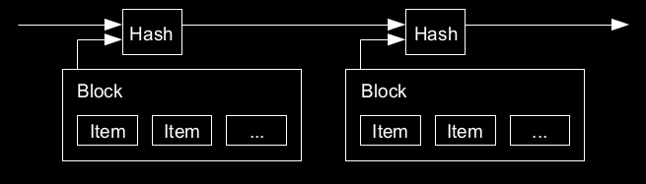
Timestamp Server
Notes:
Q: Who knows what a time server is?
Q: Have you ever lost power to a computer, and the time was reset? What problems did you run into?
It is really important for computers to understand what time it is.
Stuart Haber and W. Scott Stornetta proposed in 1990 to link issued time-stamps together into linear hash-chain, using a collision-resistant hash function.
The concept of publishing hashes was used by the company Surety, which offered a data authentication and time-stamping service. They would publish updated hashes of their attestations on a weekly basis in the New York Times.
https://en.wikipedia.org/wiki/Linked_timestamping

Slide 14
Chain of Block Hashes
Hash a block of data, then widely publish the hash.
This proves that the data must have existed at the time of publishing, in order to calculate the hash.
Each block includes the previous hash, forming a chain, where each newly hashed block reinforces the ones before it.
Problem: Who gets to publish the hash? How do we all agree?

Slide 15
Hash Cash
Originally proposed as a mechanism to stop abuse of un-metered resources on the internet (such as email).
Server challenges the user to solve a random cryptographic puzzle, which costs the user CPU resources.
The user must run computations until they find a solution to the puzzle.
User provides their solution to the server.
Server quickly verifies the solution, then provides access to the resource.

Slide 16
Proof of Work
Hash(Block + nonce) = 256 random bits.
Output is random, even when changing 1 bit of input.
What are the odds of calculating 256 random bits that has a numerical value below 2^250?
How would you prove your work?

Slide 17
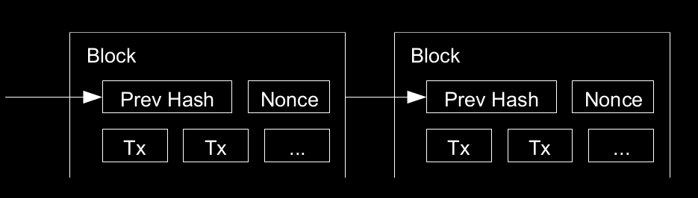
Proof-Of-Work Chain

Slide 18
{
"id": "00000000000000000008692864d3247c5d6c5a389353ec98343bbe84f0142afb",
"height": 750867,
"version": 536870912,
"timestamp": 1661323786,
"tx_count": 2654,
"size": 1533321,
"weight": 3993447,
"merkle_root": "490f4da18b11ea3d45cbc54ddaf4f237ae8726be5527e0df35e1a9d58eecc80a",
"previousblockhash": "00000000000000000006b77f478f544ebc513ec268f5a62d4a8cc73f3f04ee7a",
"mediantime": 1661320505,
"nonce": 657930235,
"bits": 386526600,
"difficulty": 28351606743493
}

Slide 19
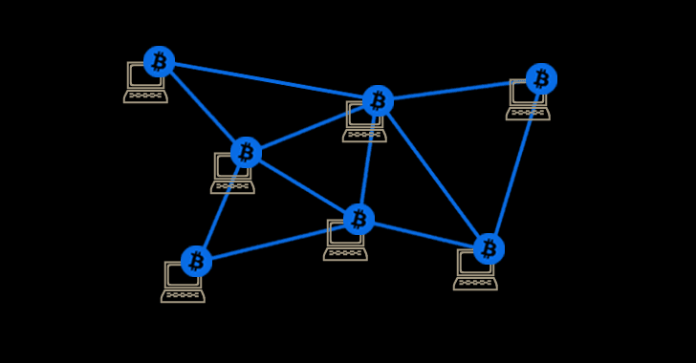
Network
Image source: gbhackers.com
Notes:
Resources:
https://nakamoto.com/bitcoins-p2p-network

Slide 20
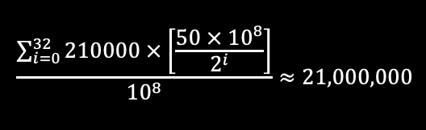
Incentive / Reward

Slide 21
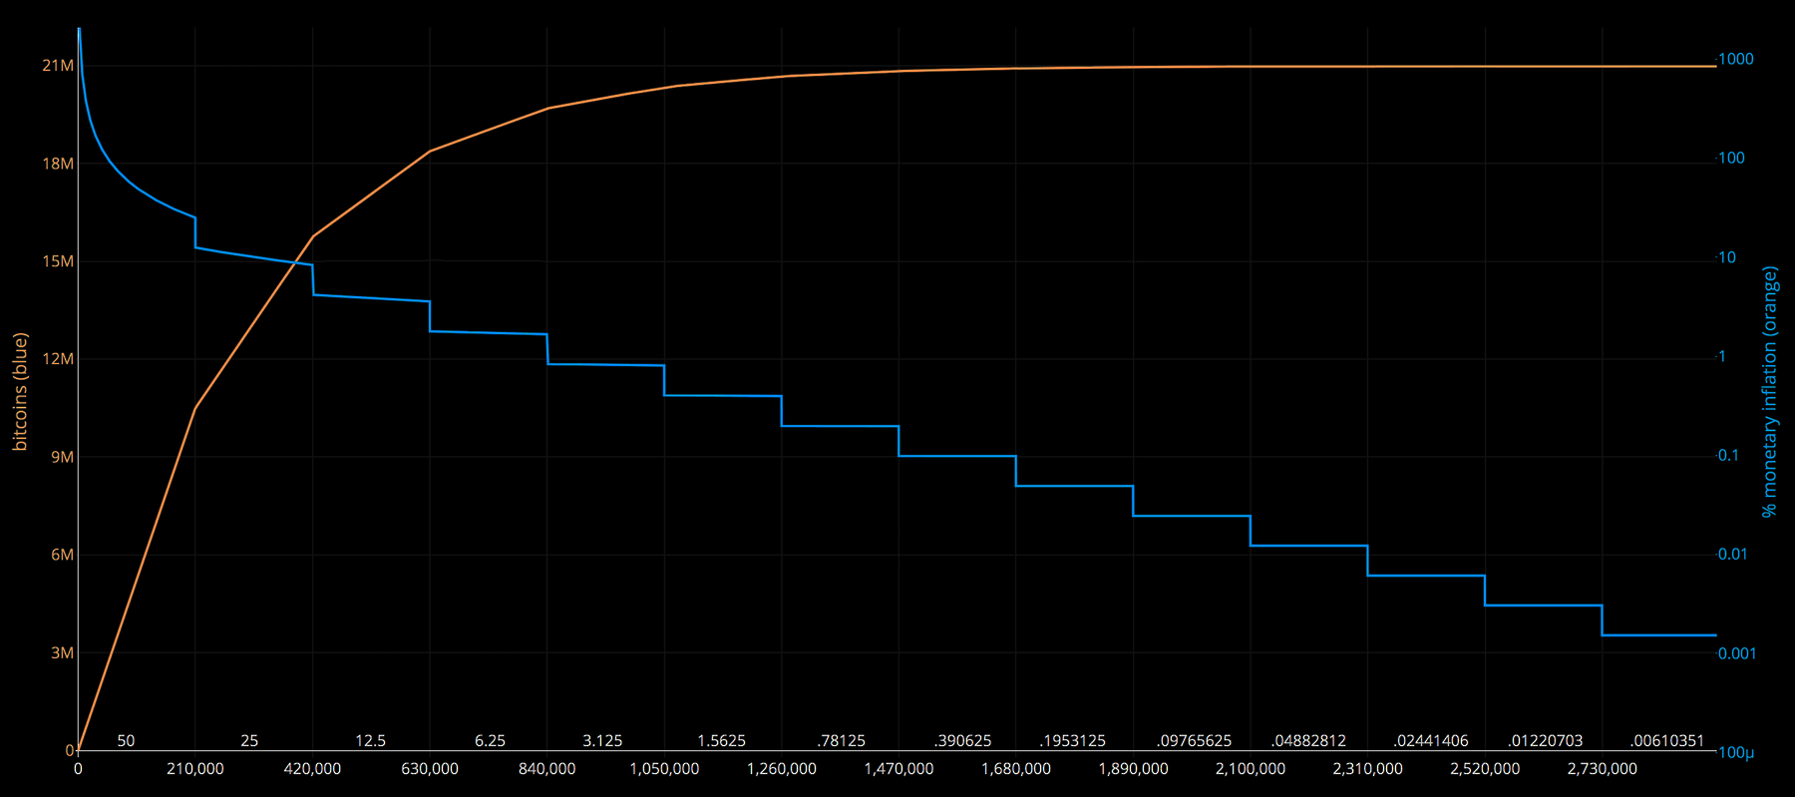
Distribution / Inflation
Source: https://cvj.ch/wp-content/uploads/2020/05/Bitcoin-Halving-Chart.png

Slide 22
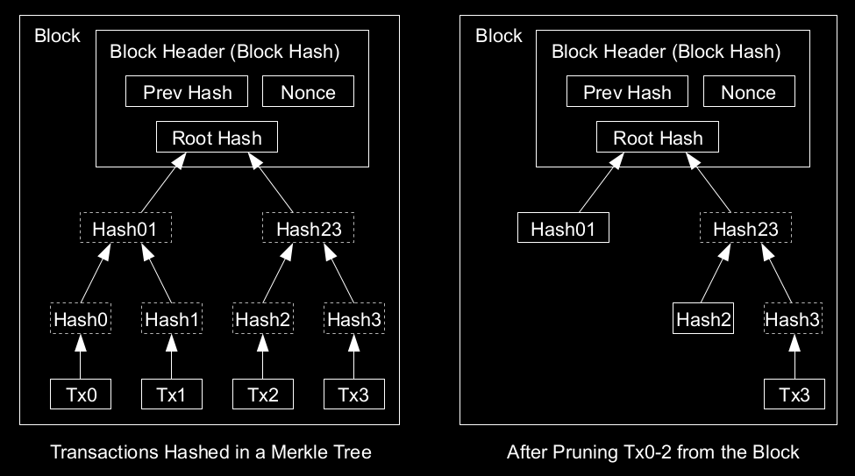
Reclaiming Disk Space

Slide 23
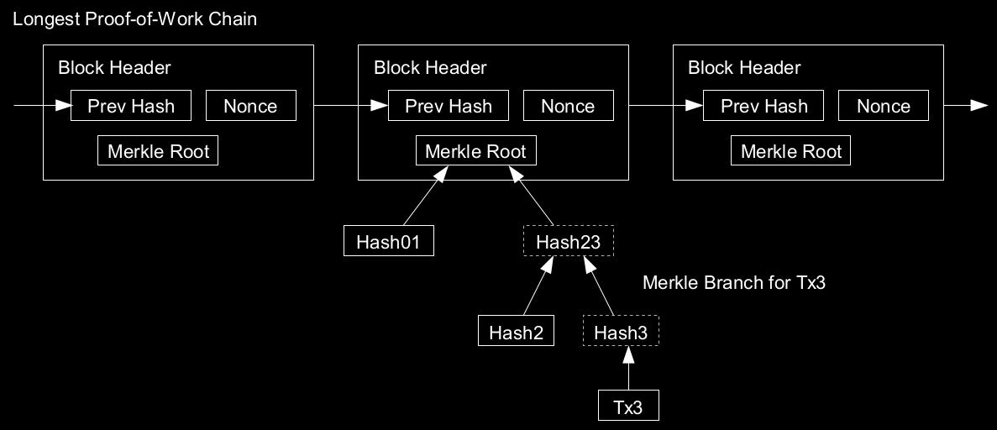
Simple Payment Verification

Slide 24
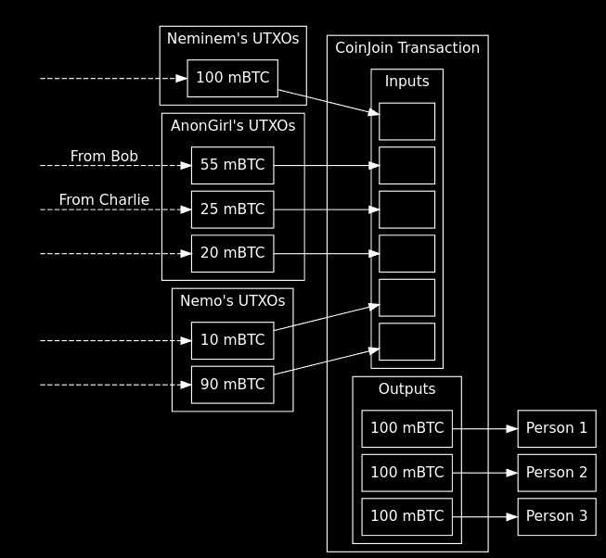
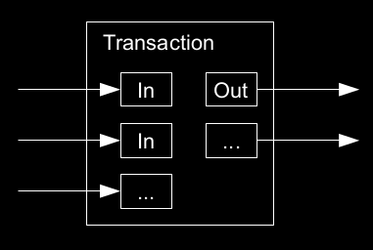
Combine and Split Values

Slide 25
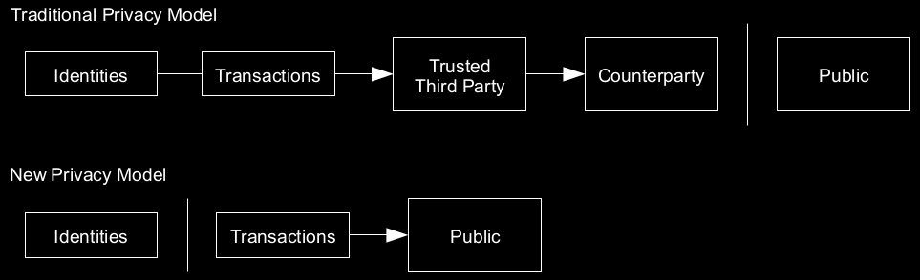
Privacy Model

Slide 26
Forks / Chain Splits

Slide 27
References
Wei Dai’s B-Money
Hashcash White Paper (by Adam Back)
S. Haber, W.S. Stornetta
Ralph C. Merkle, “Merkle Trees”
W. Feller, "An introduction to probability theory and its applications," 1957.

Slide 28
Homework
Download Bitcoin Core Software.
Run Bitcoin-Qt (make sure it works!)
Bonus: Play around with bitcoin.conf
Extra Bonus: Run ‘getblockchaininfo’ in console.

