Slide 1
Bitcoin Programming
Presented by Christopher Scott

Slide 2
Topics
Transactions
Blocks
Nodes / Relays
Network

Slide 3
What is Bitcoin?
Crypto-Currency
Payment Network
Software
Ecosystem
White Paper

Slide 4
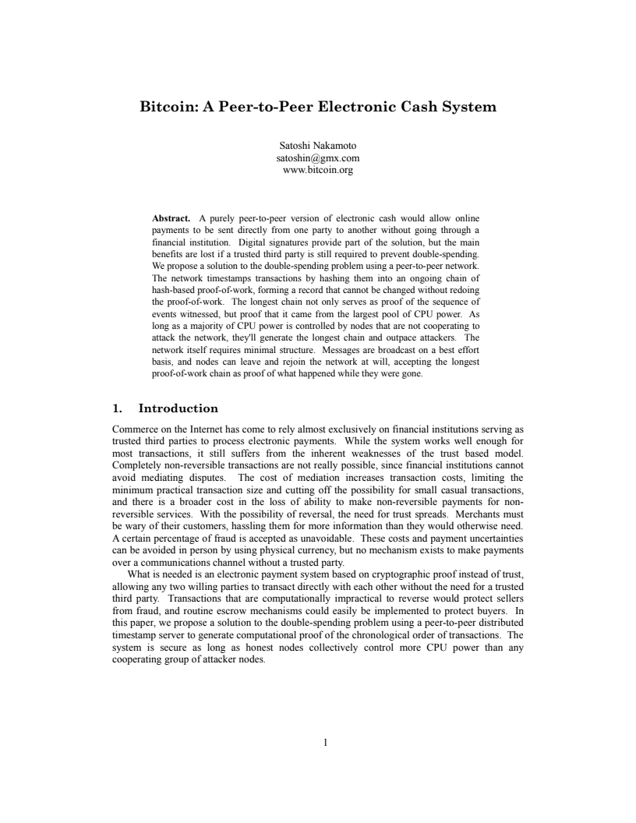

Slide 5
Abstract
A purely peer-to-peer version of electronic cash would allow online payments to be sent directly from one party to another without going through a financial institution.
Digital signatures provide part of the solution, but the main benefits are lost if a trusted third party is still required to prevent double-spending.
We propose a solution to the double-spending problem using a peer-to-peer network.

Slide 6
Abstract
The network timestamps transactions by hashing them into an ongoing chain of hash-based proof-of-work, forming a record that cannot be changed without redoing the proof-of-work.
The longest chain not only serves as proof of the sequence of events witnessed, but proof that it came from the largest pool of CPU power.
As long as a majority of CPU power is controlled by nodes that are not cooperating to attack the network, they'll generate the longest chain and outpace attackers.

Slide 7
Abstract
The network itself requires minimal structure.
Messages are broadcast on a best effort basis, and nodes can leave and rejoin the network at will, accepting the longest proof-of-work chain as proof of what happened while they were gone.

Slide 8
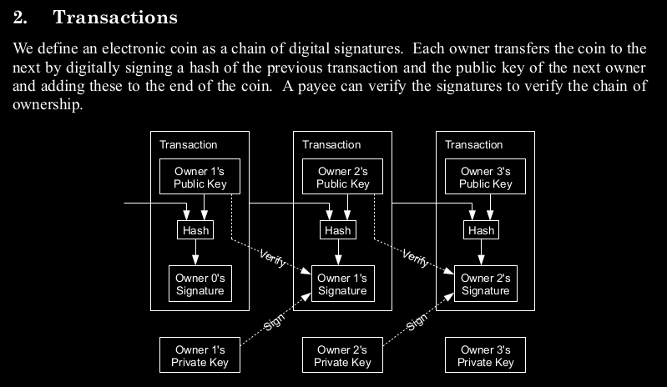

Slide 9
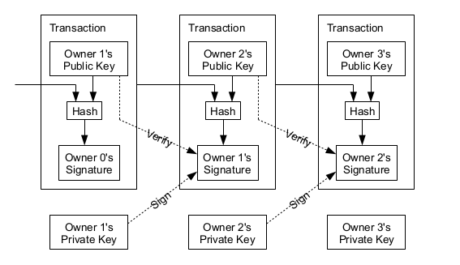
Transactions
We define an electronic coin as a chain of digital signatures. Each owner transfers the coin to the
next by digitally signing a hash of the previous transaction and the public key of the next owner
and adding these to the end of the coin. A payee can verify the signatures to verify the chain of
ownership.

Slide 10
{
"txid": "2b59c31bc232c0399acee4c2a381b564b6fec295c21044fbcbb899ffa56c3da5",
"hash": "2b59c31bc232c0399acee4c2a381b564b6fec295c21044fbcbb899ffa56c3da5",
"version": 2,
"size": 85,
"vsize": 85,
"weight": 340,
"locktime": 0,
"vin": [
{
"txid": "ca4898d8f950df03d6bfaa00578bd0305d041d24788b630d0c4a32debcac9f36",
"vout": 0,
"scriptSig": {
"asm": "",
"hex": ""
},
"sequence": 4294967295
}
],
"vout": [
{
"value": 0.00001000,
"n": 0,
"scriptPubKey": {
"asm": "OP_DUP OP_HASH160 e7c1345fc8f87c68170b3aa798a956c2fe6a9eff OP_EQUALVERIFY OP_CHECKSIG",
"hex": "76a914e7c1345fc8f87c68170b3aa798a956c2fe6a9eff88ac",
"reqSigs": 1,
"type": "pubkeyhash",
"addresses": [
"n2eMqTT929pb1RDNuqEnxdaLau1rxy3efi"
]
}
}
]
}

