Slide 1
Transactions
Notes:
Relevant Links:
https://mempool.space

Slide 2
Topics
Basics of a transaction.
Transferring custody via the locking of coins.
Unspent Outputs (UTXO) and the chain-state.
Change Outputs and Fees.
Evolution of transaction types and scripts.
Life-cycle of a Transaction, from created to confirmed.

Slide 3
Spooky Language
The Mempool
UTXO / Chain-state
P2PKH, P2SH, P2W-PKH/SH, P2TR
Base58 / Bech32
Segregated Witness
OP_DUP OP_HASH160 <PKH> OP_EQUALVERIFY OP_CHECKSIG

Slide 4
What is a Transaction?
Transactions represent a transfer of value on the blockchain.
A transaction can have multiple inputs and outputs.
Each output stores a number value and locking script.
Each input provides keys to unlock an output from a previous transaction.
Notes:
“A transaction is a transfer of Bitcoin value that is broadcast to the network and collected into blocks.” - bitcoin.it wiki
“Transactions are data structures that encode the transfer of value between participants in the Bitcoin system.” - Mastering Bitcoin by Andreas Antonopolis
Transactions, simply put, are value transfers from one contract to another. - Programming Bitcoin by Jimmy Song
Empowerment promise for today.

Slide 5
Basics of a Transaction
“version”: 1
“vin”: [
{
“txid”: a1b2c3d4e5f6
“vout”: 0
“scriptSig”: [ signature, pubkey ]
“sequence”: 0xFFFFFFFF
}
]
“vout”: [
{
“value”: 100 000 000
“scriptPubkey”: [ locking_script ]
}
]
“locktime”: 800000
Version
Inputs
Outputs
Locktime
Notes:
Think of a Bitcoin Transaction as having these four main components.
Sequence field was depreciated for a long time, has since been repurposed for new features such as RBF, CPFP, and CSV.
Locktime allows you to post-date the transaction, similar to post-dating a check.
Transactions are presented with many additional fields (txid, size, weight, etc.). Those fields are calculated from these main fields.
A big-endian system stores the most significant byte at the smallest memory address. A little-endian system stores the least-significant byte at the smallest address.
From book Gulliver’s Travels (1726):
“The conflict between sects of Lilliputians divided into those breaking the shell of a boiled egg from the big end or from the little end.”
https://en.wikipedia.org/wiki/Endianness

Slide 6
Coins
Each unspent transaction output (utxo) stores 8-bytes of value.
This value can be seen as a spendable coin.
Transactions can move, join and split coins.
Coins trace back to their coinbase transaction.

Slide 7
Payment Network
Settlement Layer
Chain-State
Mempool
Validation Layer

Slide 8
Chain State
The total collection of spendable coins on the blockchain is known as the chain-state.
Transactions bid to make permanent changes to this state.
Blocks settle and commit these changes.
Non-spendable coins are also removed.

Slide 9
Mempool
To save bandwidth, relayed transactions are cached.
Nodes use this cache to validate incoming blocks.
Nodes can request missing transactions from their network peers.
The collective state of unconfirmed transactions on the network is known as the Mempool.

Slide 10
Settlement
When a block is accepted, its transactions become settled.
Each new block buries these transactions in computational work.
Settled transactions have less validation rules.

Slide 11
Payment Network
Settlement Layer
Chain-State
Mempool
Validation Layer

Slide 12
Unlocking an Output
Previous Transaction
New Transaction
## Hash256 of the transaction.
“txid”: a1b2c3d4e5f6,
“vout”[0]: {
“value”: 200 000 000,
“scriptPubkey”: [
locking_script
]
}
“vin”[0]: {
“txid”: a1b2c3d4e5f6,
“vout”: 0,
“scriptSig”: [
script_argument_2
script_argument_1
],
“sequence”: 0xFFFFFFFF
}
Notes:
When Bitcoin was first released, the public key was not hashed.
In order to preserve forward secrecy and better security from future quantum attacks, coins are locked to a hash of the recipient’s public key.
Hashes are much shorter than public keys, reducing transaction size and cost.
The majority of transactions use P2PKH or P2WPKH.

Slide 13
Lock and Unlock
Custody Transfer of Coins
Alice wants to send some coins to Bob.
Bob provides Alice with a script to lock the coins.
Alice prepares a transaction that:
- Selects some unspent coins.
- Includes the keys to unlock those coins.
- Spends x coins to a new output with Bob’s lock.
- Spends y change to a new output with Alice’s lock.
Notes:
Outputs → Inputs → Outputs are how coins are moved.
Outputs lock up funds, inputs unlock funds and move them from one output to another.
Coins can only move forwards.
You cannot partially spend a UTXO, you must spend all of it.
Any remaining balance can be sent to a new output, commonly referred to as a change output.

Slide 14
Alice Sends To Bob
Alice UTXO
Alice Transaction (with change)
”vout”[0]: {
“value”:
100 000 000
“scriptPubkey”:
<bob script>
}
”vout”[1]: {
“value”:
99 999 000
“scriptPubkey”:
<alice script>
}
“txid”:
a1b2c3d4e5f6
”vout”[0]: {
“value”:
200 000 000
“scriptPubkey”:
<alice script>
}
”vin”[0]: {
“txid”:
a1b2c3d4e5f6
“vout”:
0
“scriptSig”: [
<alice signature>
<alice pubkey>
]
}

Slide 15
Change Outputs
Coins cannot be partially spent.
To pay an exact coin value, spend coins with greater value, return the rest as change.
This is analogous to spending a large bill, and receiving change in return.

Slide 16
Fees
Transaction fees are implicit bids for block space.
Bids equal the spread between outputs minus inputs.
Miners typically sort their bids by value per byte.
Most nodes enforce a minimum fee on transactions in order to avoid spam on the network.

Slide 17
Payment Address
A payment address is simply the encoded version of a public key hash or script hash.
## Example of Base58 encoding.
“pubkey” : 020fdeab2468c464bb2914a1d18fdd3b3cb3702890796a52d65ba2e59bd7905d90
“hash” : 050688649b067200dbd2d402f103903a17b7ec39
“address” : mfyXVvFuXmXwd2iK9QedqR7u3fgRA4tQqx
## Example of Bech32 encoding.
“pubkey” : 02024764db3bee1269ffd3b7c895a545236a476693dde99029ec28c3f107c91ac63d
“hash” : 6f5699d0c49fd51f88456711337dc053bc6f2496
“version” : 0 (program script version)
“hrp” : bc1 (network prefix and encoding version)
“address” : bc1qut0m3ltc2qkhtnxeawxpu28xlfcy5qv9rgv62r
Notes:
When you “spend” to an address, you are transferring funds to the hash or locking script encoded within the address.
Base58 is similar to Base64, with a few ambiguous characters removed.
The Base58 address format includes a hash256 checksum, but there is no form of error-checking.
Bech32 improves on the above standard by eliminating case-sensitive characters (uppercase) and using a BCH code for error-checking. (BIP 173)
The Bose–Chaudhuri–Hocquenghem (BCH) code guarantees detection of any error affecting at most 4 characters and has less than a 1 in 10**9 chance of failing to detect more errors.

Slide 18
Pay-to-Pubkey Hash (P2PKH)
Previous Output (UTXO)
New Transaction Input
“vin”: [
{
“txid”: a1b2c3d4e5f6,
“vout”: 0,
“scriptSig”: [
signature
public_key
],
“sequence”: 0xFFFFFFFF
}
]
“vout”[0]: {
“value”: 100 000 000,
“scriptPubkey”: [
OP_DUP,
OP_HASH160,
<20 byte hash>,
OP_EQUALVERIFY,
OP_CHECKSIG
]
}
Notes:
When Bitcoin was first released, the public key was not hashed.
In order to preserve forward secrecy and better security from future quantum attacks, coins are locked to a hash of the recipient’s public key.
Hashes are much shorter than public keys, reducing transaction size and cost.
The majority of transactions today still use P2PKH or some variation.
There are size and scalability issues with storing the locking script in the transaction output .

Slide 19
Pay-to-Script Hash (P2SH)
“vin”: [
{
“txid”: a1b2c3d4e5f6,
“vout”: 0,
“scriptSig”: [
signature,
public_key,
redeem_script
],
“sequence”: 0xFFFFFFFF
}
]
“vout”[0]: [
{
“value”: 100 000 000,
“scriptPubkey”: [
OP_HASH160,
<20 byte hash>,
OP_EQUAL
]
}
]
Old Nodes
Returns TRUE
New Nodes (BIP 16)
Evaluate Redeem Script
with Arguments
Notes:
As scripts became more complex, they grew in size. (For example, multi-signature scripts)
This became a scalability problem, as the scripts of unspent outputs had to be stored in the chain-state.
The solution was to create a new payment type: Pay-to-Script Hash. (BIP 16)
Instead of locking coins to a script, you could use the hash of a script instead.
This greatly reduced the size of the chain-state, as you only reveal the script when spending the coins.
This also allows nodes to prune script data from their local blockchain.

Slide 20
Pay-to-Witness
(P2W-PKH)
“vin”[0]: {
“txid”: a1b2c3d4e5f6
“vout”: 0
“scriptSig”: []
“sequence”: 0xFFFFFFFF
“txinWitness”: [
signature
public_key
]
}
“vout”[0]: {
“value”: 100 000 000,
“scriptPubkey”: [
## A 20-byte hash implies
## a P2PKH script.
0, <pubkey hash>
]
}
[ OP_DUP, OP_HASH160, <20 byte hash>, OP_EQUALVERIFY, OP_CHECKSIG ]
Notes:
Before Segwit, there was a critical issue with how transactions and signature hashes were calculated.
It was possible to modify a transaction and change its hash (txid), without invalidating the signature.
Transaction malleability made it near impossible to negotiate and sign a transaction that relied upon a pre-calculated source of funds.
There were many other scalability issues with Bitcoin, such as the quadratic hashing problem.
Solutions to many of these problems were packaged together in a major upgrade called Segwit.

Slide 21
Pay-to-Witness
(P2W-SH)
“vin”[0]: {
“txid”: a1b2c3d4e5f6,
“vout”: 0,
“scriptSig”: [],
“sequence”: 0xFFFFFFFF,
“txinWitness”: [
<script argument 2>
<script argument 1>
<script>
]
}
“vout”[0]: {
“value”: 100 000 000,
“scriptPubkey”: [
## A 32-byte hash
## implies a script.
0, <script hash>
]
}
[ OP_ADD, OP_5, OP_EQUAL ]
Notes:
All elements in the witness stack are passed into the final script as arguments.
The final element in the witness stack is the script itself, which is hashed using sha256 and compared to the hash provided in the locking script.
Pay-to-Witness transactions have version numbers in the locking script field, for simpler upgrades in the future (such as P2TR).
In order to make future versions backwards-compatible, unrecognized version number are treated as “anyone-can-spend” by the network.
Every time we change something significant, we leave version fields behind to make future upgrades easier.

Slide 22
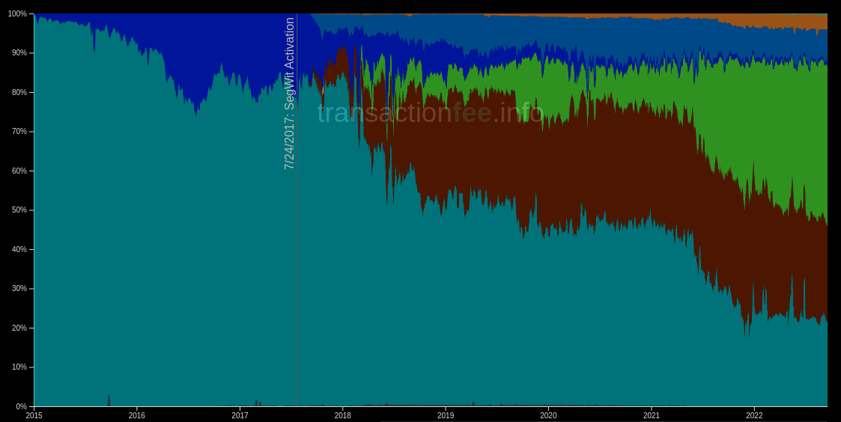

Popularity of Transaction Types

Slide 23
Transaction Life-cycle
Bob gives Alice an address / locking script.
Alice creates, signs, and broadcasts a transaction to her peers.
Her peers verify the transaction and relay it across the network.
The transaction propagates into the memory pool of miners.
Miners add the transaction to their block to collect fees.
A valid block is then broadcast across the network.
Nodes relay the new block, and update their chain-state.
Bob can now confirm the coins are in his custody.

Slide 24
Future Topics
Decoding a raw transaction.
Parsing variable words lengths and opcodes.
Calculating Public Key / Script Hashes.
Constructing a signature hash.
Calculated fields: TXID, Hash, Size, Weight.
Decoding Segregated Witness flag and data.

Slide 25
Smart Contracts with Bitcoin Script
Coming up next ...

