Slide 1
Bitcoin Script Execution

Slide 2
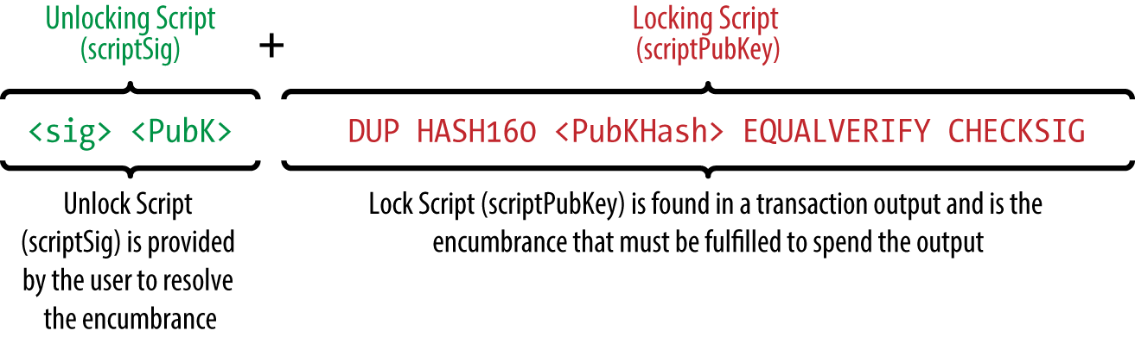
Unlocking an Unspent Output (UTXO)

Slide 3
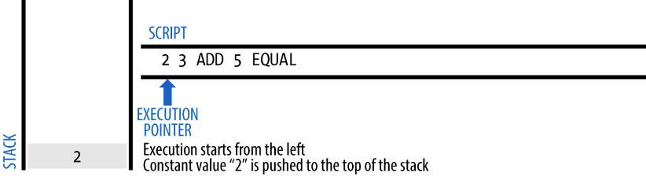
Basic Addition Script

Slide 4
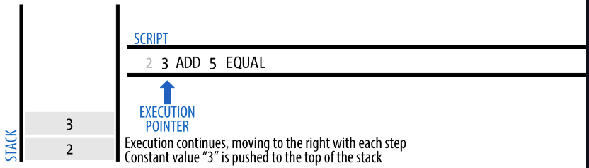

Slide 5
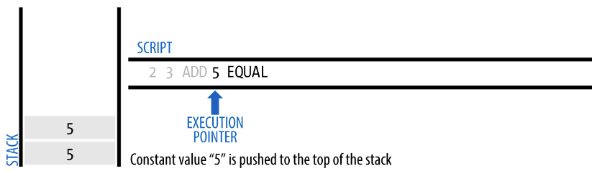

Slide 6
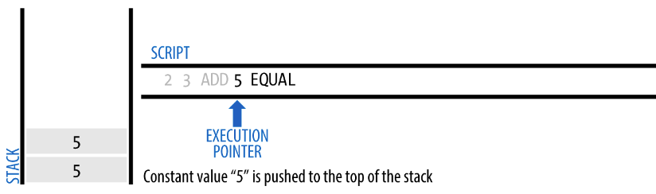

Slide 7
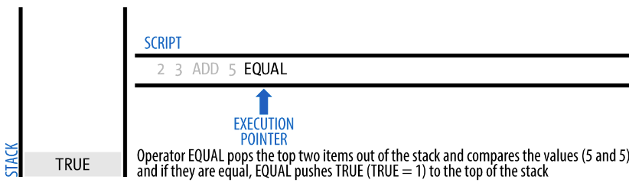

Slide 8
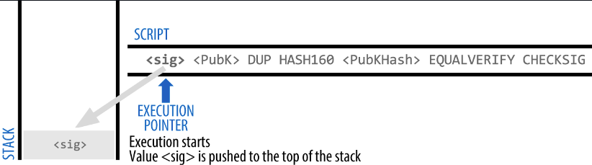
Pay To Pub-key Hash (P2PKH)

Slide 9
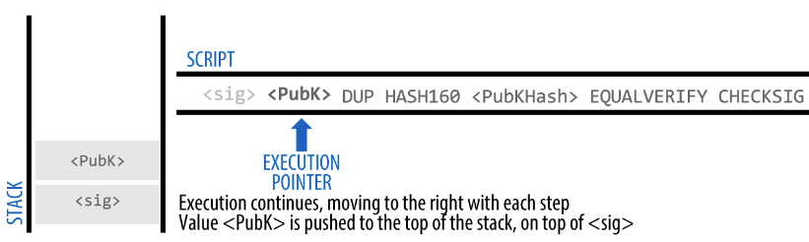

Slide 10
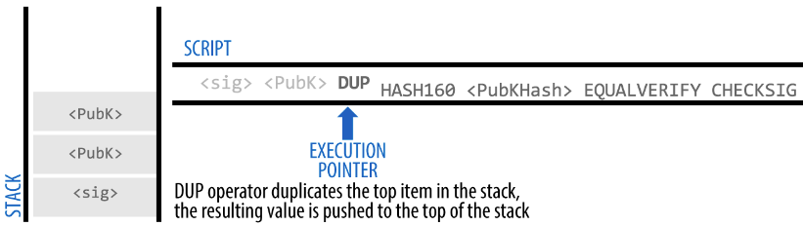

Slide 11
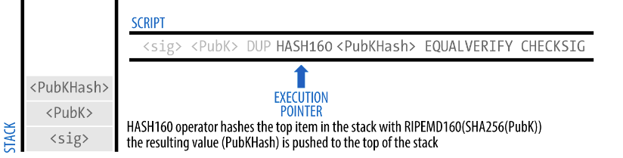

Slide 12
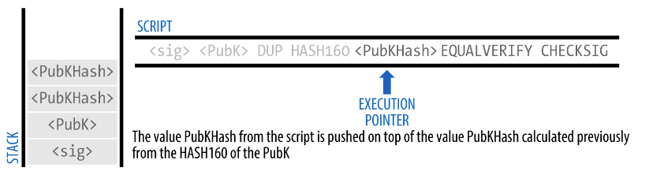
"vout": [
{
"value": 0.10000000,
"scriptPubKey": "OP_DUP OP_HASH160 7f9b1a7fb68d60c536c2fd8aeaa53a8f3cc025a8 OP_EQUALVERIFY OP_CHECKSIG"
}
]

Slide 13
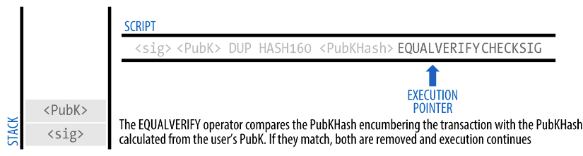

Slide 14
