Slide 2
Prepare environment
For doing the assignments

Slide 3
Download and start containers
Make sure you have Docker Desktop or equivalent on your system
Clone repository https://github.com/cmeerbeek/datagen-splunk-workshop
Go into the directory datagen-splunk-workshop and run ‘docker-compose up’

Slide 4
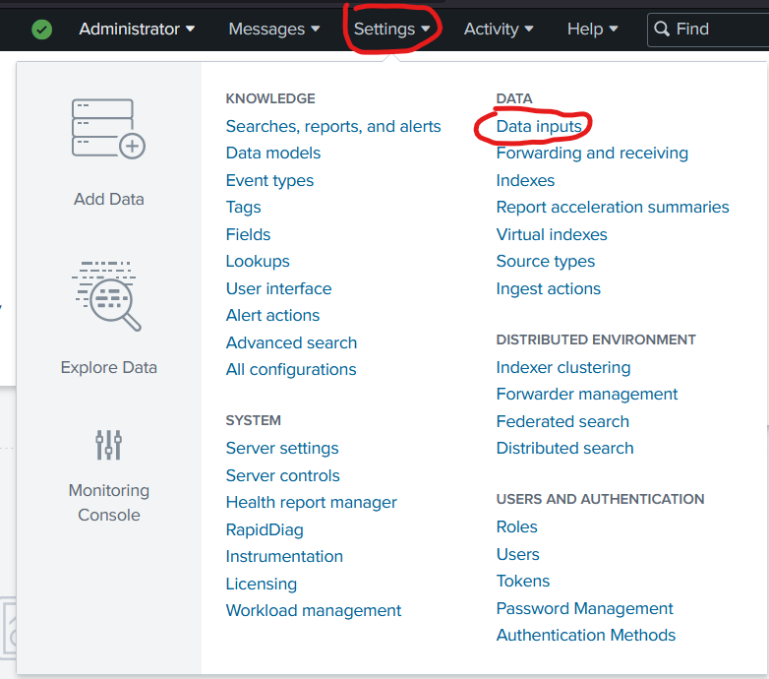
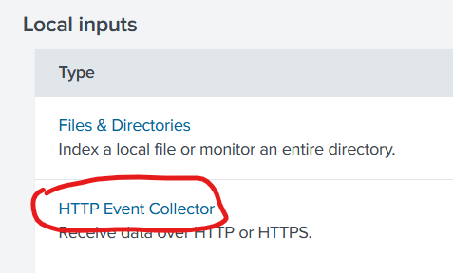
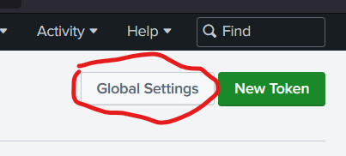
Configure Splunk
Go to http://localhost:18000 and login with admin and changeme
Change the password if you want to do so
Go to Settings -> Data Inputs -> HTTP Event Collector
Click Global Settings -> uncheck “Enable SSL” -> click Save

Slide 5
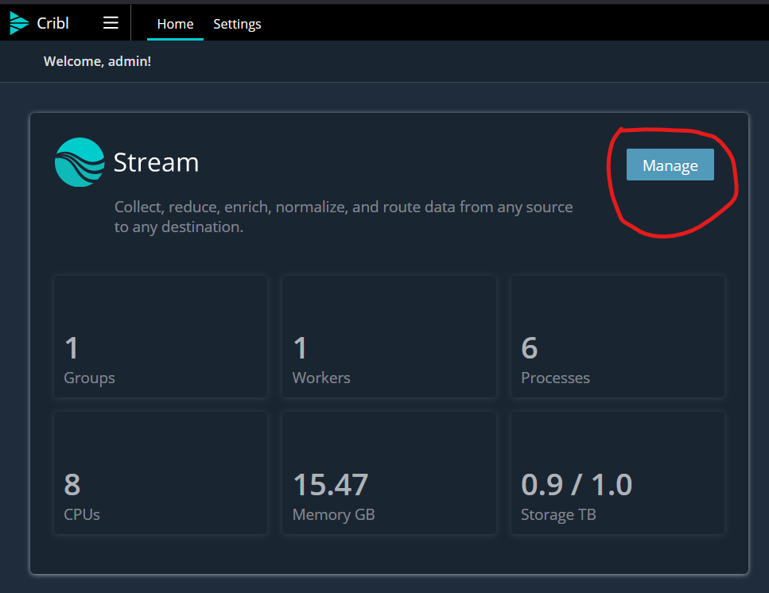
Configure Cribl I
Go to http://localhost:19000 and login with admin and admin
Change the password if you want to do so
Click on Manage

Slide 6
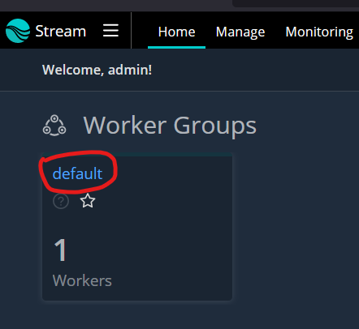
Configure Cribl II
Click on default

Slide 7
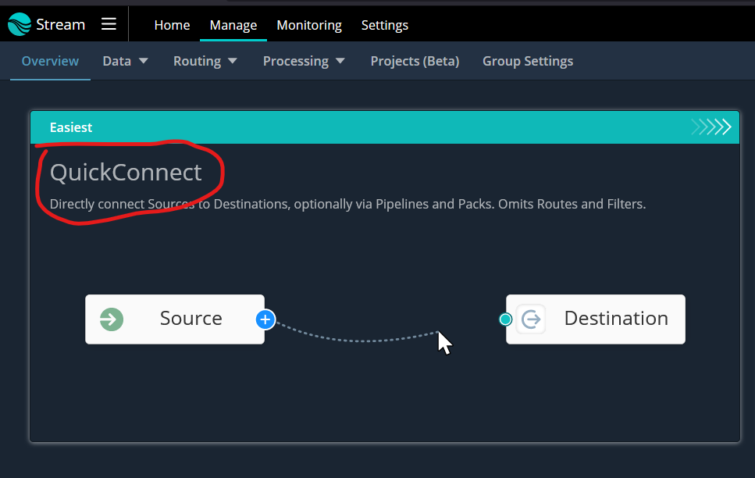
Configure Cribl III
Click on QuickConnect

Slide 8
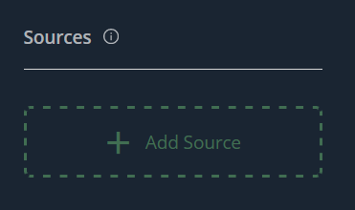
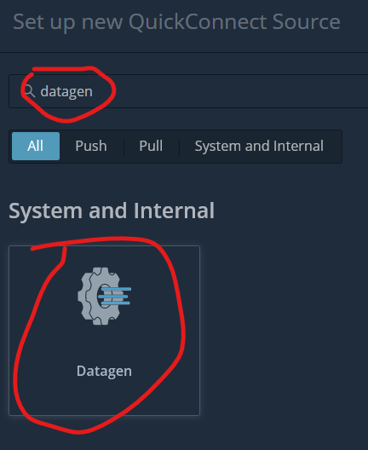
Configure Cribl IV
Click on Add Source
Type datagen in the searchbox and click on it

Slide 9
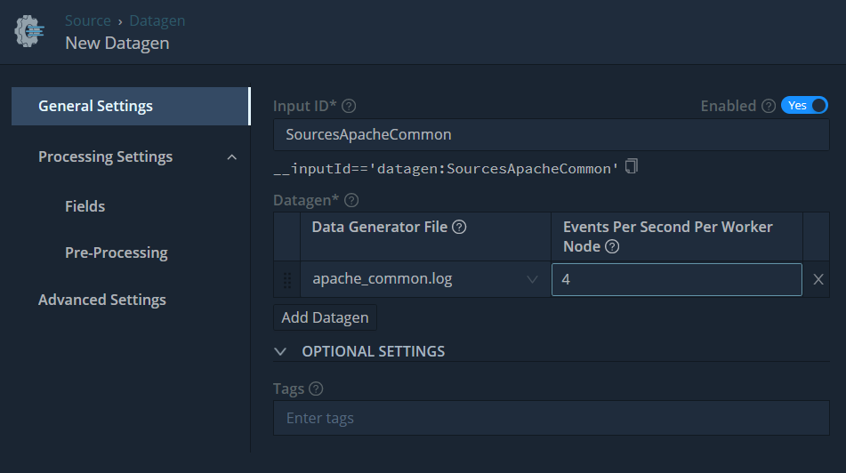
Configure Cribl V
Type “SourcesApacheCommon” in the first box
Select “apache_common.log” from the dropdown
Change 10 to 4 for Events per Second
Click Save

Slide 10
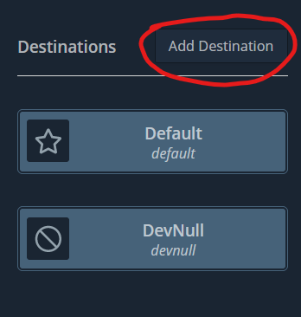
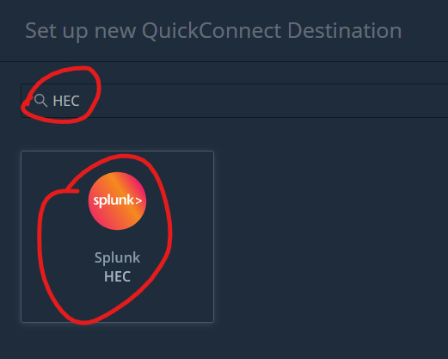
Configure Cribl VI
Click “Add Destination”
Search for “HEC” and click on “Splunk HEC”

Slide 11
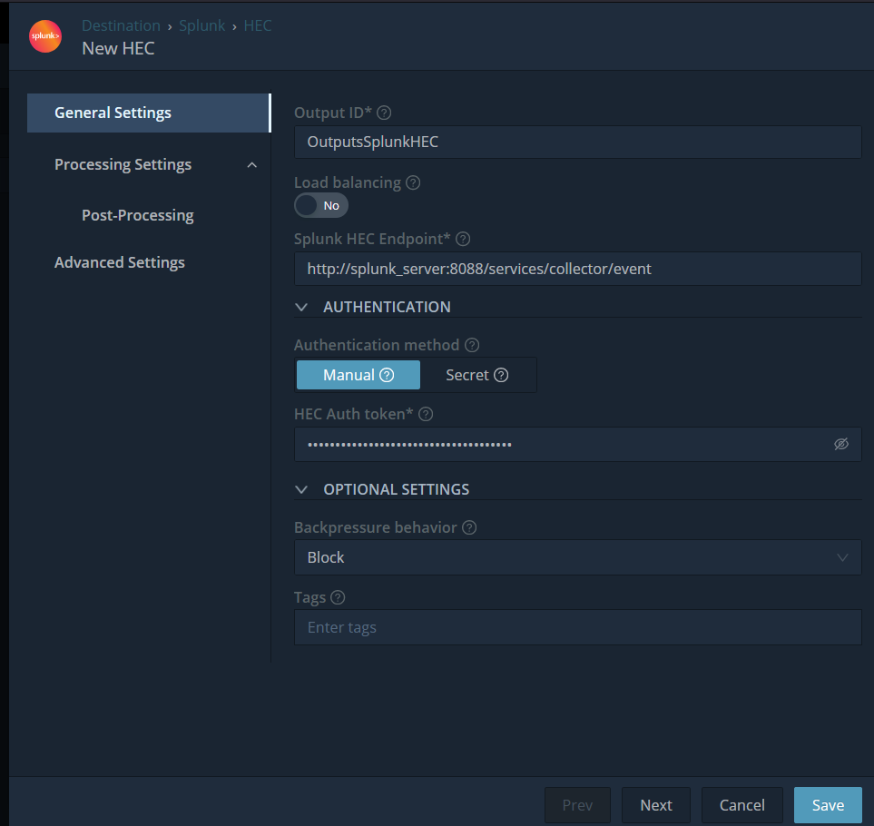
Configure Cribl VI
Type Outputs ID is “OutputsSplunkHEC”
Change the URL to http://splunk_server:8088/services/collector/event
Add to “HEC Auth Token”: 00000000-0000-0000-0000-0000000000000
Click Save

Slide 12
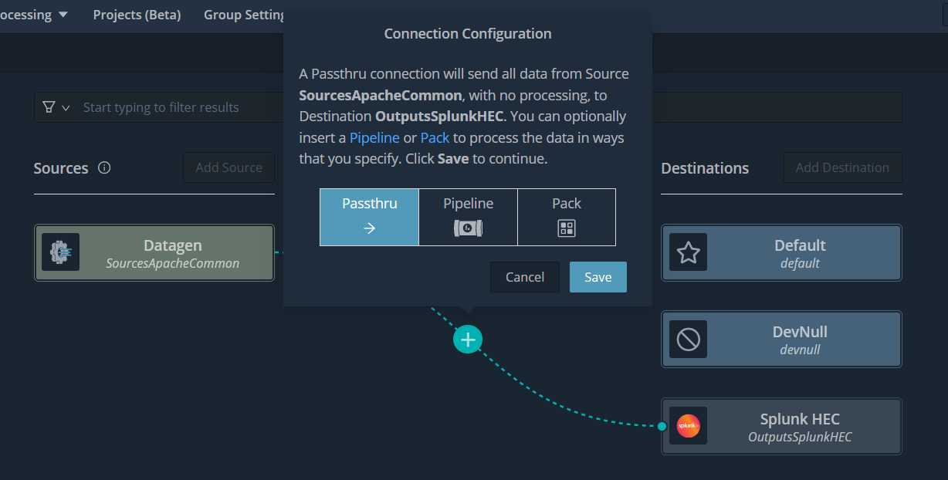
Configure Cribl VII
Click on the + sign, right next to your datagen, and drag it on top of the Splunk HEC outputs
On release select Passthru and press Save

Slide 13
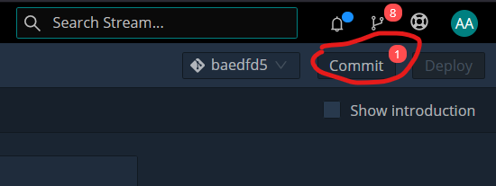
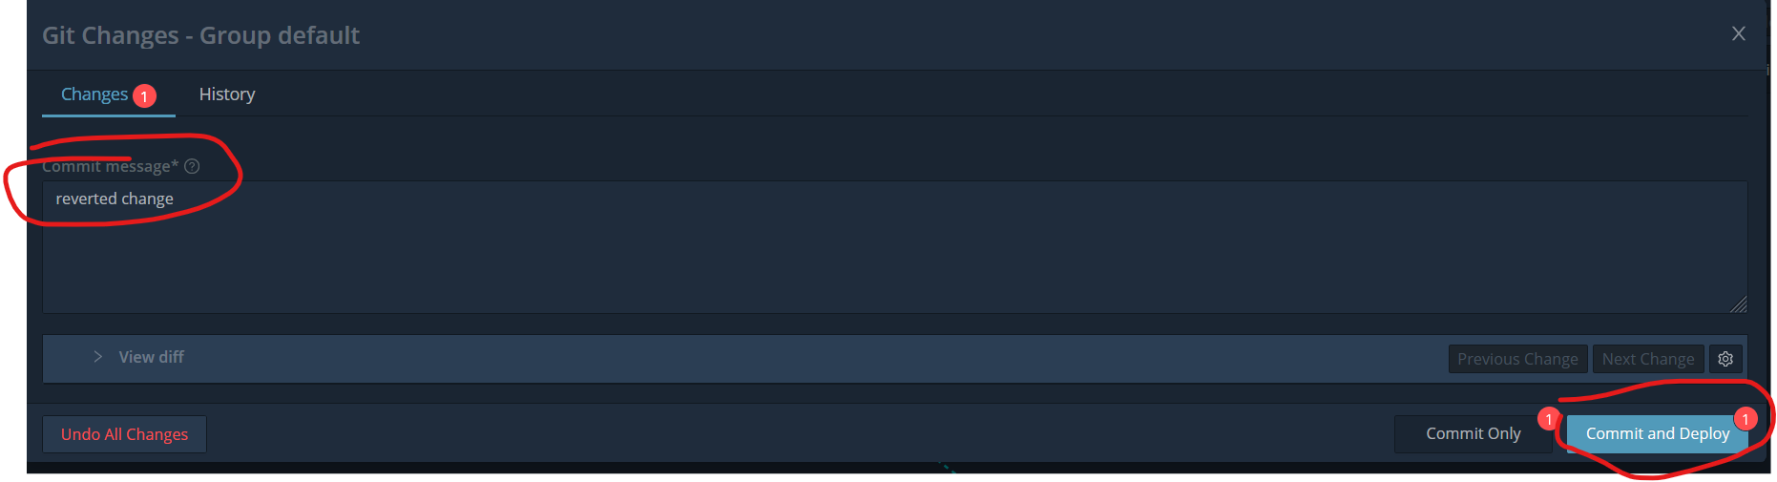
Configure Cribl VIII
Click “Commit”
Write a commit message and click “Commit and Deploy”

Slide 14
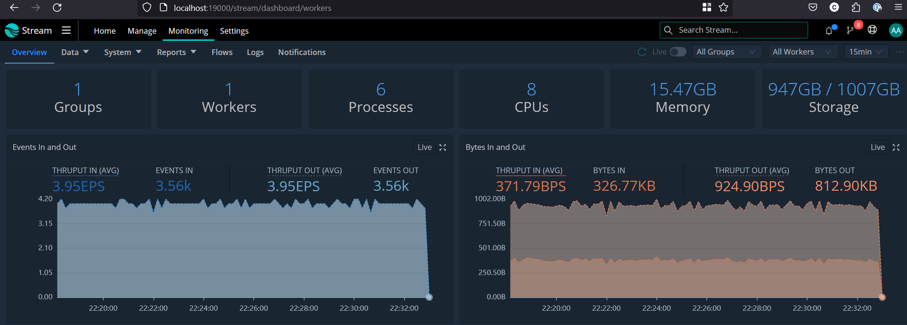
Configure Cribl IX
Wait for a few minutes before some data starts flowing into Splunk
Click on “Monitoring” to see that

