Slide 1
Datahack: Understanding Police Misconduct
 | Mehraveh Salehi
 | Chintan Mehta
 | Rasmus Kyng
 | Chris Harshaw
 |  |  |  | Yale

Slide 2
Data and Question
Yale Policy Lab, The Justice Collaboraty, The Invisible Institute
Chicago Police Complaint Data set
All complaints against CPD officers 2009-2016
Can we make sense of who offends?
Who will offend in the future?

Slide 3
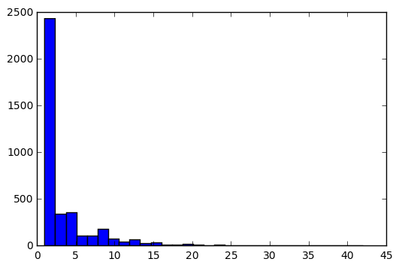
Total Aggregate Complaints Histogram

Slide 4
Basic Features
Appointed date
Age
Gender
Race
Complaints with
incident time
complaint type (-> severity)
sustained/not sustained
co-accused

Slide 5
Network Based Features
Hypothesis
Receiving complaints together with frequent ’offenders’
increases your likelihood receiving complaints
Features
# of complaints of neighbors (excluding own)
# of frequent offender neighbors
Issues
How to aggregate over neighborhood?
Does timing matter?

Slide 6
Complaint Graph
officers
incidents
High offender?

Slide 7
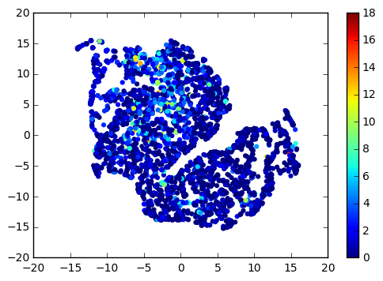
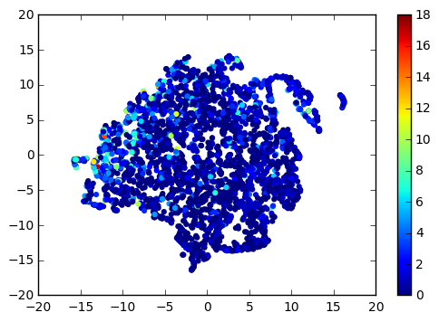
Network Features at a Glance
t-SNE visualization: red color = high complaint count
no network
network

Slide 8
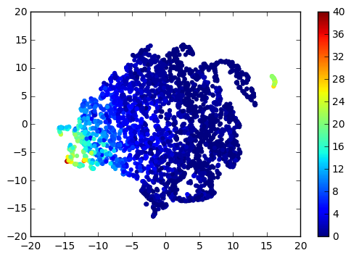
What changed?
Network-based ‘prediction’
# high offenders

Slide 9
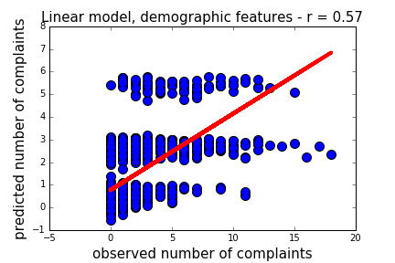
Linear regression, demographics only
Train: 2009-2012
Predict: 2013-2015

Slide 10
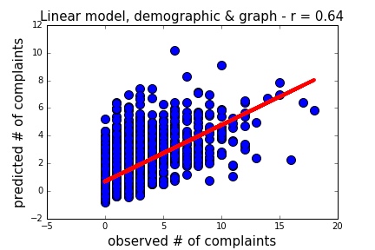
Linear model, adding graph features & history

Slide 11
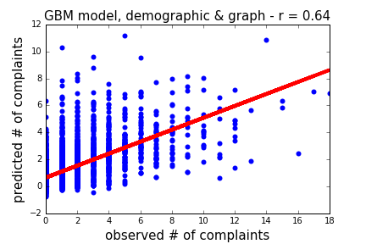
Gradient Boosting Machines w. same features

Slide 12
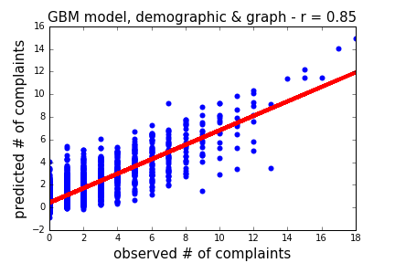
Gradient Boosting Machines w. same features

Slide 13
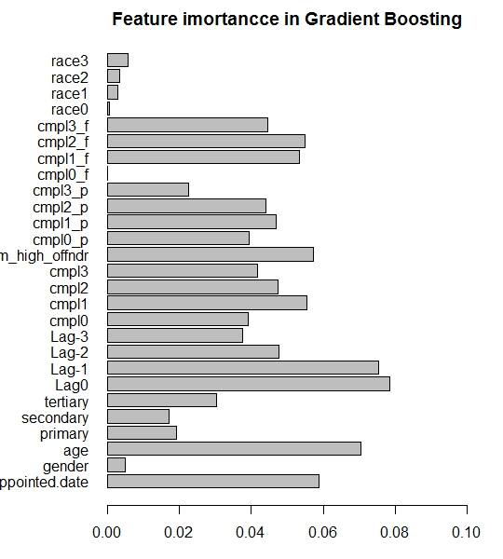
Feature Importance in GBM

