Slide 1
Fundamentals of machine learning Credit Card Fraud
By: Curtis Meister

Slide 2
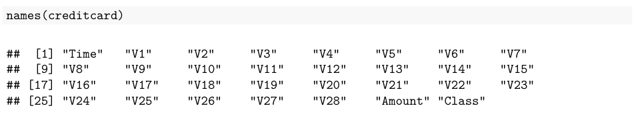
Credit card fraud detection background
Credit Card Dataset: https://www.kaggle.com/datasets/mlg-ulb/creditcardfraud?resource=download
This data was pulled from the online source Kaggle.
“The dataset contains transactions made by credit cards in September 2013 by European cardholders.
It contains only numerical input variables which are the result of a PCA transformation. Unfortunately, due to confidentiality issues, we cannot provide the original features and more background information about the data. Features V1, V2, … V28 are the principal components obtained with PCA, the only features which have not been transformed with PCA are 'Time' and 'Amount'. Feature 'Time' contains the seconds elapsed between each transaction and the first transaction in the dataset. The feature 'Amount' is the transaction Amount, this feature can be used for example-dependant cost-sensitive learning. Feature 'Class' is the response variable and it takes value 1 in case of fraud and 0 otherwise.” (Kaggle)
Below lists all names associated with the dataset:

Slide 3
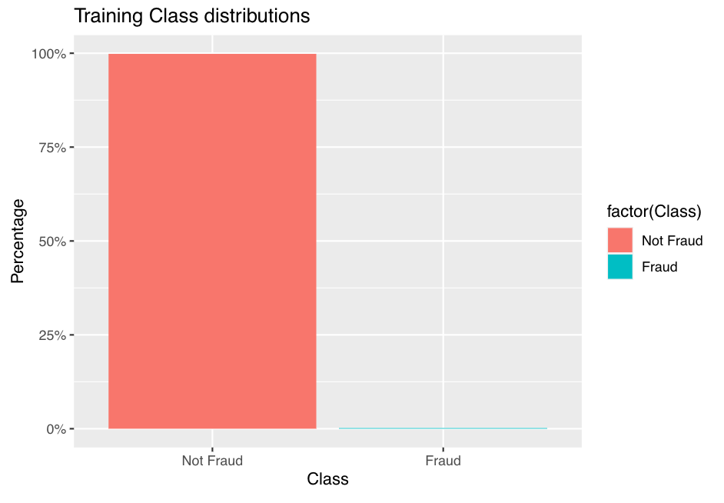
Problem & How to solve
Problem:
How to solve fraud amount with specific amount of transactions.
How many total transactions:
Length(creditcard$class) = 284,807 total transactions
How much fraud with given transactions
Summary(as.factor(creditcard$class) = 492/284,807 were fraud, 284,315 were not fraud
492/284,807 = .172% of all transactions were credit card fraud in the 2013 European study

Slide 4
conclusions
While the amount of credit card fraud transactions were low at .172%, the only ideal amount would be absolutely 0%.
The findings in this study would help in future years determine banking losses and find ways to further determine whether a credit card transaction is fraud when the purchase is being done.
More findings included in R Markdown file. Please see Github for final reports:
https://github.com/cmeister2012/64060_-cmeiste5

