Slide 1
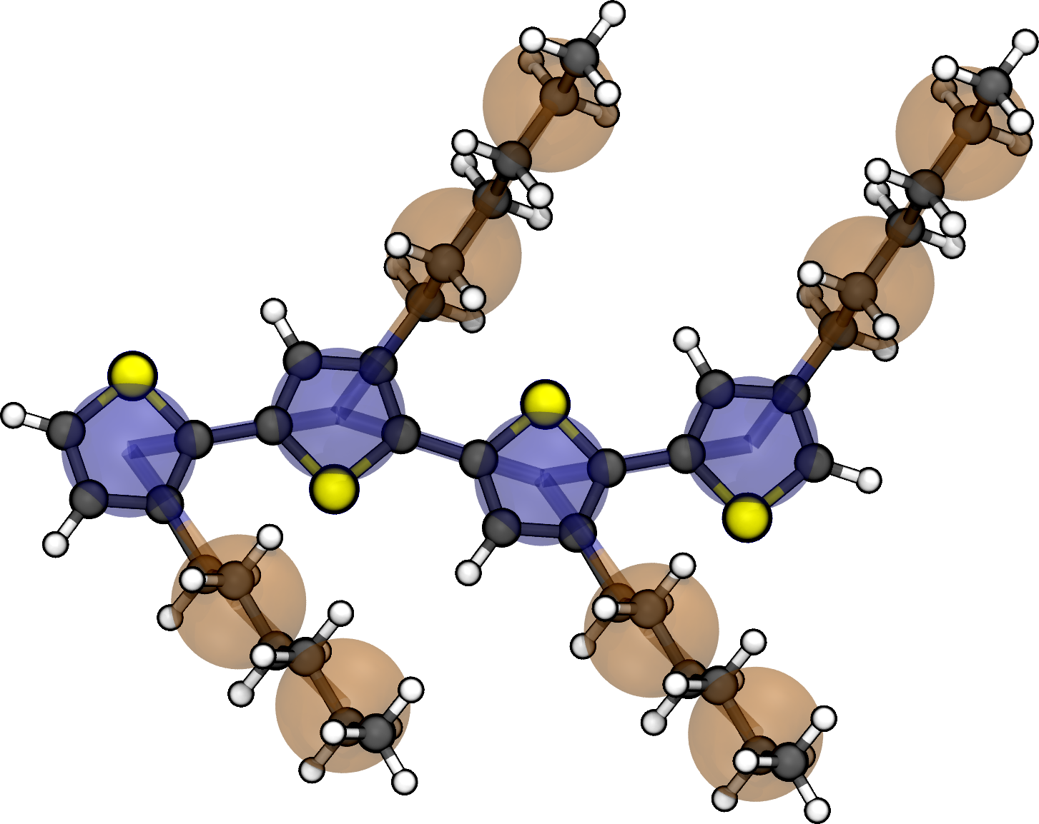
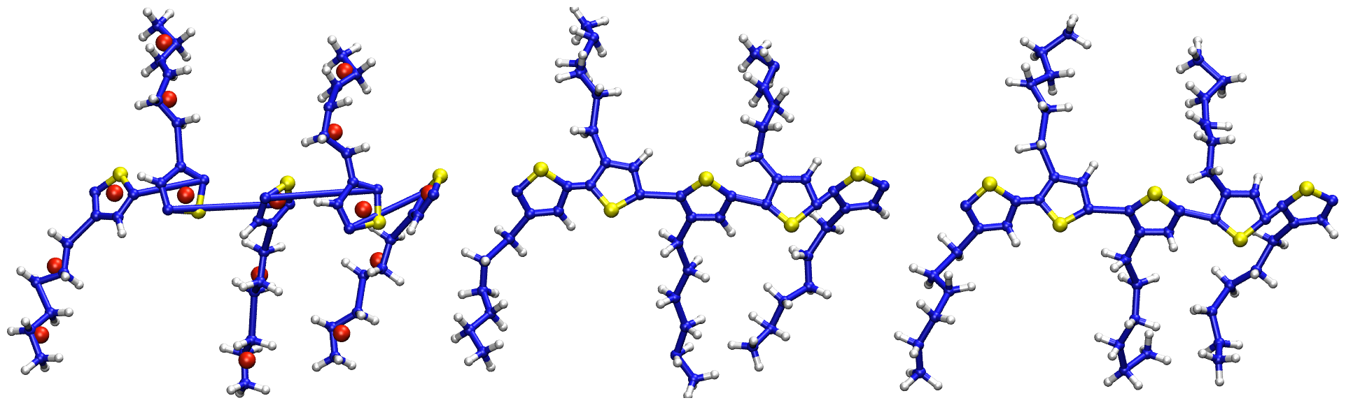
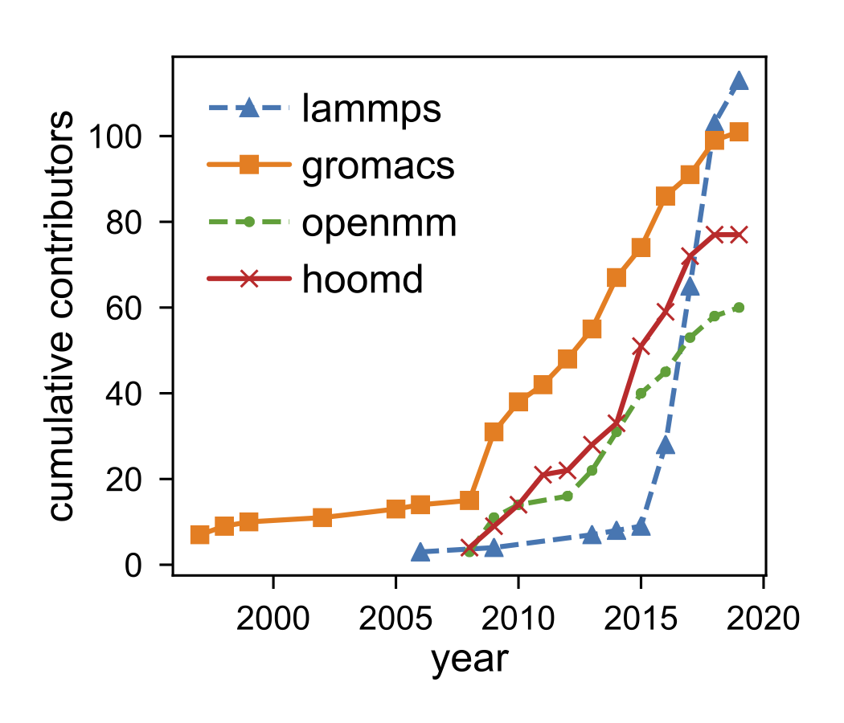
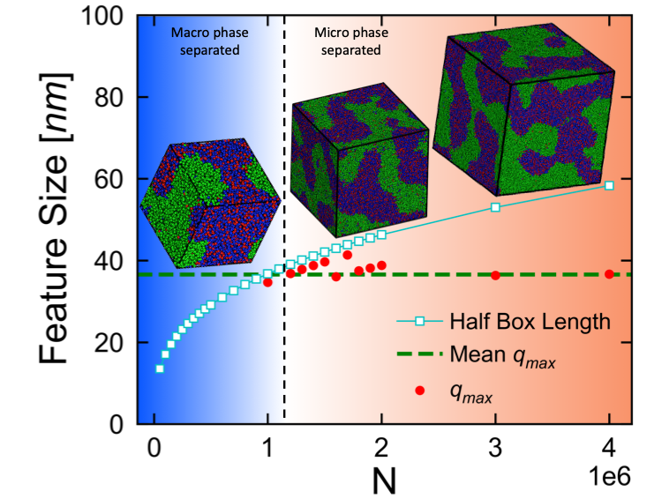


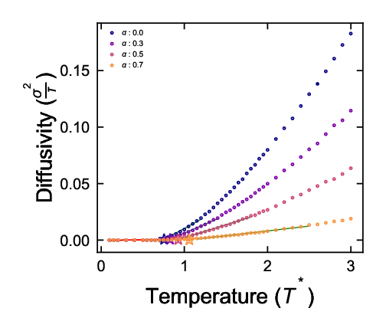
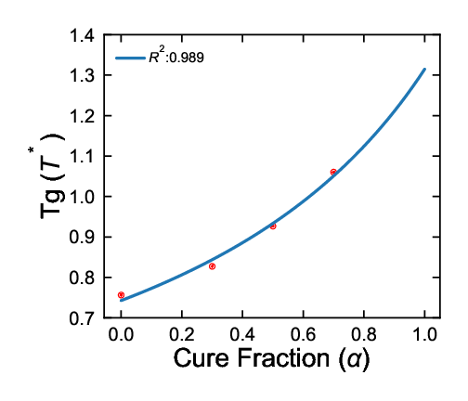
Starting simply and being nice maximizes large-scale simulation impact
Automating Transferable Coarse-Model Generation and Back-Mapping with an Open Source Toolchain
Michael Henry, Jenny Fothergill, Chris Jones, and Eric Jankowski
Aims
Experimentally relevant structure predictions enabled with coarse-grained models
Transferable, Reproducible, Usable, Extensible simulations
Approach: Improve access
Software interfaces
SMILES strings
mBuild+foyer+freud+signac = MSIBI
Community interfaces
Inclusive dev meetings
Code of conduct
Best practices
Results
Experimentally relevant time and length scales
Charge transport calculations for organic photovoltaics: N = 3.8e5, L = 15 nm, t = 3 μs
Reacting epoxy thermoset structure, Tg predictions: N = 4e6, L = 0.1 μm, ⍺ ≤ 98%
c4sc(c3sc(c2sc(c1sccc1CCCCCC)cc2CCCCCC)cc3CCCCCC)cc4CCCCCC
Non-Cognitive Predictors of Student Success: A Predictive Validity Comparison Between Domestic and International Students
c1sccc1
CCC
Get the code, paper, and more!

