Slide 1
Intro Question
What is your favorite video game/board game?

Slide 2
Design Patterns
Decorator

Slide 3
Parts of the Pattern
The Component is the interface that is to be implemented by the ConcreteComponent and the Decorator, for the objects that can have responsibilities added to them
The ConcreteComponent is the object to which additional responsibilities can be attached
The Decorator inherits off the Component interface and maintains a reference to a Component object
The Concrete Decorator adds responsibilities to the component.

Slide 4
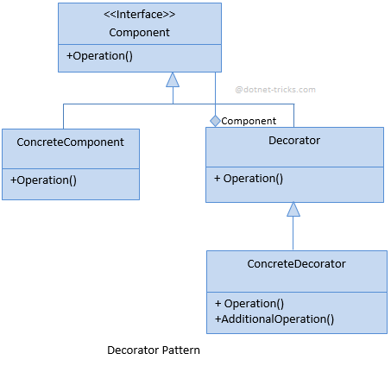
Diagram

Slide 5
Pros & Cons
Pros
Way more flexible than inheritance, can dynamically add features/responsibilities to an object without having multiple complex subclasses
Can have as many decorators as we want, also without having to worry about order that we add them
Gives additional functionality to an object without affecting any other object
Cons
You can have lots of different decorators which have similar code, makes it harder to maintain and distinguish

Slide 6
Strategy vs Decorator
Strategy allows you to change the implementation of a method/object at run time
While the Decorator allows you to augment the functionality at run time
Ex:
Sorting strategy: You could build a client that uses some sort of sorting strategy interface, ISortingStrategy, and at runtime your client would choose the appropriate implementation of ISortingStraegy. This would be harder to code with the Decorator pattern.

