Slide 1
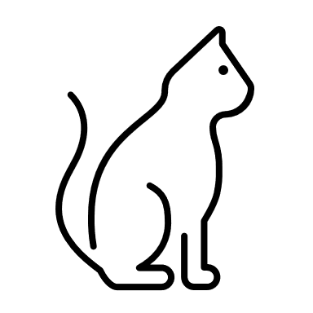
Arduino Uno
Mechanical Support
Ultrasound
Sensor
Food Bowl
distance
Bobby the cat

