Slide 1

Airline Passenger Satisfaction Prediction
Presented by:
Trina, Frances, Carolina, Iryna

Slide 2

Introduction
This project aims to develop a predictive model to determine airline passenger satisfaction using machine learning techniques, focusing on handling real-world data and optimizing model performance.

Slide 3

Data Handling
Data is retrieved from a SQL database and undergoes preprocessing steps such as encoding, normalization, and standardization to ensure the quality of input for our models.

Slide 4
Model Implementation
A Random Forest classifier is implemented with initial parameters. The model is trained on 70% of the data with a test split of 30% to evaluate performance.

Slide 5
Model Optimization
The model undergoes several iterations of hyperparameter tuning to enhance its predictive accuracy. Documentation of each step and its impact on model performance is provided.

Slide 6
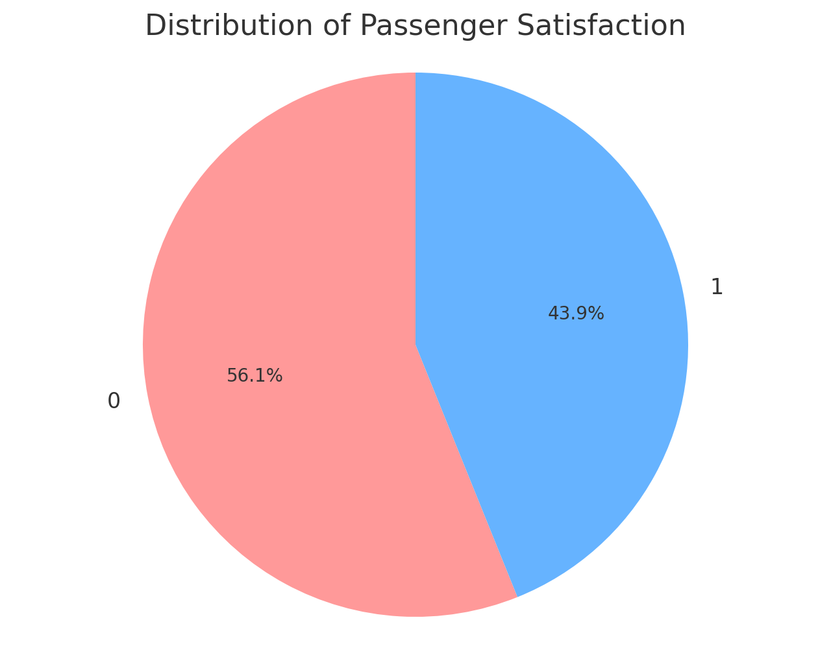
Distribution of Satisfaction A pie chart showing the proportion of satisfied versus neutral or dissatisfied passengers.

Slide 7
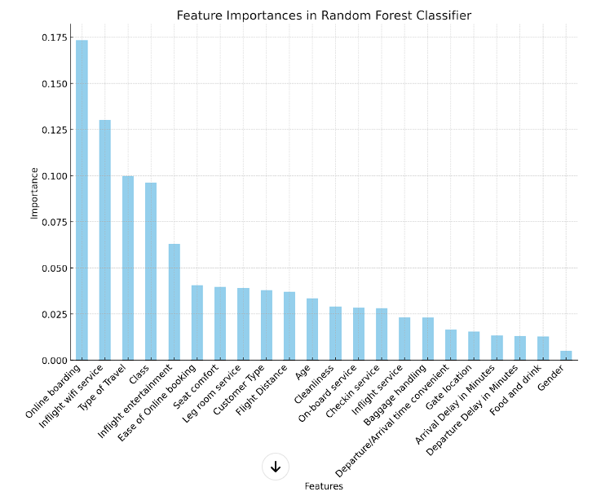
Feature Importance A bar chart from the Random Forest model illustrating which features most influence satisfaction.
This bar chart displays the feature importances, highlighting which variables are most influential in predicting passenger satisfaction according to the Random Forest model.

Slide 8
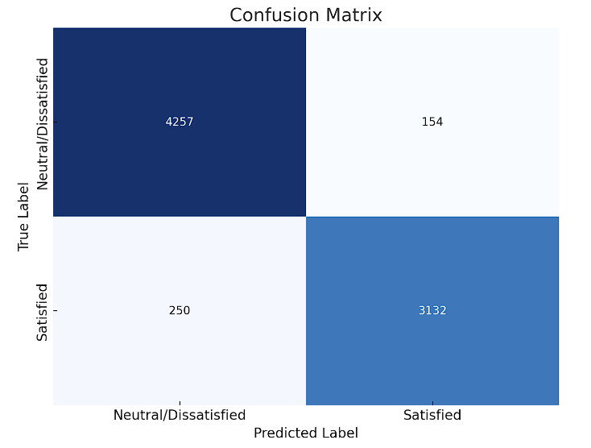
Confusion Matrix
To demonstrate how well the model distinguishes between satisfied and neutral or dissatisfied passengers.

Slide 9

Results
The optimized model achieves an accuracy of over 95%, demonstrating significant predictive power and an improvement from initial evaluations.

Slide 10

Conclusion
The project successfully predicts passenger satisfaction with high accuracy, illustrating the effectiveness of the preprocessing and optimization strategies used.

Slide 11

Q&A
Thank you for your attention. We welcome any questions or discussions about the project.

