Slide 1
Case Study Findings
August 11, 2019
Chen Meng

Slide 2
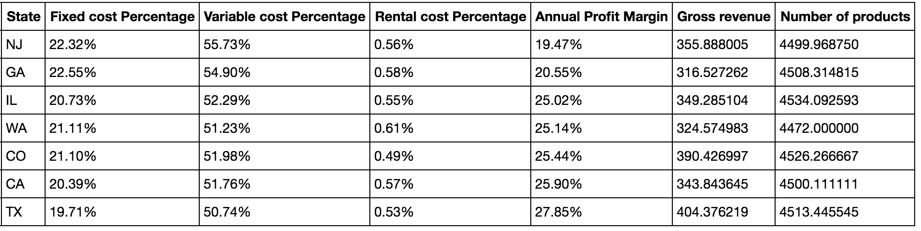
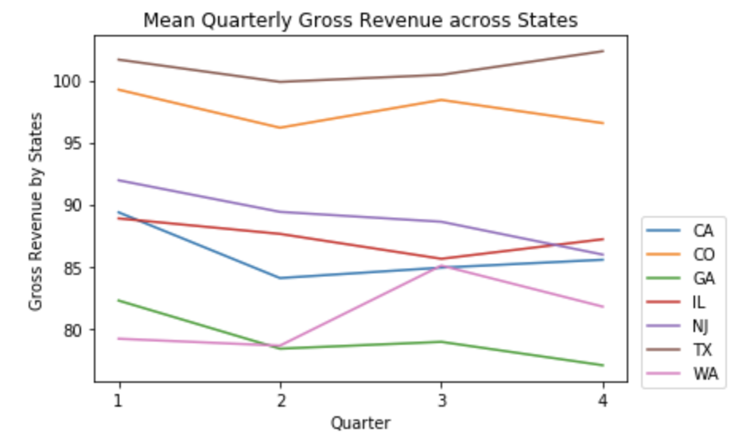
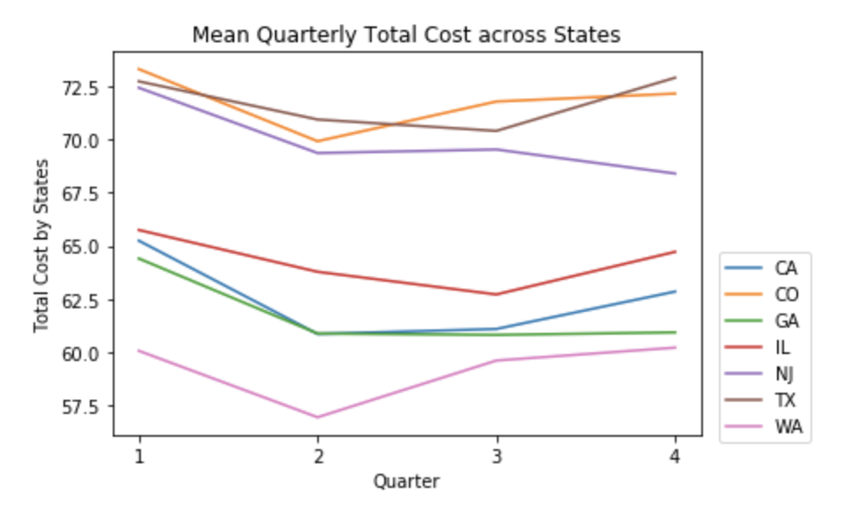
Profit Margin Analysis on State Level
Key Takeaway: NJ and GA have the lowest average annual profit margins, with NJ due to relatively high cost (both fixed and variable) and GA due to relatively low gross revenue.
Notes:
Rental cost flat, # of products flat

Slide 3
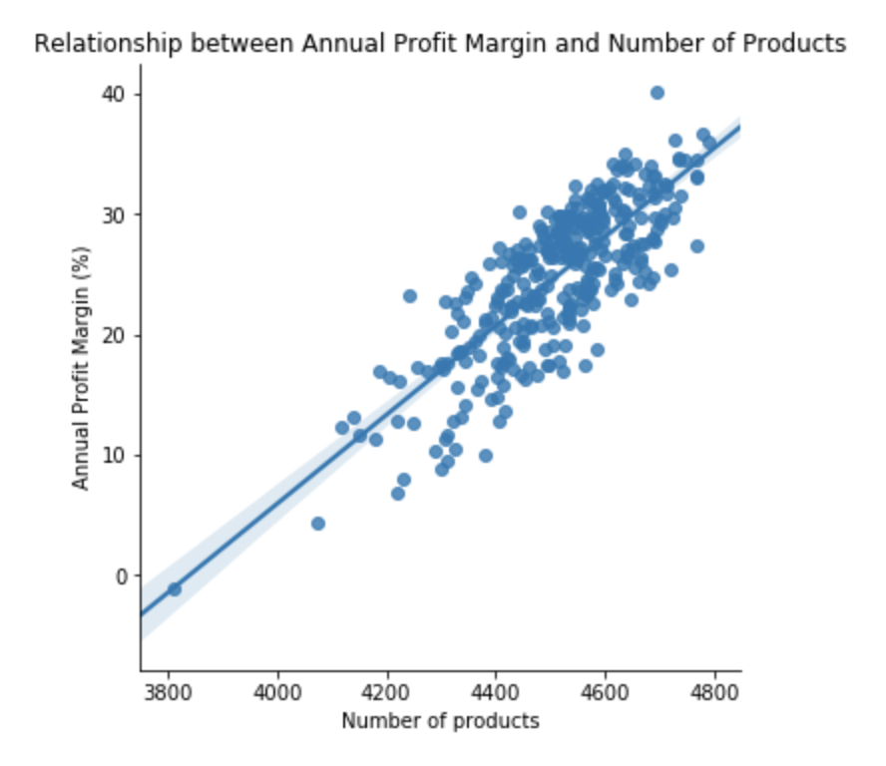
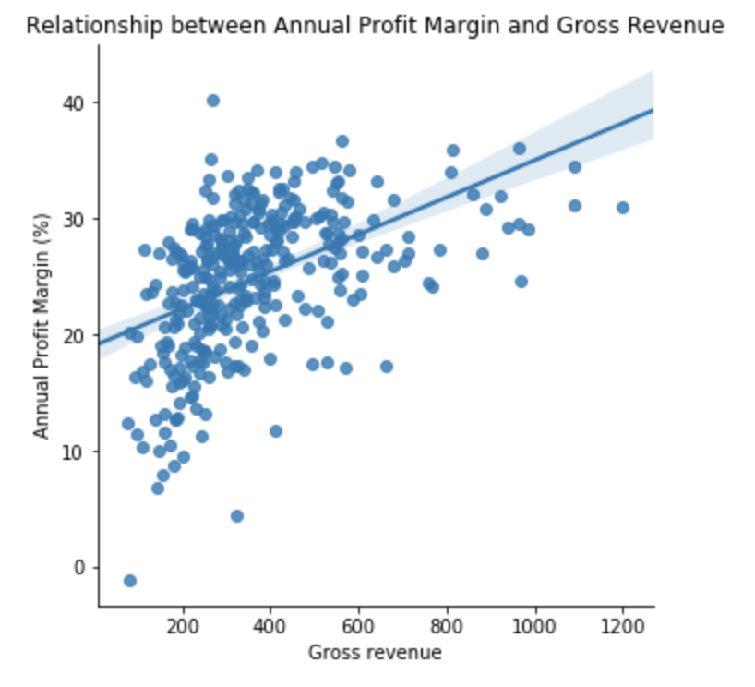
Profit Margin Analysis on Location Level
y = -141.64 + 0.0369x
R^2 = 0.645
y = 19.04 + 0.0159x
R^2 = 0.234
Annual Profit Margin = -130.2898 + 0.0043 Gross Revenue + 0.0340 # Products
Both variables are statistically significant, with R^2 = 0.658
Key Takeaway: Number of products and location size (represented by gross revenue) are highly positively correlated with profit margin at each location. To maximize profit margin, two approaches are: increasing the breadth of products offered, and expanding location size to achieve economy of scale.

Slide 4
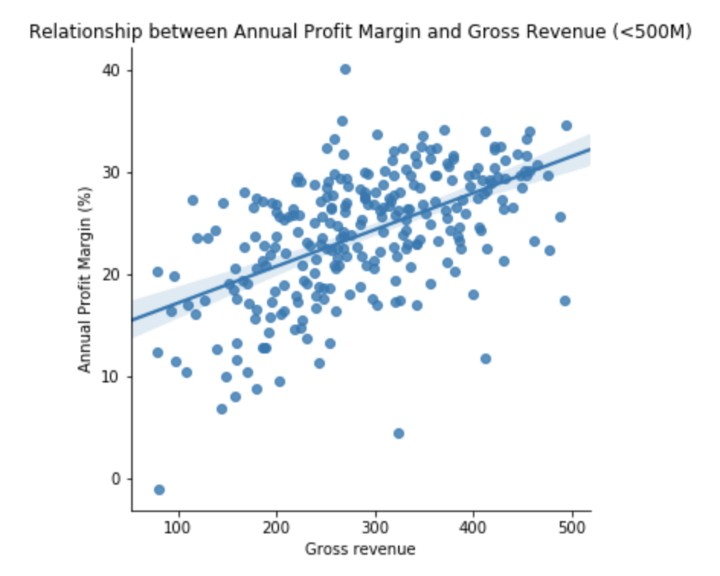
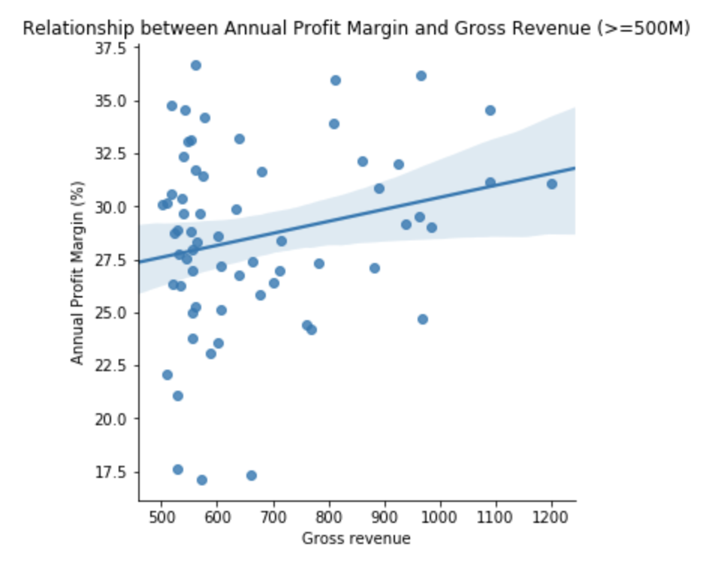
Appendix I
y = 13.57 + 0.0359x
R^2 = 0.29
y = 24.76 + 0.0056x
R^2 = 0.05
Key Takeaway: The positive relationship between profit margin and the location gross revenue is manifested the most for smaller locations (specifically with gross revenue less than 500M).

