Slide 1
JP Morgan Transaction Fraud Detection
Cassidy Mentus

Slide 2
Summary
Recover $ X per transaction using our model. Includes the cost of reviewing mislabeled transactions.
  Sum of $ recovered - $200 x # identified as fraud.
Develop performance metrics robust to different prevalences and price ranges of fraud.
  AUC of Precision, Recall ($amt basis) curve.
Tackle challenge of missing data and class imbalance (<5% fraudulent transactions.)
Investigate performance changes using features with the least – most missing entries.
Introduce new features: sending account age + parse beneficiary name.
Measure impact features have on prediction.

Slide 3
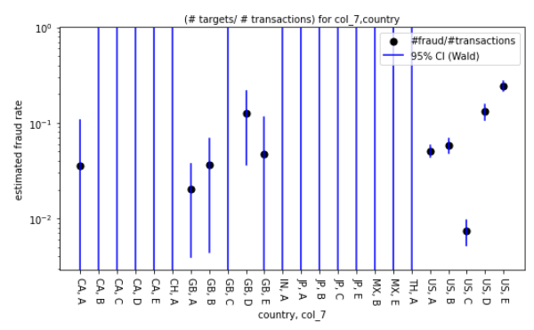
Tour of data
Cross section of categorical data – country + col_7.

Slide 4
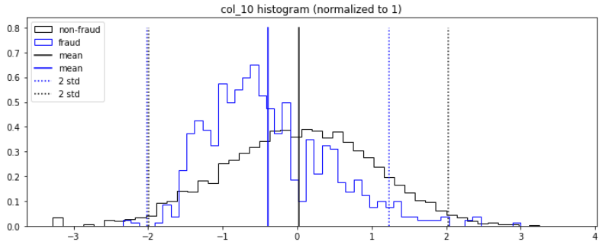
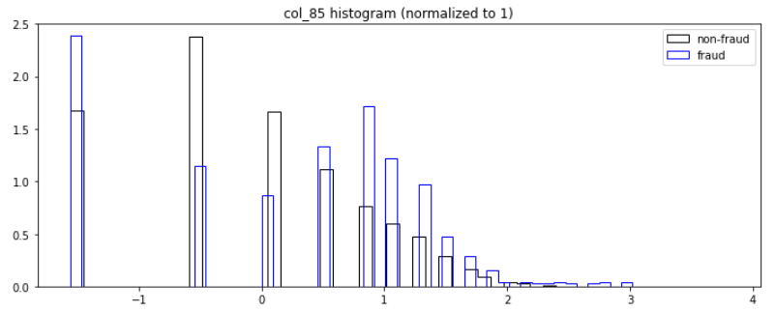
Tour of data

Slide 5
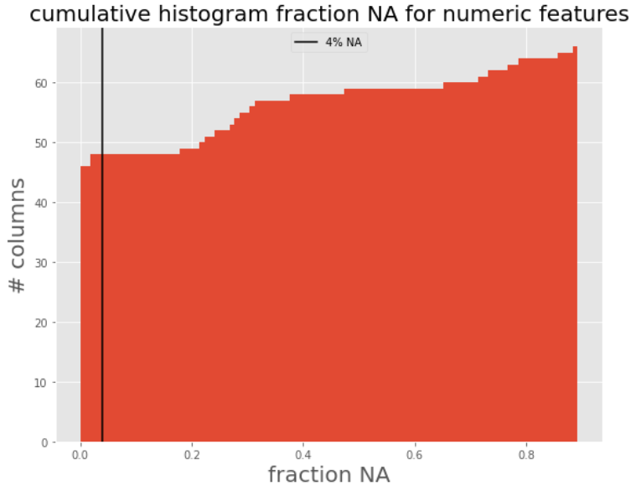
Missing values
66 numeric columns. Prevalence missing values (NA) between 0% 90%. 47 out of 77 have low (<4%) NA.
Impute NA in each row using the mean of 3 nearest neighbors utilizing the filled entries in the row.
Imputation is an imperfect solution.
Train-test models on admitting columns with <4%, <60%, <100% NA.

Slide 6
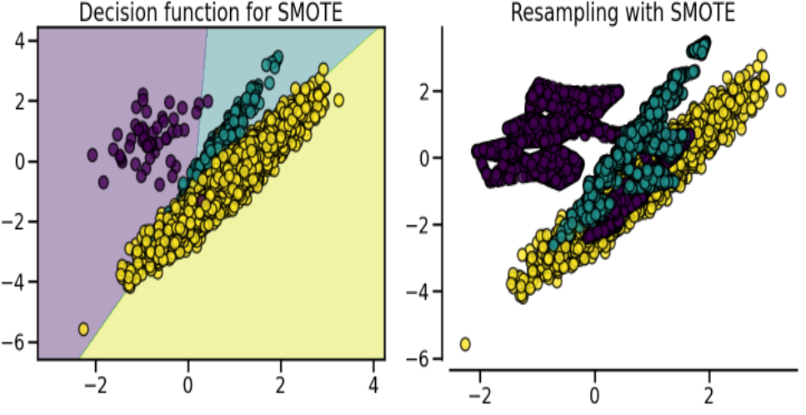
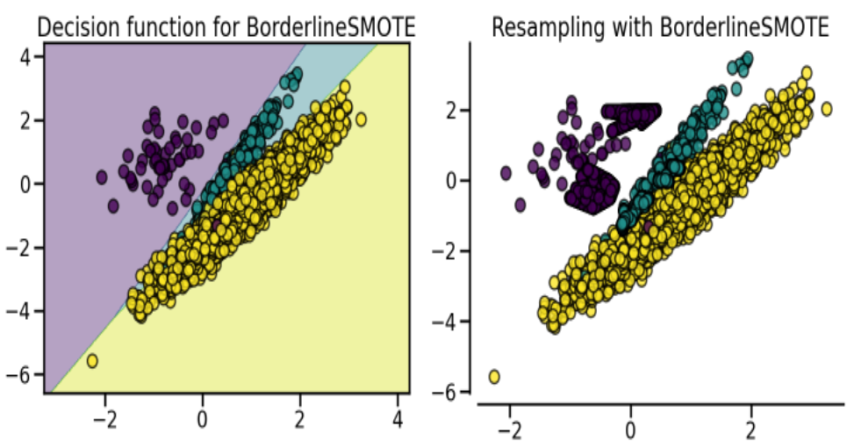
Data imbalance solution
Heavy class imbalance: 4.3% fraud. 95.7% - not fraud.
Use BorderlineSMOTE to over-sample synthetic points from the minority class.
Apply only to the training set.
Best results compared to other SMOTE variants and applying weights to data

Slide 7
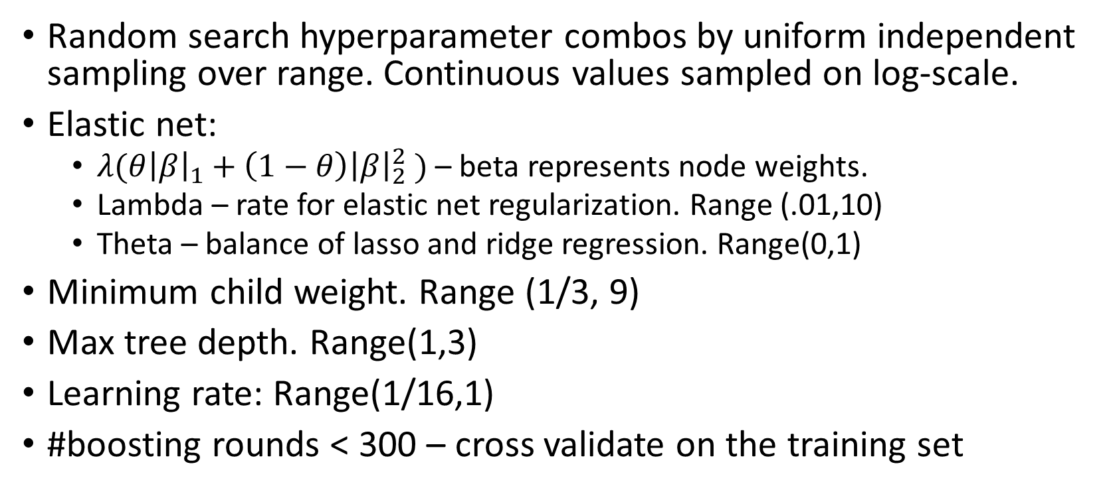
XGBoost Gradient boosted trees hyperparameters
Random search hyperparameter combos by uniform independent sampling over range. Continuous values sampled on log-scale.
Elastic net:
  $λ({θ\left|β\right|}_{1}+\left(1−θ\right){\left|β\right|}_{2}^{2} )$ – beta represents node weights.
  Lambda – rate for elastic net regularization. Range (.01,10)
  Theta – balance of lasso and ridge regression. Range(0,1)
Minimum child weight. Range (1/3, 9)
Max tree depth. Range(1,3)
Learning rate: Range(1/16,1)
#boosting rounds < 300 – cross validate on the training set

Slide 8
Model workflow
Split data into training 70%, validation 15% and test 15% sets.
On all data: fit one-hot encoder for categorical features. Fit count vectorizer on beneficiary names. Compute account age (transaction date – acct creation date).
Fit knn imputer on numeric features in training data.
Augment training data - oversample fraud class with SMOTE.
Fit XGBoost for a set of hyperparameters:
  Cross validate (in parallel) on training data to optimize # rounds for hyperparameter combination (performance metric AUC-PR).
  Train model using optimal rounds. Measure AUC – PR ($amt basis on validation).

Slide 9
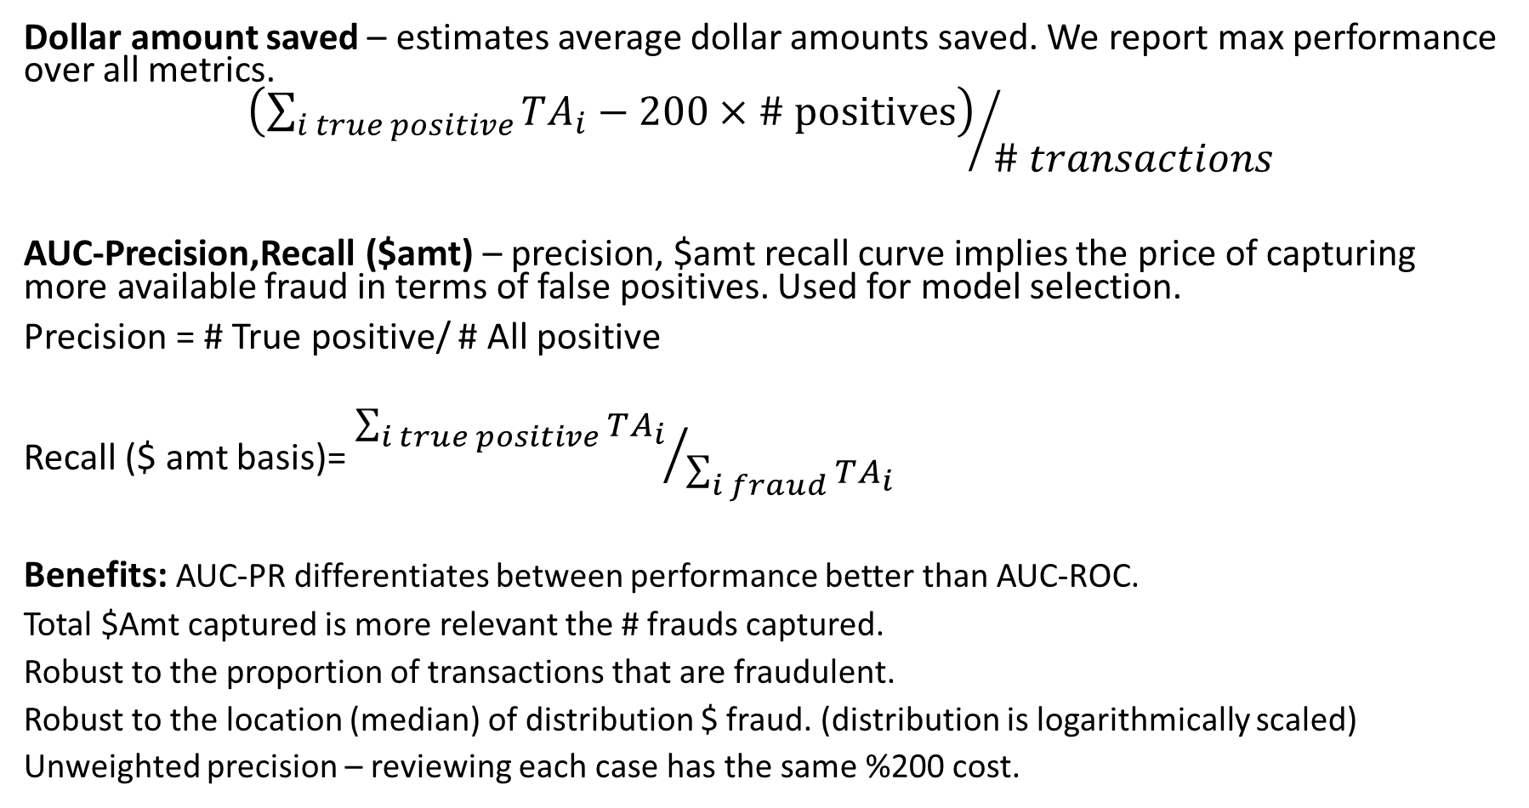
Performance metrics
Dollar amount saved – estimates average dollar amounts saved. We report max performance over all metrics.
$${\left(\sum_{i true positive}{TA_{i}}−200×\# \text{positives}\right)}/{\# transactions}$$
AUC-Precision,Recall ($amt) – precision, $amt recall curve implies the price of capturing more available fraud in terms of false positives. Used for model selection.
Precision = # True positive/ # All positive
Recall ($ amt basis)= ${\sum_{i true positive}{TA_{i}}}/{\sum_{i fraud}{TA_{i}}}$
Benefits: AUC-PR differentiates between performance better than AUC-ROC.
Total $Amt captured is more relevant the # frauds captured.
Robust to the proportion of transactions that are fraudulent.
Robust to the location (median) of distribution $ fraud. (distribution is logarithmically scaled)
Unweighted precision – reviewing each case has the same %200 cost.

Slide 10
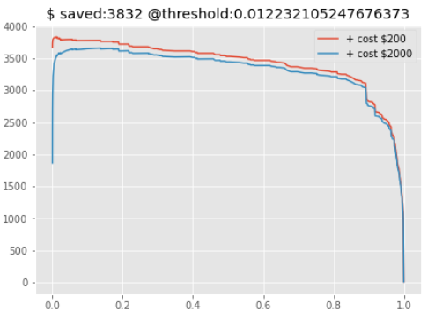
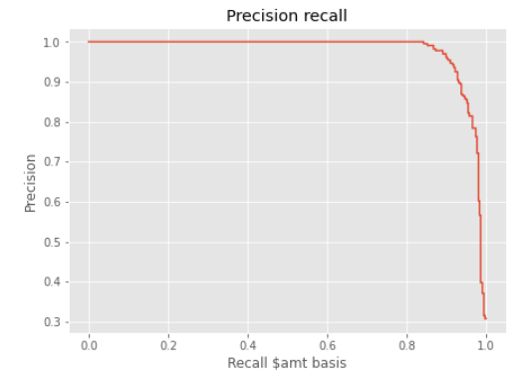
Results: best model
Hyper parameters: 'max_depth': 1.0, 'eta': 0.26, 'objective': 'binary:logistic', 'lambda': 0.00498, 'alpha': 0.011,
'min_child_weight': 4.46, 'eval_metric': 'aucpr', 'frac_nan': 0.6

Slide 11
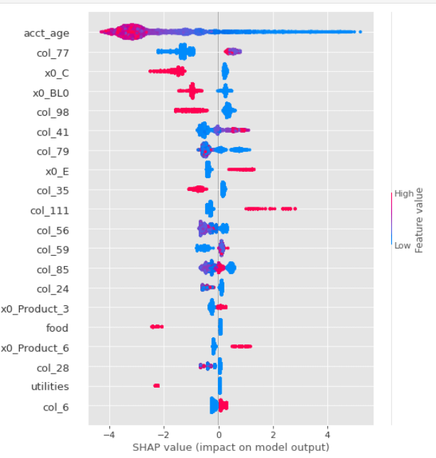
Feature importance best model

Slide 12
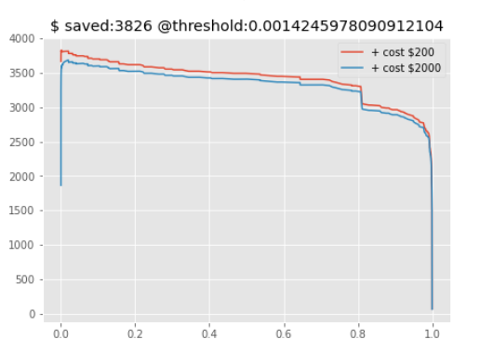
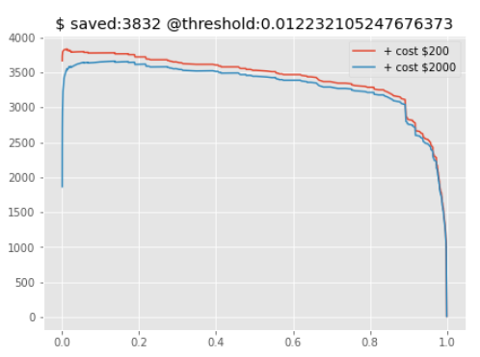
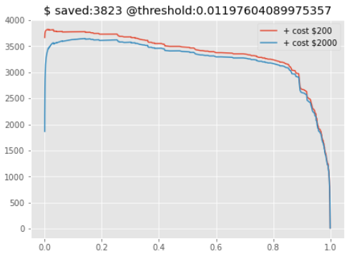
Results for different levels of missing values
<4% missing
<60% missing
<100% missing

