Slide 1
Credit default risk model
Cassidy Mentus

Slide 2
Code and repository
train_models.ipynb – Create and train models.
Load data, create train test sets, build logistic regression and lightgbm sklearn pipelines with cross-validation.
analyze_models.ipynb – Analyze models and data.
load train/test sets, load model .joblib files, analyze models (coefficients, SHAP, numerical results), analyze data.
logistic_pipeline.html – sklearn pipeline of logistic regression model.
Includes grid-search cross-validation, feature transformations and model.
Gbdt_pipeline.html –sklearn pipeline of light gbm gradiend boosted tree model.
Includes random-search cross-validation, lightgbm model and CV- probability calibration.

Slide 3
Goal
Design, build and benchmark an ML model to predict risk of default given applicant data and credit $ amount.
The model will be able to do the following:
Score credit applications. Calculate a risk score given applicant credit indicators that ranks credit by it’s default risk for typical credit amounts. Used to approve/deny credit applications.
Risk score for different credit $ amounts. For approved apps, calculate default risk given applicant info and user input credit amount. Used to determine credit limits.
Other predictions and estimates. E.g. Expected time to default, probability of default by 12 mo., expected cashflow.
To optimally perform these functions the model must be both discriminative and calibrated (accurate probabilities).

Slide 4
Project summary
Credit default data
Given 1000 rows of data consisting of applicant credit variables, duration from time of credit origination, credit $ amount and binary defaulted status.
Discuss the process of credit and $ amount approval.
Data can be used to estimate the probability of default occurring by any time duration, suggesting a way to …
Model credit default risk
Given applicant variables and loan amount, we predict the curve of probability of default as time elapses. Equivalent to a survival model approach.
Equivalent to the simpler task of classifying default using credit vars, amount and duration as inputs.
Candidate models based on gradient boosted decision trees and regularized logistic regression. Probability calibration of tree ensemble model.
How to score new applications and risk for different credit amounts.
Model outputs numbers for given duration. For an application, we can vary duration producing a curve of probabilities.
Score applications by flattening the model output. Average over duration and credit amount from training distribution, producing a single numeric value.

Slide 5
Project outline continued
Measuring model performance
Develop ways to measure ability to predict risk of default for credit originating at the same time (within cohort)
Idea: Calculate the metric for data at each fixed duration. Then take the average over all durations.
Present model performance metrics.
Model final selection.
Results and analysis
Demonstrate model outputs such as survival curves and duration x credit amt risk heat maps.
Feature importance using Shapely values.

Slide 6
Credit default data

Slide 7
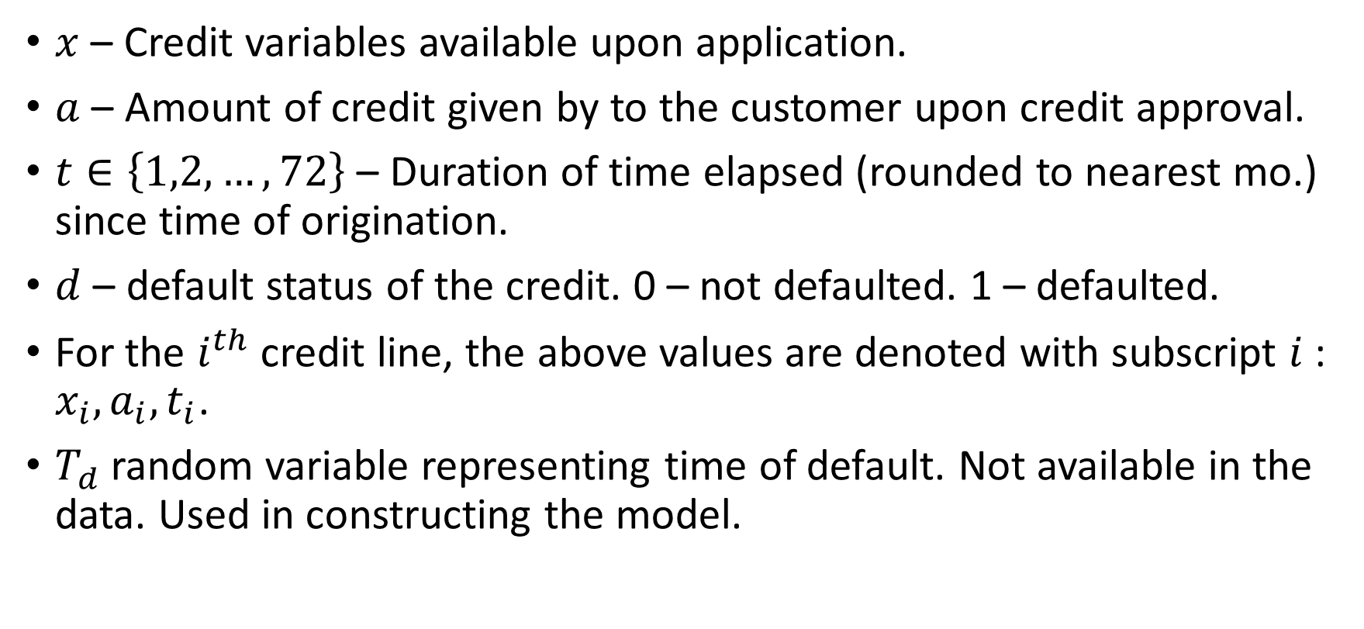
Definitions
$x$ – Credit variables available upon application.
$a$ – Amount of credit given by to the customer upon credit approval.
$t∈\left\{1,2,…,72\right\}$ – Duration of time elapsed (rounded to nearest mo.) since time of origination.
$d$ – default status of the credit. 0 – not defaulted. 1 – defaulted.
For the $i^{th}$ credit line, the above values are denoted with subscript $i$ : $x_{i},a_{i},t_{i}$.
$T_{d}$ random variable representing time of default. Not available in the data. Used in constructing the model.

Slide 8
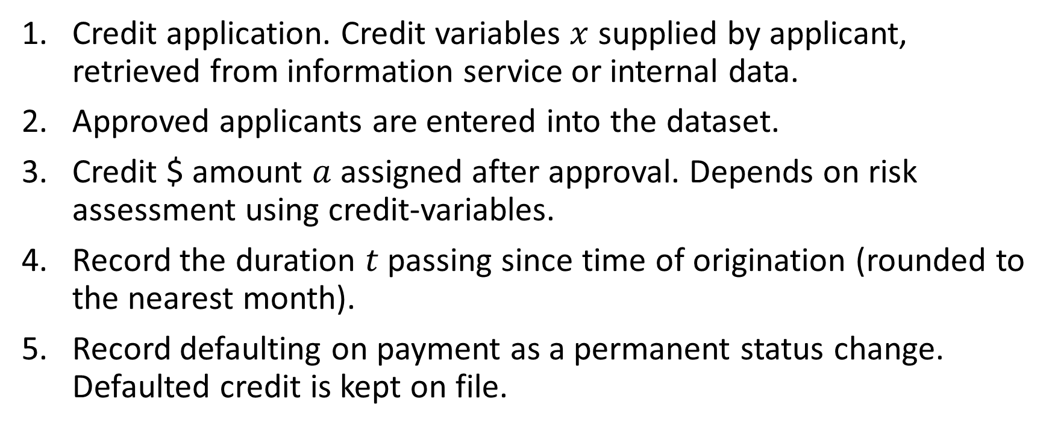
The credit data generating process
Credit application. Credit variables $x$ supplied by applicant, retrieved from information service or internal data.
Approved applicants are entered into the dataset.
Credit $ amount $a$ assigned after approval. Depends on risk assessment using credit-variables.
Record the duration $t$ passing since time of origination (rounded to the nearest month).
Record defaulting on payment as a permanent status change. Defaulted credit is kept on file.

Slide 9
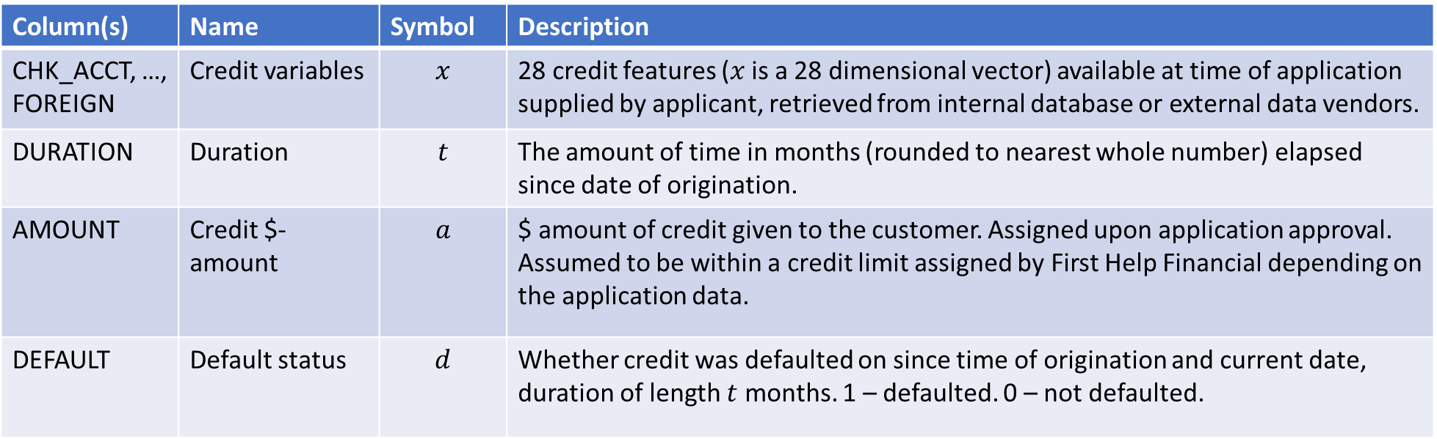
Dataset
Data for 1000 credit lines originating as far back as 6 years ago (72 months) from the current date (date of last data retrieval) with the following variables.
Column(s) | Name | Symbol | Description
CHK_ACCT, …, FOREIGN | Credit variables | $$x$$ | 28 credit features ($x$ is a 28 dimensional vector) available at time of application supplied by applicant, retrieved from internal database or external data vendors.
DURATION | Duration | $$t$$ | The amount of time in months (rounded to nearest whole number) elapsed since date of origination.
AMOUNT | Credit $-amount | $$a$$ | $ amount of credit given to the customer. Assigned upon application approval. Assumed to be within a credit limit assigned by First Help Financial depending on the application data.
DEFAULT | Default status | $$d$$ | Whether credit was defaulted on since time of origination and current date, duration of length $t$ months. 1 – defaulted. 0 – not defaulted.

Slide 10
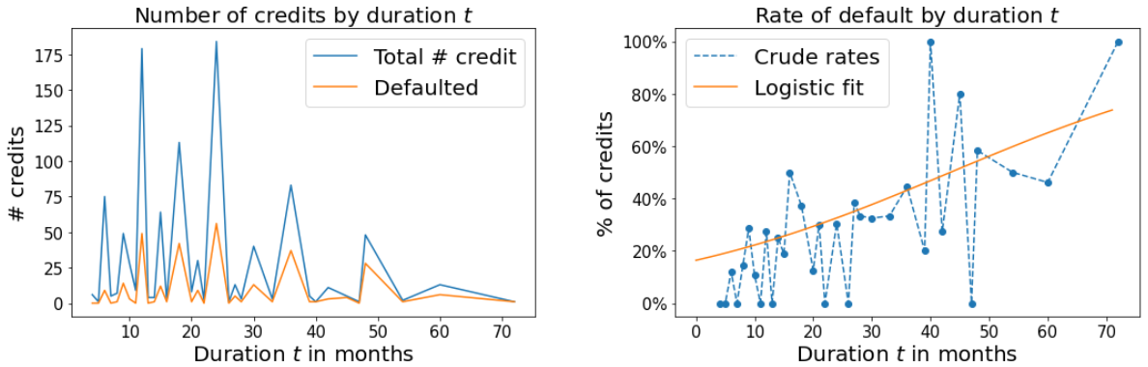
Data volumes and default rates by duration

Slide 11
Modeling credit default risk
Predicting the risk that a customer defaults on their credit as time progresses based on credit variables and credit $ amount. Describe and justify model design choices leading up to the model blueprint.

Slide 12
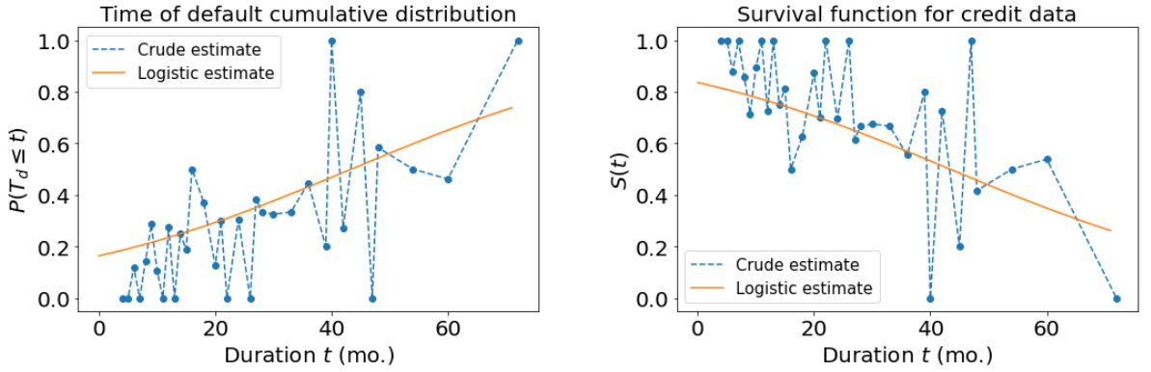
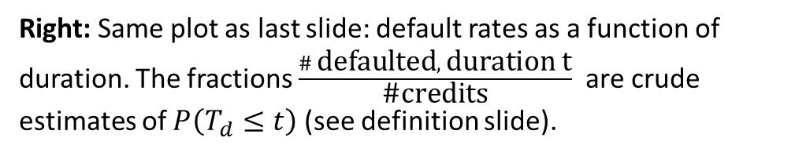
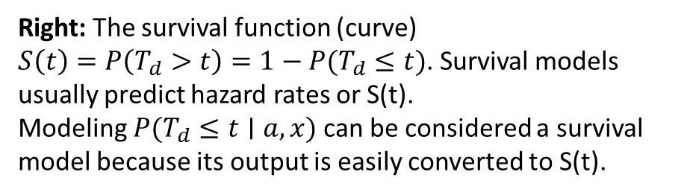
Survival analysis of credit defaults
Right: The survival function (curve)
$S\left(t\right)=P\left(T_{d}>t\right)=1−P(T_{d}≤t)$. Survival models usually predict hazard rates or S(t).
Modeling $P(T_{d}≤t∣a,x)$can be considered a survival model because its output is easily converted to S(t).
Right: Same plot as last slide: default rates as a function of duration. The fractions $\frac{\# \text{defaulted}, \text{duration} \text{t}}{\text{\#}\text{credits}}$ are crude estimates of $P\left(T_{d}≤t\right)$ (see definition slide).

Slide 13
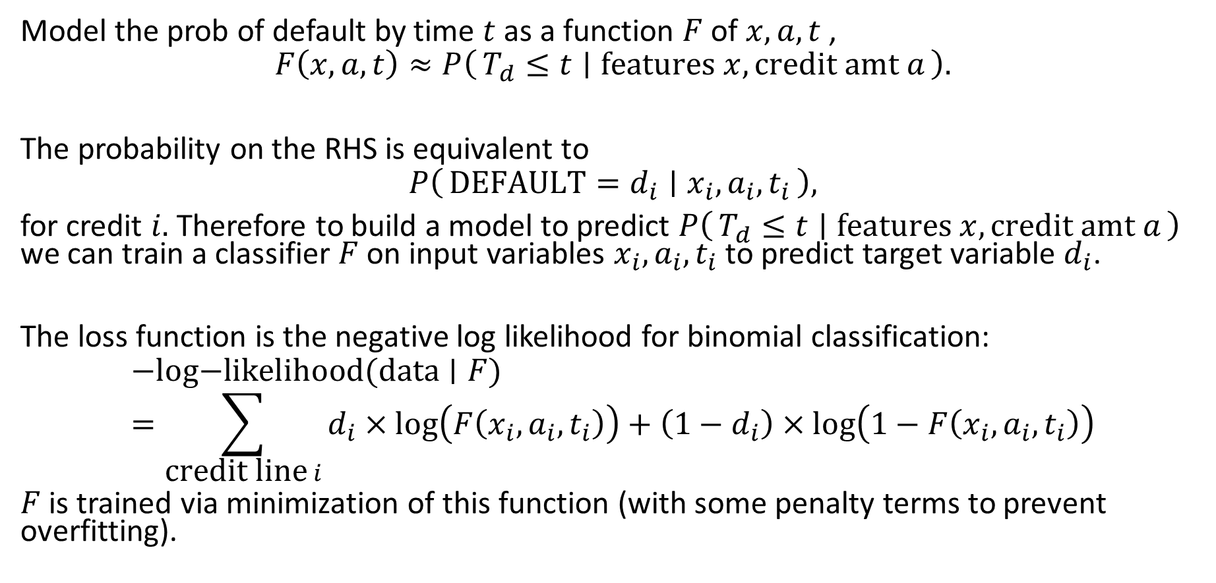
Credit survival expressed as classification problem
Model the prob of default by time $t$ as a function $F$ of $x,a,t$ ,
$$F\left(x,a,t\right)≈P\left(T_{d}≤t ∣ \text{features} x, \text{credit} \text{amt} a\right).$$
The probability on the RHS is equivalent to
$$P\left(\text{DEFAULT}=d_{i} ∣ x_{i},a_{i},t_{i}\right),$$
for credit $i.$Therefore to build a model to predict $P\left(T_{d}≤t ∣ \text{features} x, \text{credit} \text{amt} a\right)$ we can train a classifier $F$ on input variables $x_{i},a_{i},t_{i}$ to predict target variable $d_{i}$.
The loss function is the negative log likelihood for binomial classification:
$$−\text{log}\text{−}\text{likelihood}\text{(}\text{data}∣F)=\sum_{\text{credit} \text{line} i}{d_{i}×log\left(F\left(x_{i},a_{i},t_{i}\right)\right)+\left(1−d_{i}\right)×log\left(1−F\left(x_{i},a_{i},t_{i}\right)\right)}$$
$F$ is trained via minimization of this function (with some penalty terms to prevent overfitting).

Slide 14
Effect of credit $ amount on default risk
Predicting credit limits requires estimating the effect different credit amounts have on default risk.
Data credit amounts are the result of the firm’s estimated risk for the customer using applicant data.
There is a causal link between the customer’s credit features and the AMOUNT variable in the data.
Since credit variables cause both the
Accounting for the confounding credit variables requires interactions terms with AMOUNT and credit features in the model.
Credit features
causes
causes
AMOUNT
causes
Default risk

Slide 15


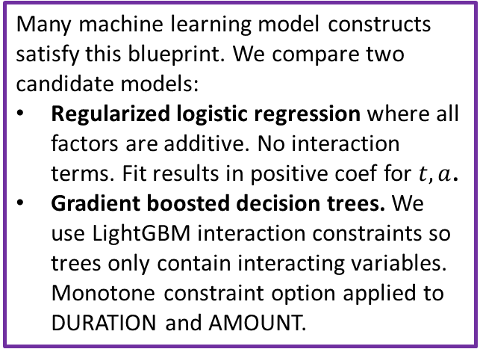
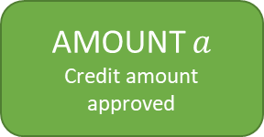


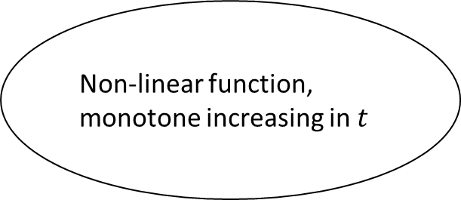
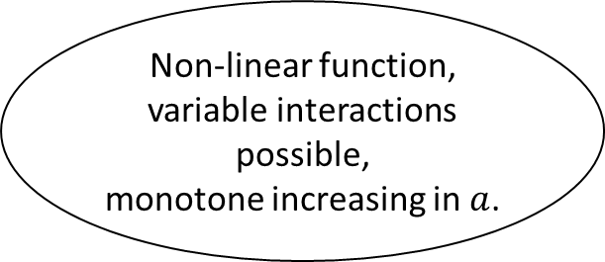
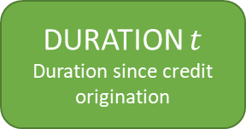
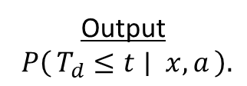
Model blueprint
Duration $t$ has an additive effect, separated from interactions with other features.
Results in credit time-risk curves having same baseline trend shifted higher/lower by a function of $a,x$.
Guarantee risk extrapolates to later durations.
Non-linear function, monotone increasing in $t$
DURATION $t$
Duration since credit origination
Output
$P\left(T_{d}≤t ∣ x, a\right).$
logit
$$\frac{e^{x}}{1+e^{x}}$$
Monotone increasing because $P\left(T_{d}≤t\right)$ is an increasing function of t.
Credit variables $x$
Non-linear function, variable interactions possible,
monotone increasing in $a$.
Many machine learning model constructs satisfy this blueprint. We compare two candidate models:
Regularized logistic regression where all factors are additive. No interaction terms. Fit results in positive coef for $t,a$.
Gradient boosted decision trees. We use LightGBM interaction constraints so trees only contain interacting variables. Monotone constraint option applied to DURATION and AMOUNT.
(Interactions)
AMOUNT $a$
Credit amount approved
Monotone increasing because assumption:
holding other variables constant,
more credit => larger installments => more default risk.

Slide 16
Model descriptions
Design and describe in details models to predict default risk according to our blue print. Models represent the two major opposing approaches to ML:
1.Explainable by design, transparent, and often parametric.
2.Algorithmic, black-box, yet expressive models. Potential for high performance.
Logistic regression. Gradient boosted decision trees.

Slide 17
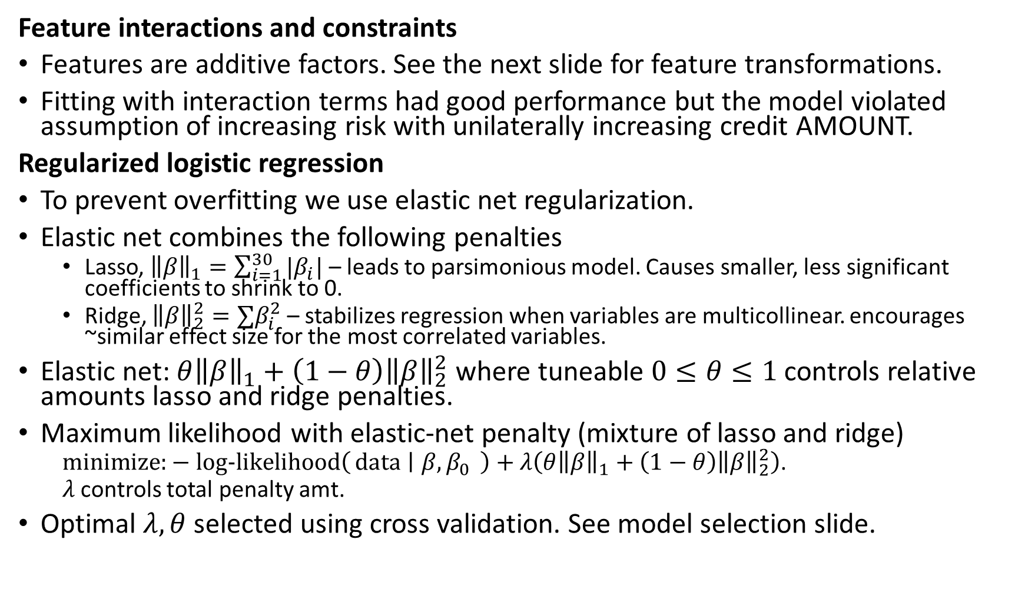
Model description: Logistic regression (LR)
See appendix for implementation details
Feature interactions and constraints
Features are additive factors. See the next slide for feature transformations.
Fitting with interaction terms had good performance but the model violated assumption of increasing risk with unilaterally increasing credit AMOUNT.
Regularized logistic regression
To prevent overfitting we use elastic net regularization.
Elastic net combines the following penalties
Lasso, ${\left\|β\right\|}_{1}=\sum_{i=1}^{30}{|β_{i}|}$ – leads to parsimonious model. Causes smaller, less significant coefficients to shrink to 0.
Ridge, ${\left\|β\right\|}_{2}^{2}=∑β_{i}^{2}$ – stabilizes regression when variables are multicollinear. encourages ~similar effect size for the most correlated variables.
Elastic net: $θ{\left\|β\right\|}_{1}+\left(1−θ\right){\left\|β\right\|}_{2}^{2}$ where tuneable $0≤θ≤1$ controls relative amounts lasso and ridge penalties.
Maximum likelihood with elastic-net penalty (mixture of lasso and ridge)
$\text{minimize}\text{:}−\text{log}\text{−}\text{likelihood}\left(\text{data} ∣ β,β_{0} \right)+λ\left(θ{\left\|β\right\|}_{1}+\left(1−θ\right){\left\|β\right\|}_{2}^{2}\right)$.
$λ$ controls total penalty amt.
Optimal $λ,θ$ selected using cross validation. See model selection slide.

Slide 18
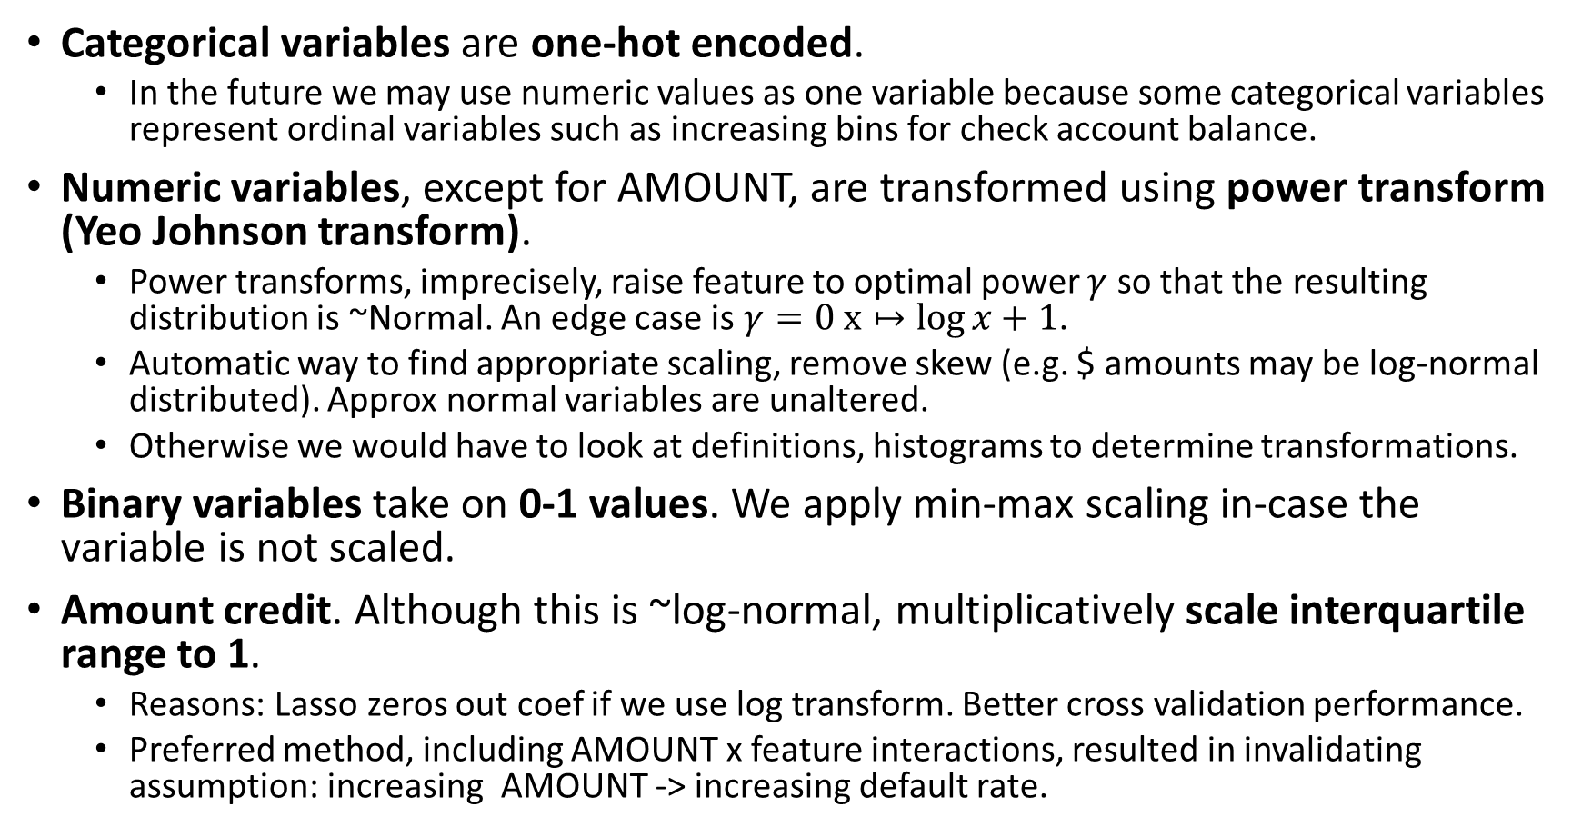
Logistic regression feature pre-processing
Categorical variables are one-hot encoded.
In the future we may use numeric values as one variable because some categorical variables represent ordinal variables such as increasing bins for check account balance.
Numeric variables, except for AMOUNT, are transformed using power transform (Yeo Johnson transform).
Power transforms, imprecisely, raise feature to optimal power $γ$ so that the resulting distribution is ~Normal. An edge case is $γ=0$ $x↦\log{x+1}$.
Automatic way to find appropriate scaling, remove skew (e.g. $ amounts may be log-normal distributed). Approx normal variables are unaltered.
Otherwise we would have to look at definitions, histograms to determine transformations.
Binary variables take on 0-1 values. We apply min-max scaling in-case the variable is not scaled.
Amount credit. Although this is ~log-normal, multiplicatively scale interquartile range to 1.
Reasons: Lasso zeros out coef if we use log transform. Better cross validation performance.
Preferred method, including AMOUNT x feature interactions, resulted in invalidating assumption: increasing AMOUNT -> increasing default rate.

Slide 19
Model description: Calibrated gradient boosted decision trees (GBDT)
See appendix for implementation details
Implementation
LightGBM (Microsoft) GBDT is used for its performance, speed, efficient handling of categorical variables and options for model tuning.
DART booster drops a 10% of trees each iteration preventing overfitting and sensitivity to number of iterations.
Feature interactions and constraints
LightGBM interaction constraint applied to allow interactions within the groupings {DURATION}, {AMOUNT, all other credit features}.
Results in two types of decision trees:
trees containing only splits along DURATION,
trees containing splits along any input variable except for DURATION.
Monotone increasing constraint applied to DURATION and AMOUNT.
Feature transformations are unnecessary for tree-based models. LightGBM does not require one-hot encoding of categorical variables.
Probability calibration
Tree ensembles, although discriminative classifiers, tend to produce inaccurate likelihood estimates. They are uncalibrated.
Logistic regression does not face this problem.
Cross-validation (CV) calibration with logistic regression method:
Generate 5 fold cross-validation train-test subset pairs.
For each fold: fit GBDT on ‘train’ subsets + fit logistic regression: GBDT outputs -> DEFAULTED on ‘test’ subsets
Finally, ensemble average the 5 GBDT -> logistic regression pipelines.

Slide 20
Credit risk scores
Using the model, we define a single numeric credit score to form a criteria for credit approval/denial given their application info. Define a score incorporating credit amount to use in deciding credit limits.

Slide 21
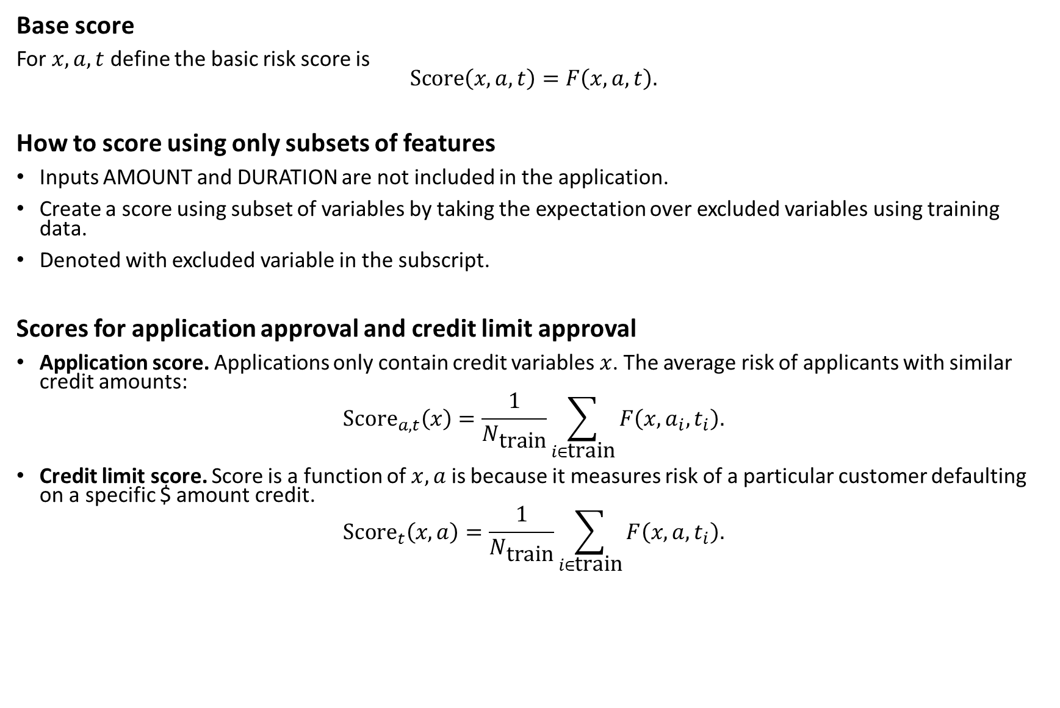
Score definitions
Base score
For $x,a,t$ define the basic risk score is $$\text{Score}\left(x,a,t\right)=F\left(x,a,t\right).$$
How to score using only subsets of features
Inputs AMOUNT and DURATION are not included in the application.
Create a score using subset of variables by taking the expectation over excluded variables using training data.
Denoted with excluded variable in the subscript.
Scores for application approval and credit limit approval
Application score. Applications only contain credit variables $x$. The average risk of applicants with similar credit amounts:
$${\text{Score}}_{a,t}\left(x\right)=\frac{1}{N_{\text{train}}}\sum_{i∈\text{train}}{F\left(x,a_{i},t_{i}\right).}$$
Credit limit score. Score is a function of $x,a$ is because it measures risk of a particular customer defaulting on a specific $ amount credit.
$${\text{Score}}_{t}\left(x,a\right)=\frac{1}{N_{\text{train}}}\sum_{i∈\text{train}}{F\left(x,a,t_{i}\right).}$$

Slide 22
Model performance benchmarks and selection
Define useful metrics for measure the performance of models predicting default risk over time. Train (cross-validate) and benchmark scores (see last section) for both models. Report cross-validation and benchmarking metrics. Select one model from our choices.

Slide 23
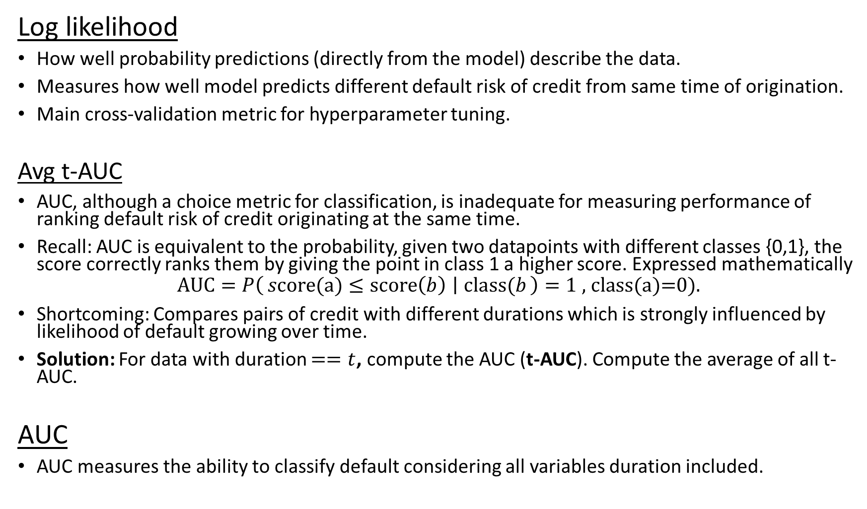
Model performance metrics
Log likelihood
How well probability predictions (directly from the model) describe the data.
Measures how well model predicts different default risk of credit from same time of origination.
Main cross-validation metric for hyperparameter tuning.
Avg t-AUC
AUC, although a choice metric for classification, is inadequate for measuring performance of ranking default risk of credit originating at the same time.
Recall: AUC is equivalent to the probability, given two datapoints with different classes {0,1}, the score correctly ranks them by giving the point in class 1 a higher score. Expressed mathematically
$$\text{AUC}=P\left(s\text{core}\text{(}\text{a}\text{)}≤score\left(b\right) ∣ \text{class}\text{(}b\right)=1 \text{, }\text{class}\text{(}\text{a}\text{)=0).}$$
Shortcoming: Compares pairs of credit with different durations which is strongly influenced by likelihood of default growing over time.
Solution: For data with duration $==t$, compute the AUC (t-AUC). Compute the average of all t-AUC.
AUC
AUC measures the ability to classify default considering all variables duration included.

Slide 24
Training and benchmark setup
Training and testing datasets selected using 80:20 random stratified train-test split.
Training data – 800 rows
Testing data – 200 rows
Hyperparameters for both models tuned on the training data using the same stratified 10-fold cross-validation folds.
Both cross validations use same folds, making it valid to compare cv metrics for both model constructs.

Slide 25
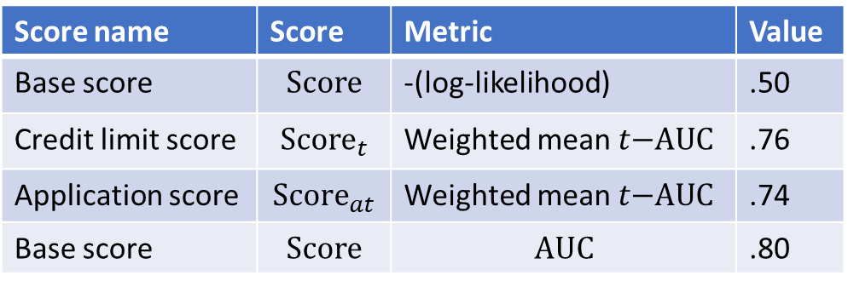
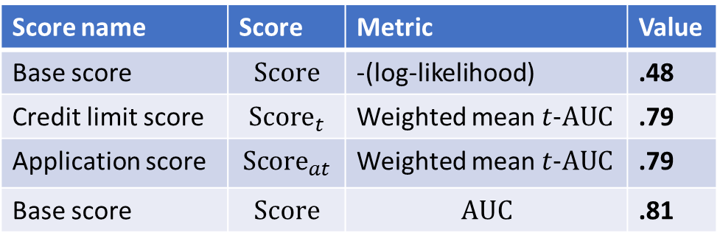
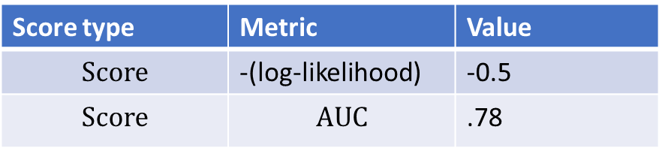
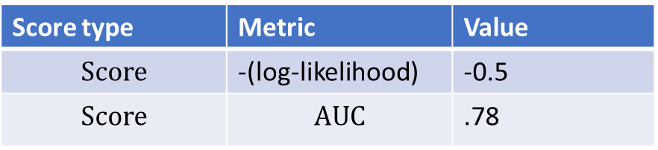
Model performance
Logistic regression
Benchmark performance (test set)
Gradient boosted decision trees
Benchmark performance
Score name | Score | Metric | Value
Base score | $$\text{Score}$$ | -(log-likelihood) | .48
Credit limit score | $${\text{Score}}_{t}$$ | Weighted mean $t\text{-}\text{AUC}$ | .79
Application score | $${\text{Score}}_{at}$$ | Weighted mean $t\text{-}\text{AUC}$ | .79
Base score | $$\text{Score}$$ | $$\text{AUC}$$ | .81
Score name | Score | Metric | Value
Base score | $$\text{Score}$$ | -(log-likelihood) | .50
Credit limit score | $${\text{Score}}_{t}$$ | Weighted mean $t\text{−}\text{AUC}$ | .76
Application score | $${\text{Score}}_{at}$$ | Weighted mean $t\text{−}\text{AUC}$ | .74
Base score | $$\text{Score}$$ | $$\text{AUC}$$ | .80
Cross validation (training set)
Cross validation (training set)
Score type | Metric | Value
$$\text{Score}$$ | -(log-likelihood) | -0.5
$$\text{Score}$$ | $$\text{AUC}$$ | .78
Score type | Metric | Value
$$\text{Score}$$ | -(log-likelihood) | -0.5
$$\text{Score}$$ | $$\text{AUC}$$ | .78

Slide 26
Model selection
Cross validation metrics for logistic and GBDT models are too close to unambiguously declare one to be the winner.
Cross validation metrics are equal up to 2 decimal places while standard deviation is ~.04.
Logistic regression performs better on benchmarks, especially time-averaged AUC.
Might be due to averaged predictions over AMOUNT combined with other covariates are unlikely, requiring some extrapolation. Tree models perform poorly on extrapolation.
The standard errors are still too large to make a call based only on metrics.
Select logistic regression for the following reasons:
Assumption of linear relation between credit variables and risk makes sense and will extrapolate reasonably well to unseen combinations of AMOUNT and credit variables in a predictable manner.
More confident about the strengths, limitations of predictions and estimating effects of credit amount and duration.
Readily interpretable. Easier to adhere to regulations and give adverse action notices for denials.

Slide 27
Results and analysis
Compute and analyze predictions and estimates using our models. Analyze model structure through parameters and feature importance.

Slide 28
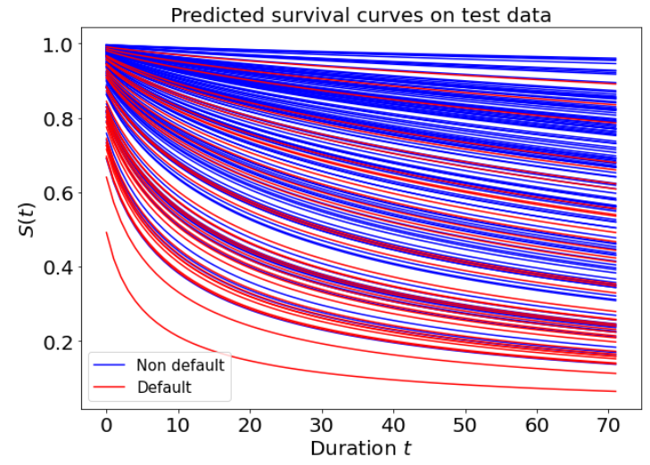
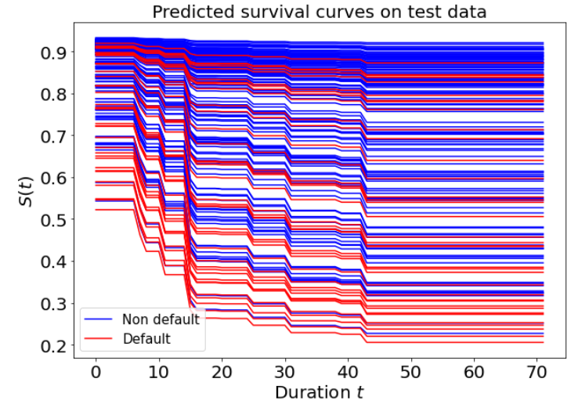
Survival curves
Logistic regression
Gradient boosted decision trees
To get a feel for our models’ predictions, we plot predicted survival curves for test data with duration < 24 mo. using credit features

Slide 29
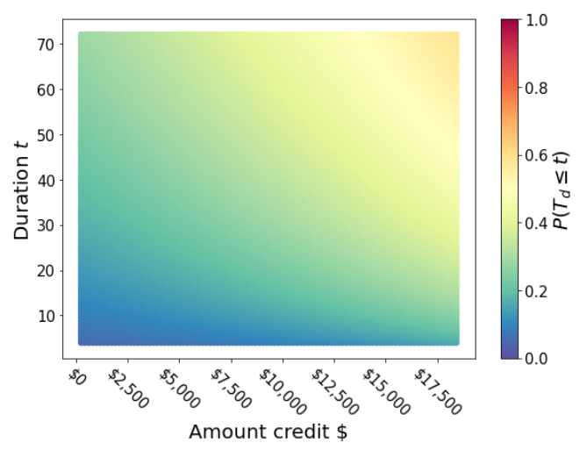
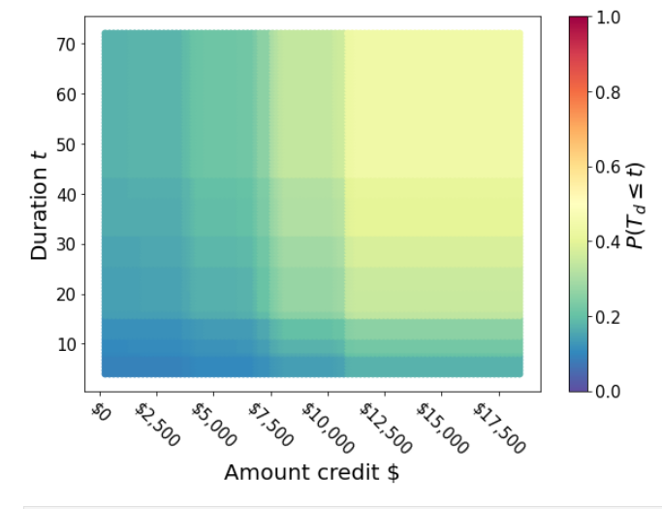
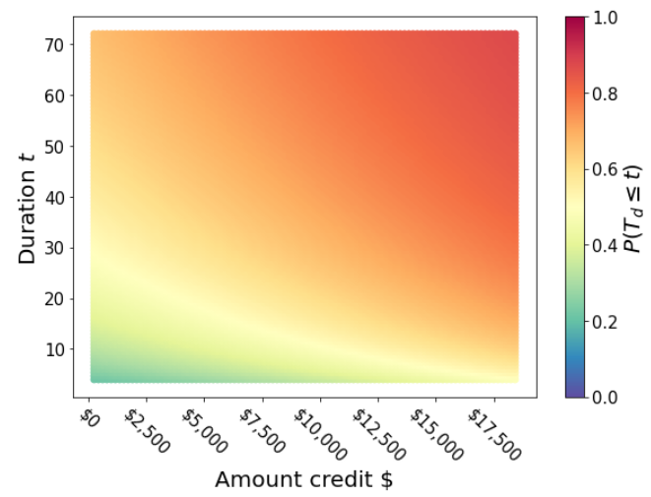
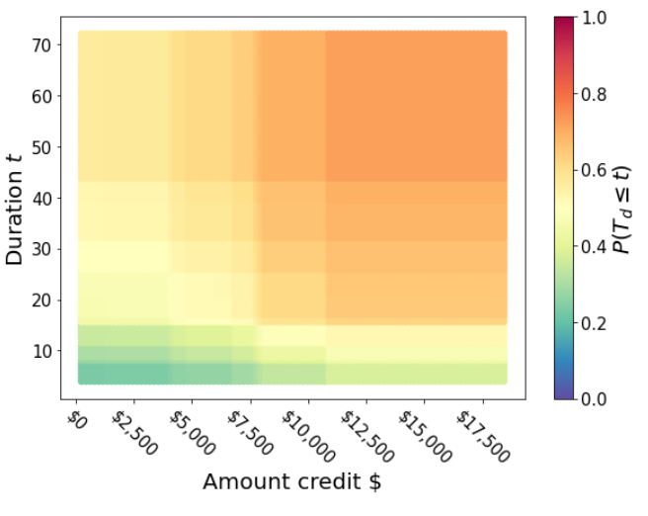
Default risk given credit amount and duration
Logistic model
GBDT model
Heatmaps of default risk as a function of credit amt and duration predicted by the models with application data fixed. Examples from test data .
top row: true default =0, bottom row: truedefault = 1.
Example: Default =0
The logistic regression keeps increasing risk as credit amount grows to extremes while the GBDT model flattens out around $12.5k.
Logistic regression seems to recommend more risk adverse policies.
Example: Default =1

Slide 30
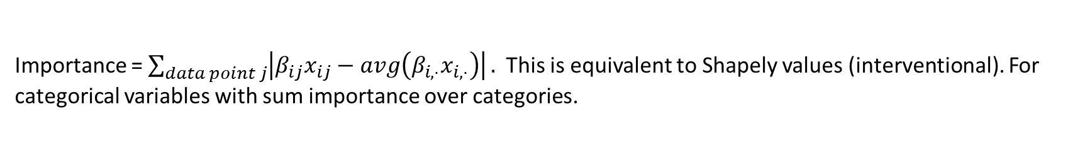
Feature importance logistic regression
Importance = $\sum_{data point j}{\left|β_{ij}x_{ij}−avg\left(β_{i,⋅}x_{i,⋅}\right)\right|}.$ This is equivalent to Shapely values (interventional). For categorical variables with sum importance over categories.

Slide 31

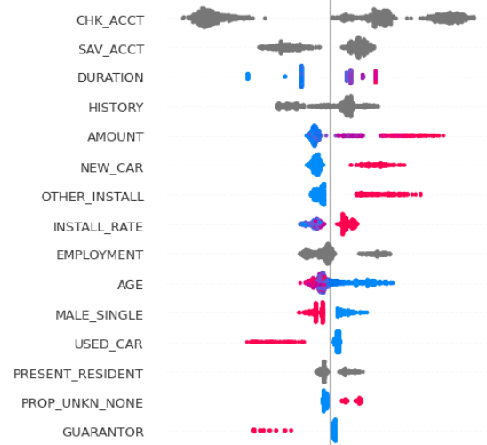
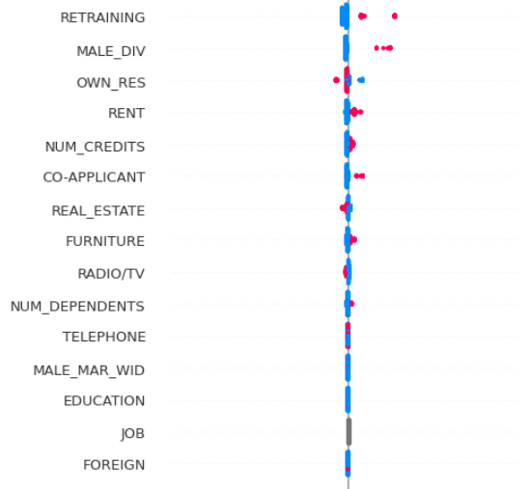

Feature importance GBDT
categorical
Contribution, importance = interventional Shapely values. We plot the feature contributions for each point and the feature value (small =blue, large = red). This shows the trend for each variable.

Slide 32
Appendix

Slide 33
Implementation details
Logistic regression
sklearn’s LogisticRegression model class.
Penalty= ‘elasticnet’
Solver = ‘saga’ (stochastic average gradient accelerated method) because it is able to quickly, accurately optimize the lasso penalty.
Feature transformations concatenated to return one dataframe using sklearn ColumnTransformer. Sklearn Pipeline to create one model instance for the composition of transformation -> LogisticRegression.
See train_models.ipynb for code.
Gradient boosted decision trees
Lightgbm.LGBMClassifier for compatibility with sklearn.
Boosting type = dart
Hyper parameters= number of iterations, learning rate, max tree depth, l2 regularization, fraction of features used for each tree, bagging.
Calibration with sklearn CalibratedClassifierCV using a final logistic regression layer (Platt’s method).
See train_models.ipynb for code.

Slide 34
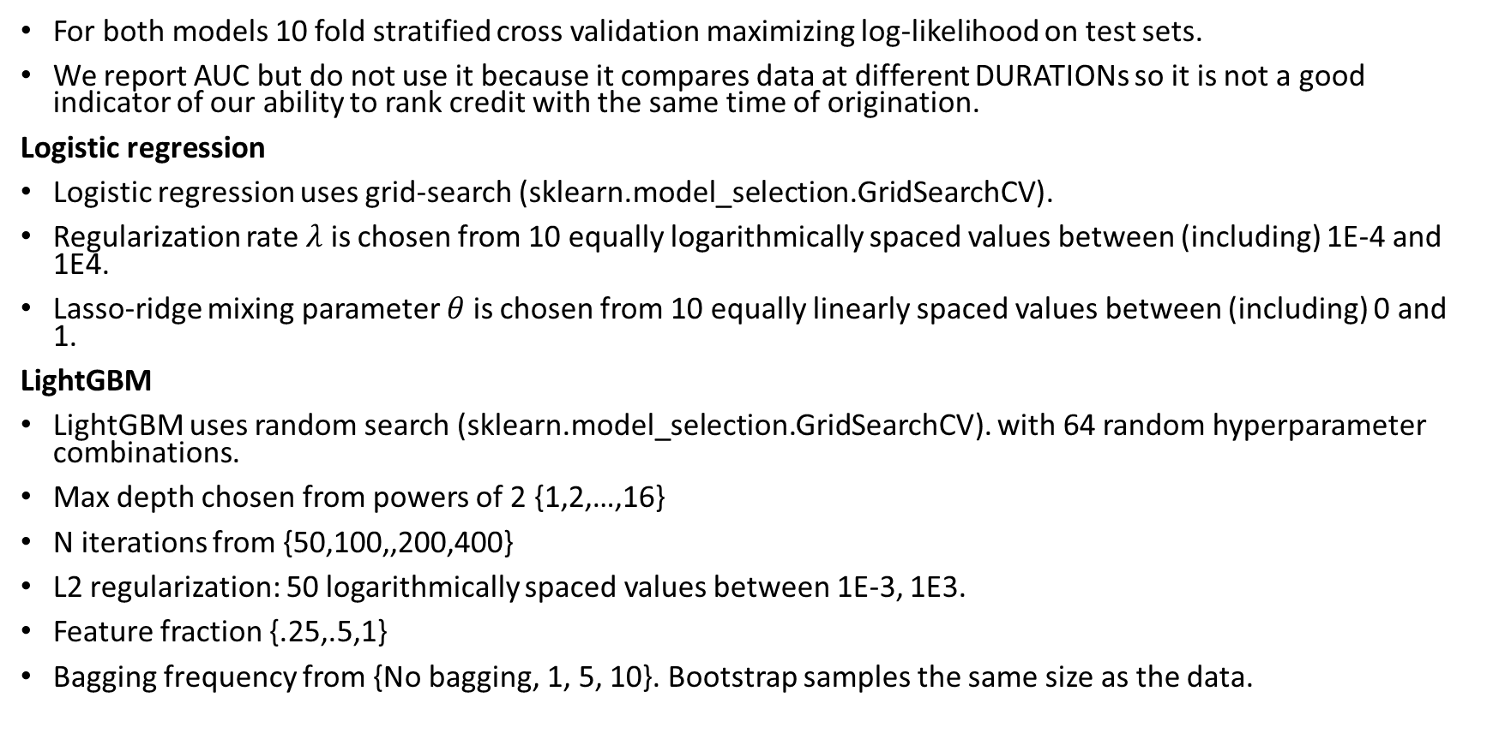
Hyperparameter tuning
For both models 10 fold stratified cross validation maximizing log-likelihood on test sets.
We report AUC but do not use it because it compares data at different DURATIONs so it is not a good indicator of our ability to rank credit with the same time of origination.
Logistic regression
Logistic regression uses grid-search (sklearn.model_selection.GridSearchCV).
Regularization rate $λ$ is chosen from 10 equally logarithmically spaced values between (including) 1E-4 and 1E4.
Lasso-ridge mixing parameter $θ$ is chosen from 10 equally linearly spaced values between (including) 0 and 1.
LightGBM
LightGBM uses random search (sklearn.model_selection.GridSearchCV). with 64 random hyperparameter combinations.
Max depth chosen from powers of 2 {1,2,…,16}
N iterations from {50,100,,200,400}
L2 regularization: 50 logarithmically spaced values between 1E-3, 1E3.
Feature fraction {.25,.5,1}
Bagging frequency from {No bagging, 1, 5, 10}. Bootstrap samples the same size as the data.

