Slide 1
Combinatorial Auctions
Li-Hsing Yen

Slide 2
Characteristics of Auctions
participants submit bids, the maximal amounts of money they are willing to pay.
Standard auctions: the winner of the auction is the participant with the highest bid.
Auctions are characterized as transactions with a specific set of rules detailing resource allocation according to participants' bids

Slide 3
Various Types of Auctions
Combinatorial Auction (CA)
 | Single Item | Multiple Items
Single Unit | English Auction, Dutch Auction, Vickrey auction | VCG, [LOS02]
Multiple Units | [LLL+16] [ZJL+16] | [JZZ+09] [ZG13] [ZG13b]

Slide 4


For the allocation of a single item (single unit)
Public Auctions
Open ascending-bid auctions (English auctions)
Open descending-bid auctions (Dutch auctions)
Sealed-Bid Auctions
bidders place their bid in a sealed envelope and simultaneously hand them to the auctioneer

Slide 5
Sealed-Bid Auctions
A seller (auctioneer) has one or more items to sell
n bidders submit simultaneous sealed bids to the seller
the highest bidder (always) wins the item(s)
Various objectives:
Maximize the auctioneer’s revenue
Maximize economic efficiency
Various payments: first-price auctions, second-price auctions

Slide 6
Valuation and Utility
Each bidder has a valuation for the item to bid
This information is private
Different bidders may have different valuations on the same item
We assume on externalities
Bidder’s utility =
0, if the bidder does not win
valuation – payment, if the bidder wins

Slide 7

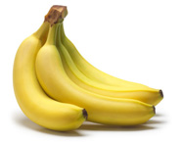




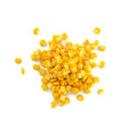
Economic Efficient Resource Allocation
Allocate the item to the one that values it the most

Slide 8
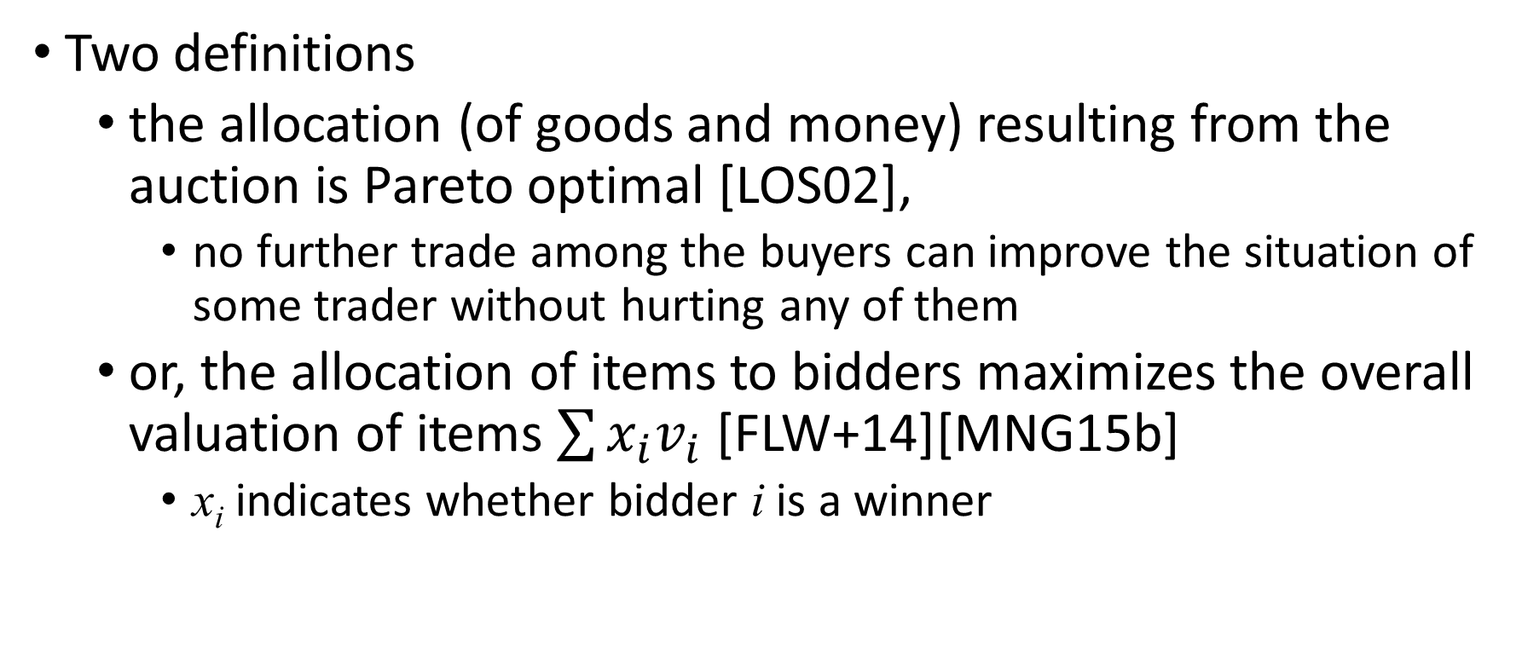
Economic Efficiency
Two definitions
the allocation (of goods and money) resulting from the auction is Pareto optimal [LOS02],
no further trade among the buyers can improve the situation of some trader without hurting any of them
or, the allocation of items to bidders maximizes the overall valuation of items $\sum{x_{i}v_{i}}$ [FLW+14][MNG15b]
x_{i} indicates whether bidder i is a winner

Slide 9
First- vs. Second-Price Sealed-Bid Auctions
First-price sealed-bid auctions
the individual with the highest bid wins, paying the amount bid
Second-price sealed-bid auctions (Vickrey auctions)
the individual with the highest bid wins, paying a price equal to the second-highest bid.

Slide 10
First-Price Auction as a Static Game
The winner pays the declared bid
Let v_{i} be bidder i’s true value for the item (private)
Bidder i’s strategy is an amount b_{i} to bid as a function of her true value v_{i}.
If b_{i} is not the winning bid, then the payoff to i is 0.
If b_{i} is the winning bid, then the payoff to i is v_{i} − b_{i}.

Slide 11
Truthful bidding is NOT a dominant strategy
max(b₁, b₂, …, b_{i-1}, b_{i+1}, …, b_{n})
 | v_{i} > max(b_{-i}) | v_{i} = max(b_{-i}) | v_{i} < max(b_{-i})
b_{i} > v_{i} | v_{i} – b_{i} < 0 | v_{i} – b_{i} < 0 | v_{i} – b_{i} < 0 or 0
b_{i} = v_{i} | v_{i} – b_{i} = 0 | 0 | 0
b_{i} < v_{i} | v_{i} –b_{i} > 0 or 0 | 0 | 0
Bidder i
weakly dominant

Slide 12
Result: May Not Be Pareto Optimal
Consider bidder i with v_{i} = 12 and b_{i} = 6 and the winner j with v_{j} = 9 and b_{j} = 7.
i’s utility = 0 and j’s utility is 9 – 7 = 2.
If j sells the object to i for $10, j’s utility is now 10 – 7 = 3 > 2 and i’s utility is 12 – 10 = 2 > 0.
That increases both bidders i’s and j’s utilities without degrading the utility of other bidders => an Pareto improvement
Therefore, the first-price auction does not guarantee Pareto optimal ⇒ not economically efficient

Slide 13
Second-Price Auction as a Game
The winner pays the value of the second-highest bid
Let v_{i} be bidder i’s true value for the object (private)
If b_{i} is not the winning bid, then the payoff to i is 0.
If b_{i} is the winning bid, and some other b_{j} is the second-place bid, then the payoff to i is v_{i} − b_{j}.
bidder | A | B | C
bid | 18 | 20 | 15
B wins and pays 18

Slide 14
Truthful bidding is a dominant strategy
 | v_{i} > max(b_{-i}) | v_{i} = max(b_{-i}) | v_{i} < max(b_{-i})
b_{i} > v_{i} | v_{i} – max(b_{-i}) > 0 | 0 | v_{i} – max(b_{-i}) < 0 or 0
b_{i} = v_{i} | v_{i} – max(b_{-i}) > 0 | 0 | 0
b_{i} < v_{i} | v_{i} – max(b_{-i}) > 0 or 0 | 0 | 0
Bidder i
weakly dominant

Slide 15
Critical Value
Given b_{-i}, the critical value for bidder i is defined to be a value v_{c} for which i wins if b_{i} > v_{c} and i loses if b_{i} < v_{c}
By definition, v_{c} = max(b_{-i})
In the second-price auction, the winner pays its critical value
win
lose
b_{i}
v_{c}

Slide 16
Strategy Proof
Consider an asymmetric game (the payoff of a particular strategy depends on who is playing that strategy) where players have private information (i.e., personal valuations of the item)
This game is strategy proof if it is a weakly-dominant strategy for every player to reveal his/her private information
you fare best or at least not worse by being truthful, regardless of what the others do

Slide 17
Revenue Equivalence
In terms of the auctioneer’s revenue, ascending open auction is equivalent to sealed-bid second-price auctions
Consider bidder i with v_{i} = 12 and another bidder j with v_{j} = 9.
In ascending open auction, bidder j will not raise the bid when it is already v_{j}. Therefore, i wins the bid and pays v_{j}.
The same expected payment in the sealed-bid second-price auction

Slide 18
Social Welfare
Utilitarian social welfare
The sum of individual utilities
The goal of the system is to maximize the overall utility
Egalitarian social welfare
The utility of the agent that is worst off
Introduces some degree of fairness in the system
Other definitions

Slide 19
Settings of Combinatorial Auctions (CAs)
There are m items to sell or buy
Each bidder places a bid for a collection of items (called bundle)
Related to weighted set cover problem
items
bidders
…
50
80
60
70

Slide 20
Set Cover Problem
We have a set of elements (the universe U) and a collection S of subsets of the universe whose union equals universe
Try to identify the smallest sub-collection of S whose union equals U
For example, U = {1, 2, 3, 4, 5}, S = {{1, 2, 3}, {2, 4}, {3, 4}, {4, 5}}
1
2
3
4
5
items
bidders

Slide 21
Weighted Set Cover Problem
Each set is assigned a weight
1
2
3
4
5
items
bidders
50
80
60
70

Slide 22
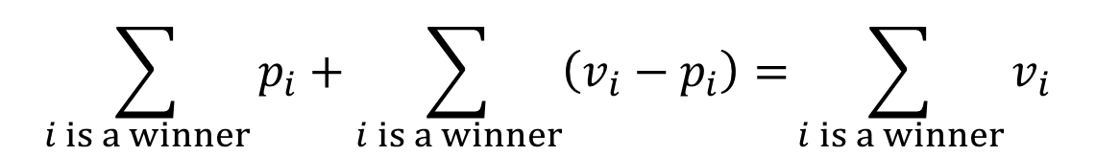
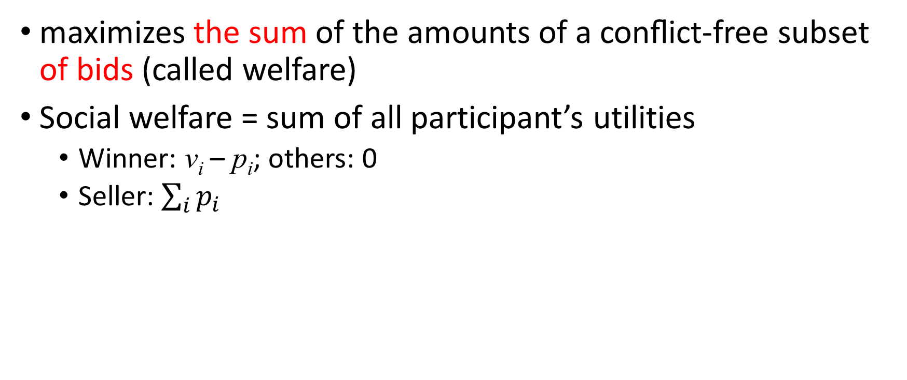

The Vickrey-Clarke-Groves (VCG) Mechanism
maximizes the sum of the amounts of a conﬂict-free subset of bids (called welfare)
Social welfare = sum of all participant’s utilities
Winner: v_{i} – p_{i}; others: 0
Seller: $\sum_{i}{p_{i}}$
If truthful
$$\sum_{i is a winner}{p_{i}}+\sum_{i is a winner}{\left(v_{i}−p_{i}\right)=}\sum_{i is a winner}{v_{i}}$$
$$=\sum_{i is a winner}{b_{i}}$$

Slide 23
VCG Bidding Example
bidder | P1 | P2 | P3 | P4 | P5
bid | $63 | $54 | $93 | $70 | $28
bundle | {A,C,D} | {A,B,C} | {B,D,E} | {D,E} | {A,C}
Possible results
{P1} ⇒ welfare = 63, {P2} ⇒ welfare = 54
{P2, P4} ⇒ welfare = 124, {P3} ⇒ welfare = 93
{P3, P5} ⇒ welfare = 121, {P4} ⇒ welfare = 70
{P4, P5} ⇒ welfare = 98, {P5} ⇒ welfare = 28

Slide 24
Payment Scheme in VCG
Non-winner: pays 0
Winner’s payment: the winner’s social opportunity cost
= the loss of other bidders’ welfare due to the winner’s involvement (the opportunity cost of winning the bid)
For winner k = (welfare of other bidders without k) – (welfare of others when k is in the auction)
Guarantees truthful bidding!

Slide 25
VCG Payment Example: for Bidder P2
Bidder k’s payment = (welfare of other bidders without k) – (welfare of others when k is in the auction)
Without P2
bidder | P1 | P3 | P4 | P5
bid | $63 | $93 | $70 | $28
bundle | {A,C,D} | {B,D,E} | {D,E} | {A,C}
{P1} ⇒ welfare = 63, {P3} ⇒ welfare = 93
{P3, P5} ⇒ welfare = 121, {P4} ⇒ 70
{P4, P5} ⇒ welfare = 98, {P5} ⇒ 28
bidder | P1 | P2 | P3 | P4 | P5
bid | $63 | $54 | $93 | $70 | $28
bundle | {A,C,D} | {A,B,C} | {B,D,E} | {D,E} | {A,C}
Suppose that {P2, P4} are winners and we want to know P2’s payment.
Welfare of others = 124 – 54 = 70
Therefore P2 has to pay = 121 – 70 = 51

Slide 26
Bidder P4’s Payment
Bidder k’s payment = (welfare of other bidders without k) – (welfare of others when k is in the auction)
Without P4
bidder | P1 | P2 | P3 | P5
bid | $63 | $54 | $93 | $28
bundle | {A,C,D} | {A,B,C} | {B,D,E} | {A,C}
{P1} ⇒ welfare = 63, {P2} ⇒ welfare = 54
{P3} ⇒ welfare = 93
{P3, P5} ⇒ welfare = 121, {P5} ⇒ 28
bidder | P1 | P2 | P3 | P4 | P5
bid | $63 | $54 | $93 | $70 | $28
bundle | {A,C,D} | {A,B,C} | {B,D,E} | {D,E} | {A,C}
Suppose that {P2, P4} are winners and we want to know P4’s payment.
Welfare of others = 124 – 70 = 54
Therefore P4 has to pay = 121 – 54 = 67

Slide 27
Truthful Bidding Enforced by Payment
bidder | P1 | P2 | P3
bid | $10 | $19 | $8
bundle | {A} | {A,B} | {B}
Possible results
{P1} ⇒ welfare = 10, {P2} ⇒ welfare = 19
{P3} ⇒ welfare = 8, {P1, P3} ⇒ welfare = 18
How much does P2 has to pay? P2’s payment = (welfare of other bidders without P2) – (welfare of others when P2 is in the auction) = 18 – 0 = 18
P1 can win if he increases his bid to 12. However, in that case he would pay 19 – 8 = 11, higher than his valuation 10
P3 can win if he increases his bid to 10, but he would pay 19 – 10 = 9

Slide 28
Revenue Deficiency of VCG
low revenues of the auctioneer
Takes place when
market competition is weak or
bidders are highly asymmetric in demands

Slide 29
Time Inefficiency Problem
VCG requires an optimal allocation!
Finding an optimal allocation requires exponential time and is computationally intractable (NP-hard).
Even if bidders are single-minded
Even if bidders declare their bids truthfully
Some heuristics have been proposed

Slide 30
Greedy Allocation [LOS02]
Sort bids by some criterion (with treatment of ties)
In particular, the average amount of bid per good
Examine bids in order and grant a bid if it does not conflict with any of previously granted bids
bidder | P1 | P2 | P3
bid (b_{i}) | $10 | $19 | $8
Bundle (s_{i}) | {A} | {A,B} | {B}
b_{i} / | s_{i} | | 10 | 9.5 | 8
b_{i} / | s_{i} |^{0.5} | 10 | 13.4 | 8
Winner = {P1, P3}
Winner = {P2}

Slide 31
One Question to Ask
Given a suitable greedy allocation, can one ﬁnd a payment scheme that makes it a truthful mechanism?
bidder | P1 | P2 | P3
bid (b_{i}) | $10 | $19 | $8
Bundle (s_{i}) | {A} | {A,B} | {B}
b_{i} / | s_{i} | | 10 | 9.5 | 8
If winner = {P1, P3}
P1 has to pay 19 – 8 = 11 > 10!
P3 has to pay 10 – 10 = 0
by VCG’s payment
Truthful bid is not P1’s best choice

Slide 32
Sufficient Conditions for Truthfulness
Four conditions
Exactness
Monotonicity
Critical
Participation

Slide 33
Exactness
a single-minded bidder either gets exactly the set of goods he desires, nothing added, or he gets nothing
He never gets only part of what he requested.
Modification on VCG meets this condition
If nobody is interested in a, a will not be allocated to one of the bidders (even if a is for free).

Slide 34
Monotonicity
Let s be a bundle (a set of items), b be a bid.
If j’s bid is granted if he declares (s, b), it is also granted if he declares (s’, b’) for any s’ ⊆ s, b’ ≥ b.
proposing more money for fewer items cannot cause a bidder to lose his bid
offering less money for more items cannot cause a lost bid to win
VCG’s allocation scheme satisﬁes Monotonicity

Slide 35
Critical Value for CA
In a mechanism that satisﬁes Exactness and Monotonicity, given a bidder j, a set s of items and declarations for all other bidders, there exists a critical value v_{c} such that
∀b_{j}, b_{j} < v_{c} ⇒ j gets nothing (i.e., j loses)
∀b_{j}, b_{j} > v_{c} ⇒ j gets s (i.e., j wins)
We do not know whether j’s bid is granted or not in case b_{j} = v_{c}.

Slide 36
The Concept of Critical Value
If all bids other than j are given
j’s result
win
lose
j’s bid
Critical value

Slide 37
Example of Critical Values (1)
Given the declarations of all other bidders
bidder | P1 | P2 | P3
bid (b_{i}) | $10 | $19 | $8
Bundle (s_{i}) | {A} | {A,B} | {B}
b_{i} / | s_{i} | | 10 | 9.5 | 8
v_{c} | 9.5 | 20 | 0
P3 wins if its bid > 0
P1 wins if its bid > 9.5
P1 loses if its bid < 9.5
P2 wins if its bid > 20
P2 loses if its bid < 20

Slide 38
Example of Critical Values (2)
Given the declarations of all other bidders
bidder | P1 | P2 | P3
bid (b_{i}) | $10 | $19 | $8
Bundle (s_{i}) | {A} | {A,B} | {B}
b_{i} / | s_{i} |^{0.5} | 10 | 13.4 | 8
v_{c} | 13.4 | 14.1 | 13.4
P3 wins if its bid > 13.4
P3 loses if its bid < 13.4
P1 wins if its bid > 13.4
P1 loses if its bid < 13.4
P2 wins if its bid > 14.1
P2 loses if its bid < 14.1

Slide 39
Example of Critical Values (3)
Critical value for each bidder
bidder | P1 | P2 | P3 | P4 | P5
bid (b_{i}) | $63 | $54 | $93 | $70 | $28
Bundle (s_{i}) | {A,C,D} | {A,B,C} | {B,D,E} | {D,E} | {A,C}
b_{i} / | s_{i} | | 21 | 18 | 31 | 35 | 14
v_{c} | 105 | 42 | 105 | 62 | 36

Slide 40
Criticality-Based Payment Scheme
a winner pays exactly the critical value v_{c} (the lowest value he could have declared and still be allocated the items he desires)
The payment p does not depend on the amount of the bid, it depends only on the other bids.

Slide 41
Recall: Payment in VCG
Each winner in fact pays exactly its critical value
bidder | P1 | P2 | P3 | P4 | P5
bid (b_{i}) | $63 | $54 | $93 | $70 | $28
Bundle (s_{i}) | {A,C,D} | {A,B,C} | {B,D,E} | {D,E} | {A,C}
v_{c} | 124 | 51 | 96 | 67 | 31
{P1} ⇒ welfare = 63, {P2} ⇒ welfare = 54
{P2, P4} ⇒ welfare = 124, {P3} ⇒ welfare = 93
{P3, P5} ⇒ welfare = 121, {P4} ⇒ 70
{P4, P5} ⇒ welfare = 98, {P5} ⇒ 28

Slide 42
Why payment p = v_{c}?
在一滿足exactness, monotonicity, 與 participation的拍賣機制中，payment p = v_{c}才有辦法讓bidder有真實出價的動機
If p < v_{c}
任何認為s真實價值在p與v_{c}之間的bidder若真實出價會輸(因 v < v_{c})，因此有動機出 v > v_{c}的價(會贏而且會付比真實價值小的payment)
沒有辦法讓bidder有真實出價的動機
If p > v_{c}
任何認為s真實價值在v_{c} 與p之間的bidder若真實出價會贏(因 v > v_{c})但是要付的payment p > v所以utility是負的。這樣此bidder有動機出 v < v_{c}的價(會輸但至少utility為0不為負)
沒有辦法讓bidder有真實出價的動機

Slide 43
Participation
an unsatisﬁed bidder pay zero
The utility of an unsatisﬁed bidder is then zero
bidders may not lose by participating in the auction
Together with Critical, it implies that the utility of a truthful bidder is nonnegative

Slide 44
Lemma 9.3
在滿足exactness, monotonicity, critical, 與 participation的拍賣機制中，真實的bidder其utility不會為負的
如bidder未得標，則不用付錢(participation)。
如bidder得標，則其標金(v ≥ v_{c}) (Lemma 9.1)，且其payment p = v_{c} (critical)。因其為真實的bidder, 故認為s的真實價值為v 。其utility為 v – p ≥ 0.

Slide 45
Lemma 9.4
在滿足exactness, monotonicity, critical, 與 participation的拍賣機制中，反應真實價值的投標會比較有利
假設反映真實價值的投標為(s, v)，其他為(s, v’)。
如果(s, v’)未得標則utility為0。Lemma 9.3告訴我們(s, v)的utility ≥ 0。故選擇(s, v)較有利。
如果(s, v’)與(s, v)兩者皆得標，則兩者付一樣的錢(critical)。
如果(s, v’) 得標但(s, v)未得標，則一定是v’ ≥ v_{c} ≥ v。 (s, v)的利益為0，而(s, v’)的利益為v – v_{c} ≤ 0。

Slide 46
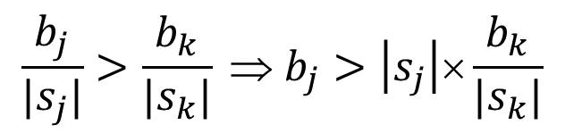
Payment for the Greedy Allocation (b / |s|)
a bidder pays, per good, the average price proposed by the ﬁrst bid that is denied because of this bid
Let k be the ﬁrst bid following j that has been denied but would have been granted were it not for the presence of j.
Bidder j, as a winner, should pay (b_{k} / |s_{k}|) × |s_{j}|
This is exactly the critical value for j because j wins as long as
$$\frac{b_{j}}{|s_{j}|}>\frac{b_{k}}{|s_{k}|} ⇒ b_{j}>\left|s_{j}\right|\text{×}\frac{b_{k}}{|s_{k}|}$$
The critical value for bidder j

Slide 47
Greedy Allocation/Payment Example 1
Let n(j) be the ﬁrst bid following j that has been denied but would have been granted were it not for the presence of j
bidder | P1 | P2 | P3
bid (b) | $10 | $19 | $8
Bundle (s) | {A} | {A,B} | {B}
b / | s | | 10 | 9.5 | 8
n(j) | P2 | -- | --
Winner = {P1, P3}
P1 has to pay 9.5
P1 will lose if it bids less than 9.5
P3 has to pay nothing
P2 will win if he bids 21, but then he gets negative utility

Slide 48
Greedy Allocation/Payment Example 2
bidder | P1 | P2 | P3 | P4 | P5
bid (b) | $63 | $54 | $93 | $70 | $28
Bundle (s) | {A,C,D} | {A,B,C} | {B,D,E} | {D,E} | {A,C}
b / | s | | 21 | 18 | 31 | 35 | 14
n(j) | -- | P5 | -- | P3 | --
Winner = {P4, P2}
P4 has to pay 62
P4 will lose if it bids less than 62
P2 has to pay 42
P2 will lose if it bids less than 42

Slide 49
Lessons We Learned
If satisfied bidders pay exactly the critical values
 | v_{c} > v | v_{c} < v
Bid b > v | Lose (if b < v_{c}) or win but pay more | Win
Bid b = v | Lose | Win
Bid b < v | Lose | Win (if b > v_{c}) or lose
weakly dominant strategy

Slide 50
Another Winner Determination Heuristic
First construct a conflict graph
Nodes = bidders
An edge exists between two bidders if they compete for a common good
P4
P3
bidder | P1 | P2 | P3 | P4 | P5
Bundle (s) | {A,C,D} | {A,B,C} | {B,D,E} | {D,E} | {A,C}
P1
P5
P2
A set of winners = a maximal independent set in the conflict graph

Slide 51
Determining Winners
Consider conflict number (degree in the conflict graph), minimizing b / (| N_{i} |+1), where | N_{i} | is i’s node degree in the conflict graph
bidder | P1 | P2 | P3 | P4 | P5
bid (b) | $63 | $54 | $93 | $70 | $28
Bundle (s) | {A,C,D} | {A,B,C} | {B,D,E} | {D,E} | {A,C}
| N_{i} | | 4 | 3 | 3 | 2 | 2
b / (| N_{i} |+1) | 12.60 | 13.50 | 23.25 | 23.33 | 9.33
b / (| N_{i} |+1)^{0.5}

Slide 52
Payments of This Heuristic
satisfied bidders pay exactly the critical values
bidder | P1 | P2 | P3 | P4 | P5
bid (b) | $63 | $54 | $93 | $70 | $28
Bundle (s) | {A,C,D} | {A,B,C} | {B,D,E} | {D,E} | {A,C}
| N_{i} | | 4 | 3 | 3 | 2 | 2
b / (| N_{i} |+1) | 12.60 | 13.50 | 23.25 | 23.33 | 9.33
v_{c} | 116.65 | 37.33 | 93.32 | 69.75 | 40.5
_{Payment [LOS02]} |  | 42 |  | 62

Slide 53
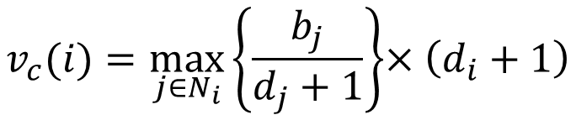
Decentralized Winner Determination
Locally calculate the critical value (bidder i wins if b_{i} > v_{c}(i))
Place a bid if the value of the bundle > the critical value; place bid 0 otherwise
$$v_{c}(i)=\max_{j∈N_{i}}\left\{\frac{b_{j}}{d_{j}+1}\right\}{×\left(d_{i}+1\right)}$$

Slide 54
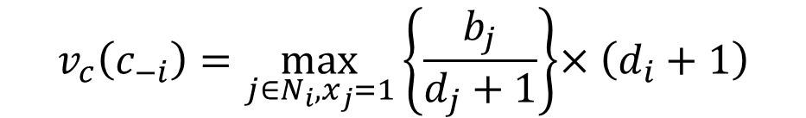
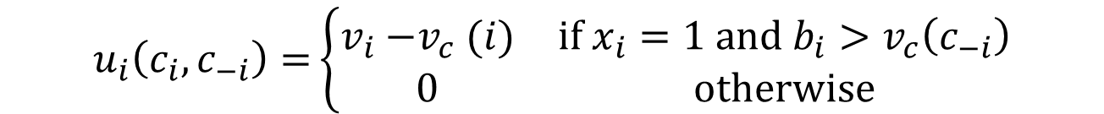
Game Model
Strategy set S_{i} = {(b_{i}, x_{i})}, where x_{i} = 0 or 1 indicating whether bidder i places the bid b_{i}
Utility function
$$u_{i}\left(c_{i},c_{−i}\right)=\left\{\begin{matrix}v_{i}{−v}_{c}(i) & \text{if} {x_{i}=1 and b}_{i}>v_{c}\left(c_{−i}\right) \\ 0 & \text{otherwise}\end{matrix}\right.$$
where
$$v_{c}\left(c_{−i}\right)=\max_{j∈N_{i}, x_{j}=1}\left\{\frac{b_{j}}{d_{j}+1}\right\}{×\left(d_{i}+1\right)}$$

Slide 55
Strategy of i given the knowledge of other bids
If i has no knowledge of other bids
v_{c} = 0. However, v_{c} could be greater than v_{i} later on.
the best strategy is to set b_{i} = v_{i} regardless whether v_{c} > v_{i} or not
If i has partial knowledge of other bids
v_{c} may or may not be greater v_{i}
the best strategy is still b_{i} = v_{i}
If i has full knowledge of other bids
Whether v_{c} > v_{i} is known
If v_{i} > v_{c}, i has no incentive to set b_{i} other than v_{i}
If v_{i} < v_{c}, i can still win, so its best strategy is still b_{i} = v_{i}
Setting b_{i} to any value other than v_{i} does not give i extra benefit
do not guarantee truthful bidding but still strategy-proof

Slide 56
Multiple Units
[ZG13] S. Zaman and D. Grosu, “Combinatorial auction-based allocation of virtual machine instances in clouds,” J. Parallel Distrib. Comput., 73:495-508, 2013.

Slide 57

Multiple Units
Each type of good has multiple instances
Represent the bundle by a vector: S_{i} = (s₁, s₂, .., s_{m})
define an ordering to compare bids
For example
Examine bids in order and grant a bid if it does not conflict with any of previously granted bids
$$\frac{b_{i}}{\sum_{i=1}^{m}{s_{i}}}$$

Slide 58
[ZG13]: Multi Units Extension to [LOS02]
Five types of goods {A, B, C, D, E}. The system has (3, 2, 2, 2, 2)
bidder | P1 | P2 | P3 | P4 | P5
bid (b_{i}) | $63 | $54 | $93 | $70 | $28
Bundle (S_{i}) | (1,0,2,1,0) | (2,1,1,0,0) | (0,1,0,1,2) | (0,0,0,2,1) | (1,0,1,0,0)
b_{i} / Σs_{i} | 15.75 | 13.5 | 23.25 | 23.33 | 9.33
v_{c} | 93.33 | 0 | 93.33 | 69.75 | 0

Slide 59
Applications: Channel Allocations
X. Zhou, S. Gandhi, S. Suri, and H. Zheng, “ebay in the sky: Strategy-proof wireless spectrum auctions,” in Proc. MobiCom, pp. 2–13 , Sep. 2008.
X. Zhou and H. Zheng, “TRUST: A general framework for truthful double spectrum auctions,” in Proc. IEEE INFOCOM, pp. 999–1007, Apr. 2009.
L. Deek, X. Zhou, K. Almeroth, and H. Zheng, “To preempt or not: Tackling bid and time-based cheating in online spectrum auctions,” in Proc. IEEE INFOCOM, pp. 2219–2227, Apr. 2011.
F. Wu et al., “A strategy-proof auction mechanism for adaptive-width channel allocation in wireless networks,” IEEE J. Sel. Areas Commun., vol. 34, no. 10, pp. 2678-2689, Oct. 2016.

Slide 60
Applications: Resource Allocations in Device-to-Device Communications
[XSH+13] C. Xu et al., “Efﬁciency resource allocation for device-to-device underlay communication systems: A reverse iterative combinatorial auction based approach,” IEEE J. Sel. Areas Commun., vol. 31, no. 9, pp. 348–358, Sep. 2013.

