Slide 1
Database 2015 Project 2
Last modified time : 2015-5-2 pm 02:30

Slide 2
Specification--1. Job vacancy
Brief introduction
Following from project 1
Add new function
Job vacancy
Search
Sort
Job seeker
My favorite list
Apply for a job
Employer
Application list
Hire a job seeker

Slide 3
Specification--1. Job vacancy
Job Vacancy List
You have to show the columns :
id, occupation, location, working_time, education,
experience, salary
Add two new function : search and sort
You have to add the two new function in the following cases:
Job seeker log in
Employer log in
None of them log in

Slide 4
Specification--1. Job vacancy
Sort : sort by the “salary” column ( You have to use SQL syntax: ORDER BY )
If two columns of salary are the same, sort them by the “id” column in ascending order.
Two options : in ascending order and in descending order
Sort them by the “id” column in ascending order by default

Slide 5
Specification--1. Job vacancy
Search: search one column or more than one columns simultaneously
The columns being searched contains :
occupation, location, working_time ,education,
experience, salary
Searching result can still be sorted in ascending order or
descending order

Slide 6
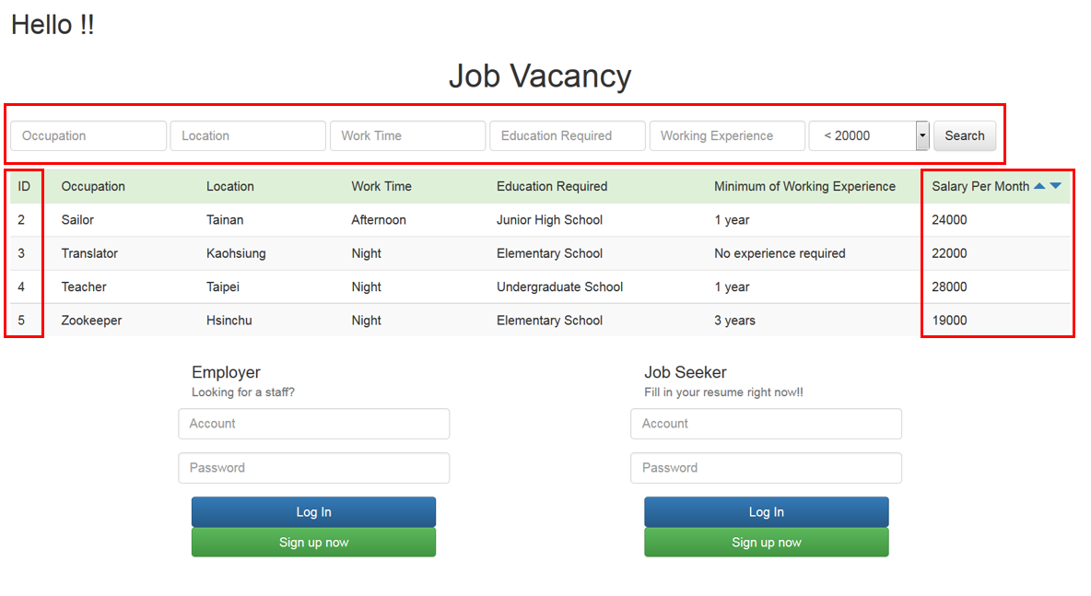
Specification--1. Job vacancy
Notes:
未登入也要有搜尋和排序的功能 預設是用ID排序

Slide 7
Specification--2. Job seeker
Job seeker
1. Search and sort
2. My favorite list
3. Apply for a job

Slide 8
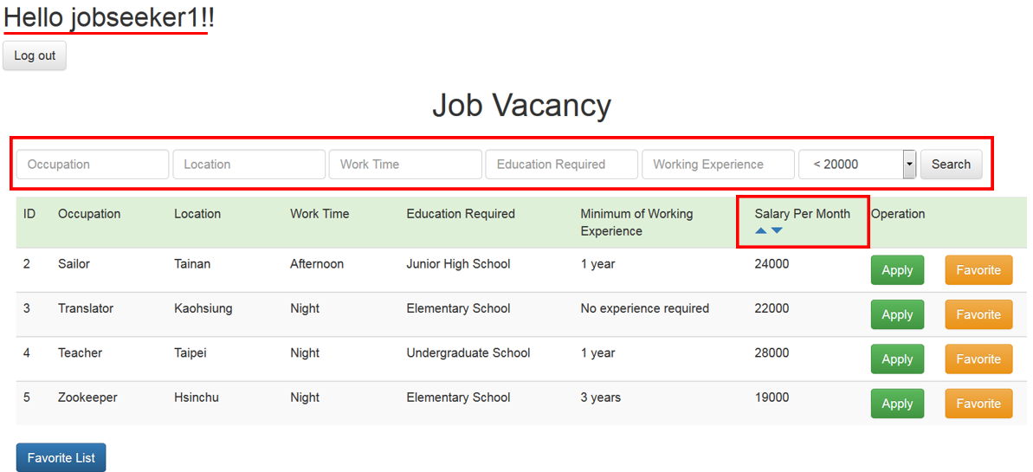
Specification--2. Job seeker
1.Search and sort

Slide 9
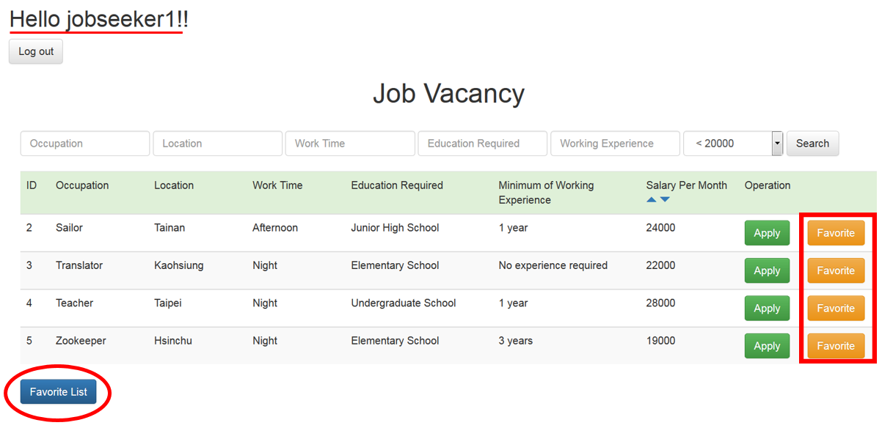
Specification--2. Job seeker
2.Job seeker can add job to his/her favorite list.
Notes:
Seeker一樣要有搜尋和排序的功能

Slide 10
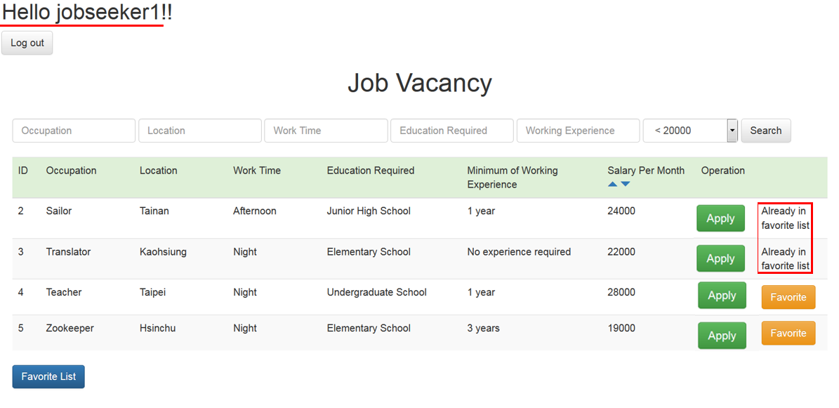
Specification--2. Job seeker
After adding to favorite list, show “In favorite list”.

Slide 11
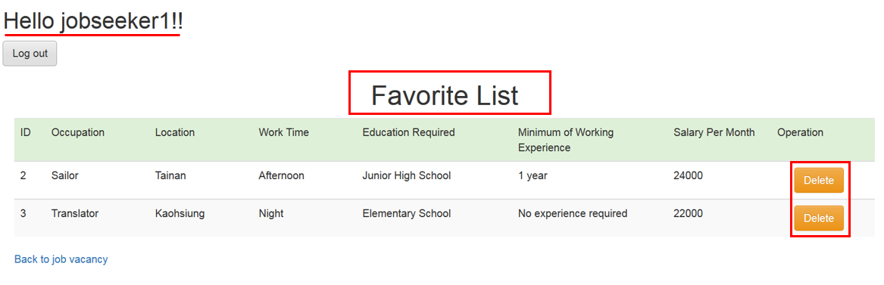
Specification--2. Job seeker
My favorite list (You have to use SQL syntax: JOIN)
Every job seeker has his/her own favorite list
The columns in favorite list are the same as job vacancy list
Job seeker can delete jobs from his/her favorite list

Slide 12
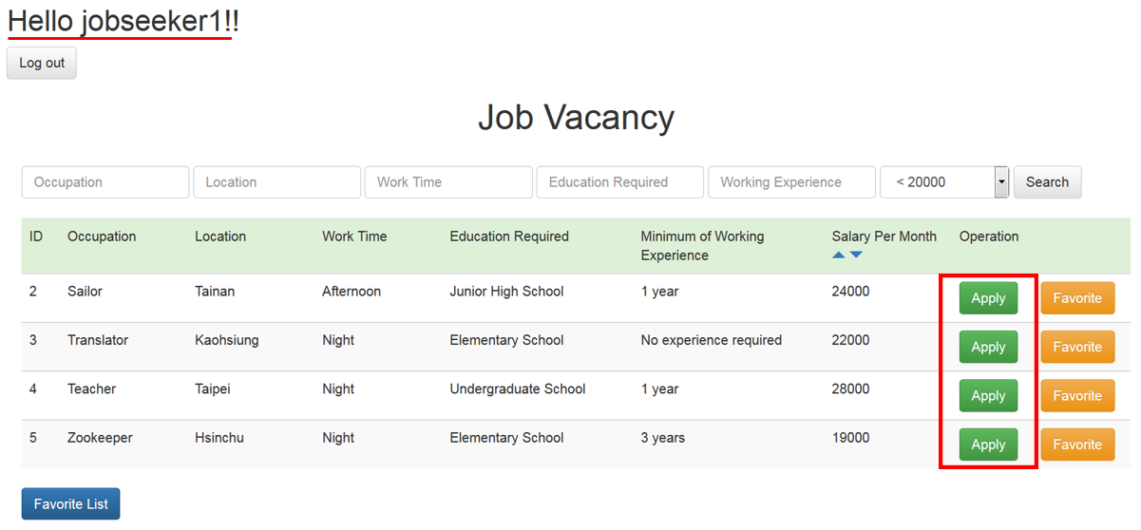
Specification--2. Job seeker
3.Job seeker can apply for a job.

Slide 13
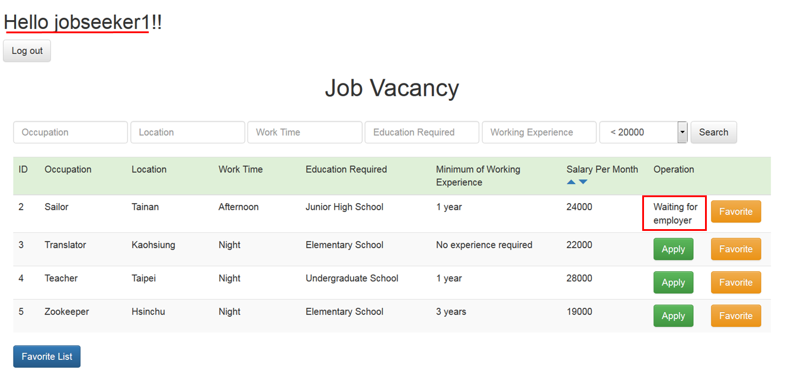
Specification--2. Job seeker
If a job seeker has applied for a job, show “Waiting for employer”.

Slide 14
Specification—3. Employer
Employer
1.Search and sort
2.Application list
3.Hire a job seeker

Slide 15
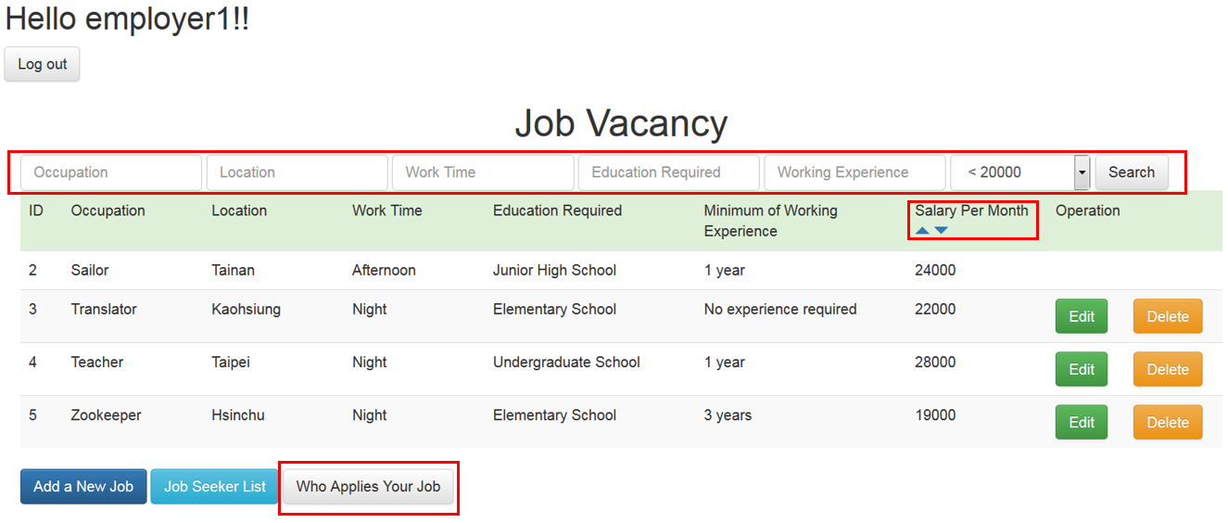
Specification--3. Employer
1.Search and sort

Slide 16
Specification--3. Employer
2.Application list ( You have to use SQL syntax: JOIN)
Each employer has his/her own application list
Application list contains :
1.Information of the job, the columns contains :
occupation, location, working_time, education, salary
2.Information of the job seeker who applies for the job, the
columns contains:
account, password, age, education, expected_salary, phone,
gender, email, specialty
occupation | location | working_time | education | experience | salary
Account | gender | age | education | expected_salary | phone | email | specialty

Slide 17
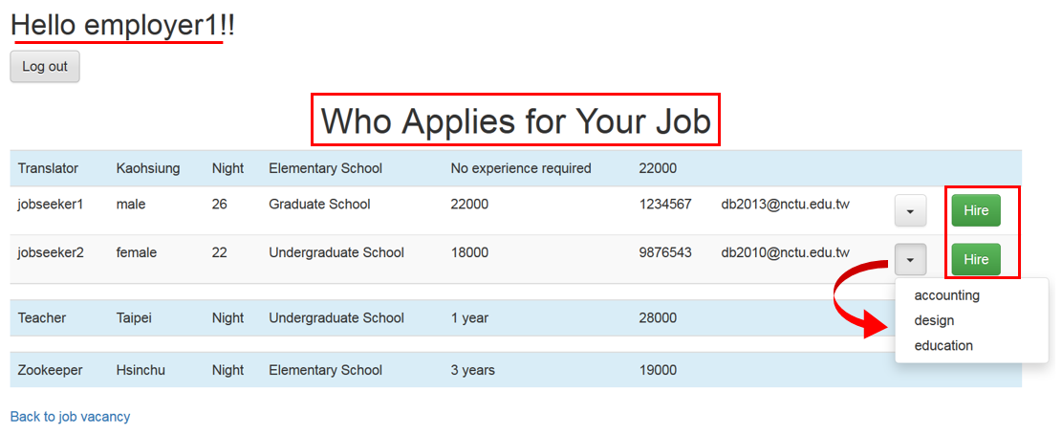
Specification--3. Employer
3.Employer can hire job seeker who applies for
his/her job

Slide 18
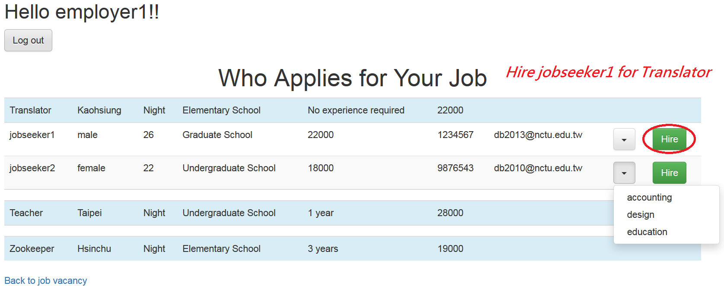
Specification--3. Employer
After hiring a job seeker：
Delete the job from job vacancy list and table: recruit
You don’t need to show the job which you have hired a job seeker and all of the job seekers who apply for this job in application list

Slide 19
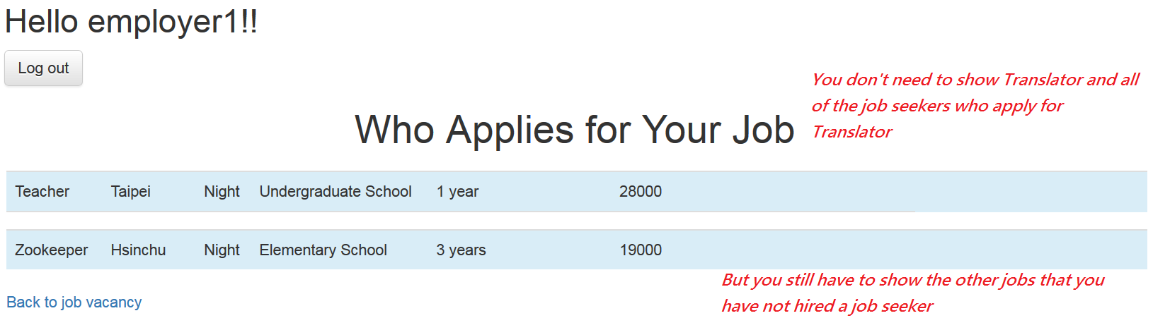
Specification--3. Employer
After hiring a job seeker：
Delete the job from job vacancy list and table: recruit
You don’t need to show the job which you have hired a job seeker and all of the job seekers who apply for this job in application list

Slide 20
Specification
Database
You need 2 tables
Table name : favorite (jobseeker’s table)
Attribute | Type | Index
user_id | int | foreign key, references to user table
recruit_id | int | foreign key, references to recruit table

Slide 21
Specification
Database
You need 2 tables
Table name : application (employer’s table)
Attribute | Type | Index
user_id | int | foreign key, references to user table
recruit_id | int | foreign key, references to recruit table

Slide 22
Specification
Upload your source code & report to E3
One group, one report
Report can only be .pdf format which contains the following information
Name, student ID of your team members
URL of your webpage (can be accessed by TA while you demonstrate your website)

Slide 23
Specification
Deadline : 5/11 23:59:59
Hand in delay: delay one day, your score will be 20% off.
E.g. Delay one day: score*0.8
E.g. Delay two day: score*0.8*0.8
Demonstration time : undetermined

Slide 24
Q&A
If you have any question about this project, please post it on E3 forum

Slide 25
Please modify a table: user_specialty
Modify this table in project2, not project1
Database-project1
Table name : user_specialty
Foreign Key
user <-> user_specialty
Delete some rows in user_specialty table if some rows in user table are deleted
Attribute | Type | Index | Description
id | int | primary key , auto-increment
user_id | Int | foreign key, references to user table
specialty_id | Int | foreign key, references to specialty table | what kind of specialty does the user(job seeker) have

