Slide 1
October4, 2020
SeleniumReview_zoomMeeting
21:30-24:00

Slide 2
FlippedClass
ForgettingCurve

Slide 3
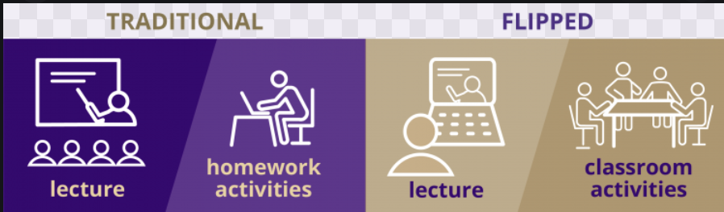

Slide 4
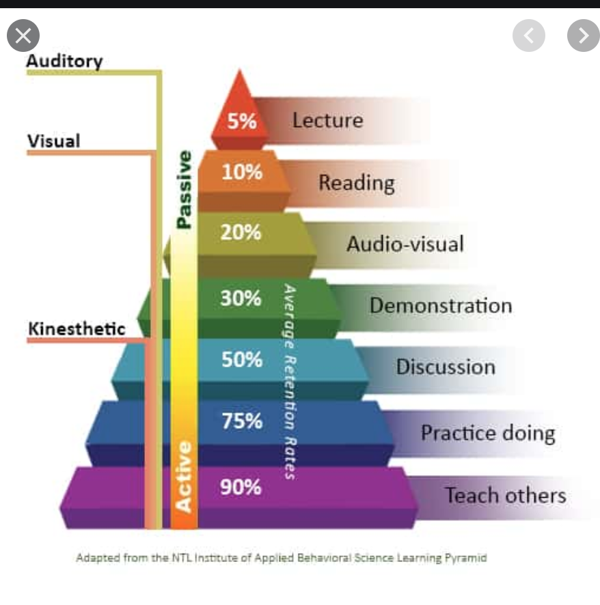

Slide 5
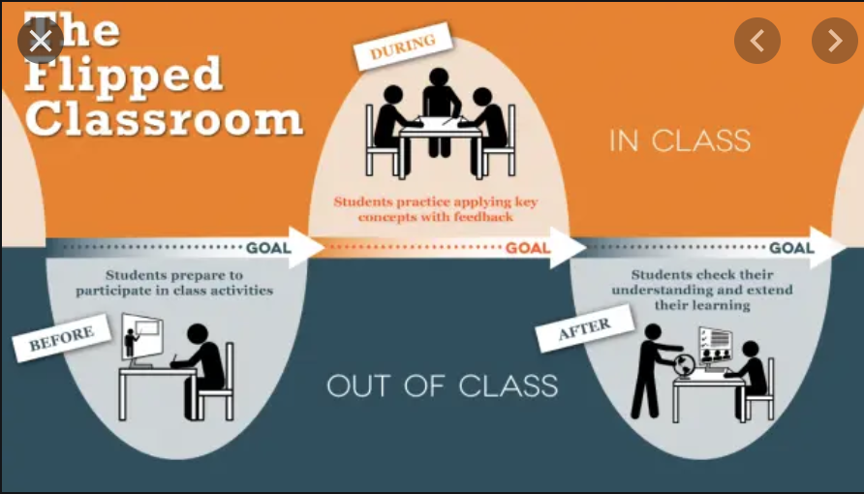

Slide 6
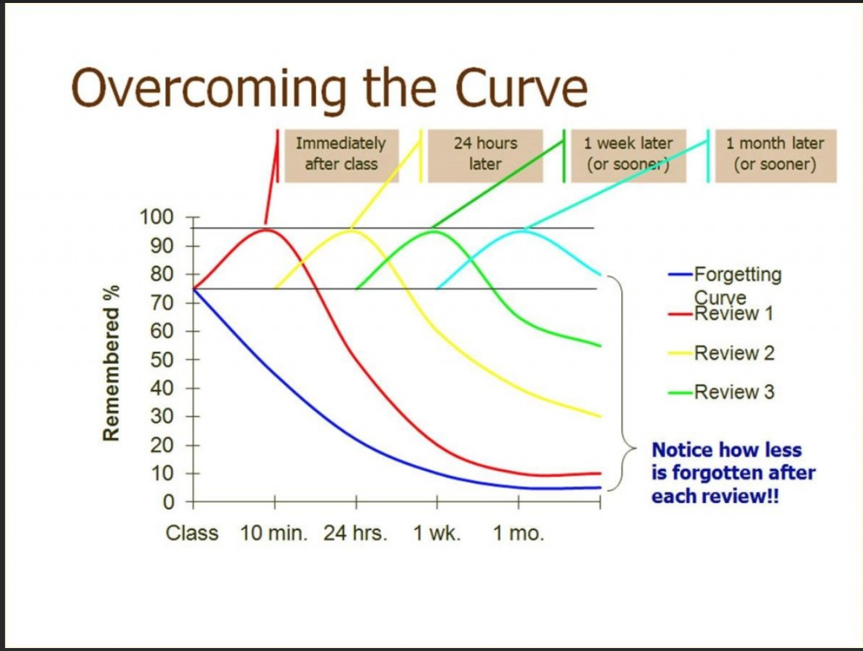

Slide 7
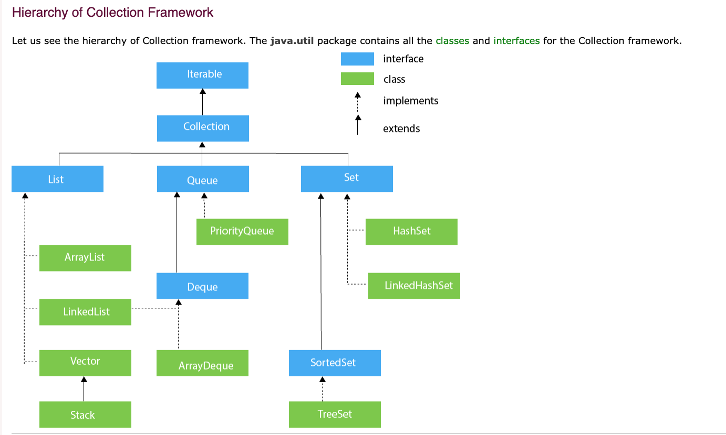

Slide 8
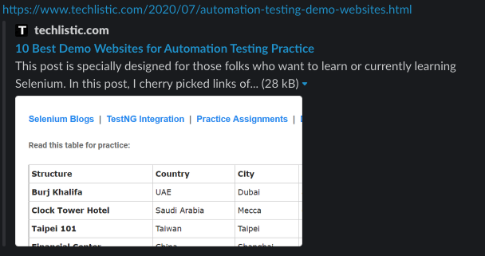
Selenium
https://www.techlistic.com/p/selenium-practice-form.html
https://www.techlistic.com/2020/07/automation-testing-demo-websites.html

Slide 9
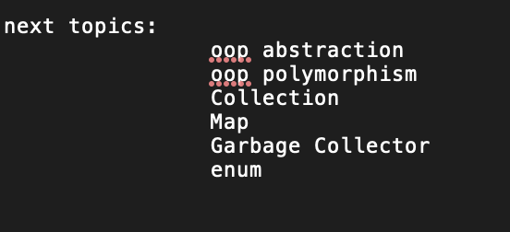
https://docs.google.com/spreadsheets/d/1xUZziuoOP-09QtaI7kYzpQsX1SO3jyaSMLSUa8ackqE/edit#gid=0
10/03/2020 Ismail - Collections
. https://youtu.be/6qXpX7ClA9A

Slide 10
P.I.Q. Inheritance : TestBase (extended to test base) Abstract : TestBase class is abstract class Polymorphism : Used polymorphism with our WebDriver Encapsulation : DRIVER UTILS

Slide 11
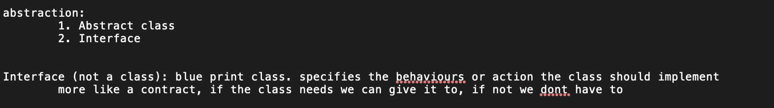

Slide 12
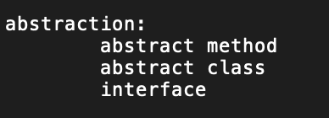

Slide 13
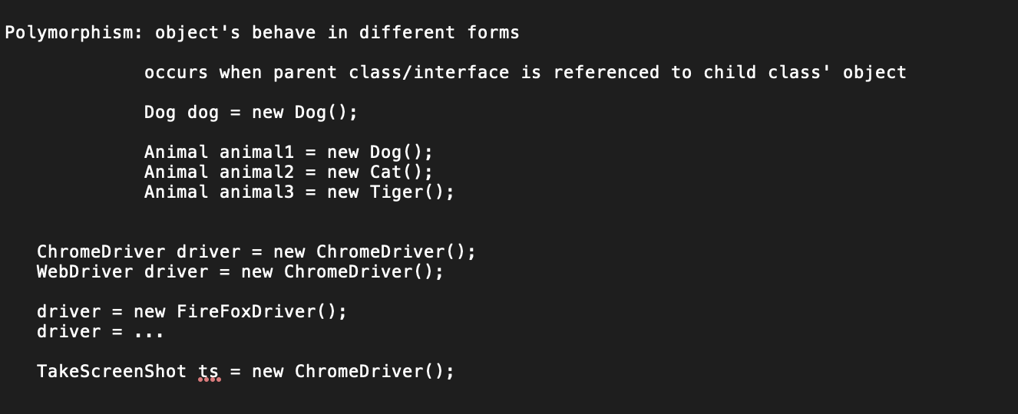

Slide 14
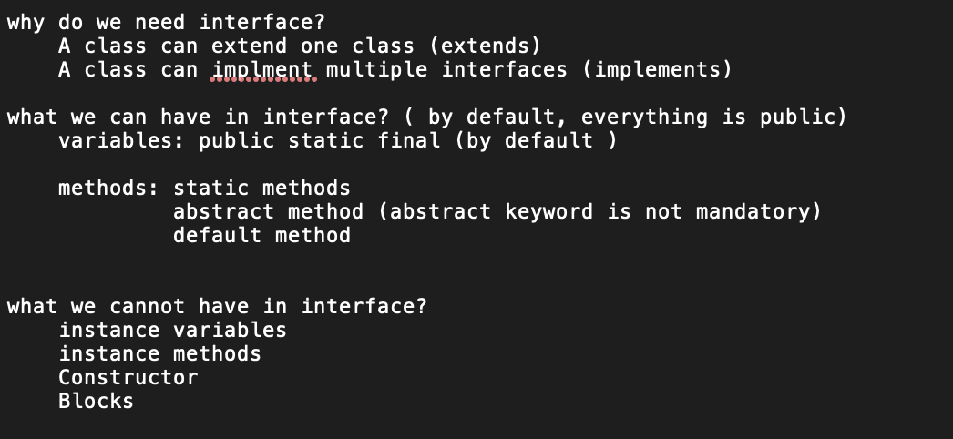

Slide 15
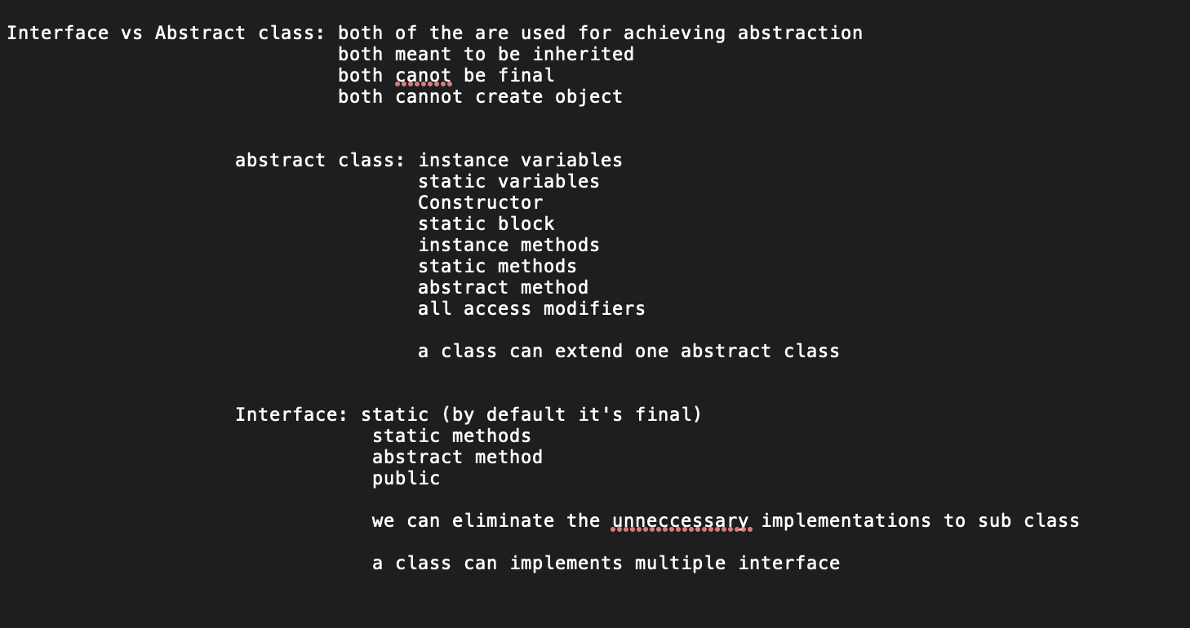

Slide 16
https://phptravels.com/demo
https://astronautweb.co/snippet/font-awesome/
https://www.automationtestinginsider.com/p/blog-page.html
https://www.techbeamers.com/selenium-webdriver-quiz/
JS Alert box:
https://www.seleniumeasy.com/test/javascript-alert-box-demo.html
https://www.techbeamers.com/websites-to-practice-selenium-webdriver-online/
DropDown, iframe:
https://www.automationtestinginsider.com/2019/08/textarea-textarea-element-defines-multi.html
https://ultimateqa.com/dummy-automation-websites/
DropDown:
https://www.seleniumeasy.com/test/jquery-dropdown-search-demo.html

Slide 17
- Testbase - Properties/Configuration Reader - Driver Utils

Slide 18
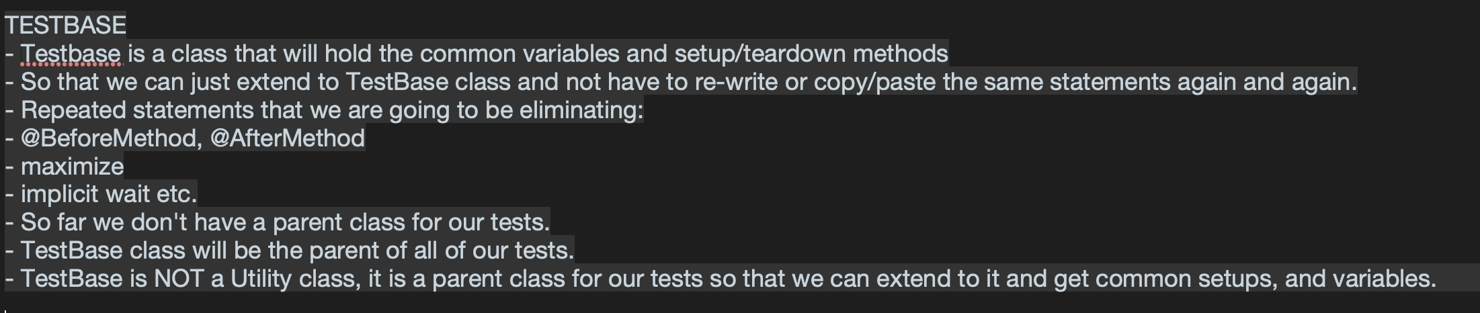

Slide 19
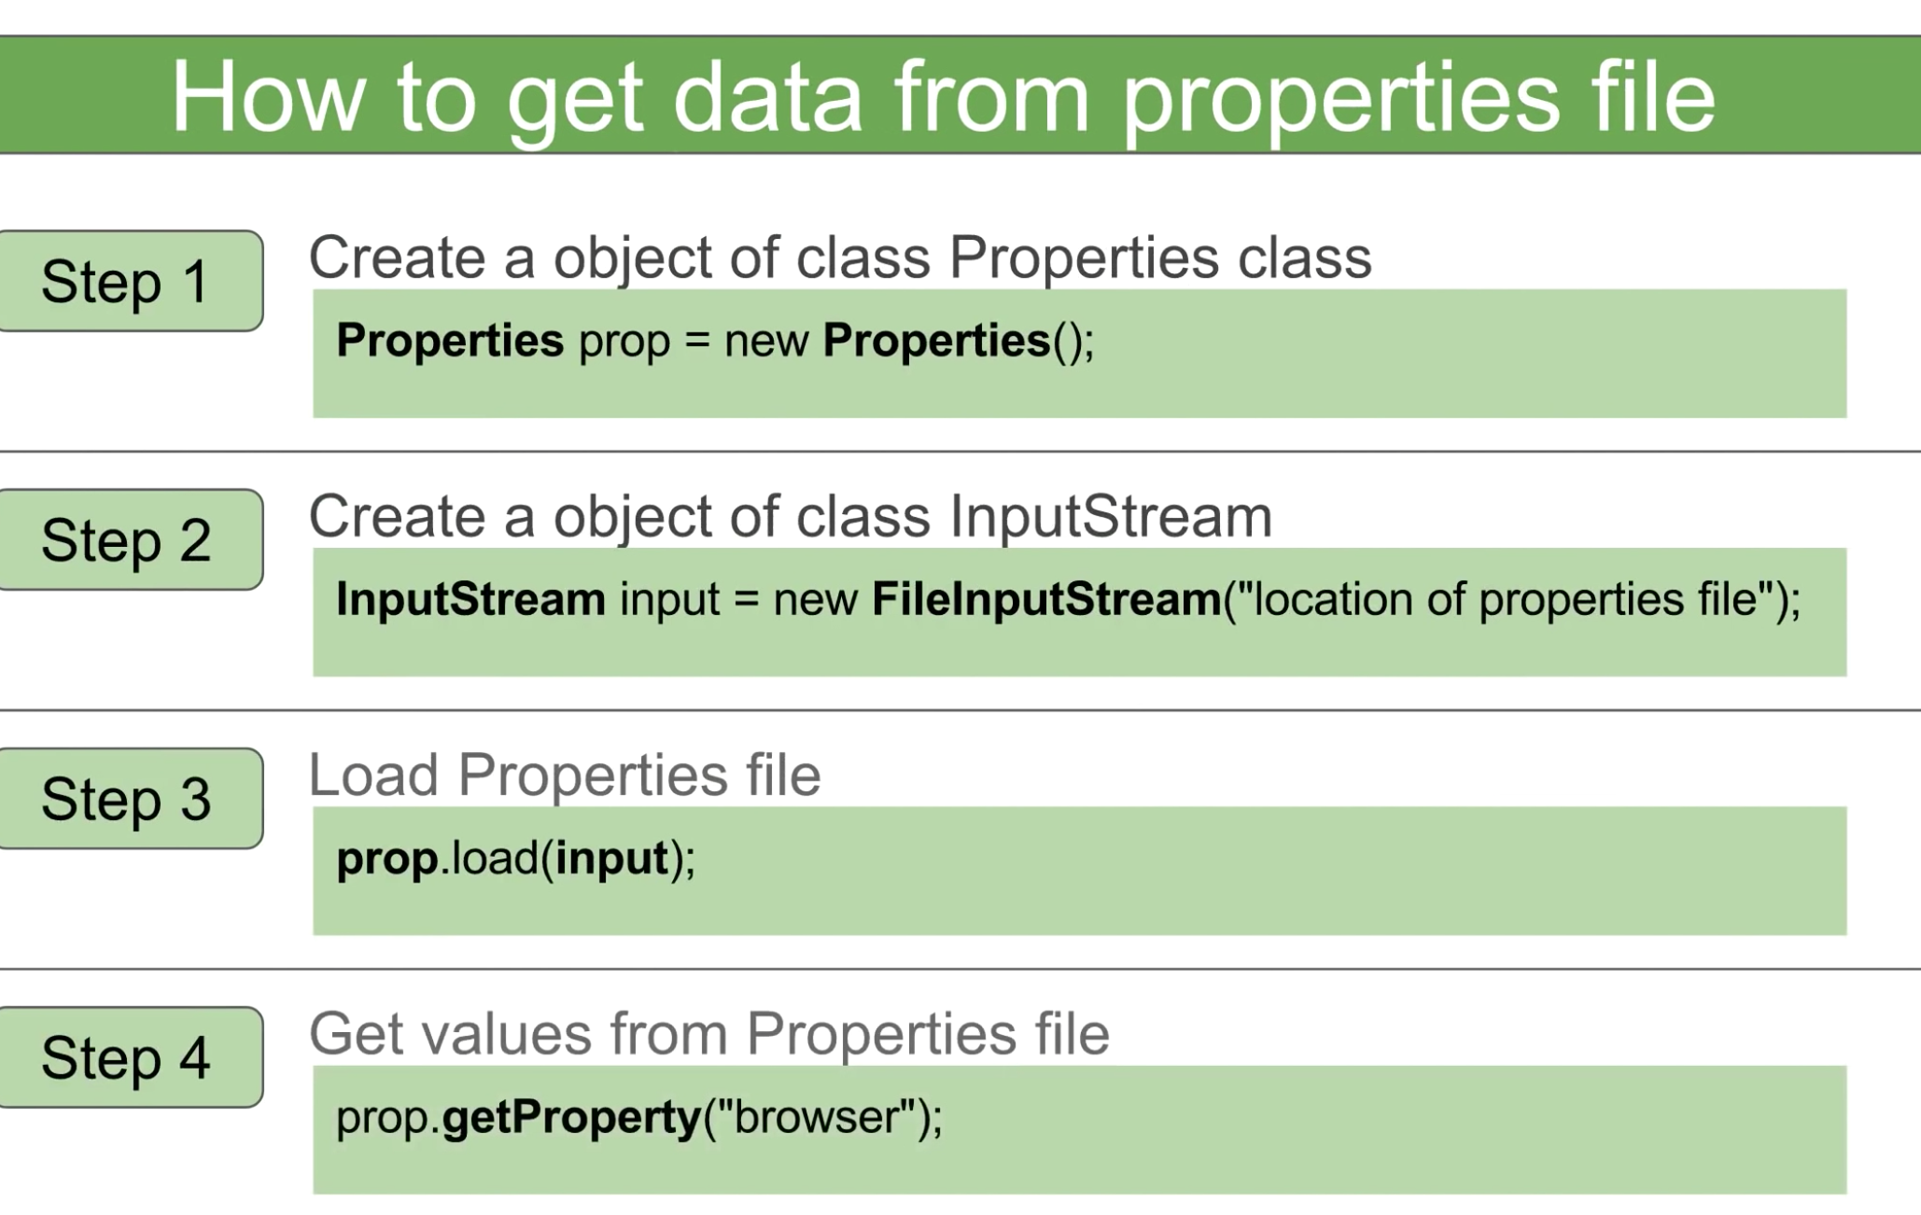
Source: http://automationstepbystep.com/2017/12/30/selenium-beginner-10-how-to-use-config-properties-file/

Slide 20
User Story – 1. As a user, I should be able to send messages by clicking on Message tab under Active Stream.
AC:
1. User should be able to click on upload files icon to upload files and pictures from local disks, download from external drive, select documents from bixtrix24, and create files to upload.
2. User should be able to add users from selecting contact from E-mail user, Employees and Departments and Recent contact lists.
3. User should be able to attach link by clicking on the link icon.
4. User should be able to insert videos by clicking on the video icon and entering the video URL.
5. User should be able to create a quote by clicking on the Comma icon.
6. User should be able to add mention by clicking on the Add mention icon and select contacts from the lists provided in dropdown.
7. User should be able to click on Visual Editor and see the editor text-bar displays on top of the message box.
8. User should be able to click on the Topic icon to see the Message Topic text box displays on top of the message box.
9. User should be able to click on "Record Video" tab to record a video and attach it with the message.

