Slide 1



Heritage
by
@CarstenMeyke
@cmeyke

Slide 2
Heritage Smart Contract and App
https://heritage-gamma.vercel.app/
Smart wallet focused on trustless
inheritance management

Slide 3
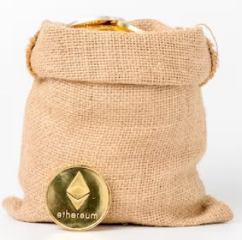
Problem Statement ❌
How to inherit your ethereum based crypto assets in a trustless way
In order to inherit a seed phrase you would need to trust a third party (e.g. notary)
Multisig wallets alone are also not the
answer, because a trusted third party
would still be necessary

Slide 4

My Solution ✅
Introducing a time based Element: “TimeAlive” ⏰
Introducing roles: “Appointer” and “Heir”
Only the “Appointer” is able to call the “alive” method which restarts the timer
Only the “Appointer” can transfer ERC20 tokens and ETH
The “Heir” can’t do anything until “TimeAlive” has passed and the “Appointer” did not call “alive”. He is then able to accept the inheritance and become an “Appointer” himself.

Slide 5
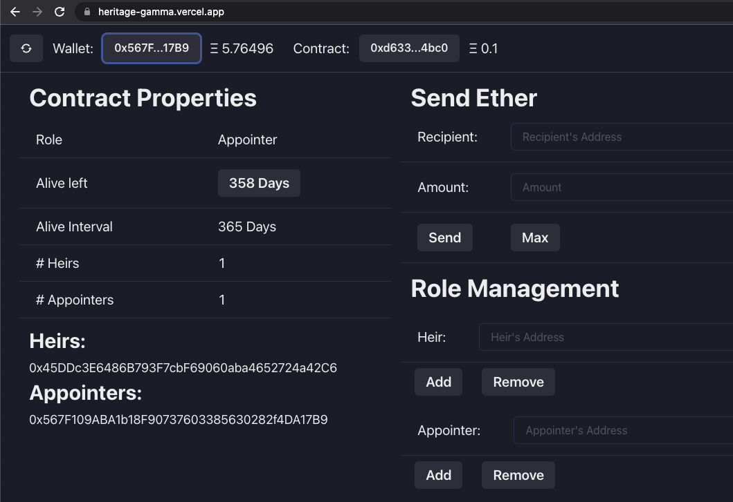
Please try it out!
Goerli testnet only!
https://heritage-gamma.vercel.app/

Slide 6
Next Steps 🔜
Support ERC 20 Tokens via UI
Support NFTs
Wallet Integration
More Test-Cases
Better Modularization and Code Commentary
Better Documentation
Security Audit

Slide 7
Thank you!

