Slide 1
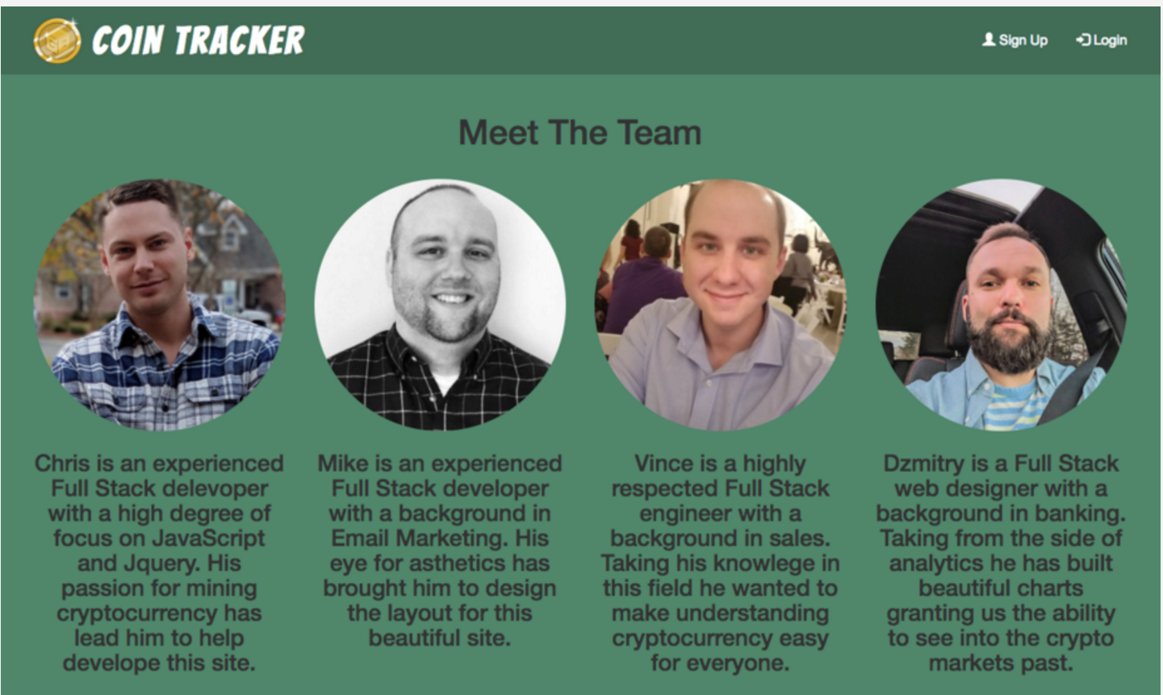
Coin Tracker
By: Team dahL

Slide 2
Idea Origination.
Originally, we wanted to provide a site that allowed the most basic level investor to come educate their self, keep track of their favorite coins and then opt in for notifications when there was a change in the status of their favorite coins.
REFOCUSED TO:
“Coin Tracker” achieves all of this by providing a place where anyone of any Experience level can come to track and chart data at a basic level while informing themselves of relevant news topics on the coins of their choice.

Slide 3

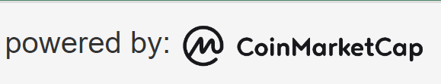
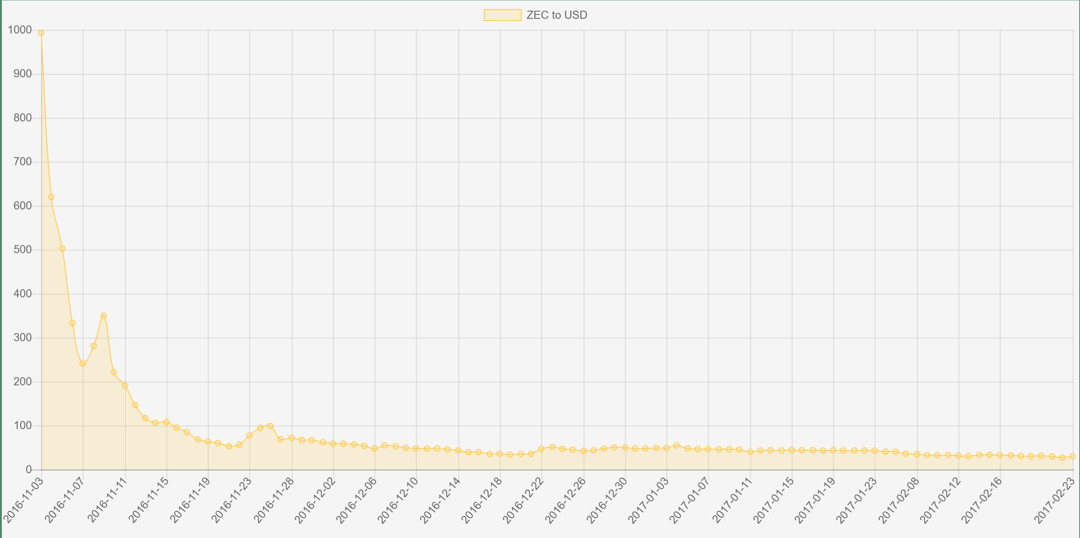
Orginal idea
Create an app that worked like a library for users new to crypto and investing
Created a framework for dev team to place ideas in
We wanted to build a crypto based app.
Final design
Use of API calls to gather data and display to viewport.
Needed historical data to interact with.
Needed to display in a visually appealing way.
Wanted public and private pages for users.
Created private and public pages.
Login with authentication.
Display historical data in chat-form
News feed to cycle through relevant articles.

Slide 4
Challenges faced.
- Building a general framework to display all data in a cohesive manner.
- Allowing authentication to give users a private area to hone in on the coins they are interested in while still having the ability to review and news data.
- Finding data to display visual icons.
- Using JavaScript to loop through and create area for top 50 coins, news feed, login and setups.
- Creating the code to display charts with multiple coins for comparison.

Slide 5
technology to overcome.
Vincent’s use of bootstrap styling allows for easy mobile responsiveness across viewports while keeping a clean and visually aesthetic app. Also JavaScript usage for tile creation from API.
Chris’s JavaScript was essential in firebase storage for authenticating sign up and log in usernames and passwords. Also the use of coinmarketcap.com API gives data for tiles.
Michaels news feed provides quick views to external news sites for relevant stories through the use of newsAPI.org .
Dzmitiry’s chartJS code allows the user to access historical data of their favorite coins that is presented in a uniform visual.

Slide 6
Demo time!
https://cmg87.github.io/Project-1/

