Slide 1
Chapter 5 Linear Models: Regression
Beckerman et al. p. 108-118;

Slide 2
Linear Models
General linear models are a class of model that includes regression, multiple regression, ANOVA, and ANCOVA.
All of these are fundamentally linear models.
Don’t confuse the general linear model with the generalized linear model (different assumptions).
These models share a common framework for estimation (least squares) and a common set of assumptions, centered around the idea of normally distributed residuals.

Slide 3
Least Squares Estimation: Draw a line that minimizes residuals (squared-residuals)
Response Variable
Predictor Variable
Notes:
All about minimizing residuals. In statistics, the term y hat (written as ŷ) refers to the estimated value of a response variable in a linear regression model.

Slide 4
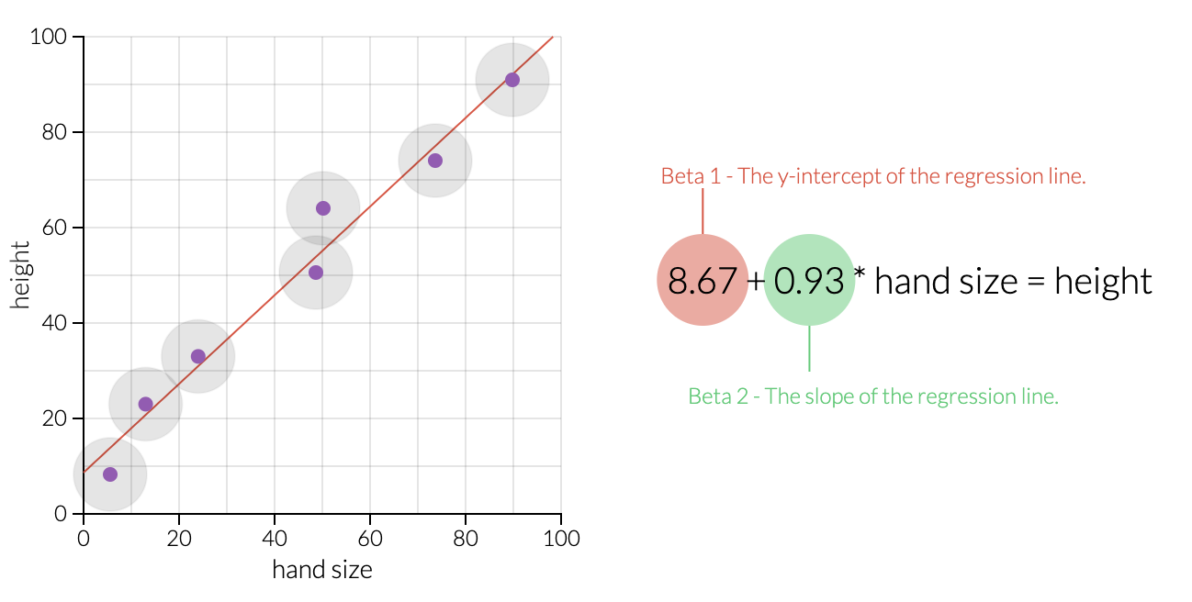
Let's Simulate OLS Estimation:
https://setosa.io/ev/ordinary-least-squares-regression/

Slide 5
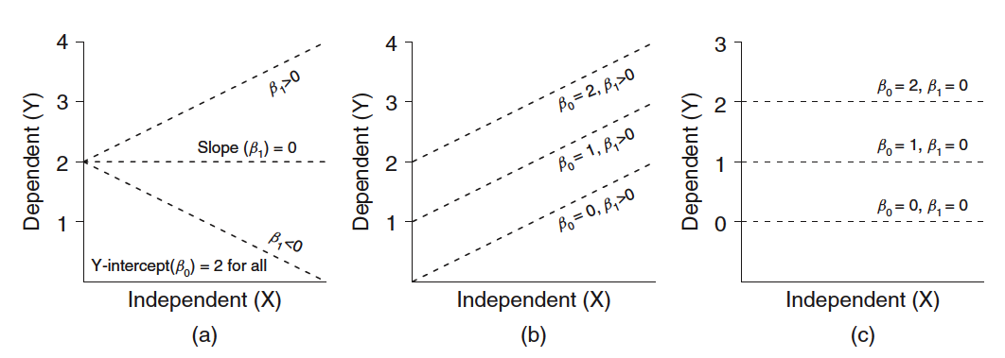
GLM: Comparing Regression Coefficients (βetas)
The formula for a General Linear Model:
Y = predicted value of variable Y
β₀= Y-intercept
β₁= slope
X = value of X variable
ε = error
Notes:
E = error

Slide 6
Linear Models
lm() is the basic function for fitting linear models
Our initial examples will focus on the relationship between two continuous variables (1 predictor/1 response)
plant_gr <- read.csv("plant.growth.rate.csv")
glimpse(plant_gr)
ggplot(plant_gr,
aes(x = soil.moisture.content, y = plant.growth.rate)) +
geom_point() +
ylab("Plant Growth Rate (mm/week)") +
theme_bw()
Note on good coding practice: Each plot argument is on a separate line, ending with a +

Slide 7
Two parameters of Interest:
Y-Intercept (β₀) and Slope (β₁)
Let’s take a guess…
Intercept looks to be between 15-20
Slope of the relationship is obviously positive
Y-units between 20-50 = 30 units and
X-units between 0-2.0 = 2 units.
Slope is around 30/2 or 15
Biological interpretation = ~15 mm in growth (per week) with every 1 unit increase in soil moisture

Slide 8
Add Model Predictions (Fit-Line) to Figure
ggplot(plant_gr,
aes(x = soil.moisture.content, y = plant.growth.rate)) +
geom_point() +
geom_smooth(method = 'lm') +
ylab("Plant Growth Rate (mm/week)") +
theme_bw()

Slide 9
The new feature here is the prediction layer:
geom_smooth(method = "lm")
This is ggplot-speak for ‘use a linear-model fitted line, and the standard error of the fit’
This works well with facet_wrap(), fitting different lines for each panel ‘group’ (categorical) variable

Slide 10
Fit the model
model_pgr <- lm(plant.growth.rate ~ soil.moisture.content,
data = plant_gr)
This reads, “Fit a linear model, where we hypothesize that plant growth rate is a function of soil moisture content, using the variables from the plant_gr data frame.”
Notice that people often choose to use the type of object as a prefix in object name (we have seen this before); more intuitive
model_abc123
figure_abc123
table_abc123
data_abc123
Note also that response variable specified first, predictor variable second; opposite of ggplot2 specifications

Slide 11
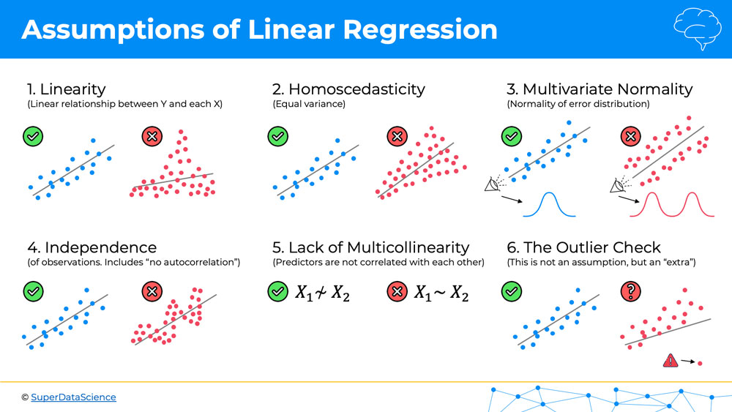
Each test has a set of assumptions that should be met.
X-Y Plots with Problems: Violating Basic Assumptions
(plotting raw X-Y data, not model residuals)
Notes:
We can mostly ignore #5 and multivariate part of #3.

Slide 12
Check model assumptions more formally
library(ggfortify) #quick model diagnostics
autoplot(model_pgr, smooth.colour = NA)

Slide 13
Points flagged as potentially problematic are identified by number (in order of occurrence in dataframe)
Top-left: linearity; should be scatter-shot; no obvious hump-shapes or U-shaped distribution
Top-Right: Evaluates assumption of normality; dots should all be very nearly on the expected line
Bottom-Left: Evaluates assumption of equal variance; should be scatter-shot
Bottom-Right: Detects outliers ‘leveraging’ the distribution.
Generally, things look OK.

Slide 14
Model Interpretation
anova(model_pgr) #produces a classic table in statistics, the sums-of-squares table.
It provides the overall F-value for the model, representing the ratio of variance explained by the explanatory variables (only one in this case; soil moisture) to the leftover variance (this is the ANOVA part).
P-value evaluating the null hypothesis (slope = zero)
Analysis of Variance Table
Response: plant.growth.rate
Df Sum Sq Mean Sq F value Pr(>F)
soil.moisture.content 1 2521.15 2521.15 156.08 < 2.2e-16 ***
Residuals 48 775.35 16.15
---
Signif. codes: 0 ‘***’ 0.001 ‘**’ 0.01 ‘*’ 0.05 ‘.’ 0.1 ‘ ’ 1

Slide 15
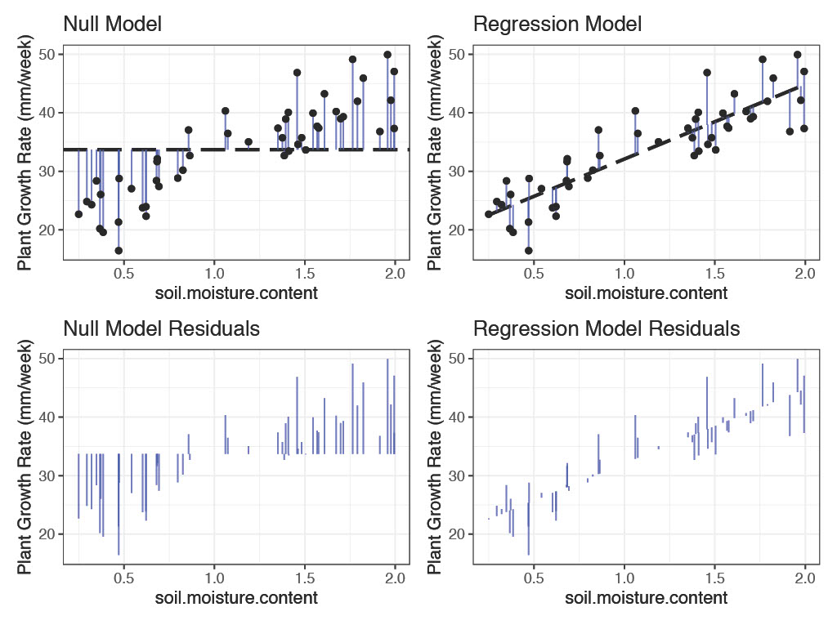
Testing the Null Hypothesis
Visually, it appears as though the fit regression model has lower overall ‘error’ (sum of [squared] residuals); fits better than null model.
Visual evidence to reject null hypothesis; accept alternative.

Slide 16
Model Interpretation
summary(model_pgr) produces estimates of the coefficients of the line that is “the model”: an intercept and a slope
Call:
lm(formula = plant.growth.rate ~ soil.moisture.content, data = plant_gr)
Residuals:
Min 1Q Median 3Q Max
-8.9089 -3.0747 0.2261 2.6567 8.9406
Coefficients:
Estimate Std. Error t value Pr(>|t|)
(Intercept) 19.348 1.283 15.08 <2e-16 ***
soil.moisture.content 12.750 1.021 12.49 <2e-16 ***
---
Signif. codes: 0 ‘***’ 0.001 ‘**’ 0.01 ‘*’ 0.05 ‘.’ 0.1 ‘ ’ 1
Residual standard error: 4.019 on 48 degrees of freedom
Multiple R-squared: 0.7648, Adjusted R-squared: 0.7599
F-statistic: 156.1 on 1 and 48 DF, p-value: < 2.2e-16

Slide 17
Model Interpretation
summary(model_pgr) produces estimates of the coefficients of the line that is “the model”: an intercept and a slope
Statistic | Description | Example
β coefficients (Estimate) | Direction and magnitude of effect | β_soil.moisture.content = 12.75
Standard errors (SE) | Estimate precision | SE = 1.02
t-values | Significance test for each β | t = 12.49
p-values | Significance level | p < 0.001
R² | Proportion of variance explained | R² = 0.75
F-statistic | Overall model significance when compared to a null model | F₍_{1,48}₎ = 156.1, p < 0.001
Residual standard error (RSE) | Average deviation of residuals | RSE = 4.01

Slide 18
summary(model_pgr): The t- and p-values provide tests of whether the model coefficients (slope and intercept) are different from zero (the null statistical hypothesis)
In fact, we might even report something like the following:
“Soil moisture had a positive effect on plant growth. For each unit increase in soil moisture, plant growth rate increased by 12.7 mm/week (slope = 12.7, t = 12.5, d.f. = 48, p < 0.001).”
In case you were wondering, it is also be fine to report the F-value, degrees of freedom, and the p-value from anova(). They test exactly the same thing in this example (because there is only a single predictor variable, soil moisture). This isn’t generally true of all GLMs.

Slide 19
summary(lm_object) and anova(lm_object) are answering two different statistical questions about the same fitted model:
Function | What question is it answering? | Level of inference | Typical output
anova() | “Does adding this predictor (or set of predictors) significantly improve model fit compared to a simpler model without it?” | Model / term-level (change in residual SS) | Sequential (Type I) sum of squares, F-tests comparing nested models
summary() | “Given all the other predictors in the model, is this particular coefficient different from 0?” | Coefficient-level (partial / marginal effect) | Estimates (β̂), SEs, t-values, p-values for each predictor
Use anova() when you want to compare models (e.g. test the fitted model to the null model) or test the overall contribution of predictors (as steps in model building).
Use summary() when you want to interpret regression coefficients. (*mostly our goal)

Slide 20
Using Coefficients for Prediction
Since we have an equation for a line of best fit (from the coefficients table), how would we use the equation to predict new values of X?
#new value of soil.moisture.content
new_point <- data.frame(soil.moisture.content=c(1.75))
new_point #just checking
#1.75
predict(model_pgr, new_point)
#41.66015

Slide 21
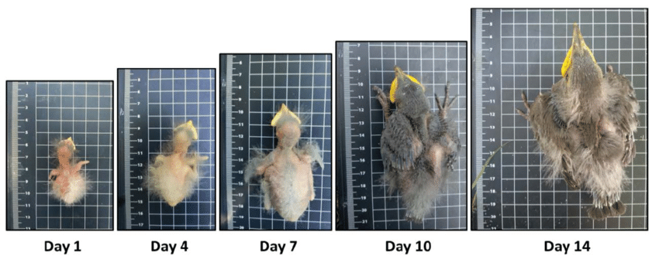
Another Example
Determine the association between two continuous variables.
H_{o}: β₀ = 0
H_{a}: β₀ ≠ 0
H_{o}: β₁ = 0
H_{a}: β₁ ≠ 0
Test slope = 0
Test Y-intercept = 0
Age (days) | Wing Length (cm)
3 | 1.4
4 | 1.5
5 | 2.2
6 | 2.4
8 | 3.1
9 | 3.2
10 | 3.2
11 | 3.9
12 | 4.1
14 | 4.7
15 | 4.5
16 | 5.2
17 | 5
“There is a positive relationship between age and wing length in sparrows (r² = 0.97, F_{1,11} = 401.09, P < 0.0001). For each additional day in age, nestling wing length was predicted to increase 0.27 cm.”
Notes:
This is simple linear regression. Just another general linear model (GLM). Usually not interested in testing whether y-intercept = 0.
20 nests, 1 random nest sampled per day; else repeated measures design necessary.
In all regressions the line is fit through the mean of X and mean of Y; software fits line via OLS, which minimizes the distance between points and a fitted line

Slide 22
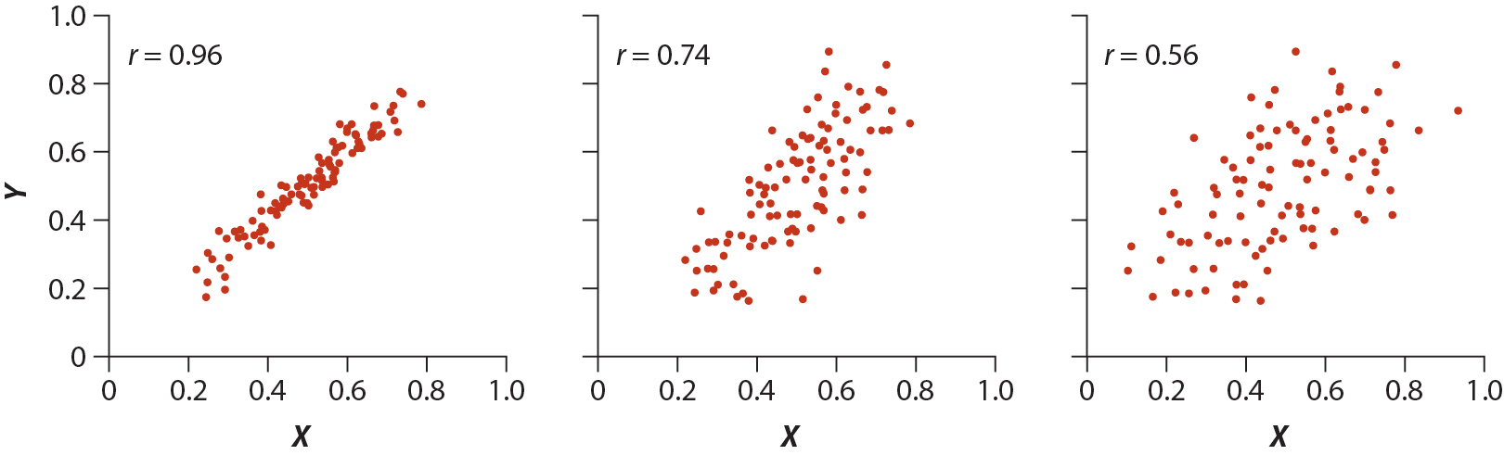
r² = coefficient of determination
2
2
2
96% of the variability in Y can be attributed to X.
4% of the variability due to measurement error or some other biological factor.
56% of the variability in Y can be attributed to X.
44% of the variability due to measurement error or some other biological factor.
video
Notes:
See also:
https://en.wikipedia.org/wiki/Anscombe%27s_quartet

Slide 23
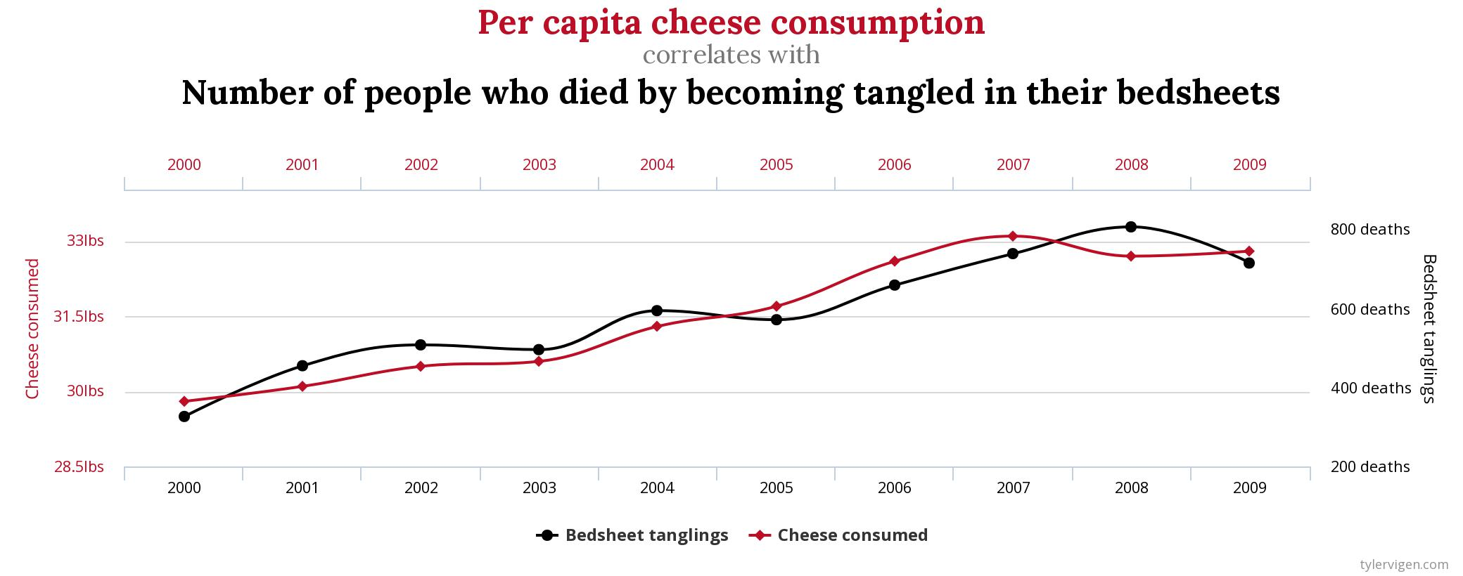
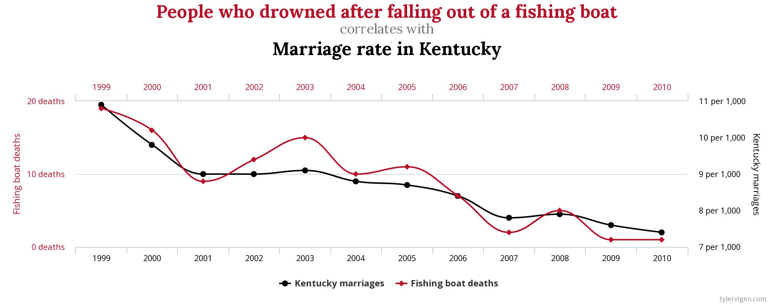
Not all Correlations are Meaningful
http://www.tylervigen.com/spurious-correlations

Slide 24
Regression Practice
1. Using iris data (built-in to R):
-petal length to predict petal width (all species combined)
2. Using penguins dataset from palmerpenguins package:
-flipper length to predict bill length (all species combined)
-what is the predicted bill length for a penguin with a 200 mm flipper length?
3. Using the state.x77 dataframe (built-in to R):
-create and interpret 2 regression analyses that describe meaningful predictive relationships.
-In each analysis, what is the predicted value of the response at the mean value of the predictor?
Note: run this line of code before starting state.x77 analysis:
state.x77<- data.frame(state.x77)
?state.x77 #information describing variables
(the raw data frame has spaces in column names; this fixes that)
Format each response as you would a results statement in a journal publication.
Notes:
Format each response as you would a results statement in a journal publication.

Slide 25
Chapter 5 Linear Models: ANOVA
Beckerman et al. p. 118-128

Slide 26
One-Way ANOVA
Similar to regression, but predictor variable (x-axis) is categorical rather than continuous.
daphnia <- read.csv("Daphniagrowth.csv”)
daphnia$parasite <- as.factor(daphnia$parasite) #forces factor
glimpse(daphnia)
Observations: 40
Variables: 3
$ parasite <fct> control, control, control, control, control, control, control, Met...
$ rep <int> 1, 2, 3, 4, 5, 6, 7, 8, 9, 10, 1, 2, 3, 4, 5, 6, 7, 8, 9, 10, 1, 2, 3, 4, 5,...
$ growth.rate <dbl> 1.0747092, 1.2659016, 1.3151563, 1.0757519, 1.1967619, …
Remember that $ refers to a column within a specific dataframe.
Notes:
Daphnia, a genus of small planktonic crustaceans, are 0.2–5 millimetres (0.01–0.20 in) in length. Daphnia are members of the order Cladocera, and are one of the several small aquatic crustaceans commonly called water fleas because their saltatory swimming style resembles the movements of fleas. Daphnia live in various aquatic environments ranging from acidic swamps to freshwater lakes and ponds.

Slide 27
Dig a little deeper…
Use BaseR notation to find out more about the dataframe. Commands below assume that the import sees ‘parasite’ variable as a factor. Three ways to do this:
-Manually change ‘parasite’ variable to be a factor (already did this), or
-Click ‘strings as factors’ box when importing dataset via dialog box, or
-stringsAsFactors = TRUE as argument when importing programmatically
nlevels(daphnia$parasite)
[1] 4
levels(daphnia$parasite)
[1] "control" "Metschnikowia bicuspidata"
[3] "Pansporella perplexa" "Pasteuria ramosa"
unique(daphnia$parasite)
[1] control Metschnikowia bicuspidata
[3] Pansporella perplexa Pasteuria ramosa
4 Levels: control Metschnikowia bicuspidata ... Pasteuria ramosa

Slide 28
Daphnia Example
The question we are asking focuses on water flea growth rates and has two parts.
First, we are asking generally whether parasites alter growth rates. (differences overall)
Second, because it is a well-replicated and designed experiment, we can also ask whether each of three different parasite species reduces growth, compared with
a control, no parasite treatment. (pairwise differences)

Slide 29
First plot the data
ggplot(daphnia,
aes(x = parasite, y = growth.rate)) +
geom_boxplot() +
theme_bw()
X-axis is a mess, so flip
the axes. Append ggplot
statement
coord_flip()

Slide 30
Considerable variation among groups
Control group has highest growth rate (1.2 mm/day); all others cause inhibition of growth
We can see that there is likely to be a parasite treatment effect overall (question 1), and an ordering in the growth rates, with parasites generally driving down the growth rate, and P. ramosa < M. bicuspidata < P. perplexa (question 2)

Slide 31
Calculating means with dplyr
# get the mean growth rates
sumDat <- daphnia %>%
group_by(parasite) %>%
summarise(meanGR = mean(growth.rate))
sumDat
# A tibble: 4 x 2
parasite meanGR
<fct> <dbl>
1 control 1.21
2 Metschnikowia bicuspidata 0.801
3 Pansporella perplexa 1.08
4 Pasteuria ramosa 0.482
Now you have some context for how much each different parasite species influences the growth rate of Daphnia.
Notes:
meanGR is a new variable you are creating to summarize data using the mean

Slide 32
Construct Linear Model
model_grow <- lm(growth.rate ~ parasite, data = daphnia)
autoplot(model_grow, smooth.colour = NA)
Model diagnostics looks OK.
(takes a little practice to see)

Slide 33
Evaluate the Linear Model
anova(model_grow) # test our model against null model
Similar output as regression (why?)
Evidence of that parasite treatment has produced overall effect. Low P-value indicates little support for null hypothesis. What would statistical null hypothesis look like?
Analysis of Variance Table
Response: growth.rate
Df Sum Sq Mean Sq F value Pr(>F)
parasite 3 3.1379 1.04597 32.325 2.571e-10 ***
Residuals 36 1.1649 0.03236
---
Signif. codes: 0 ‘***’ 0.001 ‘**’ 0.01 ‘*’ 0.05 ‘.’ 0.1 ‘ ’ 1

Slide 34
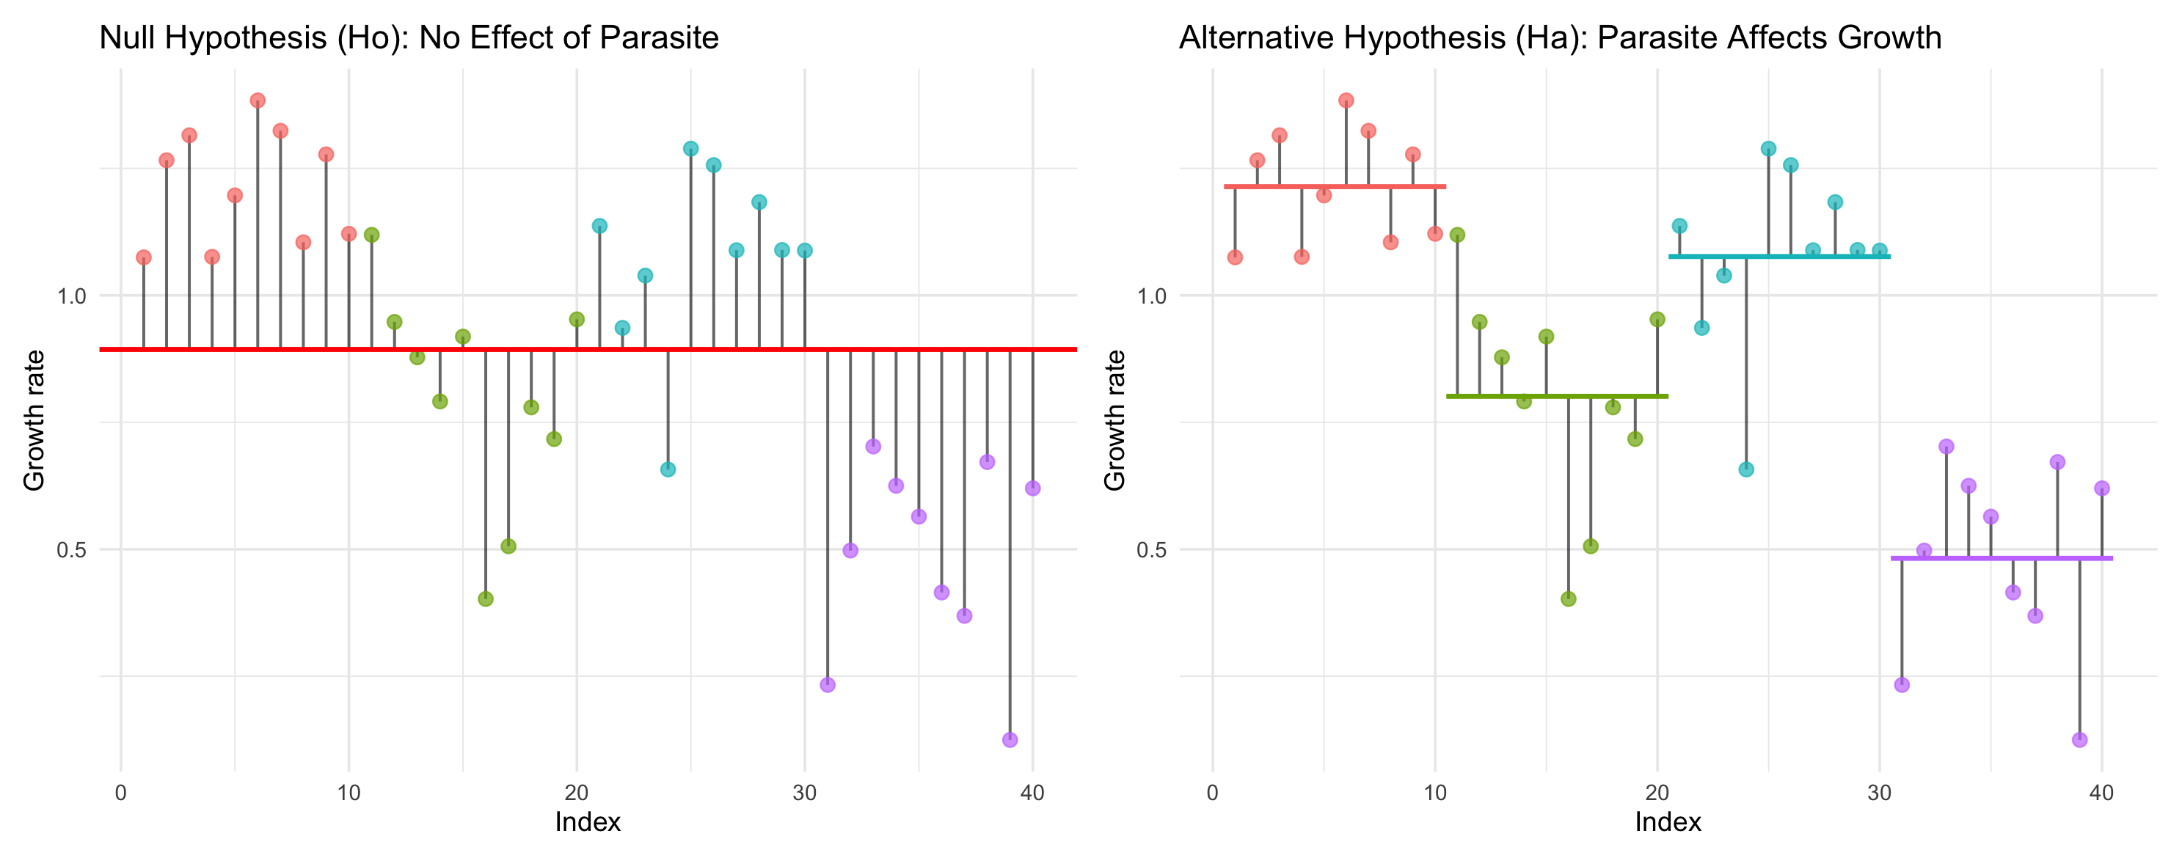
Null Hypothesis in ANOVA: all the groups come from populations with the same mean.
Alternative Hypothesis in ANOVA: all the groups come from populations with different means.
Notes:
https://www.polypompholyx.com/2014/02/r-anova-1-way/

Slide 35
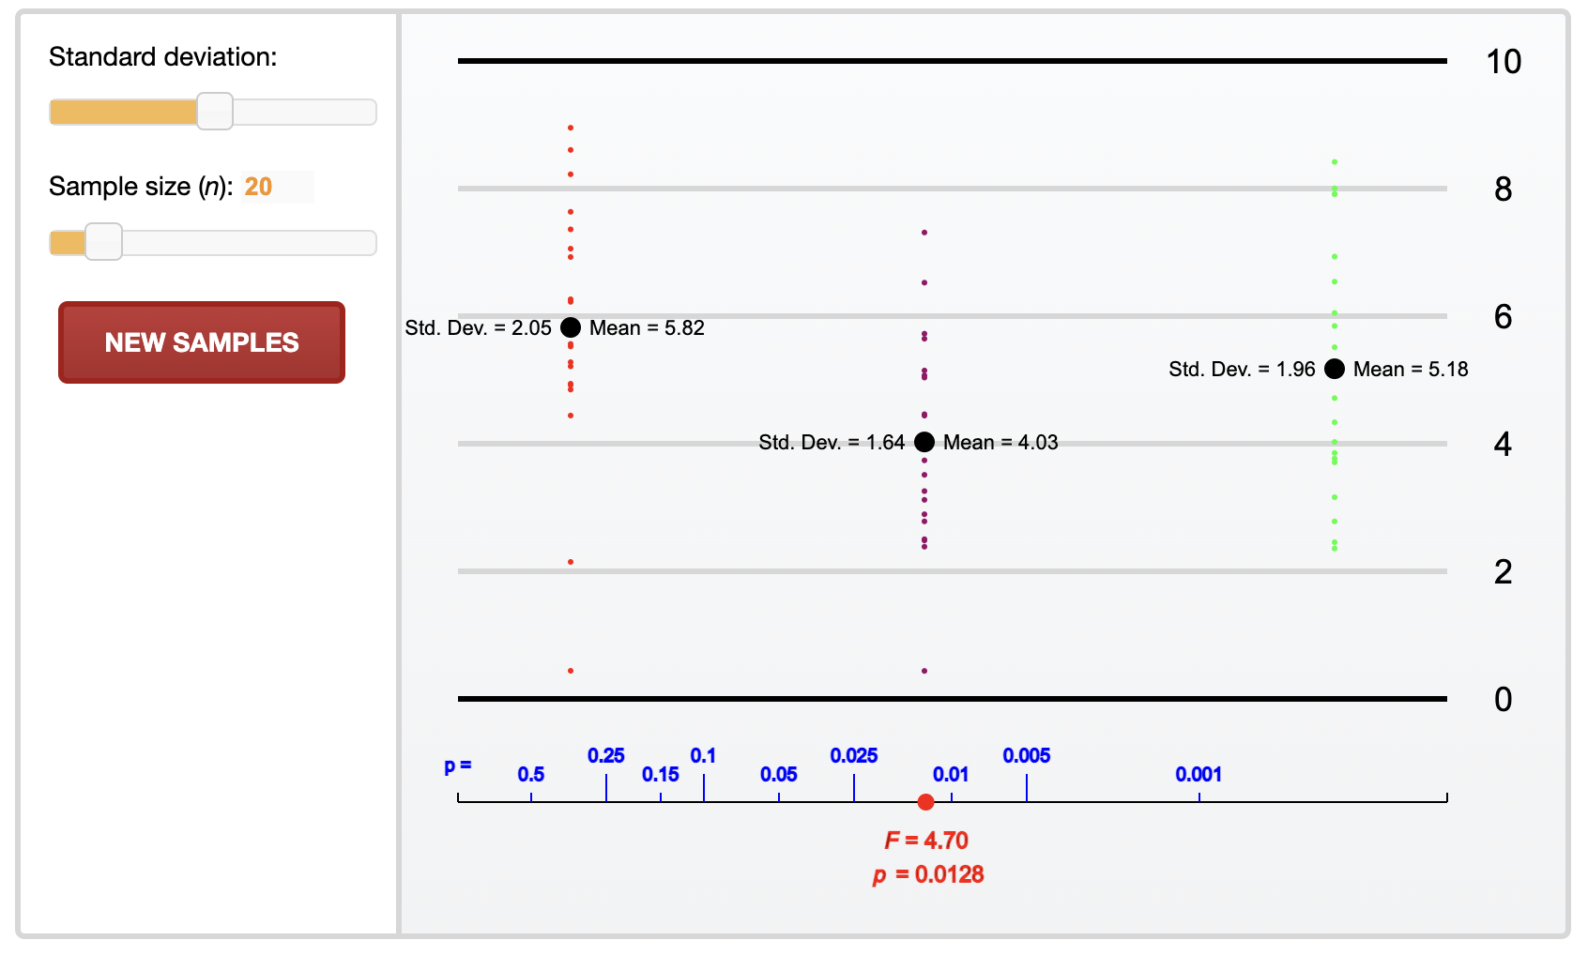
Null Hypothesis in ANOVA: all the groups come from populations with the same mean.
Alternative Hypothesis in ANOVA: all the groups come from populations with different means.
Use link to experiment http://digitalfirst.bfwpub.com/stats_applet/stats_applet_1_anova.html
Notes:
https://digitalfirst.bfwpub.com/stats_applet/stats_applet_1_anova.html
Recall our discussions of effect size, sample size, and variation. This widget allows you to model each input separately.

Slide 36
Back to Daphnia parasitism example:
Analysis of Variance Table
Response: growth.rate
Df Sum Sq Mean Sq F value Pr(>F)
parasite 3 3.1379 1.04597 32.325 2.571e-10 ***
Residuals 36 1.1649 0.03236
---
Signif. codes: 0 ‘***’ 0.001 ‘**’ 0.01 ‘*’ 0.05 ‘.’ 0.1 ‘ ’ 1
F-statistic is the ratio of the between-group variance to the within-group variance.
1.04/0.03 = 32.3
32 times more variation among groups than within
As the former is large relative to the latter, this produces a large F-value, and thus a small p-value that allows us to reject the null hypothesis that there are no overall differences among treatments.

Slide 37
Treatment Contrasts
After considering overall differences among groups, are there then pairwise differences between groups?
summary(model_grow)
Mean of the control group.
‘control’ is first alphabetically
control<M. bicuspidata<P. perplexa<P. ramosa
Call:
lm(formula = growth.rate ~ parasite, data = daphnia)
Residuals:
Min 1Q Median 3Q Max
-0.41930 -0.09696 0.01408 0.12267 0.31790
Coefficients:
Estimate Std. Error t value Pr(>|t|)
(Intercept) 1.21391 0.05688 21.340 < 2e-16 ***
parasiteMetschnikowia bicuspidata -0.41275 0.08045 -5.131 1.01e-05 ***
parasitePansporella perplexa -0.13755 0.08045 -1.710 0.0959 .
parasitePasteuria ramosa -0.73171 0.08045 -9.096 7.34e-11 ***
---
Signif. codes: 0 ‘***’ 0.001 ‘**’ 0.01 ‘*’ 0.05 ‘.’ 0.1 ‘ ’ 1
Residual standard error: 0.1799 on 36 degrees of freedom
Multiple R-squared: 0.7293, Adjusted R-squared: 0.7067
F-statistic: 32.33 on 3 and 36 DF, p-value: 2.571e-10
How group means
differ from the ‘control’
How this model
differs from the null model (overall).
Notes:
R just loves the alphabet.
In fact, it defaults to presenting things in alphabetical order. In this
example, if we look at the alphabetical order of all of the treatment levels,
we find that control<M. bicuspidata<P. perplexa<P. ramosa.
So, in an ANOVA framework, we can assume that the word ‘(Intercept)’
represents the first level of the alphabetically ordered treatment levels.

Slide 38
Treatment Contrasts
Coefficients:
Estimate Std. Error t value Pr(>|t|)
(Intercept) 1.21391 0.05688 21.340 < 2e-16 ***
parasiteMetschnikowia bicuspidata -0.41275 0.08045 -5.131 1.01e-05 ***
parasitePansporella perplexa -0.13755 0.08045 -1.710 0.0959 .
parasitePasteuria ramosa -0.73171 0.08045 -9.096 7.34e-11 ***
---
Signif. codes: 0 ‘***’ 0.001 ‘**’ 0.01 ‘*’ 0.05 ‘.’ 0.1 ‘ ’ 1
Residual standard error: 0.1799 on 36 degrees of freedom
Multiple R-squared: 0.7293, Adjusted R-squared: 0.7067
F-statistic: 32.33 on 3 and 36 DF, p-value: 2.571e-10
In an ANOVA, we can assume that the word ‘(Intercept)’ represents the first level of the alphabetically ordered treatment levels.
Treatment contrasts report differences between the reference level (in this case, the control) and the other levels (not the means)
So, in the summary table, the numbers associated with each parasite are differences between growth rates associated with that parasite and the control. This is why they are all negative.
Notes:
R just loves the alphabet.
In fact, it defaults to presenting things in alphabetical order. In this
example, if we look at the alphabetical order of all of the treatment levels,
we find that control<M. bicuspidata<P. perplexa<P. ramosa.
So, in an ANOVA framework, we can assume that the word ‘(Intercept)’
represents the first level of the alphabetically ordered treatment levels.

Slide 39
Recall calculating means with dplyr
# get the mean growth rates
sumDat <- daphnia %>%
group_by(parasite) %>%
summarise(meanGR = mean(growth.rate))
Now you can calculate by hand how 1.21 (the control growth rate) minus the treatment contrast for a given parasite in the summary() gives you the mean growth rate for that parasite.
For example, using the P. ramosa coefficient (see the summary table), we take 1.21 –0.73 = 0.48, which is the mean growth rate for P. ramosa.
# A tibble: 4 x 2
parasite meanGR
<fct> <dbl>
1 control 1.21
2 Metschnikowia bicuspidata 0.801
3 Pansporella perplexa 1.08
4 Pasteuria ramosa 0.482

Slide 40
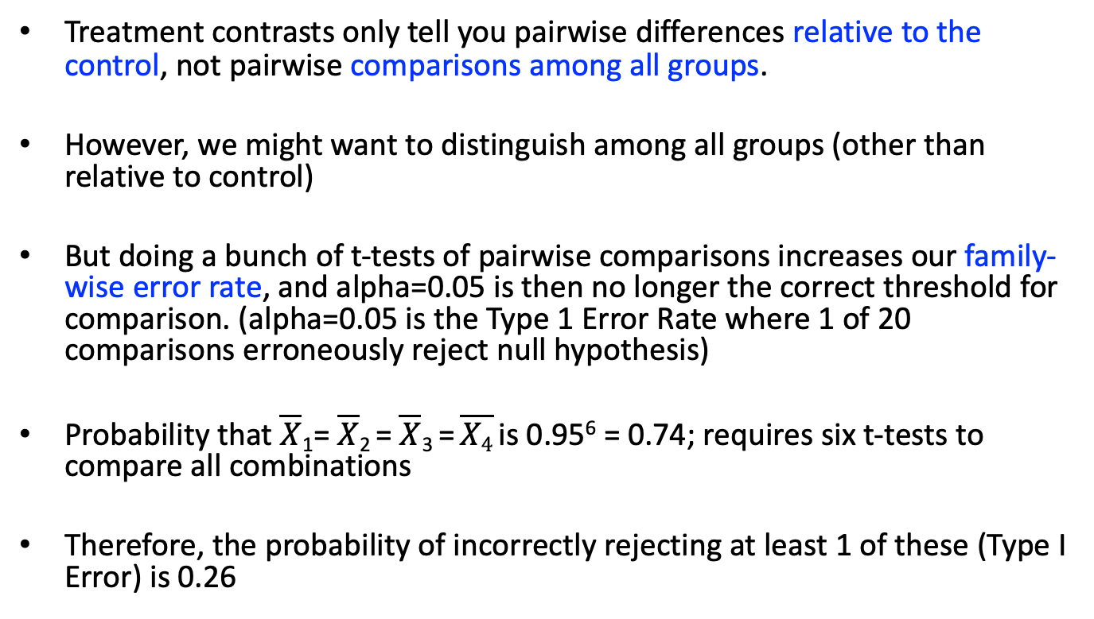
Multiple Contrasts
Treatment contrasts only tell you pairwise differences relative to the control, not pairwise comparisons among all groups.
However, we might want to distinguish among all groups (other than relative to control)
But doing a bunch of t-tests of pairwise comparisons increases our family-wise error rate, and alpha=0.05 is then no longer the correct threshold for comparison. (alpha=0.05 is the Type 1 Error Rate where 1 of 20 comparisons erroneously reject null hypothesis)
Probability that $\overline{X}$₁= $\overline{X}$₂ = $\overline{X}$₃ = $\overline{X4}$ is 0.95⁶ = 0.74; requires six t-tests to compare all combinations
Therefore, the probability of incorrectly rejecting at least 1 of these (Type I Error) is 0.26

Slide 41
Multiple Contrasts
Traditional “Bonferroni Correction” would adjust by taking the number of comparisons/alpha value to get new threshold alpha value. Way too conservative.
For 4 groups being compared = 6 possible comparisons; k(k-1)/2, where k is the number of groups
0.05/6 = 0.0083 as new Bonferroni decision threshold
Only pairwise comparisons <0.0083 would be considered significant.
There is an alternative method that is less rigid; Tukey HSD
We will implement this via the emmeans package (added advantage that this will be same commonly used comparison method for other more complicated GLMs)
Notes:
https://en.wikipedia.org/wiki/Bonferroni_correction
Calculate number of pairwise comparisons:
https://psych.unl.edu/psycrs/handcomp/hclsdhsd.pdf

Slide 42
Compare all possible levels of this variable
Multiple Contrasts using emmeans package
emm_model_grow<- emmeans(model_grow, "parasite")
pairs(emm_model_grow) #show me pairwise differences
contrast estimate SE df t.ratio p.value
control - Metschnikowia bicuspidata 0.4127547 0.08044585 36 5.131 0.0001
control - Pansporella perplexa 0.1375537 0.08044585 36 1.710 0.3335
control - Pasteuria ramosa 0.7317058 0.08044585 36 9.096 <.0001
Metschnikowia bicuspidata - Pansporella perplexa -0.2752010 0.08044585 36 -3.421 0.0082
Metschnikowia bicuspidata - Pasteuria ramosa 0.3189511 0.08044585 36 3.965 0.0018
Pansporella perplexa - Pasteuria ramosa 0.5941521 0.08044585 36 7.386 <.0001
P value adjustment: tukey method for comparing a family of 4 estimates

Slide 43
Multiple Contrasts using emmeans package
#Estimated Marginal Means (also called Least Square means)
plot(emm_model_grow, comparisons = TRUE) #visualize differences
EM means are not always equal to raw means.
They are ‘adjusted’ based on other effects in model.
This is a simple model with no effects other than growth ~ group (no adjustment; means = emmeans)
Notes:
Code has changed: emmeans no longer supports CLD; use multcomp::cld
Good practice to calc emmean as working with more complex models won’t change procedure.

Slide 44
Multiple Contrasts using emmeans package
The purple-blue bars are confidence intervals for the EMMs, and the red arrows are for the comparisons among them.
If an arrow from one mean overlaps an arrow from another group, the difference is not “significant” (Tukey adj., Alpha = 0.05)
Notes:
https://rvlenth.github.io/emmeans/articles/comparisons.html

Slide 45
Multiple Contrasts using multcomp package
Estimated Marginal Means (also called Least Square means)
Provides a Connecting Letters Differences report
multcomp::cld(emm_model_grow)
Visual aid to help symbolize differences among groups using a shared letter or number; shared symbol=not sig. different
parasite emmean SE df lower.CL upper.CL .group
Pasteuria ramosa 0.4822030 0.05688381 36 0.3668373 0.5975687 1
Metschnikowia bicuspidata 0.8011541 0.05688381 36 0.6857884 0.9165198 2
Pansporella perplexa 1.0763551 0.05688381 36 0.9609894 1.1917208 3
control 1.2139088 0.05688381 36 1.0985431 1.3292745 3
Confidence level used: 0.95
P value adjustment: tukey method for comparing a family of 4 estimates
significance level used: alpha = 0.05
Notes:
Code has changed: emmeans no longer supports CLD; use multcomp::cld

Slide 46
1
3
2
3
pairwise
overall
“There was an overall reduction in growth rate of Daphnia as a result of parasitism
(F_{3,36} = 32.3, P < 0.001). On a pairwise basis, P. ramosa and M. bicuspidata caused reduced growth relative to non-parasitized individuals (0.73 and 0.41 mm, respectively; P < 0.0001 for both), however, P. perplexa did not significantly inhibit growth relative to control individuals (P = 0.33). All three parasitized treatments differed from one another (P < 0.01 for each comparison).

Slide 47
ANOVA Practice Example
data=omega3.csv
What is the effect of different sources of dietary protein on the concentration of omega-3 fatty acids in the blood? Please report as if this was your research:
visual representation of comparison (boxplot)
report overall effect
report pairwise effects

Slide 48
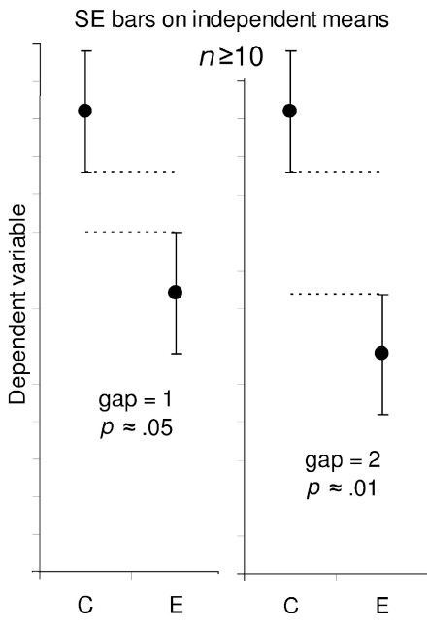
Bar Chart for Omega Example
Bonus: bar chart or point chart with means +/- SE bars. Summarize data using dplyr, then graph. We will talk about this more in the next chapter.
Review Beckerman et al. Section 3.7 for examples.
Look ahead to Beckerman et al. Section 6.2.8 for other examples.

Slide 49
More Practice Problems
There are three practice problems in the ‘practice’ folder of the 5-Linear_Models repository.
Click on ANOVA_practice.html for descriptions.
streams polluted by heavy metals
diet type influences on chick growth
concentration of Basildiol in three strains of Basil

Slide 51
The following example details this hypothetical example. Looking at the means from the Summarize function in FSA, we might think there is a meaningful difference between the classrooms, with a mean height of 153.5 cm vs. 155.0 cm. But looking at the estimated marginal means (emmeans), which are adjusted for the difference in boys and girls in each classroom, this difference disappears. Each classroom has an estimated marginal mean of 153.5 cm, indicating the mean of classroom B was inflated due to the higher proportion of girls.
Notes:
Use dplyr instead of FSA

Slide 52
More on Estimated Marginal Means
Imagine a case where you are measuring the height of 7th-grade students in two classrooms and want to see if there is a difference between the two classrooms. You are also recording the gender of the students, and at this age girls tend to be taller than boys. Say classroom A happens to have far more girls than boys. If you were to look at the mean height in the classrooms, you might find that classroom A had a higher mean, but this may not be an effect of the different classrooms, but because of the difference in the counts of boys and girls in each. In this case, reporting estimated marginal means for the classrooms may give a more representative result. Reporting estimated marginal means for studies where there are not equal observations for each combination of treatments is sometimes recommended. We say the design of these studies is unbalanced.
Notes:
https://rcompanion.org/handbook/G_05.html

