Slide 1
Ambrose Ch. 8
Selected Statistical Tests: ANOVA and Post Hoc tests
Notes:
Get through calculating variance for the 3 experiments in class by 1 hr 35 minutes – could have them calc variance after first example and bring in for HW, but they shockingly NEED to do it in class…
Had to do a short beetle count b/c not enough class time.

Slide 2
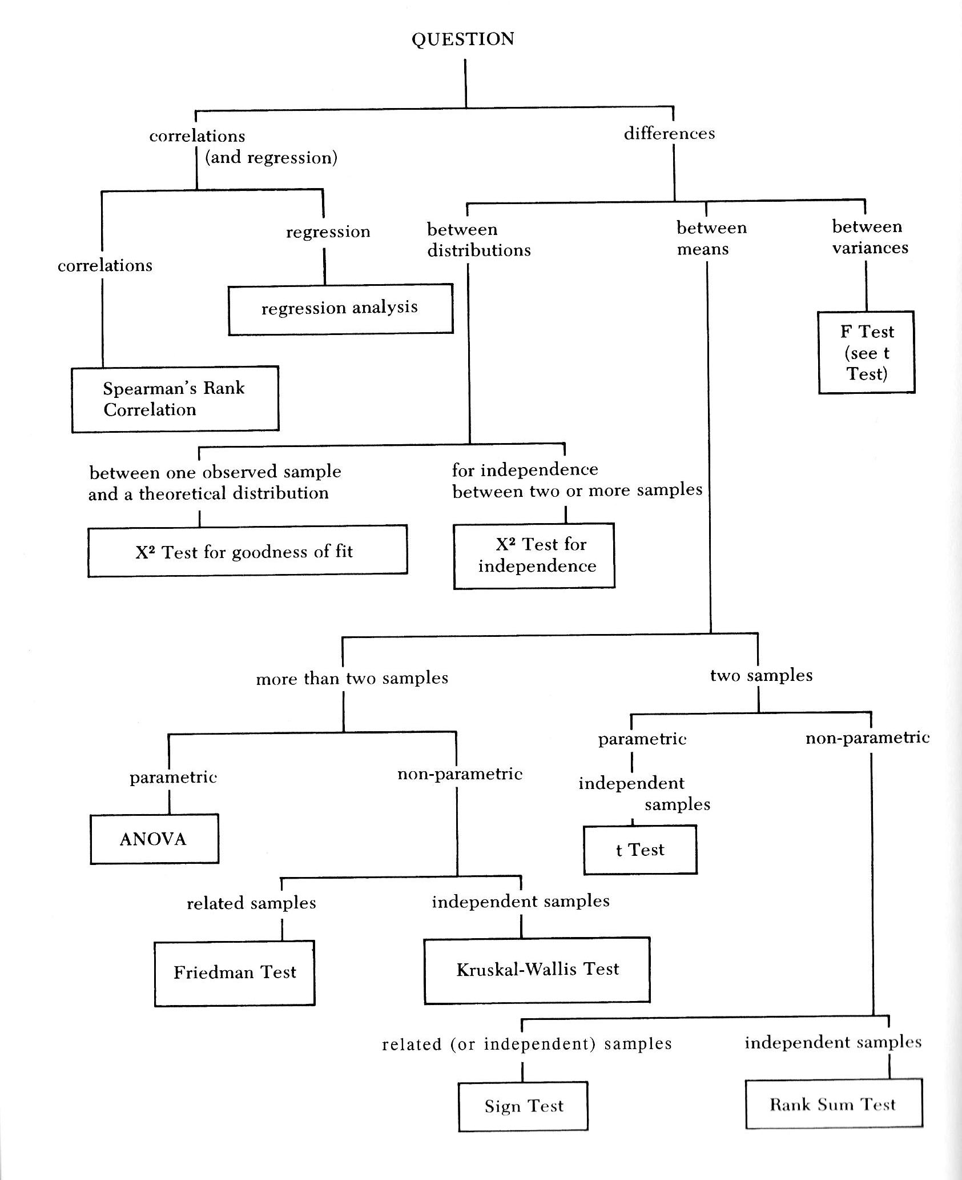
Ambrose et al. 2007, Ch. 8

Slide 3
Analysis of Variance ANOVA
A parametric test for the differences between means of more than two independent samples.
Examines whether the means of test samples vary further from the population mean than would be expected based on fluctuations (variability) within your samples

Slide 4
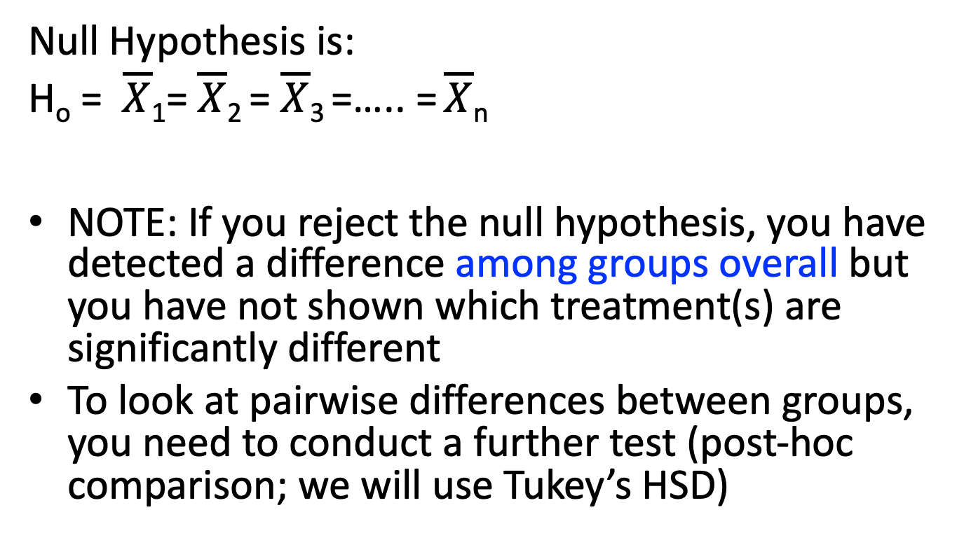
Null Hypothesis is:
H_{o} = $\overline{X}$₁= $\overline{X}$₂ = $\overline{X}$₃ =….. = $\overline{X}$_{n}
NOTE: If you reject the null hypothesis, you have detected a difference among groups overall but you have not shown which treatment(s) are significantly different
To look at pairwise differences between groups, you need to conduct a further test (post-hoc comparison; we will use Tukey’s HSD)

Slide 5
Why an ANOVA and not Multiple t-tests?
2-sample t-test at alpha = 0.05
95% probability we correctly conclude to fail to reject the null hypothesis
Probabilities: When looking at the probability of two independent events you multiply probabilities
Probability that H¹ = H², H² = H³, H¹ = H³ is 0.95 * 0.95 * 0.95 = 0.95³ = 0.86
Therefore the probability of incorrectly rejecting at least 1 of these is 0.14 (Type I Error)

Slide 6
ANOVA Assumptions
Individual observations are independent of each other
Observations are continuous type of data
Observations are normally distributed
Homogeneity of variances (F-test)
Equal sample sizes are not required BUT increase power; most real world data have different sample size among groups
Notes:
How would individuals/observations NOT be independent? (same individual, maybe genetic similarity,
Continuous data: Interval OR Ratio
NORMAL DISTRIBUTION – what does this mean?
Variance : how data are scattered around the mean.

Slide 7
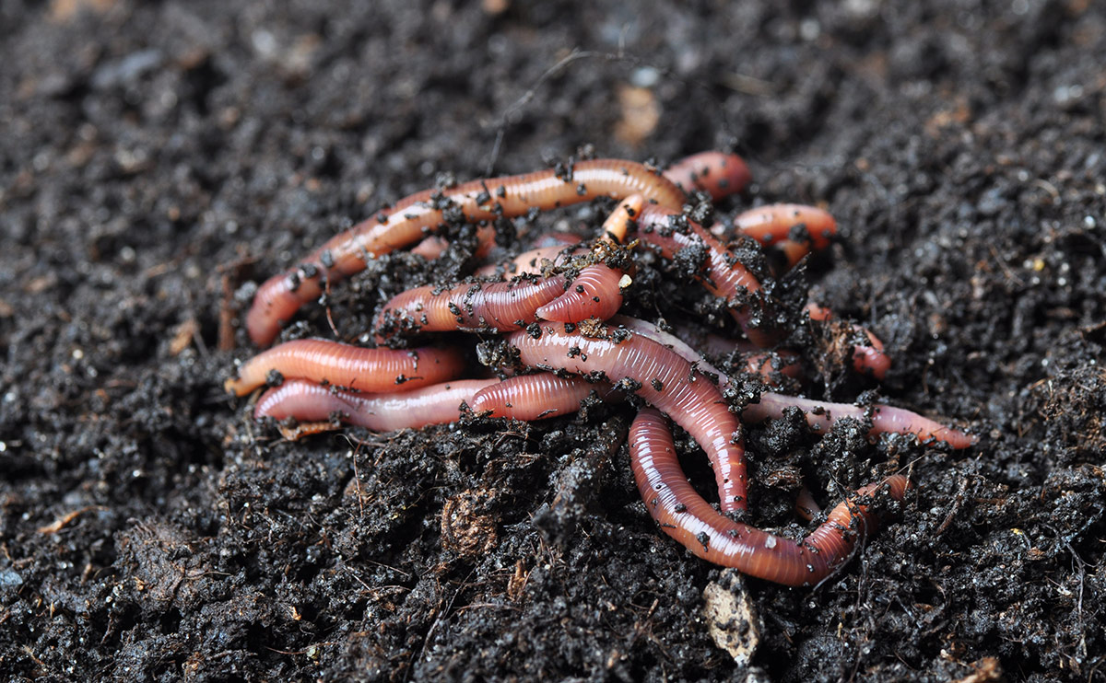
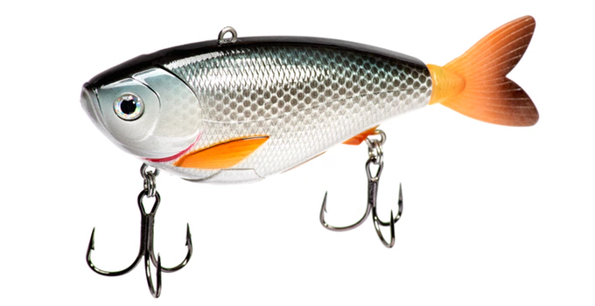
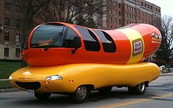
ANOVA in Action
Worms | Lures | Bologna
1 | 1 | 6
3 | 2 | 8
2 | 4 | 7
Notes:
Example:
Two-taile: the speed of handwriting is different for left handed and right handed groups.
One-tailed: the speed of handwriting is SLOWER in left handed group. (or faster, but not either)

Slide 8
ANOVA shows significant difference…OK
Now What?... Post-Hoc Tests
Worms | Lures | Bologna
1 | 1 | 6
3 | 2 | 8
2 | 4 | 7
Fail to Reject
Reject
Reject
Notes:
Example:
Two-taile: the speed of handwriting is different for left handed and right handed groups.
One-tailed: the speed of handwriting is SLOWER in left handed group. (or faster, but not either)

Slide 9
Report Your Findings
Worms | Lures | Bologna
1 | 1 | 6
3 | 2 | 8
2 | 4 | 7
There was a significant effect of bait type on the number of fish caught overall (F = 16.17; P < 0.05). Our analysis indicated that bologna captured significantly more fish than either worms (t₆ = 4.77, P < 0.05) or lures (t₆ = 5.10, P < 0.05). However, no significant difference in capture rate was noted between worms and lures (t₆ = 0.34, P < 0.05).
Notes:
Example:
Two-taile: the speed of handwriting is different for left handed and right handed groups.
One-tailed: the speed of handwriting is SLOWER in left handed group. (or faster, but not either)

