Slide 1
Chapter 6 Linear Models: 2-Way ANOVA
Beckerman et al. p. 131-144;

Slide 2
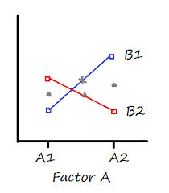
Extend Linear Models to Mult. Predictors
The two-way ANOVA corresponds to data that have structure in two dimensions.
The response variable may vary with both predictor variables.
Experiments associated with a two-way ANOVA investigate how the response varies with one variable and may depend on the other variable.
This is a statistical interaction.

Slide 3
Extend Linear Models to Mult. Predictors
The two grey dots indicate the main effect means for Factor A. Their height is pretty much the same, so there would be no main effect for Factor A.
The two grey Xs indicate the main effect means for Factor B. Sure, the B1 mean is slightly higher than the B2 mean, but not by much. In most data sets, this difference would not be significant.
But there clearly is an interaction. The difference in the B1 means is clearly different at A1 than it is at A2 (one difference is positive, the other negative).

Slide 4
Extend Linear Models to Mult. Predictors
You’d say there is no overall effect of either Factor A or Factor B, but there is an interaction.
The effect of B on the response variable is opposite, depending on the value of Factor A.

Slide 5
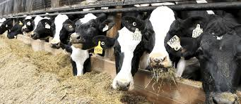
Cow Growth Data
Cows fed one of three diets; barley, oats, wheat
Diets enhanced with one of four supplements
Data are from a fully factorial experimental design, where each combination of diet and supplement was replicated three times.
This means that there are three diets X four supplements = 12 treatment combinations, each with three cows in them (36 times).

Slide 6
Cow Growth Data
growth.moo <- read_csv("growth.csv")
glimpse(growth.moo)
levels(growth.moo$diet)
# [1] "barley" "oats" "wheat"
levels(growth.moo$supplement)
#[1] "agrimore" "control" "supergain" "supersupp"
One of the things we can immediately see is that the supplements include a control level, but the agrimore level is in front of it alphabetically.

Slide 7
Cow Growth Data
Here we employ the function relevel(), which creates a new reference level by re-ordering the factor.
We use it with the mutate() function from dplyr:
growth.moo <-
mutate(growth.moo,
supplement = relevel(supplement, ref="control"))
levels(growth.moo$supplement)
## [1] "control" "agrimore" "supergain" "supersupp"

Slide 8
Cow Growth Data
# calculate mean and SD of gain for all 12 combinations
sumMoo <- growth.moo %>%
group_by(diet, supplement) %>%
summarise(meanGrow = mean(gain))
# make sure it worked
sumMoo
## Source: local data frame [12 x 3]
## Groups: diet [?]
##
## diet supplement meanGrow
## (fctr) (fctr) (dbl)
## 1 barley control 23.29665
## 2 barley agrimore 26.34848
## 3 barley supergain 22.46612
## 4 barley supersupp 25.57530
## 5 oats control 20.49366
…

Slide 9
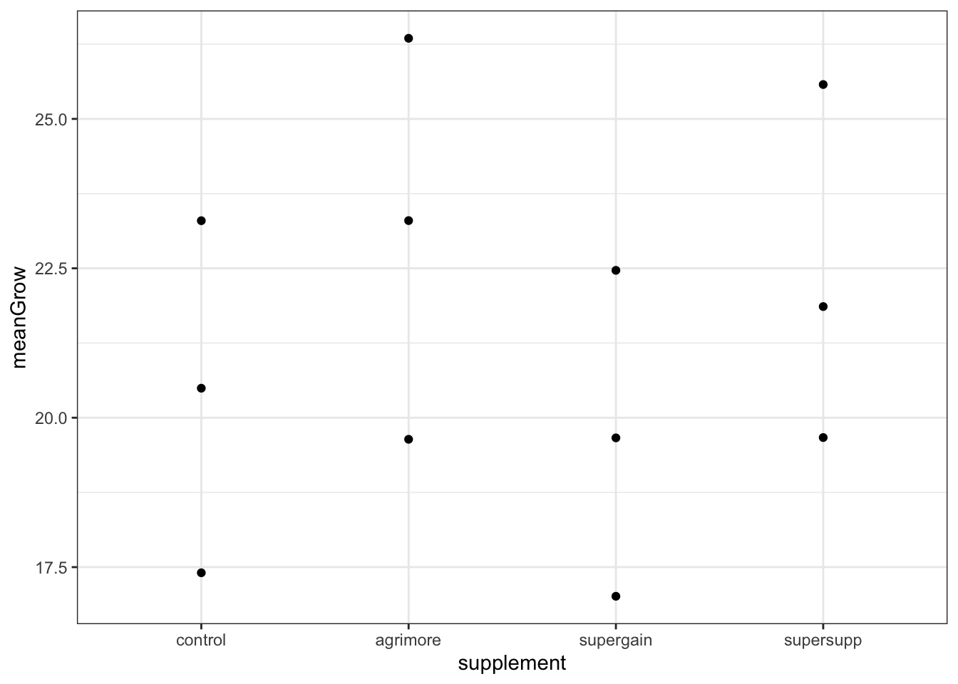
Cow Growth Data
As always, our first step in analysis is a figure:
ggplot(sumMoo, aes(x = supplement, y = meanGrow)) +
geom_point() +
theme_bw()
The effect of supplement type on cow weight gain depends on the diet.

Slide 10
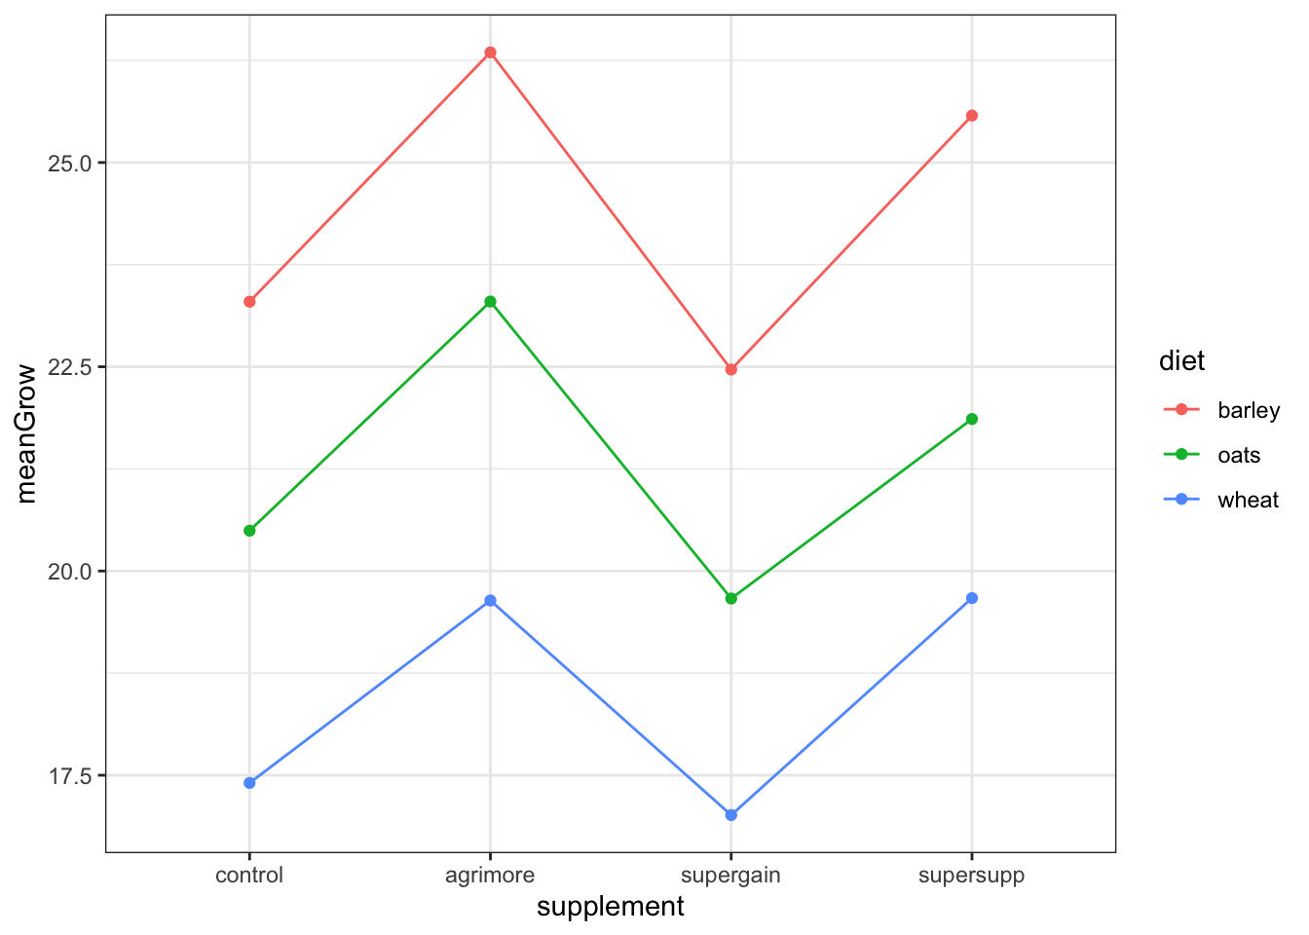
Cow Growth Data
The next step is connecting the dots to visualize the
second factor.
ggplot(sumMoo, aes(x = supplement, y = meanGrow,
colour = diet, group = diet)) +
geom_point() +
geom_line() +
theme_bw()
Does the effect of supplement type on cow weight gain depend on the diet?

Slide 11
Cow Growth Data
Both diet and supplement type seem to have an effect.
Build a model to test both main effects, and their interaction.
model_cow <- lm(gain ~ diet * supplement, data = growth.moo)
This says “test the hypothesis that weight gain is a function of diet, supplement, AND their interaction”. (Notice the * notation)
First, examine model assumptions.
autoplot(model_cow, smooth.colour = NA)

Slide 12
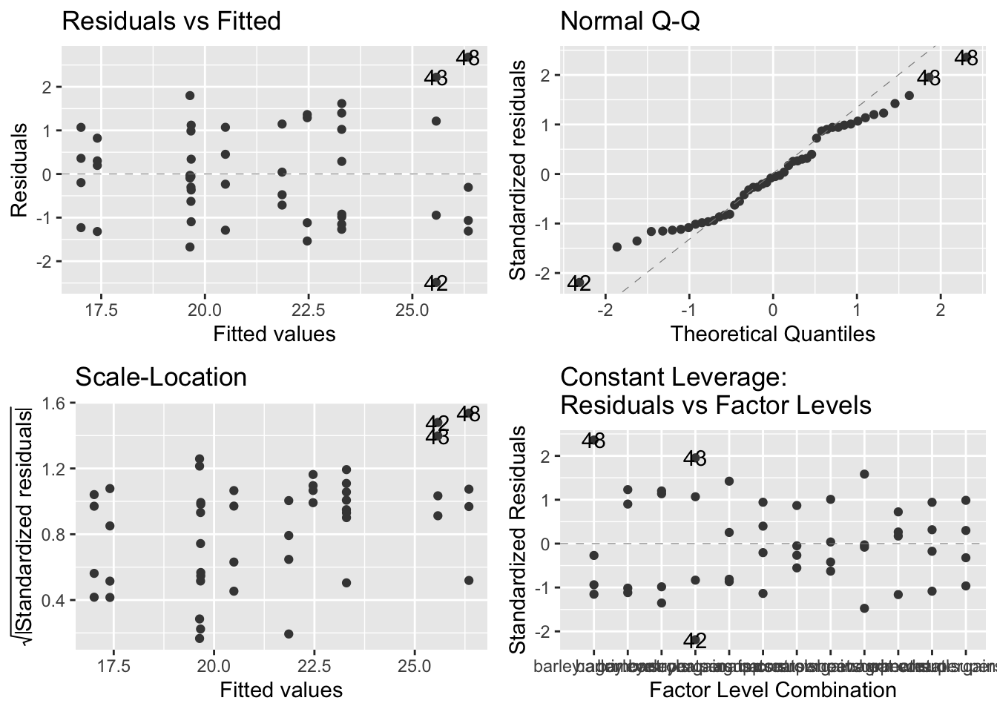
Cow Growth Data
Not great, but no troublesome patterns. The general linear model is actually quite robust to moderate deviations from normality, so let’s keep going.

Slide 13
Cow Growth Data
Here we employ the function relevel(), which creates a new reference level by re-ordering the factor.
We use it with the mutate() function from dplyr as follows:
ggplot(plant_gr,
aes(x = soil.moisture.content, y = plant.growth.rate)) +
geom_point() +
ylab("Plant Growth Rate (mm/week)") +
theme_bw()

Slide 14
Cow Growth Data
anova(model_cow)
## Analysis of Variance Table
##
## Response: gain
## Df Sum Sq Mean Sq F value Pr(>F)
## diet 2 287.171 143.586 83.5201 2.999e-14 ***
## supplement 3 91.881 30.627 17.8150 2.952e-07 ***
## diet:supplement 6 3.406 0.568 0.3302 0.9166
## Residuals 36 61.890 1.719
## ---
## Signif. codes:
## 0 '***' 0.001 '**' 0.01 '*' 0.05 '.' 0.1 ' ' 1
The majority of variation due to diet
143 out of a total of 176.5
Supplement explained 30.6 out of a total of 176.5
Interaction explained 0.57 out of a total of 176.5
using diet*supplement has indeed expanded to provide three rows, corresponding to the variation explained by diet, the supplement, and the interaction. (:=*)

Slide 15
Cow Growth Data-Anova Table
anova(model_cow)
## Analysis of Variance Table
##
## Response: gain
## Df Sum Sq Mean Sq F value Pr(>F)
## diet 2 287.171 143.586 83.5201 2.999e-14 ***
## supplement 3 91.881 30.627 17.8150 2.952e-07 ***
## diet:supplement 6 3.406 0.568 0.3302 0.9166
## Residuals 36 61.890 1.719
## ---
## Signif. codes:
## 0 '***' 0.001 '**' 0.01 '*' 0.05 '.' 0.1 ' ' 1
“We tested the hypothesis that the effect of diet supplement on bovine weight
gain depended on cereal diet. We found no evidence to support the presence
of an interaction between diet and supplement (F = 0.33; df = 6, 36; p = 0.92).”

Slide 16
Cow Growth Data
## Response: gain
## Df Sum Sq Mean Sq F value Pr(>F)
## diet 2 287.171 143.586 83.5201 2.999e-14 ***
## supplement 3 91.881 30.627 17.8150 2.952e-07 ***
## diet:supplement 6 3.406 0.568 0.3302 0.9166
## Residuals 36 61.890 1.719
## ---
## Signif. codes:
## 0 '***' 0.001 '**' 0.01 '*' 0.05 '.' 0.1 ' ' 1
Usually state the main effects first:
“We found an influence of diet (F = 83.5; df = 2,36; P < 0.0001) and supplement
type (F = 17.8; df = 3,36; P < 0.0001) on bovine weight gain.
“We tested the hypothesis that the effect of diet supplement on bovine weight
gain depended on cereal diet. We found no evidence to support the presence
of an interaction between diet and supplement (F = 0.33; df = 6, 36; p = 0.92).”
Also notice I tried hard to avoid using ‘significant’; forces you to focus more of the
effect size (biology) rather than statistical significance.

Slide 17
Cow Growth Data-Summary Table
summary(model_cow)
##
## Call:
## lm(formula = gain ~ diet * supplement, data = growth.moo)
##
## Residuals:
## Min 1Q Median 3Q Max
## -2.48756 -1.00368 -0.07452 1.03496 2.68069
##
## Coefficients:
Estimate Std. Error t value Pr(>|t|)
(Intercept) 23.2966499 0.6555863 35.536 < 2e-16 ***
dietoats -2.8029851 0.9271390 -3.023 0.00459 **
dietwheat -5.8911317 0.9271390 -6.354 2.34e-07 ***
supplementagrimore 3.0518277 0.9271390 3.292 0.00224 **
supplementsupergain -0.8305263 0.9271390 -0.896 0.37631
supplementsupersupp 2.2786527 0.9271390 2.458 0.01893 *
dietoats:supplementagrimore -0.2471088 1.3111726 -0.188 0.85157
dietwheat:supplementagrimore -0.8182729 1.3111726 -0.624 0.53651
dietoats:supplementsupergain -0.0001351 1.3111726 0.000 0.99992
dietwheat:supplementsupergain 0.4374395 1.3111726 0.334 0.74060
dietoats:supplementsupersupp -0.9120830 1.3111726 -0.696 0.49113
dietwheat:supplementsupersupp -0.0158299 1.3111726 -0.012 0.99043
Residual standard error: 1.311 on 36 degrees of freedom
Multiple R-squared: 0.8607, Adjusted R-squared: 0.8182
F-statistic: 20.22 on 11 and 36 DF, p-value: 3.295e-12
Too many post-hoc comparisons (n=66) to interpret all.

Slide 18
Cow Growth Data-Mean/SD
# calculate mean and sd of gain for all 12 combinations
sumMoo <- growth.moo %>%
group_by(diet, supplement) %>%
summarise(
meanGrow = mean(gain),
seGrow = sd(gain)/sqrt(n())
)
The standard error of the mean is given by the standard deviation divided by the square root of the sample size, and dplyr provides a function n() that counts the rows in each group.
Be careful…if you have missing values, n() will still count these rows.

Slide 19
Cow Growth Data-Mean/SD
sumMoo
# A tibble: 12 x 4
# Groups: diet [3]
diet supplement meanGrow seGrow
<fct> <fct> <dbl> <dbl>
1 barley control 23.3 0.703
2 barley agrimore 26.3 0.919
3 barley supergain 22.5 0.771
4 barley supersupp 25.6 1.06
5 oats control 20.5 0.506
6 oats agrimore 23.3 0.613
7 oats supergain 19.7 0.349
8 oats supersupp 21.9 0.413
9 wheat control 17.4 0.460
10 wheat agrimore 19.6 0.710
11 wheat supergain 17.0 0.485
12 wheat supersupp 19.7 0.475

Slide 20
Cow Growth Data-Plot Mean/SE
With this summary table, we can now add three layers to the figure: points, lines, and error bars.
To do this, we introduce geom_errorbar(), which has its own aesthetics: the lower and upper limits of the vertical lines that we call error bars.
These limits are called ymin and ymax.
Each vertical line is made by placing a line between these limits, passing through meanGrow.

Slide 21
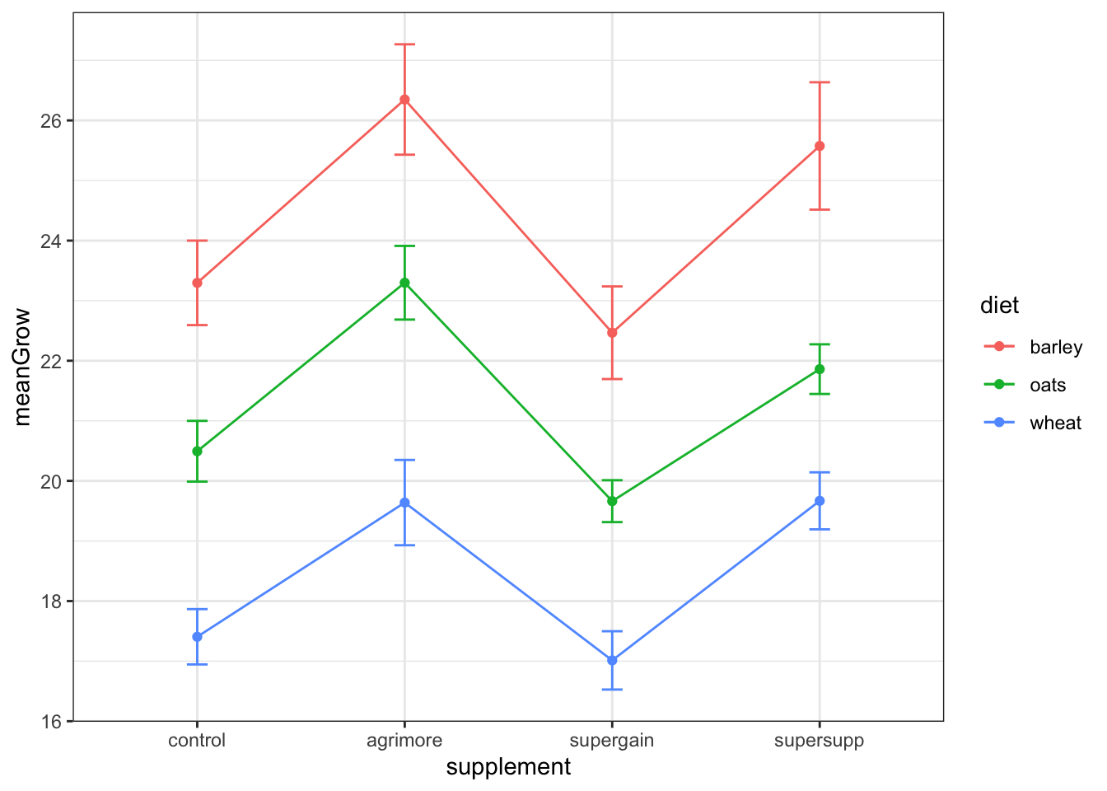
Cow Growth Data-Plot Mean/SE
ggplot(sumMoo, aes(x = supplement, y = meanGrow,
colour = diet, group = diet)) +
geom_point() +
geom_line() +
geom_errorbar(aes(ymin = meanGrow - seGrow,
ymax = meanGrow + seGrow), width = 0.1) +
theme_bw()

Slide 22
Not covered:
comparing interaction vs. additive models
producing minimum adequate model
Post-hoc comparisons when model has interaction
Notes:
Interaction contrasts:
https://cran.r-project.org/web/packages/emmeans/vignettes/interactions.html

Slide 23
Elevated CO₂ Example
Next time?

