Slide 1
Ambrose Ch. 5 Description of Data: Dispersion

Slide 2
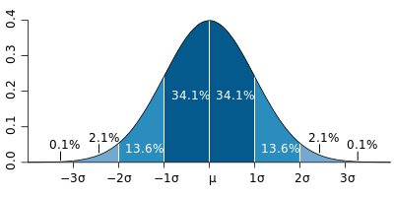
Dispersion – spread of the data around the mean
Range - a measure of dispersion
= Maximum Value – Minimum Value

Slide 3

Univariate Analysis (Spread cont.)
Standard Deviation (σ or s)
Measure of Dispersion of data from the mean
“average distance each point is from the mean”
If a distribution is statistically Normal, then:
~68% of the scores in the sample fall within one standard deviation of the mean
~95% of the scores in the sample fall within two standard deviations of the mean
~99% of the scores in the sample fall within three standard deviations of the mean
Notes:
σ=population SD
s=sample SD

Slide 4
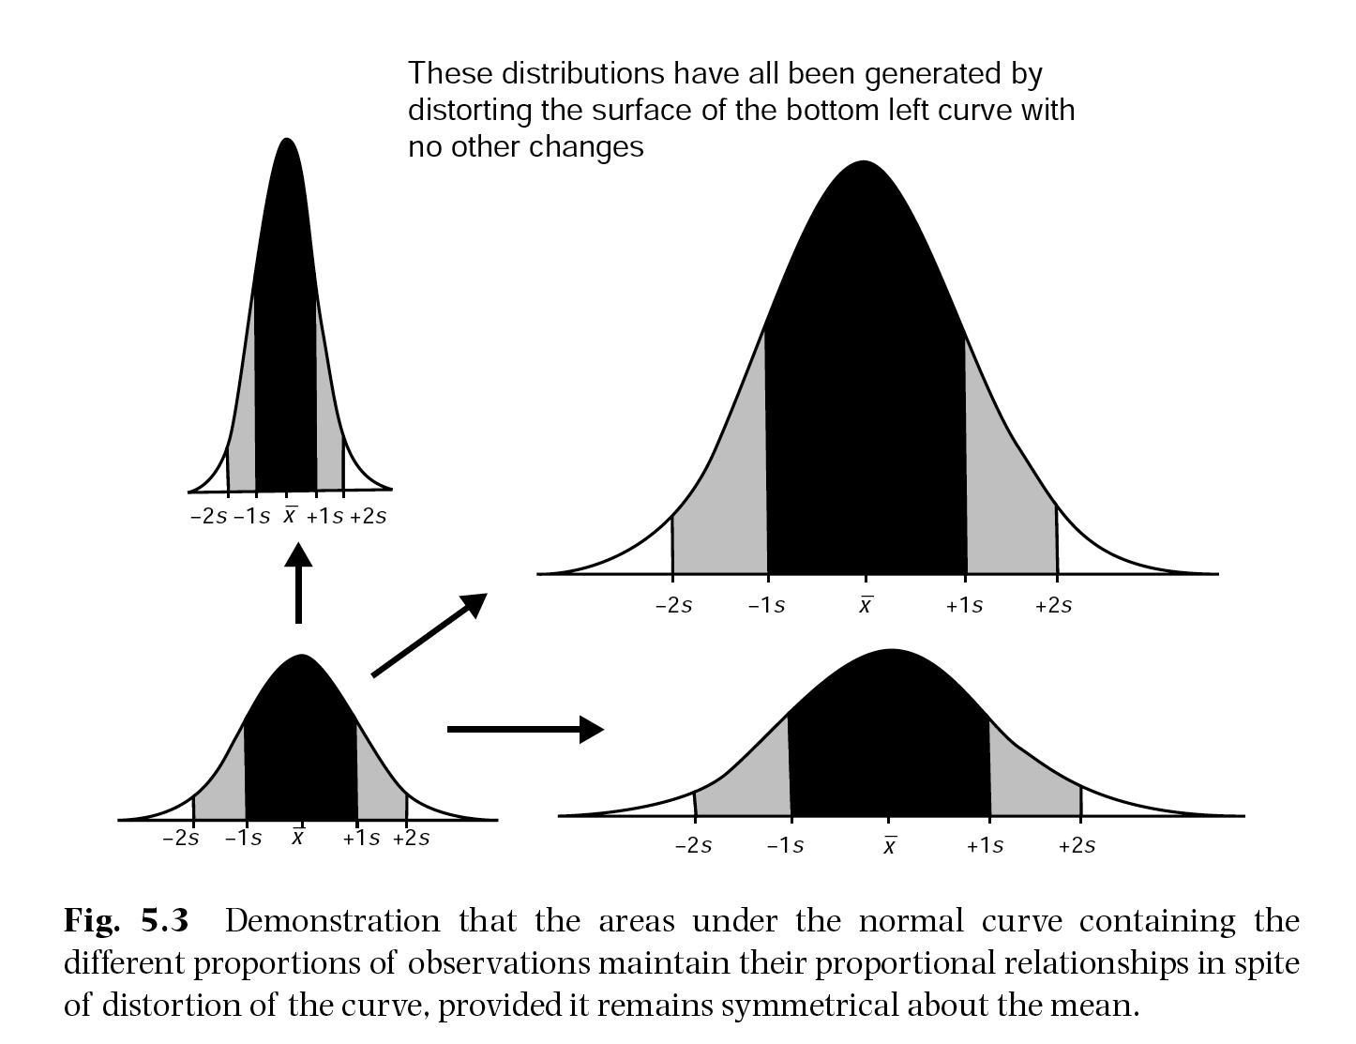
Note relationship between SD and relative frequency of values.
Proportionally, the # of observations encompassed by SD do not change.

Slide 5




How to Calculate Standard Deviation
Island 1 | Island 2 | Island 3 | Island 4
8 | 5 | 1 | 8
8 | 6 | 2 | 10
9 | 8 | 5 | 10
10 | 10 | 10 | 10
11 | 12 | 15 | 10
12 | 14 | 18 | 10
12 | 15 | 19 | 12
7 trees measured on each of 4 different islands.
Notes:
Both equations give you the same result.

Slide 6
As always, first step is to visualize the data.
Data appear highly non-normal
Later on we will see how to test if the distribution approximates a normal distribution.
Results and interpretation will be suspect if data extremely non-normal.

Slide 7
Example Calculation
 | Island I | x-mean | (x-mean)^2
 | 8 | -2 | 4
 | 8 | -2 | 4
 | 9 | -1 | 1
 | 10 | 0 | 0
 | 11 | 1 | 1
 | 12 | 2 | 4
 | 12 | 2 | 4
sum | 70 | 0 | 18
Setup values in a column
Subtract the mean from each x (these are deviations from the mean).
Square each deviation and sum them.
Divide sum of squared deviations by n-1
Take square root.
Mean = 10
Count = 7
Notes:
SD of Island 1 Trees = 1.73

Slide 8
Lets Try Another Calculation
Island II | x-mean | (x-mean)^2
5 | -5 | 25
6 | -4 | 16
8 | -2 | 4
10 | 0 | 0
12 | 2 | 4
14 | 4 | 16
15 | 5 | 25
70 | 0 | 90
Setup values in a column
Subtract the mean from each x (these are deviations from the mean).
Square each deviation and sum them.
Divide sum of squared deviations by n-1
Take square root.
Mean = 10
Count = 7
Notes:
SD of Island 2 Trees = 3.872

Slide 9
Lets Try Another Calculation
Island III | x-mean | (x-mean)^2
1 | -9 | 81
2 | -8 | 64
5 | -5 | 25
10 | 0 | 0
15 | 5 | 25
18 | 8 | 64
19 | 9 | 81
70 | 0 | 340
Setup values in a column
Subtract the mean from each x (these are deviations from the mean).
Square each deviation and sum them.
Divide sum of squared deviations by n-1
Take square root.
Mean = 10
Count = 7
Notes:
SD of Island 2 Trees = 3.872

Slide 10
Lets Try Another Calculation (last one)
Island IV | x-mean | (x-mean)^2
8 | -2 | 4
10 | 0 | 0
10 | 0 | 0
10 | 0 | 0
10 | 0 | 0
10 | 0 | 0
12 | 2 | 4
70 | 0 | 8
Setup values in a column
Subtract the mean from each x (these are deviations from the mean).
Square each deviation and sum them.
Divide sum of squared deviations by n-1
Take square root.
Mean = 10
Count = 7
Notes:
SD of Island 2 Trees = 3.872

Slide 11
What do mean and SD tell us?
Center point and dispersion of data
We can get more details from the 5-number summary for trees on each island.
Notes:
Bar charts of mean with error bars are much cleaner way to depict the data.

Slide 12
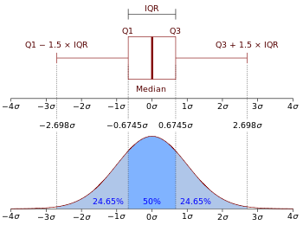
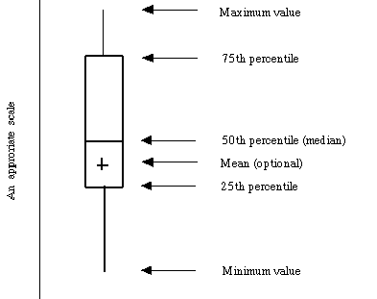
Univariate Analysis (Spread)
5 number summary
Minimum – smallest observation
Q1 – median of the first half of a distribution
Median – median of a distribution
Q3 – median of the second half of a distribution
Maximum – largest observation
1.5*IQR rule to detect outliers
Notes:
Recall that range was minimum to maximum values (encompasses all values in dataset)

Slide 13
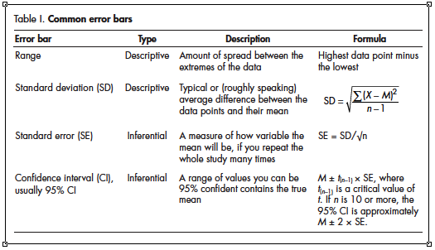
Other measures of dispersion from the mean: Visually can be represented as error bars
Descriptive Error Bars: Describe distribution of data points (Range and SD)
Inferential Error Bars: Allow us to infer if two or more distributions are significantly different (standard error and 95% CI).

Slide 14
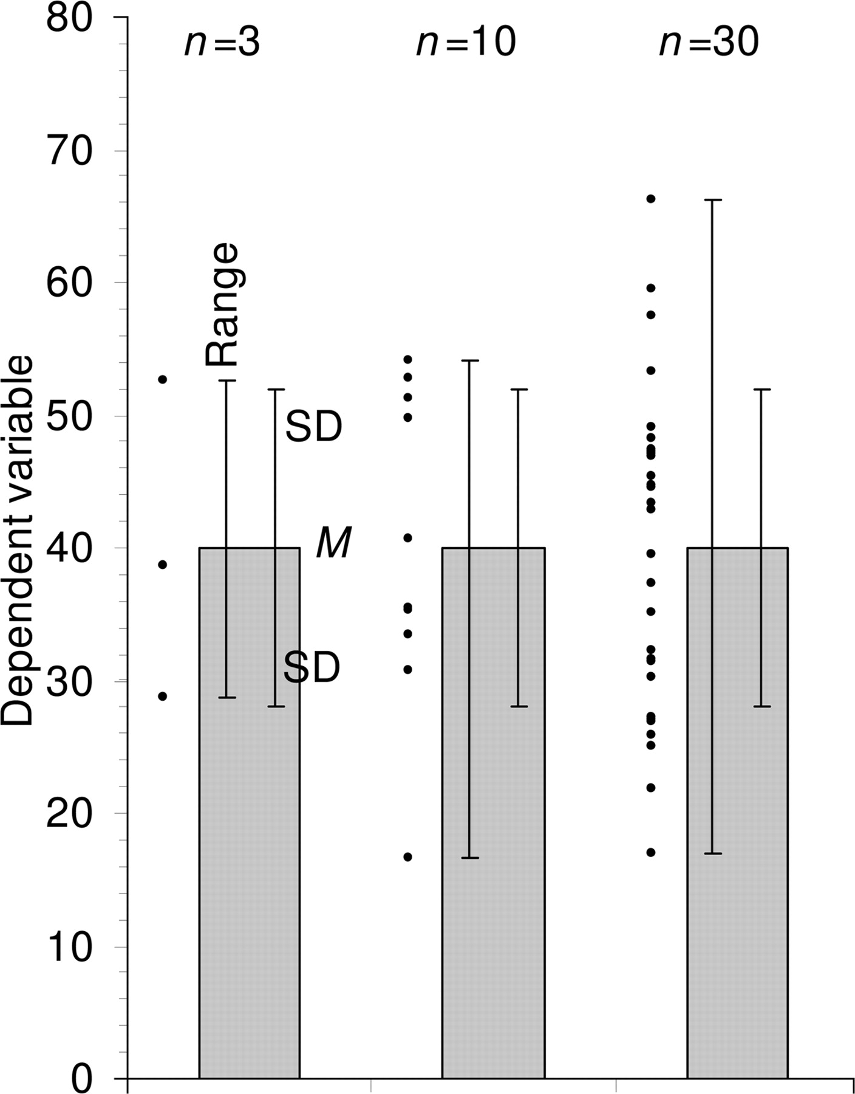
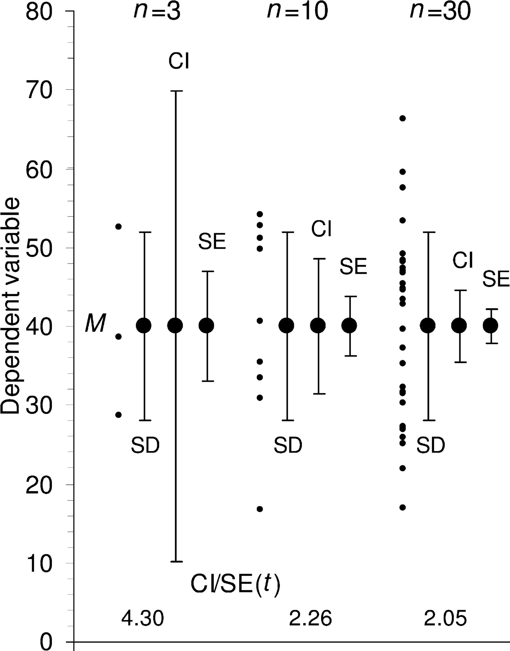
Descriptive Error Bars
Inferential Error Bars
As you increase sample size, the mean of your sample population ( ) gets closer and closer to the actual mean of the entire population (μ). SD does not change systematically with sample size (68% of samples still within 1SD, regardless of n).

Slide 15
Other measures of dispersion from the mean
Standard Error: Builds on Standard Deviation. Used to infer whether two groups differ significantly from one another (e.g. control group vs. experimental group)
Island I vs. Island IV; are the tree heights on
these two islands significantly different
from one another?
Standard Error bars overlap greatly, so we can tentatively say there is no significant difference between heights of trees on Island I vs. trees on Island IV.

Slide 16
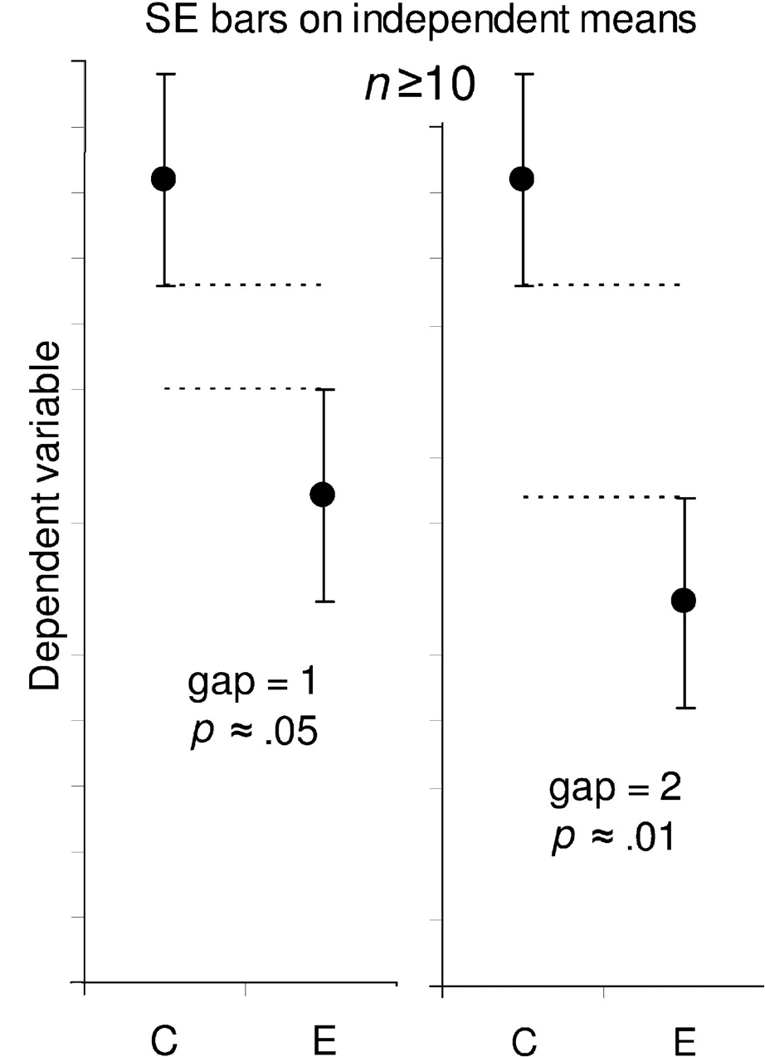
Estimating statistical significance using the overlap rule for SE bars.
“Gap” refers to the number of error bar arms
We focus on example with n ≥ 10 replicates. An experiment with 3 or fewer samples (Cumming et al. paper) isn’t all that trust worthy.
a gap of 2 means the distance between the Control and Experimental error bars is equal to twice the average of the SEs for the two samples
P value = probability that null hypothesis of no difference between means is true.
Notes:
Estimating statistical significance using the overlap rule for SE bars. Here, SE bars are shown on two separate means, for control results C and experimental results E, when n is 3 (left) or n is 10 or more (right). “Gap” refers to the number of error bar arms that would fit between the bottom of the error bars on the controls and the top of the bars on the experimental results; i.e., a gap of 2 means the distance between the C and E error bars is equal to twice the average of the SEs for the two samples. When n = 3, and double the length of the SE error bars just touch (i.e., the gap is 2 SEs), P is ∼0.05 (we don't recommend using error bars where n = 3 or some other very small value, but we include rules to help the reader interpret such figures, which are common in experimental biology).

Slide 17
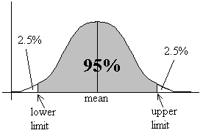
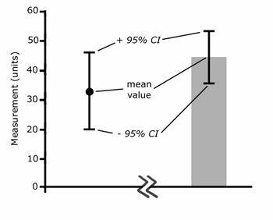
Other measures of dispersion from the mean
95% Confidence Interval: Also builds on Standard Deviation and Standard Error. Used to infer whether two groups differ significantly from one another (e.g. control group vs. experimental group)
Example: Measured the resting heart rate of 15 student athletes.
Mean = 69.0 bpm
Standard Deviation = 2.2 bpm
What is the 95% confidence interval around the mean of 69.0 bpm?
Answer:
SE = SD/√n
95% CI = mean± 2(SE)
= 69.0 + 2(.568)
= 69.0 – 2(.568)
95% CI = 67.9 – 70.1
Visualized as smoothed frequency distribution, or as a bar chart.
Notes:
This assumes you use +/- 2 SE rather than the 1.96 used by statisticians.

Slide 18
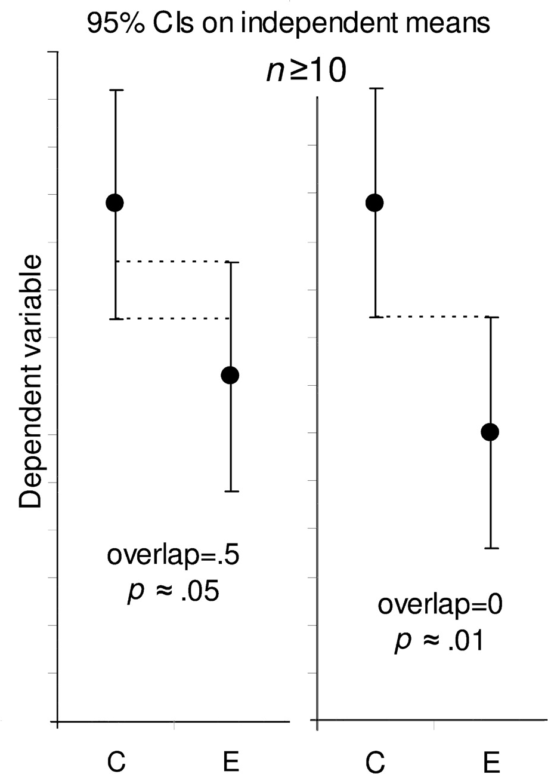
Estimating statistical significance using the overlap rule for 95% CI bars.
“Overlap” refers to the fraction of the average CI error bar arm, i.e., the mean of the control (C) and experimental (E) arms.
When n ≥ 10, if CI error bars overlap by half the average arm length, P ≈ 0.05. If the tips of the error bars just touch, P ≈ 0.01.
P value = probability that null hypothesis of no difference between means is true.
Notes:
Estimating statistical significance using the overlap rule for 95% CI bars. Here, 95% CI bars are shown on two separate means, for control results C and experimental results E, when n is 10 or more. “Overlap” refers to the fraction of the average CI error bar arm, i.e., the average of the control (C) and experimental (E) arms.
When n ≥ 10, if CI error bars overlap by half the average arm length, P ≈ 0.05. If the tips of the error bars just touch, P ≈ 0.01.

Slide 19
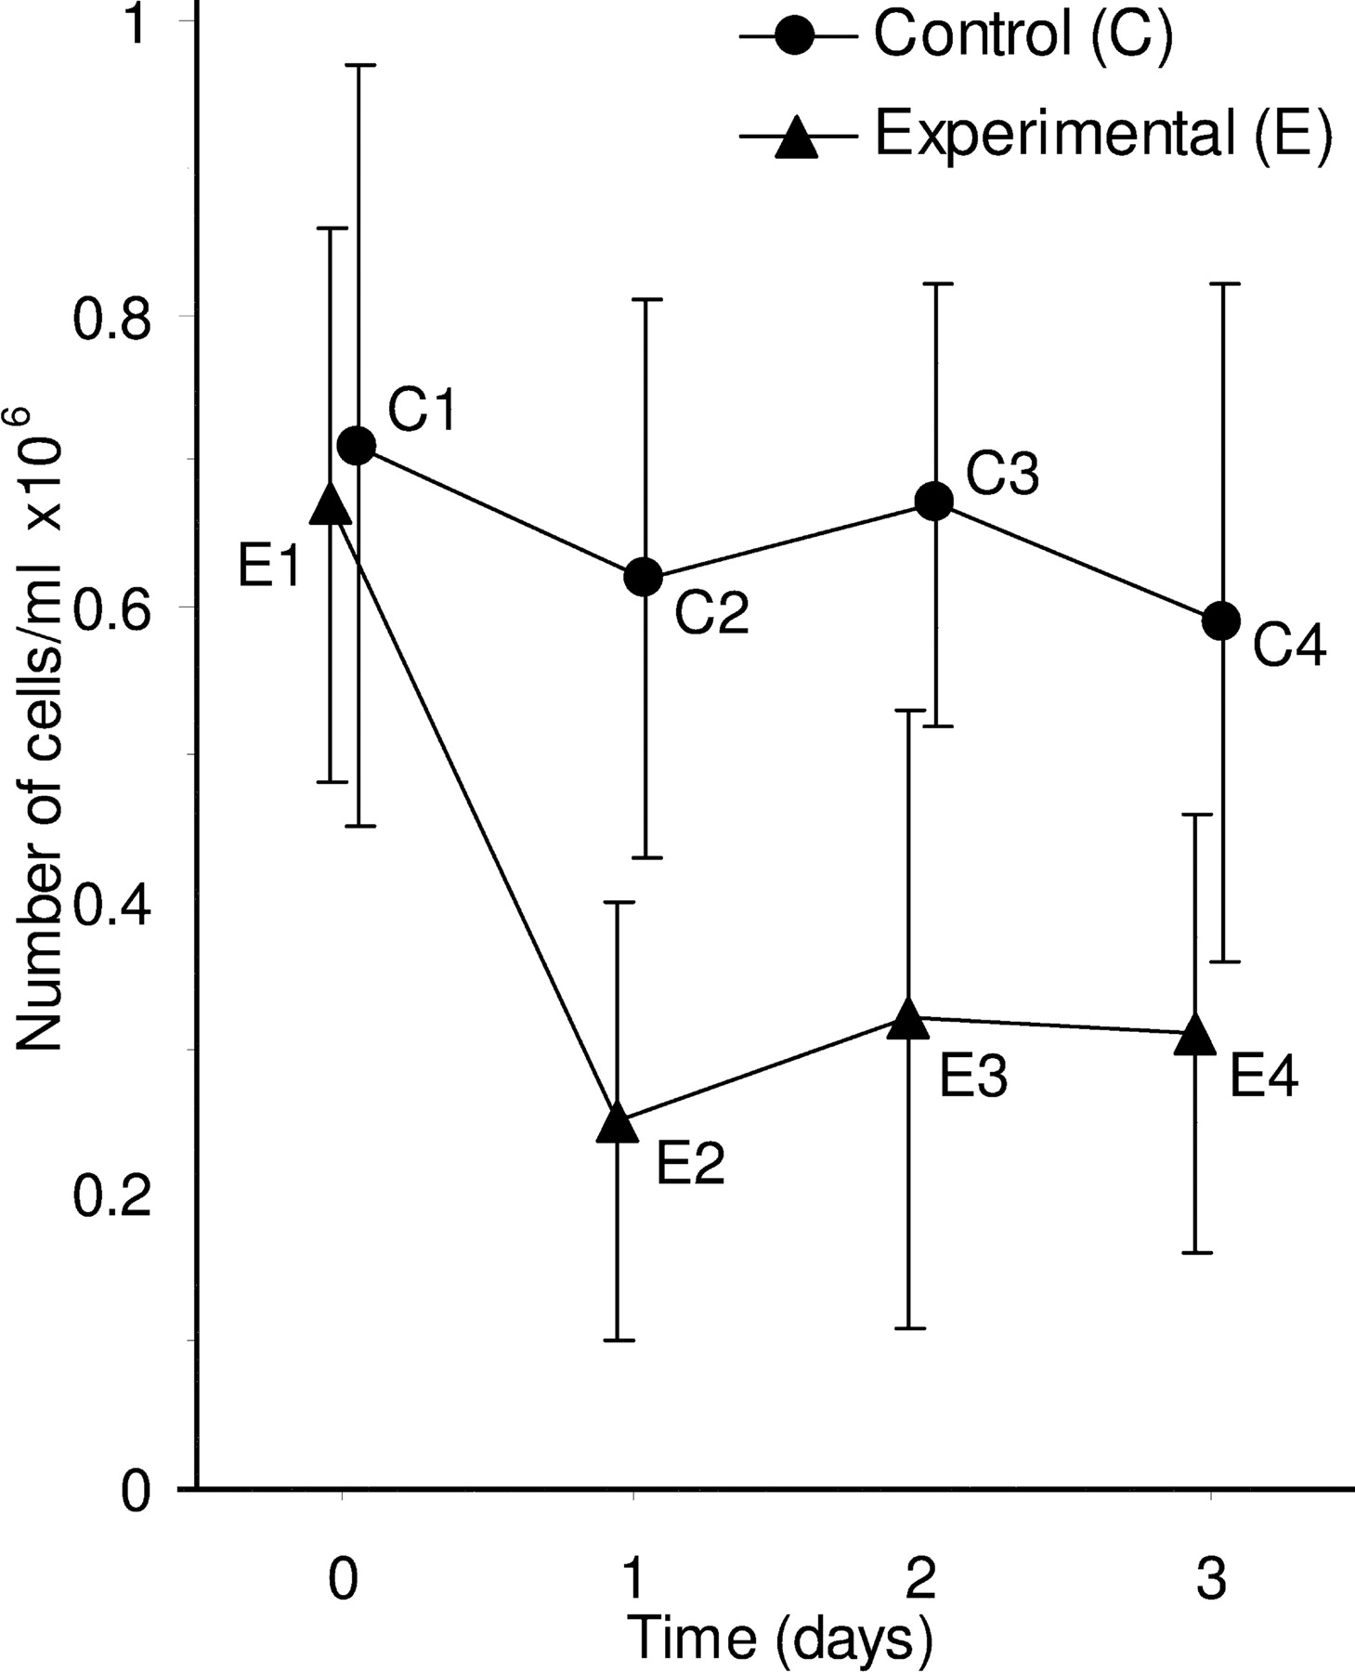
Inferences between and within groups (using SE or 95% CI).
Means and SE bars are shown for an experiment where the number of cells in three independent clonal experimental cell cultures (E) and three independent clonal control cell cultures (C) was measured over time.
Error bars can be used to assess differences between groups at the same time point, for example by using an overlap rule to estimate P for E1 vs. C1, or E3 vs. C3; but the error bars shown here cannot be used to assess within group comparisons, for example the change from E1 to E2.
Notes:
Inferences between and within groups. Means and SE bars are shown for an experiment where the number of cells in three independent clonal experimental cell cultures (E) and three independent clonal control cell cultures (C) was measured over time. Error bars can be used to assess differences between groups at the same time point, for example by using an overlap rule to estimate P for E1 vs. C1, or E3 vs. C3; but the error bars shown here cannot be used to assess within group comparisons, for example the change from E1 to E2.

Slide 21
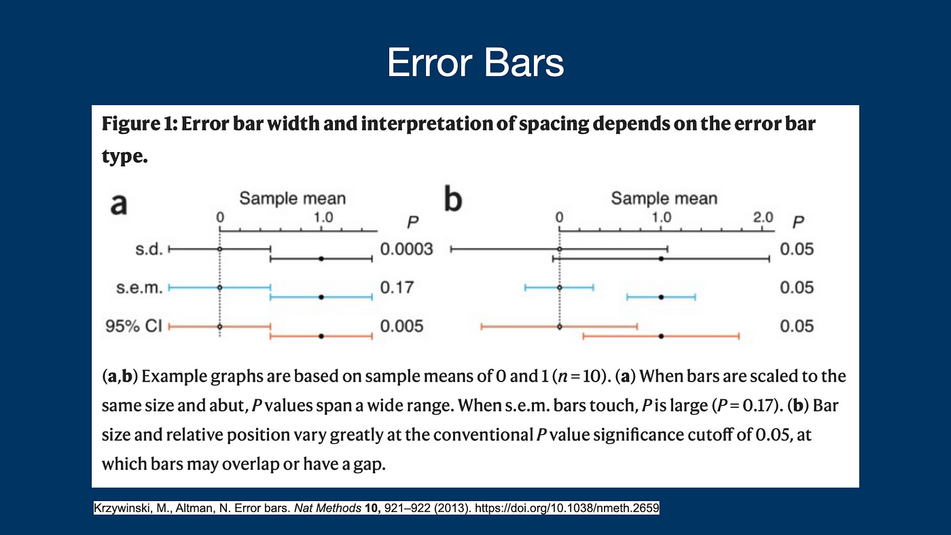

Slide 22
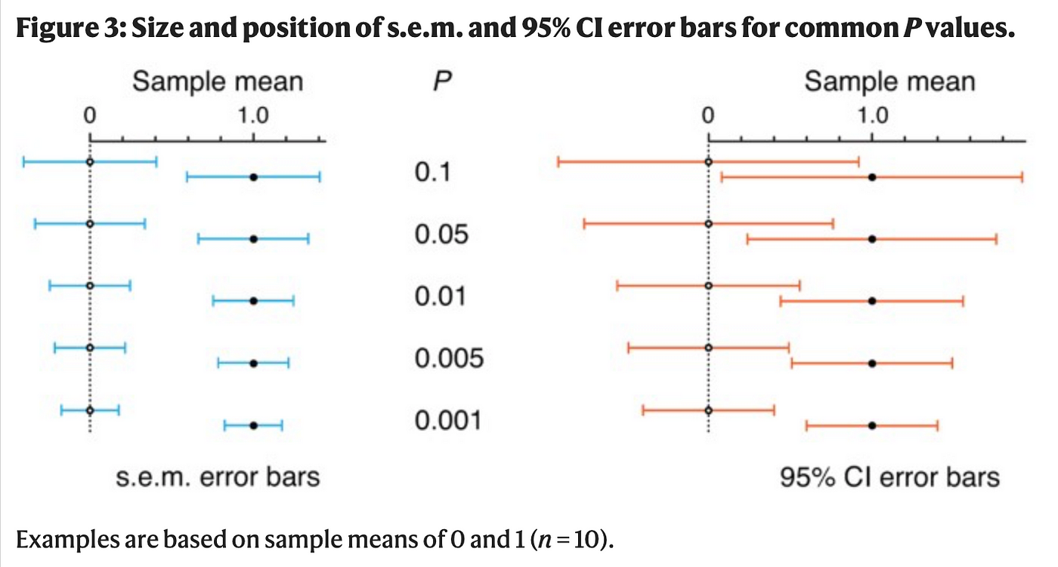
Summary
1. You cannot get any information about statistical significance from s.d. error bars. 2. You can draw conclusions about statistical significance from s.e.m. or 95% C.I. error bars, but whether or not they are less than 0.05 p-value is not intuitive.
from Krzywinski, M., Altman, N. Error bars. Nat Methods 10, 921–922 (2013). https://doi.org/10.1038/nmeth.2659
Notes:
https://medium.com/one-minute-machine-learning/how-to-properly-interpret-error-bars-4a6410625656

