Slide 1
Main Effects vs. Interaction Effects
Using 2-Way designs to gage more complex biological phenomenon

Slide 2
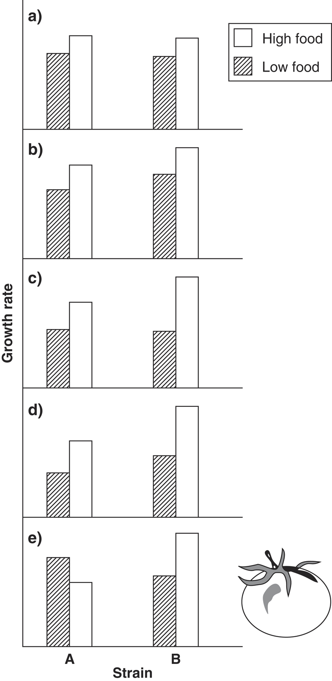
Interaction Effects (2-way example)
Two factors, each with two levels = Four Treatment Combinations
Main effect of feeding regime only; growth not dependent on strain
Both feeding regime and strain have separate effects on growth rate
c,d,e) there is an interaction between the two factors, such that the effect of one factor is different for different levels of the other factor

Slide 3
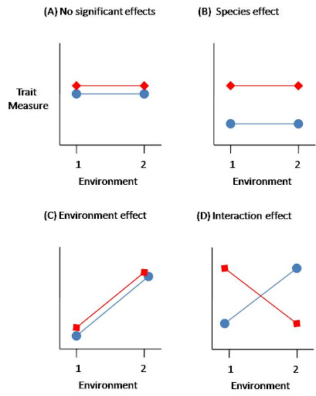
Interaction terms make it difficult to interpret the main effects
Any discussion of the main effects are in the context of the level of the treatment you are referencing
Makes it tough to discuss overall differences in a meaningful way
Graphically, the tell-tale sign for a significant interaction is when lines connecting means across levels and treatments cross
Growth Rate (mm/day)
*Note that the species and environmental variables are transposed in second example.
Notes:
Note that the species and environmental variables flipped in second example.
Phenotypic plasticity.

Slide 4
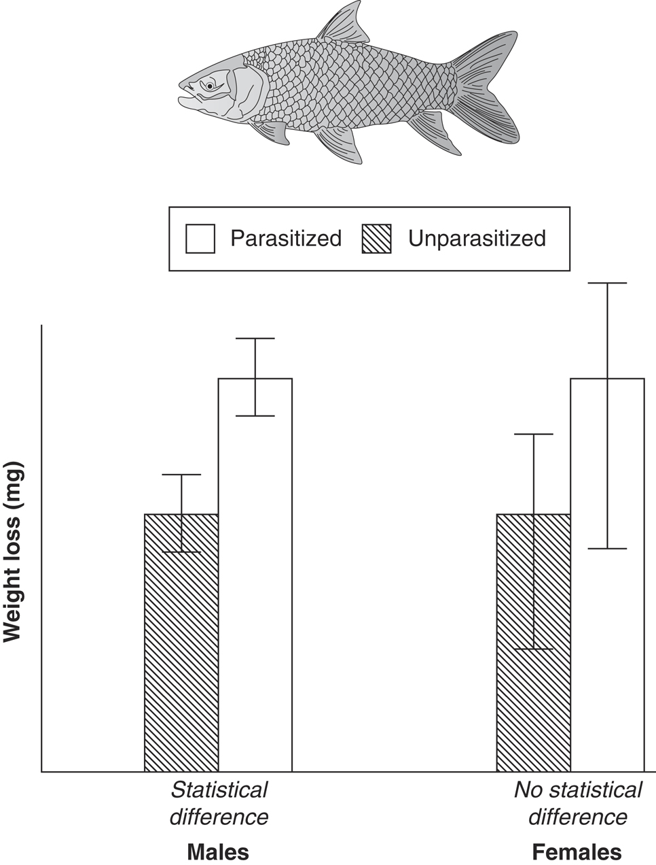
More on Interactions
Two-factor Design
Infection Status (parasites–no parasites) = Factor 1
Sex (male–female) = Factor 2
Weight change = response variable to estimate the costs of parasitism.
Cannot just conduct two one-way experiments (comparing males and females separately) because the hypothesis was about the interaction.
The reason this would be wrong is that the researcher has only tested for main effects of parasitism, but not the interaction between parasitism and sex.
By doing separate tests, the researcher has looked at the difference in male fish caused by the parasites, but has not directly compared the difference in male fish to the difference in female fish (reference group).
Looking at the graphs, there is no good evidence for a difference in the way males and females respond to parasitism. If the researcher does not test for the interaction, the conclusion would have been that parasitized males lost more body weight than unparasitized; erroneous (incomplete) conclusion. Parasitized males lose no more mass than parasitized females.

Slide 5
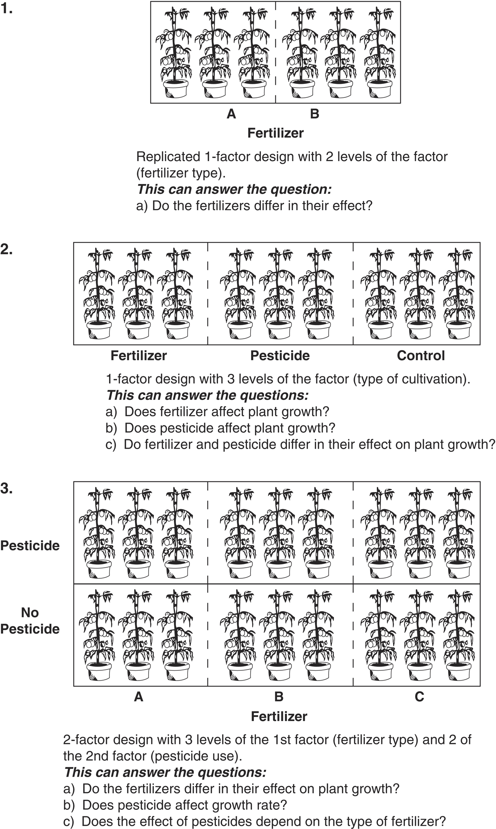
Different Experimental Designs Allow Different Questions About the Study System to be Explored
Why not just do two different one-way experiments?
Notes:
Because sometimes we are interested in the interaction explicitly.
Also run into family-wise error rate issues (need to correct for that)

