Slide 1
Chapter 6 Linear Models: 2-Way ANOVA
Beckerman et al. p. 131-144;

Slide 2
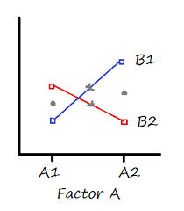
Extend Linear Models to Multiple Predictors
The two-way ANOVA corresponds to data that have structure in two dimensions.
The response variable may vary with both predictor variables.
Experiments associated with a two-way ANOVA investigate how the response varies with one variable and may depend on the other variable.
This is a statistical interaction.

Slide 3
Extend Linear Models to Mult. Predictors
The two grey dots indicate the main effect means for Factor A. Their height is pretty much the same, so there would be no main effect for Factor A.
The two grey Xs indicate the main effect means for Factor B. Sure, the B1 mean is slightly higher than the B2 mean, but not by much. In most data sets, this difference would not be significant.
But there clearly is an interaction. The difference in the B1 means is clearly different at A1 than it is at A2 (one difference is positive, the other negative).

Slide 4
Extend Linear Models to Mult. Predictors
You’d say there is no overall effect of either Factor A or Factor B, but there is an interaction.
The effect of B on the response variable is opposite, depending on the value of Factor A. (contingent inference; depends on…)
If there is evidence of a significant interaction between A and B, inferences concerning the differences in the mean treatment responses for A must be conducted separately for each level of B, because the differences in the treatment mean responses across the levels of A may differ, depending on the level of B.
Notes:
Wei et al 2012.

Slide 5
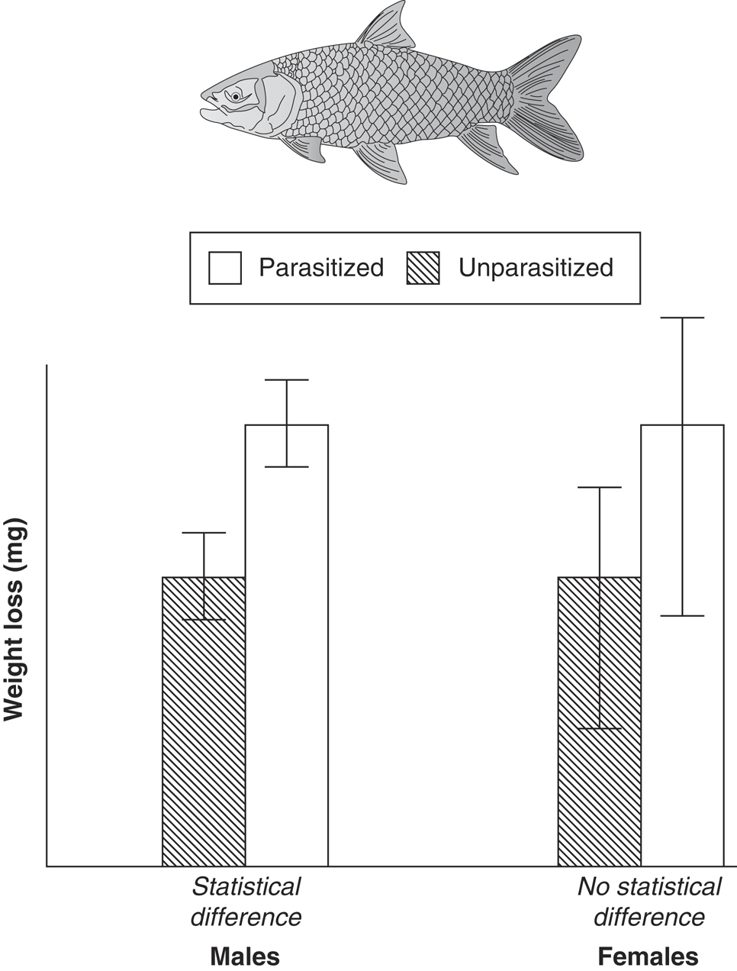
More on Interactions
Example Two-factor Experiment
Infection Status (parasites–no parasites) = Factor 1
Sex (male–female) = Factor 2
Weight change = response variable to estimate the costs of parasitism.
Cannot just conduct two one-way experiments (comparing males and females separately) because the hypothesis was about the interaction.
The reason this would be wrong is that the researcher has only tested for main effects of parasitism, but not the interaction between parasitism and sex.
By doing separate tests, the researcher has looked at the difference in male fish caused by the parasites, but has not directly compared the difference in male fish to the difference in female fish (reference group).
Looking at the graphs, there is no good evidence for a difference in the way males or females respond to parasitism. (no evidence of interaction)
If the researcher does not test for the interaction, the conclusion would have been that parasitized males lost more body weight than unparasitized; erroneous (incomplete) conclusion. Parasitized males lose no more mass than parasitized females.
Mean and SE of weight loss in fish, separated by sex and parasitism status

Slide 6
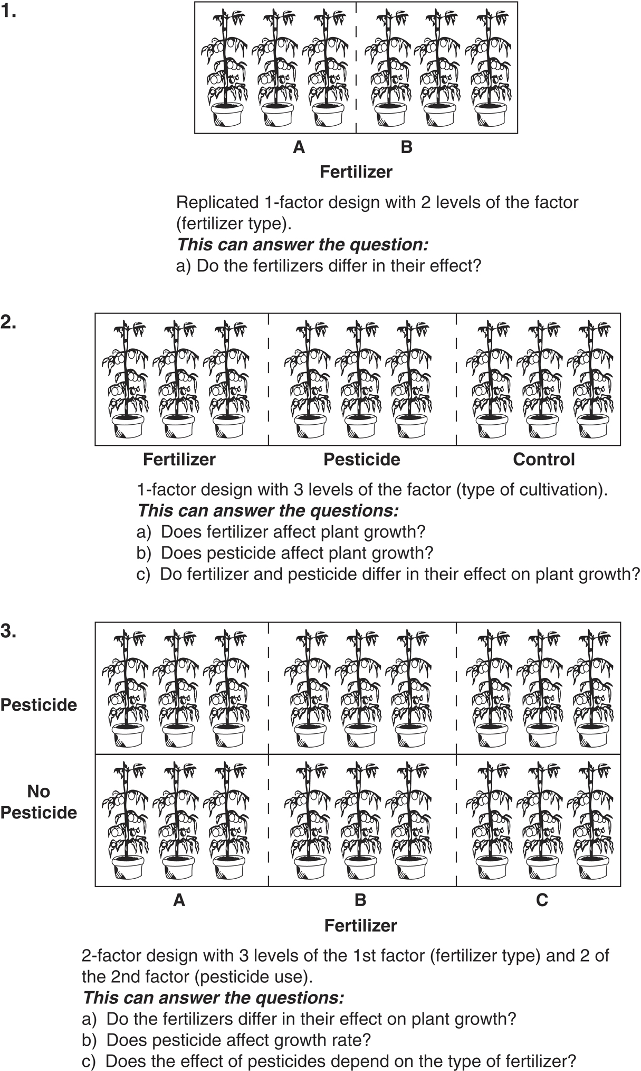
Experimental designs that consider both main effects and interaction effects allow more nuance into how a system functions.
Why not just do two different one-way experiments?
Notes:
Because sometimes we are interested in the interaction explicitly.
Also run into family-wise error rate issues (need to correct for that)

Slide 7
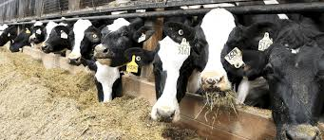
Cow Growth Data
Cows fed one of three diets; barley, oats, wheat
Diets enhanced with one of four supplements
Data are from a fully factorial experimental design, where each combination of diet and supplement was replicated three times. (balanced)
This means that there are three diets X four supplements = 12 treatment combinations, each with three cows in them (36 times).

Slide 8
Cow Growth Data
growth.moo <- read_csv("growth.csv")
glimpse(growth.moo)
#Rows: 48
#Columns: 3
#$ supplement <chr> "supergain", "supergain", "supergain", "supergain", "control", "contr…
#$ diet <chr> "wheat", "wheat", "wheat", "wheat", "wheat", "wheat", "wheat", "wheat…
#$ gain <dbl> 17.37125, 16.81489, 18.08184, 15.78175, 17.70656, 18.22717, 16.08650,…
# It doesn’t that know that diet and supplement should be
# considered as factors (some packages can still deal with it as is)
growth.moo$diet <-as.factor(growth.moo$diet)
growth.moo$supplement < as.factor(growth.moo$supplement)

Slide 9
Cow Growth Data
glimpse(growth.moo) # diet and supplement should be factors now
levels(growth.moo$diet)
# [1] "barley" "oats" "wheat"
levels(growth.moo$supplement)
#[1] "agrimore" "control" "supergain" "supersupp"
One of the things we can immediately see is that the supplements include a control level, but the agrimore level is in front of it alphabetically.
Important to put the control level first (if there is one) because it provides the baseline of comparison in the coefficients table (we saw this before in 1-way ANOVA; same thing here). Otherwise coefficients make less intuitive sense.

Slide 10
Cow Growth Data
Here we employ the function relevel(), which creates a new reference level by re-ordering levels of the factor.
We use it with the mutate() function from dplyr:
growth.moo <-
mutate(growth.moo,
supplement = relevel(supplement, ref="control"))
levels(growth.moo$supplement)
## [1] "control" "agrimore" "supergain" "supersupp"

Slide 11
# calculate mean weight gain for all 12 combinations
sumMoo <- growth.moo %>%
group_by(diet, supplement) %>%
summarise(meanGrow = mean(gain))
# make sure it worked
sumMoo
## Source: local data frame [12 x 3]
## Groups: diet [?]
##
## diet supplement meanGrow
## (fctr) (fctr) (dbl)
## 1 barley control 23.29665
## 2 barley agrimore 26.34848
## 3 barley supergain 22.46612
## 4 barley supersupp 25.57530
## 5 oats control 20.49366
…

Slide 12
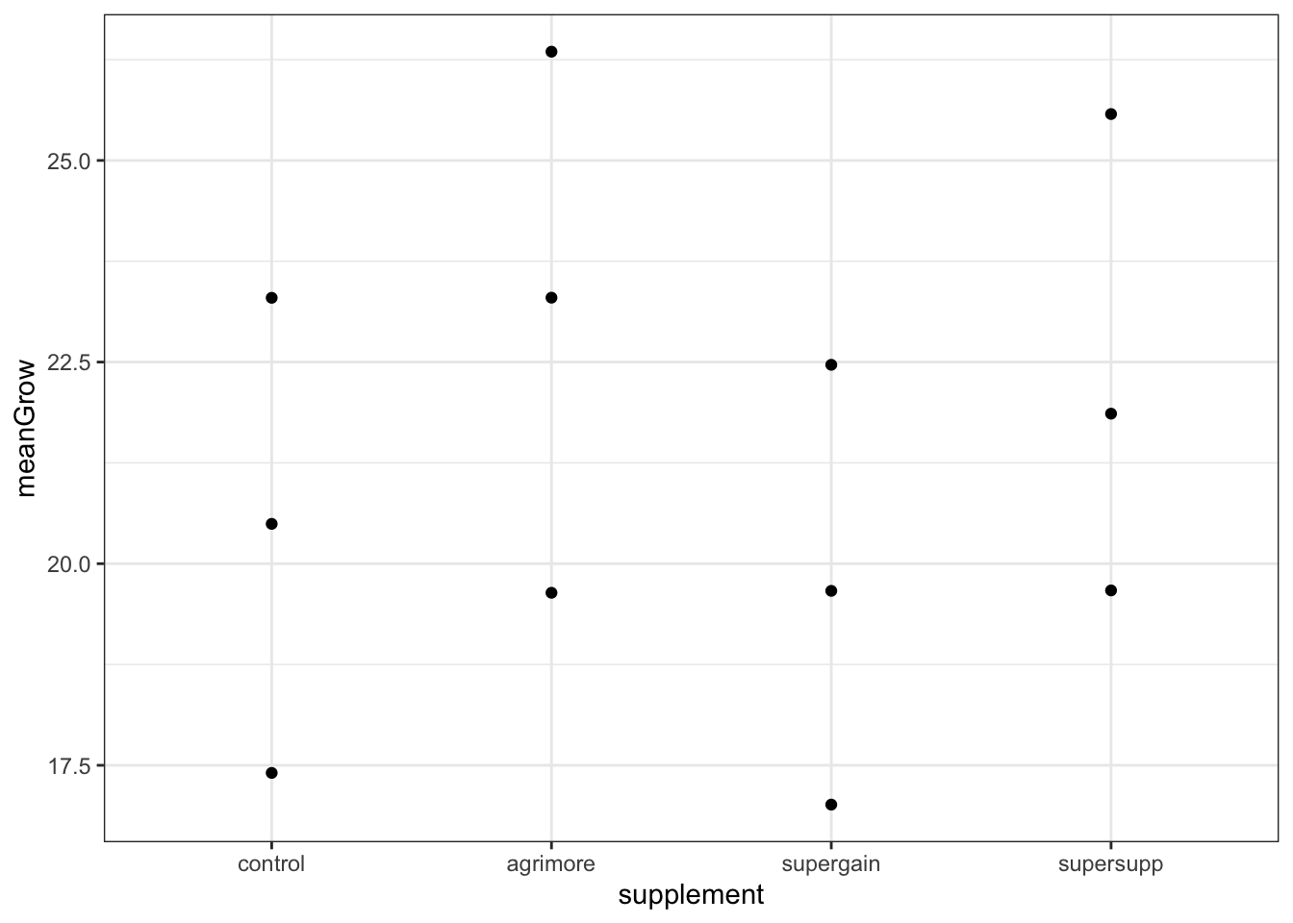
Cow Growth Data
As always, our first step in analysis is a figure:
ggplot(sumMoo, aes(x = supplement, y = meanGrow)) +
geom_point() +
theme_bw()
The effect of supplement type on cow weight gain depends on the diet.

Slide 13
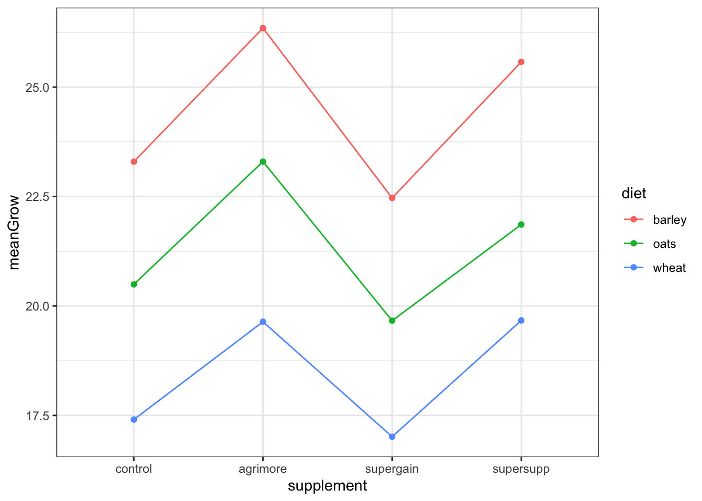
Cow Growth Data
The next step is connecting the dots to visualize the
second factor.
ggplot(sumMoo, aes(x = supplement, y = meanGrow,
colour = diet, group = diet)) +
geom_point() +
geom_line() +
theme_bw()
Does the effect of supplement type on cow weight gain depend on the diet?

Slide 14
Cow Growth Data
Both diet and supplement type seem to have an effect.
Build a model to test both main effects, and their interaction.
model_cow <- lm(gain ~ diet * supplement, data = growth.moo)
This says “test the hypothesis that weight gain is a function of diet, supplement, AND their interaction”. (Notice the * notation)
First, examine model assumptions.
autoplot(model_cow, smooth.colour = NA)

Slide 15
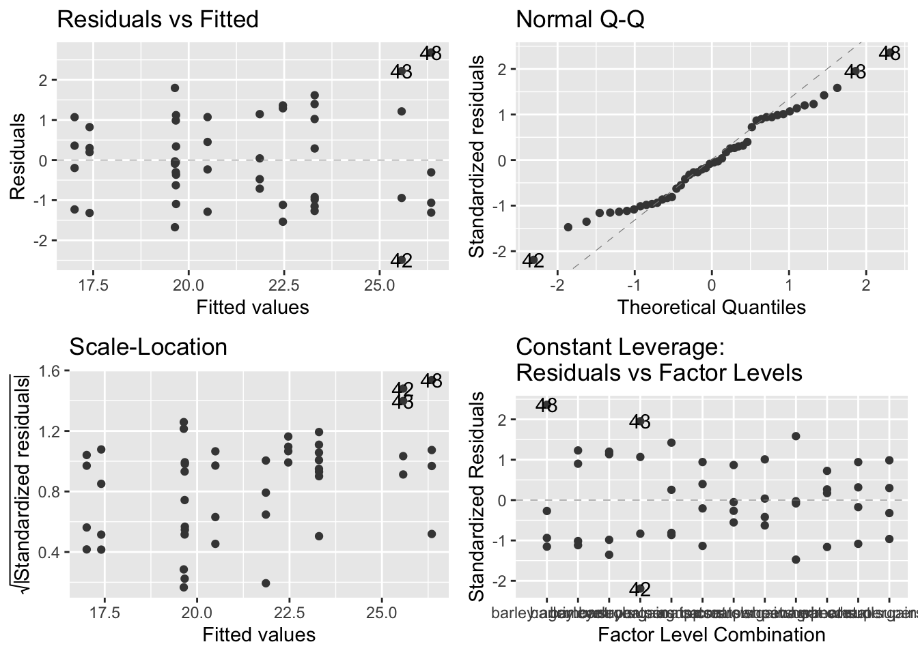
Cow Growth Data
Not great, but no troublesome patterns. The general linear model is actually quite robust to moderate deviations from normality, so let’s keep going.

Slide 16
Cow Growth Data
anova(model_cow)
## Analysis of Variance Table
##
## Response: gain
## Df Sum Sq Mean Sq F value Pr(>F)
## diet 2 287.171 143.586 83.5201 2.999e-14 ***
## supplement 3 91.881 30.627 17.8150 2.952e-07 ***
## diet:supplement 6 3.406 0.568 0.3302 0.9166
## Residuals 36 61.890 1.719
## ---
## Signif. codes:
## 0 '***' 0.001 '**' 0.01 '*' 0.05 '.' 0.1 ' ' 1
The majority of variation due to diet
143 out of a total of 176.5
Supplement explained 30.6 out of a total of 176.5
Interaction explained 0.57 out of a total of 176.5
using diet*supplement has indeed expanded to provide three rows, corresponding to the variation explained by diet, the supplement, and the interaction. (:=*)

Slide 17
Cow Growth Data
## Response: gain
## Df Sum Sq Mean Sq F value Pr(>F)
## diet 2 287.171 143.586 83.5201 2.999e-14 ***
## supplement 3 91.881 30.627 17.8150 2.952e-07 ***
## diet:supplement 6 3.406 0.568 0.3302 0.9166
## Residuals 36 61.890 1.719
## ---
## Signif. codes:
## 0 '***' 0.001 '**' 0.01 '*' 0.05 '.' 0.1 ' ' 1
Usually remind the audience of the hypothesis and state the main effects first:
“We tested the hypothesis that the effect of diet supplement on bovine weight
gain depended on cereal diet. We found an influence of diet (F = 83.5; df = 2,36;
P < 0.0001) and supplement type (F = 17.8; df = 3,36; P < 0.0001) on bovine weight gain.
We found no evidence to support the presence of an interaction between diet and
supplement (F = 0.33; df = 6, 36; p = 0.92).” [state the interaction effects last]
Also notice I tried hard to avoid using the word ‘significant’; forces you to focus more
on the effect size (biology) rather than statistical significance.

Slide 18
Cow Growth Data-Summary Table
summary(model_cow)
##
## Call:
## lm(formula = gain ~ diet * supplement, data = growth.moo)
##
## Residuals:
## Min 1Q Median 3Q Max
## -2.48756 -1.00368 -0.07452 1.03496 2.68069
##
## Coefficients:
Estimate Std. Error t value Pr(>|t|)
(Intercept) 23.2966499 0.6555863 35.536 < 2e-16 ***
dietoats -2.8029851 0.9271390 -3.023 0.00459 **
dietwheat -5.8911317 0.9271390 -6.354 2.34e-07 ***
supplementagrimore 3.0518277 0.9271390 3.292 0.00224 **
supplementsupergain -0.8305263 0.9271390 -0.896 0.37631
supplementsupersupp 2.2786527 0.9271390 2.458 0.01893 *
dietoats:supplementagrimore -0.2471088 1.3111726 -0.188 0.85157
dietwheat:supplementagrimore -0.8182729 1.3111726 -0.624 0.53651
dietoats:supplementsupergain -0.0001351 1.3111726 0.000 0.99992
dietwheat:supplementsupergain 0.4374395 1.3111726 0.334 0.74060
dietoats:supplementsupersupp -0.9120830 1.3111726 -0.696 0.49113
dietwheat:supplementsupersupp -0.0158299 1.3111726 -0.012 0.99043
Residual standard error: 1.311 on 36 degrees of freedom
Multiple R-squared: 0.8607, Adjusted R-squared: 0.8182
F-statistic: 20.22 on 11 and 36 DF, p-value: 3.295e-12
Too many post-hoc comparisons (n=66) to interpret all.

Slide 19
Cow Growth Data-Mean/SD
# calculate mean and standard error of gain for all 12 combinations
sumMoo <- growth.moo %>%
group_by(diet, supplement) %>%
summarise(
meanGrow = mean(gain),
seGrow = sd(gain)/sqrt(n()))
The standard error of the mean is given by the standard deviation divided by the square root of the sample size, and dplyr provides a function n() that counts the rows in each group.
Be careful…if you have missing values, n() will still count these rows. Must filter NA values before analyses. (na.omit, etc.)
Notes:
https://www.statology.org/dplyr-remove-na/
####### this could be helpful ###########

Slide 20
Cow Growth Data-Mean/SD
sumMoo
# A tibble: 12 x 4
# Groups: diet [3]
diet supplement meanGrow seGrow
<fct> <fct> <dbl> <dbl>
1 barley control 23.3 0.703
2 barley agrimore 26.3 0.919
3 barley supergain 22.5 0.771
4 barley supersupp 25.6 1.06
5 oats control 20.5 0.506
6 oats agrimore 23.3 0.613
7 oats supergain 19.7 0.349
8 oats supersupp 21.9 0.413
9 wheat control 17.4 0.460
10 wheat agrimore 19.6 0.710
11 wheat supergain 17.0 0.485
12 wheat supersupp 19.7 0.475

Slide 21
Cow Growth Data-Plot Mean/SE
With this summary table, we can now add three layers to the figure: points, lines, and error bars.
To do this, we introduce geom_errorbar(), which has its own aesthetics: the lower and upper limits of the vertical lines that we call error bars.
These limits are called ymin and ymax.
Each vertical line is made by placing a line between these limits, passing through meanGrow.

Slide 22
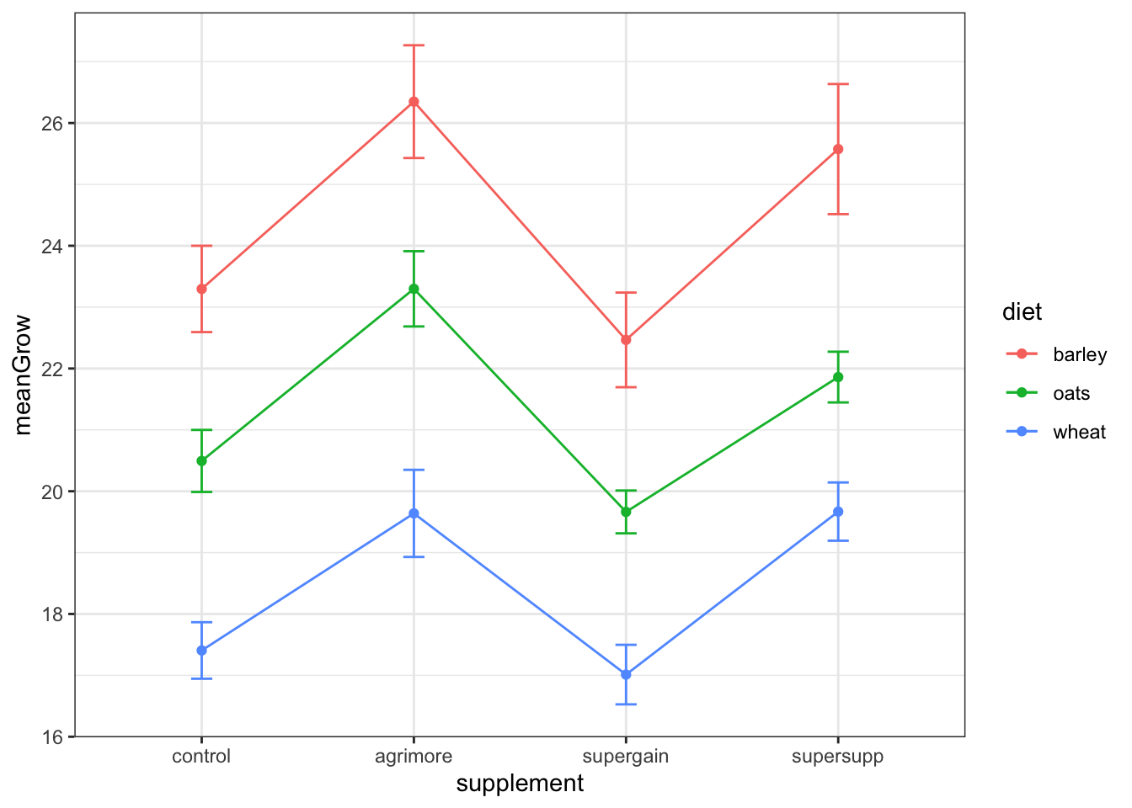
Cow Growth Data-Plot Mean/SE
ggplot(sumMoo, aes(x = supplement, y = meanGrow,
colour = diet, group = diet)) +
geom_point() +
geom_line() +
geom_errorbar(aes(ymin = meanGrow - seGrow,
ymax = meanGrow + seGrow), width = 0.1) +
theme_bw()

Slide 23
What about post-hoc tests like the CLD comparisons we did in 1-WAY ANOVA?
More next time.

Slide 24
Not covered:
comparing interaction (multiplicative) vs. additive models
producing minimum adequate model
Notes:
Interaction contrasts:
https://cran.r-project.org/web/packages/emmeans/vignettes/interactions.html

Slide 25
Elevated CO₂ Example
Next time?
?CO2 for background information
http://en.wikipedia.org/wiki/Echinochloa_crus-galli

