Slide 1
ANCOVA: Analysis of Covariance
Separate Slopes Models: What To Do When the Interaction Is Significant

Slide 2
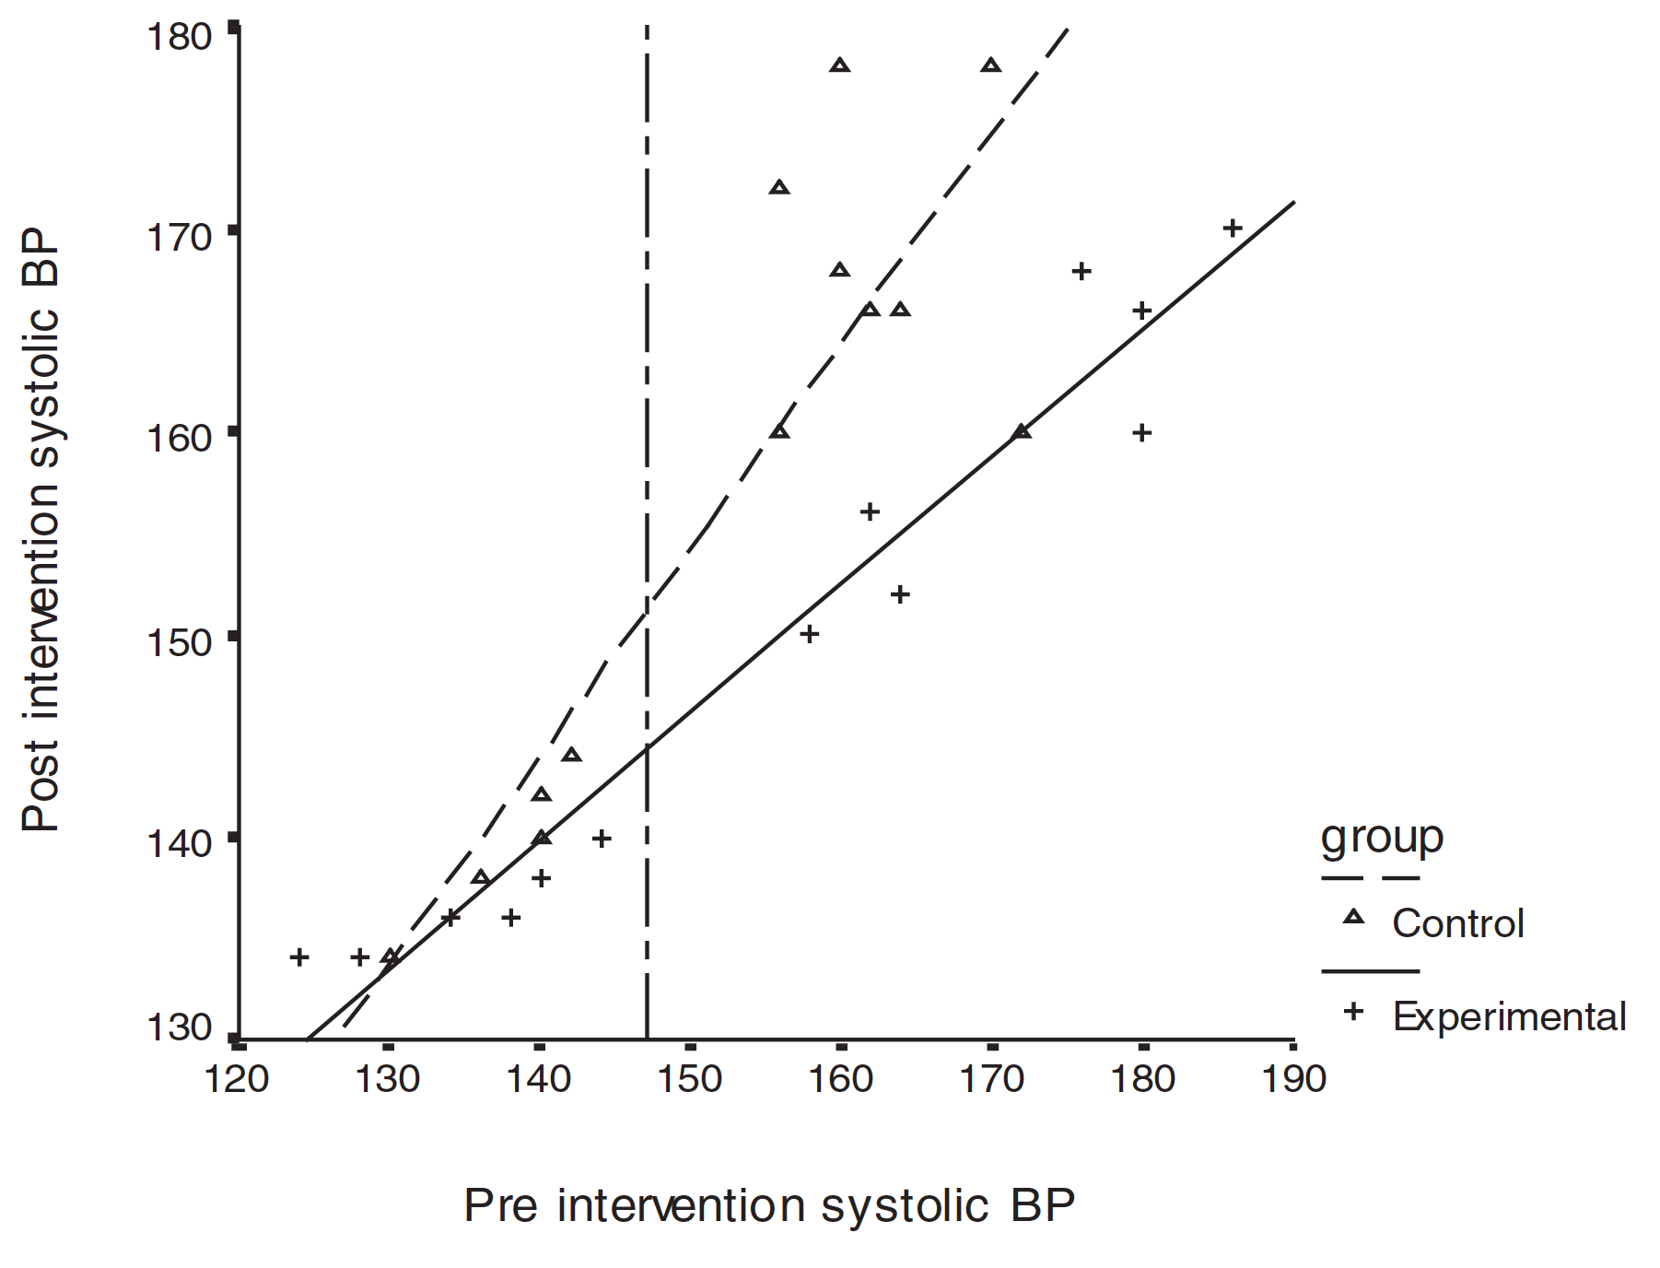
What a Significant Interaction Means
Regression slopes are not parallel
This violates the standard ANCOVA assumption of homogeneous slopes
The effect of the covariate differs across groups
The relationship between X and Y depends on the group

Slide 3
For models with significant interactions:
❌ Do NOT interpret the main effect of the factor
(it is meaningless when slopes differ)
❌ Do NOT remove the interaction just to “fix” things
(this hides real biological differences)

Slide 4
What you should do:
Keep the interaction term
Forget about interpreting adjusted means
Interpret “simple slopes” by asking, “How does the covariate response differ between groups?”
Determine the range over which the covariate (X) does not differ between groups.

Slide 5
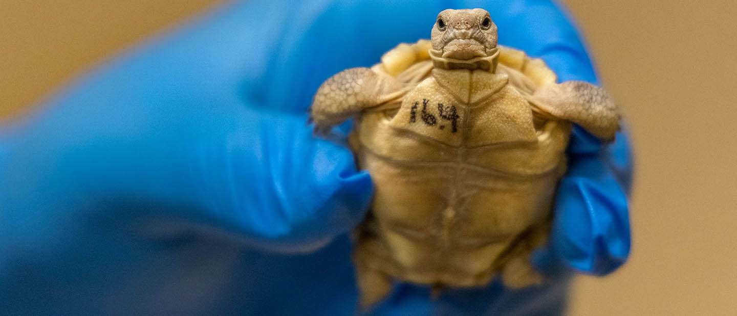
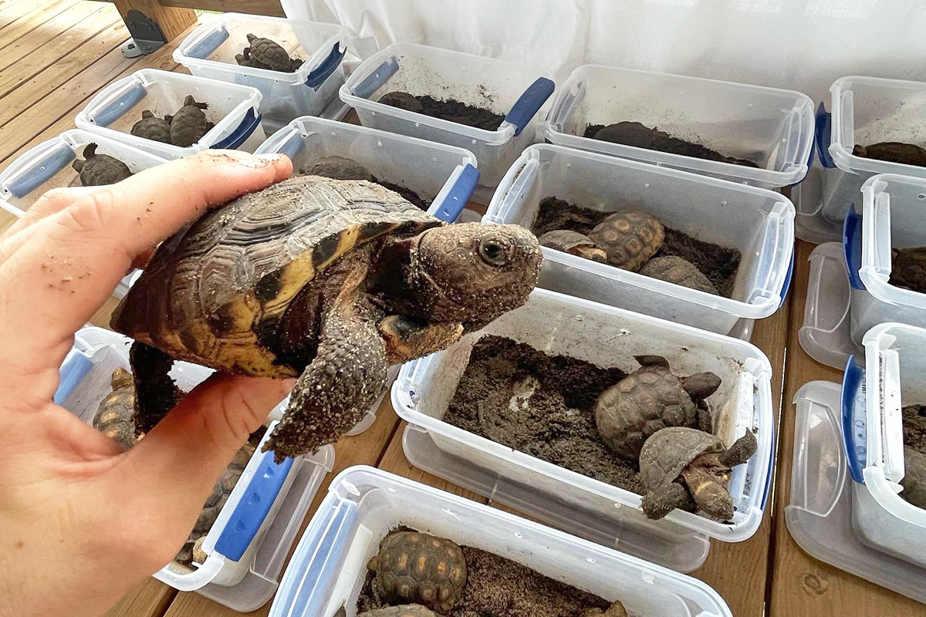
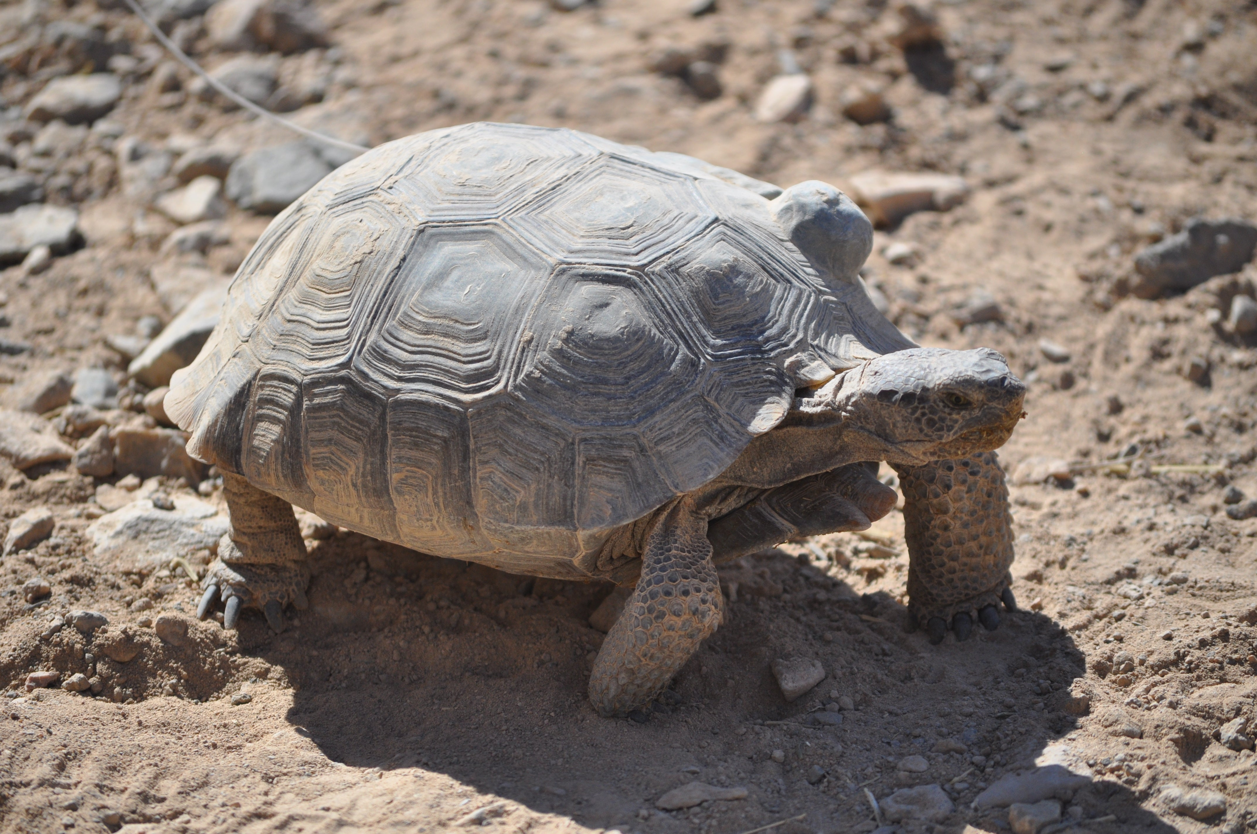
Example: Tortoise ‘Head-Starting’
A common management strategy for endangered tortoises is to captively hatch eggs from wild females, raise the hatchlings, and release them when they are old enough to survive in wild.
Does ‘head starting’ increase reproductive output relative to naturally-raised tortoises? We know that tortoises also have larger clutch sizes as they get larger (older).

Slide 6
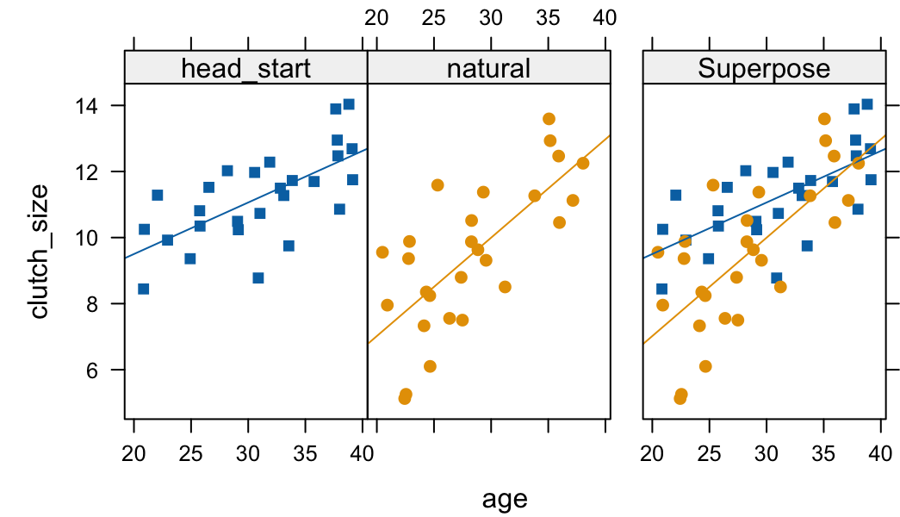
Import -> fit model -> evaluate slopes
head_start <- read.csv("head_start.csv")
head_start$treatment <- factor(head_start$treatment)
str(head_start)
# 'data.frame': 54 obs. of 3 variables:
# $ treatment : Factor w/ 2 levels # "head_start","natural"...
# $ age : num 25.8 35.8 28.2 37.7 38.8 ...
# $ clutch_size: num 10.8 11.7 12 13.9 14 ...
ancovaplot(clutch_size ~ age * treatment, data = head_start)
Notes:
If you forget to import via read.csv, we can fix it later.

Slide 7
model_sepslopes <- lm(clutch_size ~ age * treatment, data = head_start)
anova(model_sepslopes)
Analysis of Variance Table
Response: clutch_size
Df Sum Sq Mean Sq F value Pr(>F)
age 1 104.4 104.4 57.5 7.345e-10 ***
treatment 1 16.3 16.3 9.0 0.004 **
age:treatment 1 8.1 8.1 4.5 0.038 *
Residuals 50 90.7 1.8
---
Signif. codes: 0 ‘***’ 0.001 ‘**’ 0.01 ‘*’ 0.05 ‘.’ 0.1 ‘ ’ 1
Sig. Interaction = slopes are different for each group. Cannot just proceed to interpret main effects. Interpret slopes of groups separately.

Slide 8
Use emmeans package to help compare slopes; we already know they are significantly different, but what are the slope values?
emtrends(model_sepslopes, pairwise ~ treatment, var = "age")
#$emtrends
#treatment age.trend SE df lower.CL upper.CL
#head_start 0.156 0.04 50 0.066 0.246
#natural 0.298 0.04 50 0.198 0.397
#Confidence level used: 0.95
#$contrasts
#contrast estimate SE df t.ratio p.value
#head_start – natural -0.142 0.06 50 -2.122 0.038
Group slopes (simple slopes)
Difference in slopes

Slide 9
Slopes are sig. different; not a very nuanced answer.
Are there regions where the slopes are sig. vs. n.s.?
library(JNplots) # tool for determining n.s. regions using the Johnson-Neyman technique
as.data.frame(head_start) # forces dataframe for JNplots
jnt_cat(X = 'age', Y = 'clutch_size', m = 'treatment', data = head_start, plot.full = TRUE) # use ' not some other char.
Notes:
If you get this error:
# Error in xtfrm.data.frame(x) : cannot xtfrm data frames
# In addition: Warning message:
# Unknown or uninitialised column: `m`.
You have not made the data a data.frame, which is required for the JNplots package.

Slide 10
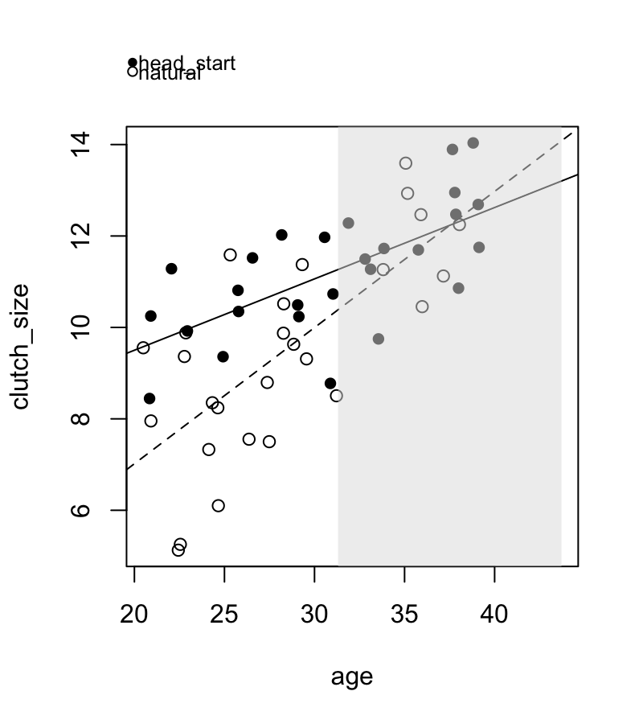
…
$`lower limit in X`
(Intercept)
31.30804
$`upper limit in X`
(Intercept)
43.71118
Gray box is range where slopes are non-significant.
Slopes are sig. different in white range of the covariate.
Notes:
If you get this error:
# Error in xtfrm.data.frame(x) : cannot xtfrm data frames
# In addition: Warning message:
# Unknown or uninitialised column: `m`.
You have not made the data a data.frame, which is required for the JNplots package.

Slide 11
ggplot(head_start, aes(x = age, y = clutch_size, color = treatment)) +
annotate("rect",
xmin = 31.3, xmax = 43.7, #range of n.s. covariate
ymin = -Inf, ymax = Inf,
fill = "grey", alpha = 0.3) +
geom_point() +
geom_smooth(method = "lm", se = FALSE) +
theme_classic(base_size = 14)

Slide 12
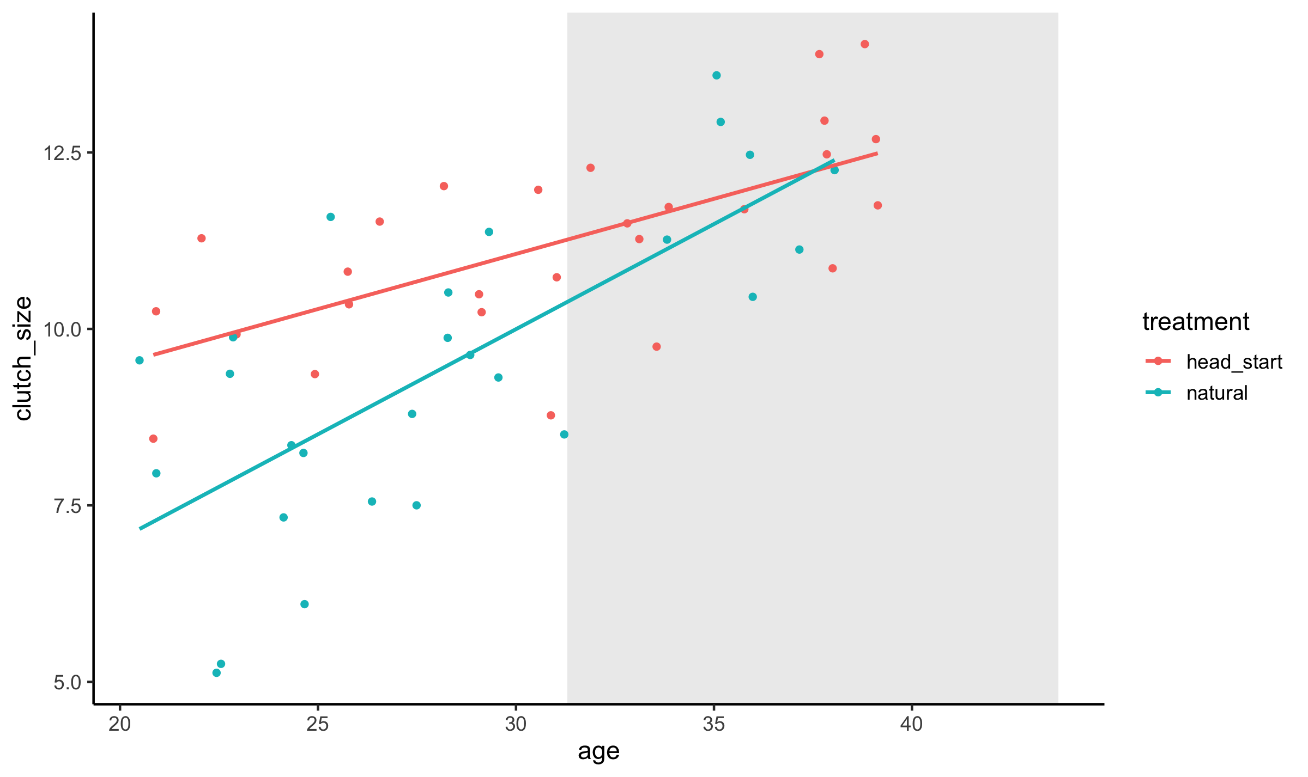

Slide 13
Results Statement:
“We tested the hypothesis that head-starting tortoises (treatment) would increase their reproduction relative to tortoises not head-started (natural; control group).
An analysis of covariance showed that clutch size increased with age (F_{1,50}=57.5, P < 0.001), but did so differently between natural and head-started individuals (slope = 0.156 vs. 0.298; t₅₀ = −2.12, p = 0.039). There was a significant interaction between age and treatment (F_{1,50}=4.5, P < 0.03), such that tortoises older than 31.3 and years did not differ in clutch size between treatment and control groups.
This clearly indicates that ‘head-starting’ benefits younger adult tortoises, but later in life (>31 years of age) tortoises that were not head-started had clutch sizes that were not distinguishable from those that were (Johnson-Neyman test).”
Notes:
Notice we have not attempted to discuss a comparison on main effects other than the range of significance.

Slide 14
Caveat:
The Johnson-Neyman technique only works for comparison of two groups.
Johnson–Neyman (J–N) can compare multiple treatments, but not in a single omnibus test. You must compute pairwise J–N regions for each pair of groups, because the technique fundamentally examines differences between two regression slopes at a time.
For a three-group comparison this produces:
J–N region for group A vs B
J–N region for group A vs C
J–N region for group B vs C

Slide 15
Interpretation
If you have 3+ treatments, the J–N approach gives you a map of significance across the covariate:
Pairwise Comparison | Significant Range of Covariate
A vs B | e.g., covariate > 12.4
A vs C | No J–N region (never differ)
B vs C | covariate < 8.7
This is often more informative than the raw ANCOVA interaction, because it shows where differences occur.
We will only consider comparisons between two groups.

Slide 16
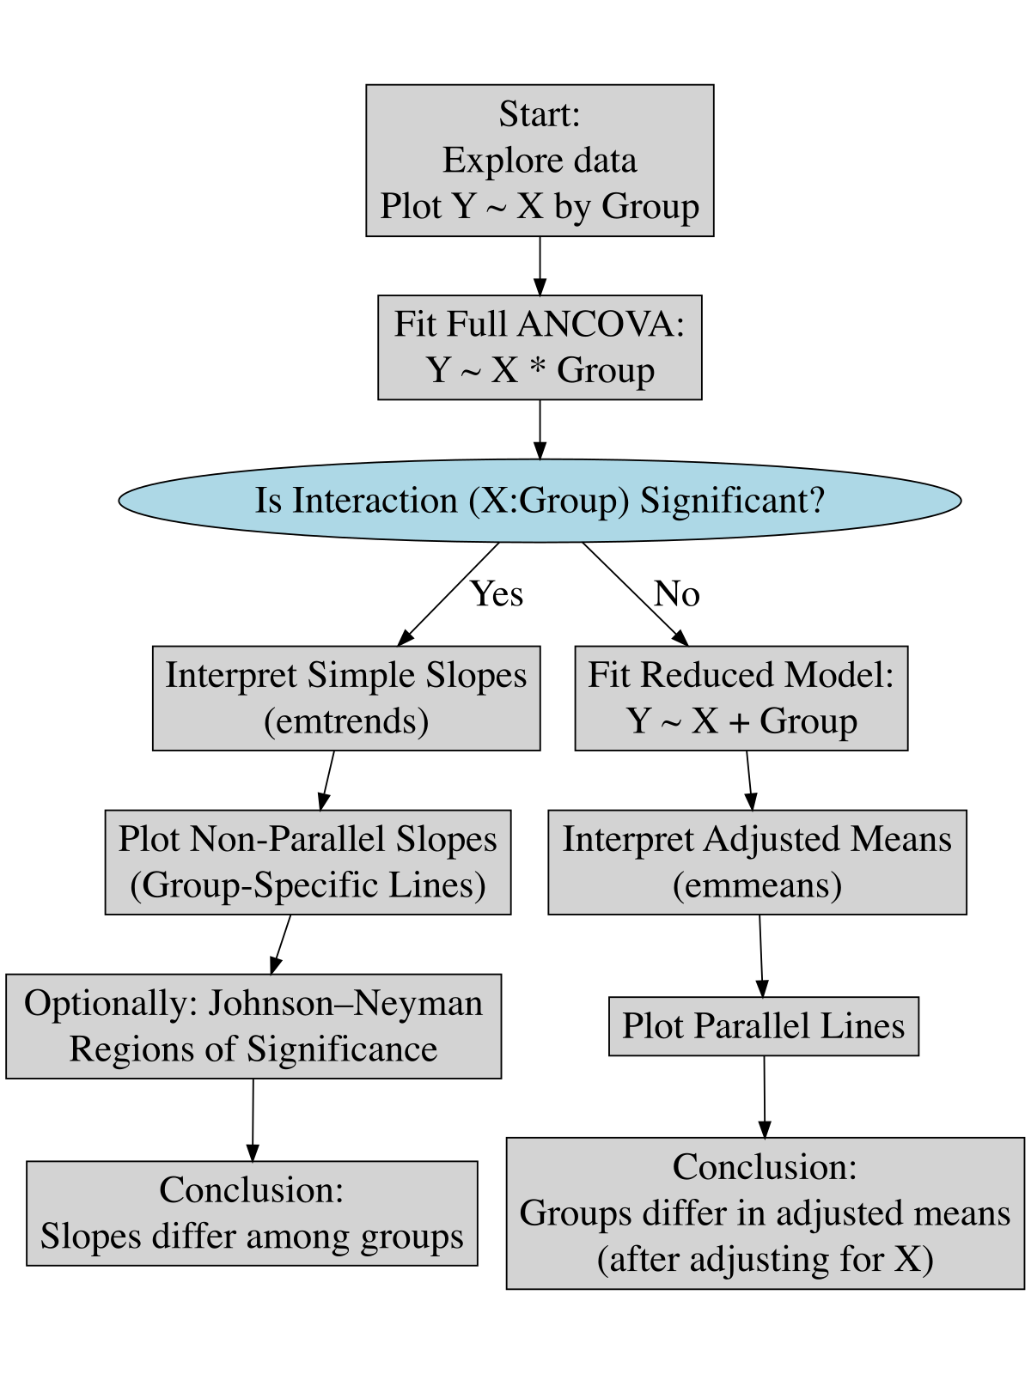
ANCOVA Flow Chart

