Slide 1
Perpetual Protocol
2022/9/5

Slide 2
What is Perpetual Protocol
On-chain future DEX with deep liquidity and builder-ready composability.
Perpetual Protocol is an open source and it runs on the blockchain (v1 on xDai and v2 on Optimism and more soon).
What can you do with Perpetual Protocol?
Trade a wide variety of assets easily, using perpetual futures
Go long or short (position)
Use leverage up to 10x
Perpetual futures are a tool for trading against the price of a wide range of assets.

Slide 3
Perpetual + Uniswap
There is no partnership between Perpetual Protocol and Uniswap. We built on top of Uniswap v3 smart contracts permissionlessly.
All operations with Uniswap v3 pools holding perpetual tokens must be performed via the protocol clearinghouse. You cannot add or remove liquidity, or swap tokens directly via Uniswap smart contracts.
Liquidity on Perpetual Protocol does not depend on Uniswap liquidity. There can be a small amount of liquidity on Uniswap v3's regular pools, and a huge amount of liquidity for the same asset in the perpetual token pool.
Perpetual Protocol only offers cash settled perpetuals—these are derivatives; you cannot swap for real assets or withdraw the real asset; you cannot provide liquidity in the real asset as a maker. All settlement and liquidity provision is in USDC.
Money lego
Perpetual Protocol Curie (v2) permissionlessly builds on top of Uniswap v3, using Uniswap's on-chain infrastructure as a key component of the protocol. This is done to solve a major bottleneck in v1—static liquidity. In addition, building on Uniswap v3 allows Perpetual Protocol to create markets with concentrated liquidity without reinventing the wheel, and makes it easy for partners familiar with Uniswap to integrate with and build on Perpetual Protocol. Classic money lego.
Trading engine
Perpetual Protocol uses Uniswap v3 as a trading engine, so all trades occur on Uni v3, mediated by the Perpetual Protocol clearinghouse. From a trader's perspective, you will trade on Perpetual Protocol, while under the hood actual token swaps are seamlessly happening in Uniswap pools.
Dynamic liquidity
Perpetual Protocol v1 used static, fixed liquidity for each market, and its design made implementing dynamic liquidity very challenging. V2 allows dynamic liquidity by introducing makers (LPs). This means liquidity is provided by dynamic actors who can be responsive to market conditions, ie. place their liquidity in price ranges corresponding to their read of the market. This create a much more stable and sustainable system overall.

Slide 4
How Perpetual Protocol works?
Basic Concepts
Valut : when we refer to the vault in the future diagrams, we refer to the contract in which all collateral is stored. All funds are commingled in this vault (i.e. it contains all of the margin that is used to open positions).
Clearing House : the clearing house is the contract that handles all the trading, liquidations and leverage.
Virtual AMM : is the V1 design where we utilised the xyk model popularised by Uniswap’s V2 (see https://uniswap.org/docs/v2/protocol-overview/how-uniswap-works/ for more details). It’s best to think of this as a pricing engine where if you put in one token you’ll receive another.

Slide 5
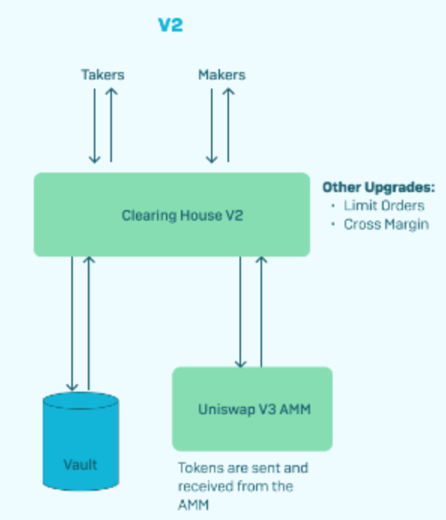
How Perpetual Protocol works?
Pervp V2 Architecture
A virtual token is simply a synthetic token with no intrinsic value
and is used for accounting purposes.
We prefix it with a v - for the following examples vETH will be
virtual ETH and vUSDC will be virtual USDC.

Slide 6
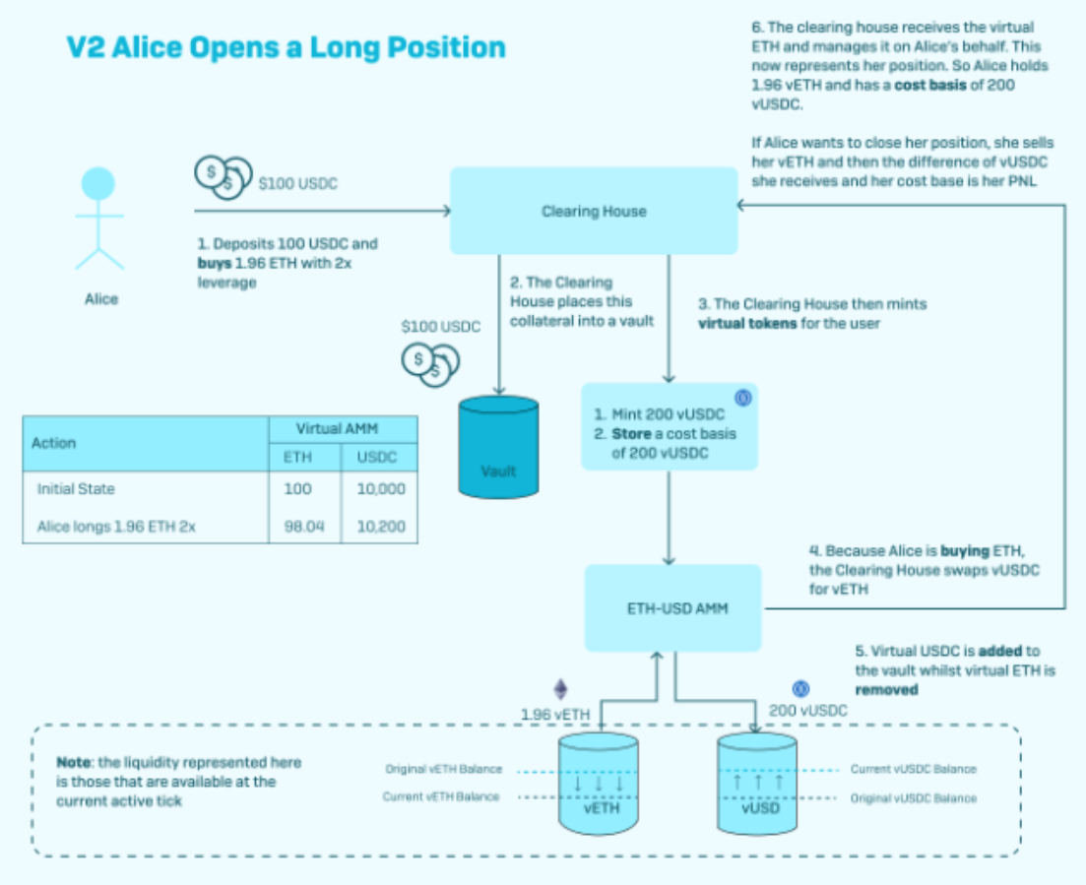
Open Long Position

Slide 7
Open Long Position
The clearing house does the following when opening a position:
Mint virtual tokens - in our scenario Alice is going long and so we mint vUSDC, if she were to short then we would mint vETH.
Store a cost basis - the cost basis is an important concept for calculating what Alice’s actual profit or loss is. We will illustrate this next.
Swap tokens - the clearing house swaps the tokens with the tokens that currently sit in the active tick and receives the opposite token.
To summarise this step, Alice currently has:
1.96 vETH (managed by the Clearing House).
Cost basis of 200 vUSDC.
100 USDC in the Vault.
Let’s assume that some time has passed since Alice opened her long position and now she wants to close her position. We’ll also assume that the price of ETH has gone up.
The beginning of this scenario is the same as previously, she takes the vETH she holds and deposits it into the AMM and receives vUSDC back. We then derive what PnL that Alice should receive - this is calculated as the vUSDC she now holds less the cost basis that she had in vUSDC. Finally, the vault sends back to Alice her collateral plus her PnL:
PnL = vUSDC - cost basis = 220 - 200 = 20.
Alice receives = collateral + PnL = 100 + 20 = 120.

Slide 8
Close Long Position
Let’s assume that some time has passed since Alice opened her long position and now she wants to close her position. We’ll also assume that the price of ETH has gone up.

Slide 9
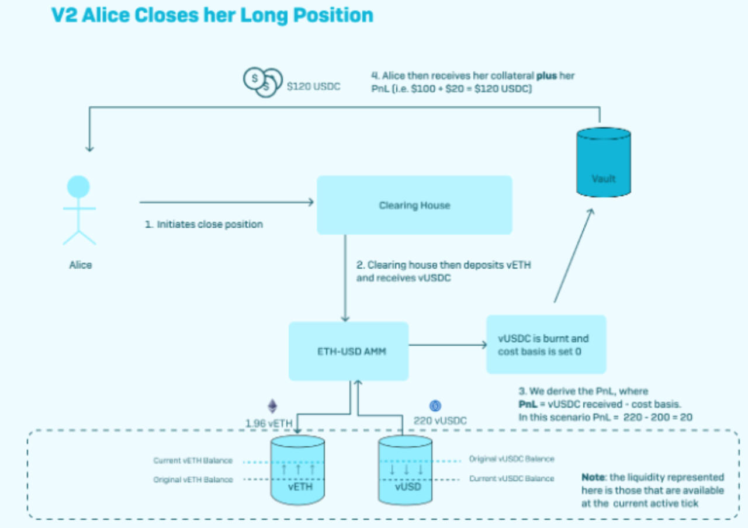
Close Long Position

Slide 10
Providing Liquidity
V2 introduces the concept of a maker who will be providing liquidity. Similar to Uniswap V3, a market maker is faced with 3 scenarios:
Place a range order below the current tick: the market maker is willing to buy the token.
Place a range order around the current tick: the market maker in this scenario is willing to both buy and sell the token.
Place a range order above the current price: the market maker is willing to sell the token.

Slide 11
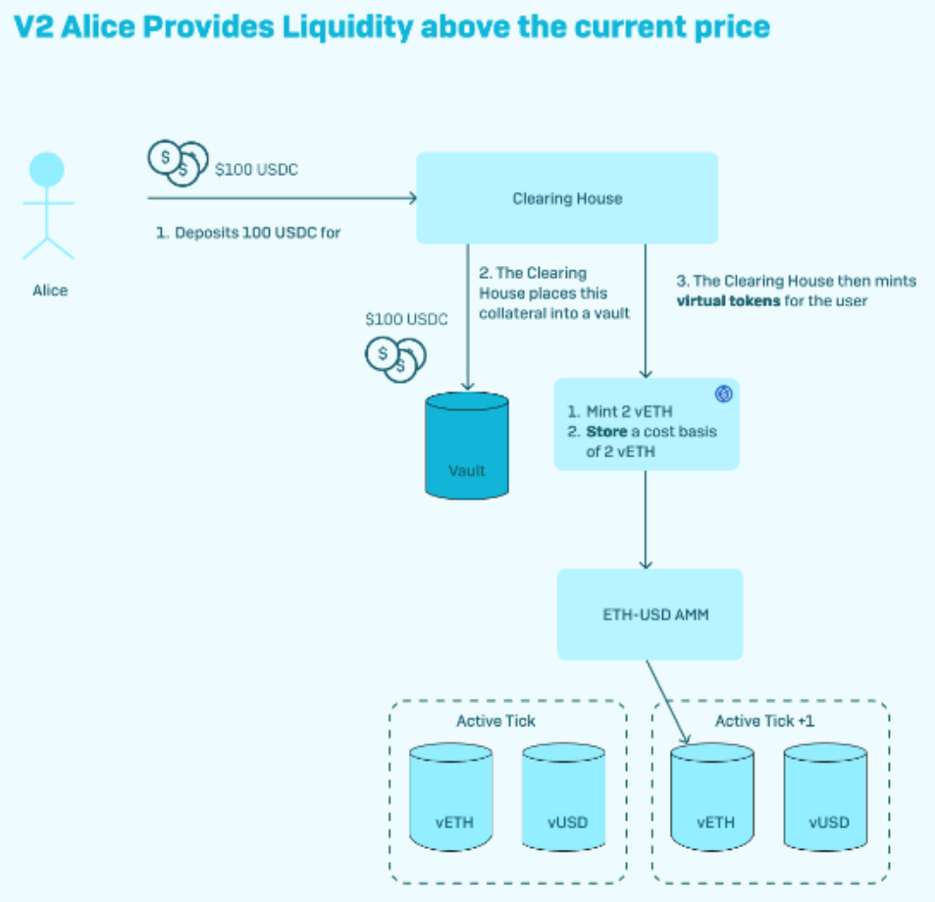
Providing Liquidity

Slide 12
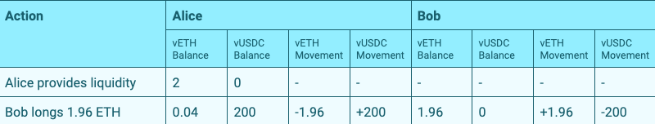
Providing Liquidity
The very first step of this scenario is similar to the previous ones. Let’s take Alice who is looking to provide 100 USDC liquidity with 2x leverage above the range:
The clearing house will mint vETH and place this vETH into the Uni v3 AMM. Let’s assume for simplicity that Alice is the only provider of liquidity and later Bob comes in as a taker and goes long 1.96 vETH. He deposits 200 vUSDC into the pool and receives 1.96 vETH. Alice now only has 0.04 vETH but holds 200 vUSDC.
Assume in the following scenario for simplicity that Alice is the only maker in this active tick. For regular scenarios Alice’s positions would move pro-rata with the other makers.

Slide 13
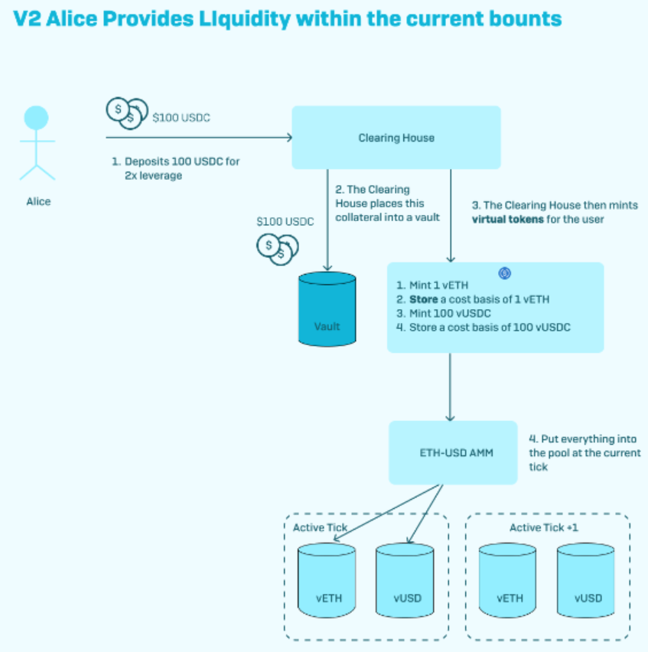
Adding Liquidity Around the Mark Price

Slide 14
Adding Liquidity Around the Mark Price
Adding liquidity around the mark price is the same as “Providing Liquidity” but with a couple of small modifications.
As Alice is willing to both buy and sell in this scenario, the Clearing House mints both vETH and vUSDC. Note that even though Alice still wants to leverage 2x, we don’t mint 200 vETH as in the previous scenario but mint 100 vUSDC and 1vETH so that the numbers add up (assuming ETH = $100, then it will be minting 100 vUSDC and 100 USDC worth of vETH = $200 of USDC equivalent, or 2x the $100 deposit).

Slide 15
Governance
Perpetual Protocol is governed by the community via forum discussions and voting on proposals. We welcome any discussion about how the governance model works, either by participating on the governance forum or in the #governance Discord channel.
Currently governance of Perpetual Protocol operates under a hybrid model.
Community governance: Covers all aspects that can be reasonably handled via community discussion and voting.
Use of Perpetual DAO funds, including PERP tokens
Exchange parameters, such as insurance fund threshold, fee level & distribution, etc.
Foundation team: Covers aspects that cannot be reasonably handled via governance at this time, or are of a sensitive nature.
Short- and mid-term strategy
Protocol design & development
Website development and maintenance
Emergency updates, fixes and operations

Slide 16
Perpetual DAO
The core of the project is the Perpetual DAO, which controls the DAO treasury including PERP tokens, and of which all PERP holders are members with voting rights.
To streamline DAO governance, operational tasks are divided among a growing set of sub-DAOs. New sub-DAOs may be proposed and added / removed as required.

Slide 17
Sub-DAOs
The vision for Perpetual Protocol is to decentralize gradually over time, eventually dissolving the foundation and transitioning it into a fully fledged Decentralized Autonomous Organization (DAO) so that the community has complete stewardship of the protocol.
Following the lead of DAOs such as Yearn Finance, one of the first projects to successfully partition itself, Perpetual Protocol is working towards compartmentalizing different aspects of the protocol, where each sub-DAO is responsible for making decisions and managing their own budgets independently.
These sub-DAOs sow the seeds for grassroots participation, enabling new forms of coordination and creating a user-centric network. Currently, a committee model is used across sub-DAOs, where token holders periodically vote for a committee, which will then make the decisions for a particular focus area.
However, the plan is for sub-DAOs to be self-organizing, allowing individuals who share a common view to create a group and then work together for the Perpetual Protocol DAO. This approach to governance is inspired by MakerDAO’s ‘The Endgame Plan’.
The current sub-DAO structure is shown below. All the current sub-DAOs use Coordinape and DeWork for to organize tasks and recognize members’ contributions. Any use of the DAO treasury funds must be first approved by token holders, through community dialogue, governance forum proposals and voting via Snapshot.
Below, we detail the sub-DAOs that currently exist or are being proposed. The formation of further sub-DAOs in the future across different areas (e.g., engineering, marketing, partnerships, etc.) will help the project achieve its goal of decentralization and immutability.

Slide 18
Token Listing DAO
The main purpose of the Token Listing DAO, created in November 2021, is to approve or reject new markets and co-marketing spends for token listing campaigns. The DAO is in place to ensure that there's some level of governance to prevent outright scams from being listed on Perp.
The DAO is composed of six committee members who are chosen via a public nomination and voting process. Members are elected every three months via a Snapshot vote.
Any markets approved by the Token Listing DAO will be listed on app.perp.com by the foundation team. Anyone can submit a proposal for a new market to the DAO and put forward a case for its inclusion. The Token Listing DAO is also responsible for the marketing budgets to bootstrap new token listings.
Each asset is considered individually for listing suitability. The criteria include:
Feasibility
price feed availability
asset stability
Demand
availability of trading options on Ethereum/Optimism
popularity of the asset, and its related project
Marketing opportunities
opportunities for co-marketing with listed projects

Slide 19
PERP as a Governance Token
The PERP token is used by its holders to vote on governance proposals.
The governance forum is the main place to propose and discuss the pros and cons of new ideas in the foreseeable future (such as new collateral types, new features, etc.). Snapshot, an external off-chain voting platform, is used to get input from the community.
The 1 token-1 vote model clearly has drawbacks, where voting power is concentrated in the hands of the few and majority rules is the default. To improve the governance process, we will be transitioning to a veToken model where token holders can lock PERP into vePERP for up to 52 weeks to boost their voting power. The longer the tokens are locked for, the greater the boost to voting power, similar to veCRV.
The amount of time tokens are locked into vePERP and the quantity of tokens held jointly determines voting power, reducing the likelihood of governance attacks (such as using flash loans to vote using borrowed tokens).

Slide 20
Proposal Lifecycle
Gauge community sentiment for a potential proposal through our community channels on Discord, Telegram and/or Twitter.
Create an account at gov.perp.fi and submit a proposal (see proposal template here).
Proposals must be discussed for at least 7 days and generate meaningful discourse. Go to this page to check and discuss current proposals.
Author or (author’s delegate) must submit their web3 address to a forum mod to be added to the Snapshot account.
Author/author’s delegate creates a vote, to last 7 days.
Votes are subject to a minimum 10% quorum.
If the proposal passes the voting stage with majority support (>50% of the vote), then it will be accepted as actionable by the Core team.
Any vote that doesn’t pass or cannot reach the quorum will be rejected, and can restart at the proposal stage.

Slide 21
Snapshot Voting
Snapshot voting calculates voting power based on the number of PERP/vePERP that you have locked up, and allows stakeholders to support proposals without any gas costs.
Follow the steps below to cast your vote:
Head over to https://snapshot.org/#/vote-perp.eth
Click on “Connect Wallet” and connect with an account that holds PERP/vePERP
Browse the active proposals
Select your preferred choice(s): for weighted voting, you can vote for more than one option.
Sign the message using your wallet and submit your vote.
Once the vote has enough support, the foundation team will implement the proposal.

Slide 22
PERP Token
Tokenomics
Tokenomics are currently under revision. Check out the following articles for info about the upcoming changes (note that details may change between now and the tokenomics launch, expected in Q2 2022):
Initial proposal: https://gov.perp.fi/t/proposal-perp-v2-tokenomics/642
Fee sharing, etc.: https://gov.perp.fi/t/proposal-fee-distribution/657
veTokenomics overview: https://blog.perp.fi/vetokenomics-explained-6b9c5683cddb

Slide 23
PERP Token
Issuance
The PERP token was launched in September 2020 using Balancer's Liquidity Bootstrapping Pool (LBP), where 7.5 million tokens (5% of the total supply) were distributed to over 1,200 participants.
An LBP is basically a weight shifting pool designed for token distributions that create constant downward pressure on the price, preventing front-running and price speculation. Read more about why we chose the LBP method here. Perpetual Protocol was the first project to launch an ERC-20 token using this innovative distribution method.

Slide 24
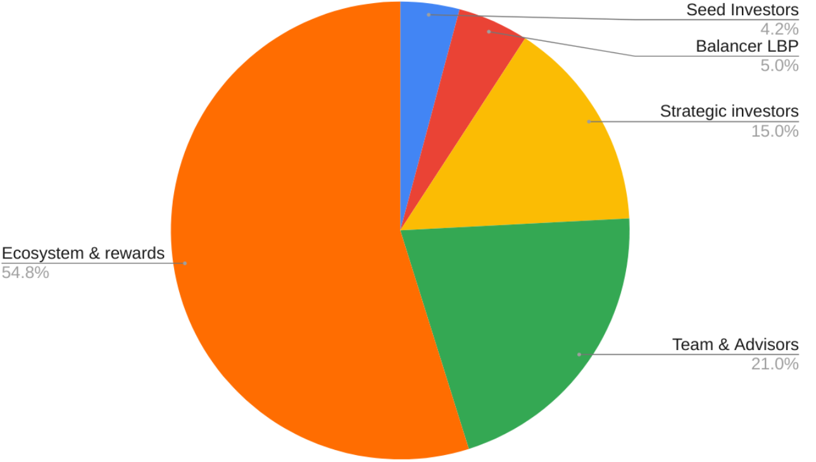
PERP Token
Issuance

Slide 25
PERP Token
Investors
All investor tokens have been fully issued and vested. Seed and strategic investors received either 1/4 or 1/5 of their tokens each quarter following the v1 mainnet launch (December 15, 2020).
Initial investor price was $0.08.
Team Allocations
31.5 million PERP tokens are to be allocated to the team (21% of total supply).
Team tokens began unlocking 6 months after mainnet launch (June 15, 2021) at a rate of 2.1% per 3-month period. 90% of these tokens are currently being held or staked by the team, with around 10% being distributed to team members so far.
Perpetual DAO
All remaining tokens ('Ecosystem & Rewards' section in the pie chart above) and token minting may only be used with a mandate from the Perpetual DAO. Currently this mandate is granted via voting on governance proposals.
Current use of DAO tokens include rewards, grants, and funding for other proposals, which have been issued since March 2021. See gov.perp.fi for past and present proposals.

Slide 26
Token Address
Ethereum mainnet: 0xbc396689893d065f41bc2c6ecbee5e0085233447
Optimism: 0x9e1028f5f1d5ede59748ffcee5532509976840e0
xDai: 0x7ecF26cd9A36990b8ea477853663092333f59979
BSC: 0x4e7f408be2d4e9d60f49a64b89bb619c84c7c6f5
Arbitrum: 0x753d224bcf9aafacd81558c32341416df61d3dac

Slide 27
Token Wallets
Wallet | Notes
0xc49f76a596d6200e4f08f8931d15b69dd1f8033e | Main token wallet Locked rewards pool and investor/team token supply.
0x0f346e19f01471c02485df1758cfd3d624e399b4 | Staking contract
0xd374225abb84dca94e121f0b8a06b93e39ad7a99 | Perpetual DAO Treasury
3rd Party Token Stats
Token Terminal
https://tokenterminal.com/terminal/projects/perpetual-protocol

Slide 28
Protocol Attributes
Base & Quotes Tokens
In Uniswap V3, a pool has two tokens: one designated as token0, and the other as token1. The order is decided by (address token0, address token1) = tokenA < tokenB ? (tokenA, tokenB) : (tokenB, tokenA)
The price of the pool is always token1/token0. The price range liquidity is added to is also based on this configuration.
Assuming we have pools such as vETH:vUSD or vBTC:vUSD, the price a Uniswap V3 Pool returns can be denominated in ETH, BTC or USD, depending on which is token0 and token1. This adds additional potential overhead.
To simplify, we force the ClearingHouse to only support Uniswap V3 Pools where token0 is base, and token1 isquote. This can be done by only deploying a BaseToken when its address is smaller than our QuoteToken (not using create2).

Slide 29
What is Leverage?
Leverage can be a crypto trader’s best friend or their worst enemy. As with any other tool, whether the use of leverage leads to positive or negative outcomes depends on how effectively it is utilized in your trading.
One definition of leverage is described as making something lighter, such as where a lever amplifies the force exerted to make the lifting of a heavy object easier. Similarly, in cryptocurrency trading, leverage refers to the situation where your buying power is multiplied and it’s made easier to get greater exposure to the price fluctuations of a crypto-asset.

Slide 30
How is Leverage Calculated?
In general, we calculate leverage using margin, which refers to the amount of collateral put up for a trade, and the position size:
Leverage = Position Size / Margin

Slide 31
Leverage calc example
Note the inverse relationship between leverage and margin. For the same position size, the lower the margin, the greater the leverage utilized (and vice versa).
With perpetual swaps, larger positions can be built than would otherwise be possible thanks to the use of leverage. For example, a deposit of $100 USDC on Perp v2 multiplies your buying power by a factor of 10 and enables you to enter a position size of up to $1,000. To apply 3x leverage, 30% of your maximum buying power would be used to open a position valued at $300 instead.
If the price of ETH is $2,000, then with just $100 USDC, a trader can use 5x leverage to open a position of 0.25 ETH worth $500. Without leverage, the trader could only get exposure to 0.05 ETH through the spot markets.
Derivatives such as perpetual swaps give you the opportunity to multiply your profits. If the price of ETH rises to $2,500, the profit of a 5x leverage position equals $125 (=$500/4). Now compare to the case where $100 worth of ETH was bought in the spot market with no leverage. The profit would be five times smaller, at just $25.

Slide 32
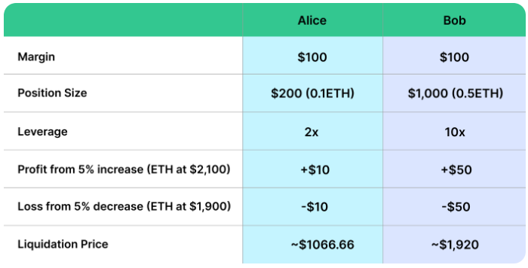
The Benefits and Risks of Leverage
Whilst offering the advantage of magnifying a trader’s profits, it’s important to keep in mind that applying leverage can also lead to larger losses if the market moves against your position. The table below illustrates the benefits and risks, which compares two traders who both go long on ETH-USD at the same entry price: $2,000.

Slide 33
How to select Leverage?
If you’re a scalp trader opening positions over very short durations, then higher leverage may be justified to magnify your profits using very large positions that capture many, tiny price movements. In contrast, swing traders who hold positions for hours or days at a time tend to use leverage at the lower end of the scale.
Since a longer-term trader aims to capture bigger percentage moves, the position size they require does not need to be as large as it would be for a scalper. So applying greater leverage can be more suitable over short timeframes, where the trader aims to quickly enter the market and get out with some profits.
To fulfil this role, the likelihood of your trade idea going to plan is perhaps the most important factor in your decision making. So it is best to avoid using leverage in high risk or high uncertainty situations.

Slide 34
Summary
TRADE
Trade the most popular products in crypto in a permissionless way
CREATE
Build new protocols and projects on top of Perpetual Protocol
MARKET MAKE
Earn a yield on your capital by becoming a liquidity provider

