Slide 1
Event Management & Mediation Configuration Management (CM)
December 2014

Slide 2
Agenda
2014 Metrics
Process Systems Administration
Access Systems Administration
Versioning Systems Administration
Build Environment Administration
Documentation

Slide 3
2014 Metrics (12/22/14)
EM&M CM Team’s 1st priority is Builds and QA Deployments.
CM work areas are managed for each delivered set of code.
These work areas are the basis for QA, Integration, Stage, and Production environments.
“Re-Works” occur each time a new delivery is made for corrections to the build, the deployment, requirements change, or for errors found in the QA, Integration, and Stage environments.
A delivered set of code is considered “Completed” when it has been checked into the Versioning System, checked out by CM, Installed to QA, all required test environments, and the Production environment.
CEMPCM JIRA tickets are consider “Resolved” when they reach a state of “Completed” or “Fixed by Another Issue”.

Slide 4
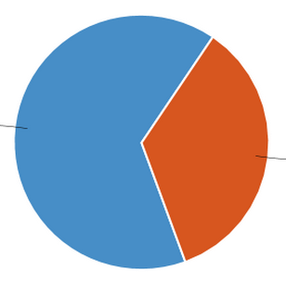
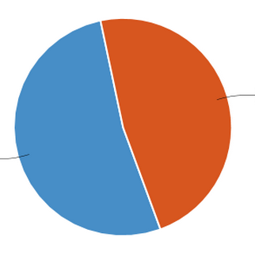
2014 Resolved
2013 Resolved
Fixed by
Another Issue
794
Completed
567
Completed
427
Fixed by
Another Issue
620
Total Tickets: 1221 Statistic Type: Resolution
Total Tickets: 1187 Statistic Type: Resolution

Slide 5
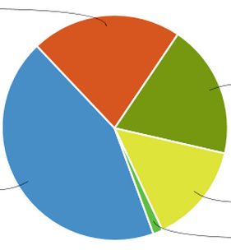
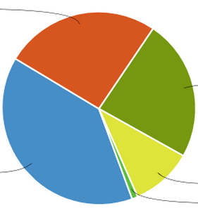
2014 Opened
2013 Opened
Voice
339
Voice
348
Data
302
Video
319
Video
684
CFX
226
CFX
526
Data
139
None
23
None
13
Total Tickets: 1574 Statistic Type: CEMP LOB
Total Tickets: 1345 Statistic Type: CEMP LOB
The difference between Resolved and Opened is “tickets in progress” and “cancelled”. There are currently 287 tickets in progress.

Slide 6
Weekly Metrics Reporting
Maintain Metric for Current and previous years via JIRA Dashboards
Validate Metrics on a weekly basis via CM Metric Reporting procedure
Send out weekly email on EM&M deployments:
Completed by Month
Reworks by Month
Opened, Resolved, and Reworks by current and previous year
Rework Type tallies

Slide 7
Process Systems Administration
SME for EM&M JIRA projects CEMPCM and CEMPBAU
CEMPCM project is Source of Record for deployments
Contact point for Development & Engineering Applications Administration team
Supported JIRA Upgrade to JIRA 6.2.
Reported failing Confluence Gadget on JIRA 6.2 dashboard.
(Insufficient coordination between Comcast JIRA and Confluence Administration to solve this issue.)
EM&M Deployment Workflow
Coordinated Changes for tracking All non-development environments
Documentation maintained with image mapping for training purposes
SME for Confluence, EM&M CM Portal (wiki documentation system)
Coordinate Legal Demand processing to Level 2 organization

Slide 8
Access Systems Administration
SME for EM&M CADA Configurations
Configured EM&M ULA CADA
Updated EM&M CADA Admin Guide accordingly
Removed need for “red” account access for all ULA CADA systems
Forces “single-sign-on” for absolute access traceablility
Added configurations for EEP Legacy systems configured by CEMP
Configurations cover both CADA and ULA CADA
Added configurations for Build/Deployment automation access
Implemented all new changes with iTRC reference and usage
Help with QA environment Admin support and coordination
(Application restarts, configurations, etc)
SME for iTRC system reference and configuration
Maintain EM&M CM systems in iTRC apps

Slide 9
Versioning Systems Administration
SME for Concurrent Versioning System (CVS)
Training for new team members
Update access in association with On-Boarding procedures
Create and maintain related scripts and procedures
SME for Git – Distributed version control system
Configured new EM&M Git System
Establish EM&M Branching and Merging Workflow
Included primary and failover systems
Uses Gitolite for EM&M Branching and Merging Workflow
Uses Gitolite for managing access
Document and maintain Administration Guide
Document and maintain User Guide
Conducted several training courses
Support EM&M Build and Deployment automation tasks
Initial review of Comcast MagNETO system

Slide 10
Build Environment Administration
Verify and execute developer delivered builds
Maintain work areas for deployables to QA, Integration, Stage, Production envs
Create and Maintain scripts for consistency
Deployment Packaging
Maintain Production deployable history
Schedule and run the release Go No Go meeting
Coordinate movement of WebLogic 10.3 builds from older windows XP
workstation to Linux build system.

Slide 11
Documentation
Maintain the EM&M Configuration Management Portal
Team/Org Calendars
EM&M Acronyms
FAQs
Standards
Administration Documentation
DevCorner
Process Documentation
Procedures
Metrics
Administrative Support for following Confluence Spaces: (wikis)
CEMP Development
Clickstream
DM
Electronic Sell Through
Intake and Deploy
Intake and Deployment Management
Interactive TV
Various Personal Spaces (Atlas wikis)

