Slide 1
EM&M Git System Training
February 18, 2015

Slide 2
  Outline
Session 1 – Git Installation
Session 2 – EMM Git Usage

Slide 3
Git Installation
The Git Installation Procedure has been prepared to:
Help you install Git for Windows
Configure Git for the EM&M Git System
  SSH Configurations
  Git User Configurations
Validate you can work with the EM&M Git System
The above bullets are required for Session 2 of this training.

Slide 4
  EMM Git Usage
EMM/Git Overviews
Git Commands
Clone your repo
Current status, branches?
Change example
Working Environment
Staging the work
What are we doing?
Process Concepts
Changing Existing Code
Fix QA Defect
Production Hotfix
Branching & Merging Workflow

Slide 5
  Overview
EM&M Git System
About Git

Slide 6
  Git Commands
  (Compare to CVS commands)
git clone
git status (demo none, -s, -v)
git branch
  git checkout
git add (to staging)
git commit (from staging)
git fetch
git merge
git push
Git Reference
  NOTES:
  -v (verbose) provides detail
  -s suppresses detail
  Indicates “remote” command

Slide 7
Clone your repo
Local repo on workstation
EMM Git System
develop
master
develop
master
Temp
Dev
branches
Temp
Ops
branches
Temp
Dev
branches
Temp
Ops
branches
Local
Repo
branches
clone

Slide 8
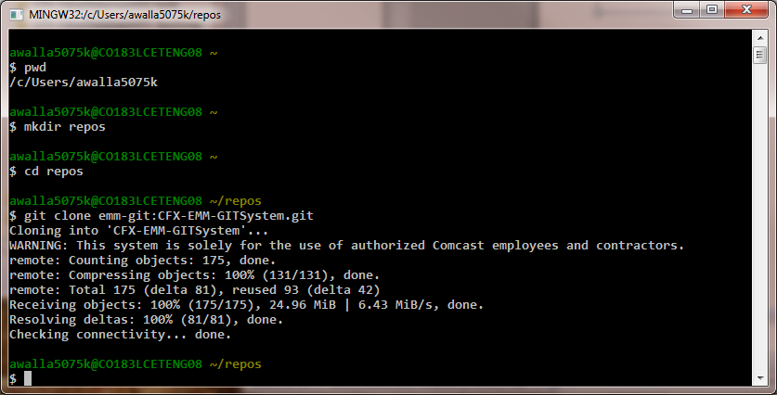
Clone repo

Slide 9
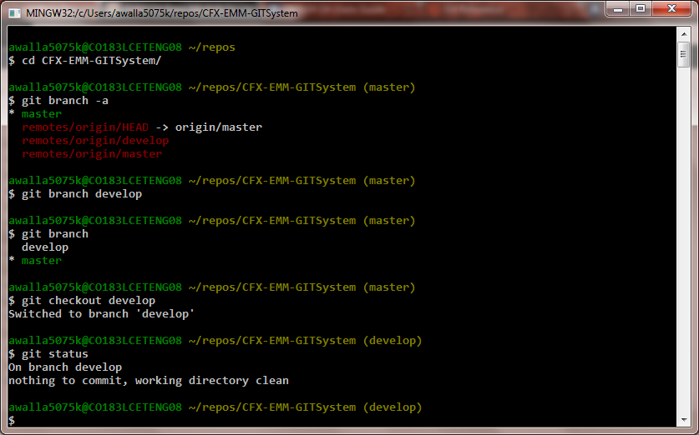
Current status, branches?

Slide 10
Change example
Create branch to code on
Change a file
Check for conflicts
Add and commit
Merge to develop
Current state

Slide 11
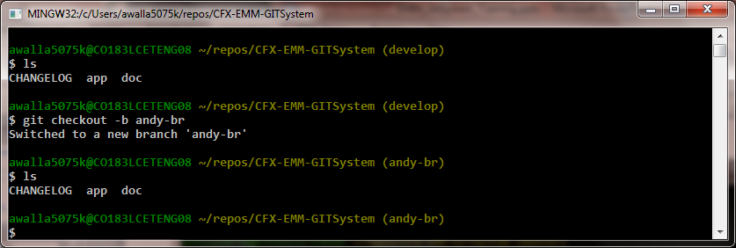
Create branch to code on
develop
master
feature

Slide 12
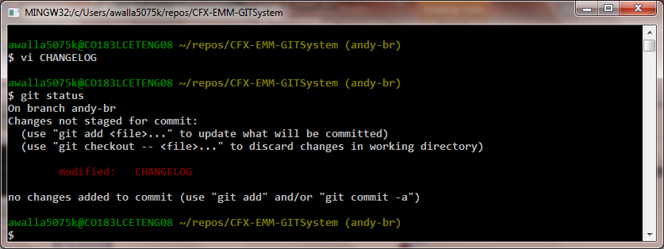
Change a file
develop
master
feature

Slide 13
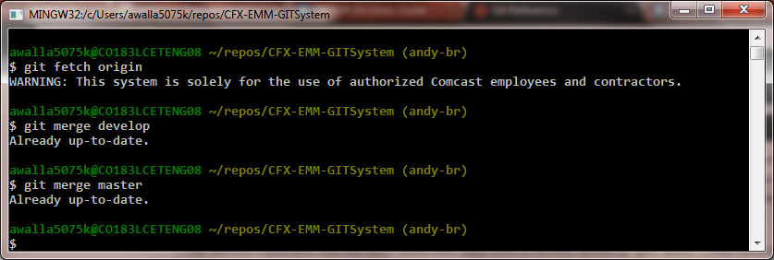
Check for conflicts
develop
master
feature

Slide 14
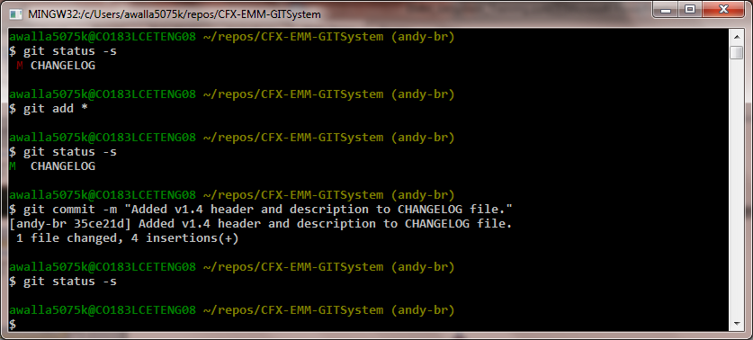
Add and commit
develop
master
feature

Slide 15
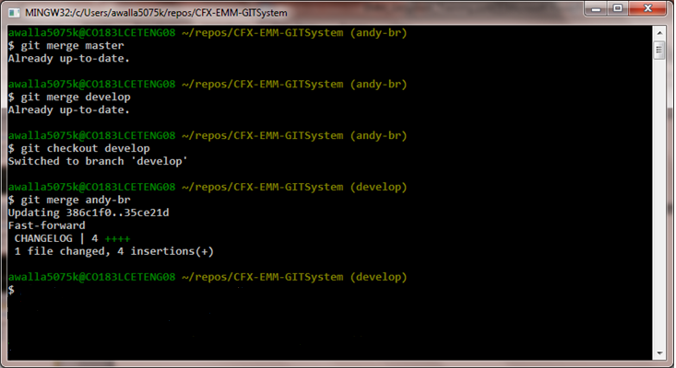
Merge to develop
develop
master
feature

Slide 16
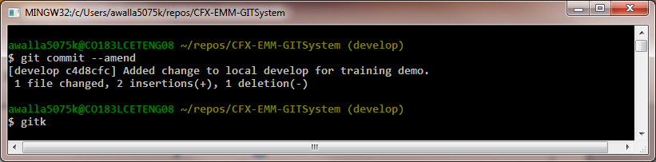
Identify Merged Branch
develop
master
feature

Slide 17
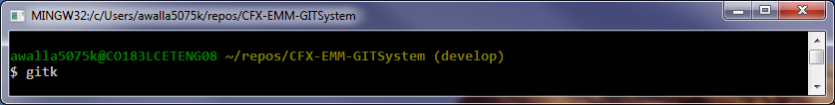
Current state
develop
master
feature
Local repo
Remote EMM Git System repo
CFX-EMM-GITSystem

Slide 18
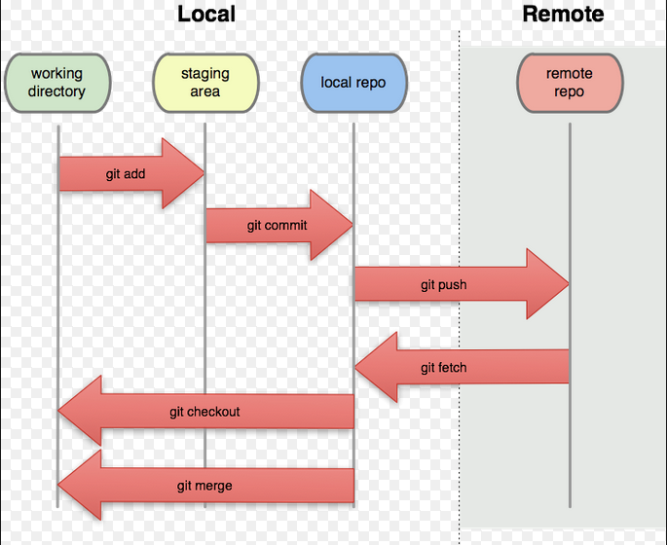
Working Environment
Local repo on workstation
EMM Git System

Slide 19
Staging the work
Switch to coding branch and add file to working area
Add and commit new-file to coding branch
Switch branches to demonstrate working directory change
Push coding branch to EMM Git System for sharing
Move to alternate git repo and update for new branch

Slide 20
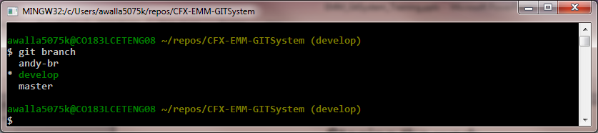
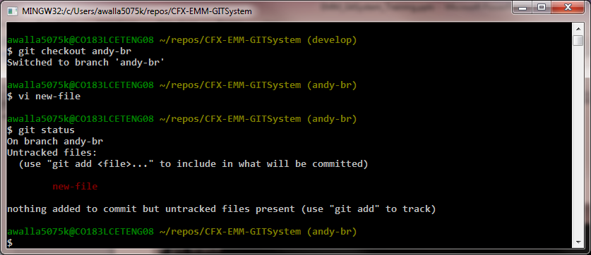
Switch to coding branch and add file
The develop branch head currently in working directory
Switch to coding branch and add file to working directory

Slide 21
Switch to coding branch and add file
Local repo on workstation
EMM Git System
develop
develop
master
develop
master
Temp
Dev
branches
Temp
Ops
branches
Temp
Dev
branches
Temp
Ops
branches
Local
Repo
branches
andy-br
fetch
push

Slide 22
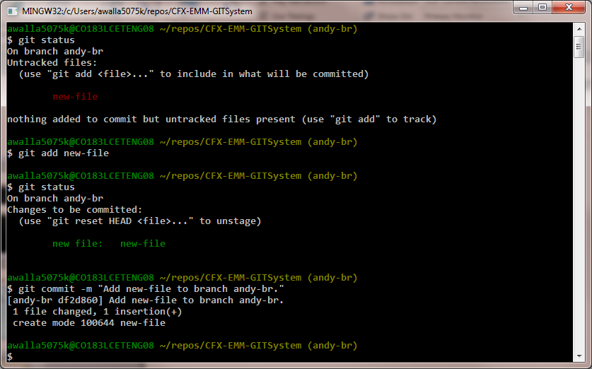
Add and commit new-file to coding branch

Slide 23
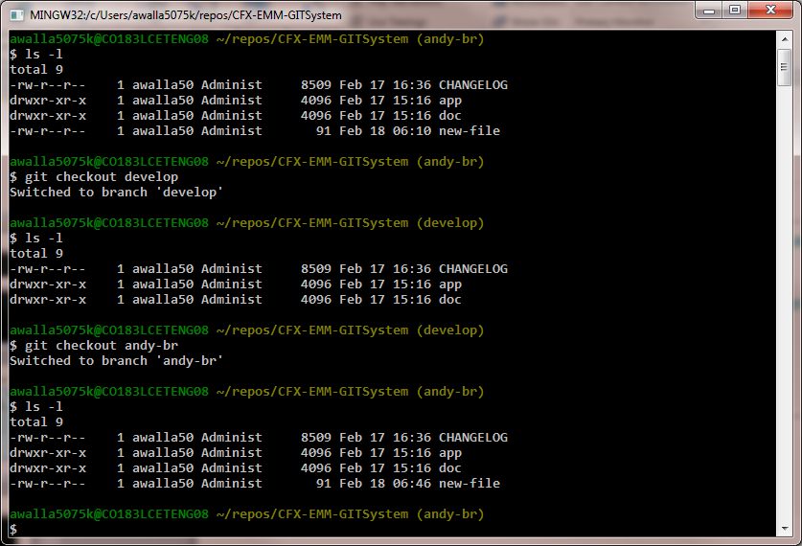
Switch branches to demonstrate working directory change

Slide 24
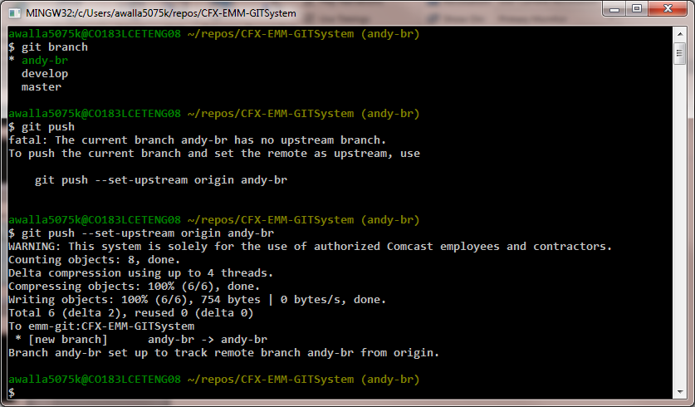
Push coding branch to EMM Git System for sharing

Slide 25
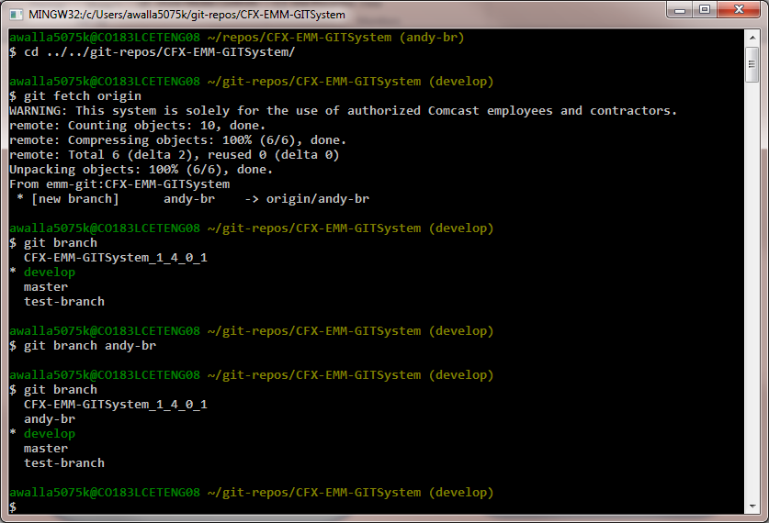
Move to alternate git repo and update for new branch

Slide 26
What are we doing?
code
hotfix
develop
master
feature
hotfix
correct
defect
release
Certified
By QA
feature

Slide 27
Process Concepts
code
hotfix
develop
master
feature
hotfix
correct
defect
release
feature

Slide 28
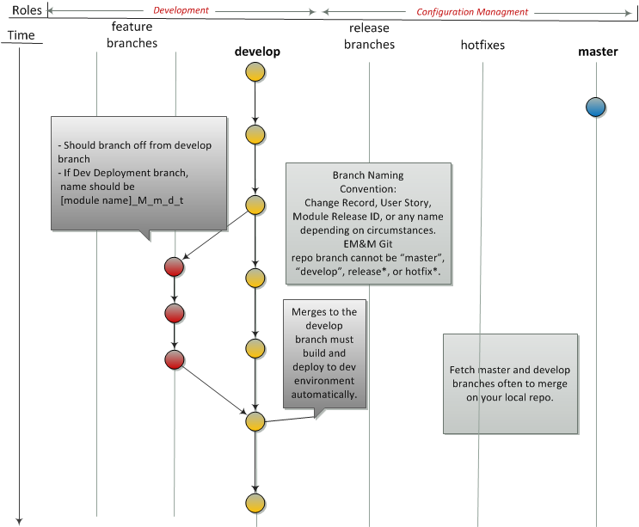
Developer Builds and Tests New Feature
Reference Development Deployment Branches

Slide 29
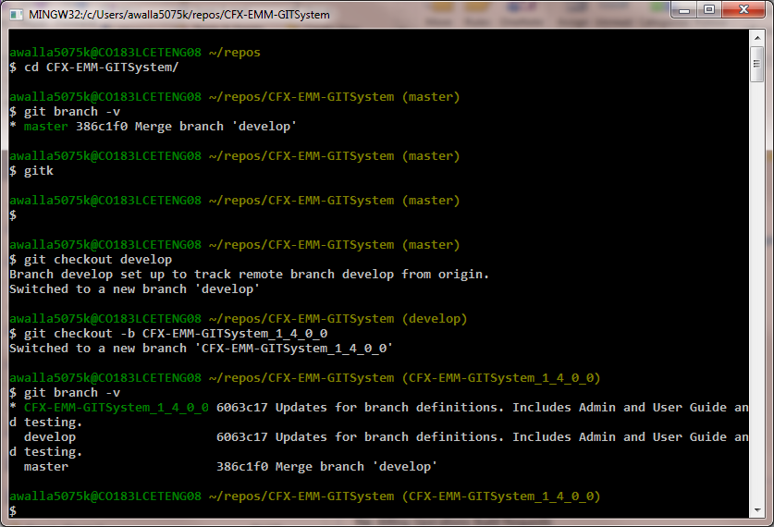
Branch from develop
Notes:
The gitk give a nice visual of your local Distributed Version Control System (DVCS) repo.
You can also reference the EM&M Git System DVCS repo on the EM&M GitWeb site at http://emm-git1.sys.comcast.net/git/

Slide 30
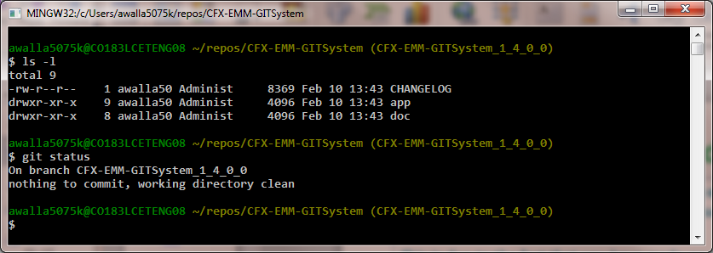
Branch from develop (2)
When you list the files in your local directory at this point, they represent the contents of your working directory which is currently equivalent to the staging area or currently “clean”.
This is due to the fact that you have made no changes yet. As you make changes, use git status to keep track of your current situation.
Notes:
Note the usage of the “git status” reference.

Slide 31
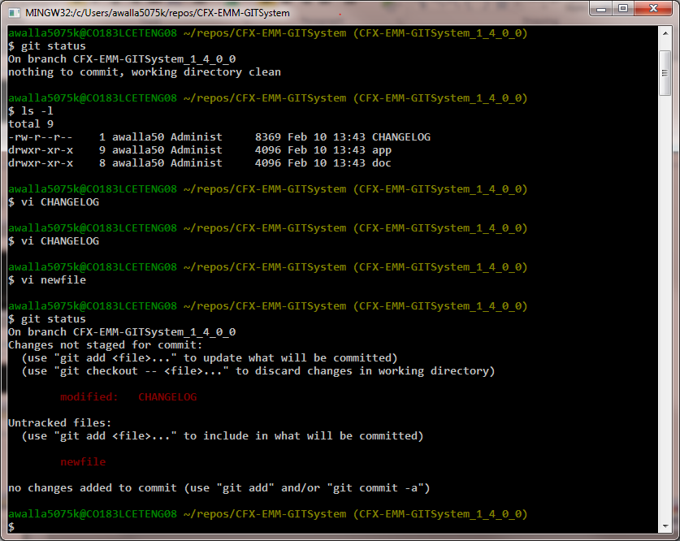
Branch from develop (3)
After making changes, the git status will keep you honest with your work area.

Slide 32
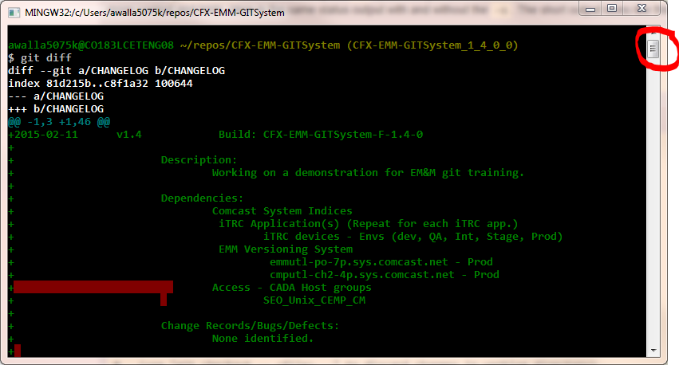
Branch from develop (4)
What Changed? (1)

Slide 33
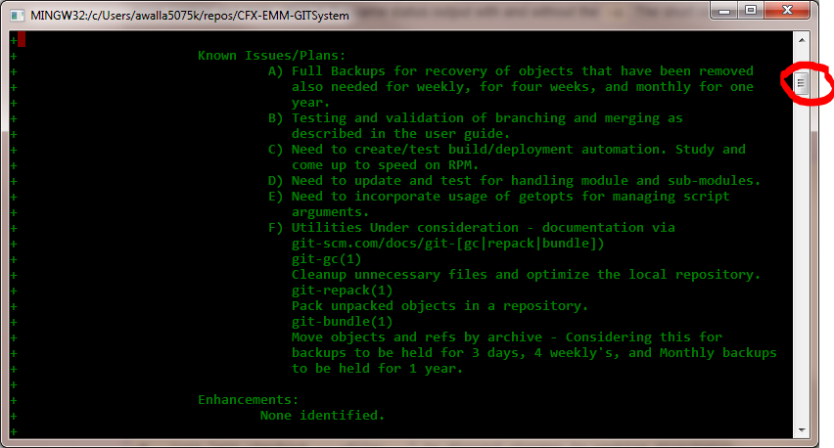
Branch from develop (5)
What Changed? (2)

Slide 34
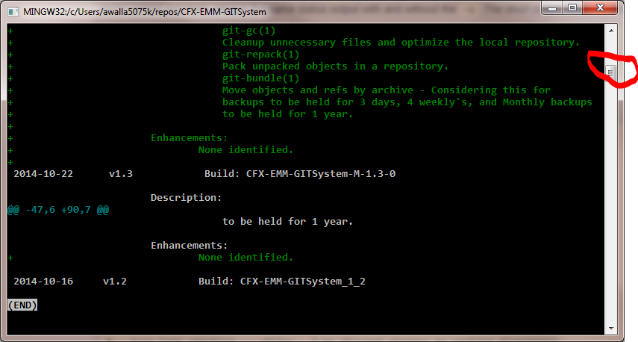
Branch from develop (6)
What Changed? (3)

Slide 35
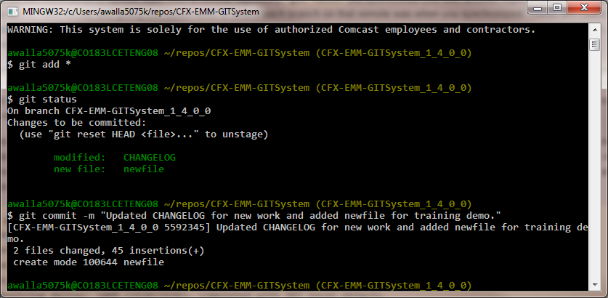
Add/commit to my branch

Slide 36
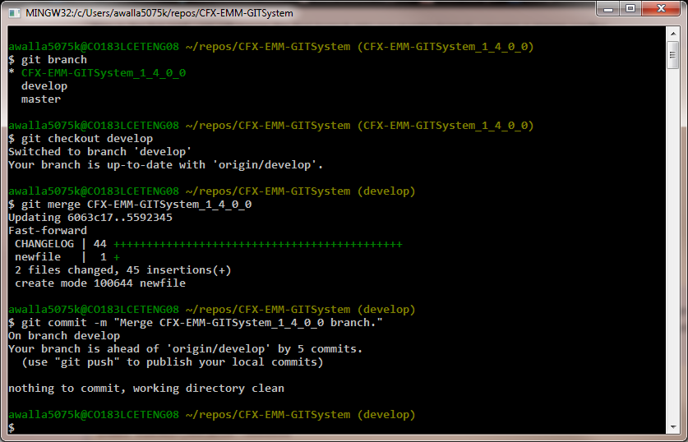
Merge to develop branch
Using git merge, to check for successful merge before committing to develop branch.

Slide 37
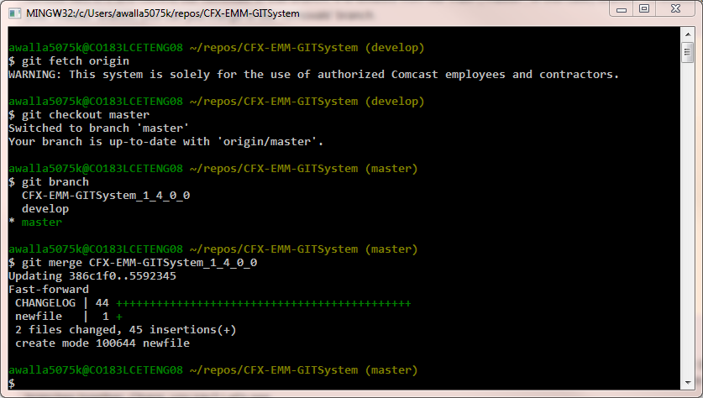
Merge to master branch
Using git merge, to insure these deltas will merge successfully with the master branch.

Slide 38
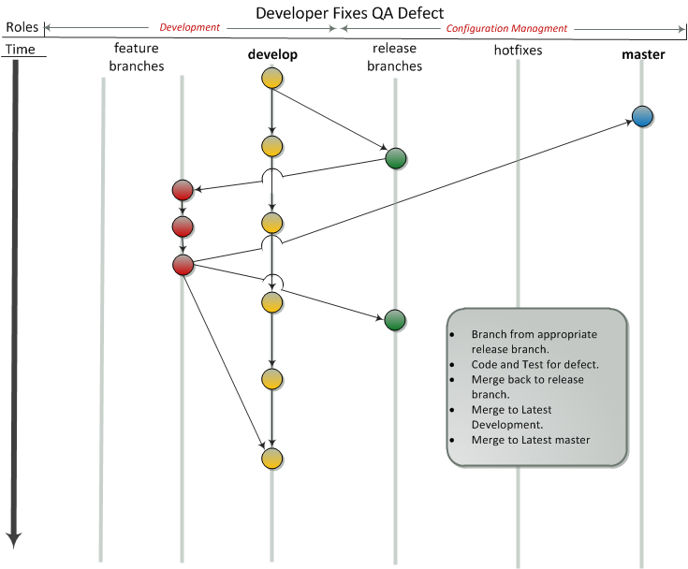

Slide 39
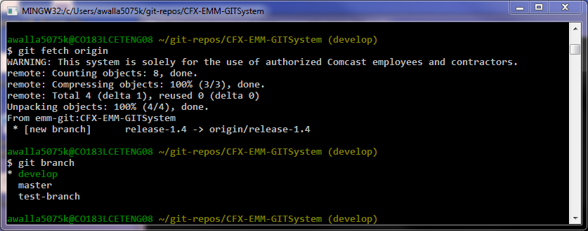
Branch from release*
The release* branches are configured by the CM team when QA requests QA install from a development delivery.
If there is a defect found, branch from the appropriate release branch.

Slide 40
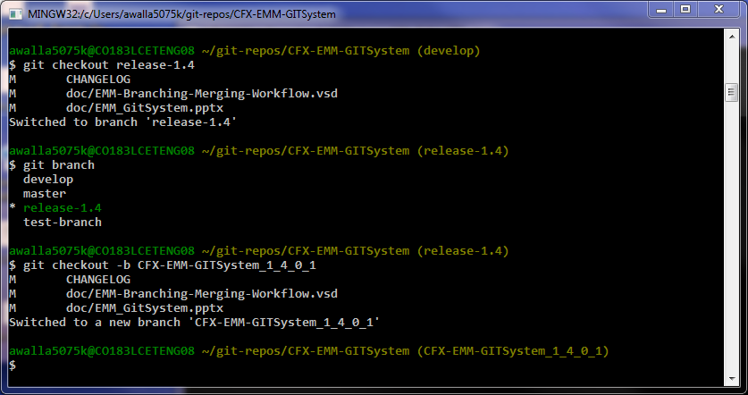
Branch from release* (2)

Slide 41
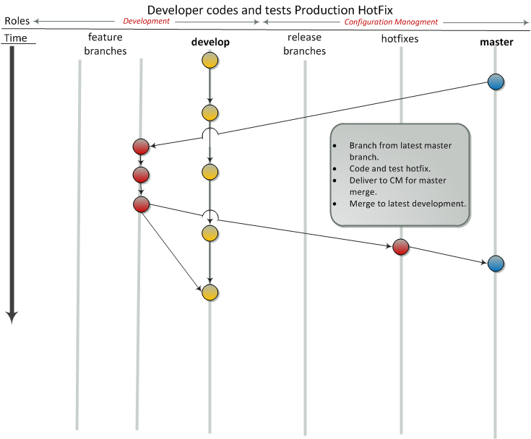

Slide 42
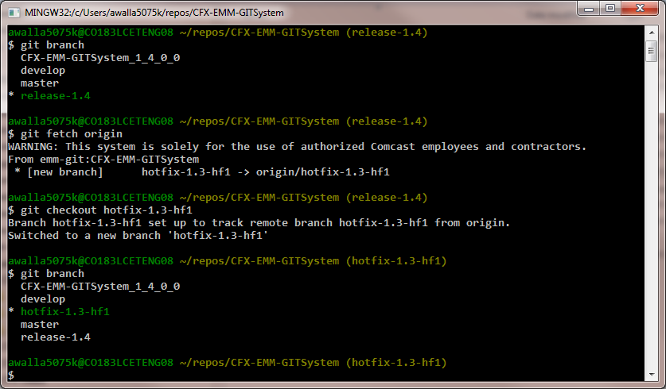
Branch from hotfix*
The hotfix* branches are configured by the CM team when a production problem is identified.

Slide 43
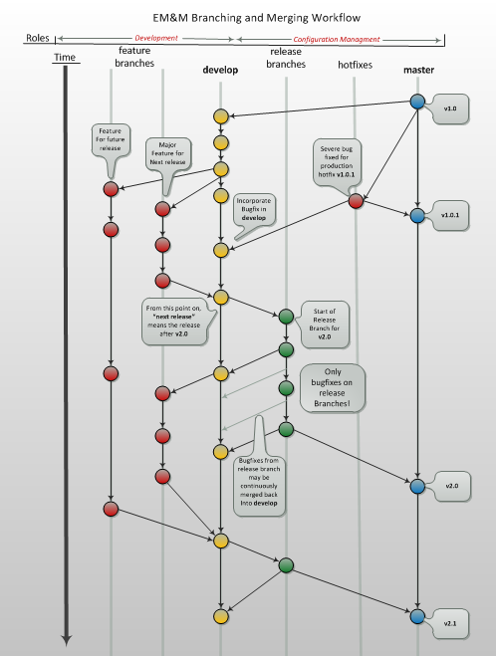

Slide 44
More Information
All things EM&M Git System can be found at this Link.
Useful Git Documentation:
Getting Started – Git Basics
Git/Introduction

