Slide 1
EM&M Git System
October 21st 2014

Slide 2
Outline
Branches
EM&M Branch Definitions
Branching and Merging Approach
Information Conductor
EM&M GitWeb
First “git push”

Slide 3
Why use a branch?
To manage release
To develop new features without impacting the main branch
To experiment with a new feature
To create hotfixes to production branches

Slide 4
Branch Types
Master - Live site, only push when release is ready.
Hotfix - Create when a fix is needed on live site.
Release - Prepare and test before pushing to live.
Develop - Add features and fixes for next release.
Feature - Work on feature outside of main dev branch.

Slide 5
EM&M Branch Definitions
Main Branch - Permanently maintained providing consistent merge points (branch heads). The merge points in the EM&M Git System are “develop” (latest development) and “master” (latest production).
Supporting Branches - Used to code, test, and share code sets for merge to Main Branches. Temporary in nature since they are removed one merged to the appropriate Main Branches. There are three types of supporting branches:
Feature - Used by development. Should branch from develop Main Branch and must merge back to develop Main Branch.
Release - Managed by CM, should branch from develop Main Branch and must merge back into develop and master Main Branches.
Hotfix - Should branch from master Main Branch. Must merge back to develop and master branches. (like EBF)
Development Deployment Branch – Should branch from develop Main Branch. Must merge bat to develop Main Branch. This branch has a naming convention of [module name]_Maj_Min_Dev_Test.

Slide 6
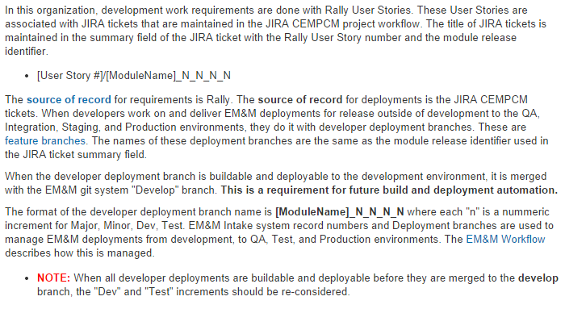
Development Deployment Branches

Slide 7
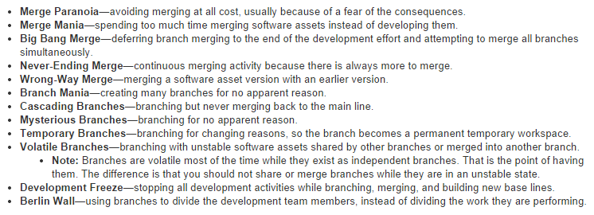
Branching and Merging Anti-Patterns

Slide 8
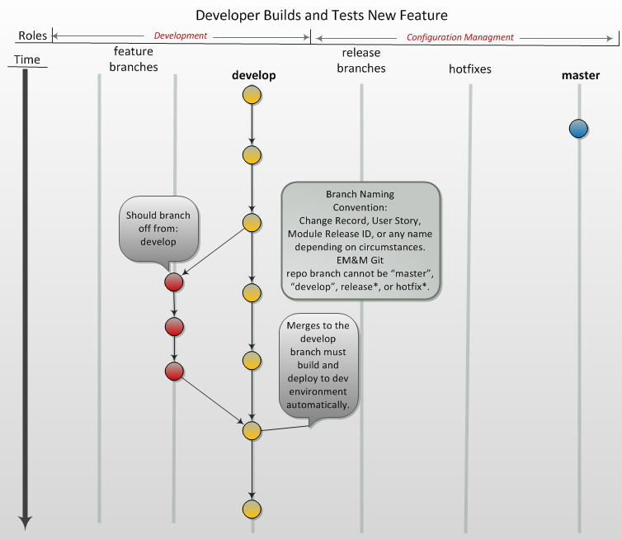

Slide 9
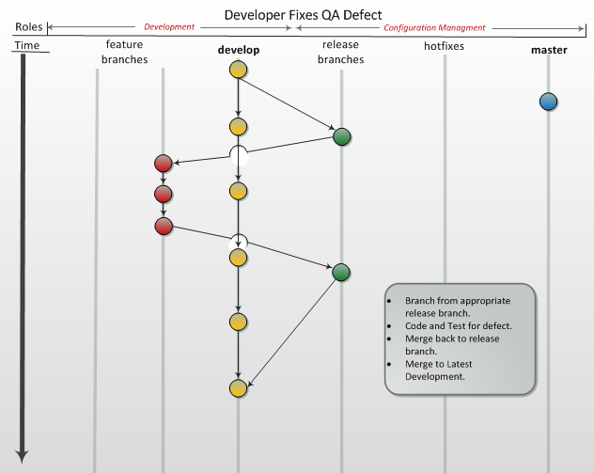

Slide 10
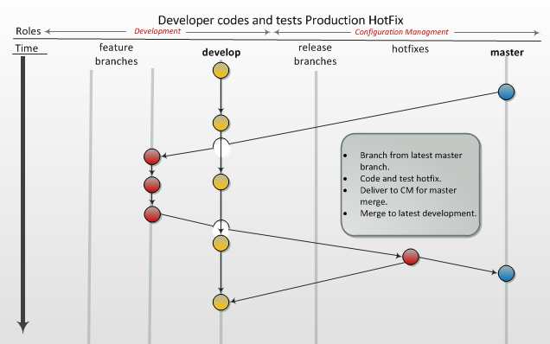

Slide 11
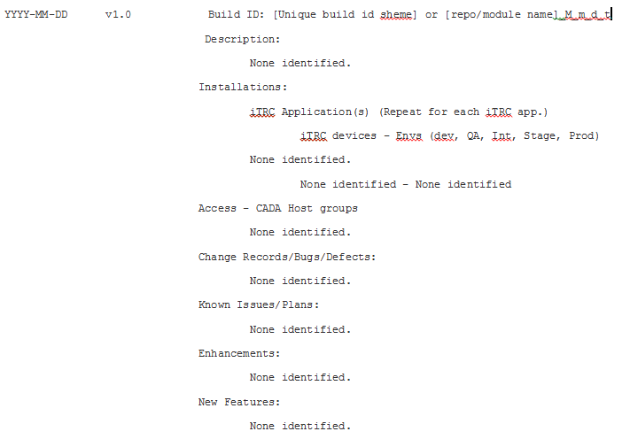
Information Conductor - CHANGELOG

Slide 12
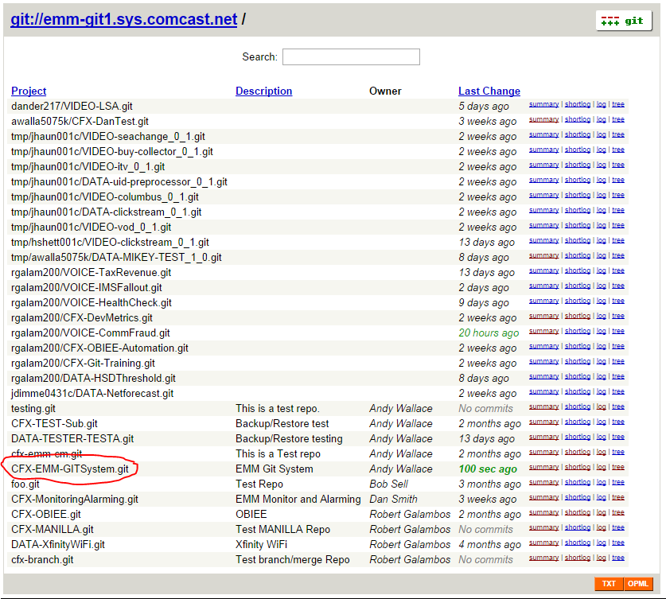
EM&M GitWeb

Slide 13
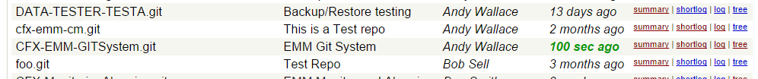
EM&M GitWeb
Links
summary
shortlog - recent commits, additional links
tags - tag with comments, additional links
Heads - branch head, additional tags
shortlog
log
tree

Slide 14
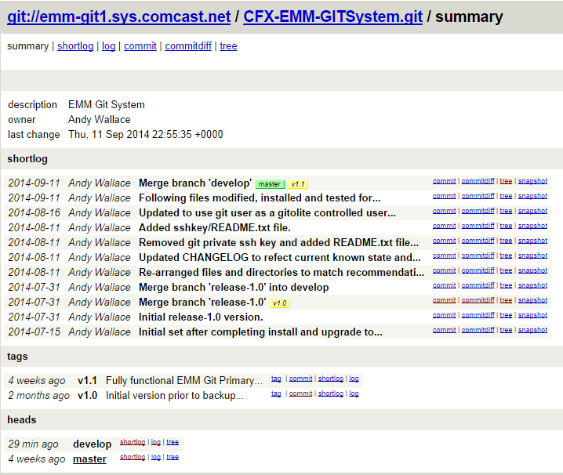
EM&M GitWeb summary

Slide 15
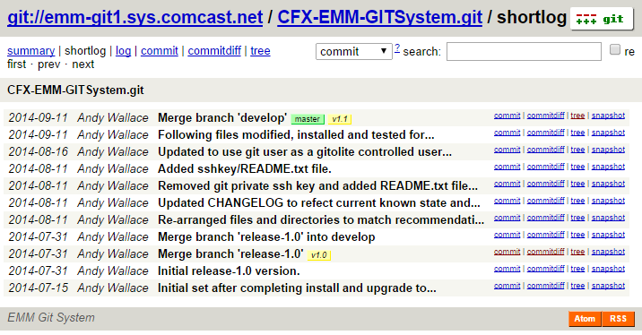
EM&M GitWeb shortlog

Slide 16
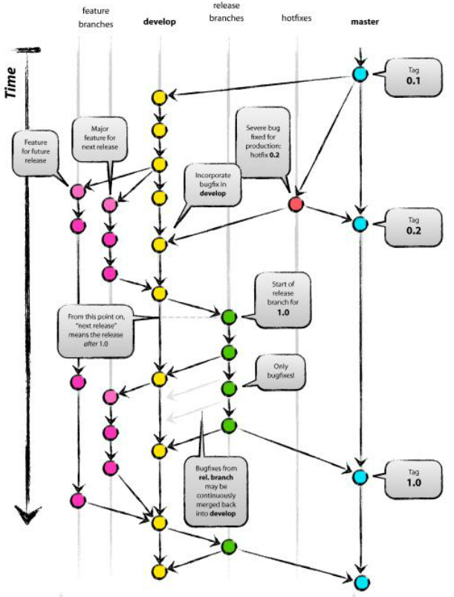
EM&M Branch Model

Slide 17
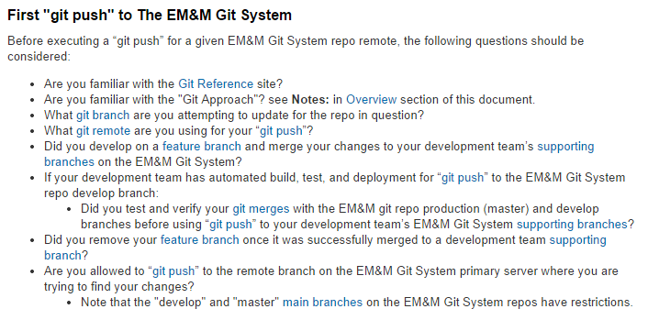
First “git push”

