Slide 1
EM&M Git System
October 21st 2014

Slide 2
Outline
Branches
EM&M Branch Definitions
Branching Approach
Information Conductor
EM&M Branching and Merging Workflow
Benefits
Development Challenges

Slide 3
Why use a branch?
To manage release
To develop new features without impacting the main branch
To experiment with a new feature
To create hotfixes to production branches

Slide 4
Branch Types
Master - Live site, only push when release is ready.
Hotfix - Create when a fix is needed on live site.
Release - Prepare and test before pushing to live.
Develop - Add features and fixes for next release.
Feature - Work on feature outside of main dev branch.

Slide 5
EM&M Branch Definitions
Main Branch - Permanently maintained providing consistent merge points (branch heads). The merge points in the EM&M Git System are “develop” (latest development) and “master” (latest production).
Supporting Branches - Used to code, test, and share code sets for merge to Main Branches. Temporary in nature since they are removed one merged to the appropriate Main Branches. There are three types of supporting branches:
Feature - Used by development. Should branch from develop Main Branch and must merge back to develop Main Branch.
Release - Managed by CM, should branch from develop Main Branch and must merge back into develop and master Main Branches.
Hotfix - Should branch from master Main Branch. Must merge back to develop and master branches. (like EBF)
Development Deployment Branch – Should branch from develop Main Branch. Must merge bat to develop Main Branch. This branch has a naming convention of [module name]_Maj_Min_Dev_Test.

Slide 6
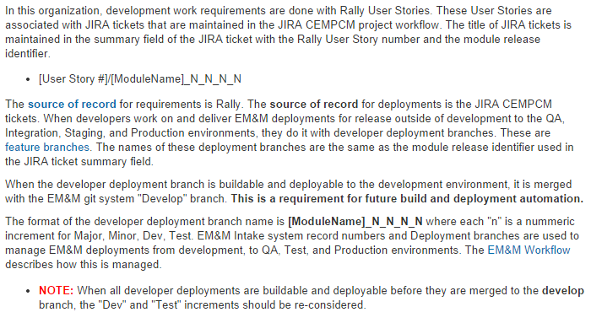
Development Deployment Branches

Slide 7
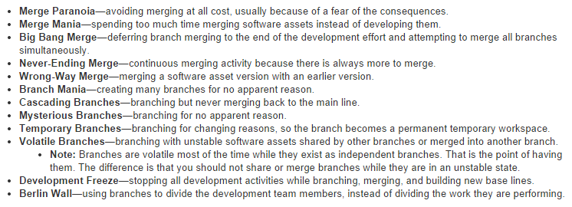
Branching and Merging Anti-Patterns

Slide 8
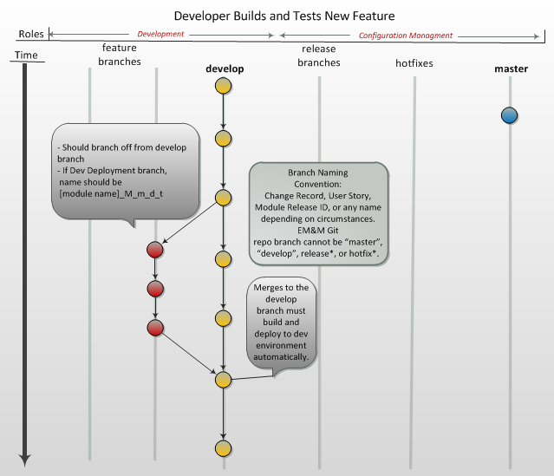

Slide 9
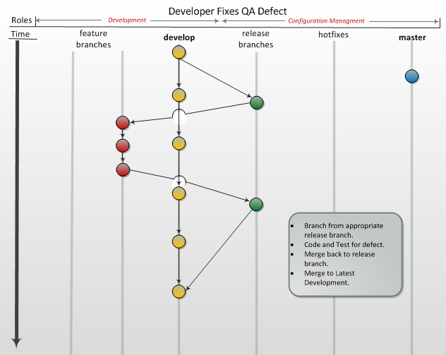

Slide 10
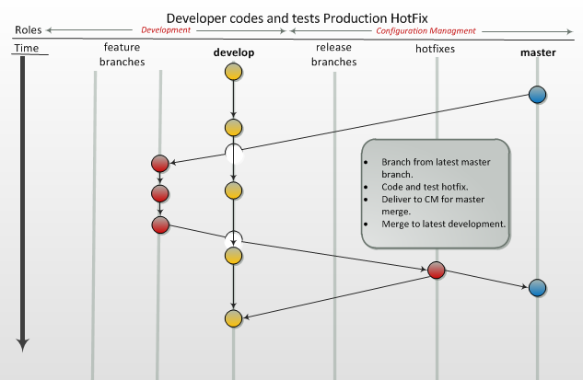

Slide 11
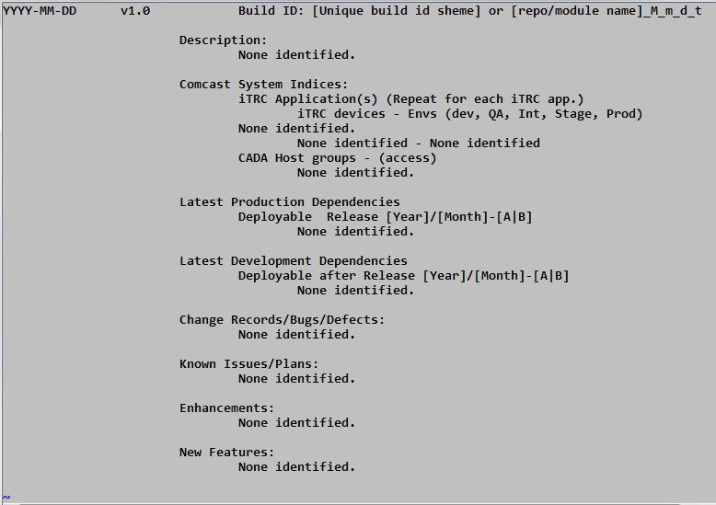
Information Conductor – CHANGELOG record

Slide 12
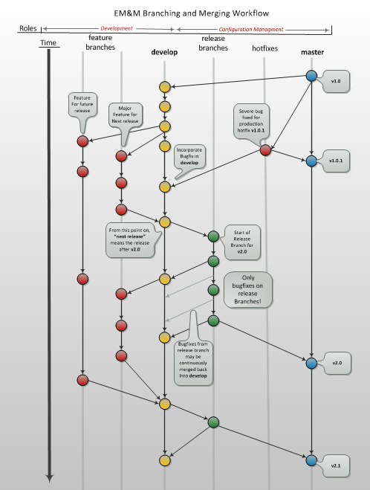

Slide 13
Benefits
The “latest development” and “latest production” is always available to developers to start working from.
Developers can maintain “in-progress” work separately from completed, test, and stable code.
Provides basis for build and deployment automation.
The “latest deployable” is tested and verified with “release” and “hotfix” supporting branches that are temporary and current for Release Management.
Repository branches can be used to isolate agile sprint coding sets.
Modules can be managed with sets of repos that are baseline deployments.

Slide 14
Development Challenges
The “master” branch should be “latest development” and not “latest production”.
Retain release branches with no “master” production branch. The “master” branch represents “latest development”.
Retain single production branch. The “master” branch represents “latest development”.

