Slide 1
EM&M Git System Introduction
February 10, 2015

Slide 2
Outline
Benefits
Branches
EM&M Branch Definitions
Build Identifier
Information Conductor
Branching Approach
EM&M Branching and Merging Workflow
Development Challenges

Slide 3
Benefits
The “latest development” and “latest production” is always available to developers to start working from.
Developers can maintain “in-progress” work separately from completed, test, and stable code.
Provides basis for build and deployment automation.
The “latest deployable” is tested and verified with “release” and “hotfix” supporting branches that are always current for Release Management.
Repository branches can be used to isolate agile sprint coding sets.
Modules can be managed with sets of repos that are baseline deployments.

Slide 4
Why use a branch?
To manage release
To develop new features without impacting the main branch
To experiment with a new feature
To create hotfixes to production branches
To Support separate development efforts with minimum impact to each effort
Provide basis for automated build identifier

Slide 5
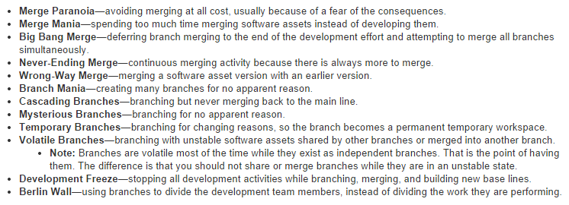
Branching and Merging Anti-Patterns

Slide 6
Branch Types
Master - Live site, only push when release is ready.
Hotfix - Create when a fix is needed on live site.
Release - Prepare and test before pushing to live.
Develop - Add features and fixes for next release.
Feature - Work on feature outside of main dev branch.

Slide 7
EM&M Branch Definitions
Main Branch - Permanently maintained providing consistent merge points (branch heads). The merge points in the EM&M Git System are “develop” (latest development) and “master” (latest production).
When merging to these main branches code is buildable and deployable. The “develop” branch head represents code that will automatically build and deploy to the development environment.
The “master” branch head represents code that will automatically build and produce deployable elements. These elements are deployed, on demand, to QA by the CM staff. The EPA staff deploys these elements, on demand to Integration, Stage, and Production environments.
Supporting Branches - Used to code, test, and share code sets for merge to Main Branches. Temporary in nature since they are removed one merged to the appropriate Main Branches. There are three types of supporting branches.

Slide 8
EM&M Supporting Branches
Feature - Used by development for all development tasks. Should branch from develop Main Branch and must merge back to develop Main Branch.
Development Deployment Branch – Naming convention lines up with JIRA identifier [module name]_Maj_Min_Dev_Test. The module name is substituted with the repo name. Used by development to deliver JIRA workflow deployments for QA, Integration, Staging and production environments.
Additional naming conventions at development discretion, less following:
develop, release*, hotfix*, master.
Release - Managed by CM, should branch from develop Main Branch and must merge back into both “master” and “develop” Main Branches. Naming format is “release-YYYYMM-[A|B|OC]” where:
YYYY – Current year, i.e., 2015
MM – Current month, i.e., 01 for Jan, 02, Feb, etc
[A|B|OC] – One of “A”, “B”, or “OC” -Meaning Off-Cycle.
Hotfix - Should branch from master Main Branch. Must merge back to master and develop main branches. Naming format is “hotfix-YYYYMM”.

Slide 9
Development Deployment Branches
The Development Deployment Branch name is the module release identifier portion of the JIRA summary field. The Module name is the repo name or one of many repos related to a given Module. It format is:
[ModuleName]_N_N_N_N
The source of record for requirements is Rally. The source of record for deployments is the JIRA CEMPCM tickets. When developers work on and deliver EM&M deployments for release outside of development to the QA, Integration, Staging, and Production environments, they do it with developer deployment branches. These are feature branches.
When the developer deployment branch is buildable and deployable to the development environment, it is merged with the EM&M git system "Develop" branch. This is a requirement for future build and deployment automation.
Each “N" is a numeric increment for Major, Minor, Dev, Test. EM&M Intake system record numbers and Deployment branches are used to manage EM&M deployments from development, to QA, Test, and Production environments. The EM&M Workflow describes how this is managed.
NOTE: When all developer deployments are buildable and deployable before they are merged to the develop branch, the "Dev" and "Test" increments should be re-considered.

Slide 10
Build Identifier
Build ID = [repo]-[branch]-[deployment]-[build#]
repo – EM&M Git Repo name
branch – EM&M Git Repo Branch type, on of:
F – feature branch
D – develop branch
R – release branch
H – hotfix branch
M – master branch
deployment – M.m – Major.minor number of repo
deployment
build# - automatically generated build increment.

Slide 11
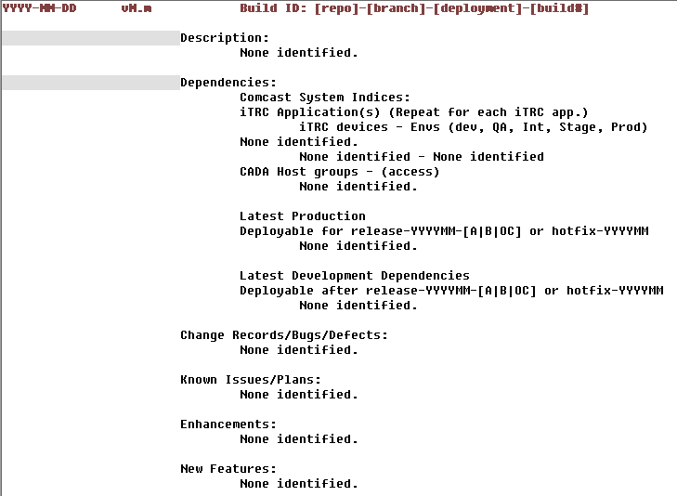
Information Conductor – CHANGELOG record

Slide 12
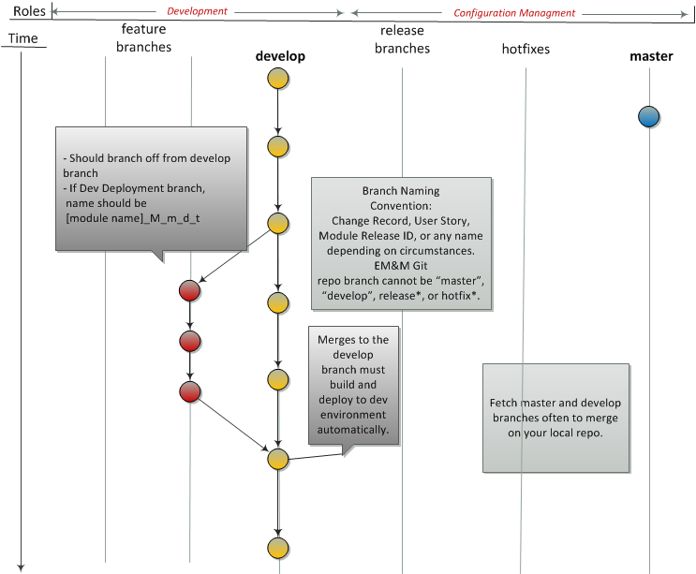
Developer Builds and Tests New Feature

Slide 13
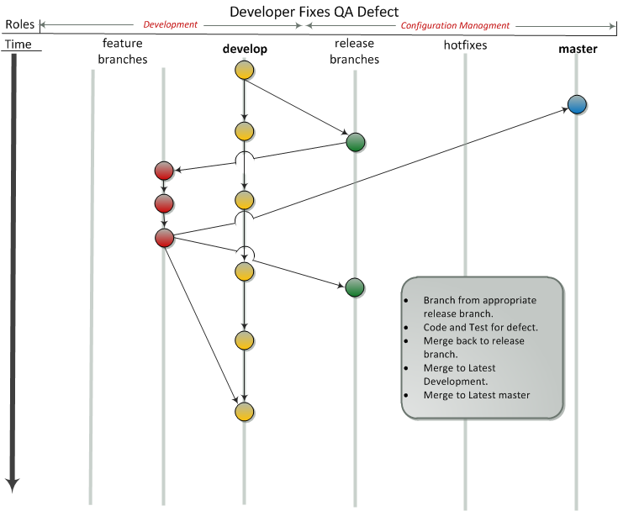

Slide 14
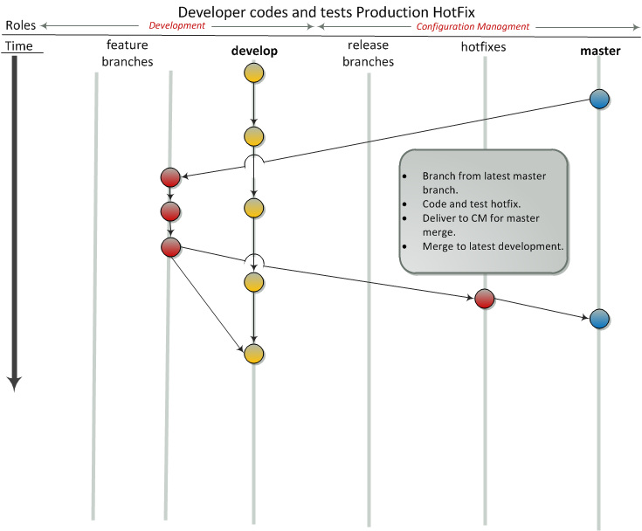
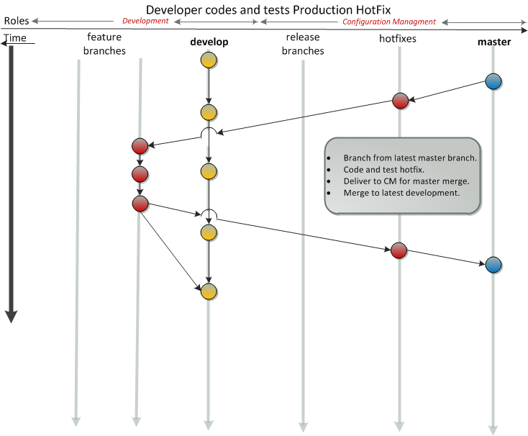

Slide 15
