Slide 1
EM&M Git System Training
March 1st 2015

Slide 2
Outline
Session 1 – Git Installation
Session 2 – EMM Git Usage

Slide 3
Git Installation
The Git Installation Procedure has been prepared to:
Help you install Git for Windows
Configure Git for the EM&M Git System
SSH Configurations
Git User Configurations
Validate you can work with the EM&M Git System
The above bullets are required for Session 2 of this training.

Slide 4
EMM Git Usage
EMM/Git Overviews
Before any commits …
Now commit
Check for conflicts
Push to remote
Git Commands
Practice sessions
Working Environment
What are we doing?
Process Concepts
Changing Existing Code
Fix QA Defect
Production Hotfix
Branching & Merging Workflow

Slide 5
Overview
EM&M Git System
About Git

Slide 6
Before any commits …
Establish a local repo (git clone)
Identify available branches on local repo (git branch -a)
Establish working directory with appropriate branch head (git checkout [branch])
Create new branch to code on (git checkout -b [new branch])
Update and/or establish CHANGELOG file.

Slide 7
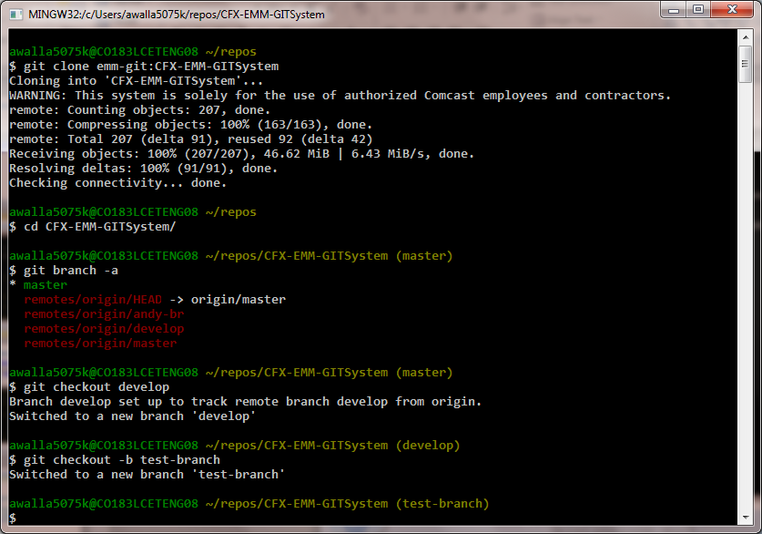
Before any commits …

Slide 8
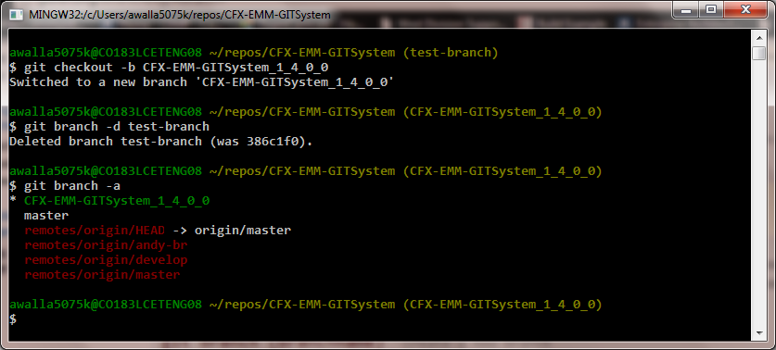
Before any commits …
At this point you have created a feature branch to code on.
If you are working on a JIRA ticket, your feature branch should be named according to the instructions in the Development Deployment Branches
CFX-EMM-GITSystem_1_4_0_0

Slide 9
Before any commits …
After you have made some changes, i.e., creating new files, modifying existing files,
and/or removing existing files,
and done some testing,
You need to git add your changes.
Now the changes can be staged for committing to your local feature branch.
You may want to identify sub-sets of your changes for more testing scenarios.
You can limit what you add to the staging environment for your next commit to accomplish this.

Slide 10
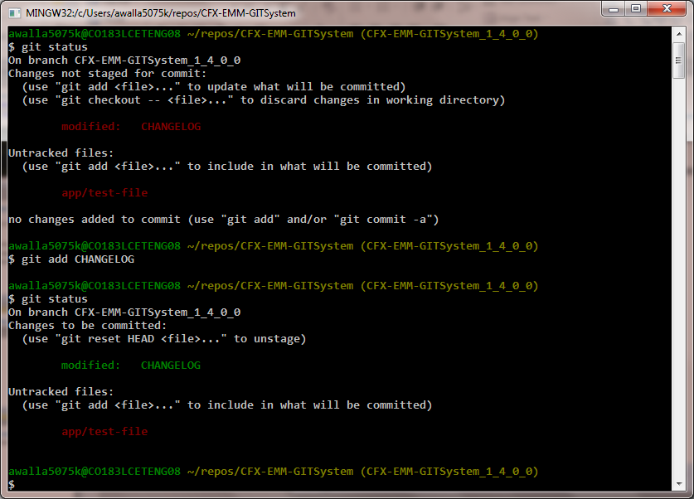
Before any commits …
Use the git status command to keep track of what you have not added and what you have staged for the next commit to your feature branch.
Use the git add command to promote changes to the staging area.

Slide 11
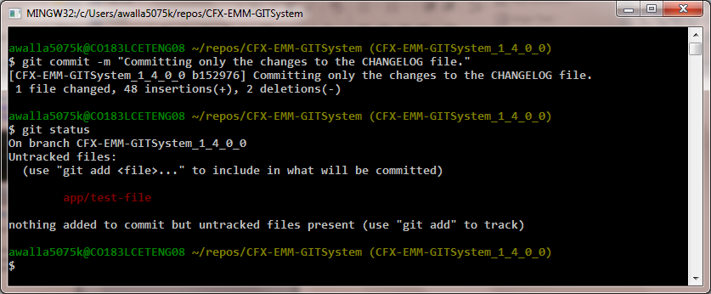
Now commit
Use git commit to commit changes to your feature branch.

Slide 12
Check for Conflicts
After each "git commit" on your feature branch, check for conflicts with main branch heads and outstanding release and hotfix branch heads. Repeat the following for each of these branches. Ordering should be master, hotfix, release, develop:
Update your local repo for any updates made by others (git fetch origin)
Make note of new and updated branches
For each new and updated branch execute the following on your feature branch:
Merge branch (git merge --no-ff [branch name])
Note successful merge type or address identified conflicts NOTE: Never code on main branches.

Slide 13
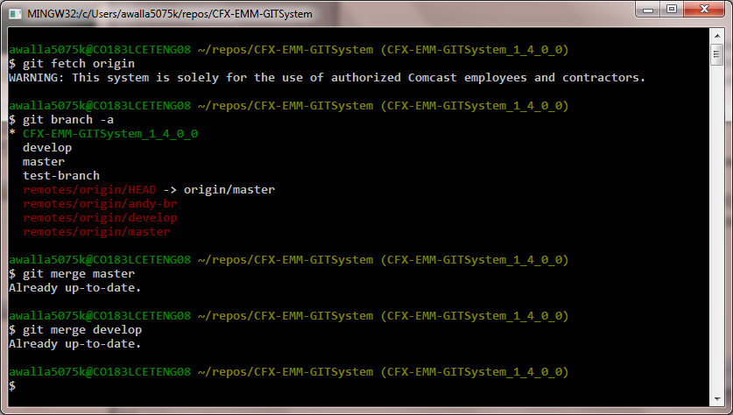
Check for Conflicts

Slide 14
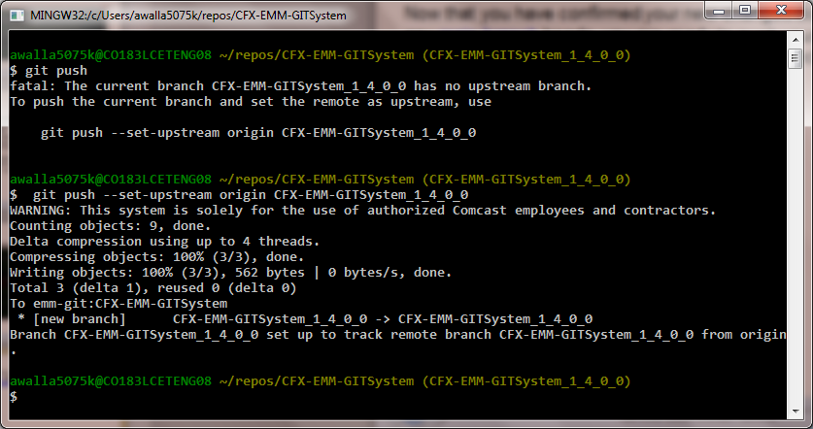
Push to remote
Now that you have confirmed your new changes do not conflict with any main branch heads, you are ready to push your changes up to the EM&M Git System. While on your feature branch, execute:
git push

Slide 15
Git Commands (Compare to CVS commands)
git clone
git status (demo none, -s, -v)
git branch
git checkout
git add (to staging)
git commit (from staging)
git fetch
git merge
git push
Git Reference
NOTES:
-v (verbose) provides detail
-s suppresses detail
Indicates “remote” command

Slide 16
Clone your repo
Local repo on workstation
EMM Git System
develop
master
develop
master
Temp
Dev
branches
Temp
Ops
branches
Temp
Dev
branches
Temp
Ops
branches
Local
Repo
branches
clone

Slide 17
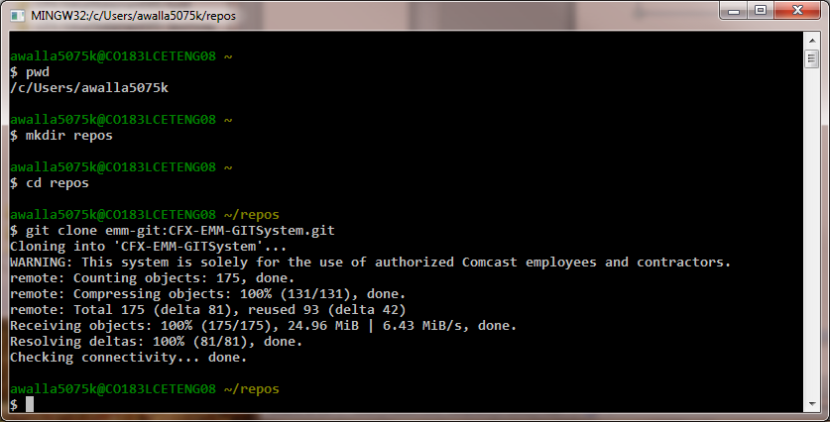
Clone repo

Slide 18
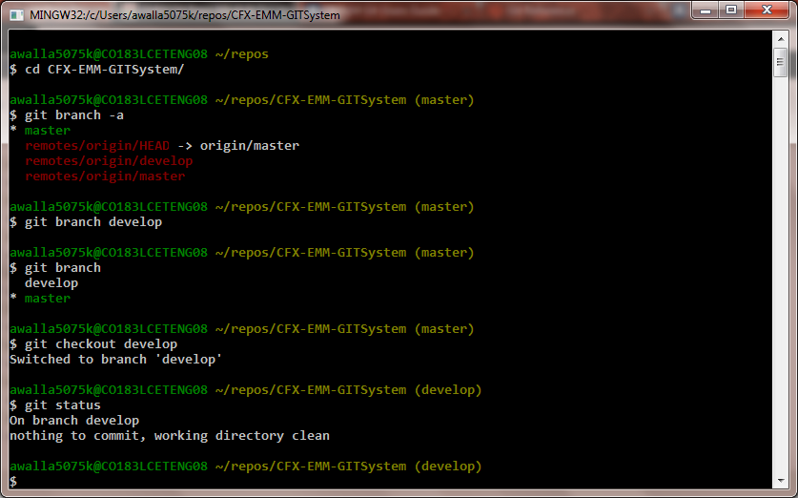
Current status, branches?

Slide 19
Change example
Create branch to code on
Change a file
Check for conflicts
Add and commit
Merge to develop
Current state

Slide 20
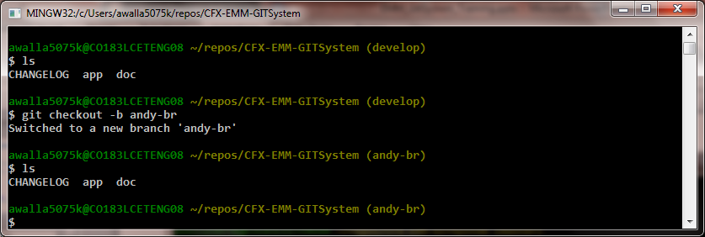
Create branch to code on
develop
master
feature

Slide 21
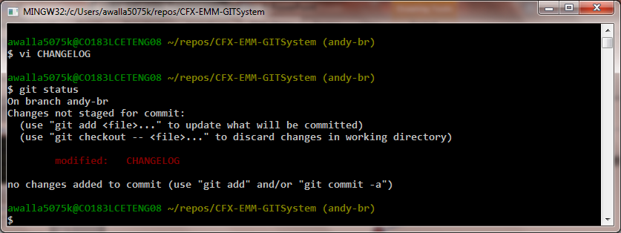
Change a file
develop
master
feature

Slide 22
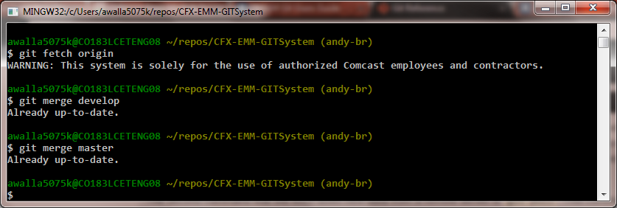
Check for conflicts
develop
master
feature

Slide 23
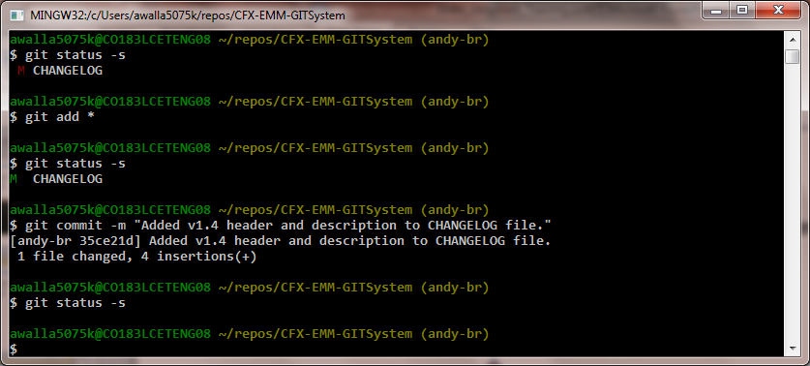
Add and commit
develop
master
feature

Slide 24
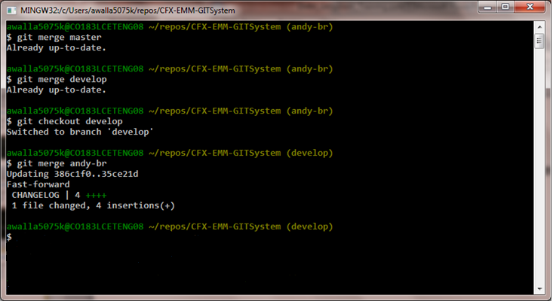
Merge to develop
develop
master
feature

Slide 25
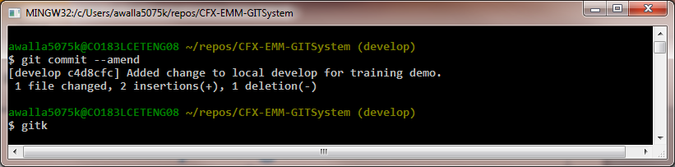
Identify Merged Branch
develop
master
feature

Slide 26
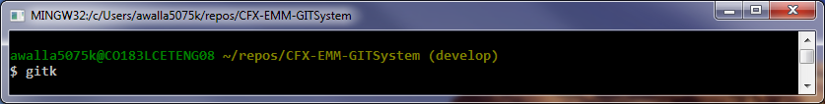
Current state
develop
master
feature
Local repo
Remote EMM Git System repo
CFX-EMM-GITSystem

Slide 27
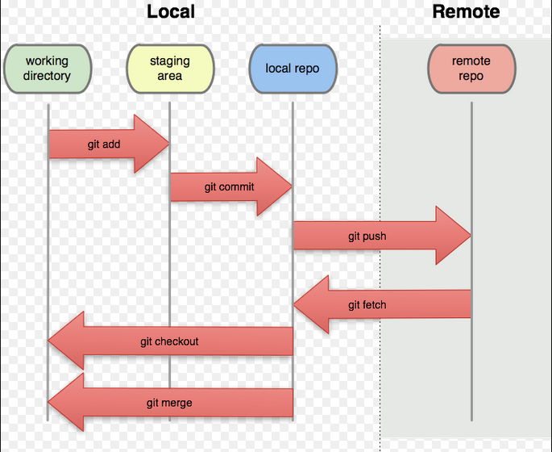
Working Environment
Local repo on workstation
EMM Git System

Slide 28
Staging the work
Switch to coding branch and add file to working area
Add and commit new-file to coding branch
Switch branches to demonstrate working directory change
Push coding branch to EMM Git System for sharing
Move to alternate git repo and update for new branch

Slide 29
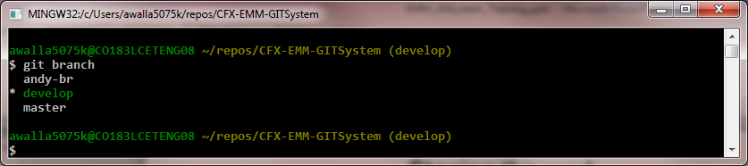
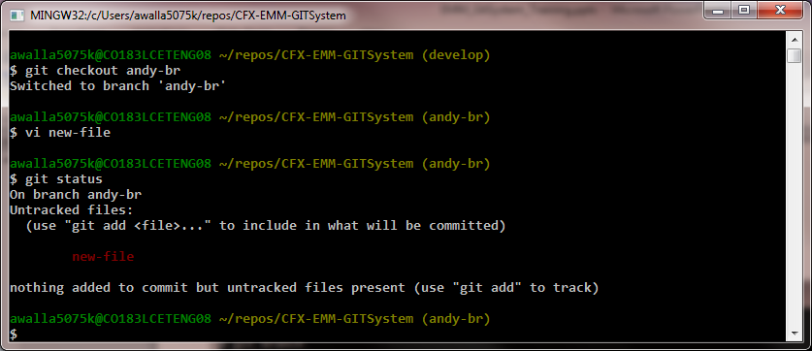
Switch to coding branch and add file
The develop branch head currently in working directory
Switch to coding branch and add file to working directory

Slide 30
Switch to coding branch and add file
Local repo on workstation
EMM Git System
develop
develop
master
develop
master
Temp
Dev
branches
Temp
Ops
branches
Temp
Dev
branches
Temp
Ops
branches
Local
Repo
branches
andy-br
fetch
push

Slide 31
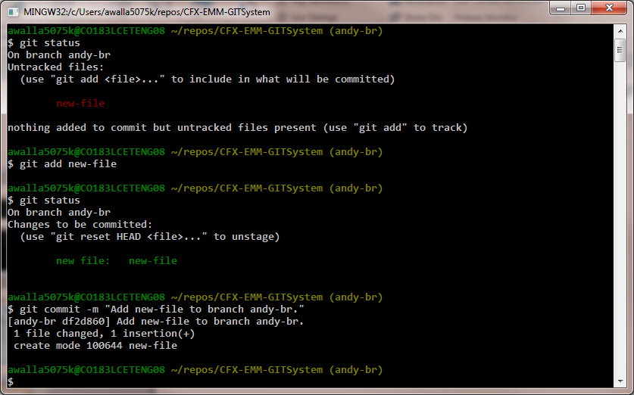
Add and commit new-file to coding branch

Slide 32
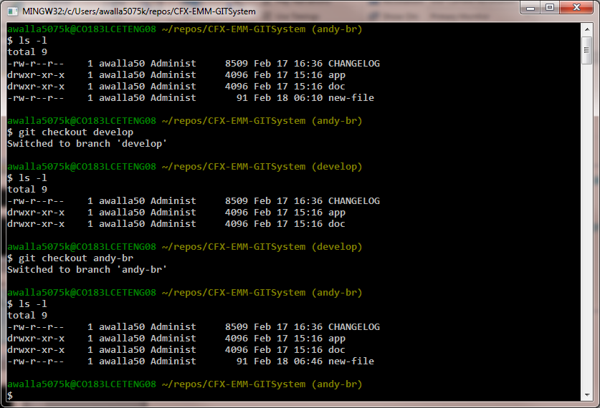
Switch branches to demonstrate working directory change

Slide 33
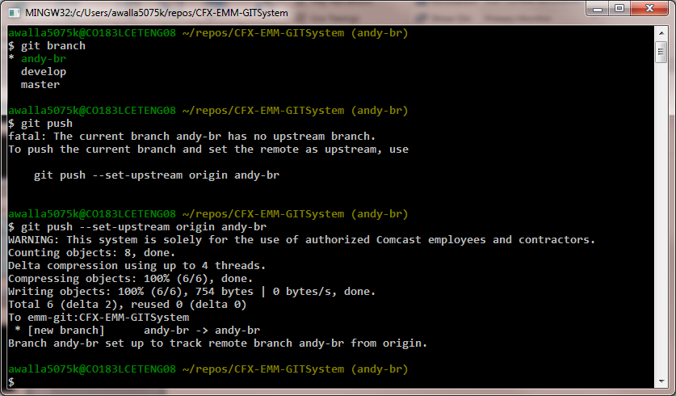
Push coding branch to EMM Git System for sharing

Slide 34
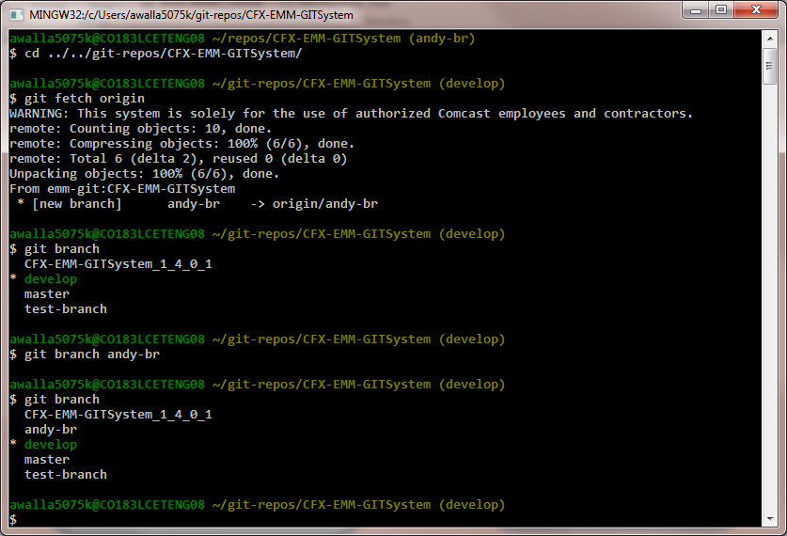
Move to alternate git repo and update for new branch

Slide 35
What are we doing?
code
hotfix
develop
master
feature
hotfix
correct
defect
release
Certified
By QA
feature

Slide 36
Process Concepts
code
hotfix
develop
master
feature
hotfix
correct
defect
release
feature

Slide 37
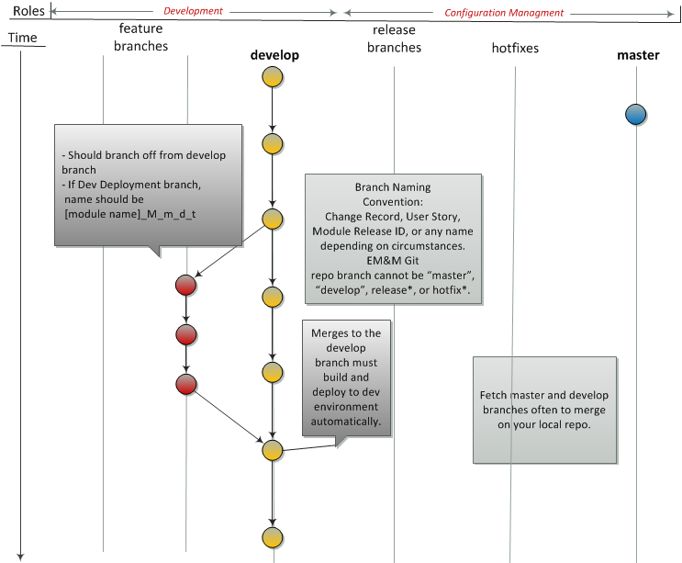
Developer Builds and Tests New Feature
Reference Development Deployment Branches

Slide 38
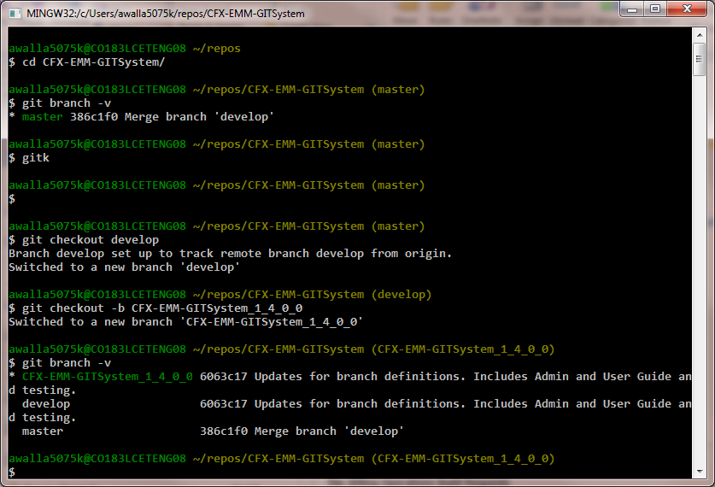
Branch from develop
Notes:
The gitk give a nice visual of your local Distributed Version Control System (DVCS) repo.
You can also reference the EM&M Git System DVCS repo on the EM&M GitWeb site at http://emm-git1.sys.comcast.net/git/

Slide 39
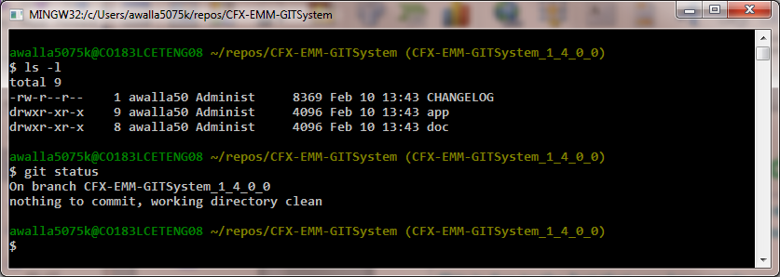
Branch from develop (2)
When you list the files in your local directory at this point, they represent the contents of your working directory which is currently equivalent to the staging area or currently “clean”.
This is due to the fact that you have made no changes yet. As you make changes, use git status to keep track of your current situation.
Notes:
Note the usage of the “git status” reference.

Slide 40
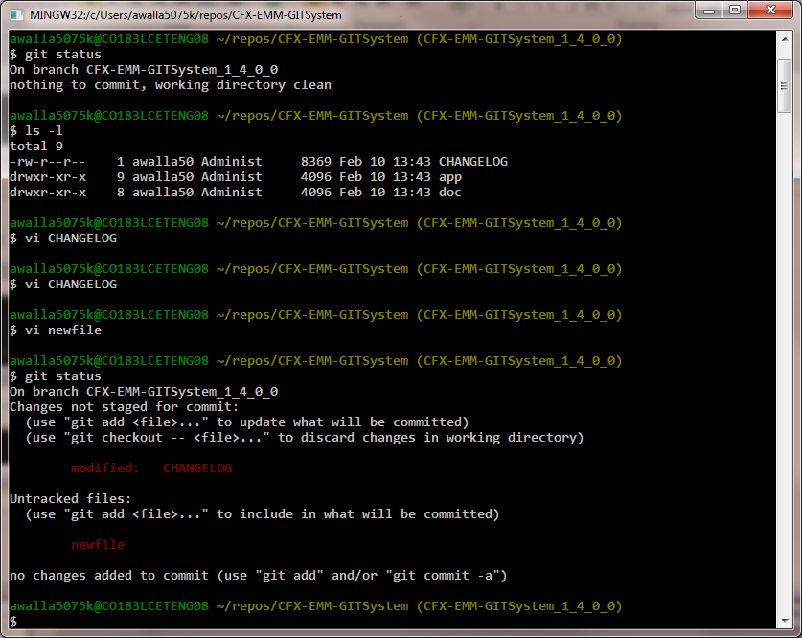
Branch from develop (3)
After making changes, the git status will keep you honest with your work area.

Slide 41
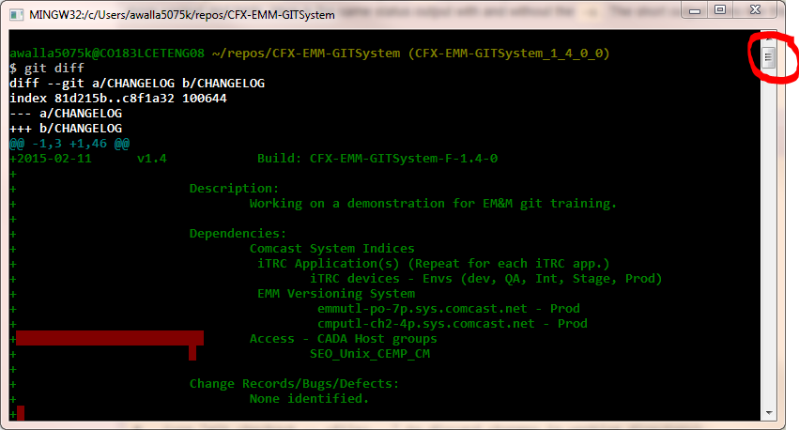
Branch from develop (4)
What Changed? (1)

Slide 42
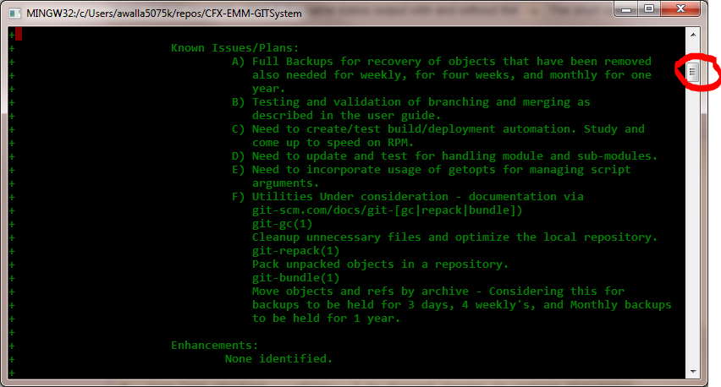
Branch from develop (5)
What Changed? (2)

Slide 43
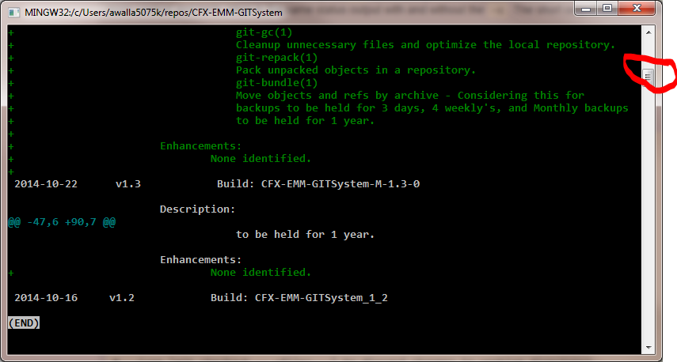
Branch from develop (6)
What Changed? (3)

Slide 44
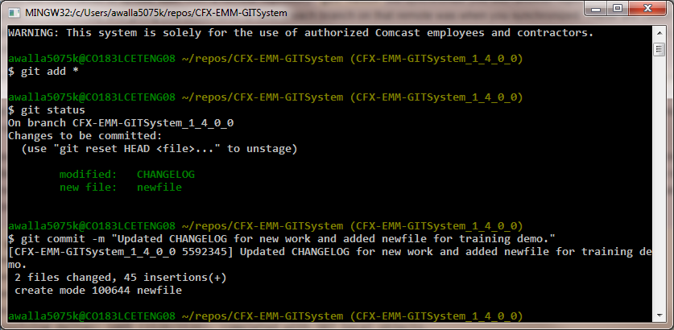
Add/commit to my branch

Slide 45
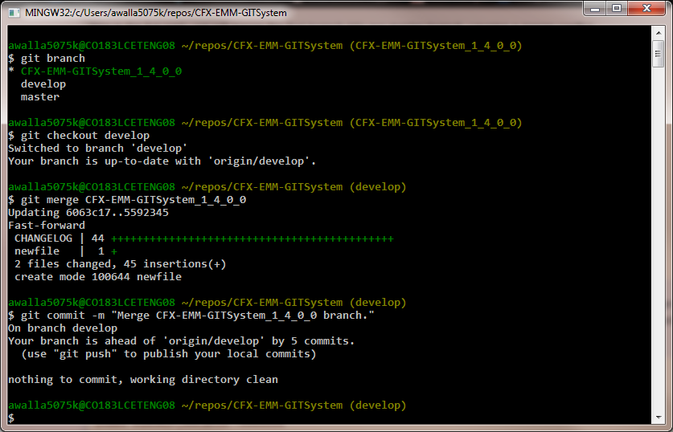
Merge to develop branch
Using git merge, to check for successful merge before committing to develop branch.

Slide 46
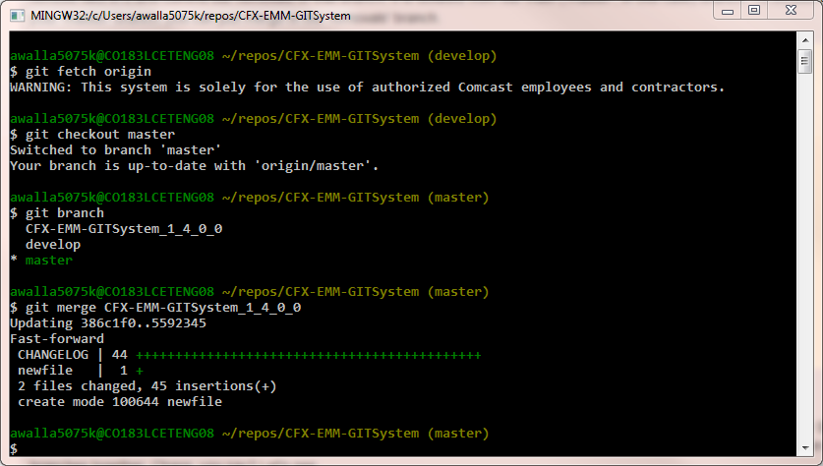
Merge to master branch
Using git merge, to insure these deltas will merge successfully with the master branch.

Slide 47
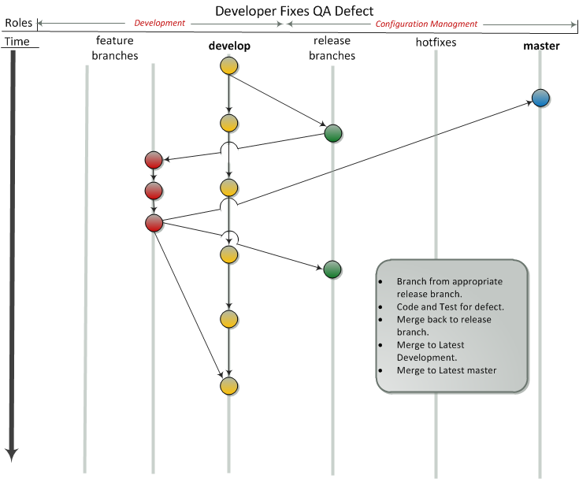

Slide 48
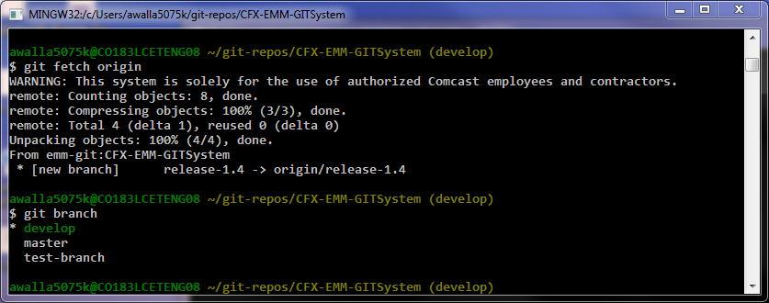
Branch from release*
The release* branches are configured by the CM team when QA requests QA install from a development delivery.
If there is a defect found, branch from the appropriate release branch.

Slide 49
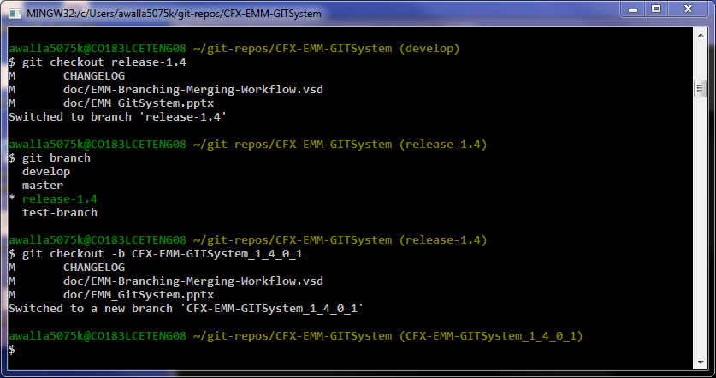
Branch from release* (2)

Slide 50
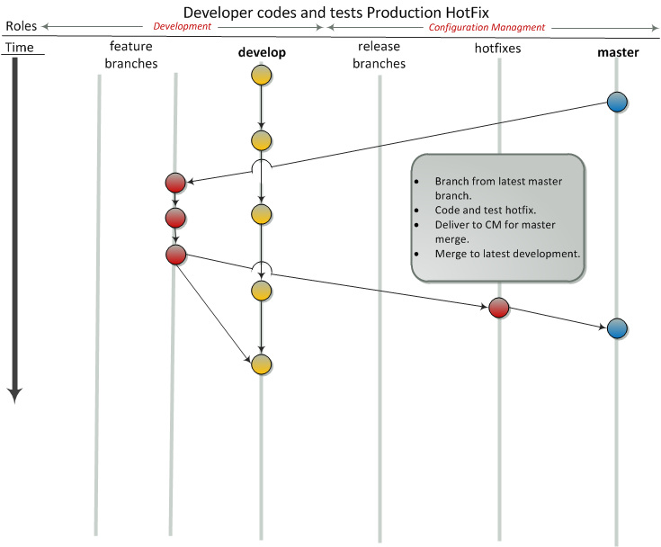

Slide 51
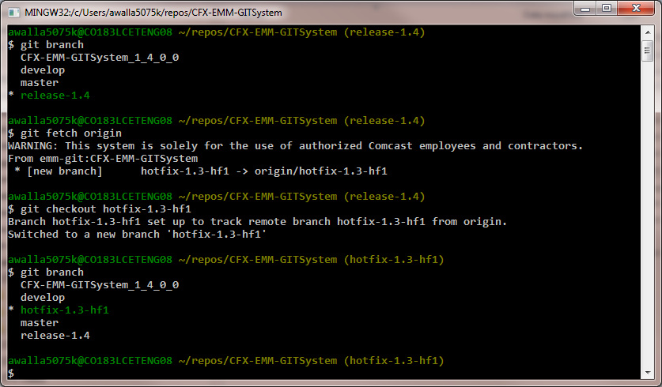
Branch from hotfix*
The hotfix* branches are configured by the CM team when a production problem is identified.

Slide 52
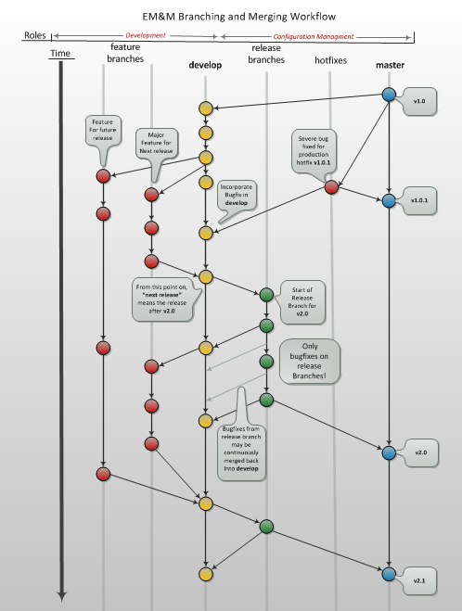

Slide 53
More Information
All things EM&M Git System can be found at this Link.
Useful Git Documentation:
Getting Started – Git Basics
Git/Introduction

